Slide 1
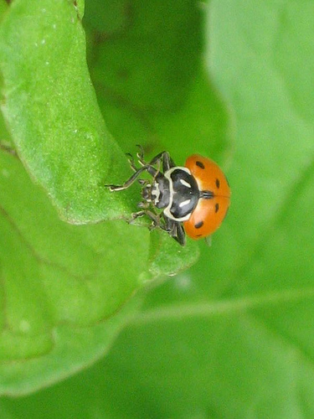
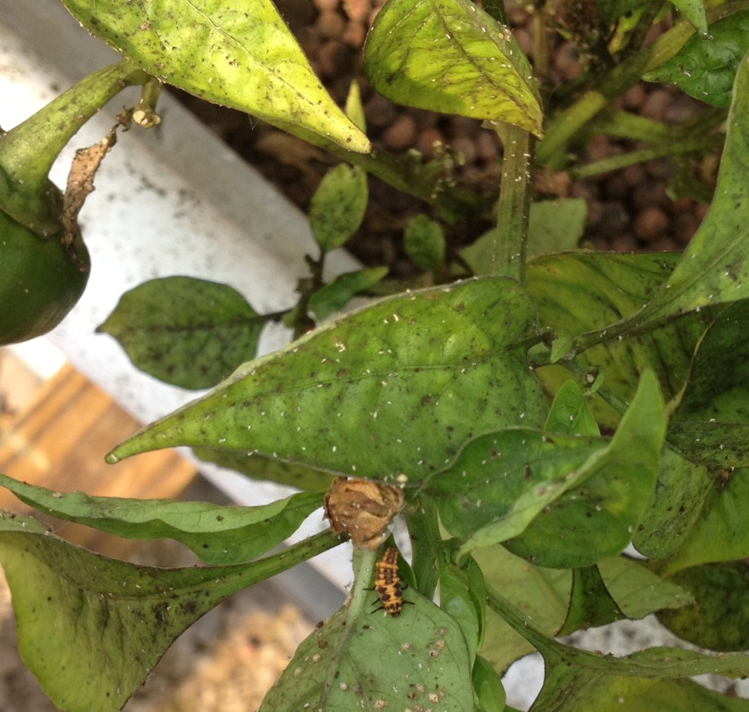
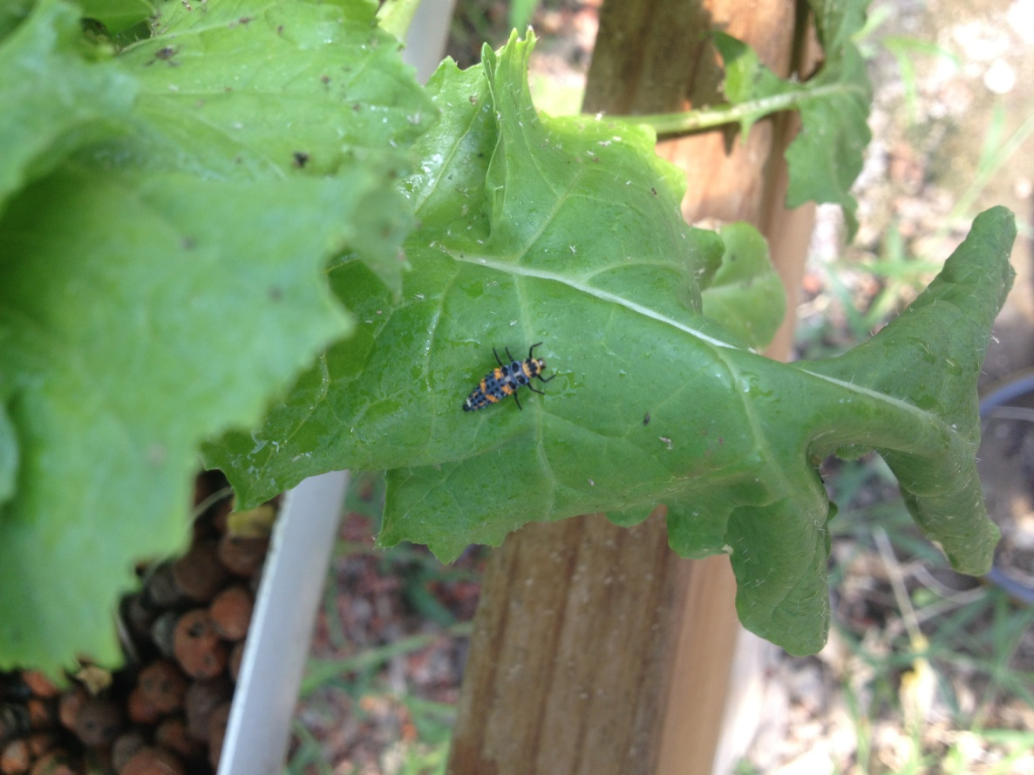
Common Problem in Gardening
Ladybug larvae feeding on aphids
*One ladybug larvae can eat 5,000 aphids in its lifetime!

Slide 2
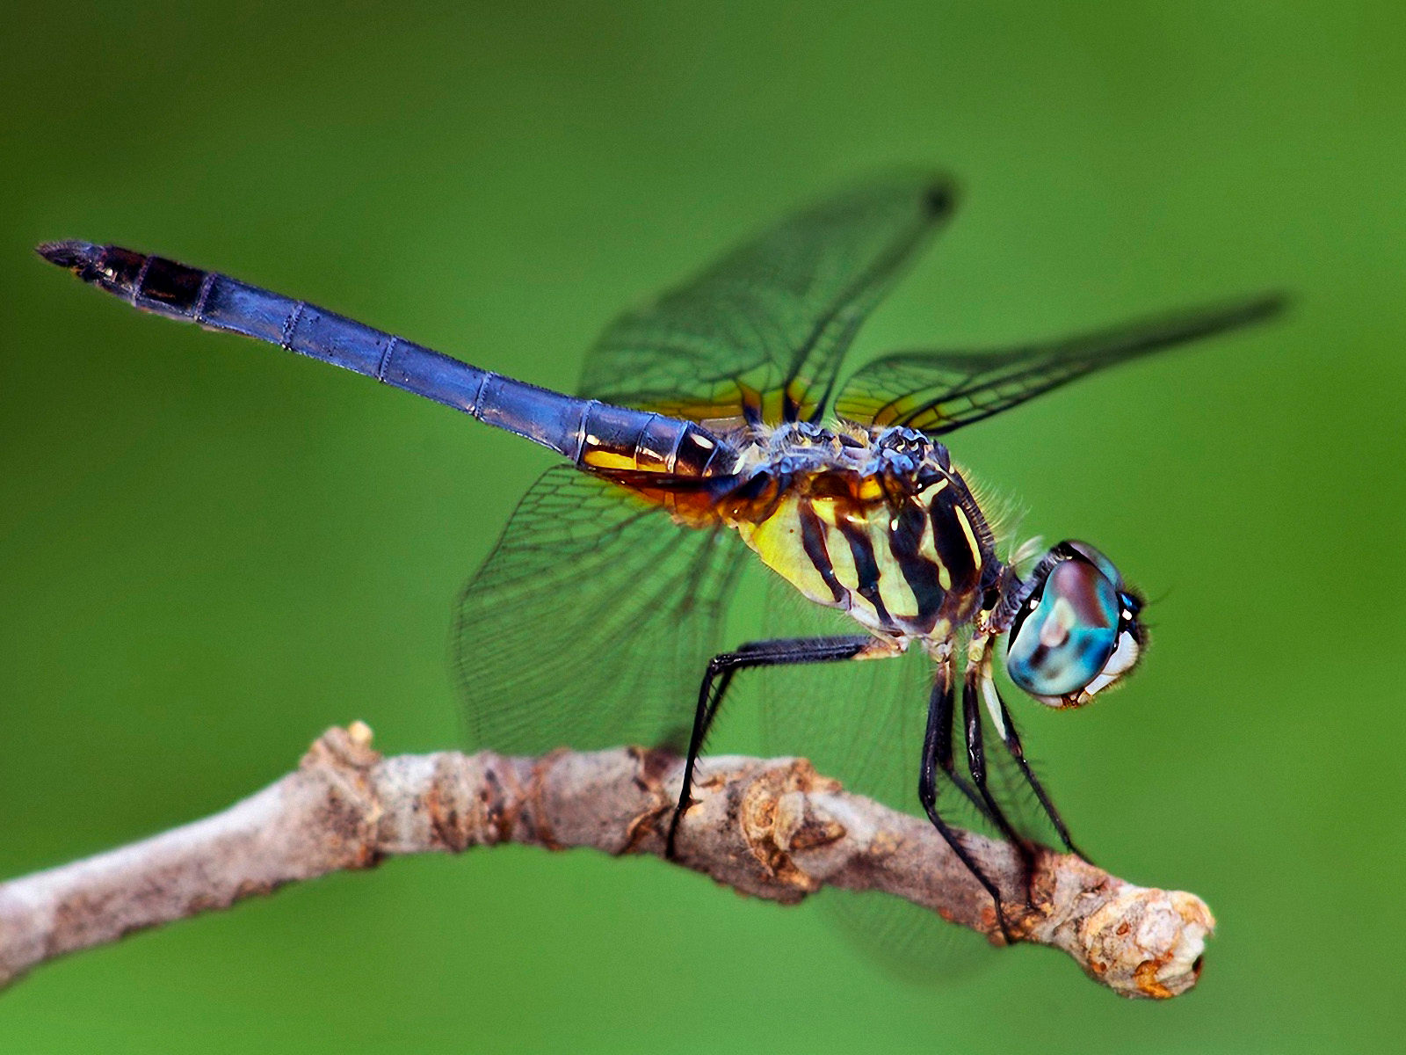
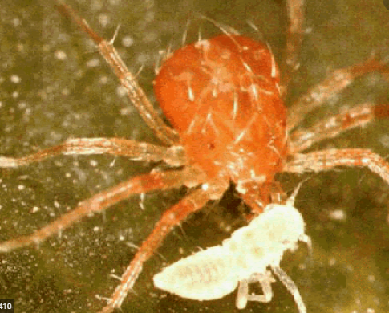
Predatory Mites
Feed on spider mites, russet mites, broad mites and thrips
Species:
  A.cucumeris
  N. californicus
  P. persimilis
  A. swirskii
Cost estimate: 500 for $10

Slide 3
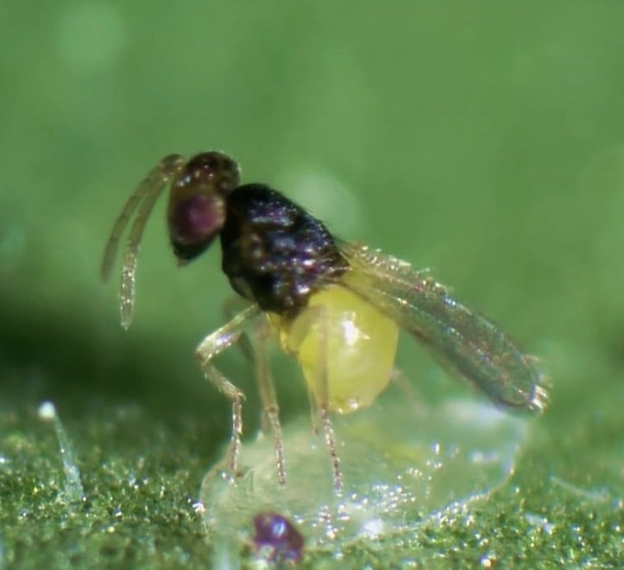
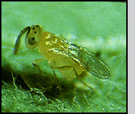
Parasitoid Wasps
Tiny wasp that lays egg in living pests, which hatch and feed on insides of pest host until they die
Aphids
Aphidius colemani
Aphidius ervi
Aphidius matricariae
Aphelinus abdominalis
Whiteflies
Eretmocerus eremicus
Encarcia Formosa

Slide 4
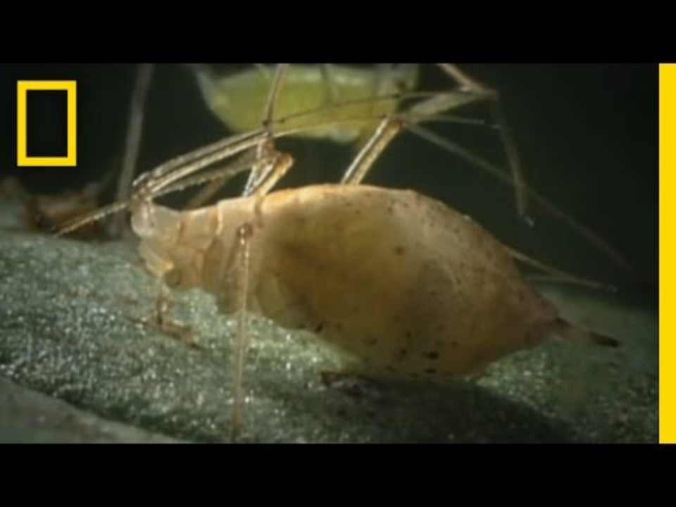

Slide 5


Slide 6
Dragonflies
Feed on mosquitos, gnats, flies, aphids
…basically anything small enough for them to catch

Slide 7
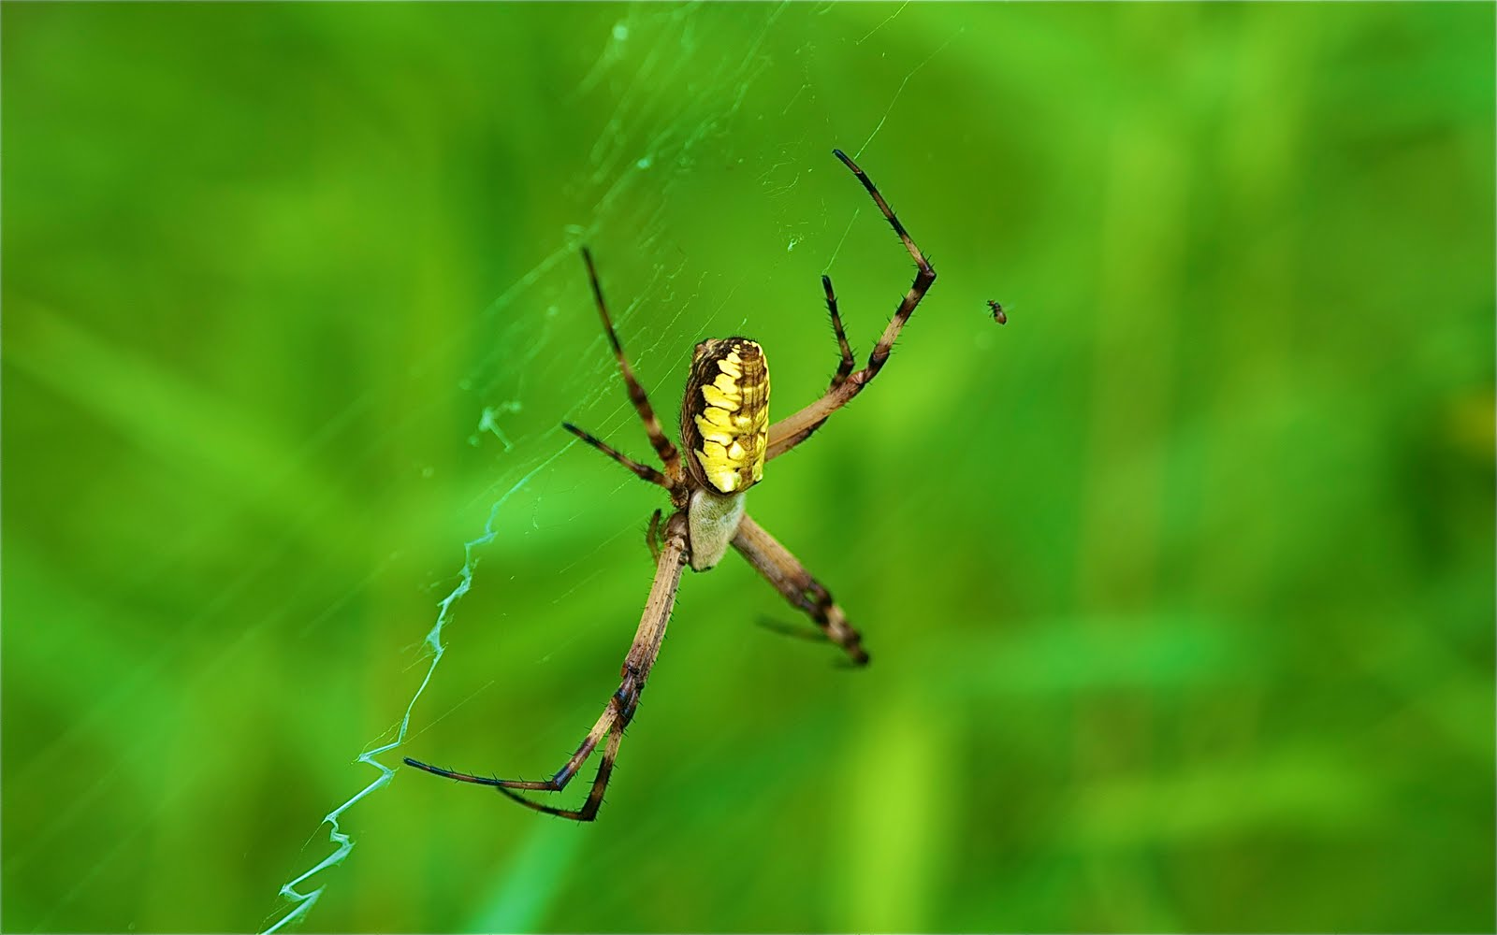
Garden Spiders
Feed on mosquitos, gnats, flies, aphids

Slide 8
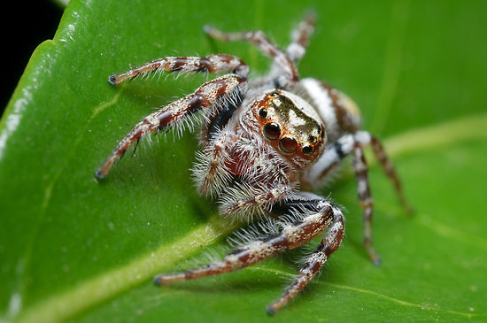
Hunting Spiders
Feed on crickets, ants, houseflies, caterpillars, beetles

Slide 9
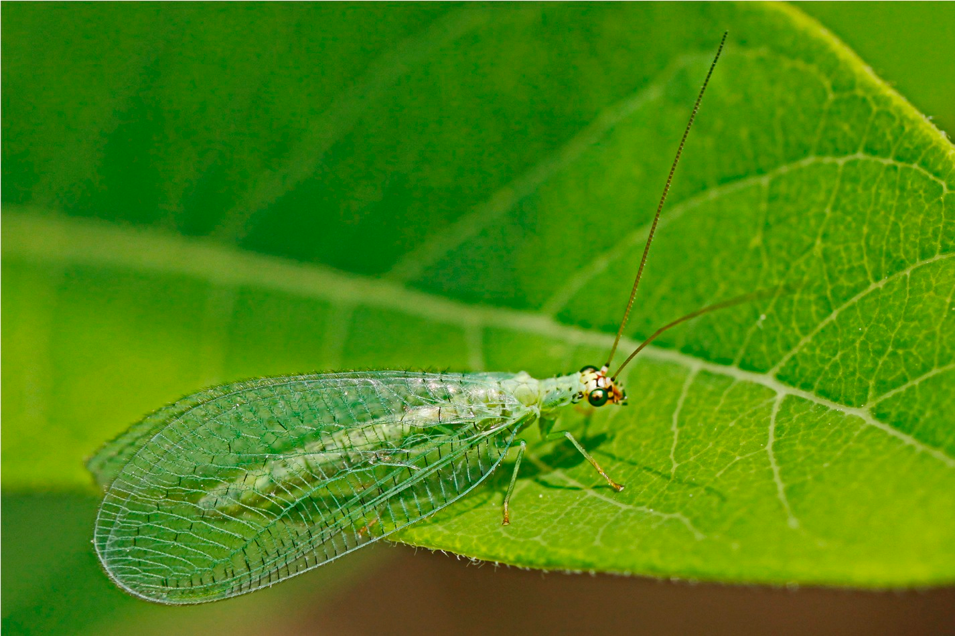
Lacewings
Feed on aphids, mites, other small arthropods
(also consume pollen and nectar)

Slide 10
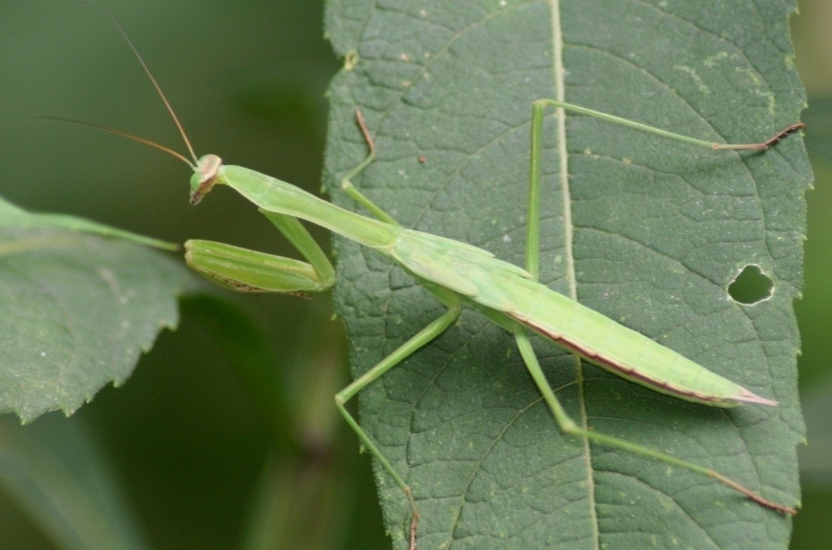
Praying Mantis
Ninja of the garden
Larvae will eat aphids
Will eat anything available, including beneficial insects
Will also eat humming birds!

Slide 11
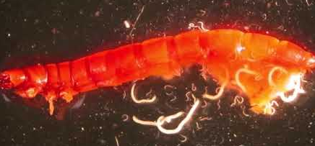
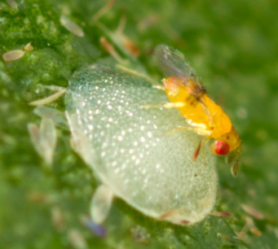
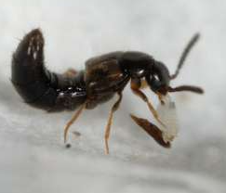
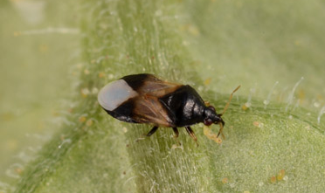
Other Great Beneficials
Beneficial nematodes
Trichogramma (parasitoid wasp)
(target moth and butterfly eggs)
Rove Beetles
Insidious Flower Bug
https://www.naturesgoodguys.com/

Slide 12
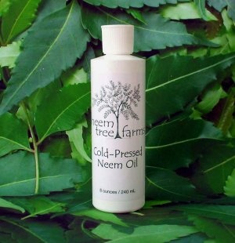
Neem Oil Solution
Organic oil extracted from Neem tree
Will kill bugs that eat leaves, so not beneficial bugs!
Will also suffocate bugs if sprayed on them
Acts like more of a deterrent than a means to get rid of an infestation
Best to be used at first sign of an insect pest

Slide 13
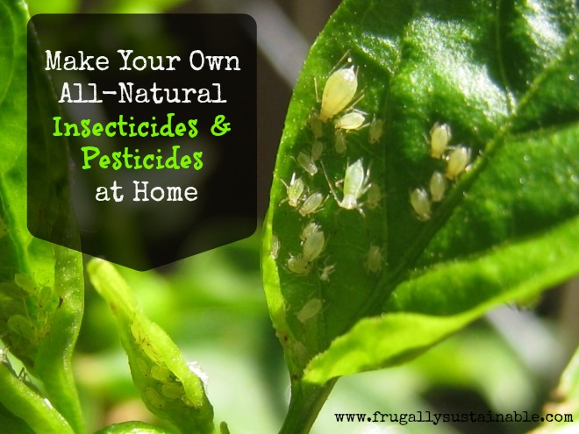
Directions:
Mix in 1 quart spray bottle (water)
1 cap full of Neem oil
1 cap full of Murphy’s oil soap, plain Dawn soap or Insecticidal soap
Extract juice from garlic chives or garlic cloves and squeeze extract into bottle or simply add 10 drops of garlic oil
Shake
Spray all over leaves, especially undersides in morning and early evening
Ingredients
Neem Oil
Organic Soap
5 blades of garlic chives, 3 cloves of garlic or 10 drops of garlic oil
Optional: Mint and Rosemary oil

Slide 14
Directions:
Mix in 1 quart spray bottle (water)
3 tsp of citric acid powder
Or
3 tsp of citric acid
1 cup rubbing alcohol
Spray all over leaves, especially undersides in early morning or early evening
Ingredients
Citric Acid
Isopropyl alcohol

Slide 15
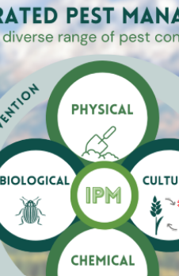
5. Evaluation
Was the Strategy effective?
What worked or didn’t work?
What should be changed or improved for future efforts

Slide 16
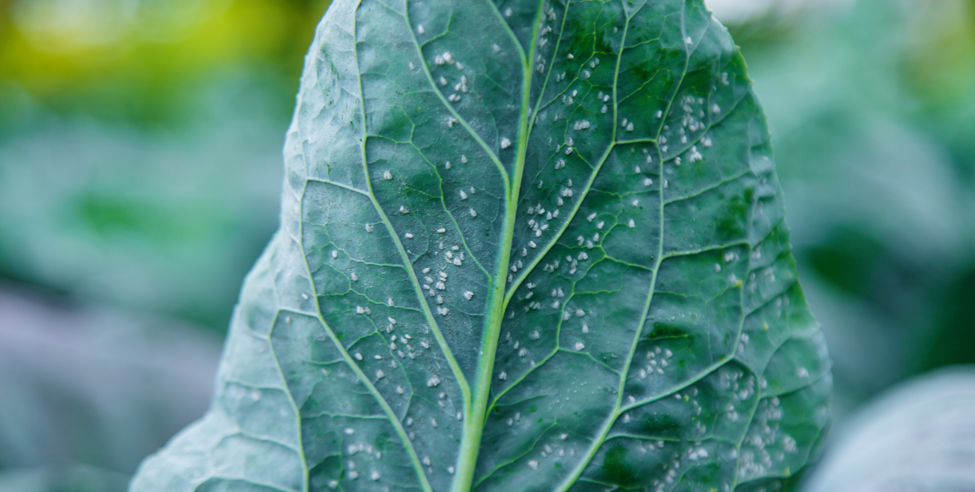
IPM Trial #1

Slide 17
IPM Trial 1
What do we do?
Identify:
  Whiteflies
Threshold met?
  Yes, >5 per leaf
Actions to be taken:
  Sticky Traps
  Mechanical removal?
    Vacuum, remove infested leaves
  Biological Controls
    Parasitic Wasps
    Ladybird beetle
  Chemical/soap spray
    Insecticidal soap
    Neem Oil
    Pyrethrins (last resort)

Slide 18
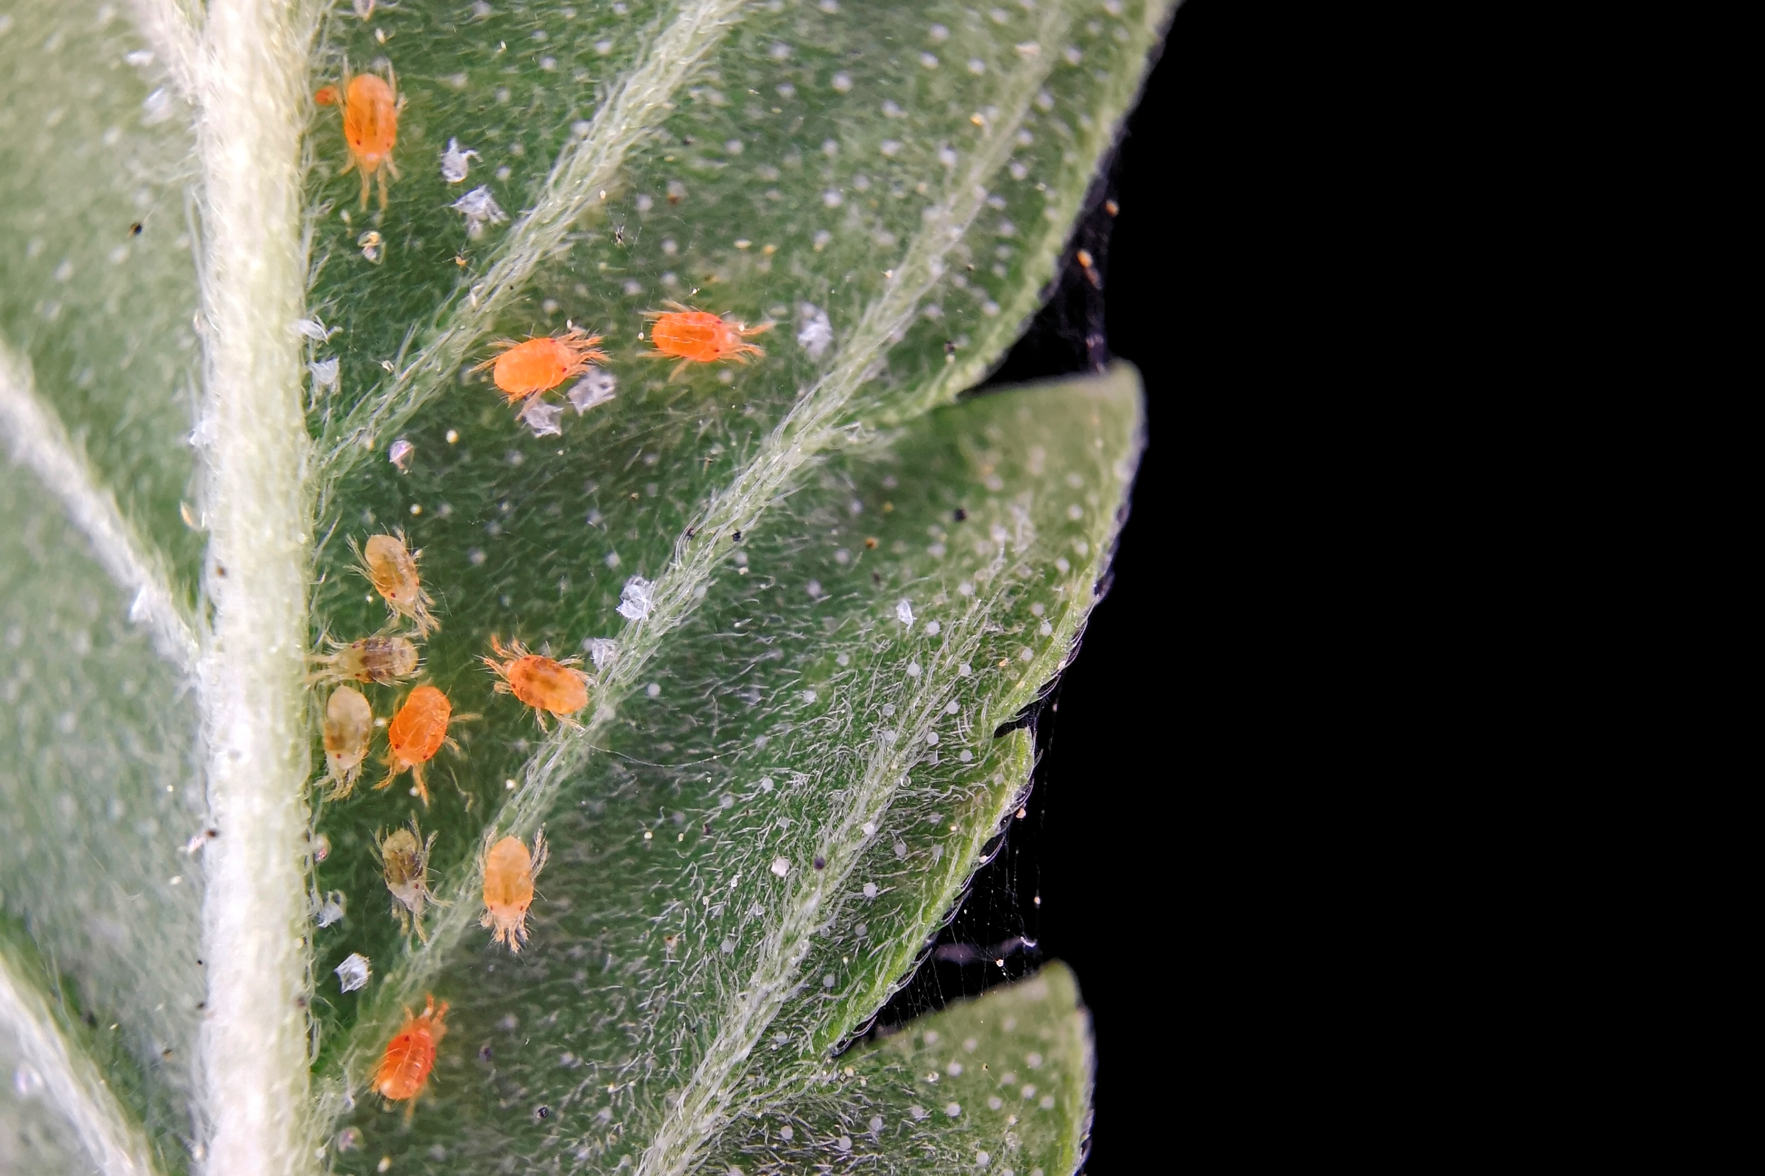
IPM Trial #2

Slide 19
IPM Trial 2
What do we do?
Identify:
  Spider mites
Threshold met?
  Yes, >1 per leaf
Actions to be taken:
  Water down plants
  Mechanical removal?
    Remove infested leaves or plants
  Biological Controls
    Predatory mites
    Ladybird beetle
  Chemical/soap spray
    Insecticidal soap
    Neem Oil
    Essential oil sprays (i.e rosemary and mint)

Slide 20

IPM is Crucial in Aquaponics
Long term Sustainability
Promotes Biodiversity
Promotes Health of Fish and Plants

Slide 21
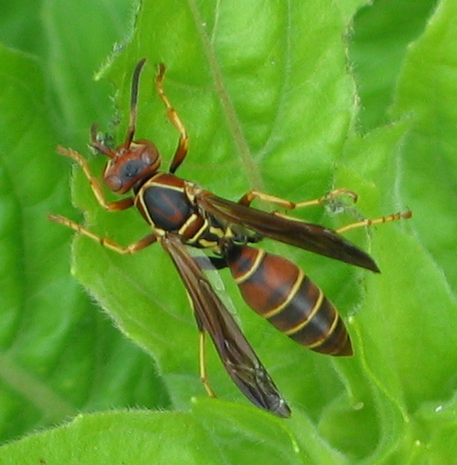
Pollinators
Honey bees and bumble bees are the best pollinators
Wasps will also pollinate as well as prey on tomato horn worms and caterpillars

