Slide 1
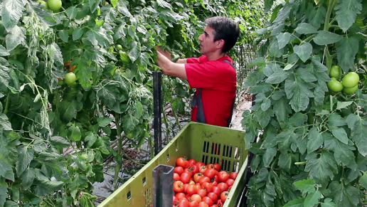
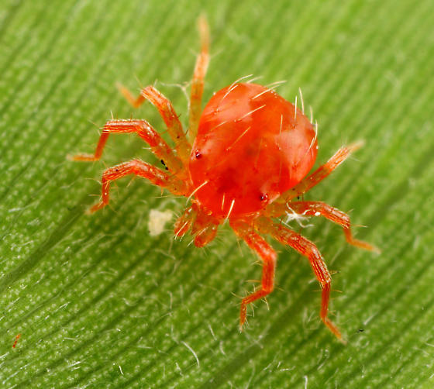
Plant Care and IPM in Aquaponics
Matt Recsetar © 2021

Slide 2
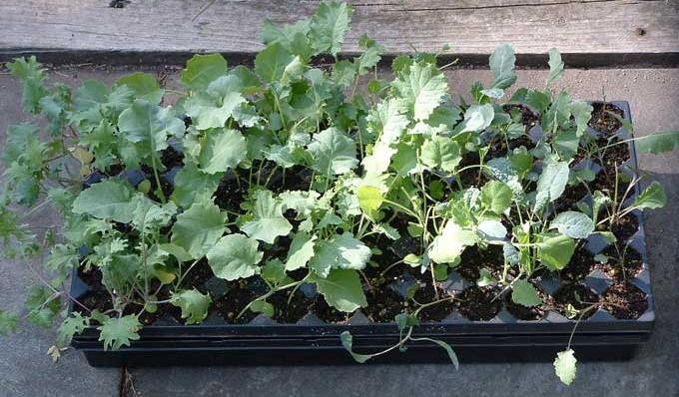
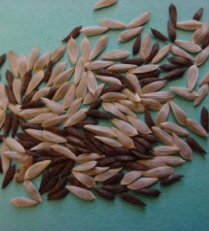
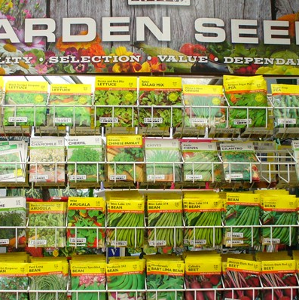
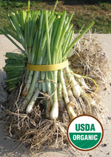
Seeds Vs. Transplants

Slide 3
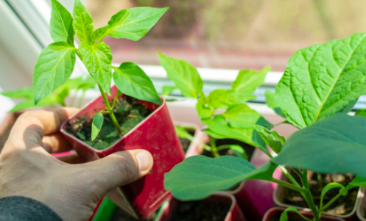
Benefits of Transplants
Less time to maturity or fruit output
Easy to organize and space out in system
Immediately visible success!

Slide 4
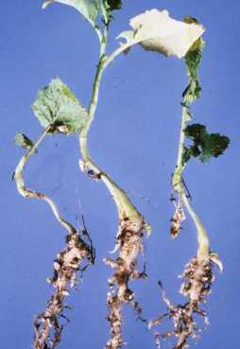
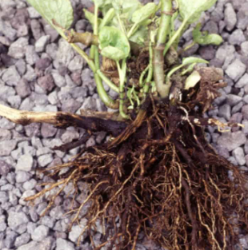

Drawbacks of Transplants
Can potentially carry in diseases or pests
Less options available
More expensive

Slide 5
Common Transplants
Preferred
Available
Tomatoes
Strawberries
Basil, rosemary and thyme, sage, dill (most herbs)
Cilantro
Peppers
Onions and Chives
Lettuce**
Artichokes
Watermelon
Cantaloupe
Mint
Some root crops

Slide 6
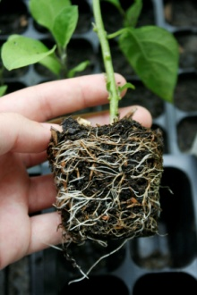
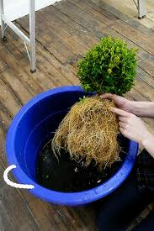
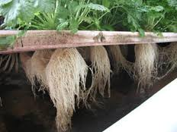
How Do I transplant Plants into My Aquaponics System?
Step 1:
Step 2:
Knock off dirt and rinse roots
Place in system so roots have access to water
Wash Those
ROOTS!

Slide 7
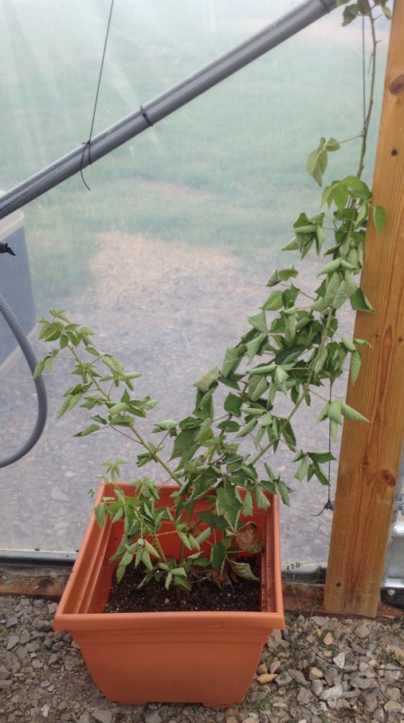
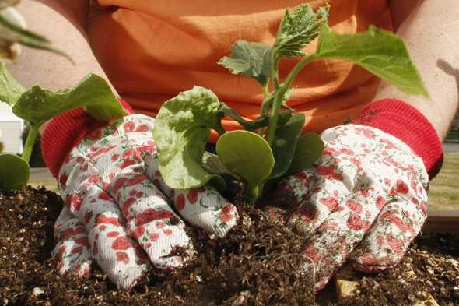
…but don’t waste the good soil!
Put it in the garden or grow in pots fertilized organically with fish waste!
blackberry

Slide 8
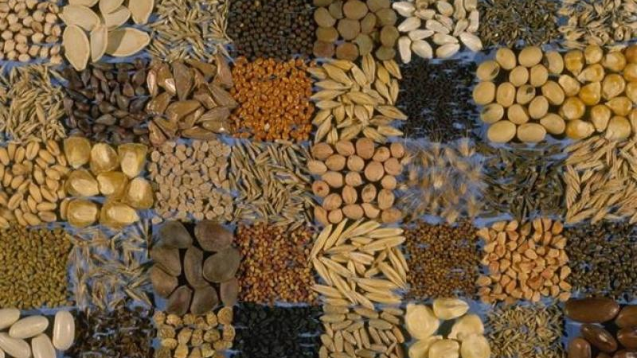
Benefits of Seeds
More Organics and heirlooms available
Cheaper
Know what you are getting

Slide 9
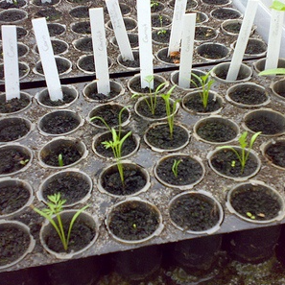
Drawbacks of Seeds
Take longer to mature and produce fruit
Sometimes they don’t work

Slide 10
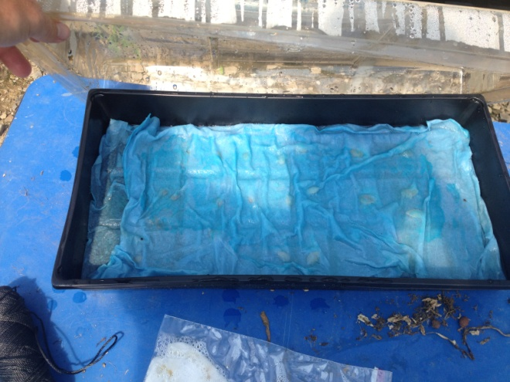
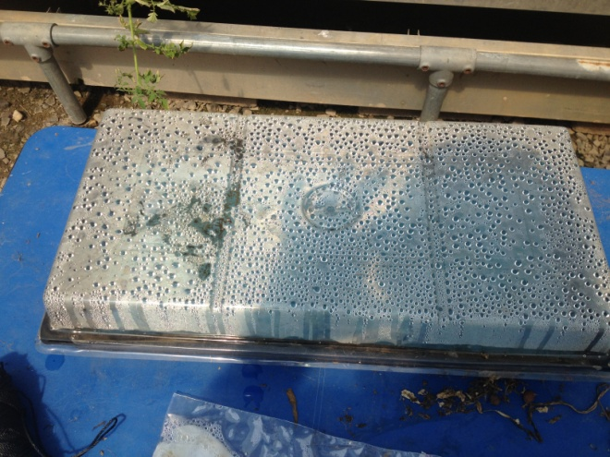
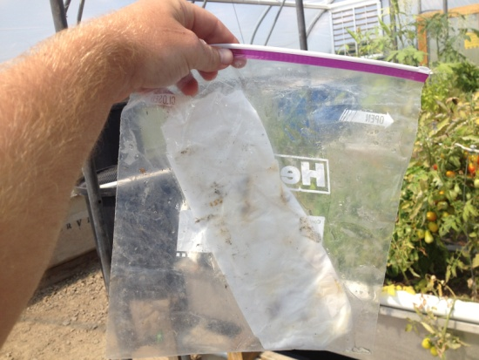
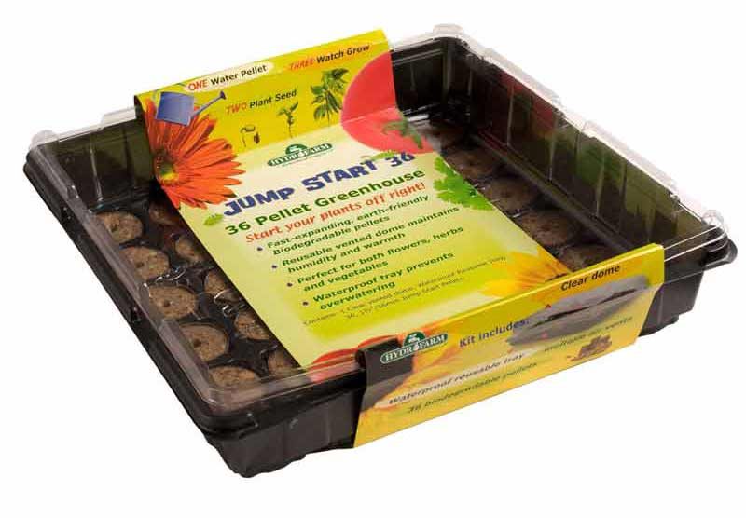
Starting your Seeds
Germination Chambers
Wet paper towel, plastic bag
Keep warm and in the dark until they sprout

Slide 11
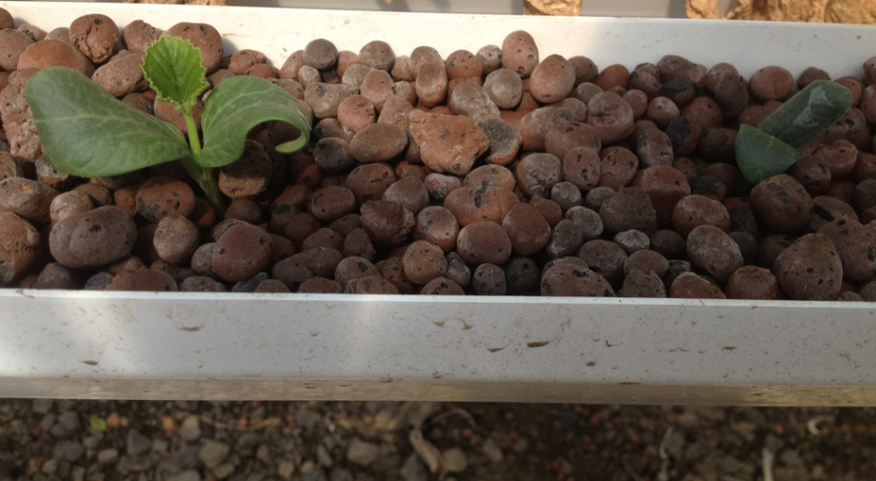
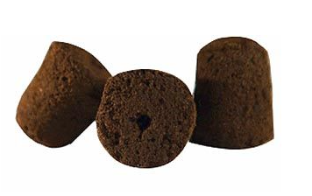
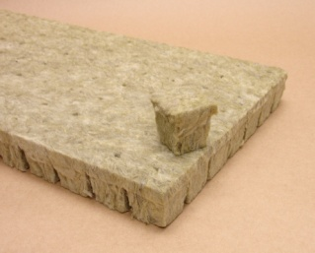
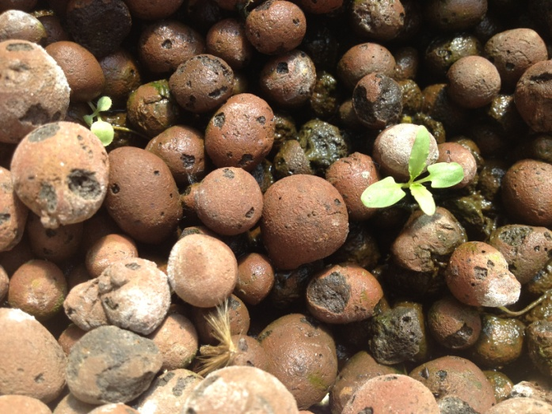
Starting your Seeds
Seeds do well in soilless mixes
Can use peat root cubes, Oasis Rockwool
Or just throw them into your system!
Zucchini Seedlings
Spinach Seedlings

Slide 12
Seeds that have directly germinated in my system
Mixed Lettuce
Romaine Lettuce
Okra
Eggplant
Celery
Onions
Pumpkin
Cherry Tomato
Zucchini (squash)
Garden Bean
Cucumber
Carrots
Radishes
Sweet Peas
Watermelon
Jalapeño pepper

Slide 13
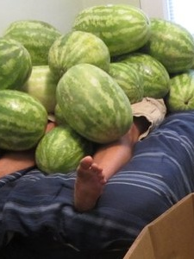
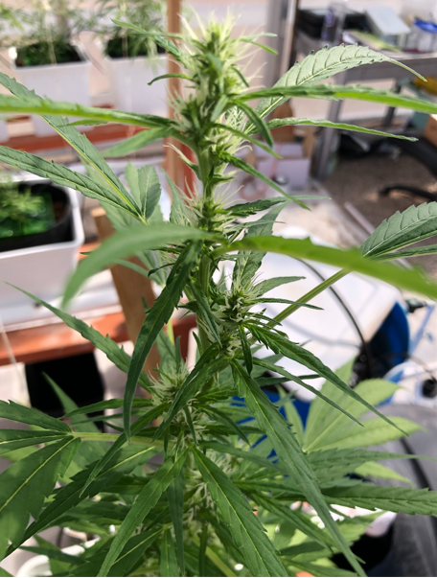
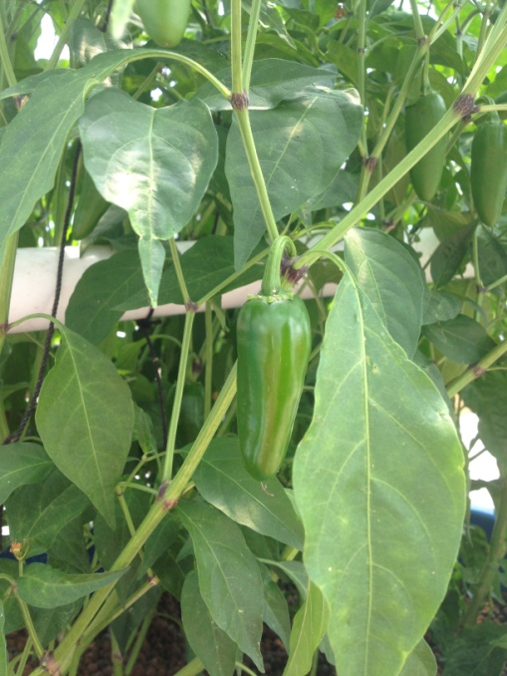
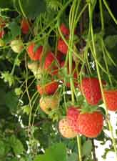

Grow whatever you like!!!

Slide 14
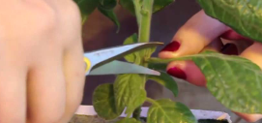
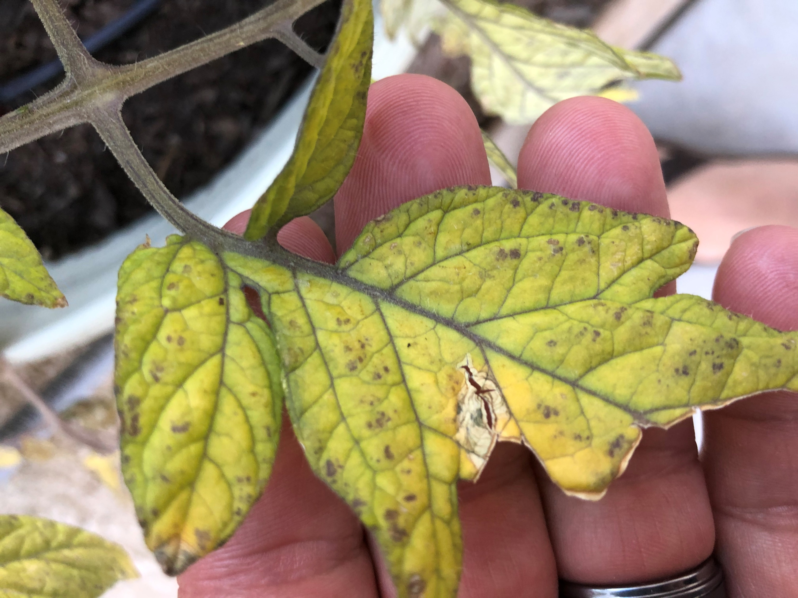
Plant Maintenance
Pruning
Observing for pests, disease and nutrient deficiencies
Deploying pest management strategies
Nutrient supplementation as needed
Harvesting plants as needed

Slide 15
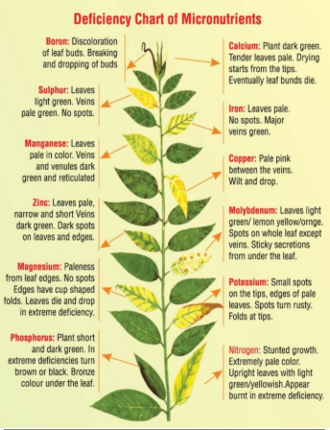
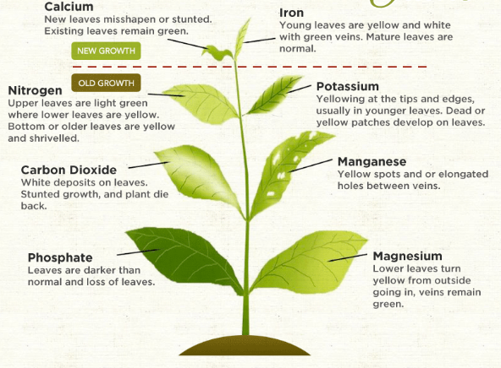
Plant Nutrient Deficiencies

Slide 16
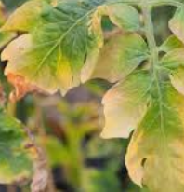
Inadequate Sunlight Can Cause Visible Issues
Indicated by:
Yellowing of lower plant leaves or even new foliage
Poor growth
Pale color
Small leaves
Long, thin stems

Slide 17
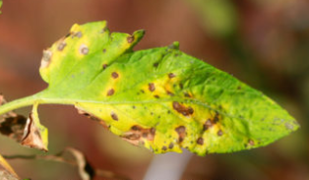
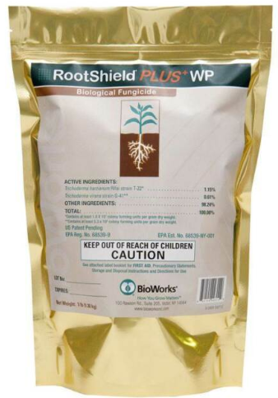
What to do About Plant Diseases?
Choose disease resistant or tolerant cultivars
Use certified disease-free seeds and seedlings
Active pest management
Thrips, white flies and other pests are potential disease vectors
Trim and dispose of infected lower branches
Do your research
https://hgic.clemson.edu/factsheet/tomato-diseases-disorders/
Consult an expert
Treatments:
-Rootshield® Plus (preventative biological root fungicide - $$$)
-Fungicides (foliar sprays only)

Slide 18
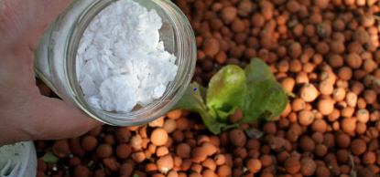
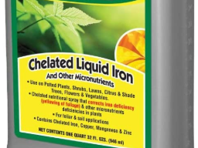
Nutrient Supplementation
Iron –Chelated iron should be added monthly in beginning for media beds or monthly for NFT and DWC systems
Calcium – Ag lime, dolomite, calcium hydroxide
Potassium – Potassium bicarbonate, Potassium hydroxide (corrosive), potassium sulfate, potassium chloride (foliar spray)
Magnesium - dolomite or Epsom salts (foliar spray)

Slide 19
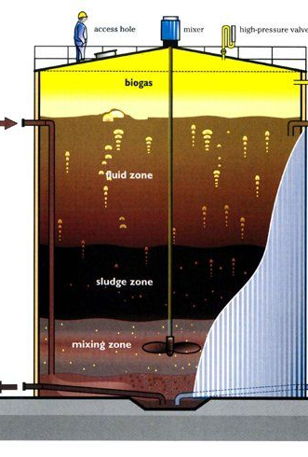
Aquaponics Nutrient Supplementation
Separate mineralization tank (aka bioreactor, biodigester, sludge digester) should provide all required plant nutrients apart from maybe Iron
Tank specifically dedicated to break down of solids that is outside of aquaponics loop (not for nitrification)
Clarified water from this tank is nutrient-rich and can return nutrients back to the aquaponics system in dissolved form (available to plants)
Anaerobic digestor

Slide 20


Growing Plants is Easy!
Sunlight
Water
Nutrients

Slide 21
What about Pests and Pollinators?

Slide 22
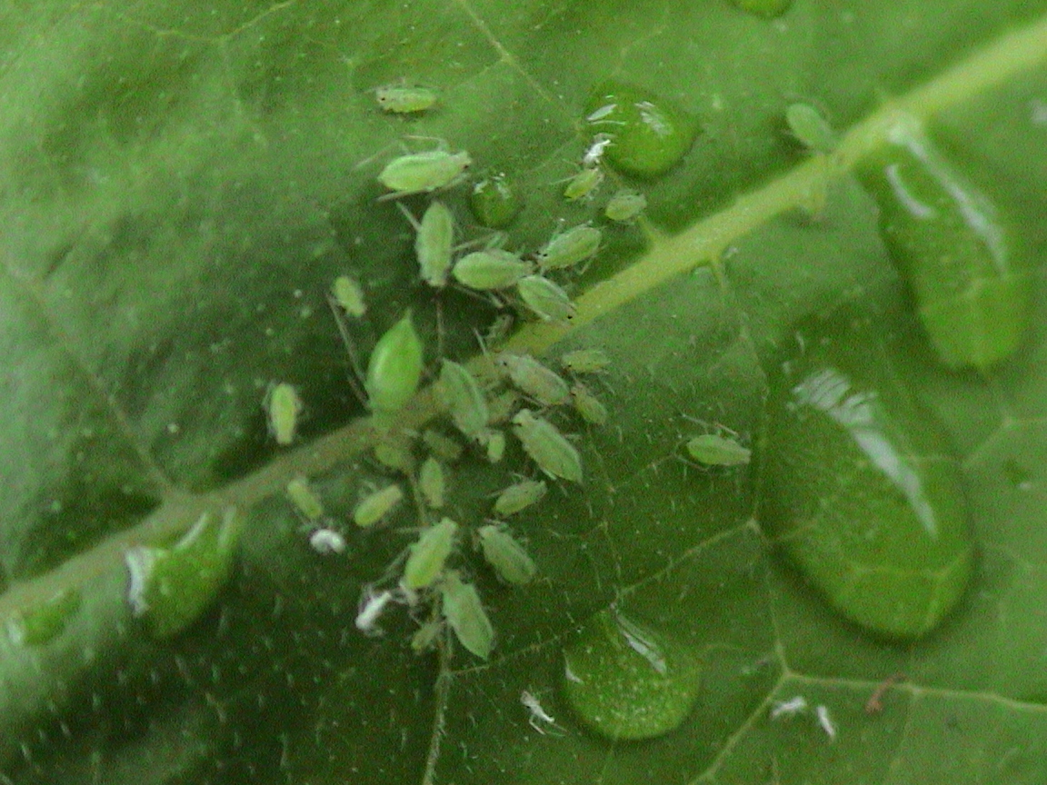
Pests in Aquaponics
Easy to confuse nutrient deficiencies with pest infestations
Pests can damage your plants in various ways
Important to recognize how your plants are being damaged
Then figure out what bugs they are and how to get rid of them

Slide 23
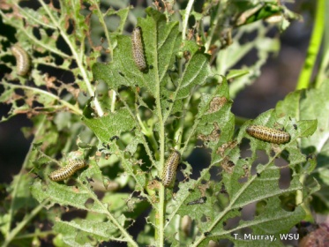
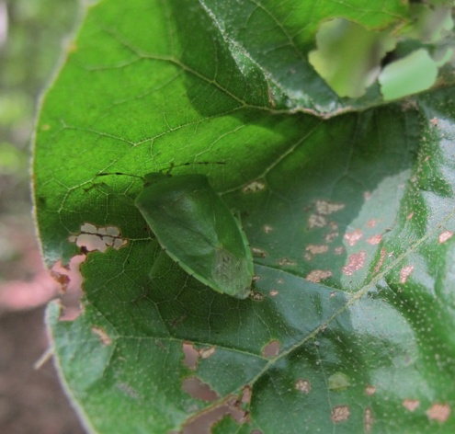
Bugs can be a huge nuisance
Damage plants by
Chewing
Piercing/sucking
Rasping/sucking
Characteristic Damage
Twisted, discolored leaves
Lacy leaves
Tiny holes in the leaf
Can Damage
Roots
Stems
Fruits
Leaves

Slide 24
Identifying those buggers
Behavior
Jump?
Fly?
Hide?
Which Plants are being affected?
Many plants?
Specific plants?
Specific parts of plants
Specific area of greenhouse?
*Most bugs will go to their favorite plant first before moving on to the next

Slide 25
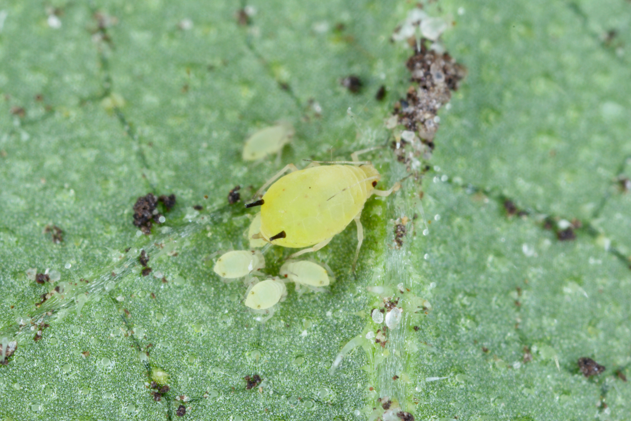
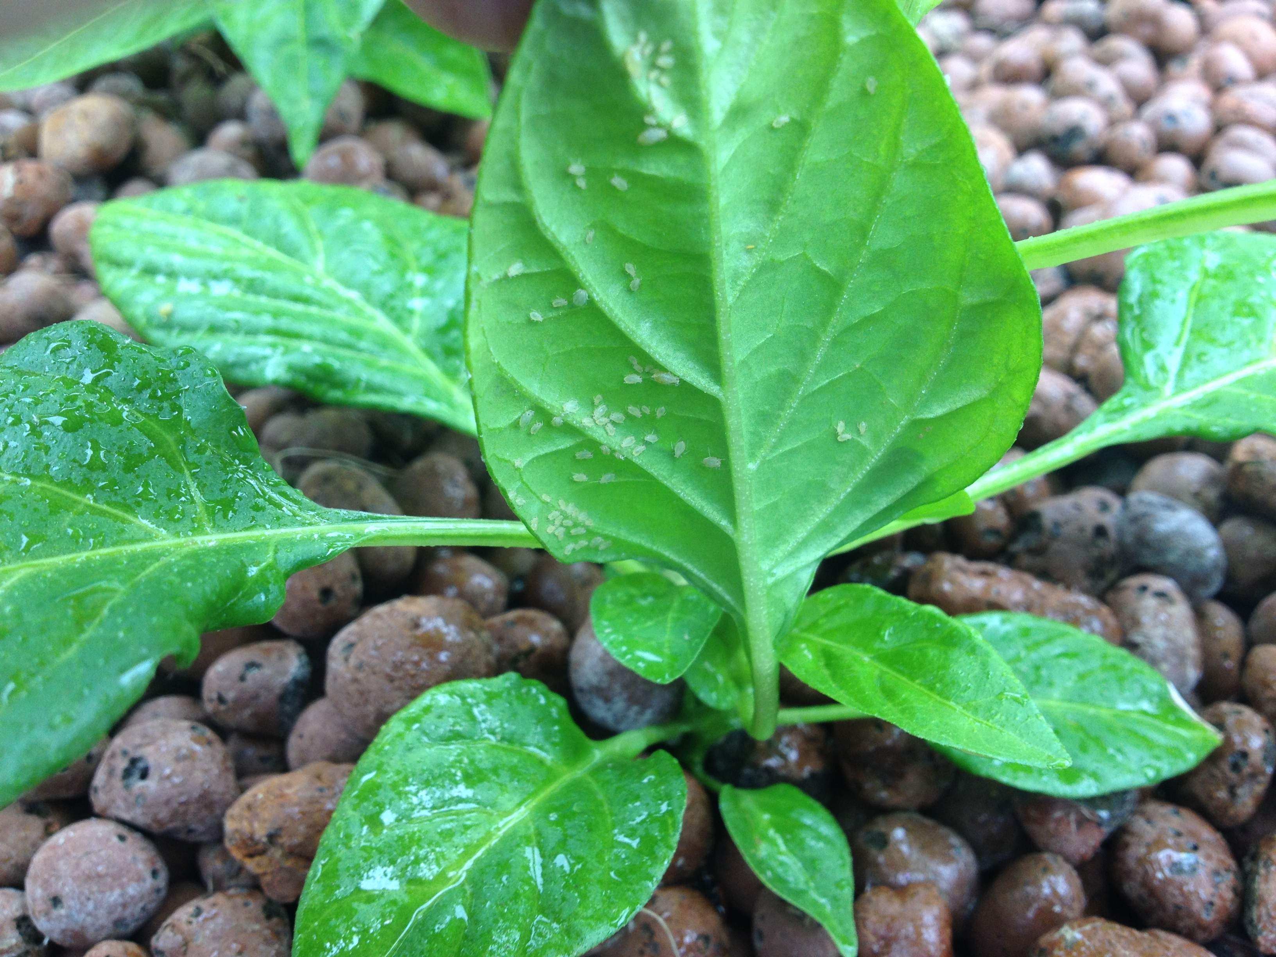
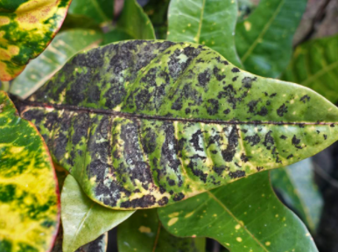
Aphids
Adults: Yellow, pale green, or powdery gray
Often Found on underside of leaves
Secrete a sticky honeydew which can lead to sooty mold
Feeding style – Piercing-sucking

Slide 26
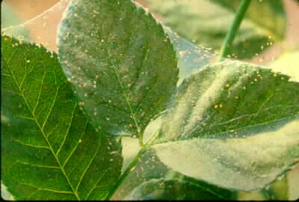
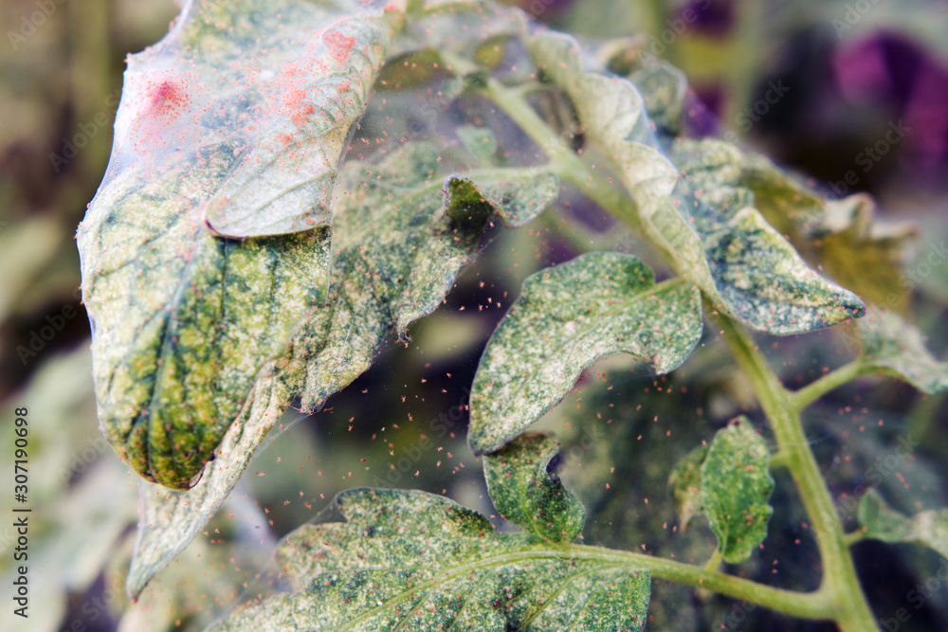
Spider Mites
Red or orangish
Smaller than a pinhead
Fine webs on the leaves
Feeding style – Cell puncturing

Slide 27
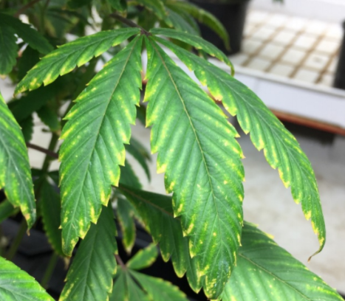
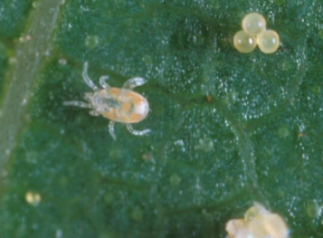
Russet Mites
Leaves get Blisters and appear “glossy”
No webs like spider mites
Easily confused for nutrient deficiencies (can’t see with naked eye)
Begins with yellowing leaves and leaf curl
Feeding style – Piercing-sucking

Slide 28
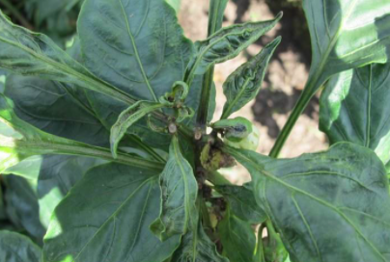
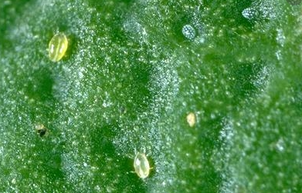

Broad Mites
Light green to yellow
Feed on newest growth
Almost impossible to see with the naked eye
Easy to identify eggs with magnifying glass
Clear round spheres
White opaque dots
Feeding style – Suck sap
and inject toxins

Slide 29


White Flies
Typically 1-2 mm in length
Adults are white and resemble tiny moths under a microscope
Similar to Aphids in that:
often found on the underside of leaves
feed by sucking plant juices
secrete honeydew which can lead to mold growth
Feeding style – Piercing-sucking

Slide 30




Thrips
Tiny yellow or brown-winged insects
Feeding style – Scraping-sucking

Slide 31

Stink Bugs
Shield-shaped
Narrow, pointed head
5/8” long
Juveniles smaller but similar shape
Feeding style – Piercing-sucking

Slide 32



Stink Bugs
Shield-shaped
Narrow, pointed head
5/8” long
Juveniles smaller but similar shape

Slide 33


Fungus Gnats
Look like fruit flies
Can be seen flying around plants
Lay eggs in plant roots where larvae can be found
Feed on dead/decaying matter
Attracted to high moisture medias
Feeding style – chewing roots

Slide 34


Ants
Ants carry aphids to host plants
Aphids excrete honeydew which the plants in turn feed on

Slide 35



Cockroaches
Attracted to dead and decaying plant roots
Attracted to fish feed

Slide 36






Other Pests
Grasshoppers and crickets
Earwigs
Caterpillars
Snails
Mice

Slide 37
Pest | Plants Commonly Affected | Damage | Control
Aphids and White Flies | Okra*, Broccoli, Peas, Eggplant, Peppers, Tomato, habaneros | Leaves wrinkle and turn yellow or brown, virus transmission | Neem Oil; beneficial bugs; citric acid
Spider mites, russet mites, broad mites | Strawberries*, Beans, peppers, squash, cucumbers, cannabis | Reduction in fruit size; leaf curl, yellowing, plant death | Neem Oil; beneficial bugs; Avoid excessive Nitrogen; insecticidal soaps; diatomaceous earth; citric acid
Stink Bugs | Artichokes*, Okra, green beans, grains, tomatoes, peppers | Yellow blotches in leaves; Fruit damage/deformation | Neem Oil; beneficial bugs
Thrips | Peppers*, Lettuce | Tips of leaves distorted and die back; plants may wither and fall over | Neem Oil; beneficial bugs; Sticky traps
Fungus Gnats | Cilantro*, basil, lettuce | Larvae will feed on roots inhibiting plant growth (Prefer new root hairs); Increase root rot; disease/ death | Sticky traps; lower moisture levels; nematodes; predatory mites
Ants | They don’t affect plants as much as they farm aphids on your plants | Aphid damage | Diatomaceous earth; wrap sticky tape around legs of growbed; poison bait

Slide 38

How do we deal with pests in aquaponics?

Slide 39



Slide 40
Integrative Pest Management (IPM)
Sustainable way of managing pests by combining multiple control methods
Goals:
Minimize risks to people, beneficials and environment
Prevent pests and monitor populations
Use mix of biological, chemical, cultural and chemical tools
Monitor populations
Reduce over-reliance on peseticides

Slide 41



1. Prevention
Sanitation
Proper irrigation (not overwatering)
Proper pruning of plants
Screens (Thrip screen)
Rotating Crops
Eliminate Pathways i.e. sticky tape, weed removal

Slide 42

2. Monitoring and Identification
Regular Scouting for pest/disease presence
Sticky traps
Leaf inspection
ID of pests and beneficials

Slide 43


Sticky Traps

Slide 44

3. Thresholds
Action only taken when pest levels reach a certain threshold
2-3 Whiteflies per leaf
>1 Spider mite per leaf
>5 Aphids per leaf
1-3 Thrips per leaf

Slide 45

4. Control Options
Mechanical Control
Manual removal
Vacuuming
Water removal
Sticky Traps
Beneficials
Insects that eat pests
Chemical Sprays
Organic approved sprays only

Slide 46

Releasing Beneficial Insects

Slide 47

Ladybugs
Your best friend in the garden
Eat aphids, thrips, mites and other bad bugs – broad spectrum beneficials
Can be purchased online or at nurseries
Will be attracted by fennel, dill, dandelion, marigold, garlic chives, coriander (strong aromas)
Delphastus catalinae
*adults can consume up to 75 aphids per day!

