Slide 1

System management
©2021 Matt Recsetar

Slide 2


If you neglect your system, it will fail

Slide 3
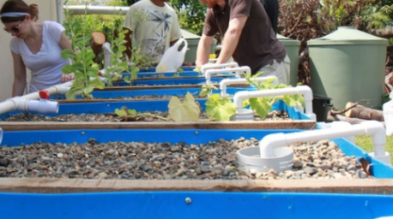
Maintenance in Aquaponics
General upkeep of conditions and performance of the system
Involves observation, monitoring, cleaning and maintain the system and its components

Slide 4
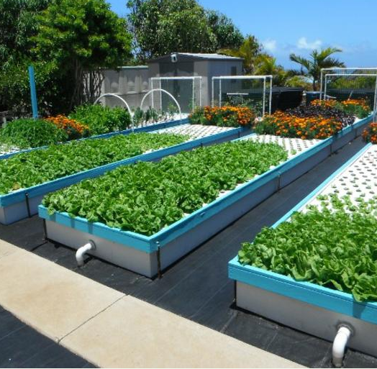
Why is Upkeep Important?
Maintaining water quality for fish and plants
Preventing clogs
Maximizing Yields
Preventing Disease in fish and plants (and workers!)
Extending lifespan of equipment (pumps, tanks structures)
*Photo Credit: Friendly Aquaponics

Slide 5

Create a Checklist and/or Schedule
Daily Checklist
Check for leaks
Check Sump and fish tank water levels
Check Water Flow
Check aeration (airstones)
Check for minor clogs or waste build up
Observe fish
Check water quality and D.O.
Feed Fish
Plant Maintenance
Mon | Tues | Wed | Thur | Fri | Sat | Sun
Feed fish | Feed fish | Feed fish | Feed fish | Feed fish | Feed fish
Measure Adjust pH |  |  | Measure Adjust pH
 | Empty Clarifier |  |  | Empty Clarifier
 |  | Prune plants

Slide 6
Your system should be inspected every day for issues
Are water levels adequate?
Is pump flow normal?
Any leaks?
Do your fish look happy?
Aeration working?

Slide 7
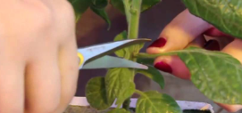
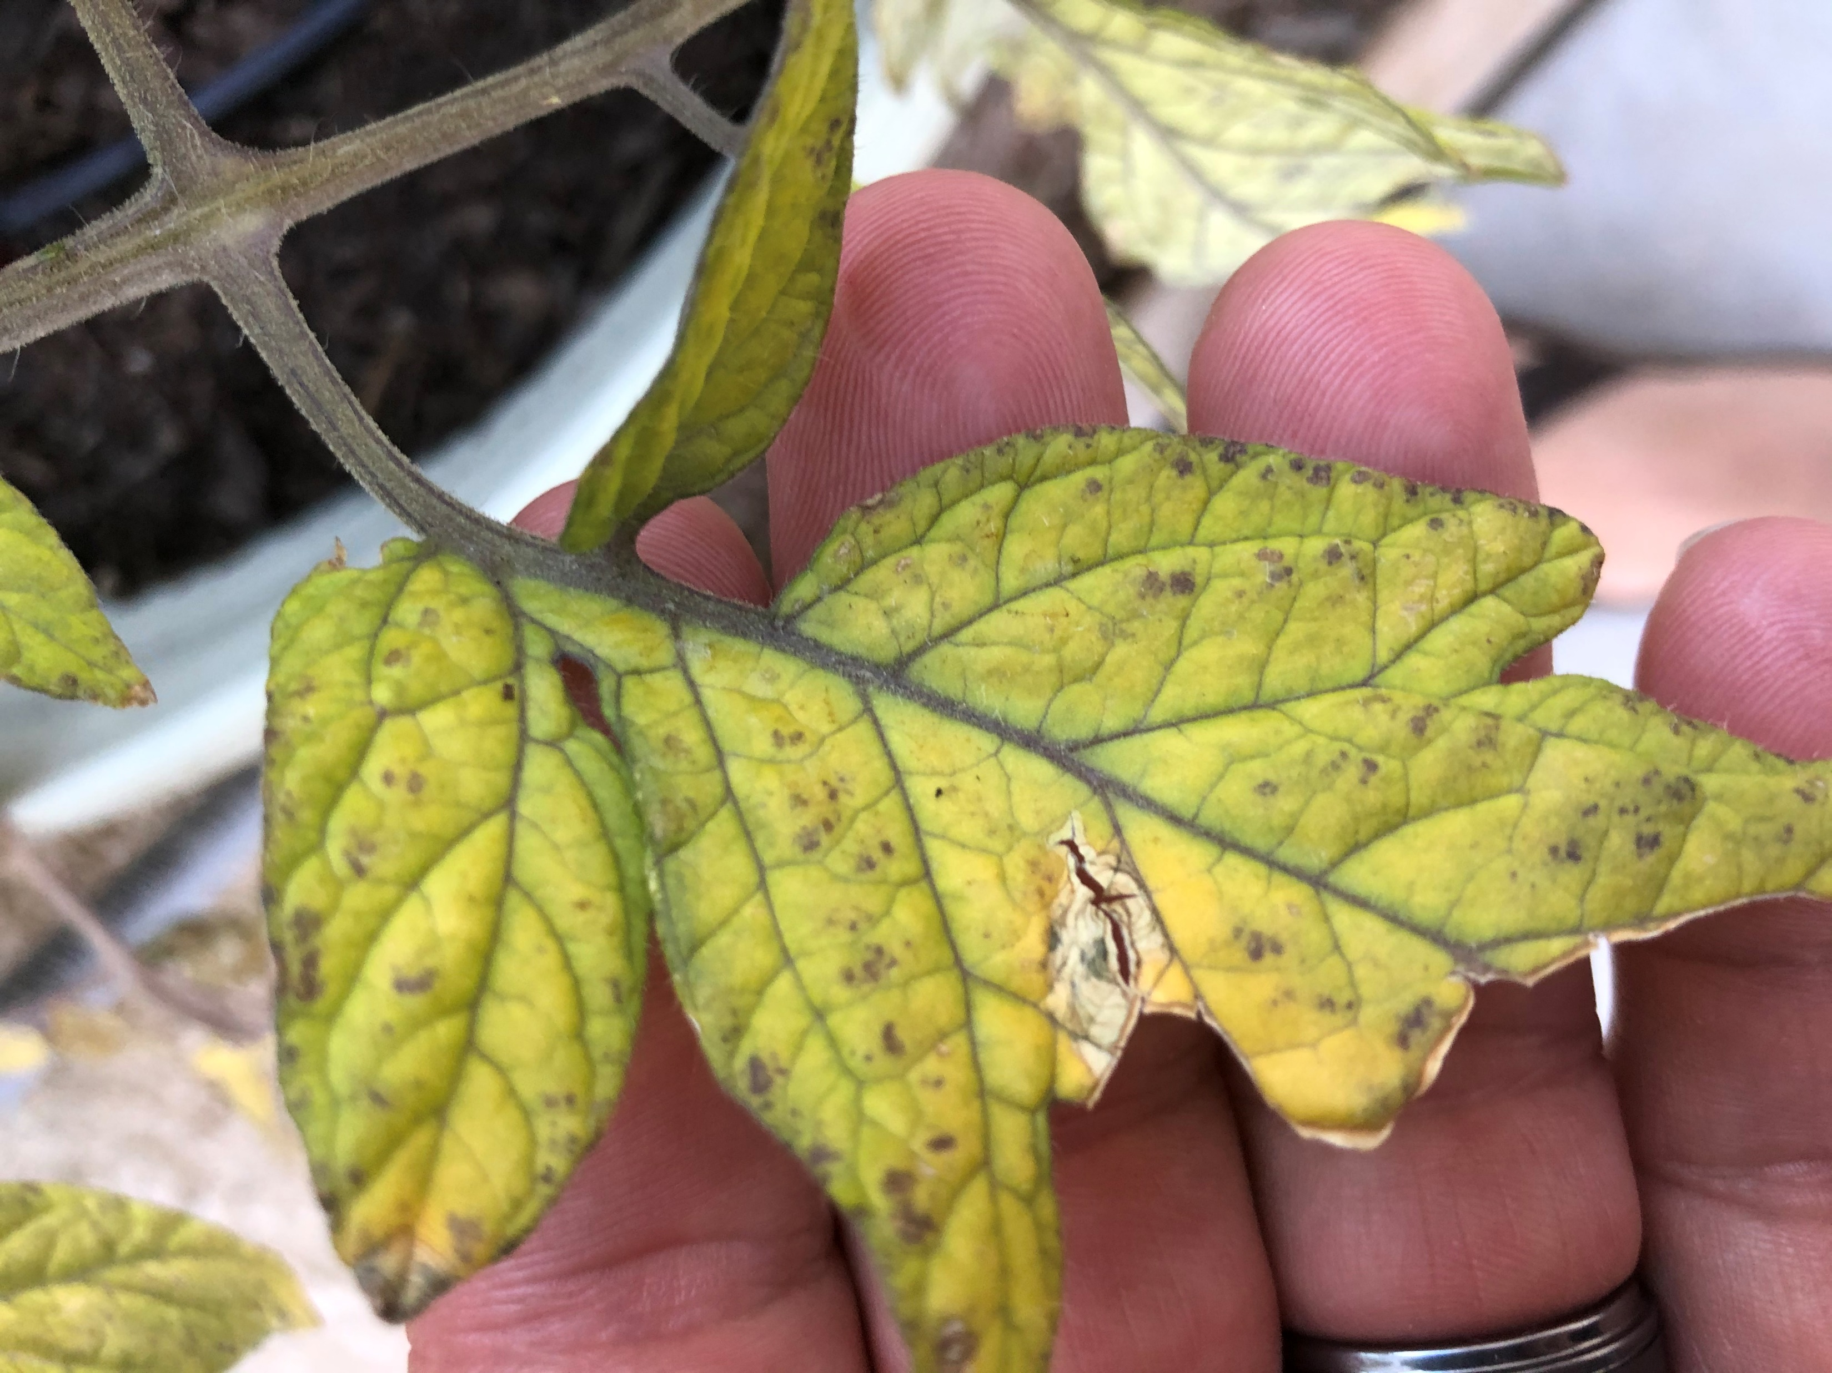
Plant Maintenance
Pruning
Observing for pests, disease and nutrient deficiencies
Deploying pest management strategies
Nutrient supplementation as needed
Harvesting plants as needed

Slide 8
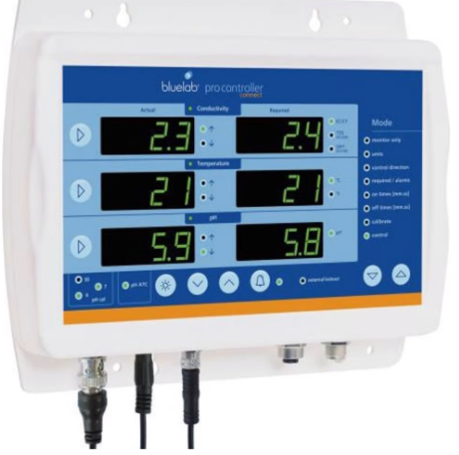
Assign Duties if multiple people will be involved and invest in a monitoring system to help out

Slide 9
Monitoring and Control is a Great Option
Can simply monitor temperature, pH and EC from your phone (among other parameters)
Some monitoring systems have feedback control
i.e. if water is too cold, turns on chiller;
if pH is too low, controller opens valve and adds base $$$

Slide 10
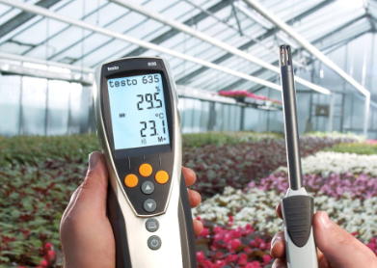
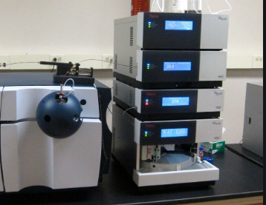
You can test almost any parameter
Water – pH, TAN, Nitrite, Nitrate, D.O., Alkalinity, Hardness, heavy metals, TDS, temperature, water level, flow rate, bacteria
Air – Relative humidity, PAR, CO₂, temperature, etc.
Tests results can be instant or timely (minutes to days)
You can determine each parameters using:
Test kits (cheap or expensive)
Probes
Meters
Expensive machines (ie. LC-mass Spectrometers)

Slide 11
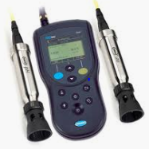
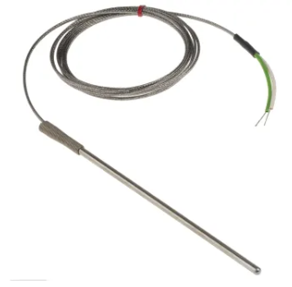
What is a Probe?
A device or instrument that is used for measuring, testing or obtaining information on a specific parameter
A probe is a type of sensor
Typically, a probe is connected to a handheld meter which reads the output
Often time it is an electrode or electrodes that measures a voltage or voltage differential
i.e. Thermocouples – two different electrical conductors produce a temperature dependent voltage
The voltage differential can be calibrated to read the corresponding temperature

Slide 12
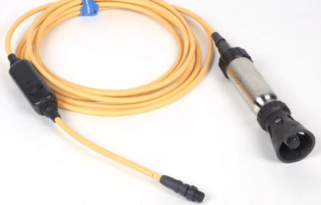
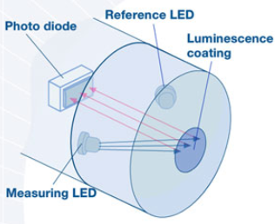
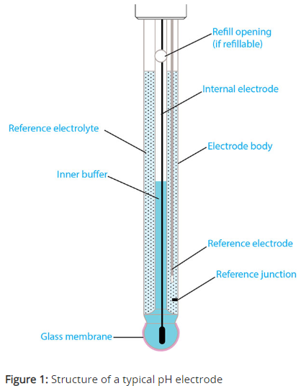
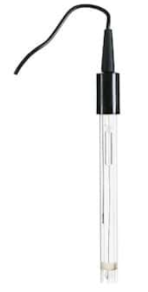
Manual Testing with Probes
Dissolved Oxygen – Probe
Luminescent Dissolved Oxygen (LDO)
pH – Probe
Glass electrode most common
Temperature – Probe
TDS – Probe
Amount of salt (mg/L)
(EC) – Probe
Ion concentration (μS/cm)

Slide 13
Real-time Monitoring and Life Support
REAL-TIME
(Manual Monitoring Only)
High Priority – minutes to react
Power
Tank water levels
Dissolved Oxygen
Aeration system
Oxygen system
Medium Priority – hours to react
Temperature
Carbon Dioxide
pH
Low Priority – days to react
Alkalinity
TAN
Nitrite

Slide 14
Emergencies (Murphy’s law – things always go wrong)
Type | Causes
Acts of God | Power outages, wind, storms, hurricanes, floods, tornadoes
Human errors | Overlooking maintenance issues that cause back-up systems or components to fail, or alarm deactivation
Tank water level | Leaks, broken drain lines, valves left open, tanks overflowing
Water flow | Pump failure or loss of suction head, intake screens or pipes clogged, return pipe breaks, PVC glue failure
Water quality | Low DO, high CO2, high/low temperature, high ammonia, nitrite, low alkalinity, super saturated water (oxygen systems only)
Filters | Excessive head losses, clogging or channeling in filters
Aeration System | Loose or broken drive belts, clogged or disconnected diffusers, supply line leaks, overheating blower motor due to excessive back-pressure
Adapted from Timmons and Ebeling 2013, Table 13.1

Slide 15
Realtime Monitoring: What you can control vs. what you need to control
Ability to Control
Dissolved oxygen
pH
Temperature
Flow Rate
Aeration pressure
Water levels
Power
(Feeding rate)
Need to Monitor and Control
Dissolved Oxygen*
Flow Rate
Power
Aeration System Pressure
(water levels)

Slide 16
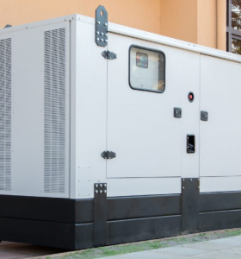
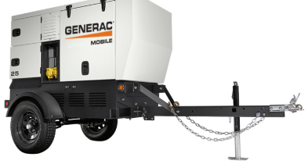
High Priority Parameters
Should have monitoring and control $$, not having monitoring and controlling in emergency $$$$
1st Priority
Electrical power – back up generators essential to any commercial system or you will lose everything in an emergency
Back up generators - should be in working order and come on-line when needed
$3000 - $20,000 depending on size of operation
Natural gas, propane, or diesel powered (some battery powered also available – solar panels)
Smaller system - air pumps with battery backup is great!

Slide 17
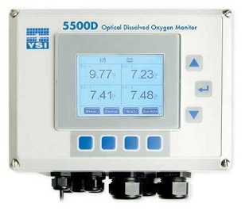
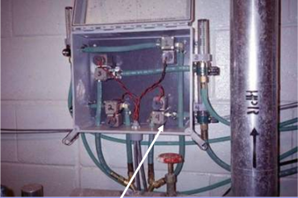
2nd Priority – Dissolved Oxygen
Most expensive parameter to continuously monitor
Depends on economics of fish, stocking density and amount of risk owner is willing to accept
If using an oxygen system, you must monitor DO
Minimally all you would want to know is that the DO is above your set point (i.e. 5 mg/L) and if not, a reserve tank of oxygen is activated to supply emergency oxygen to the fish tanks
Requires an expensive probe and a hardware interface or microcontroller (Arduino)
Software needed to integrate process control and monitoring in real-time
Wireless communication also essential to alert via alarm, text, email

Slide 18
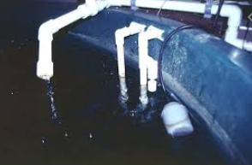
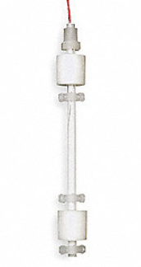
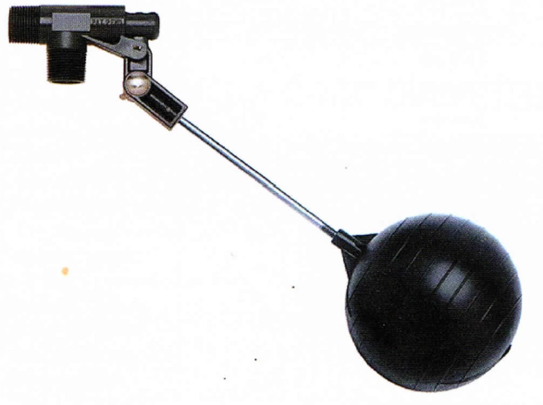
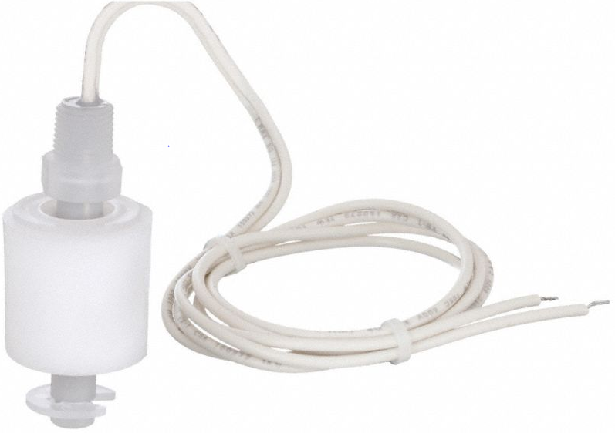
Water Level
Easiest and most inexpensive to measure ($70 each)
Monitor for low and high water levels in each fish tank and potentially sumps
Sensors will detect changes in normal water levels which can indicate fallen stand pipes, clogged drain lines, cracks in drain lines or tanks, or hoses left in tanks
Float switches – floats contain small magnets that activate a switch when water is too high or too low
Can alert to your phone via text, call ap or email
Optical sensors also available (more expensive)

Slide 19
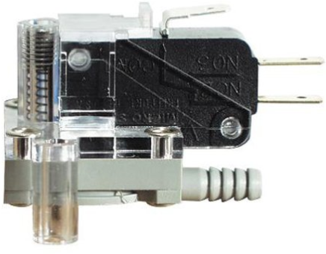
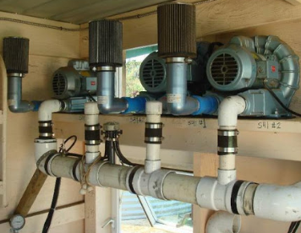
Aeration System Pressure
Critical system – shortest response time to save fish
When you pump air through your airlines, there is a normal functioning pressure (measure at farthest point)
You measure for low pressure or a significant drop in pressure, which would indicate:
Ruptured airline
Open/jammed pressure relief valve
Disconnected air stones
Dirty intake filter
Blower failure
Pressure control switch trips an electrical switch at pressure setpoint ($50)
Can trigger back up aeration/oxygen system or an alarm

Slide 20
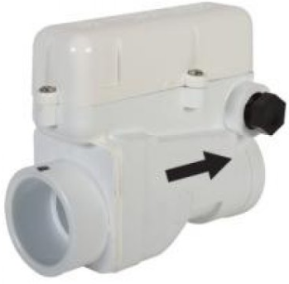
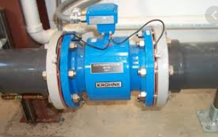
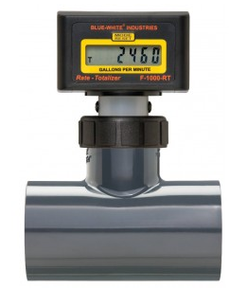
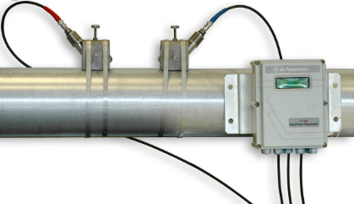
Water Flow
Typically want to measures flow/no flow (flow sensing) ~ $110
Crucial for inline heaters and chillers (some have built in shut-offs for no flow conditions)
Also needed if using submerged biological filters
Can also measure actual flow rate to optimize system performance or chemical injection systems
~$1500 for flow valve control

Slide 21
Digital Vs Analog Monitoring and Control
Digital sensors are simple and relatively inexpensive (Either on or off)
Electrical power,
Aeration system pressure
Water level
Water flow
Analog sensors are significantly more expensive (continuous output)
Dissolved oxygen monitoring
pH
Conductivity
TAN

Slide 22
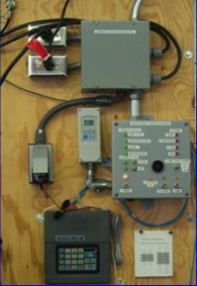
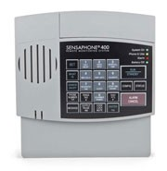
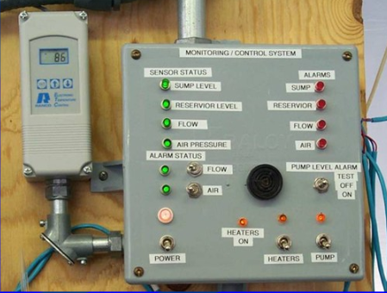
Basic Monitoring System
System power ~ $500 (done by telephone dialer)
Fish Tank water levels (high/low) $300 (4 tanks)
Aeration system pressure $50
Flow-sensing switch $110
Telephone dialer (alerts you via text either codes or problems)
Total Cost: ~ $1,000

Slide 23
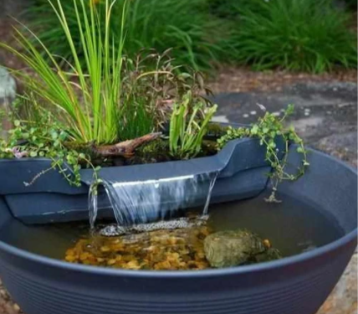
Management is Ongoing
Aquaponics is a commitment, and your system needs to be maintained and monitored daily (or weekly)
Aquaponics is fun and you should enjoy doing it!
Don’t make it more difficult than you can handle
At the very least you can stock fish at a low density and set them up with an automatic feeder and check on the system once a week

Slide 24
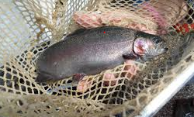
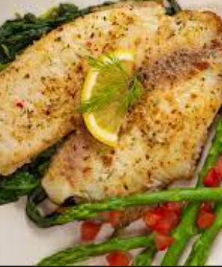

Harvesting Fish and Plants
Biosecurity and contamination are important
Wear gloves when handling fish or plants
Disinfect scissors or shears when cutting your plants
Wash your hands before and after handling fish and plants
Enjoy the fruits (and vegetables and fish) of your labor!

