Slide 1
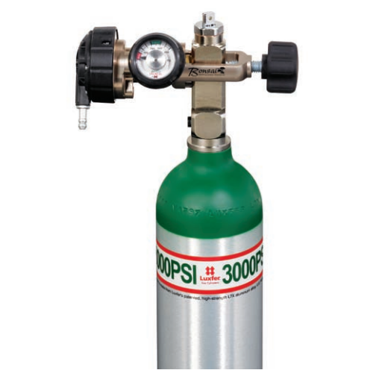
Fish Need Oxygen
If you are traveling long distances (an hour or more):
You should stop every 30 minutes to check on the fish and make sure the diffusers are working
Anything longer than a couple hours and you should have a dissolved oxygen tank with a regulator set to 3 L/min

Slide 2
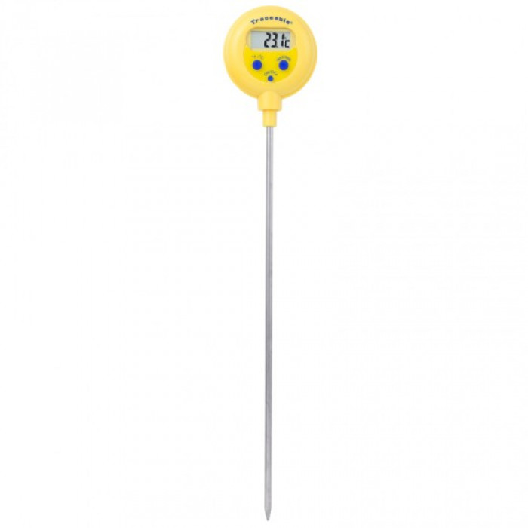
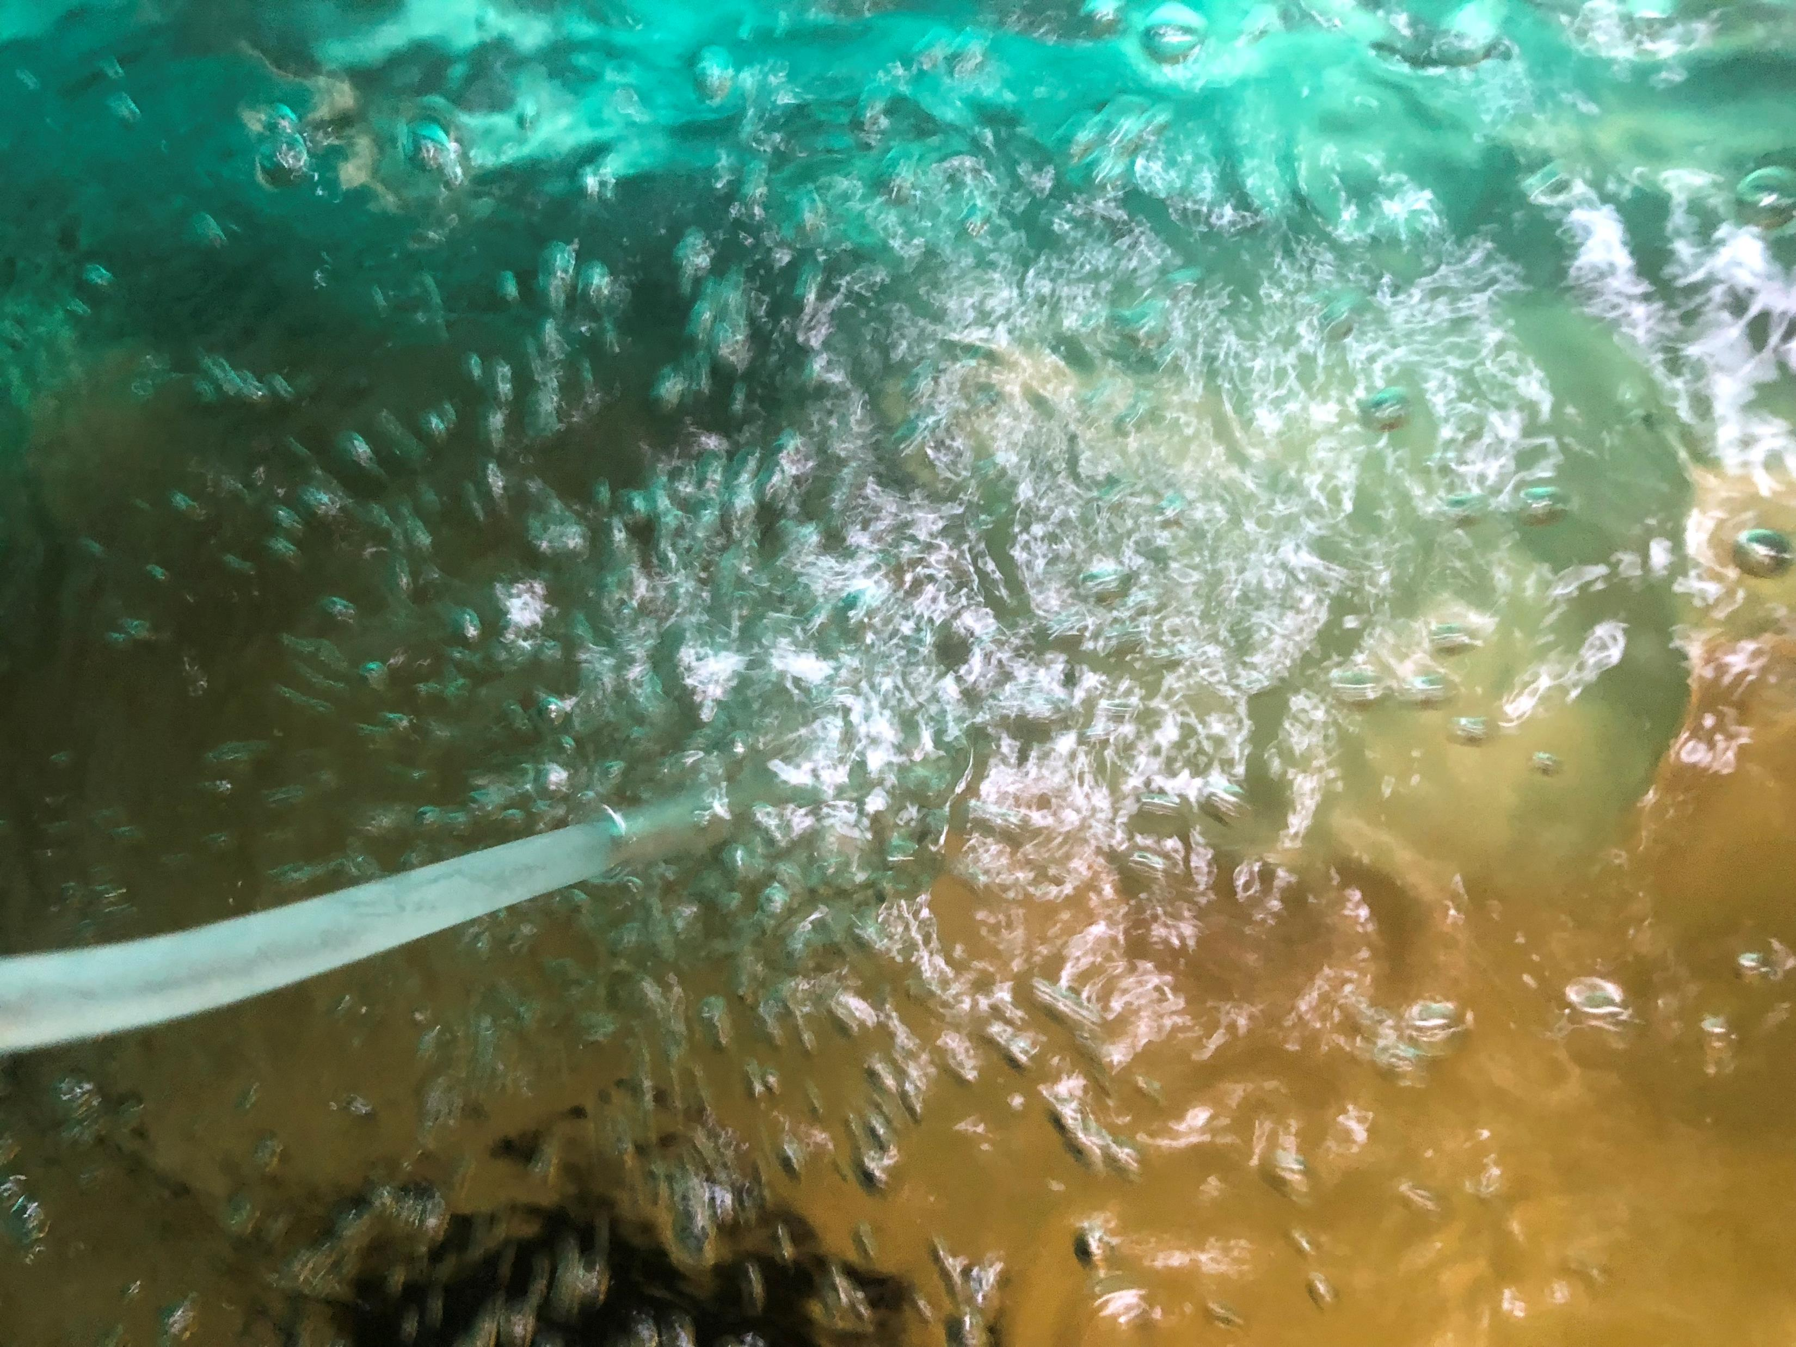
Acclimation
You want the temperatures of the transport water and the aquaponics system water to be within a few degrees (1-2°F)
Fish are extremely sensitive to abrupt changes in water temperature
Therefore, they should be allowed to acclimate to their new tank

Slide 3
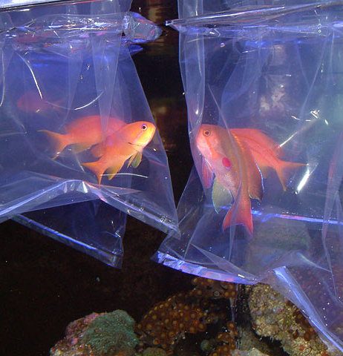
Tempering Fish
If you have a bag, you can simply place the bag in the tank and wait for the temperatures to equalize (30 min to 1 hour)
You can also temper the fish by adding water a little bit at a time from the aquaponics system until temperatures are within a degree or two
Should not increase the temperature by more than 1 degree per minute
Aeration may be necessary while tempering
Once fish are acclimated allow them to swim freely into their new tank
Photo credit: Reefs.com

Slide 4
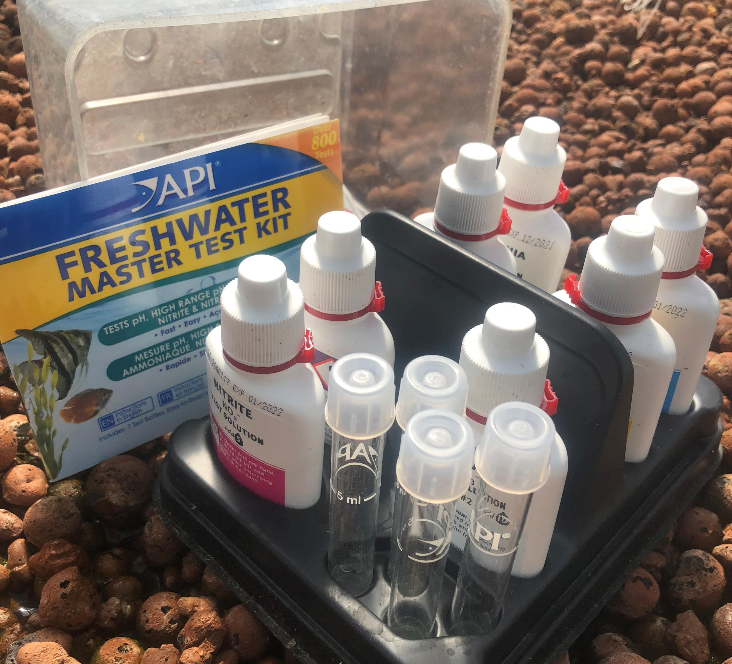
Monitoring Water Quality
Important parameters:
Temperature
Dissolved Oxygen
pH
Alkalinity
Carbon Dioxide
Ammonia
Nitrite
*Much different than plant water quality

Slide 5
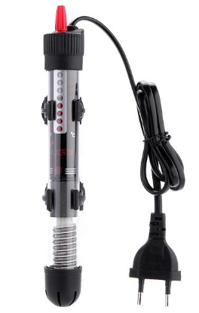
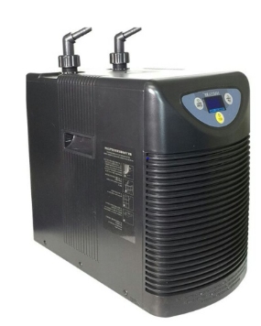
Temperature
Second most important parameter for fish growth after D.O.
Optimal temperature range depends on fish species being grown
If you are in a greenhouse, you can easily keep within a desired temperature range if you have heating and cooling capabilities
If you don’t have heating and/or cooling you can maintain water temperatures using submersible heat and inline water chillers
Temperature measurement built into most probes

Slide 6
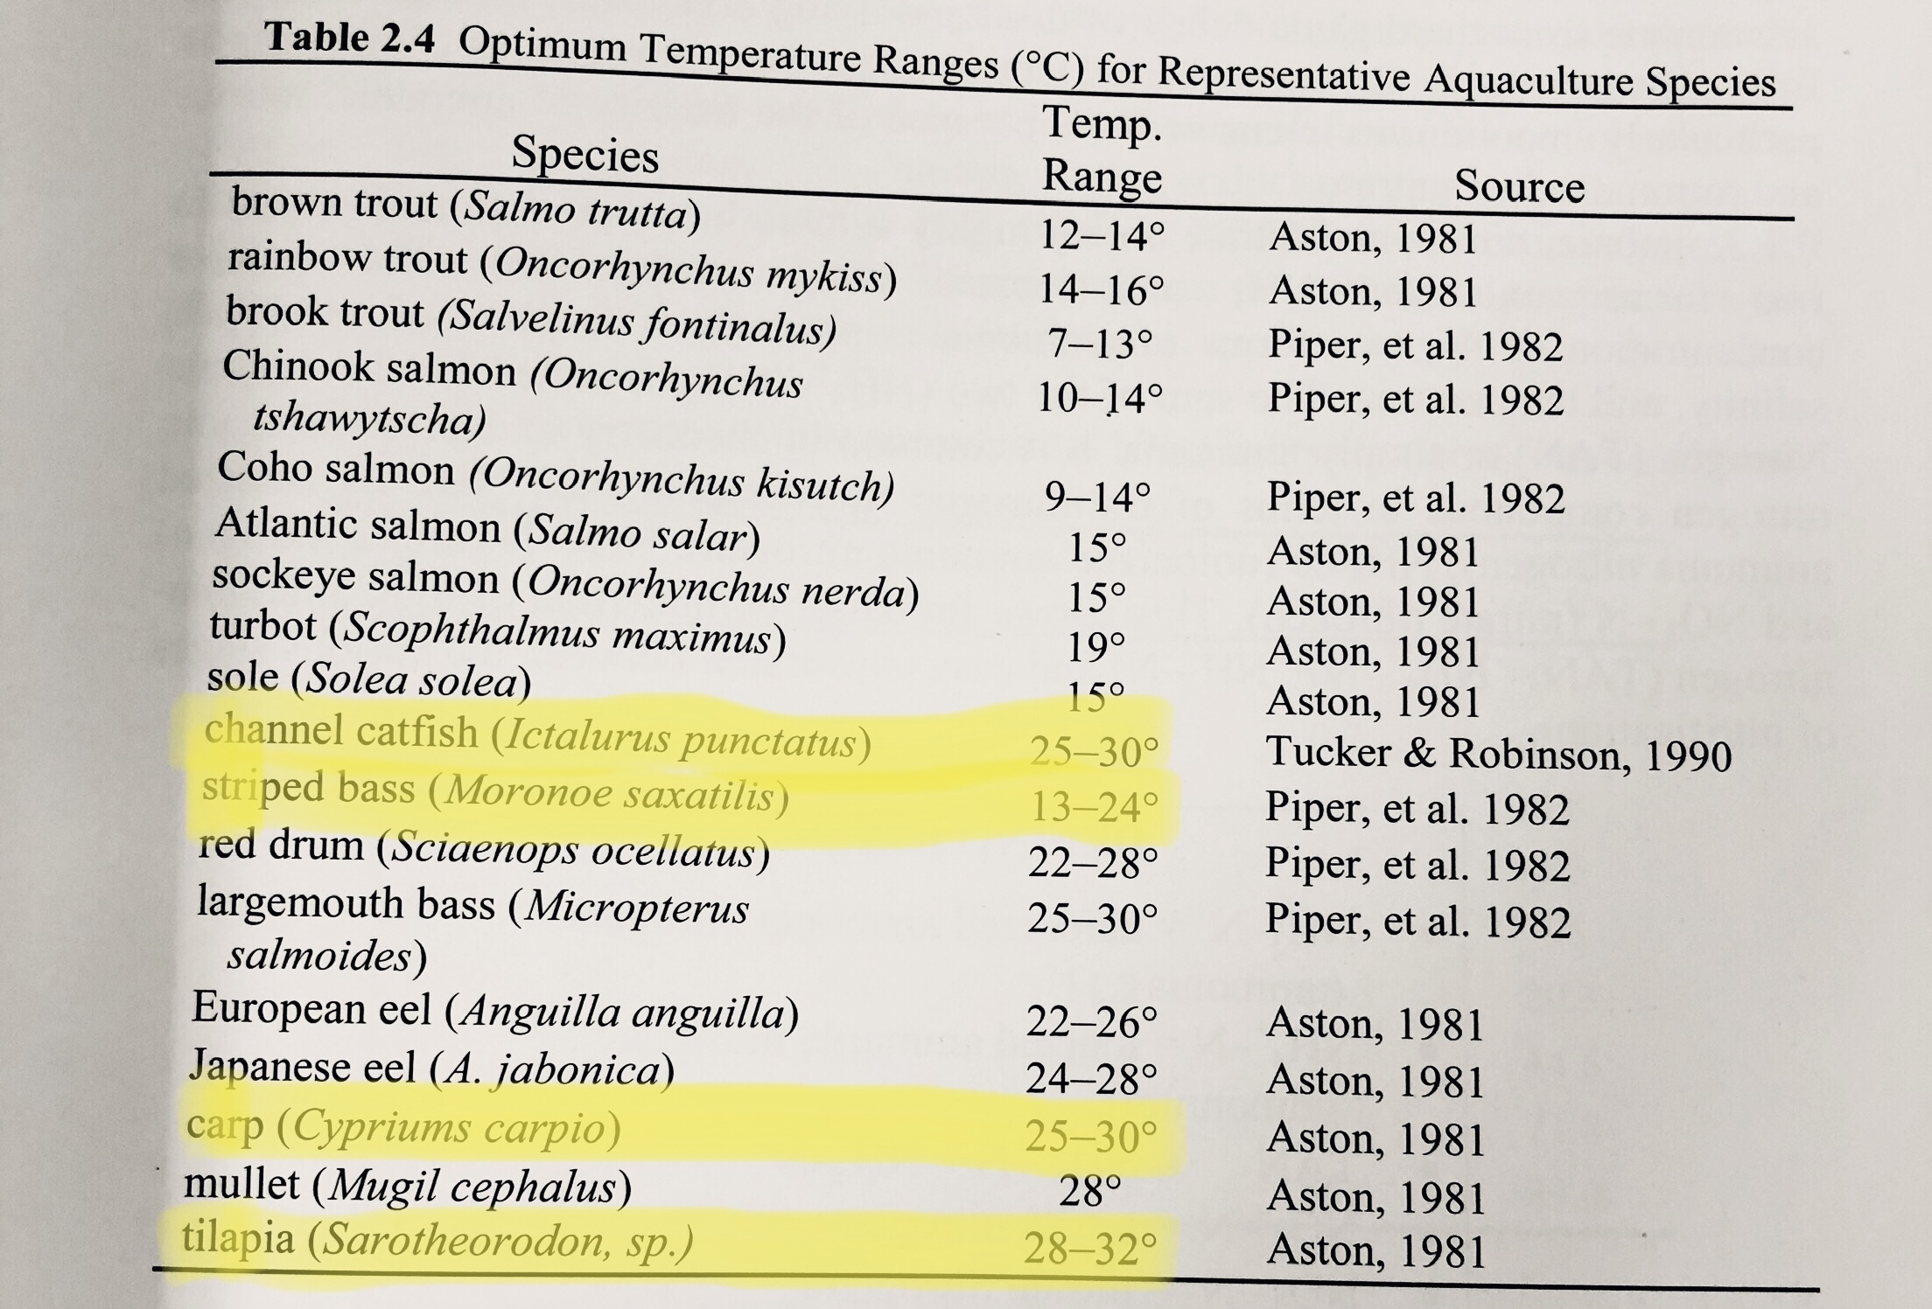
From Timmons and Ebeling

Slide 7
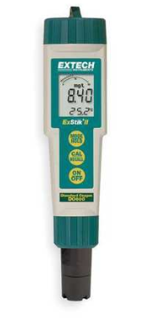
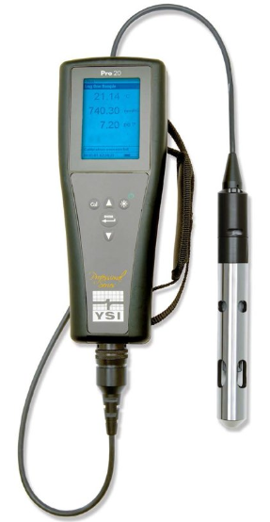
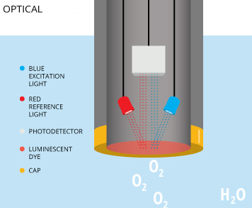
Dissolved Oxygen
Should be > 5 mg/L in fish tank
Very difficult to measure without a dissolved oxygen meter
$$$ (can find as cheap as $250, but average over $800)
LDO probes are the best
Luminescent Dissolved Oxygen
Does not require frequent cleaning or recalibration

Slide 8
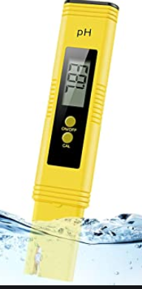
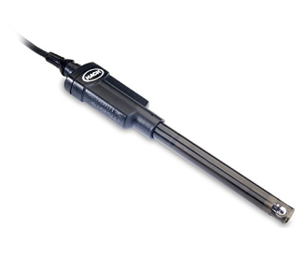
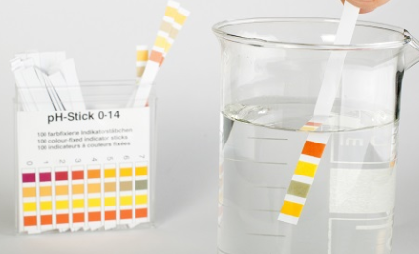
pH
pH can be measured using test strips, colorimeters or meters
Gel-filled pH probes are recommended
Optimal range for fish is from 6.5-9.0
Ideally your pH would be around 6.8-7.2
Only periodic monitoring is necessary (weekly)

Slide 9
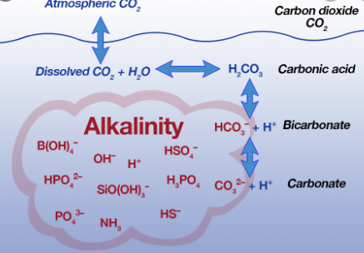
Alkalinity
Alkalinity is the capacity of the water to neutralize acid
Measured as calcium carbonate (CaCO₃) equivalent
Required to buffer pH (prevent swings in pH)
Required for nitrification
Alkalinity should be maintained above 20 mg/L
Measured using titration with sulfuric acid and color indicators or test strips

Slide 10
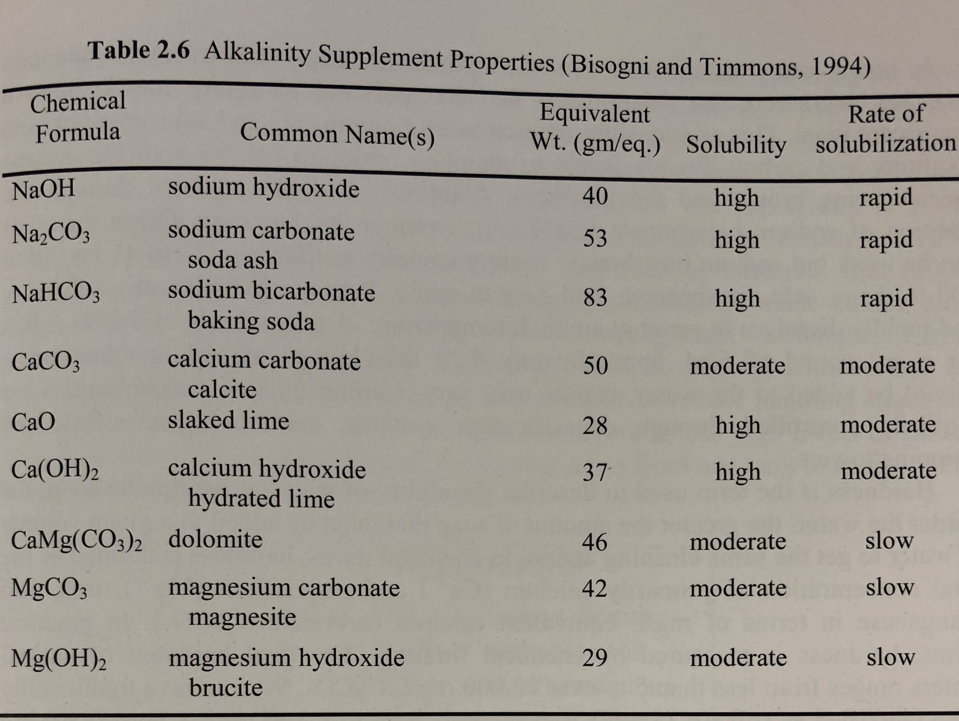
15 mg/L
17 mg/L
*KHC0₃ potassium bicarbonate 100 high rapid

Slide 11
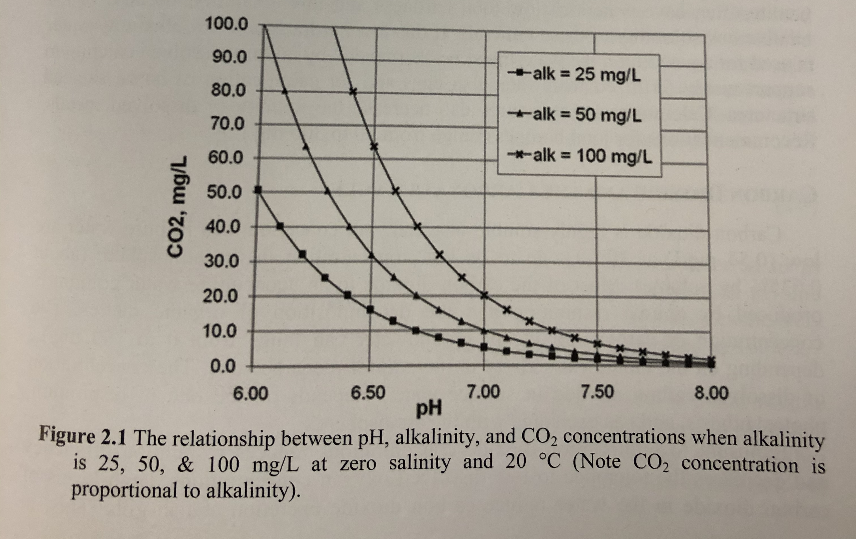
Carbon Dioxide Concentrations
With alkalinity and pH you can determine the concentration of dissolved CO₂
Caron dioxide levels should be below ~50 mg/L
60-80 mg/L can have an anesthetic effect
Ground water can contain extremely high levels of CO₂ (up to 100 mg/L), so this needs to be off-gassed before stocking fish!

Slide 12
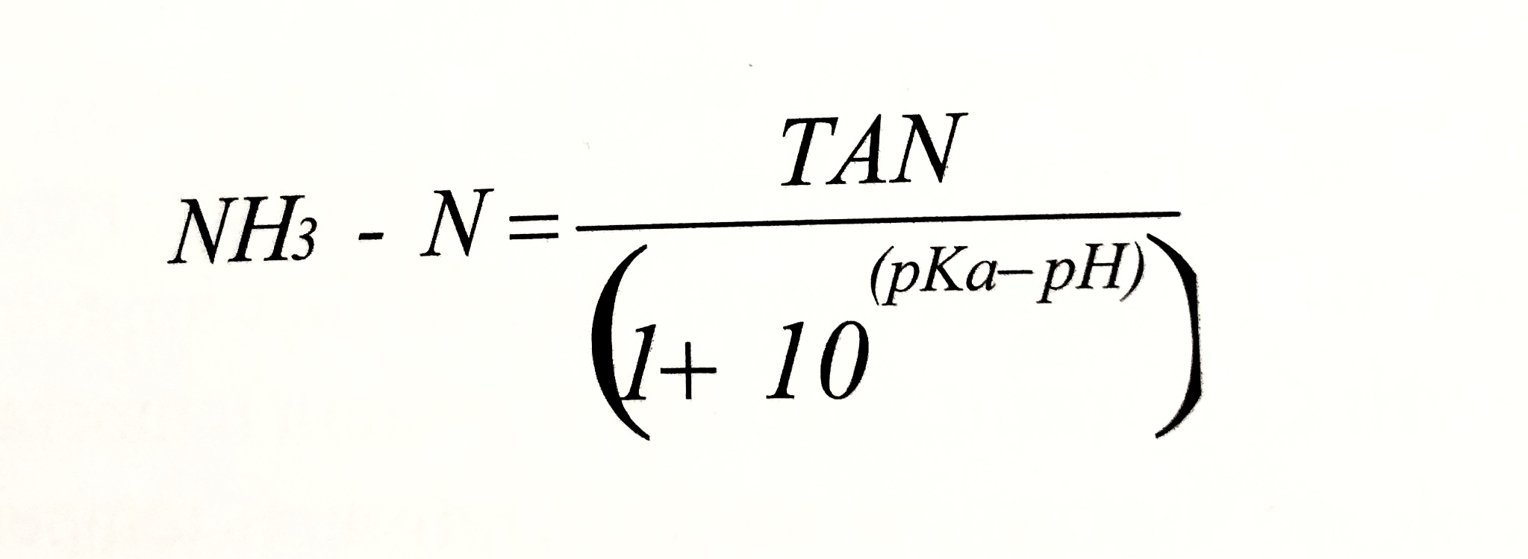
Ammonia
NH₃-N should be below 0.05 mg/L for commercial production
Soluble in water and toxic to fish depending on species, temperature and pH
Ammonia can be unionized (NH₃) or ionized (NH₄⁺)
Unionized form is the most toxic to fish!
If you measure TAN and pH you can calculate the amount of unionized ammonia
If, your water has TAN =5.0 and a pH of 7.0
NH₃-N = 5.0/ (1+10^(9.4-7.0))
NH₃-N = 0.02 mg/L or .4% (negligible impact on most fish)
If our pH was 8.0 then NH₃-N = 0.19 mg/L or 3.8%
If our pH was 9.0 then NH₃-N = 1.43 mg/L (would kill fish)
pK_{a} = 9.40 at 20° C
(acid dissociation constant)

Slide 13
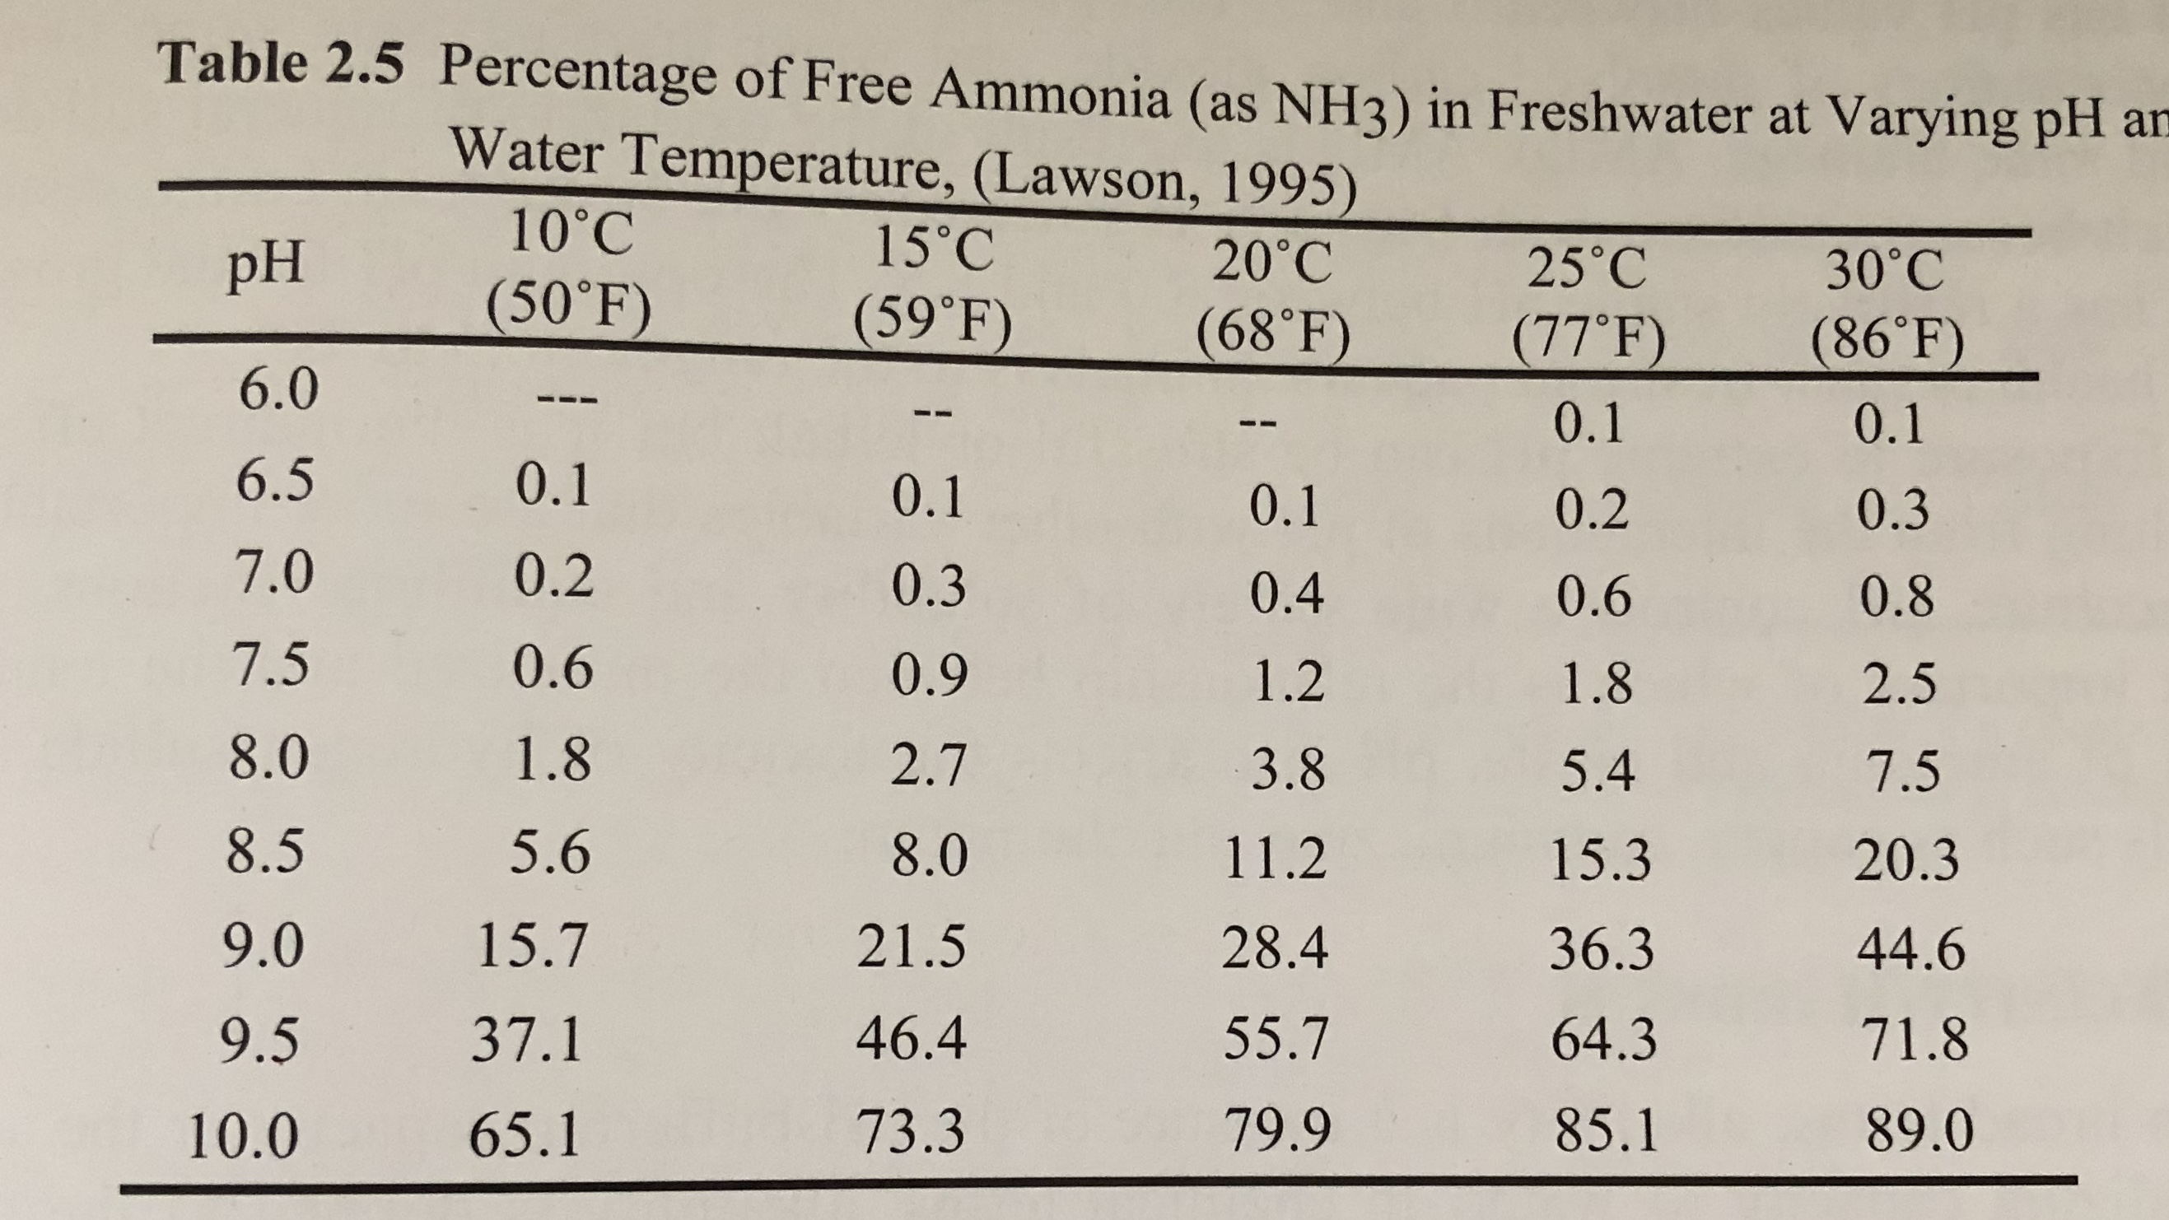

Slide 14
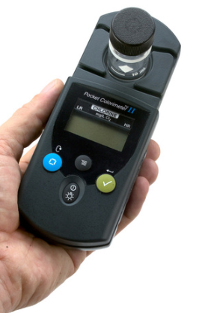
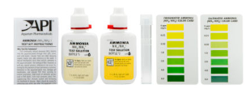
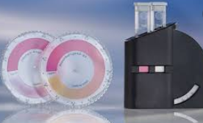
How to measure TAN
Simple test kit (5 min)
Can measure up to 8 mg/L
Add drops of solution to a water sample and match the color with a corresponding ammonia level (chart or colorwheel)
$10-$50 (additional cost for reagents)
Colorimeter
Can measure low range, mid range or high range TAN
Measures absorbance of particular wavelength of light of a water sample and compares to a sample blank for a specific parameter
$50-$1500

Slide 15
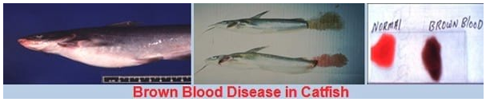
Nitrite
Most toxic nitrogen form to fish
Affects blood hemoglobin’s ability to carry oxygen
“Brown-blood disease” – iron hemoglobin oxidized to ferric state (Fe³⁺)
Increased chloride levels reduce nitrite absorption by fish
15:1 ratio Cl: NO₂-N
Can add sodium chloride (table salt) or calcium chloride (preferred by plants)
Nitrite measured by simple colorwheel test kit or colorimeter
Nitrite rarely a problem in aquaponics systems except when establishing biofilter

Slide 16
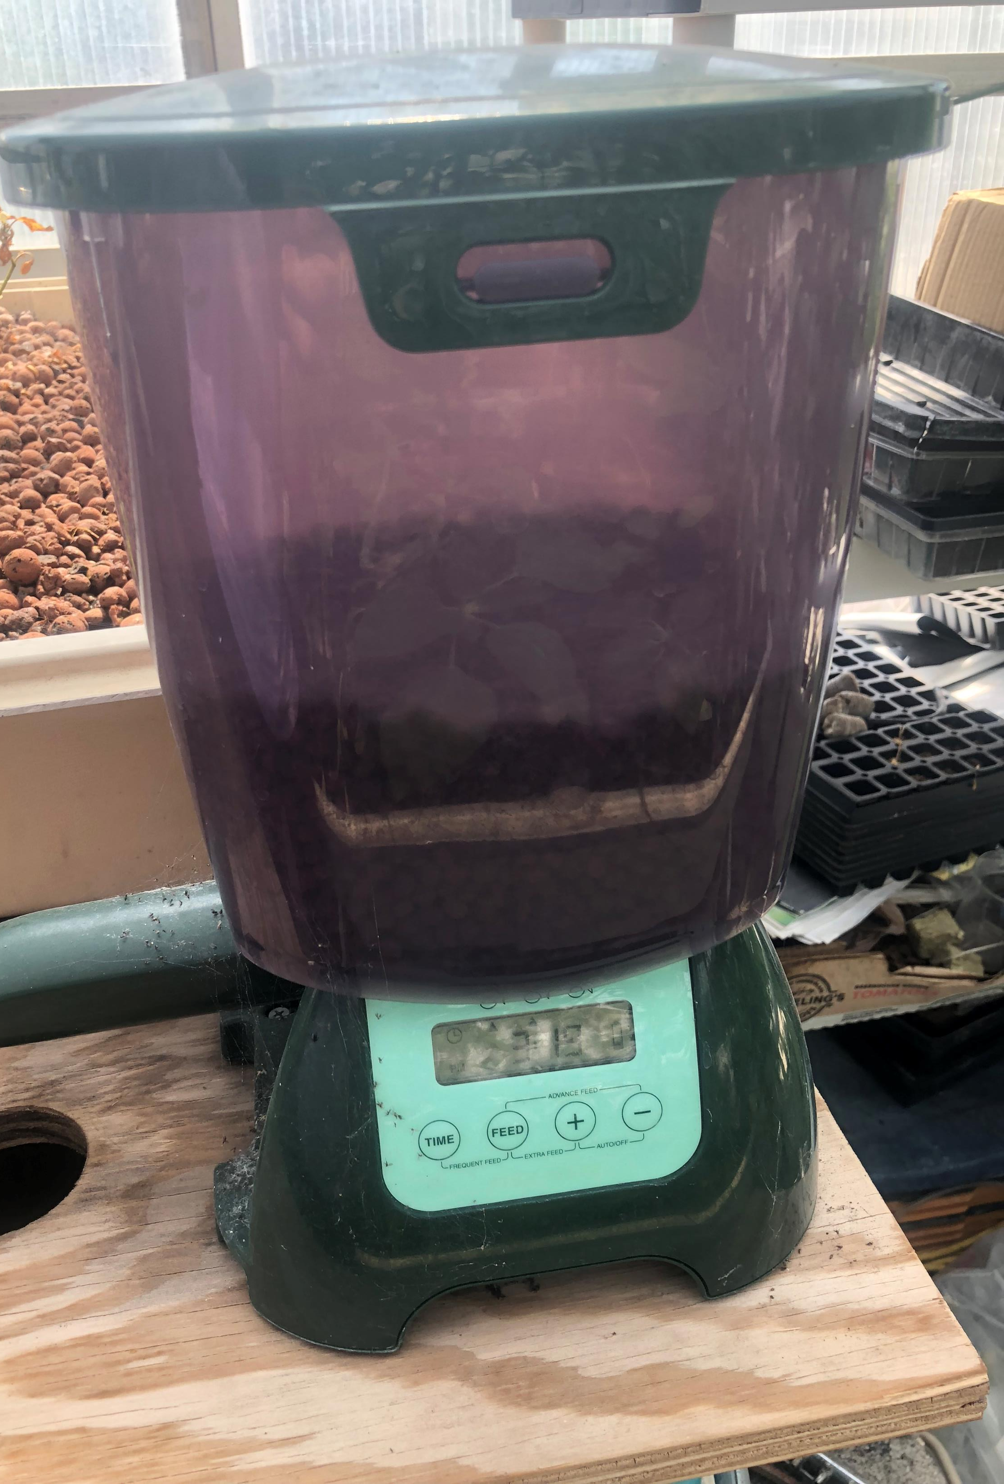
Feeding Your Fish
A common rule of thumb is to feed your fish 2% of their body weight per day (except for fry and fingerling – feed to satiation)
So, if you have 5 lb of fish, you will feed 0.1 lb. per day, which is roughly ½ cup of feed per day.
Always feed floating fish feed
This will allow you to observe your fish and be sure they are eating
Purchasing an automatic fish feeder can allow you to feed your fish multiple times per day or when you are out of town
Fish feed ranges from 28-50% protein
Tilapia, catfish, goldfish will do fine on 26-36% protein feeds
It might be a waste of money to feed a higher protein content feed than the fish needs
Carnivorous fish and young fish generally consume higher protein feeds and eat more than 2% of their body weight per day

Slide 17
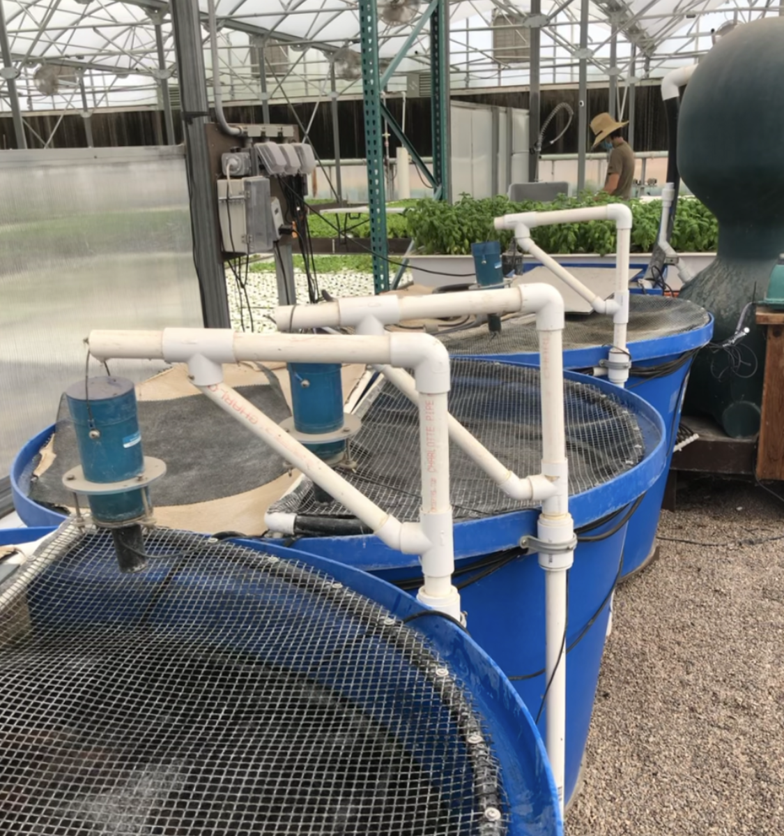
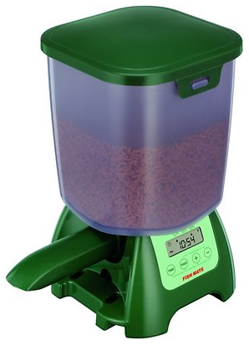
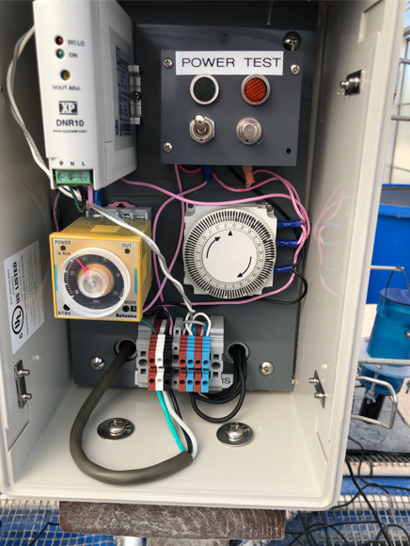
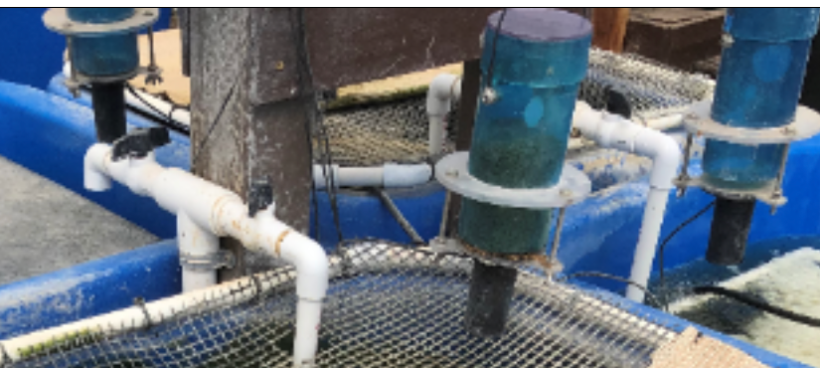
If you don’t have time to feed every day you must have an automatic feeder
Can set to feed once per day or multiple times
Keep in mind that animals will try to get to your feed

Slide 18
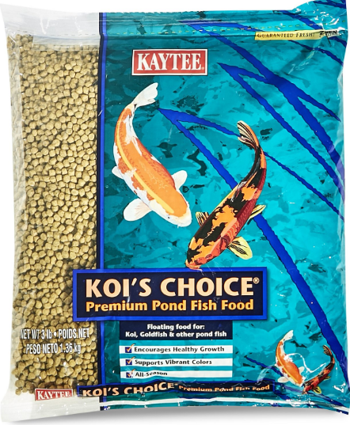
Fish Feed for Aquaponics
You can purchase feed online, at a local feed store or at Tractor Supply store
Most feed will be 32% protein
Should be higher for fry and predatory fish (i.e. 45-50%)
Higher quality feeds will keep your water clearer and be better for mineralization
Store your feed in a cool dry place that will keep out bugs and other critters
A garbage can with a lid works well

Slide 19
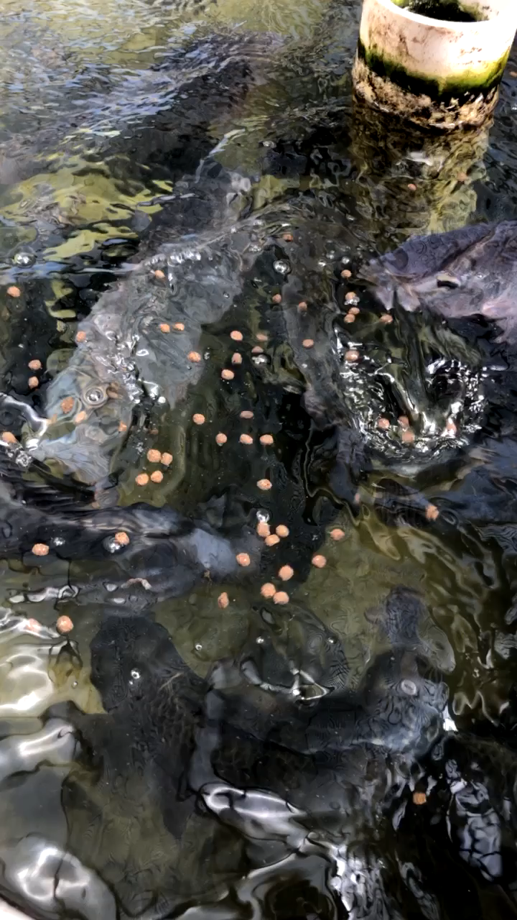
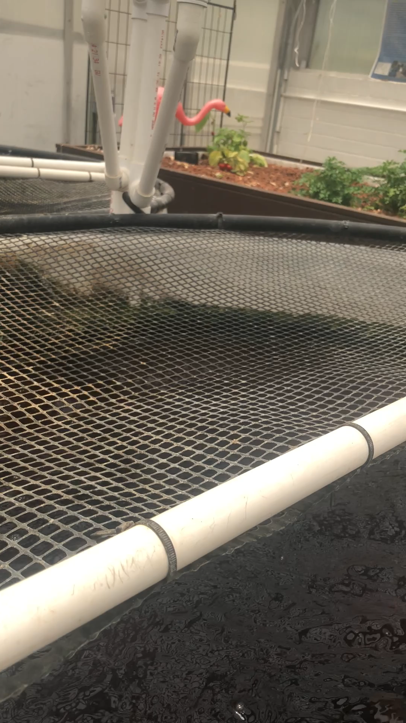

Slide 20
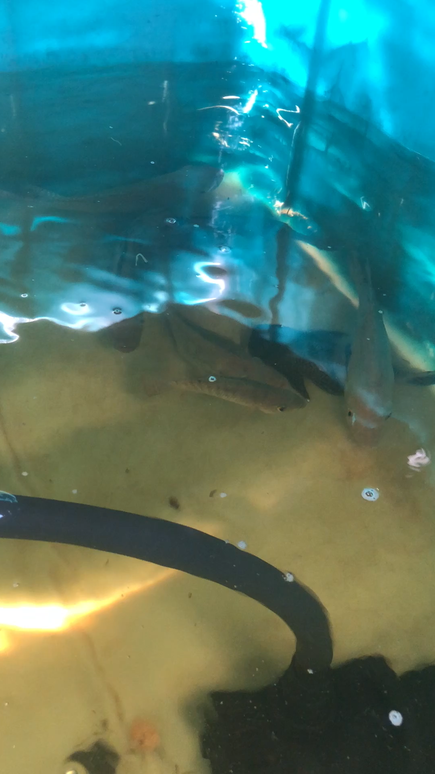
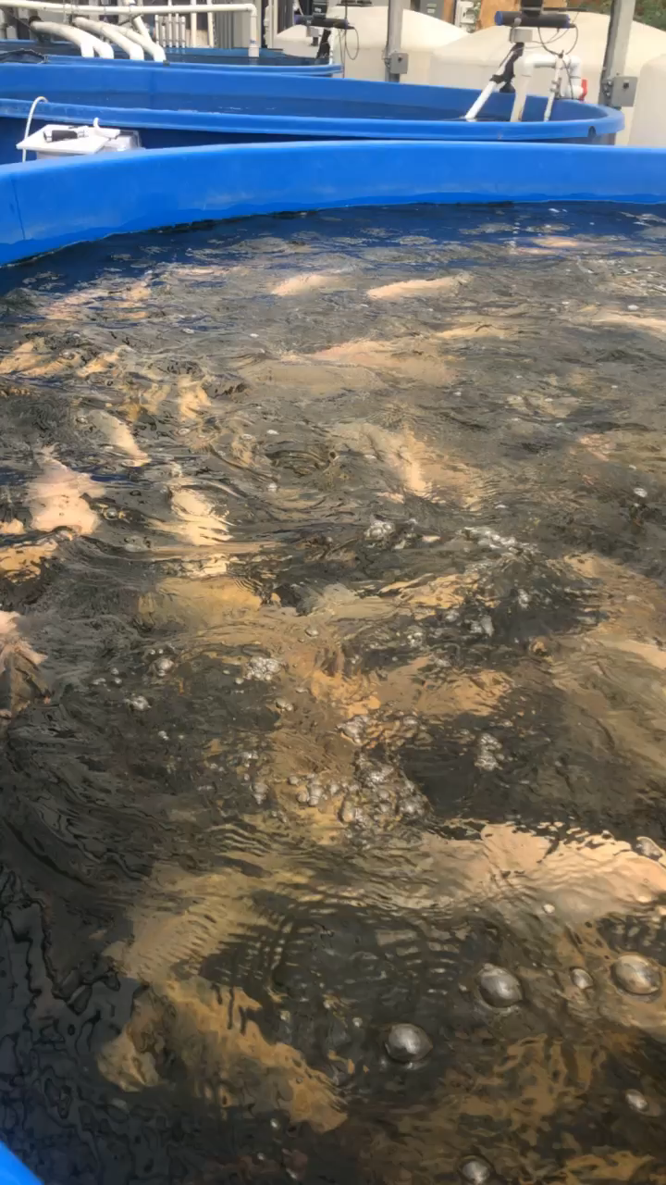
Observing Your Fish
Your fish should be actively swimming, upright and eating
It is okay for your fish to be skittish or hide especially with low stocking densities

Slide 21
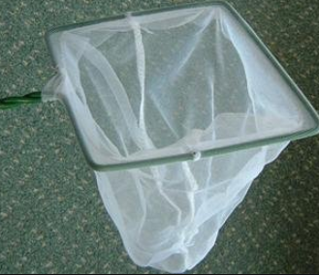
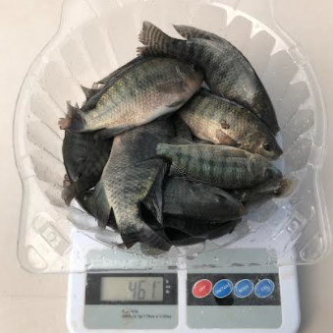
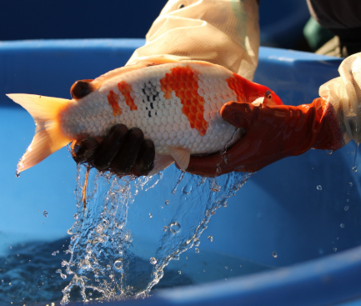
Moving and Harvesting Fish
Moving or harvesting fish can be stressful on them
Fish should always be handled with a net and you should avoid touching your fish when possible (wear gloves if you can)
If you are moving fish to another tank they should be moved as quickly as possible
If you are harvesting fish, they should be killed as quickly as possible by exposing them to an ice slurry (tilapia) or by stunning
Percussive stunning - (accurate blow to head with a blunt instrument
Spiking - driving a sharp spike into the brain of the fish

