Slide 1
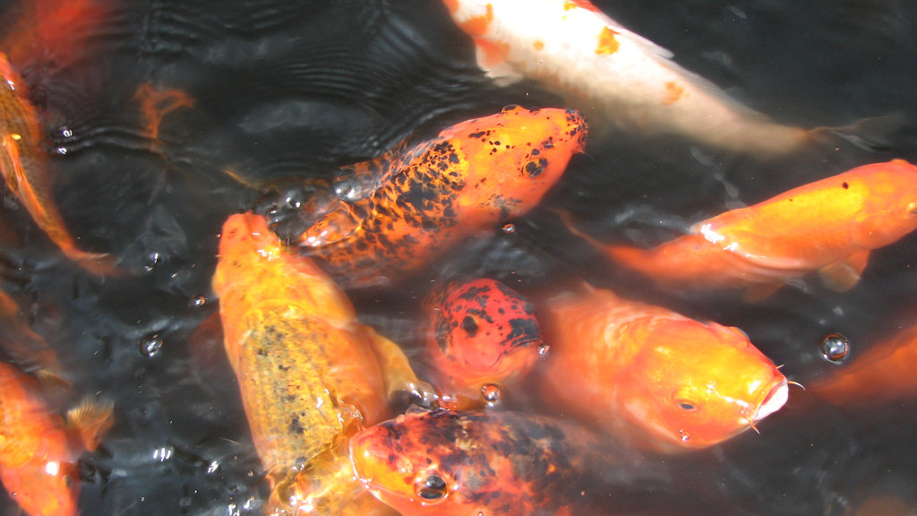
Fish and Fish Care
Kevin Fitzsimmons
©2025 Matt Recsetar

Slide 2
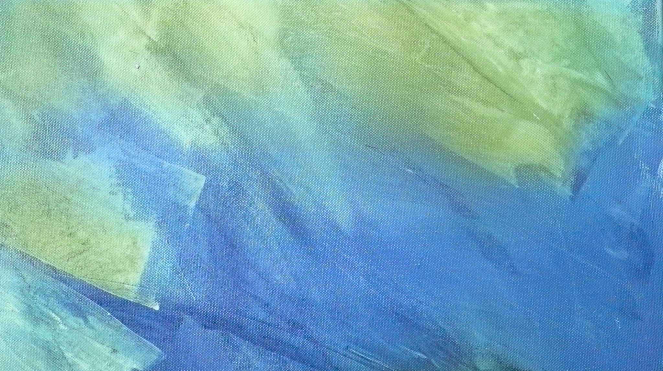
How Do I Choose Which Fish to Grow?
Tank Size
Climate
Edibility
Availability
Cost
Experience

Slide 3
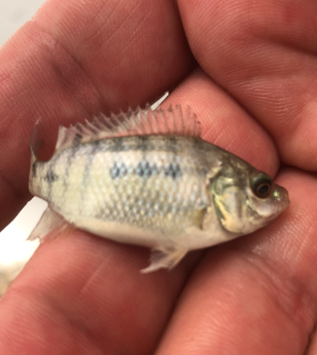
Tilapia
Very hardy fish that can withstand low oxygen, poor water quality and hot temperatures
Easy to find in many countries
Will consume just about any fish feed
Easy to spawn
Bonus of filter feeding
Cold intolerant
Will reproduce in tanks and potentially get into other parts of your system
Availability: Check local suppliers, Americulture

Slide 4
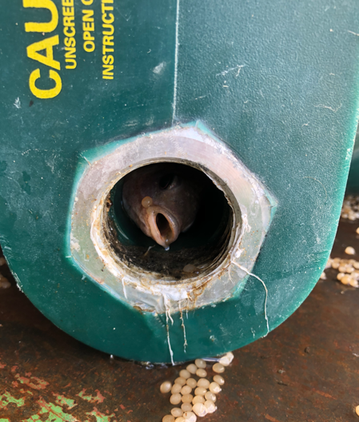
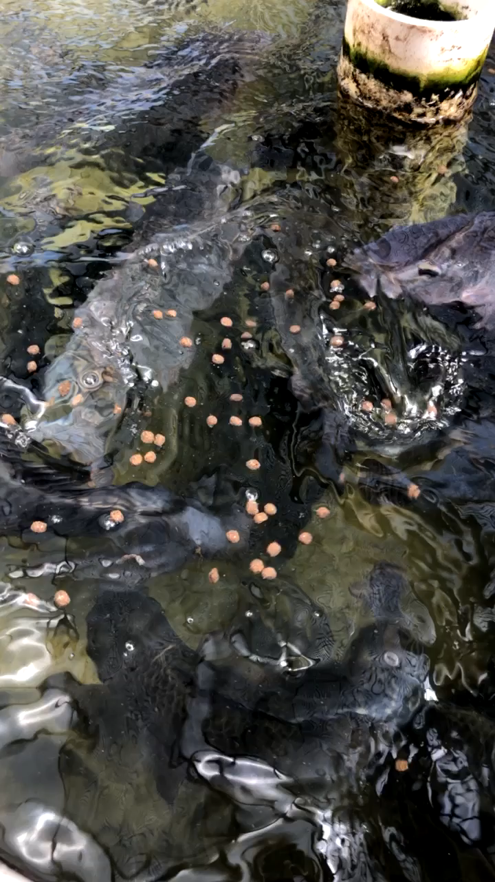

Slide 5
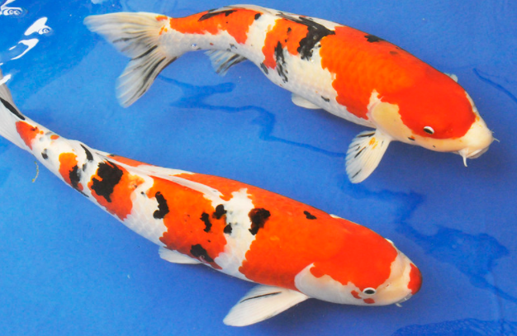
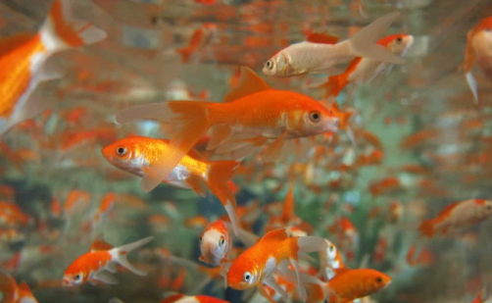
Goldfish and Koi
Hardy fish
Aesthetically pleasing
Potentially sell in ornamental market
Take a cheap fish feed
Availability: Local pet stores, many places to order from online

Slide 6
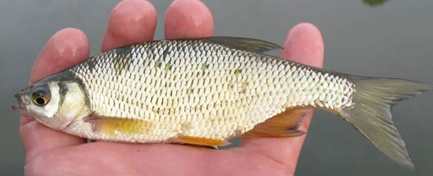
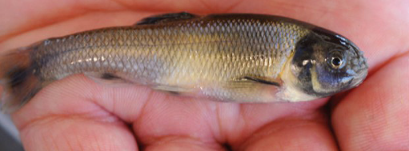
Baitfish – Fathead Minnows and Golden Shiners (other local baitfish)
Hardy fish
Will consume cheap commercial feeds
Good for maintaining supply of baitfish if you like to fish
Not edible
Availability: Check online for sources

Slide 7
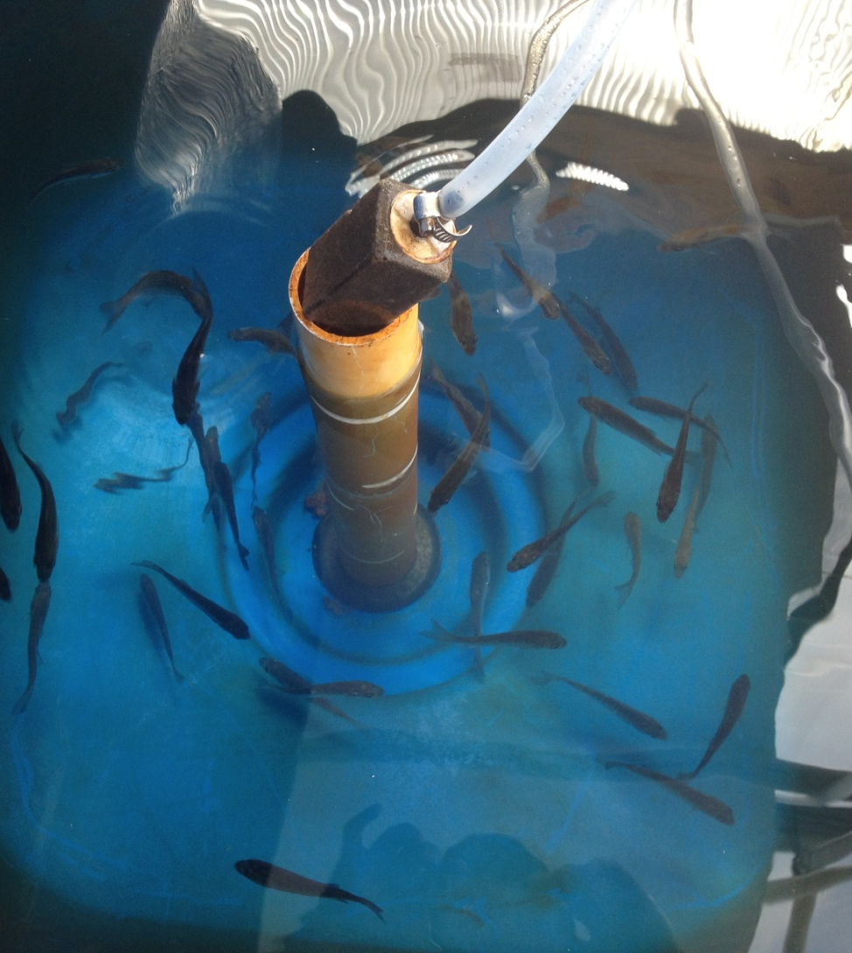
Bluegill (Hybrid bluegill)
Fairly hardy
Can potentially grow to edible size if big enough tank
Very tasty panfish
Will accept cheap commercial feeds
Availability: JMMaloneandSon.com, jonesfish.com, check online for local suppliers

Slide 8
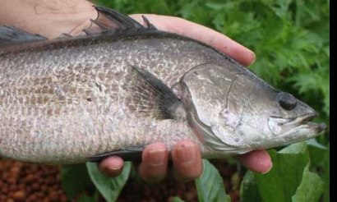
Barramundi
Commonly used for aquaponics in Australia
Native range from Australia up through Southeast Asia
Referred to as Asian Seabass
Can live in fresh or saltwater
Popular culinary fish with a sweet, mild flavor
Availability: Australis Aquaculture (US)

Slide 9

Other More Difficult Fish to Grow
Do you have prior fish culture experience?
Generally, require more expensive feeds
Larger tanks (systems) likely required $$$
Temperature control more important

Slide 10
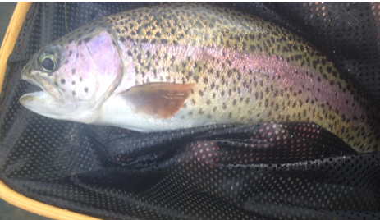
Rainbow Trout
Best for cold water or decoupled systems
Will need to maintain water temperature below 65°F (18°C)
Require higher protein feed but will easily take to feed
Fast growing (ready to eat in 9 months)
Great tasting and popular culinary fish
Availability: High availability throughout the world

Slide 11
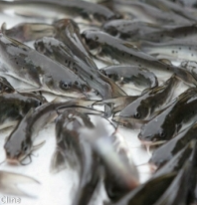
Channel Catfish
Some issues if tanks are too small or stocking density too low
Sometimes helps to stock with bluegill
Will easily take commercial feeds
Good to eat
Time to edible size depends on size stocked (6-12 months)
Availability: Southeastern US may deliver via live haul. Green Hill Gardens and Jones fish will ship via air

Slide 12
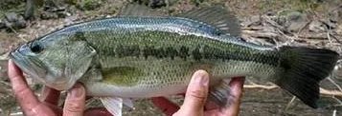
Largemouth Bass
Highly predatory fish
Need to be stocked at a specific density to discourage cannibalism
Require high protein feed
Great tasting fish
Availability: Dunnfishfarm.com, Jonesfish.com

Slide 13
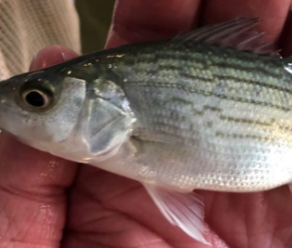
Hybrid Striped Bass
Delicious tasting and high-value fish
Fast-growing
Require high protein feed
Need large tanks
Highly sensitive to poor water quality
Availability: Keo Fish Farms (largest supplier in the world)

Slide 14
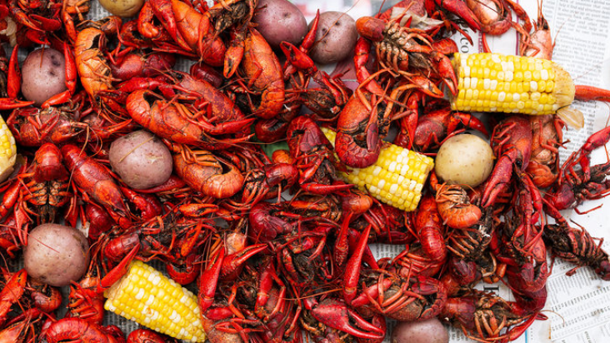
Crayfish
Highly territorial
Can climb out of tanks and get into other parts of your system
Good to eat
Require sinking feeds
Availability: Will ship from farms in Southeastern United States (Seasonally)

Slide 15
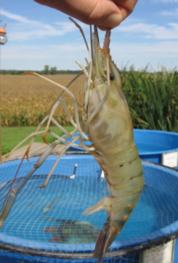
Freshwater Prawns
Territorial
Cold intolerant
Expensive
Good to eat
Availability: Low (Higher in Southeast Asia)

Slide 16
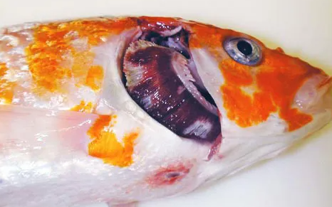
Make sure you get your fish from a reputable source that is certified disease free!!!

Slide 17
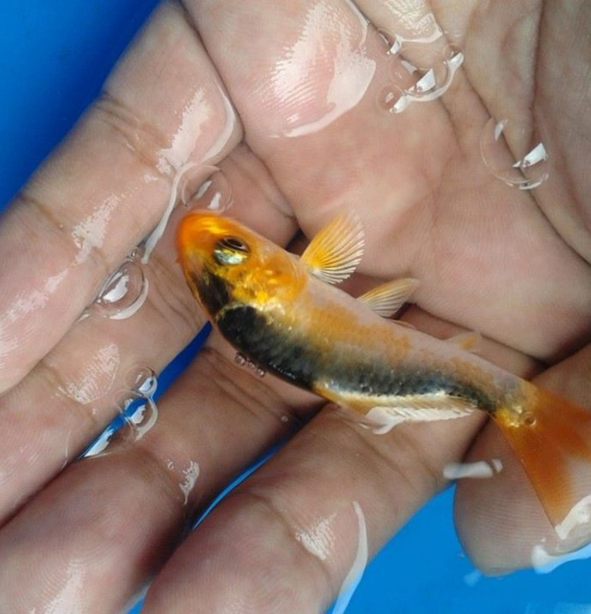
Steps of Fish Care
Transporting
Acclimating
Monitoring Water Quality
Feeding
Observing
Moving or Harvesting Fish (optional)

Slide 18
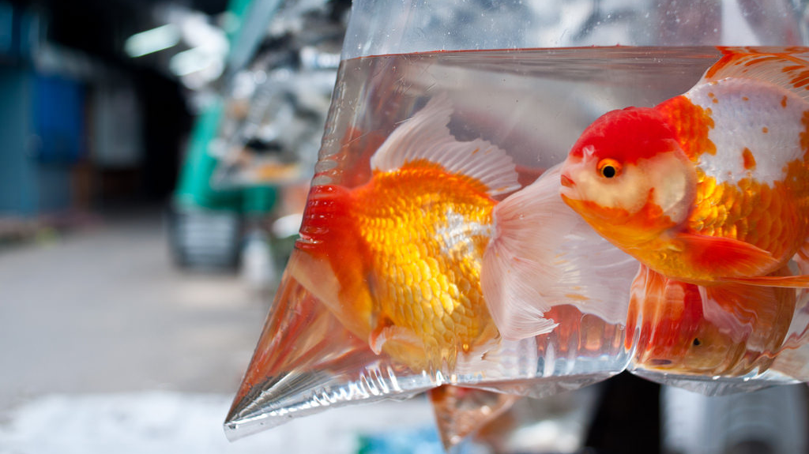
Transporting Fish
Fish should be transported with adequate oxygen for the journey
If you are coming from a pet store, they generally put enough oxygen in the bag to last a few hours
If you are transporting fish from a farm or other location you will need to have an air supply

Slide 19
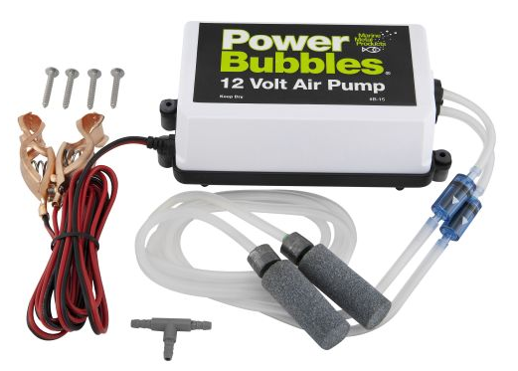
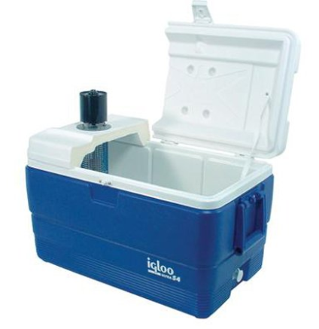
Transporting Fish
Covered container
Air pump (battery operated ones available)
Airline tubing
Air diffuser or air stone
Electricity source or power inverter

Slide 20
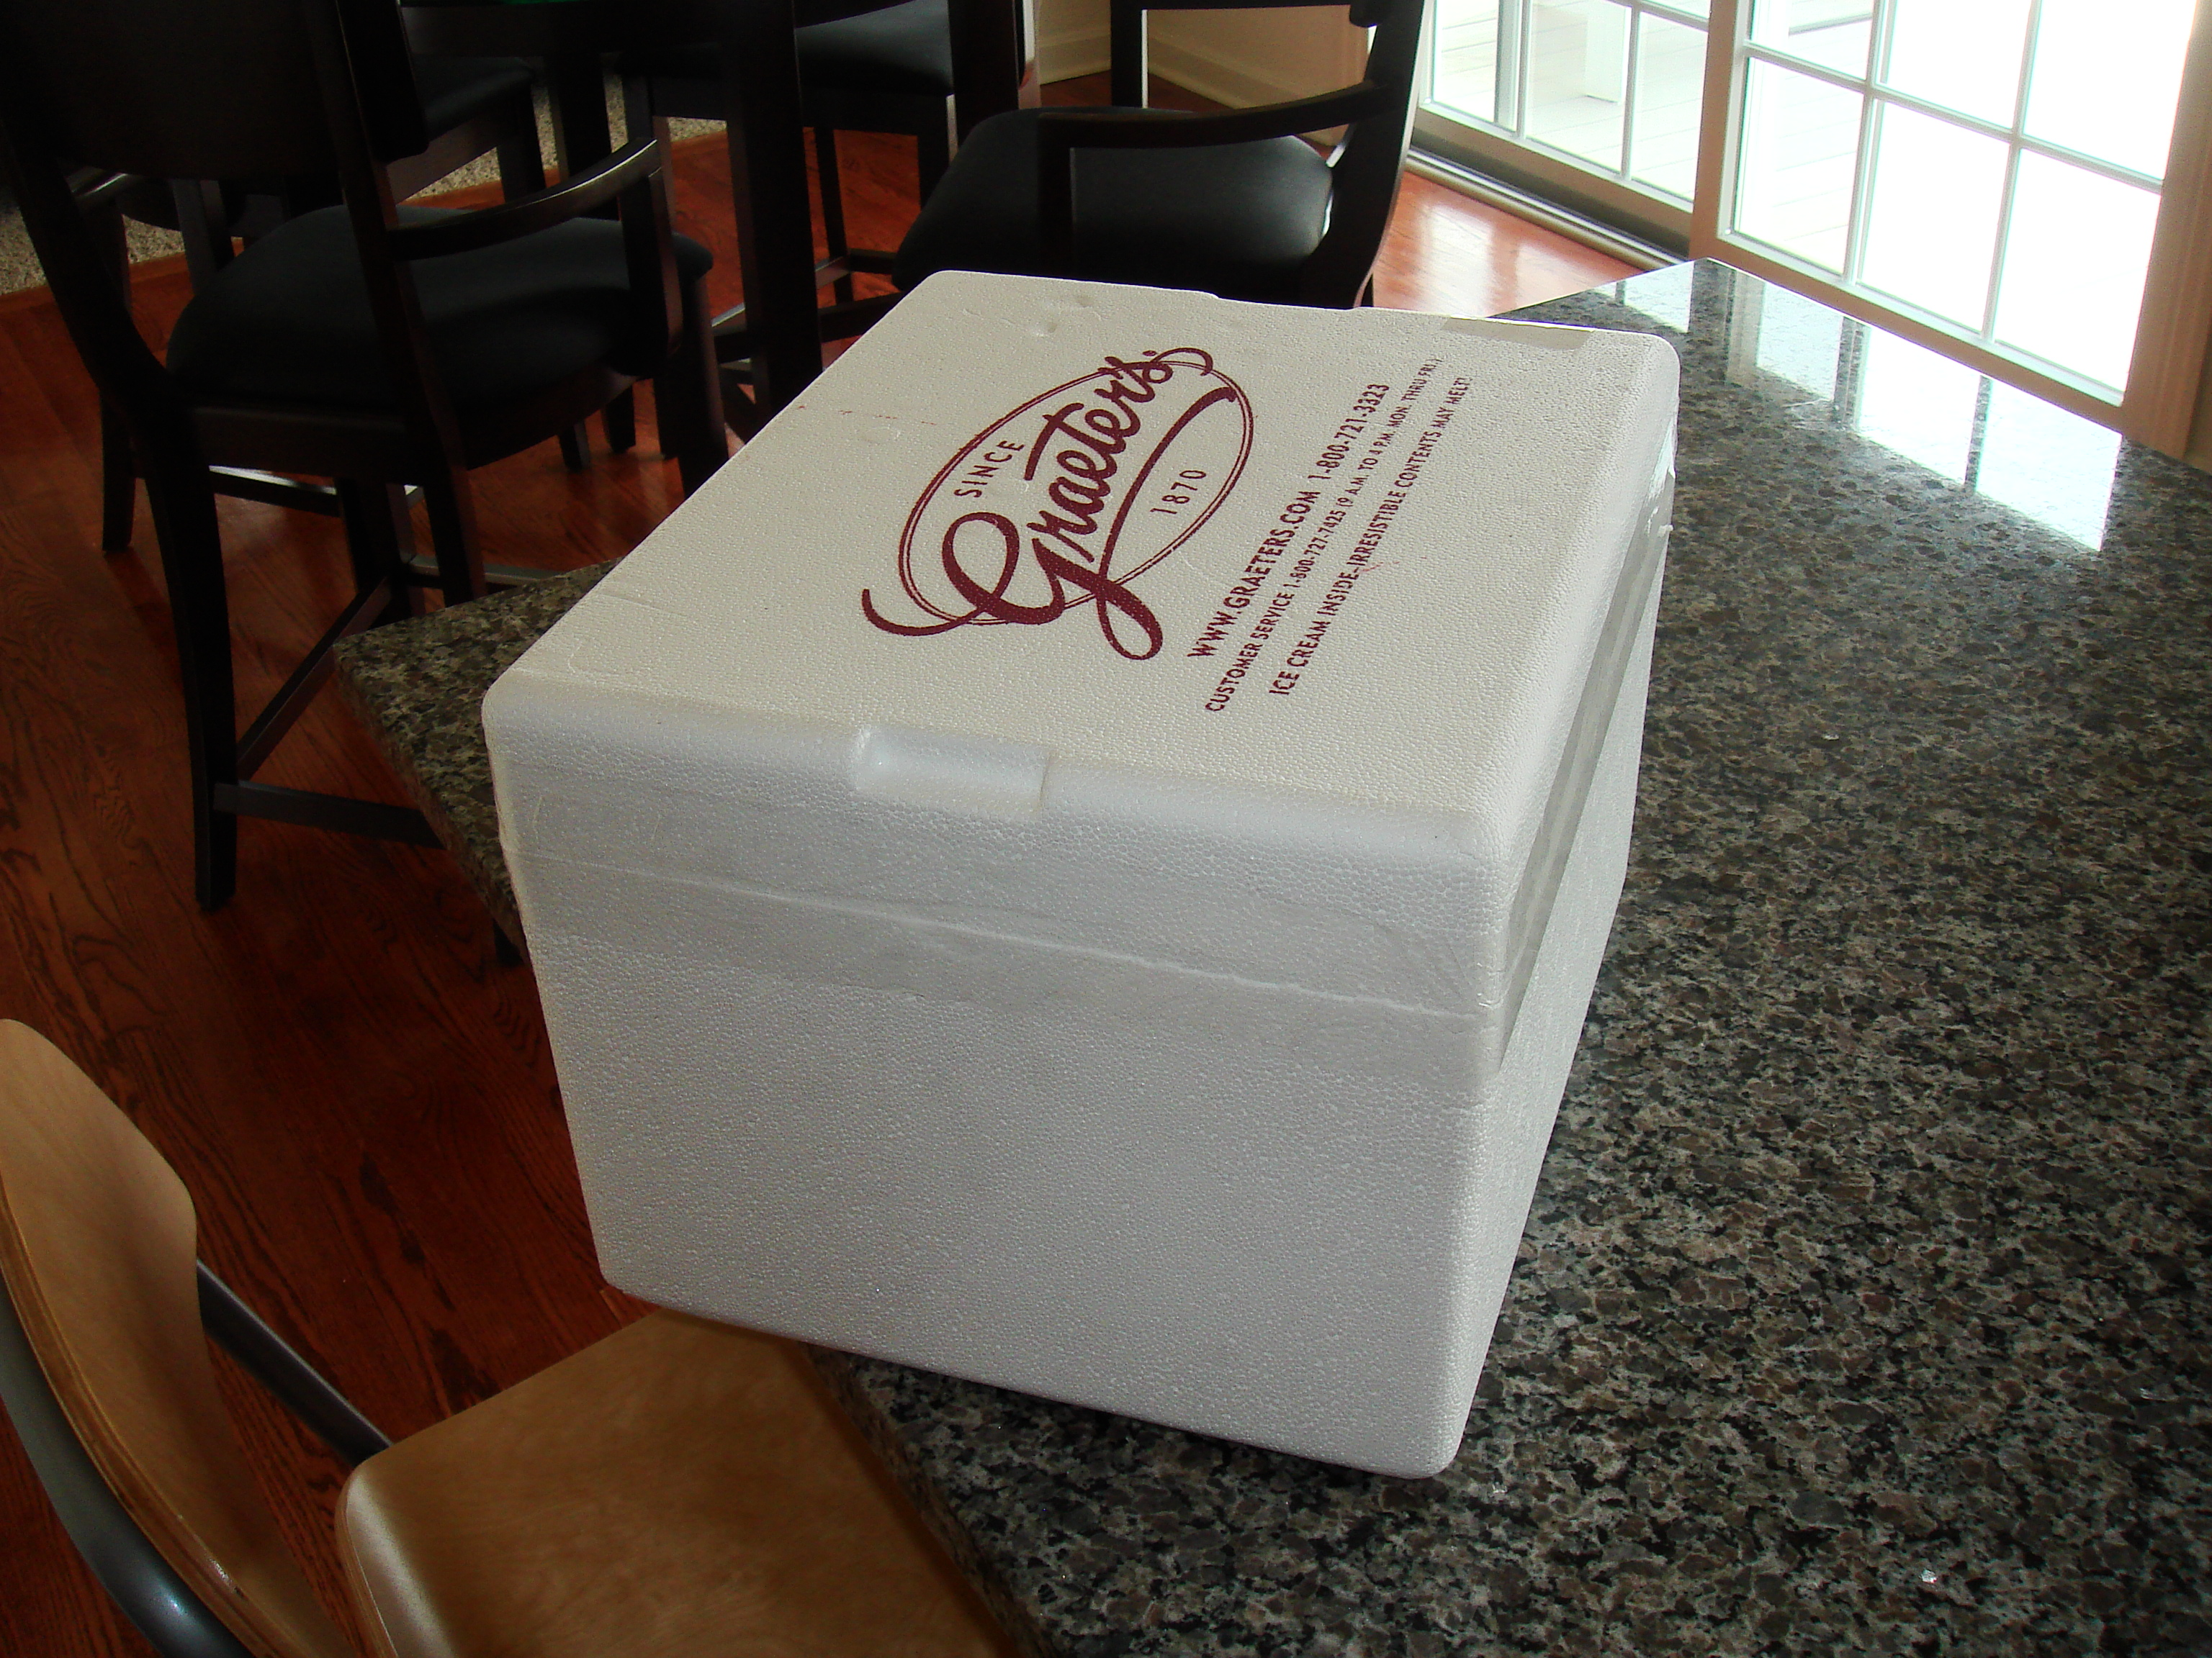
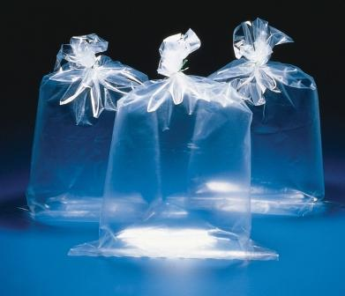
Transport Containers
Coolers work best!
Insulation helps maintain temperature
Buckets with lids are okay if not worried about temperature
Polyethylene bags are common in fish transport if oxygen (or compressed air) are available
Bags should be placed in Styrofoam coolers
More information at this link:
http://www.fao.org/docrep/009/af000e/AF000E03.htm

