Slide 1

Water Quality and Nutrients
©2021 Matt Recsetar

Slide 2
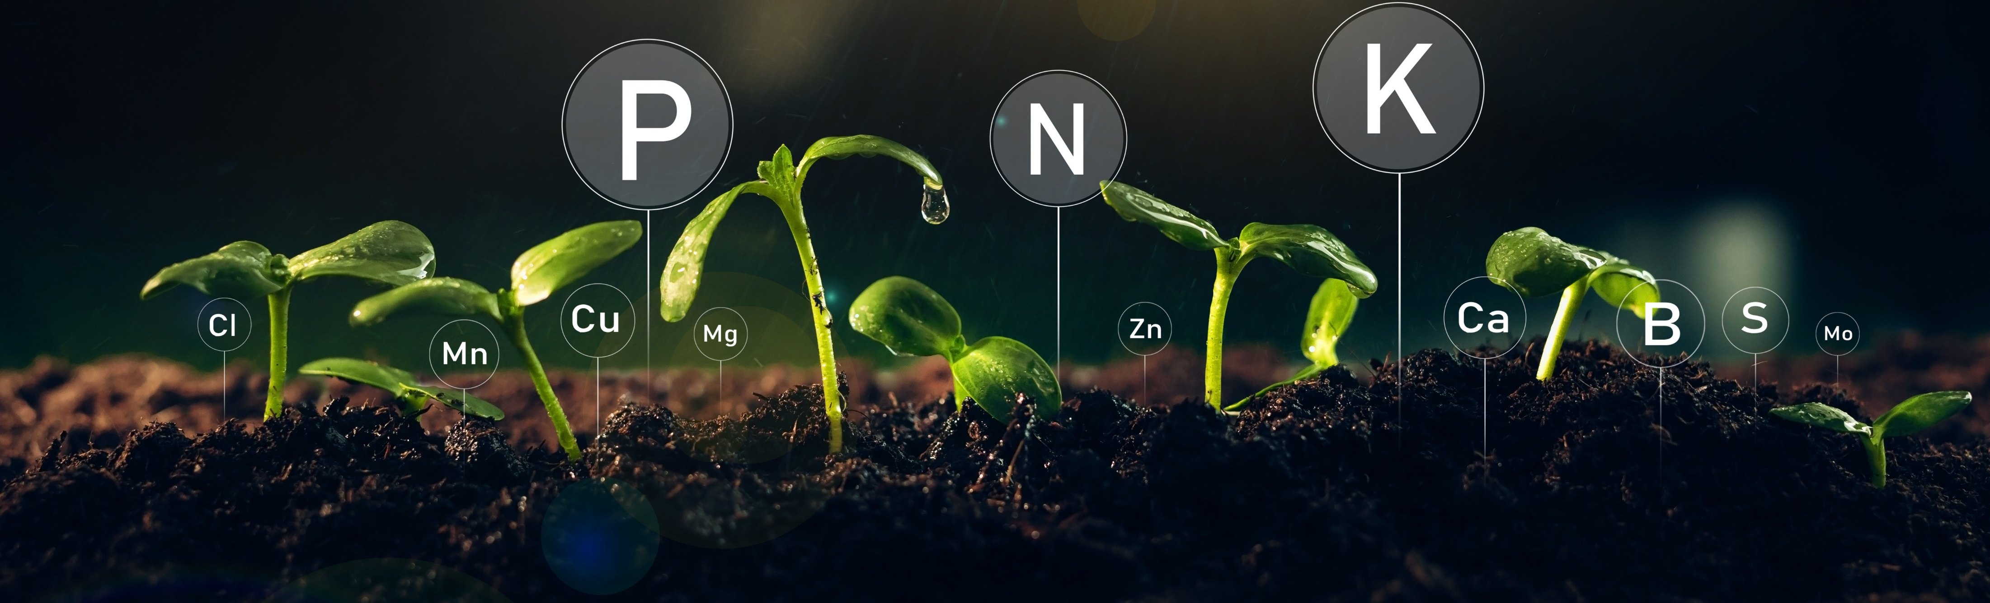
Quick Background on Aquaponics Nutrients
Plants need Various Nutrients to survive, grow, produce fruits, etc.
  Primary Macros: Nitrogen (N), Phosphorous (P), Potassium (K)
  Secondary Macros: Calcium (Ca), Magnesium (Mg), Sulfur (S)
  Micros: Chlorine (Cl), Manganese (Mn), Copper (Cu), Zinc (Zn), Boron (B), Molybdenum (Mo), Iron (Fe)
  Nutrients not obtained through roots: Oxygen (O), Hydrogen (H), Carbon (C)

Slide 3
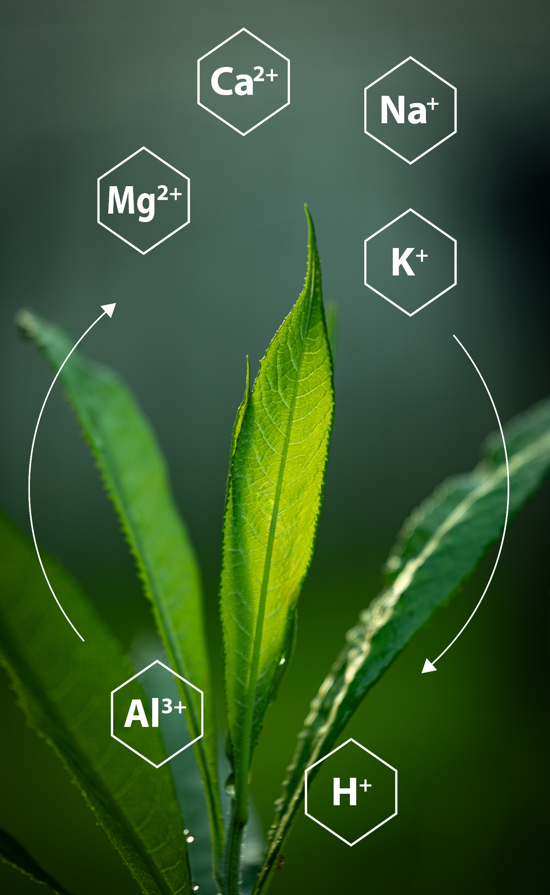
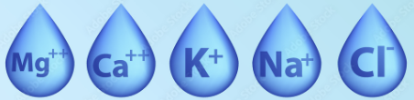
Plants Take Up Nutrients in the Form of Ions
  Macronutrients:
  N: NO₃⁻ or NH₄⁺
  P: PO₄³⁻
  K: K⁺
  Ca: Ca²⁺
  Mg: Mg²⁺
  S: SO₄²⁻
Micronutrients:
Cl: Cl⁻
Mn: Mn²⁺
Cu: Cu⁺/Cu²⁺
Zn: Zn²⁺
B: B0₃³⁻
Mo: MoO₄²⁻
Fe: Fe^{2+/}Fe³⁺

Slide 4
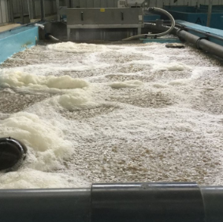
Nitrogen
Nitrogen (N) comes directly from the fish's excretion of ammonia (NH₃/NH₄⁺) from their gills (80-90%)
The Biofilter provides adequate surface area for the breakdown of ammonia into nitrate (NO₃⁻) which is preferred by plants
Plants can take up NO₃⁻ or NH₄⁺
Common Myth: Ammonia is toxic to
Plants and they cannot take it up

Slide 5
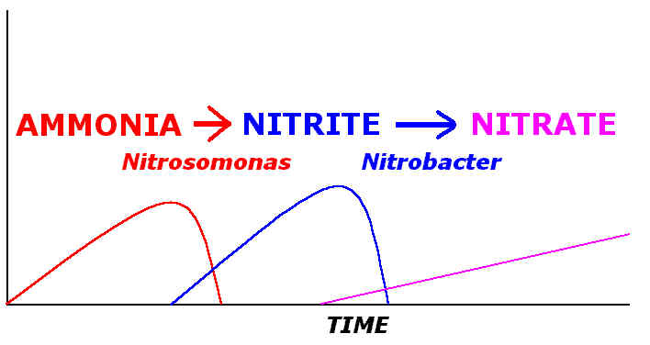
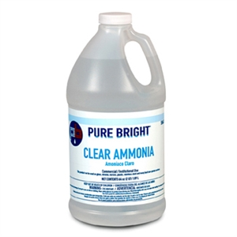
Cycling your system - Nitrification
Temperature dependent
3-4 weeks for Biofilter to establish
Check nitrites, nitrates, alkalinity and pH values
Keep pH 6.8-7.0
*Cycling your system is extremely important before putting plants in

Slide 6
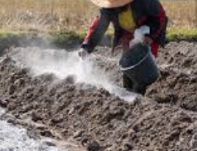
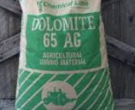
Alkalinity also required for Nitrification
Alkalinity is the buffering capacity of water (Measured as CaCO₃ equivalents)
7.05 g consumed for every gram of NH₄⁺
Alkalinity of water in system should remain above 20 mg/L
  Corrected by adding calcium carbonate and potassium bicarbonate
*Nitrification stops without alkalinity

Slide 7
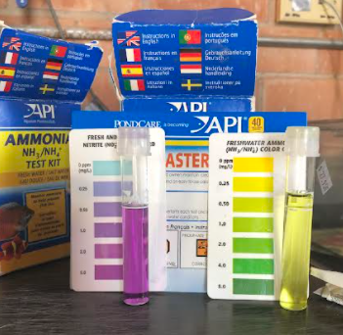
Water quality should be measured weekly at a minimum

Slide 8
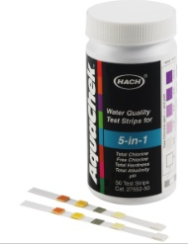
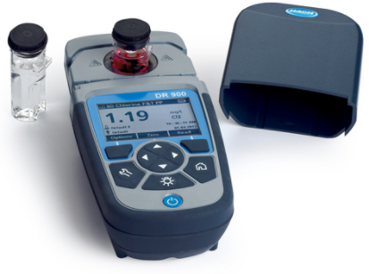
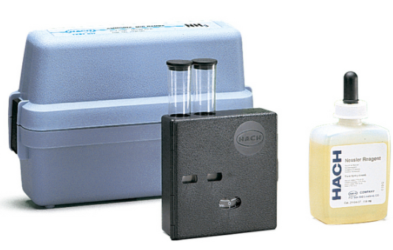
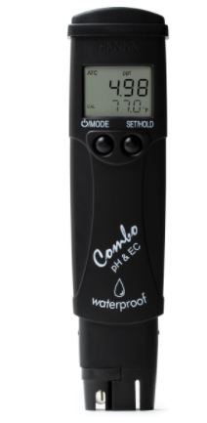
Measuring Water Quality
Test Strips
  Hach 5-in-1 (pH, alkalinity, hardness, chlorine)
Cheap Test kits ($25-$30)
  i.e. API Test kit (TAN, Nitrite, nitrate, pH)
Reagent specific test kits
Colorimeters
Probes and Meters
  i.e YSI, Hach LDO Probes; Hanna pH probe

Slide 9
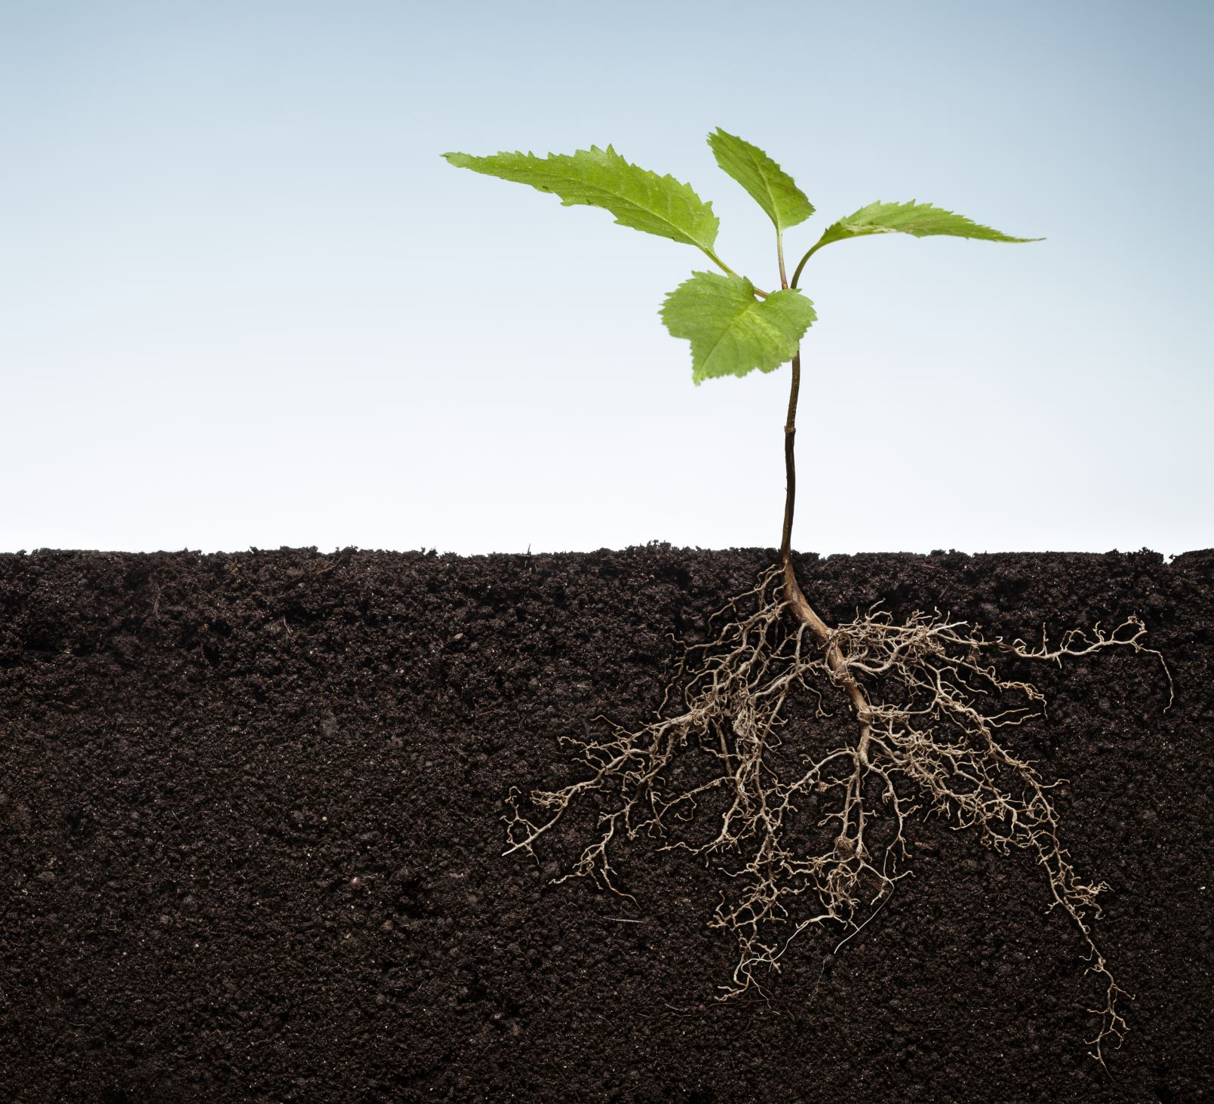
Poor water quality leads to poor plant growth

Slide 10
Water Quality Parameter Levels
Parameter | Recommended Ranges (mg/L)
pH | 6.5 – 7.2
Total Ammonia Nitrogen (TAN) | 0 – 1.0
Nitrite | 0 – 0.1
Dissolved Oxygen (DO) | 6.5 - 9
Temperature | Species Dependent
Alkalinity | 15 - 50
CO₂ | 1 - 30
EC | 1.0 – 2.4 μs/cm

Slide 11
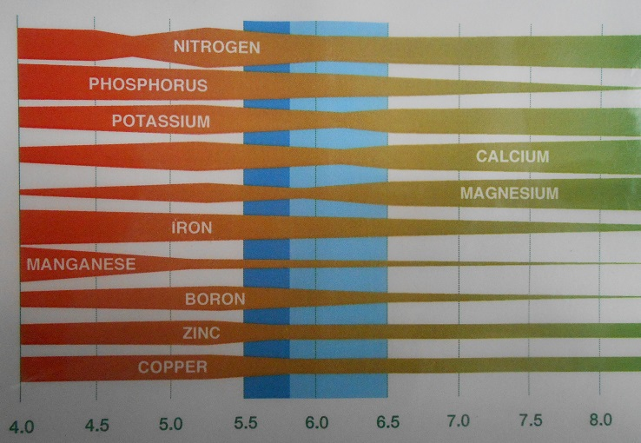
Nutrient Availability Affected by pH

Slide 12
Typical Nutrient Uptake By Plants
Lettuce Nutrient Requirements
2:1 – 4:1 ratio of N: Ca
Roughly 1:1 ratio of N:K
Tomato Nutrient Requirements
1:1 or 2:1 ratio of N:Ca
1:2 or 1:3 ratio of N:K
In Aquaponics, it is easy to model growth of lettuce or leafy greens based on the amount of fish feed fed per day and the protein content of the feed.
Therefore, if we want a certain number of lettuce heads per week, we can back calculate the biomass of fish required to produce the required amount of nitrate and then the size the fish tanks for the necessary biomass of fish.

Slide 13
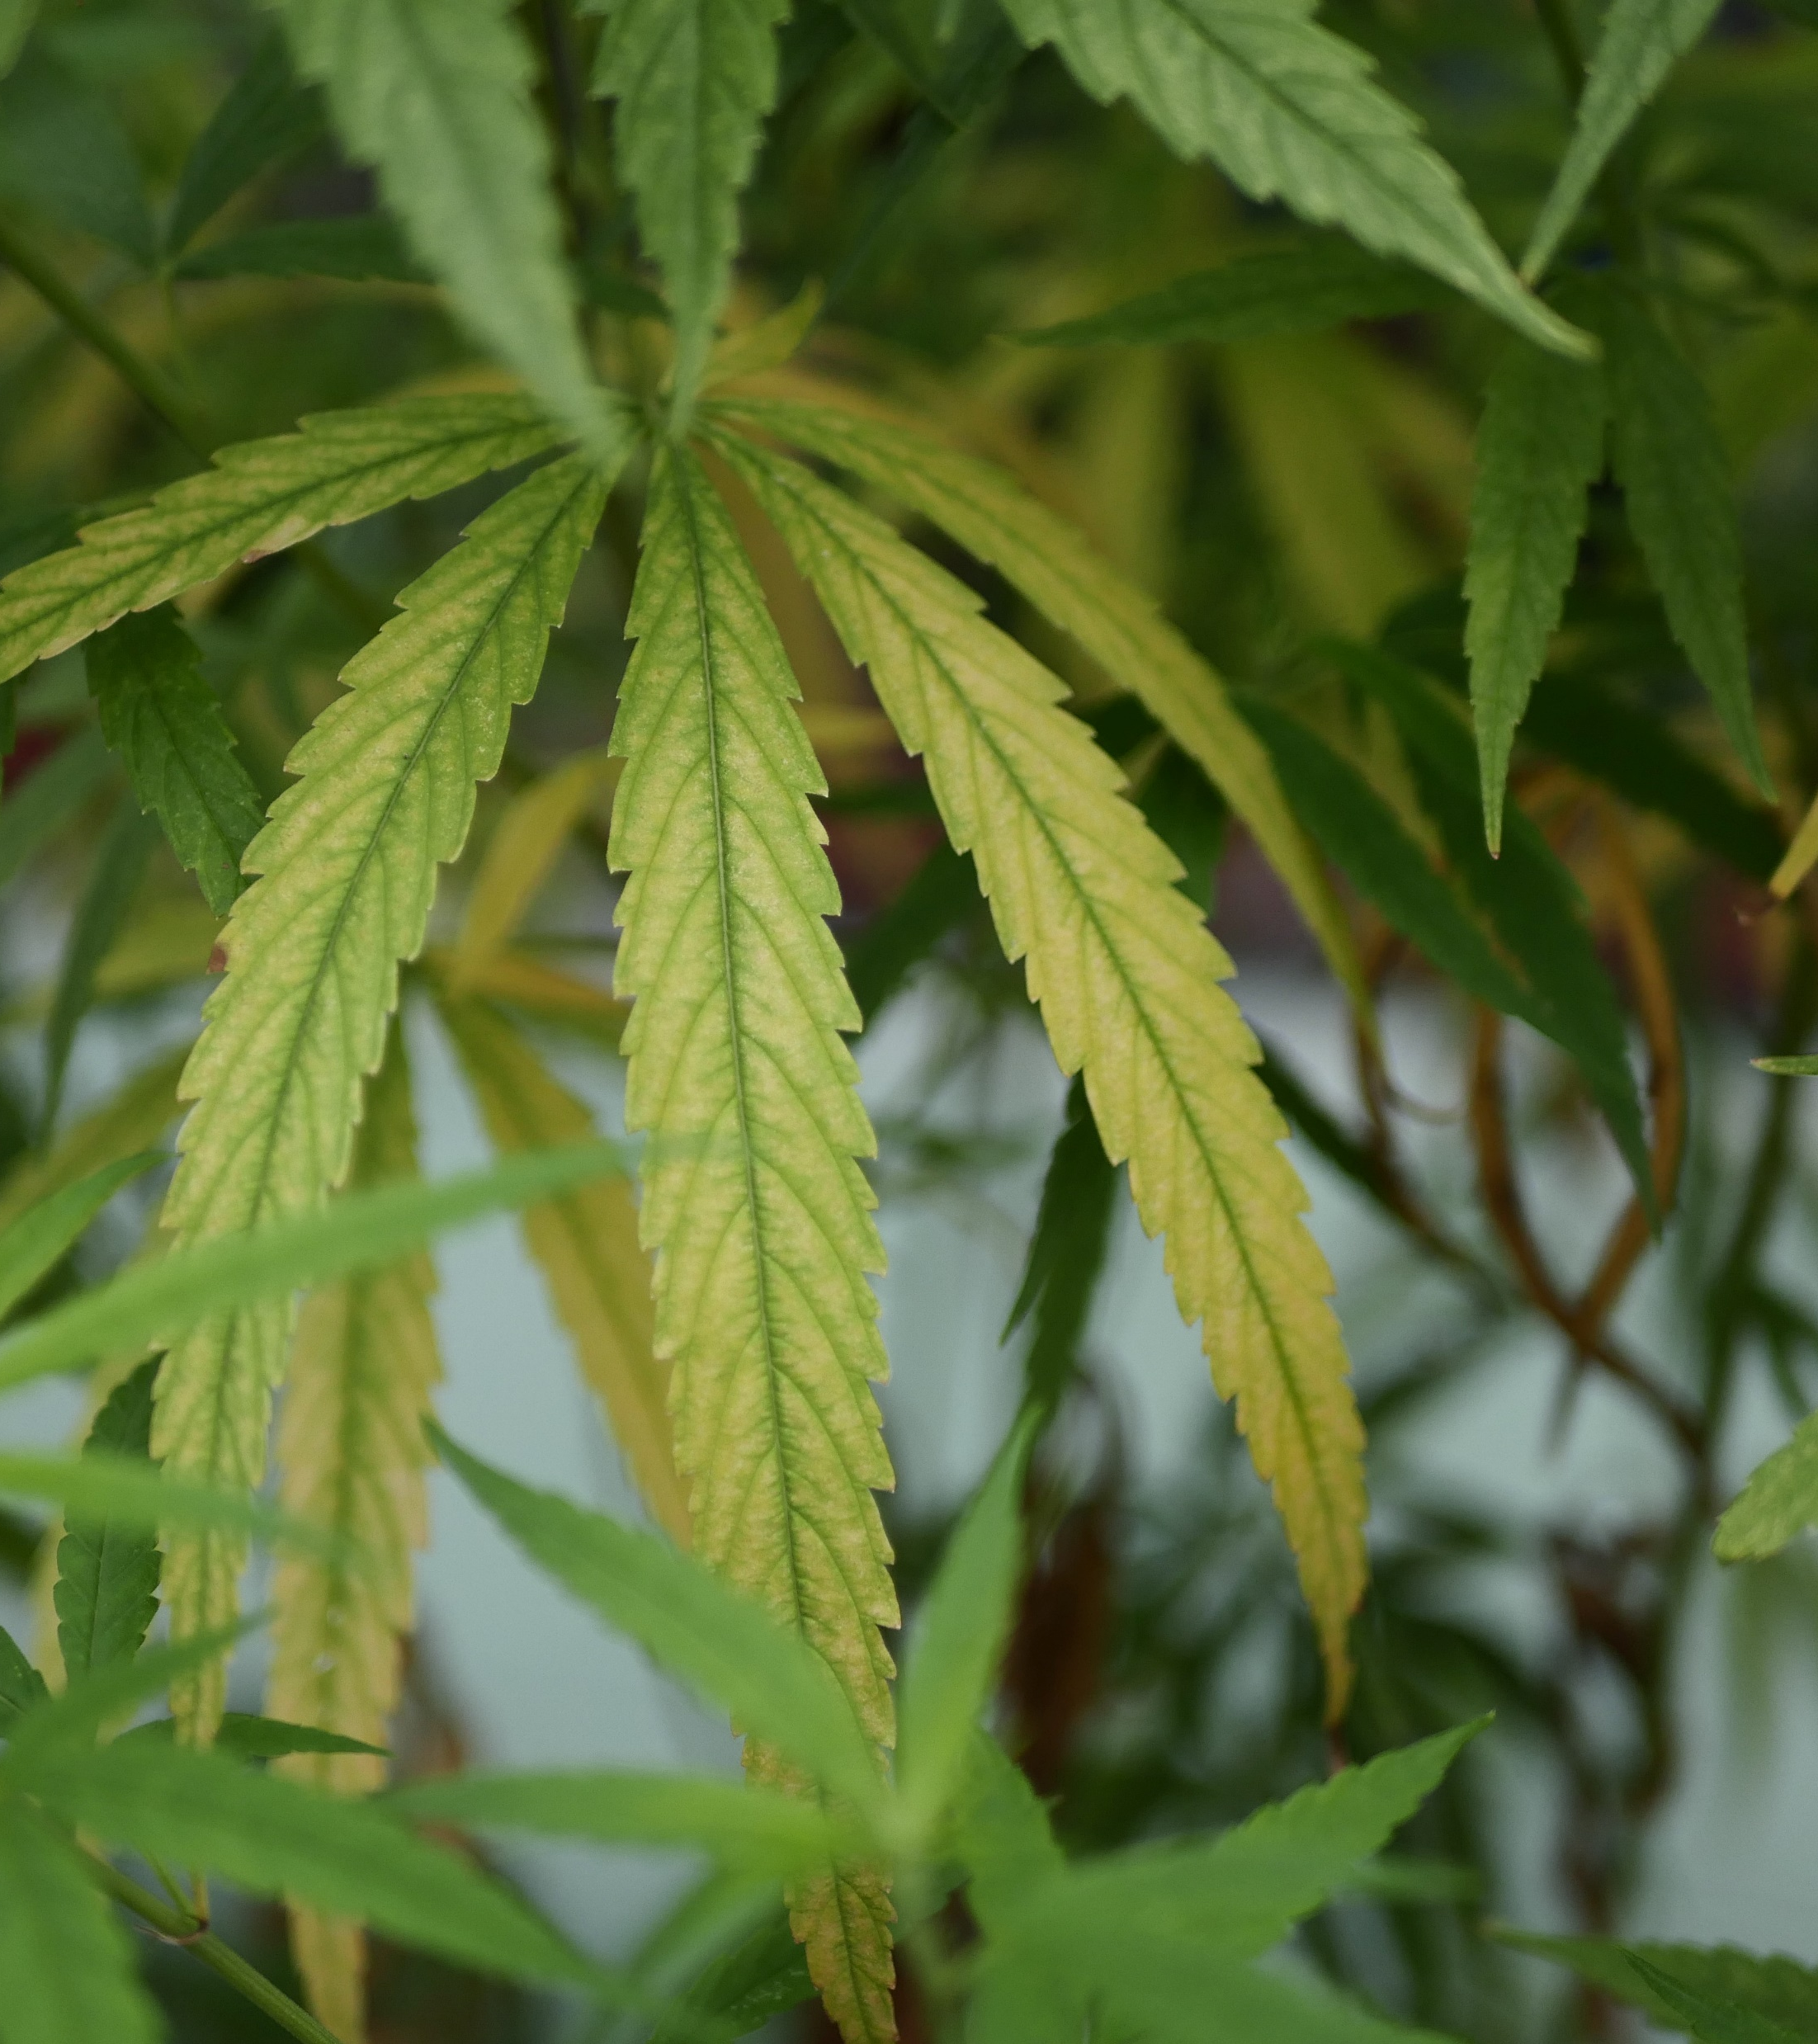
Challenge: High-nutrient Demand Crops
On a small scale you can grow just about anything and have an excess of Nitrogen, Phosphorous and Sulfur in your system
When you grow commercially, plants tend to exhibit nutrient deficiencies in potassium, calcium, magnesium and most micronutrients.
Coupled systems without nutrient mineralization develop imbalances over time

Slide 14
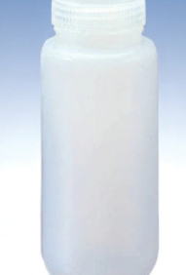
If concerned or want to know nutrient levels
Send 250 mL water sample into a lab for analysis ($20-$50 plus shipping)
  Waypoint Analytics https://www.waypointanalytical.com/
  JR Peters Inc
  https://www.jrpeters.com/lab-testing-services

Slide 15
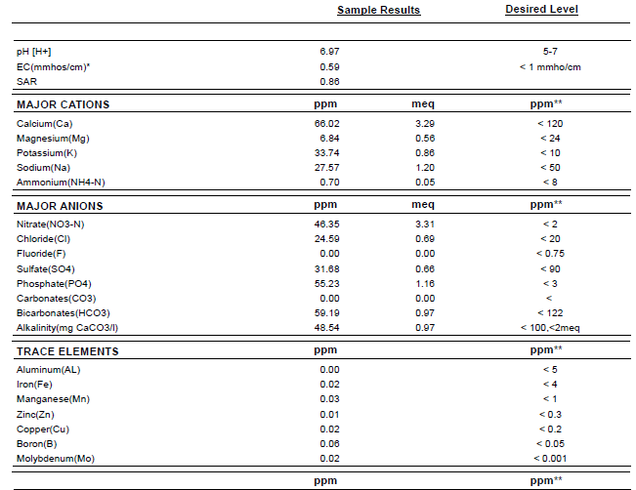

Slide 16
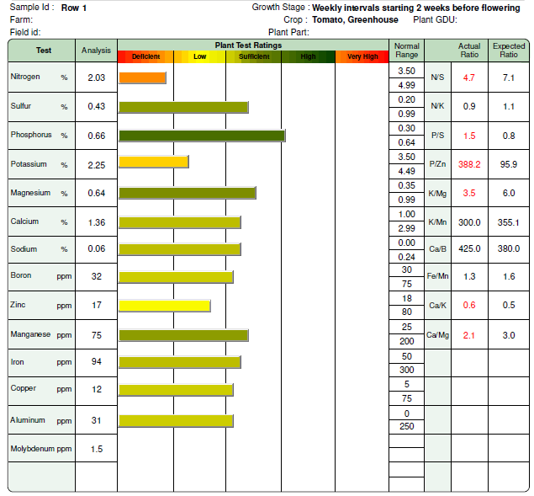
Plant Tissue Analysis also an Option

Slide 17
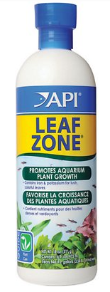
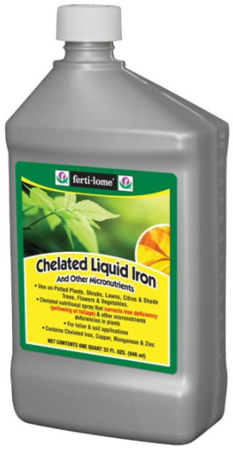
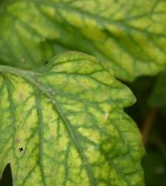
Nutrient Supplements - Iron
One of few nutrients you may need to add to your system
Yellowing leaves can be an indicator of iron deficiency in your plants
Generally, only need to add once per month
Only 0.5 ppm Fe needed (.0005 g per Liter of water)
If you add too much can possibly experience manganese deficiency

Slide 18
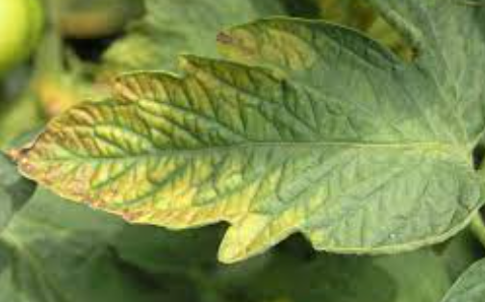
Nutrient Supplements - Potassium
Generally, only need to add potassium for fruited plants in larger growing systems
Add as potassium bicarbonate when pH is below 6.5
  Every 5th time, add calcium carbonate
Can also add potassium hydroxide (caustic), potassium sulfate or potassium chloride

Slide 19
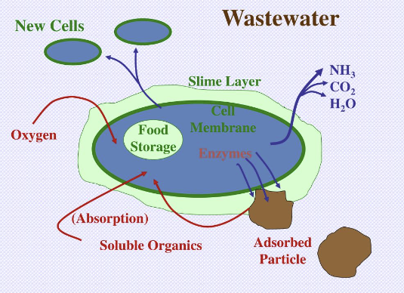
Mineralization: The Major Way to Build Nutrients
The breakdown of complex organic compounds (fish waste) by microbes (bacteria and fungi) into simpler compounds and ions (plant nutrients)

Slide 20
Benefits of External Mineralization
Improved water quality
  Less suspended solids in Recirculating Aquaculture System (RAS)
Enhanced nutrient cycling
  More control over conditions to promote efficient breakdown of solids
Reduced system maintenance
  Less frequent cleaning of RAS required
Increased breakdown (digestion) of solids into more plant-available nutrients
Ability to grow high-nutrient demand crops on a commercial scale

Slide 21
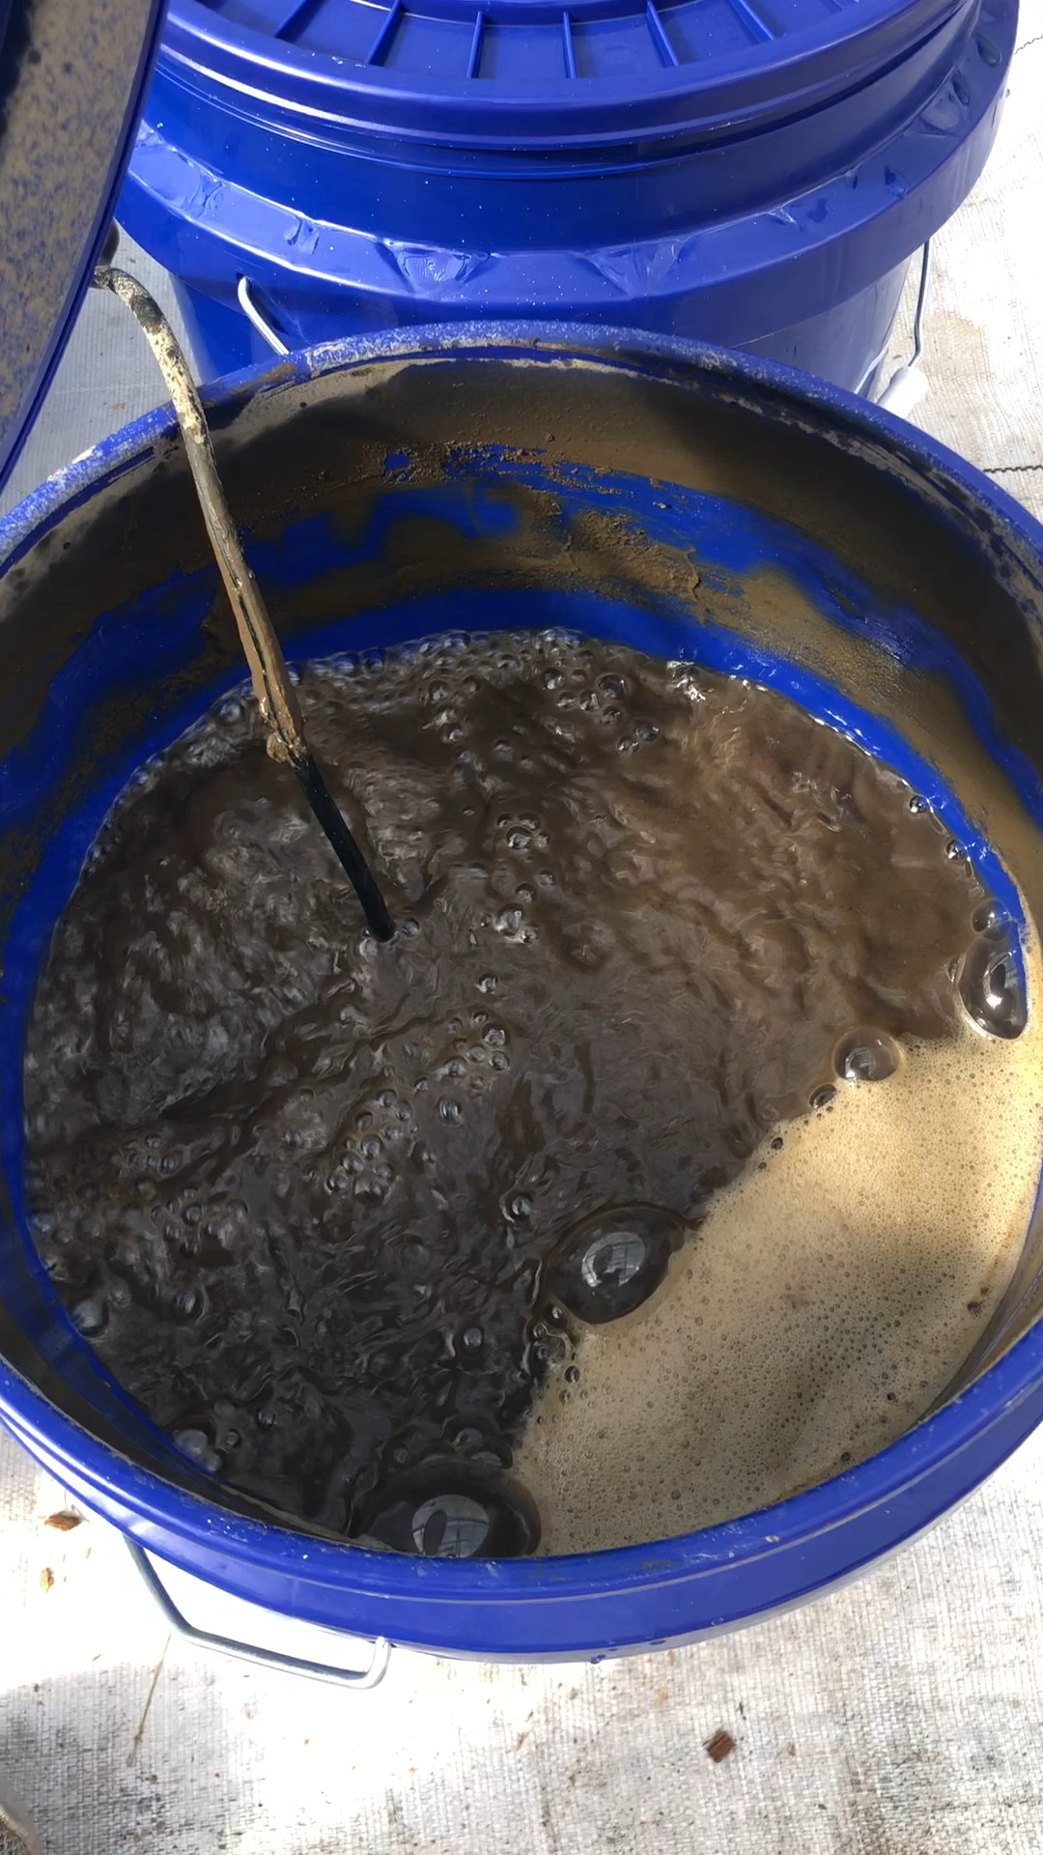
Mineralization Experiment Showed
Phosphate (PO₄³⁻) = 16.5% increase after 2 weeks; 45.0% increase after 4 weeks
Potassium (K⁺) = 20.4% increase after 2 weeks; 31.5% increase after 4 weeks
Calcium (Ca²⁺)= 25.5% increase after 2 weeks; 59.4% increase after 4 weeks
Magnesium (Mg²⁺) = 14.6% increase after 2 weeks; 42.1% increase after 4 week
Boron (B) = 30.0% increase after 2 weeks; 90% increase after 4 weeks
Manganese (Mn) = 41.7% increase after 2 weeks; 96.3% increase after 4 weeks

Slide 22
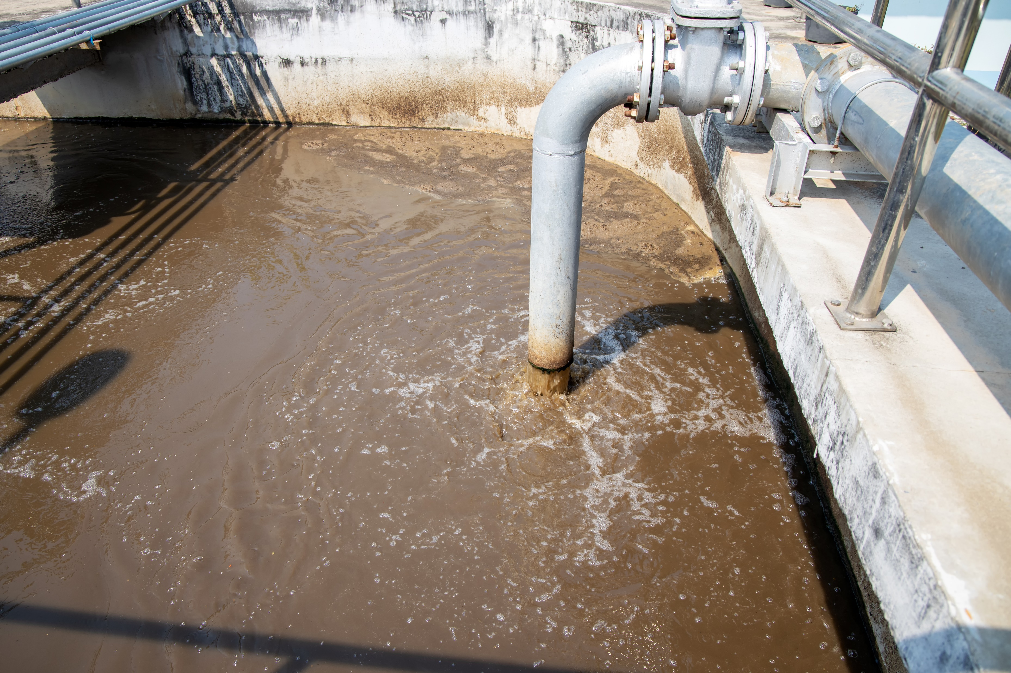
Really Must Utilize Mineralization
Uneaten feed and fish poop is loaded with nutrients which are unavailable to plants
  Aerobic mineralization (preferred) – relies on heterotrophic bacteria to break down the solids optimized with mixing and aeration
    Feed on organic matter (carbon)
    Faster degradation of organic solids
    Typically Requires C:N ratio of 20:1 ( in WWT)
    Recently Measured 8:1 and appeared okay
    (stoichiometry says 10:1 or 12:1 in real world ok)
  Typically, 4 weeks total retention time needed (often split into 2 stages)

Slide 23
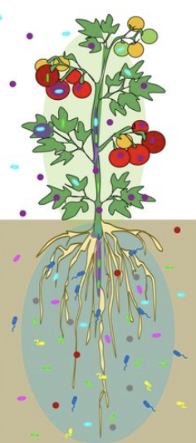
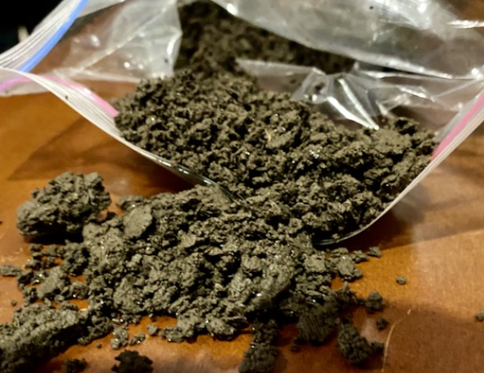

Aerobic Digestion
Production of Valuable bi-products
  Nutrient-rich effluent (liquid fertilizer)
  Stabilized Biosolids (soil amendment)
    Build up over time (dewater for use)
Maintain diverse microbiome
  Allows plants to achieve their genetic potential

Slide 24
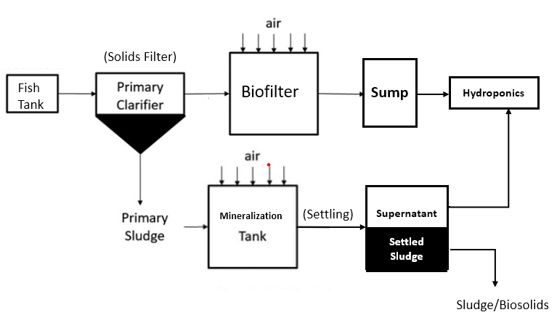
Sludge Mineralization in Aquaponics System

Slide 25
Basics: Aerobic Mineralization of Sludge
Heavily agitated with aeration
  Requires good mixing and adequate oxygen
  Kind of like a Biofloc without fish
Solid fish waste broken down by bacteria
  Ionic salts and minerals
  Water
  Residual, insoluble solids
    Depending on the amount of carbon (food) available

Slide 26
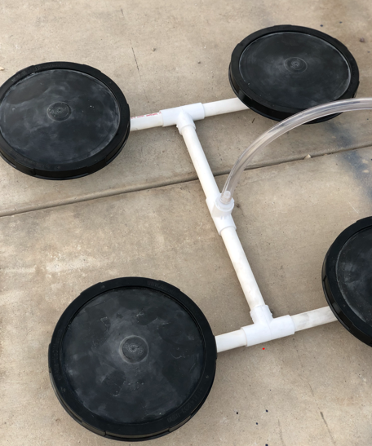
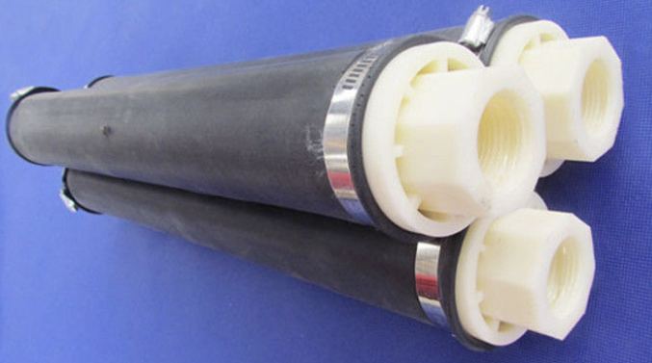
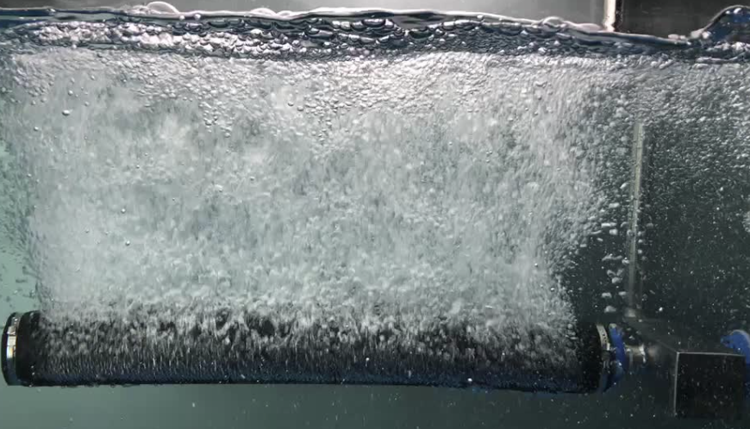
Mixing and Aeration
Fine bubble disks or aeration tubing work best
  Less prone to clogging
May need to be weighted down or fastened in place
Self-cleaning

Slide 27
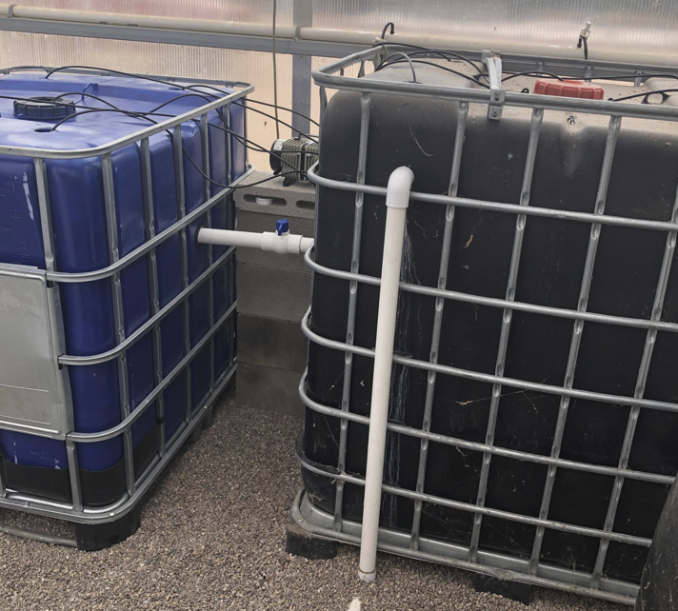
2-stage Aerobic Mineralization
Stage 2
Stage 1 ≈ 15 days
Stage 2 ≈ 30 days
Pause Mixing for at least 1-2 hours before using supernatant from stage 2 or transferring from stage 1 to stage 2
*Allows solids to settle
Stage 1

Slide 28
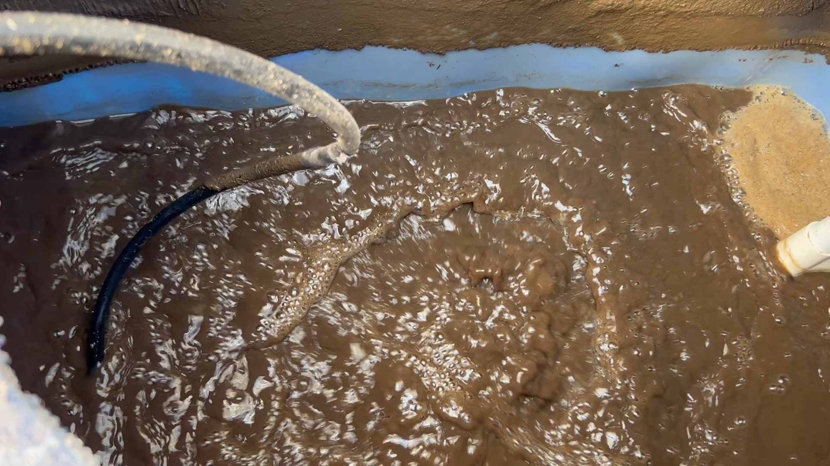

Slide 29
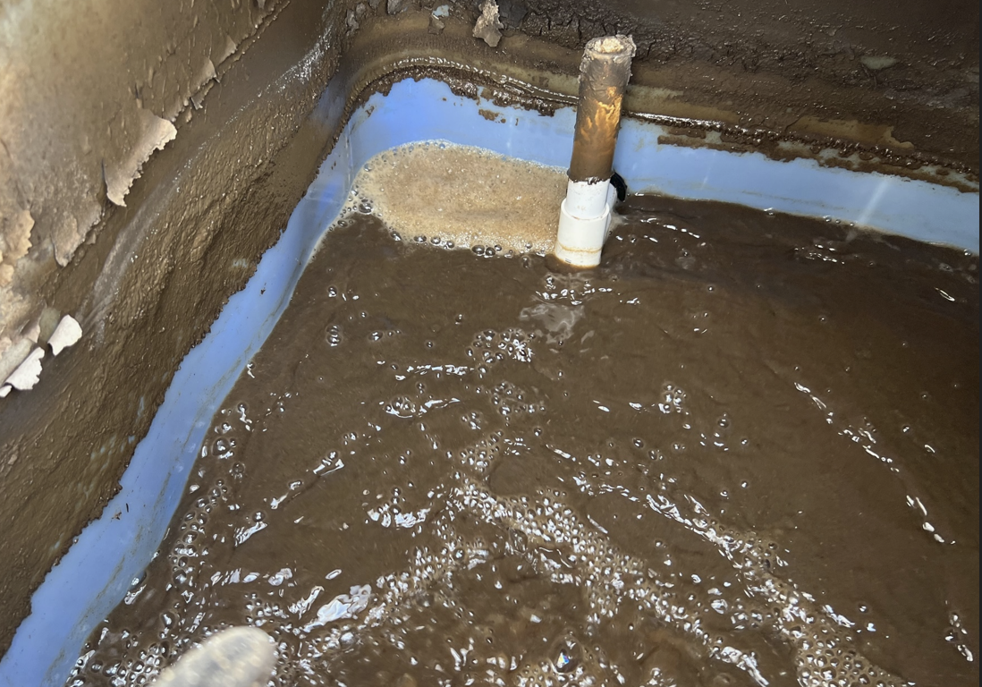
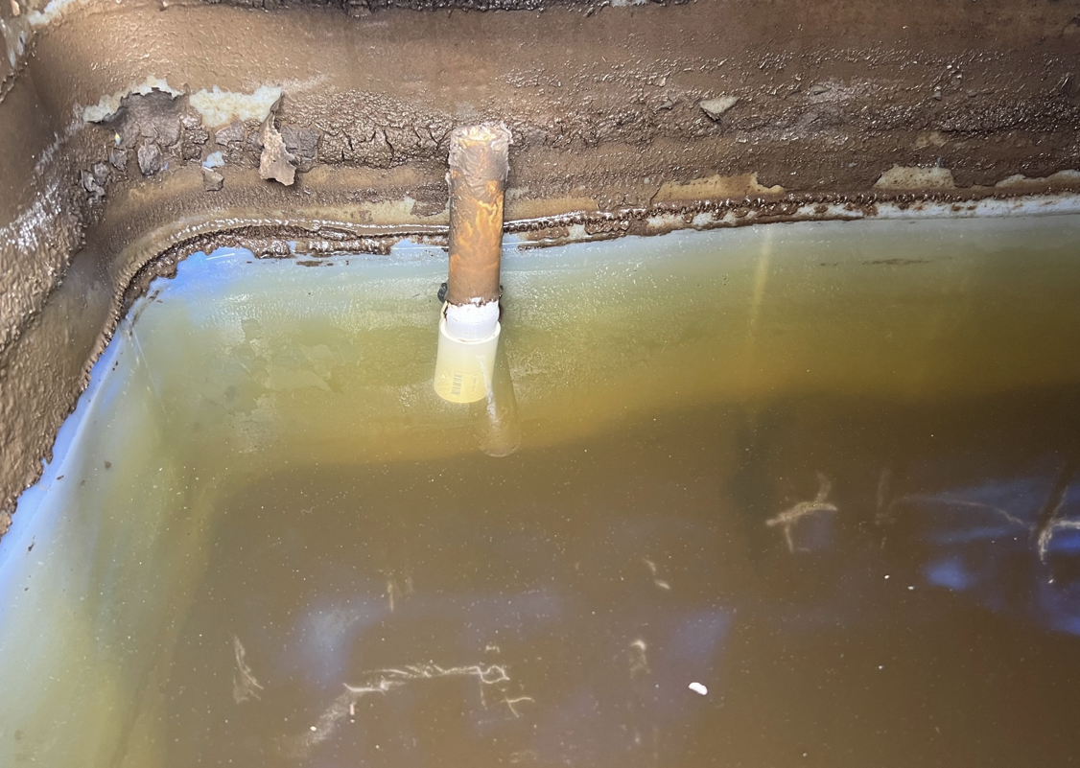
While Aerated Vs After Settling

Slide 30
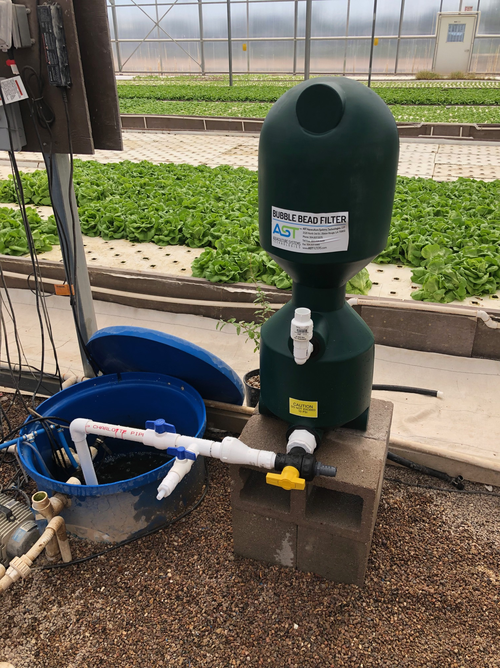
Ok then what?
It can take 1-4 hours to get good settling in stage 1 depending on C:N
Can use a pump or valve to move to stage 2
From stage 2 you can also use a pump or valve to add supernatant directly back into RAS
  Ideally you would pump through a bead filter to maintain clarity in RAS and thus for plants
Typically, you can do this every 1 or 2 weeks depending on your average sludge volume
  Want the average age of your mineralized water to be ~4 weeks

Slide 31
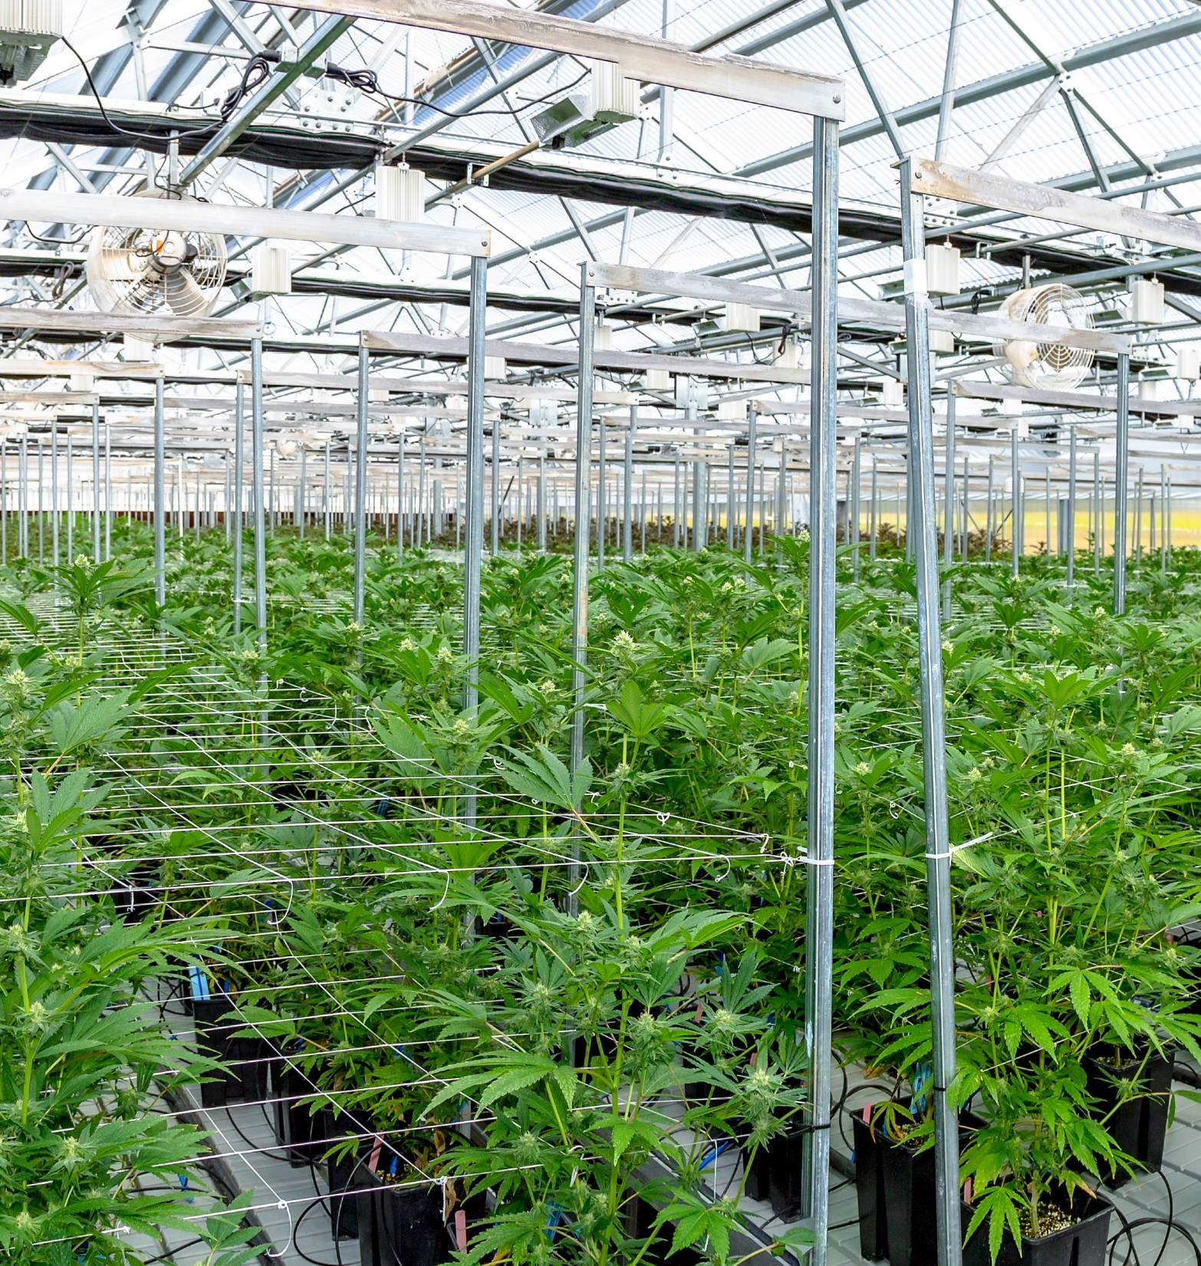
Adding Mineralized Water Allows you to Build System Nutrients over Time
Estimate 6 months minimum of running system without plants to for optimal plant production

Slide 32

In time your system will have plenty of nutrients to grow healthy and great tasting plants!

