Slide 1
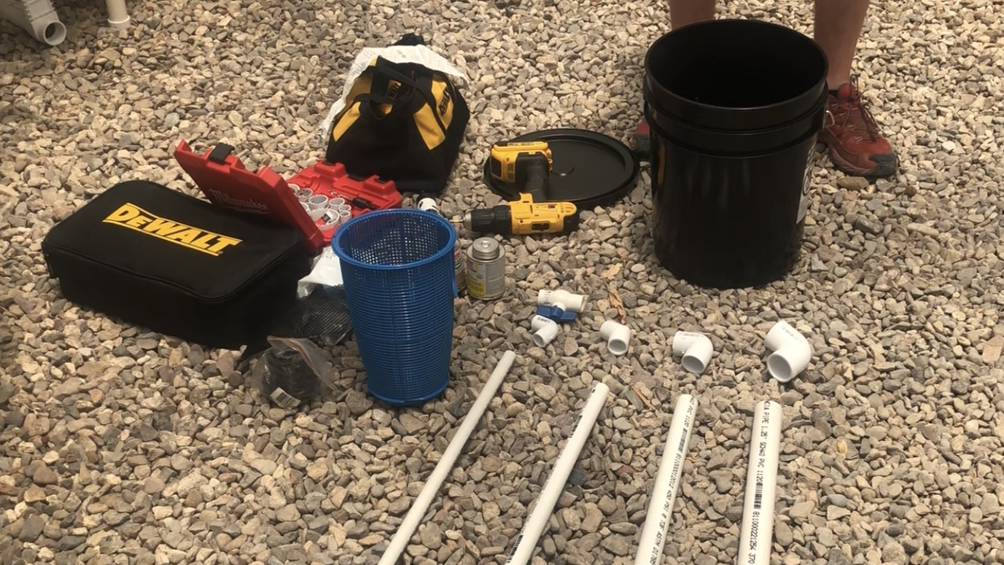
System Planning and Design
©2025 Matthew Recsetar

Slide 2
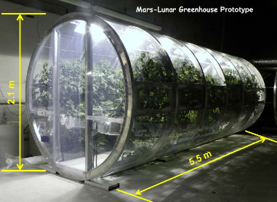
Step 1 – Site Selection
Where will you grow?
Greenhouse?
Outdoors?
Indoors?
How much space do you have?
Can you expand?
Can you grow vertically?
What is your water source?
Municipal
Well Water
Rainwater
University of Arizona

Slide 3
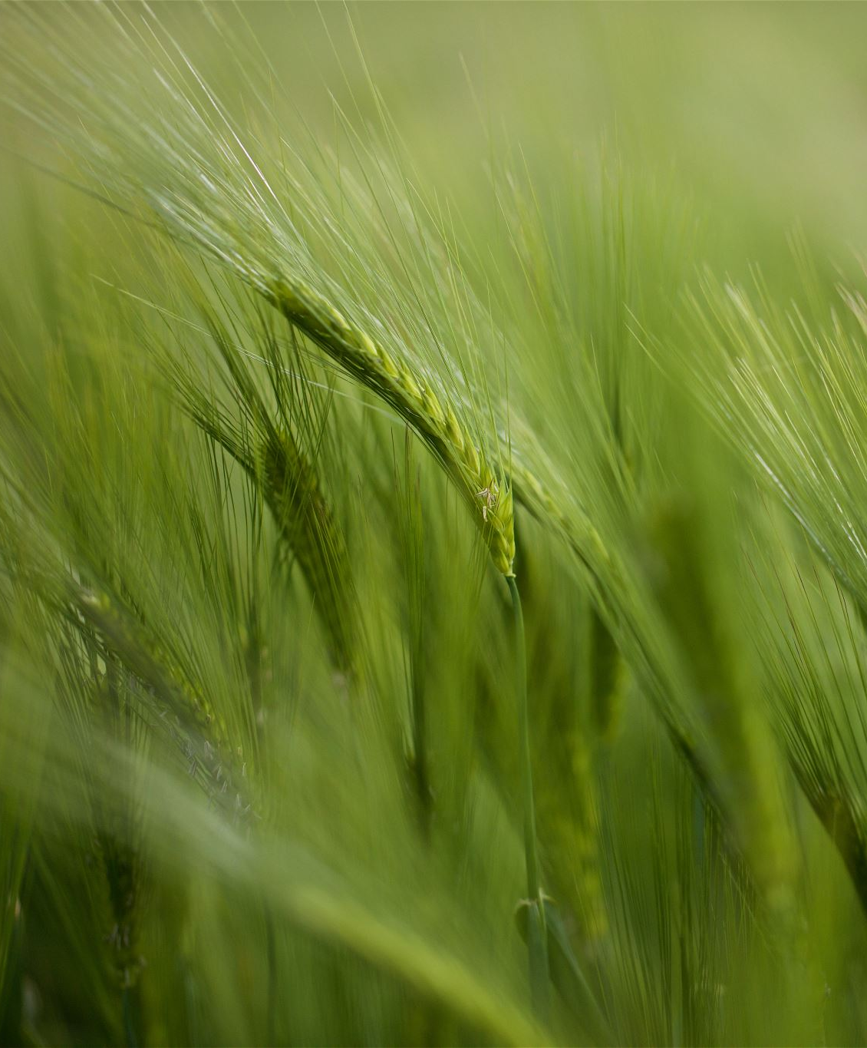
Where To Do Aquaponics
Outdoors :
May only be able to grow part of the year
Will have more issues with pests and natural elements
Try to avoid the shade
Greenhouse:
More control (humidity, pH, temperature, etc)
Longer growing season
Greater Cost
Indoors:
Can grow year round
Need lighting
Can control even more variables than in a greenhouse

Slide 4
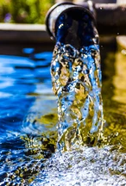
What to know about water sources
Municipal
Often treated with chlorine, so will need to run system with aeration for at least 24 hours until it dissipates before adding fish
Should measure with chlorine indicator strip (pool store or online)
If there is still chlorine need to add a dechlorinator (Vitamin C)
Generally, has good alkalinity to start
Well water
Often has very high CO2
Will need to off gas the before stocking fish
Rainwater
Lacks alkalinity and sometimes slightly acidic
Will need to add potassium bicarbonate and/or calcium carbonate to system (bring up pH and alkalinity before stocking fish)

Slide 5
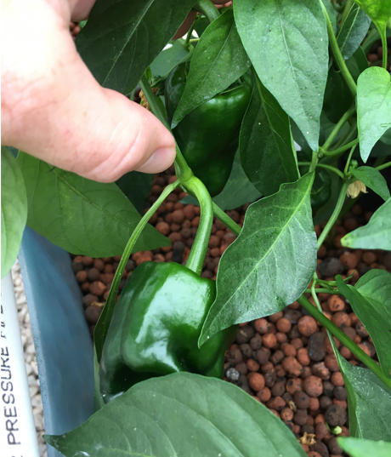
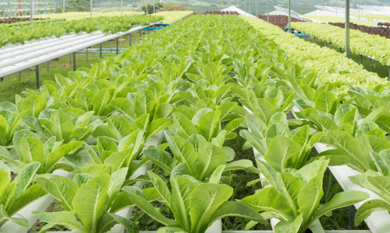
What do you want to grow?
NFT Systems
Ideal for lettuces and herbs
Floating Raft Systems
Ideal for lettuces and herbs
Media Bed Systems
Ideal for almost any crop, especially fruited plants

Slide 6
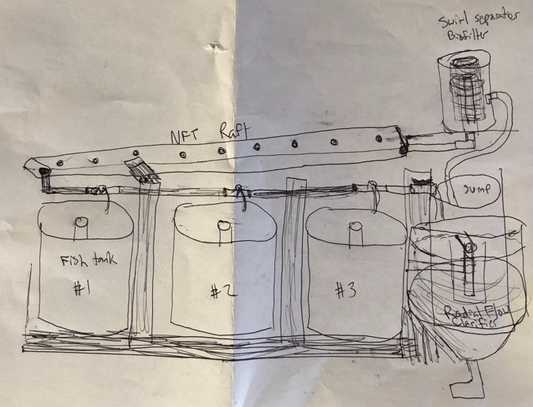
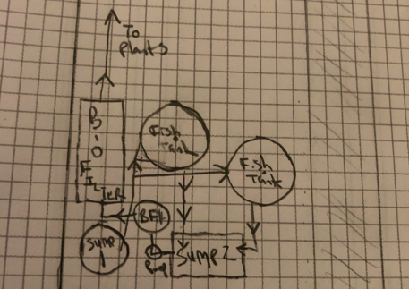
Draw a Rough Sketch
Extremely important!

Slide 7

Selecting Materials
Next step
After you have a design of your proposed system
Involves making a list of the exact specifications of each element of your design
I find it is best to make a list items by category or even better, organize it in a spreadsheet.

Slide 8
Materials List for IBC Tote System

Slide 9
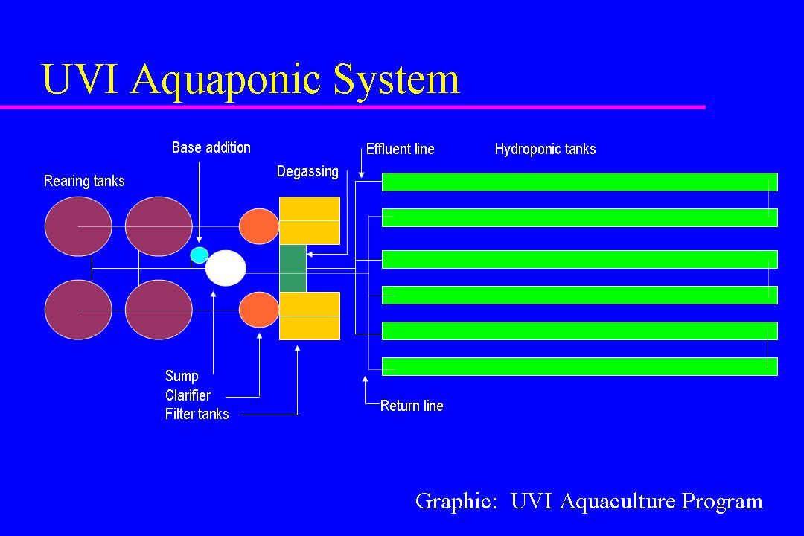

Slide 10
UVI System Cost Breakdown

Slide 11
UVI System Cost Breakdown

Slide 12
Total $49,250!
Optional Items:
What if you want a wet wall?
$2300
Water heater?
$3800
Automatic fish feeders?
$1300

Slide 13
If you are trying to stay with in a budget, you need to price everything out or you will find yourself way over budget!
Material is the next consideration
Size is the first consideration
Think about each component and find the one that you can afford that fits your application

Slide 14
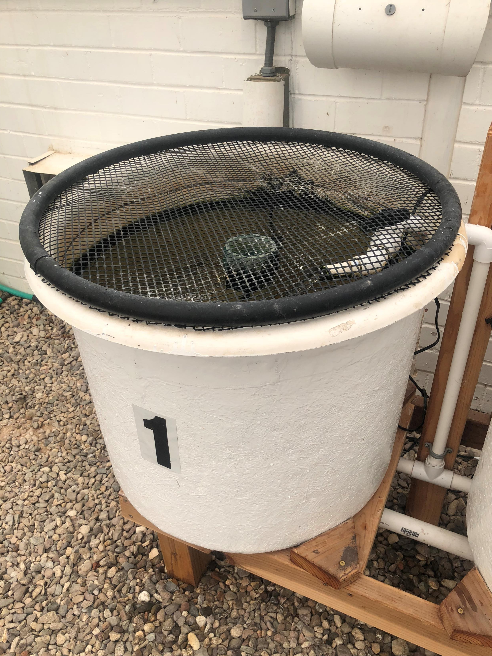
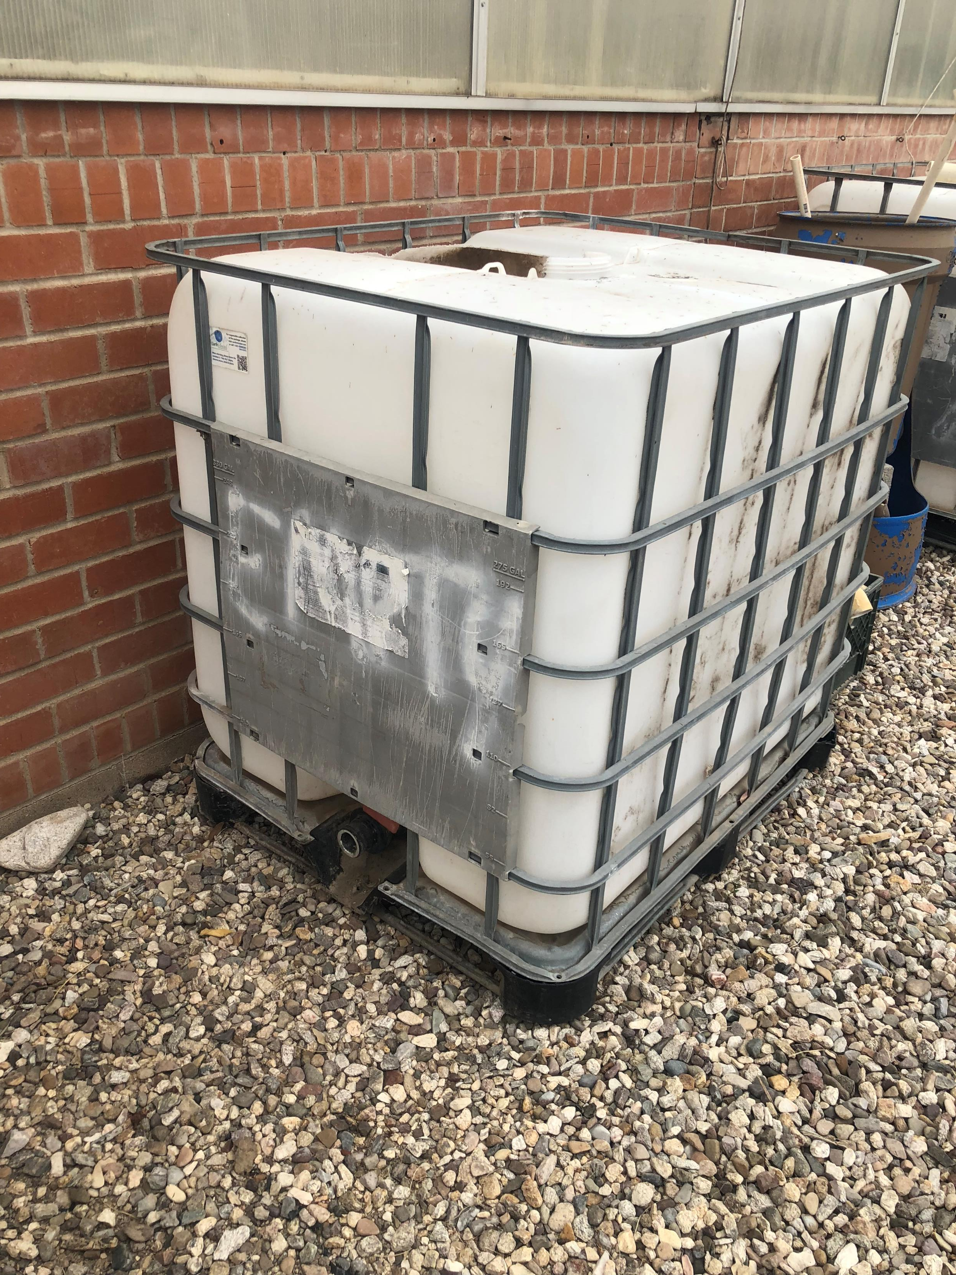
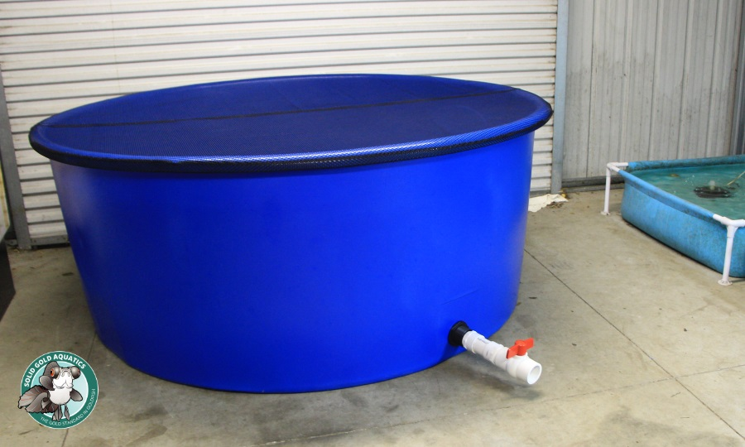
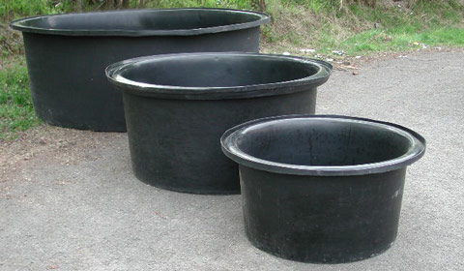
Fish Tanks
Size:
10-gallons desktop system?
50-gallon barrel system?
250-gallon back porch system?
3,000-gallon commercial system
Material:
Fiberglass (Top left)
Polyethylene (HDPE) (Top right, bottom left)
Polypropylene (Bottom right)
Acrylic (not pictured)
What’s available?

Slide 15
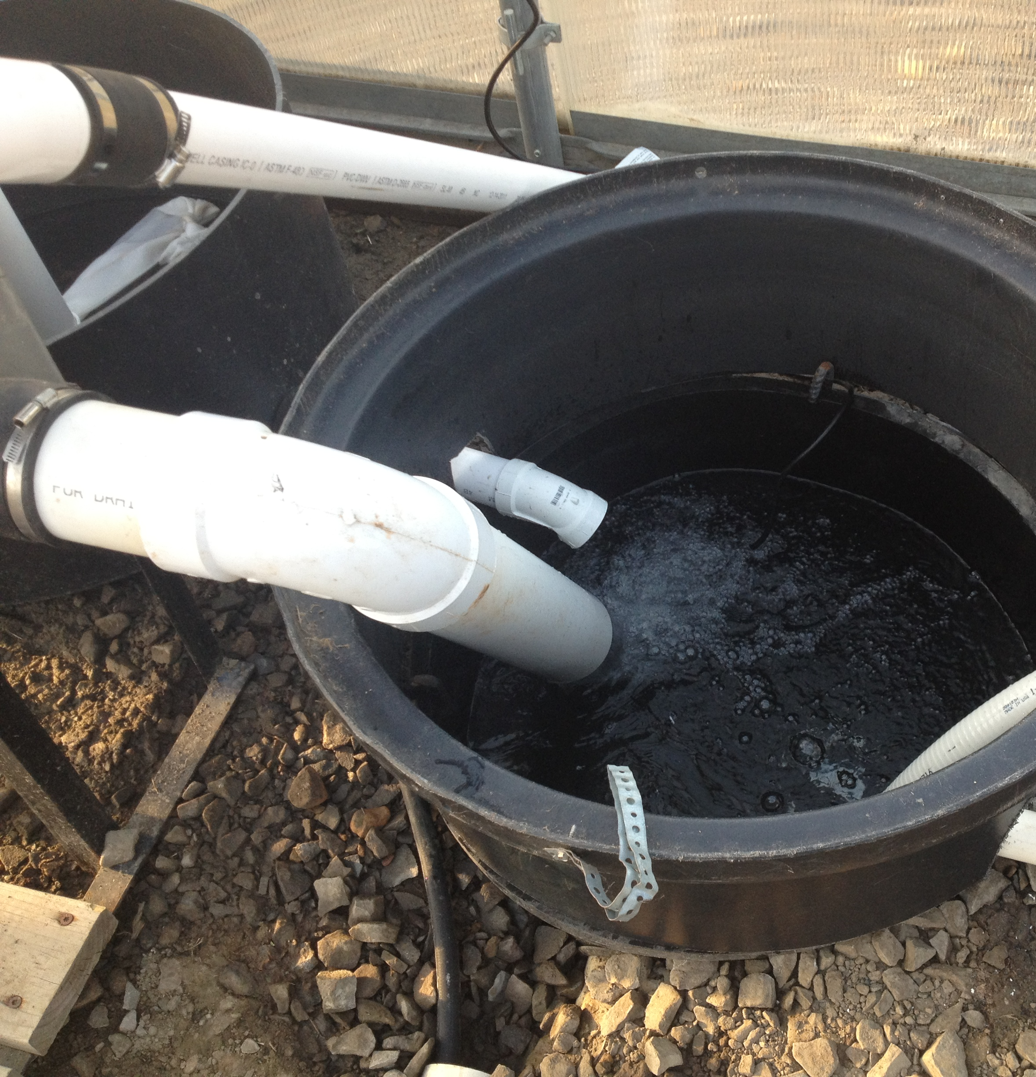
Sump Tank
In a media-bed systems, sumps should be able to hold the volume of water in your growbed.
Depending on the media you choose, water will take up close to 40% of the volume of your grow bed.
In an NFT system you want to hold a volume that is greater than the maximum volume of water that could be in the channels or gutters at one time.
In a floating raft system the sump size is less important and can be sized to hold a water level that is above the top of the pump

Slide 16

Example: Sizing a Sump
Situation
Your media-bed will be 8’ x 4’ with a maximum water depth of 9”
Your bed is filled with ⅝” gravel and is on an ebb and flow cycle
The gravel has a porosity of 0.4
Solution
The total volume of the bed = 8’ x 4’ x 0.75’ = 24 ft³
24 ft³ x 7.48 gallons/ft³ = 180 gallons
180 gallons x 0.4 = 71 gallons ≈ Choose 100-gallon sump
Size up to account for evaporation and transpiration losses unless you have a float switch that automatically fills your tank (most will still chose a sump that is half that size)

Slide 17
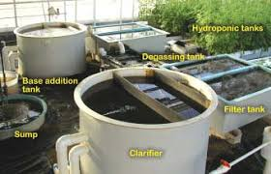
Clarifiers
Shape
Rectangular
Cylindrical
Cylindrical with cone bottom
*If you know the flow rate you can calculate the Hydraulic retention time by dividing the volume of the clarifier by the flow rate
Volume
(L*W*H)
πr² *h
⅓πr² *h + (cylinder portion volume)

Slide 18
Example: Determining the Hydraulic Retention Time (HRT)
Situation
Your conical bottom clarifier has a total height of 2 feet with the cone height 50% of the total height and a diameter of 2 feet
Your pump puts out a constant flow rate of 5 gallons per minute
Solution
Volume of Cylinder portion = πr² *h = π*1² *1 = 3.14 ft³
Volume of Cone portion = ⅓πr² *h = ⅓π1² *1 = 1.05 ft³
Total Volume = 4.19 * 7.48 gal/ft³ = 31.3 gallons
31.3 gal / 5 gpm = 6.3 min
Which essentially means you are allowing 6 min for solids to settle because a plug of water will travel through the clarifier in 6 min

Slide 19
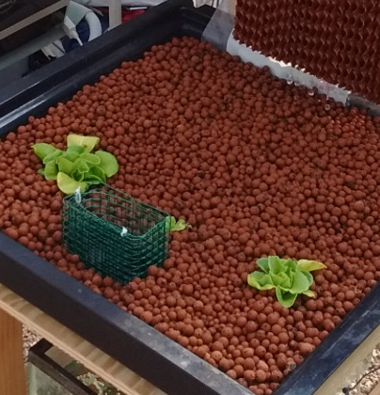
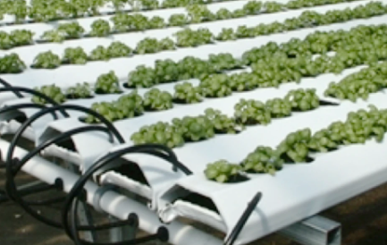
Growbeds
NFT
Buy gutters or PVC pipe and make your own channels
Buy ready-made hydroponic NFT channels
Floating Raft
Build growbed tank from wood and pond liner or use tanks that can fit rafts with at least 10” water depth
Purchase ready made rafts or make your own from polystyrene boards
Media-beds
Buy growbeds from hydroponic stores
Build growbed from plastic tanks you have
Build growbeds from wood and pond liner

Slide 20
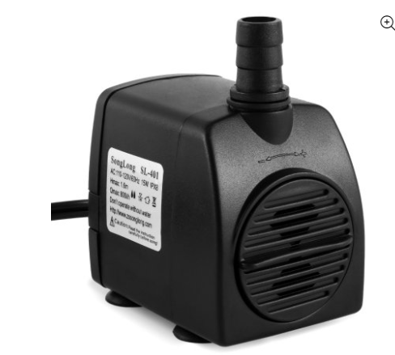
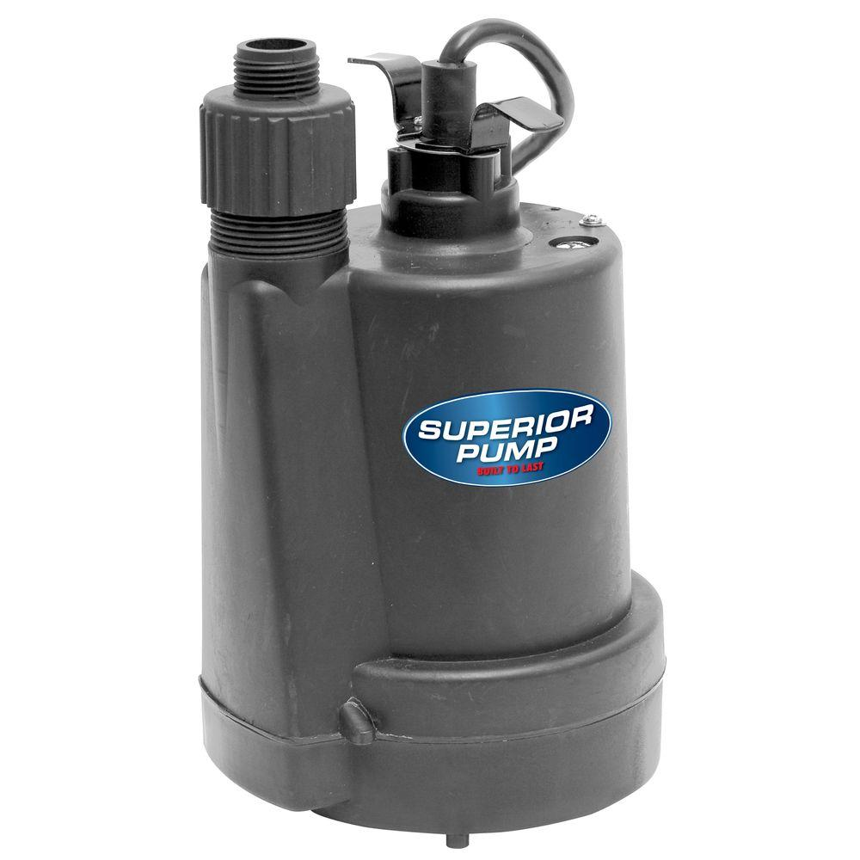
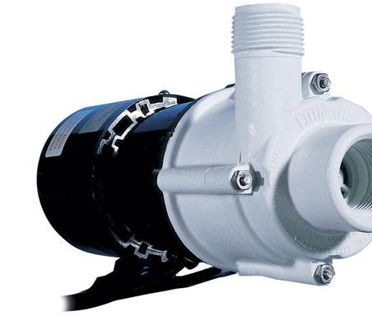
Water Pumps
Expect to spend between $40-$350 depending on the size of system
Submersible Pond Pumps
In-line pumps
Sump pumps

Slide 21
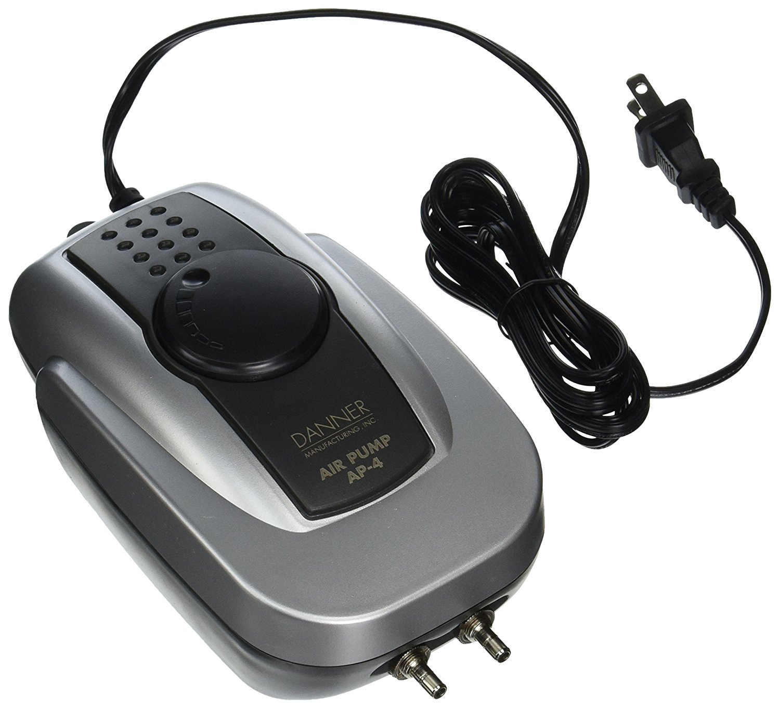
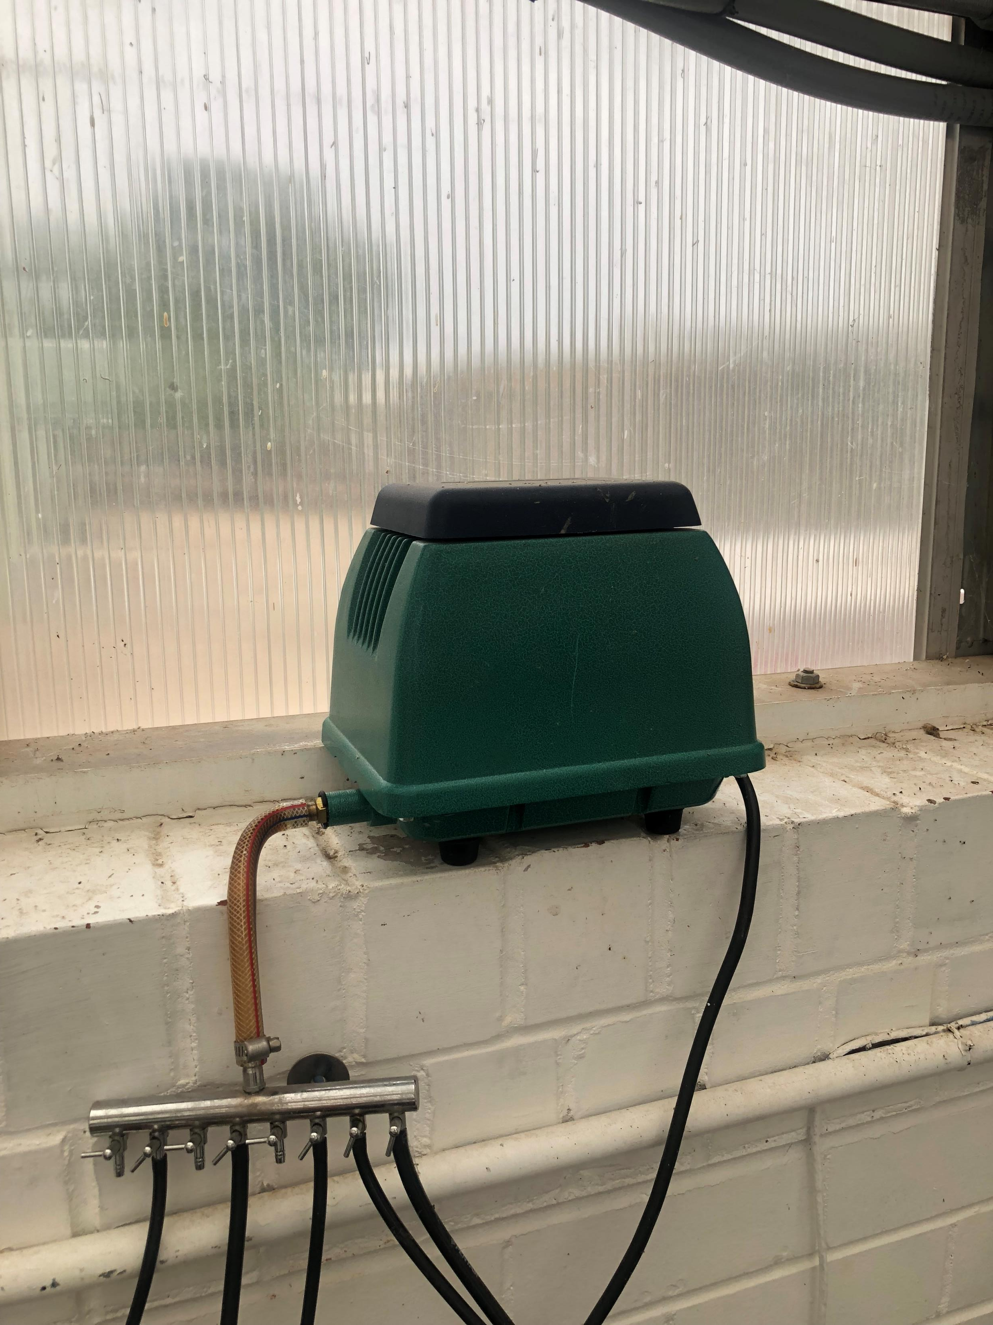
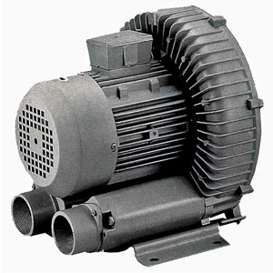
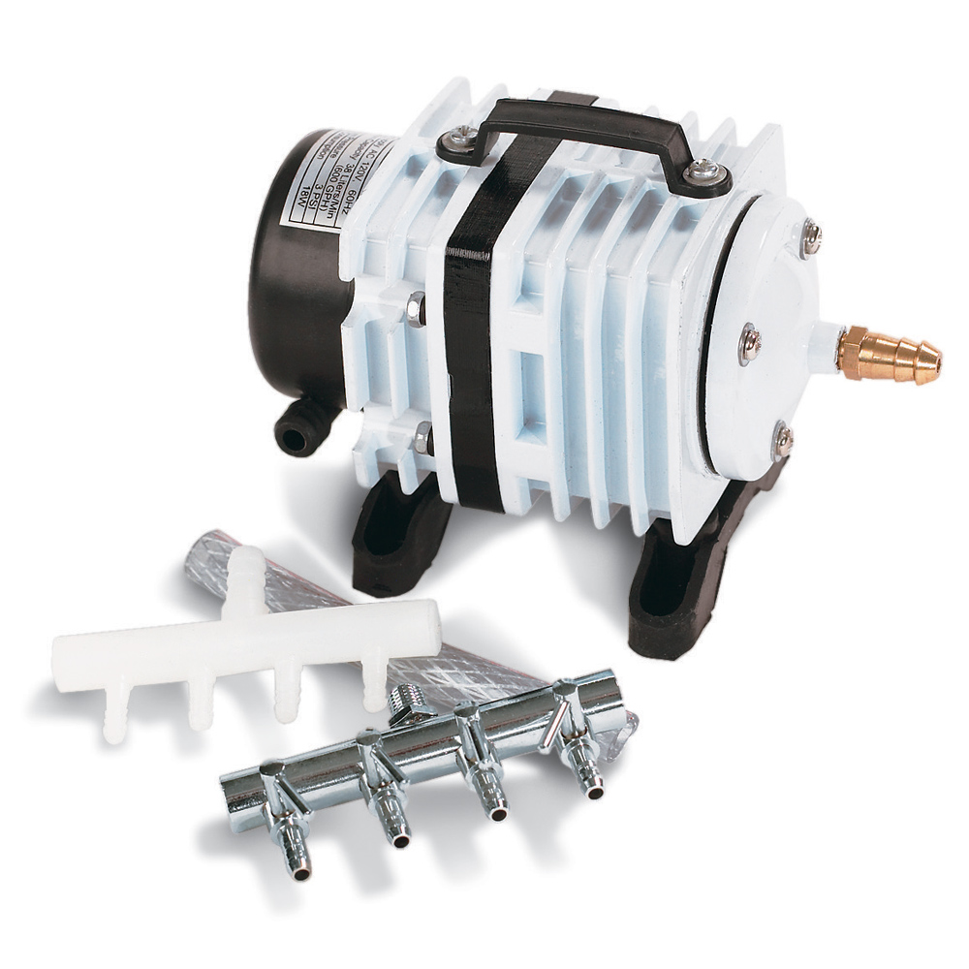
Air Pumps

Slide 22
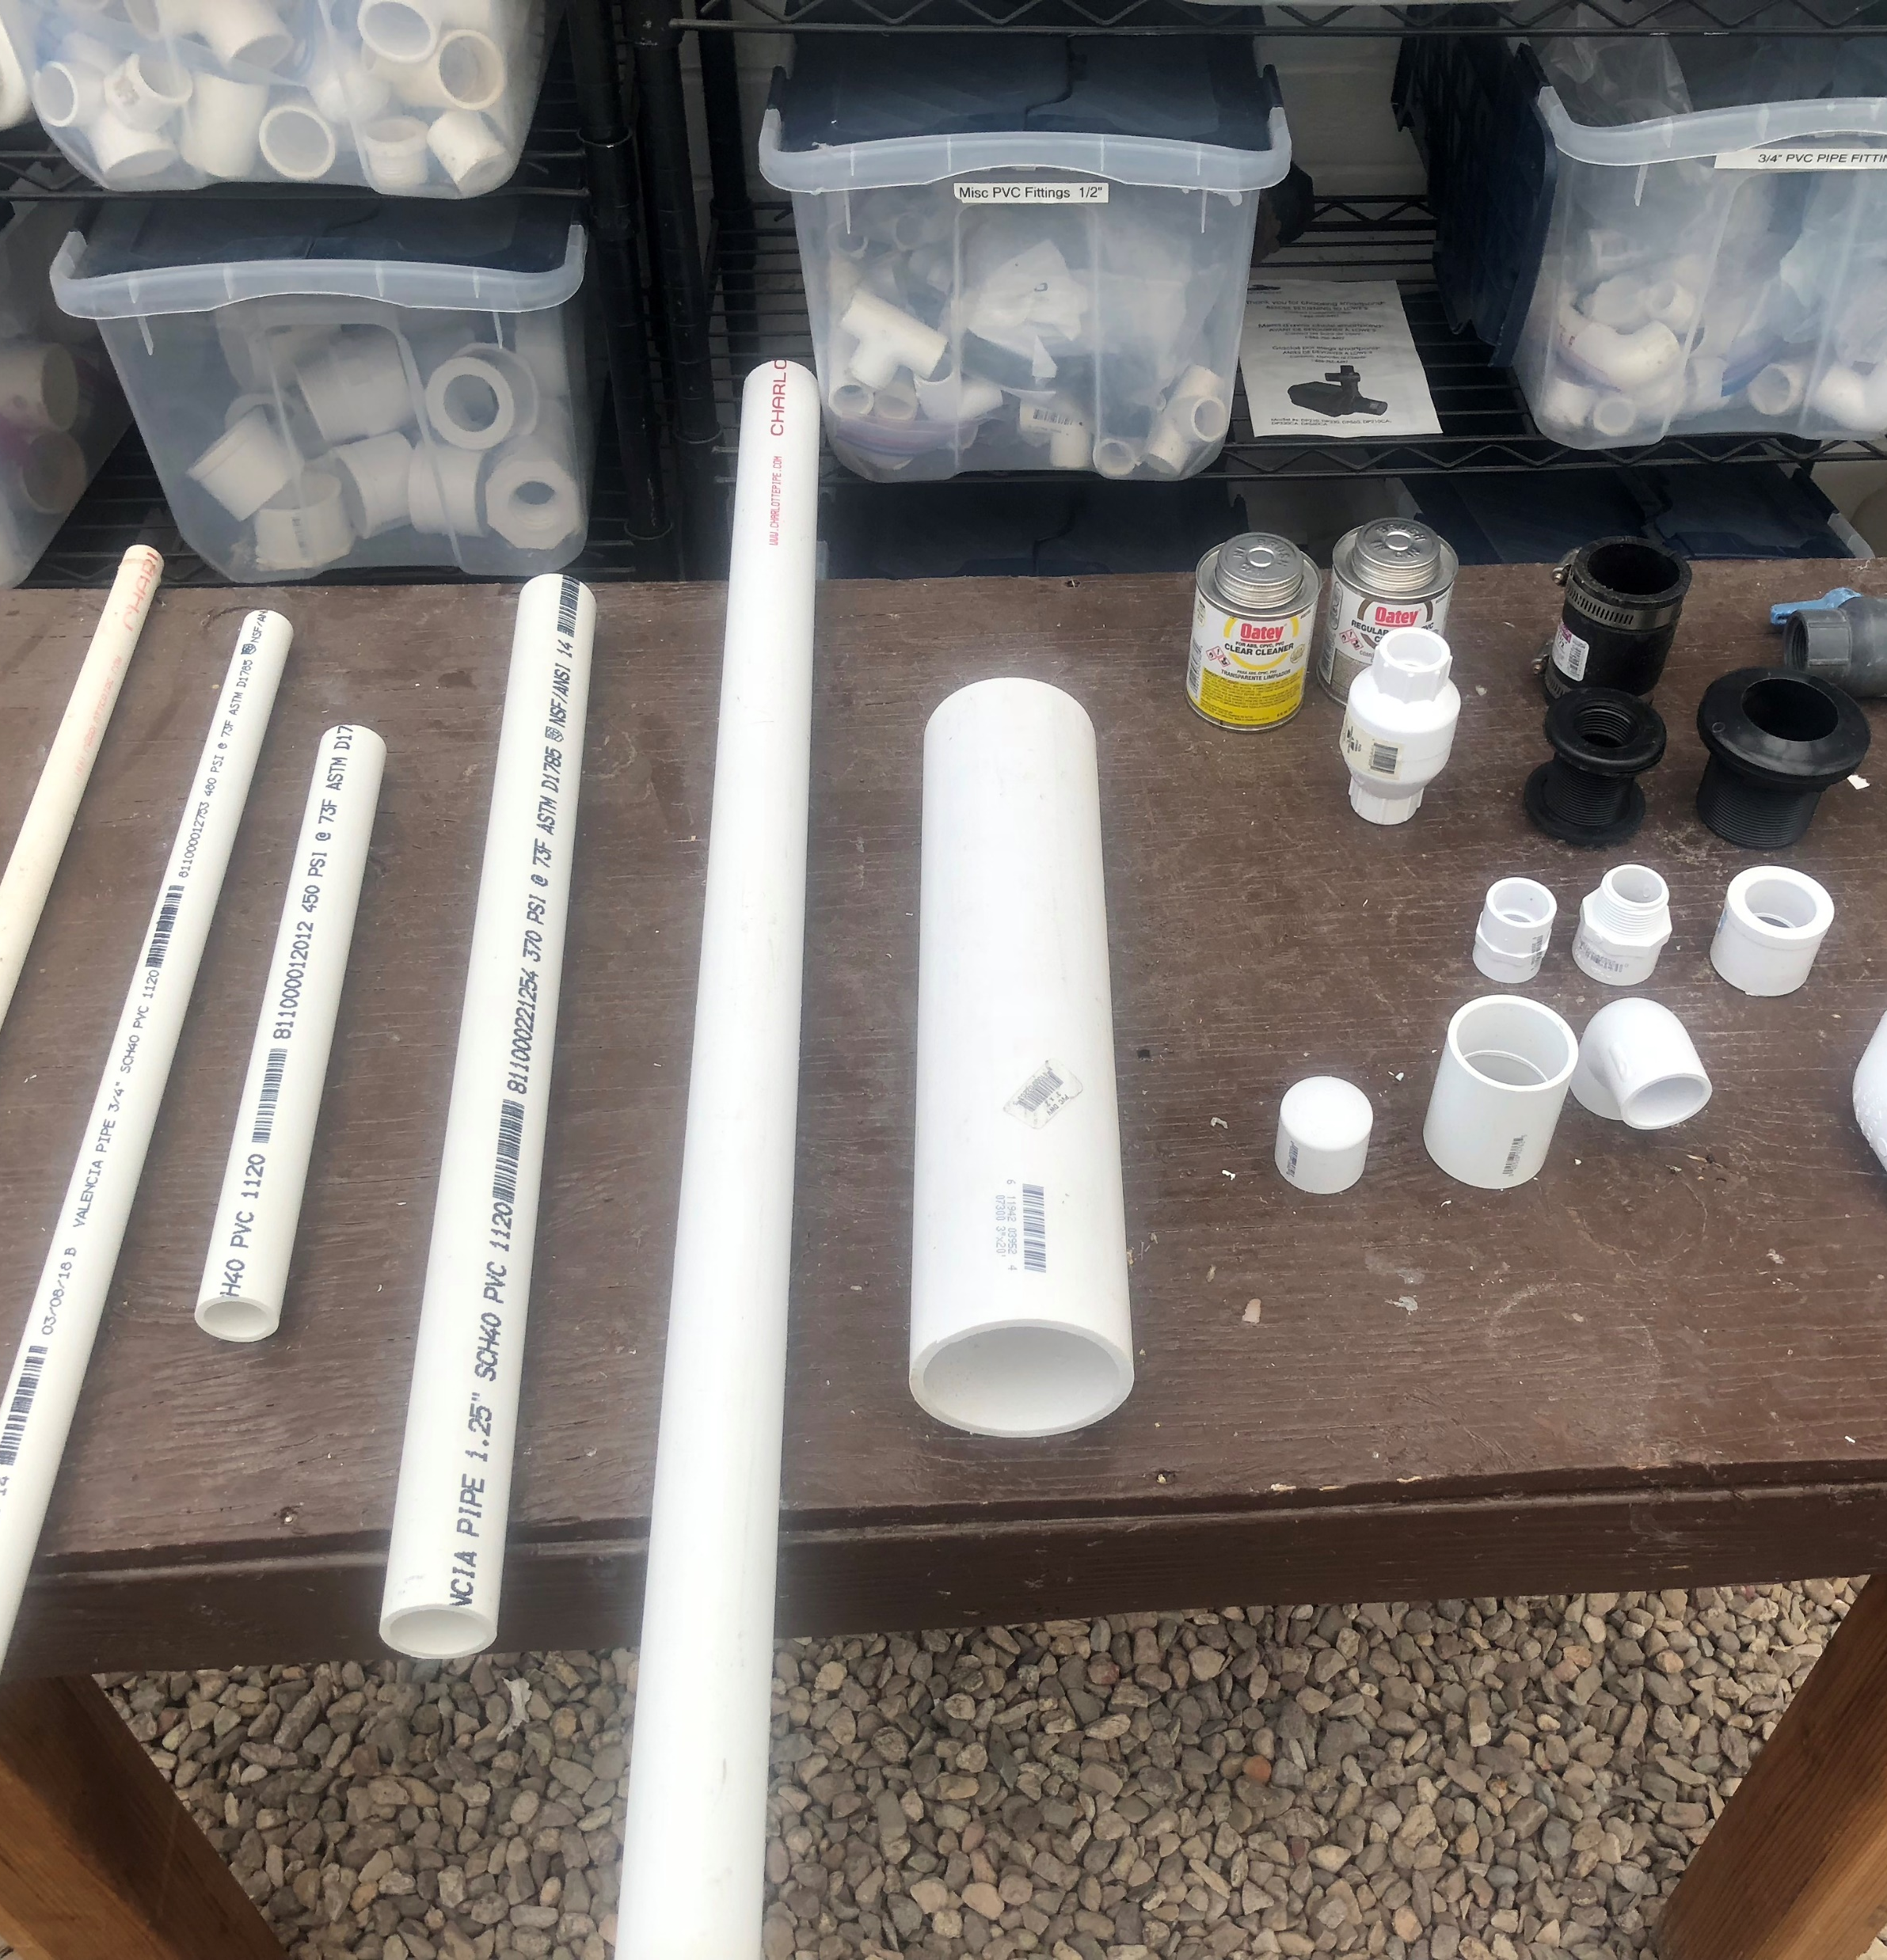
PVC Pipes and Fittings
Best to use schedule 40 PVC for piping in your system, especially for any flow that will be pressurized (from your pump)
Fittings come in all sizes and configurations so you should familiarize yourself with the different available options
Can be significantly more expensive to oversize the pipe in your system

Slide 23
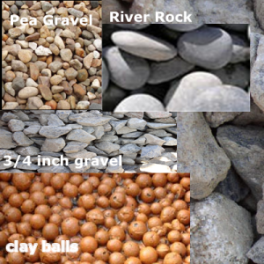
Media
Discussed earlier, but important to decide the type of media so you can determine the cost and figure out where to get it.
Determine growbed volume in square feet and convert to necessary units
Expanded clay comes in Liter bags
1 ft³ = 28.3 Liters
Largest is 50-L (~$35)
Gravel often sold by the cubic yard
27 ft³ = 1 cubic yard

Slide 24
Example: Determining Required Media Volume
Situation
Your media-bed will be 8’ x 4’ x 10” and filled with expanded clay
Expanded clay comes in bag sizes of 50-L
How many bags do you need to fill the system to 1” from the top?
Solution
The total volume of the bed = 8’ x 4’ x 9/12’ = 24 ft³
24 ft³ x 28.3 L/ft³ = 679 Liters of media needed
679 Liters/50-L bags = 13.6 ~ 14 bags!
Side note: if a bag costs $30 then it will cost $420 to fill your growbed

Slide 25
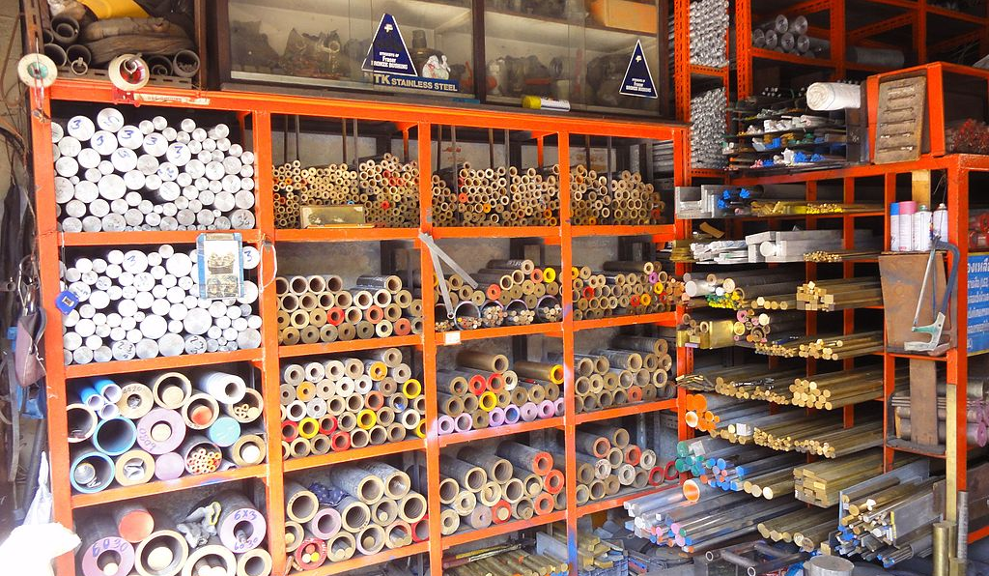
Where do you get everything from?
Hydroponics store
Home Depot/Lowe’s
Local hardware store (Basic parts)
Local garden store
Feed store
Farms
Amazon
Craigslist (tanks)
Google search

Slide 26

Remember
Size is the first most important thing when it comes to selecting Materials
The next step is choosing a material or finding the right size item that fits your budget
Search locally first then online will be your best source for finding these materials

Slide 27
GROUP ACTIVITY
Get into Groups of 3 (or Solo if you prefer)
Step 1 – Site selection (Location, space available, etc.)
Step 2 – What do you want to grow?
Step 3 – Rouch Sketch (hand drawning with components)
Step 4 – Select and price out materials from local or available sources
Step 5 – Determine rough cost estimate

