Slide 1

Plumbing Basics
©2025 Matt Recsetar

Slide 2
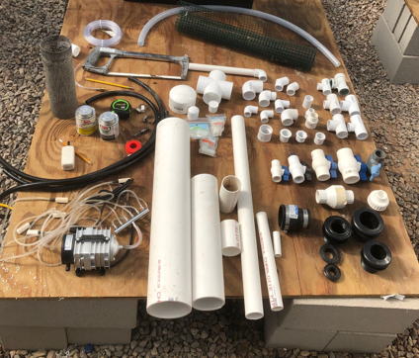
Connecting Your Components
PVC is almost exclusively used for connecting components in an aquaponics system
  Always use Schedule 40 PVC pipe and fittings
  You can get all your pipe and most basic fitting such as elbows, couplers and bushings from local hardware stores and home improvement retailers.

Slide 3
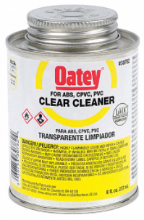
4 Tips for Connecting PVC in Aquaponics
PVC Tip #1
It isn’t necessary to use primer, use clear cleaner instead
It can also be used to revive and clean up the ends of older pipes

Slide 4
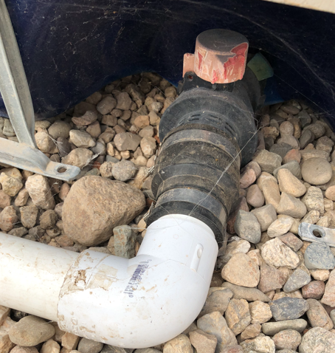
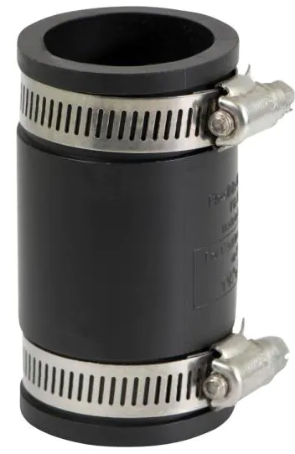
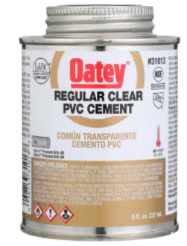
PVC Tip #2
Use PVC cement when connecting pieces that will be under pressure (pump flow)
If you don’t want to create a permanent connection, use a compression coupling
Pipes under 2” diameter do not need to be glued if it is gravity flow

Slide 5
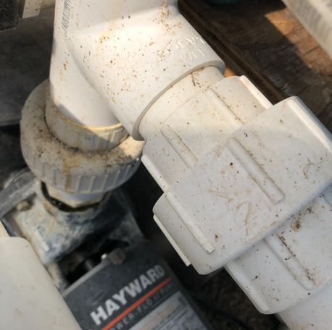
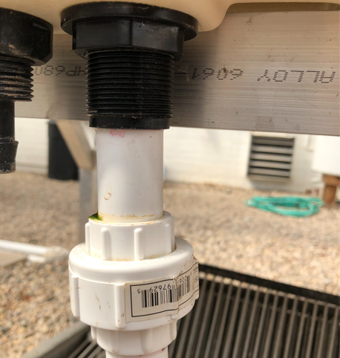
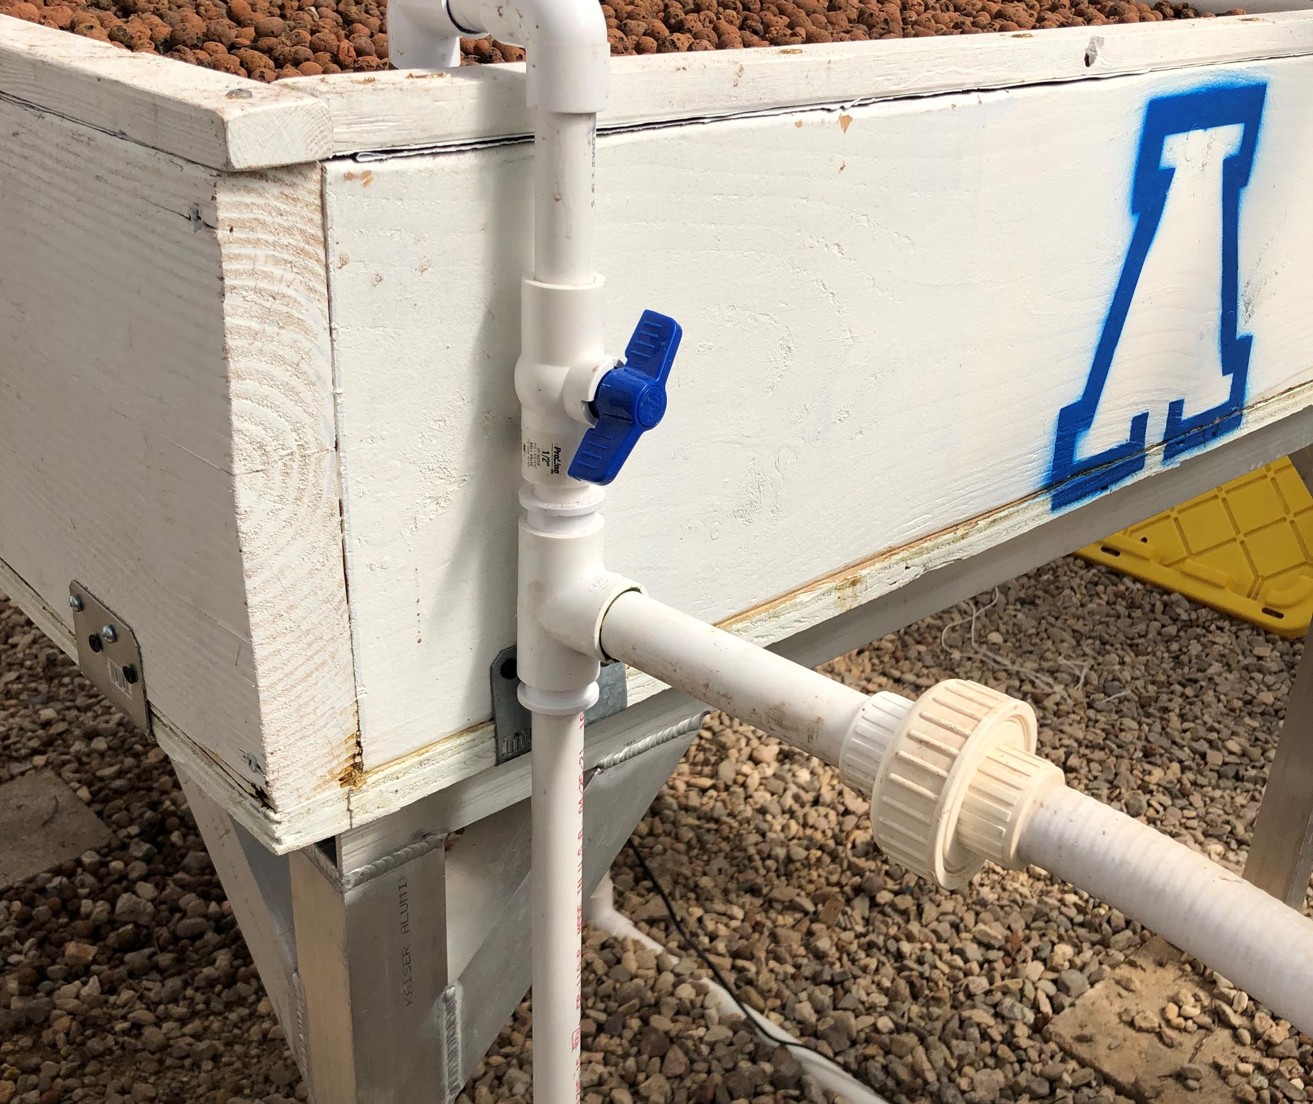
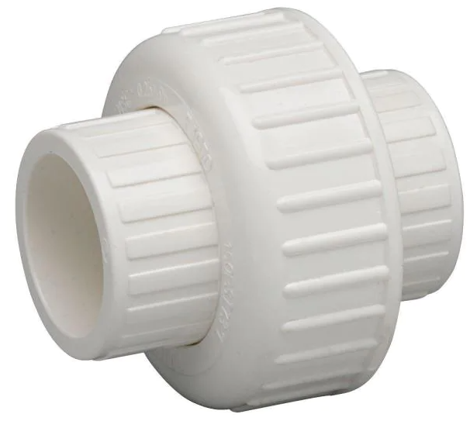
PVC Tip #3
It is recommended to have a PVC union or quick disconnect before and after components that you may need to replace or remove (i.e. pumps, filters, tanks)

Slide 6
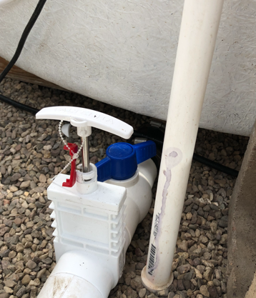
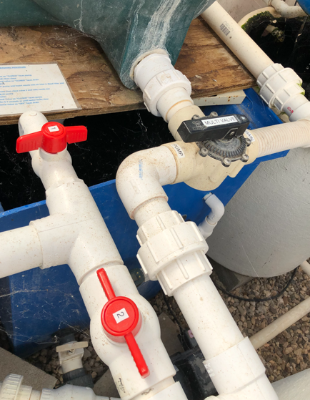
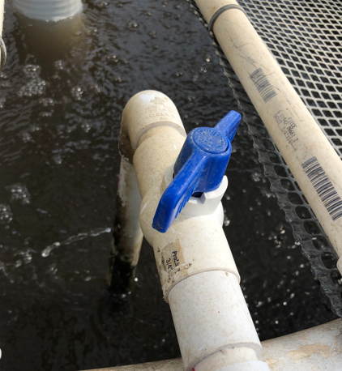
PVC Tip #4
Use a PVC ball valve or gate valve wherever you may want to stop or control flow (i.e. drains, inflows, outflows, redirections)
*Gate Valves are best to use on the ground

Slide 7
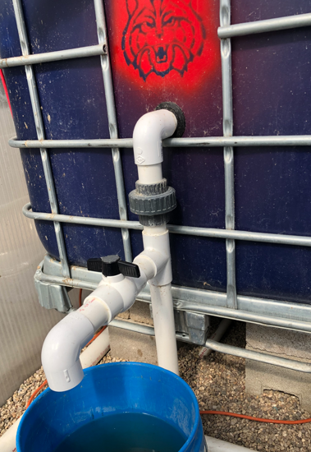
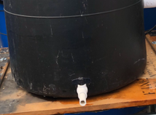
PVC Tip #5
Have a drain opening with a valve in every tank, if possible, to allow for easy draining or removal of settled solids

Slide 8
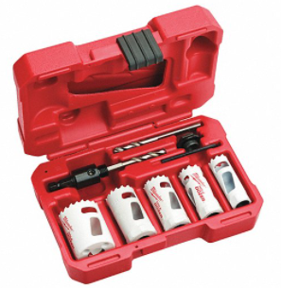
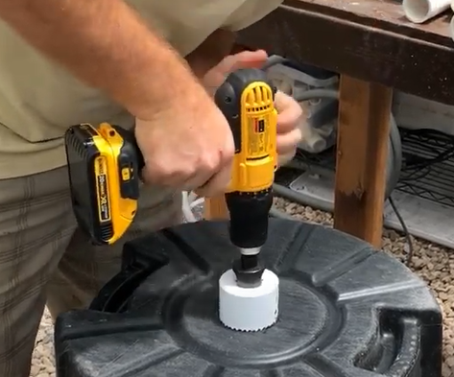
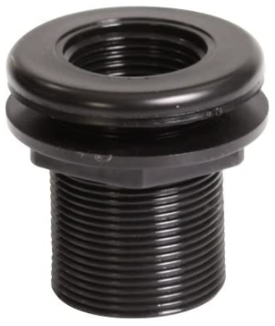
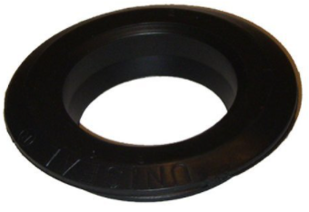
Connecting to Your Tanks
Parts needed:
Bulkhead fittings or Uniseals
Tools needed:
Drill
Hole saw

Slide 9
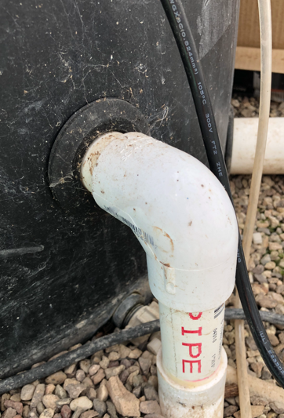
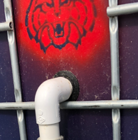
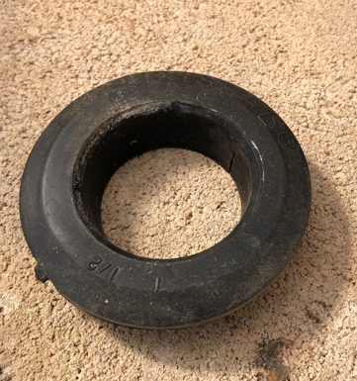
Uniseals
Cheaper than bulkheads
Flexible, so suitable for curved surfaces
  Round tanks, PVC pipe, rough surfaces
Hole must be exact or Uniseal will not work
Pipes can be difficult to insert through Uniseals and even more difficult to remove

Slide 10
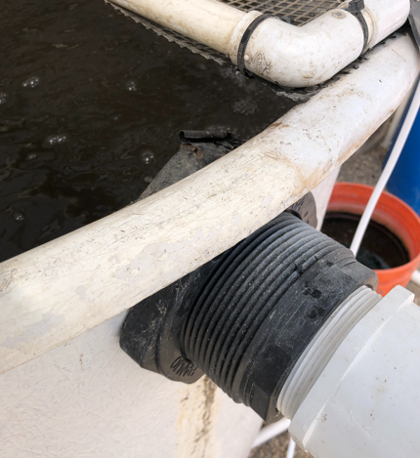
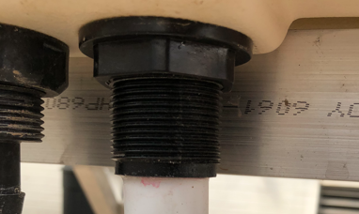
Bulkheads
Available in slip or threaded
Locknut threads onto fitting putting pressure on gasket which creates watertight seal
Best for use on tank bottoms and flat surfaces
Ok to use for irregular holes if gasket contacts tank all the way around the hole
ABS, polypropylene or Sch 80 PVC

Slide 11
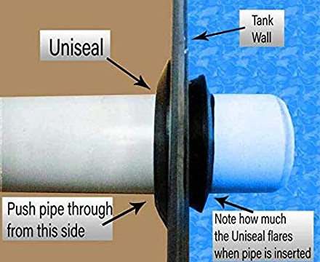
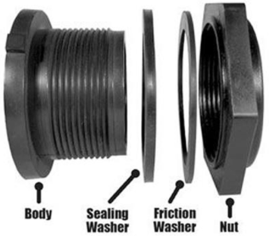
Side Views
Photo credit: aquaponicshowto.com

Slide 12
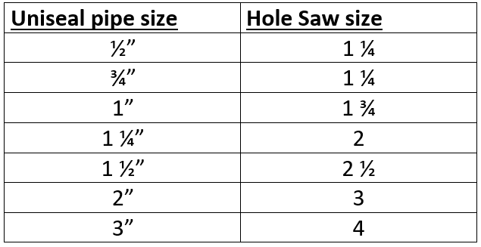

Slide 13
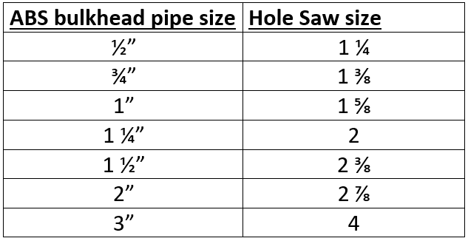

Slide 14
Plumbing Heights
Always important to measure heights of inlets and outlets in each tank
Important note: The top of the standpipe for your fish tank should be higher than the outlet of your next tank

Slide 15
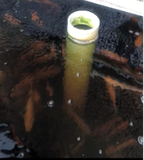
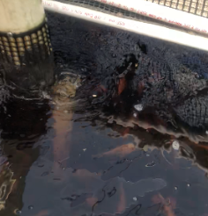
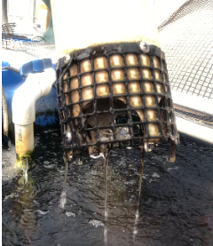
Plumbing Fish Tanks
Tanks under 300 gallons: use center drain with internal stand-pipe

Slide 16
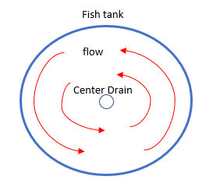
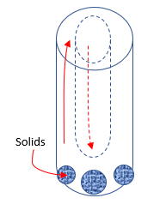
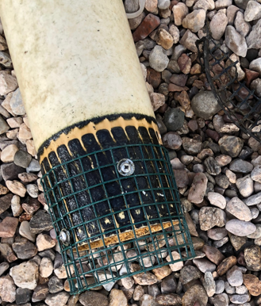
Water Flow Pattern

Slide 17
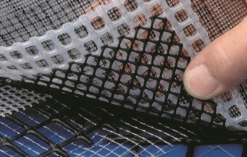
Exclusion Screens
Important to keep fish and larger particles (i.e. biofilter media) from getting into and clogging plumbing
Use screens to cover drain outlets (and inlets) as necessary as well as the tops of tanks
  Screen or mesh size should be large enough to not impede flow but small enough to contain fish and large particles
  ½” Ideal for large fish, but will need to go increasingly smaller if dealing with small fish
  1/8” mesh will contain most fry
Should be corrosion-resistant screening material such stainless steel, perforated sheets of aluminum, fiberglass or plastics
Purchase at local hardware stores or online

Slide 18
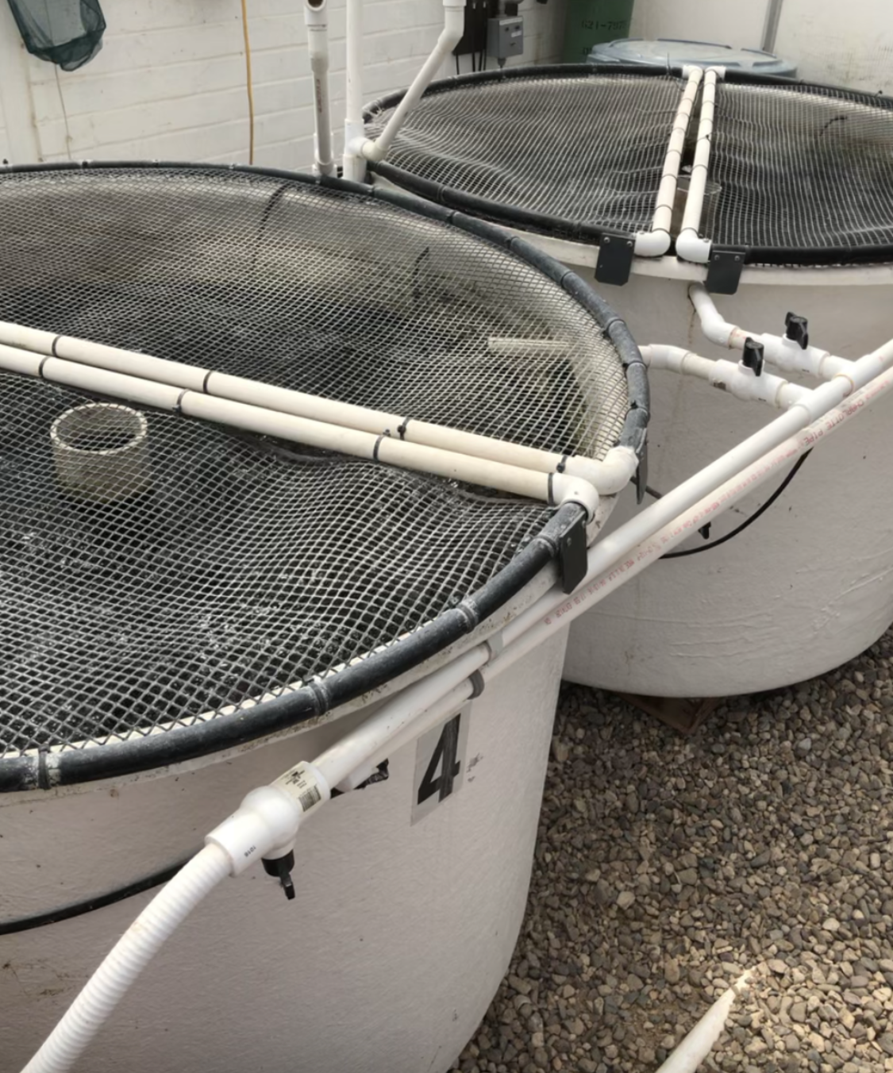
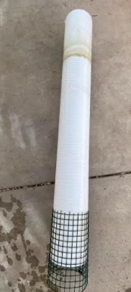
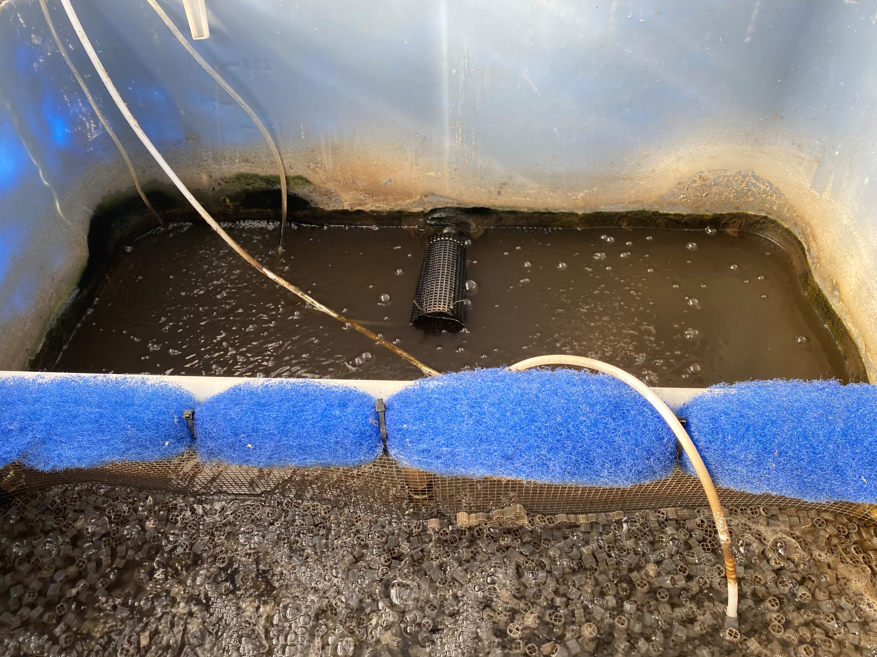
Screens are a must!
½” PVC coated wire mesh
¼’ Plastic hardware cloth
smaller than ¼” and screens start to get clogged
Tip: Zip ties are great for securing screens

