Slide 1
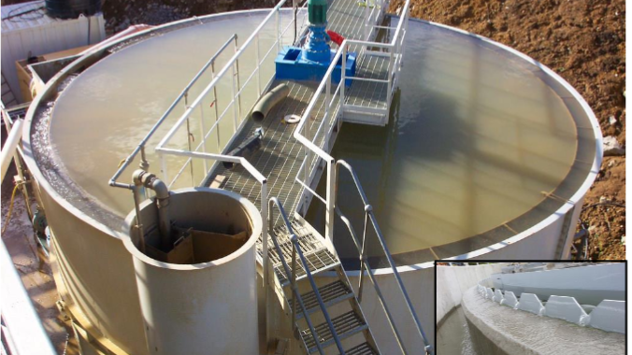
Aquaponics Filtration
©2025 Matt Recsetar

Slide 2
What is the point of filtration?
Water from the fish tanks is filtered so it can be reused
Elevated suspended solids stressful to fish
High ammonia and nitrite are toxic to fish
Fish waste that isn’t removed increases BOD in fish tanks which lowers DO and degrades water quality
Hydroponic component allows for added filtration and removal of nitrate, lowers overall water usage
BOD (Biochemical Oxygen Demand) – Amount of DO used by aerobic microbes to decompose organic matter (fish poop)

Slide 3
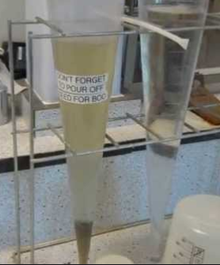
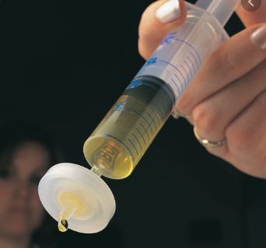
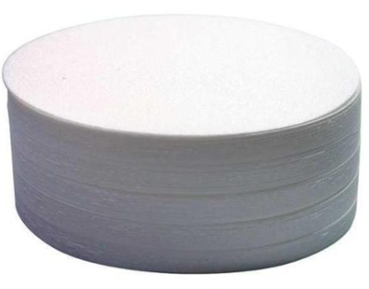
Step 1: Solids Removal
Settleable Solids
Mass of solids settled after 1 hour
Total Suspended Solids
Particles > 2 µm or more specifically
Mass of solid particles that can be removed by a GF/C Filter
Glass microfiber filter – 1.2 µm pore size
1 human cell is about 8 microns

Slide 4
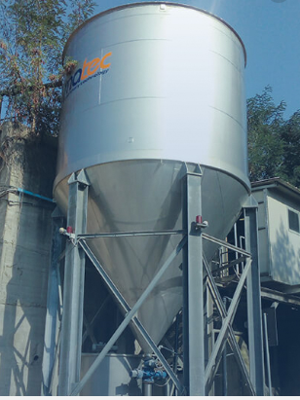
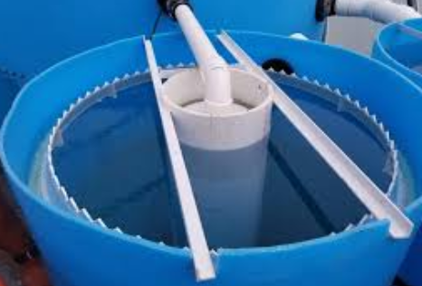
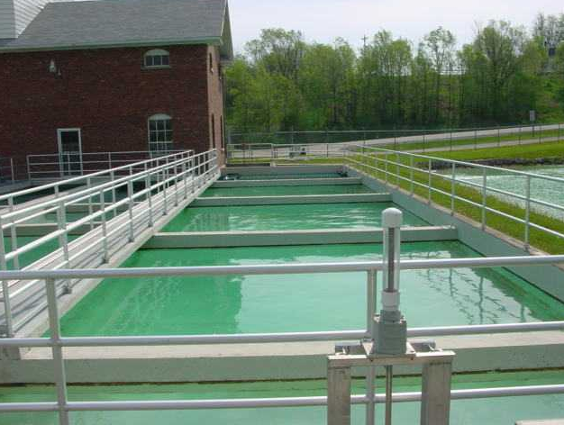
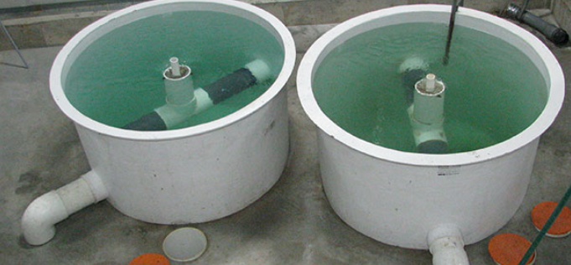
Removing Settleable Solids (Gravity)
Fish poop settles at 3.7-9.2 cm/s (1.5-3.7in/s
Settling Basins or Sedimentation Basins
Deep cone Clarifiers
Radial Flow Clarifiers
Swirl Separators
From Getchemready.com
From Aquaculture Alliance
From Dura-Tech

Slide 5
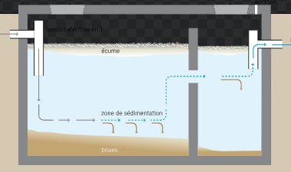
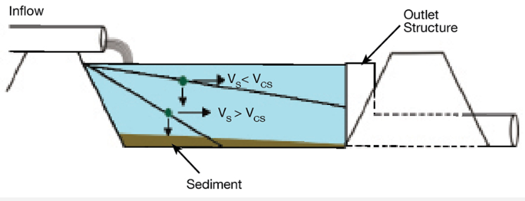
Settling Basins or Sedimentation Basins
*Septic tank

Slide 6
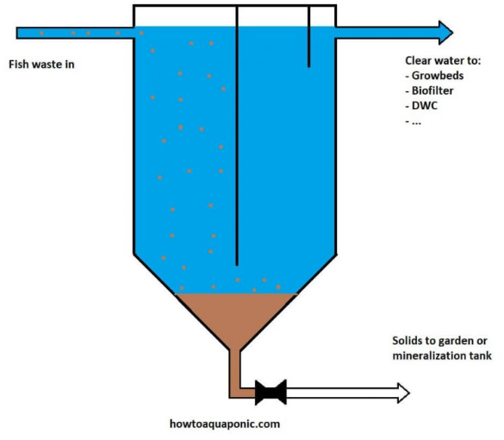
Deep Cone Clarifiers

Slide 7
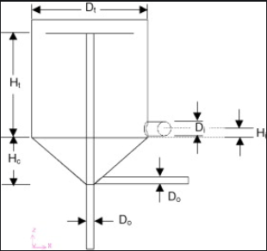
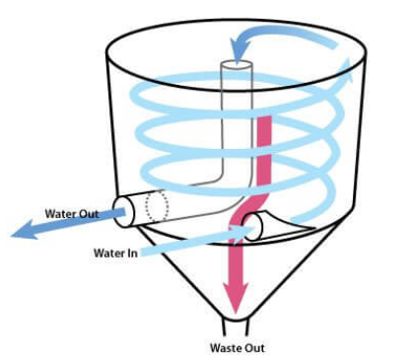
Swirl Separators
Strong horizontal mixing; Weak axial mixing
Sized based on flow rate (Q) and desired solids removal efficiency
Fairly easy to build and a lot of how to videos online. Water leaves from top of a center pipe.

Slide 8
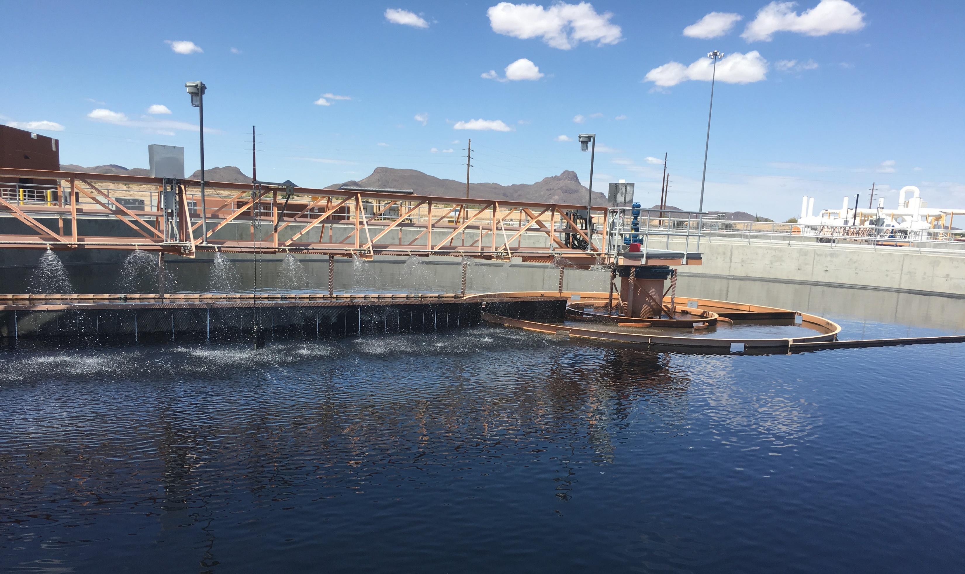
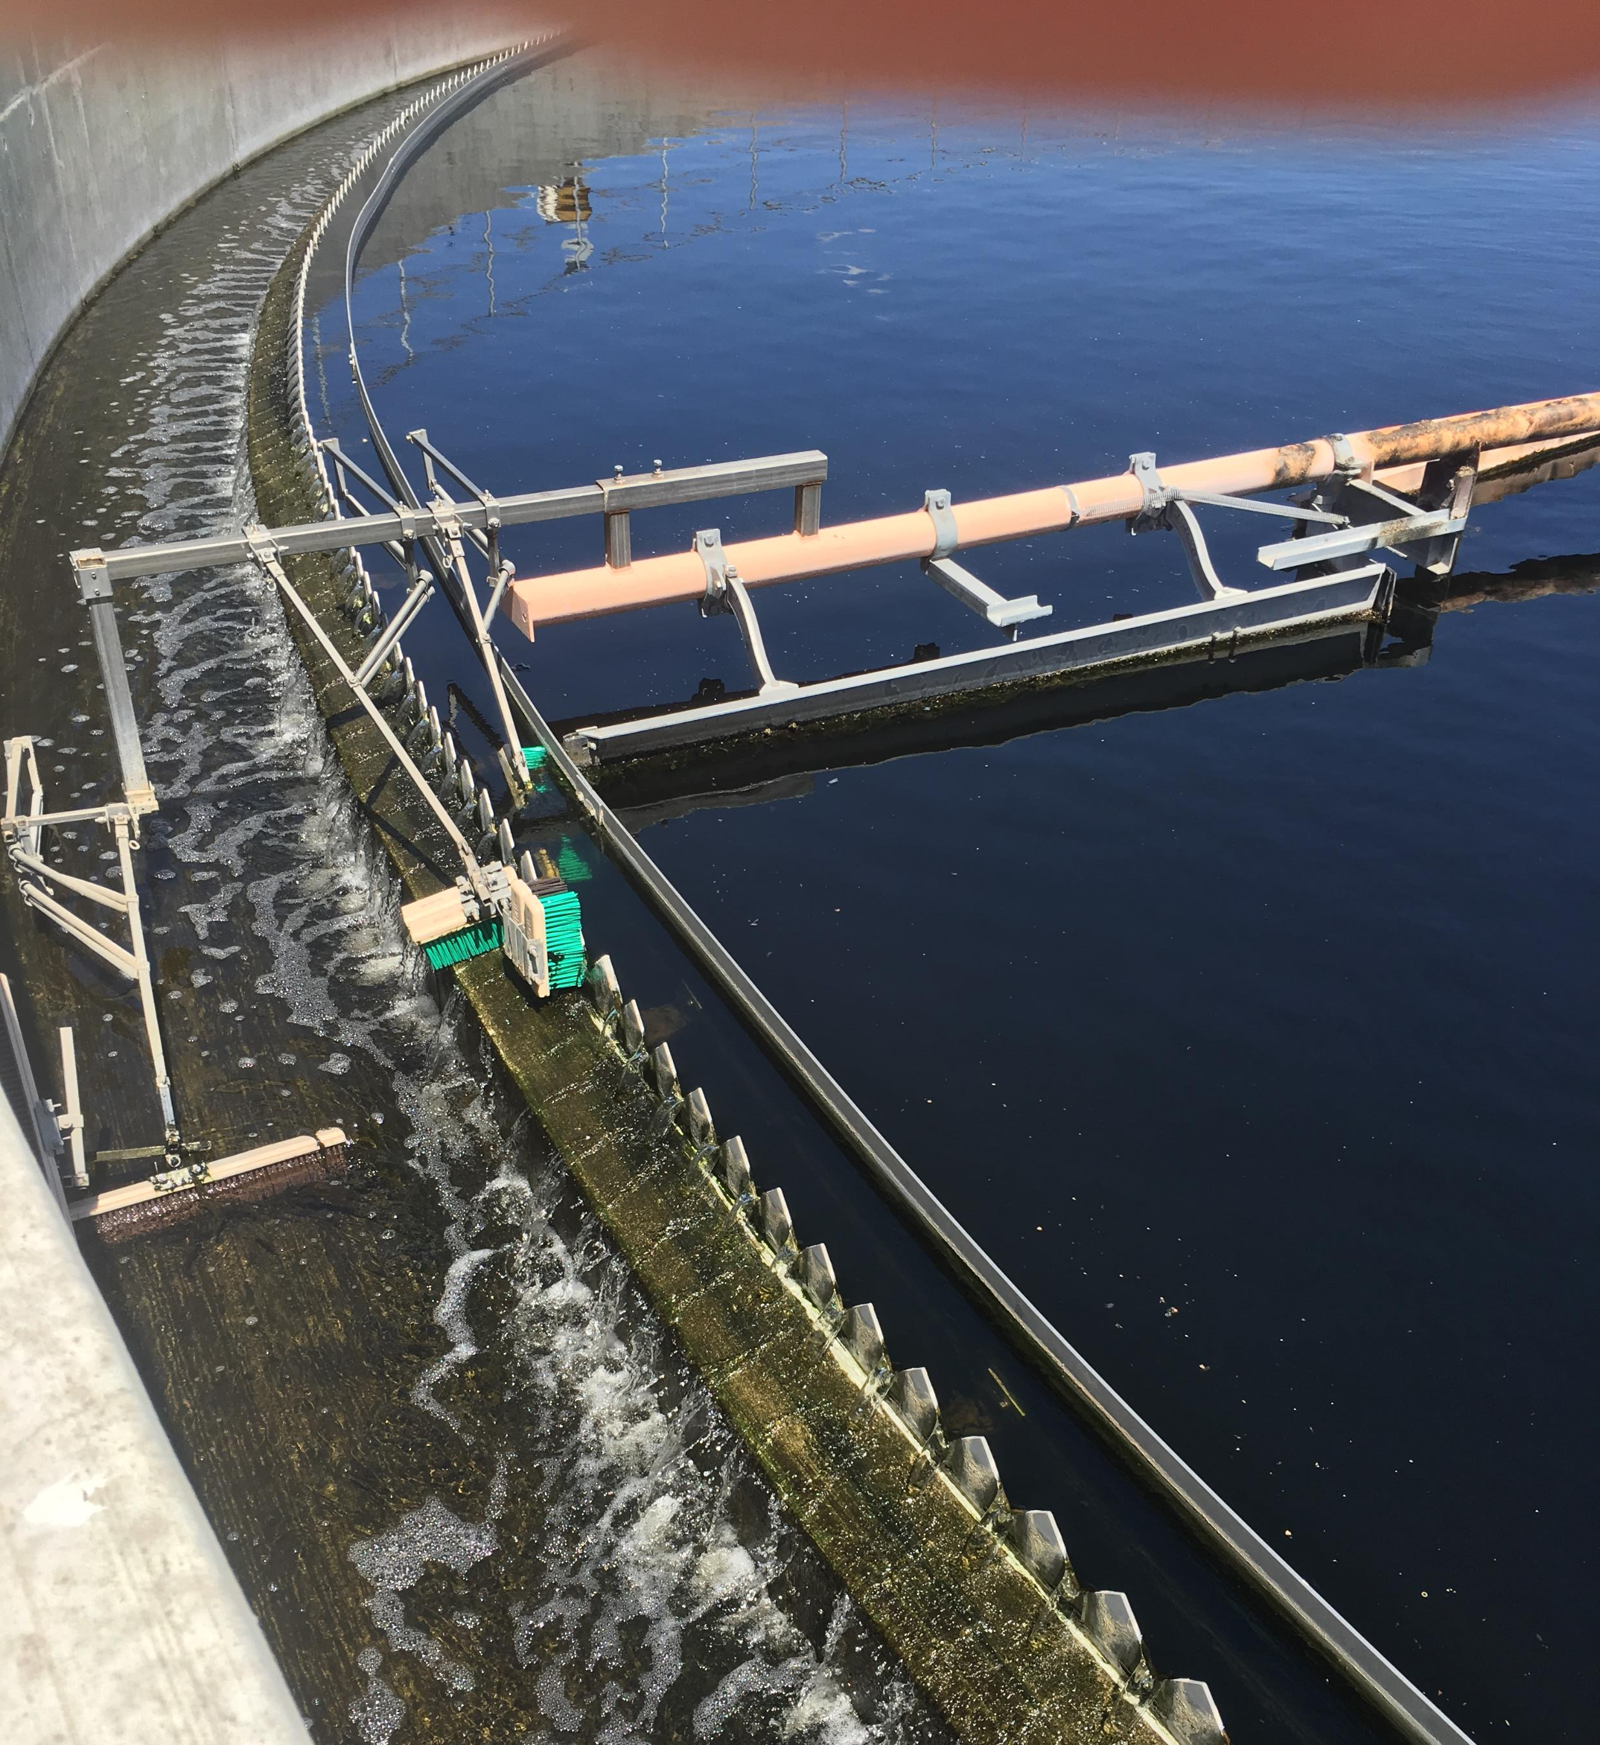
Radial Flow Settlers (Clarifiers)
Used in wastewater treatment plants
Water enters in the center of the tank and moves ‘radially’ outward
As water slowly moves towards the outer edge, solids fall to the bottom
The weir around the edge keeps floating scum from leaving the tank

Slide 9
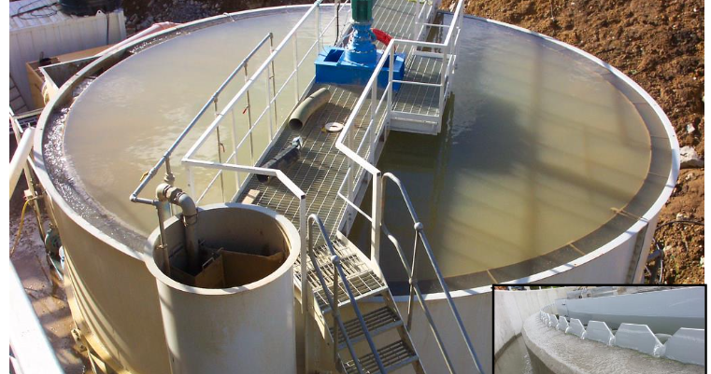

Slide 10
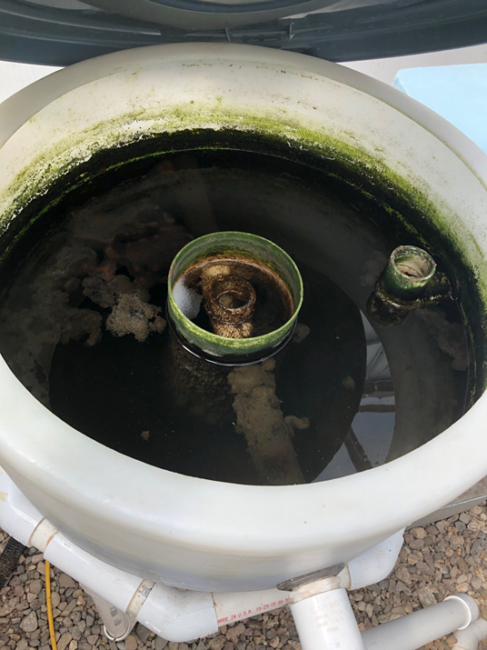
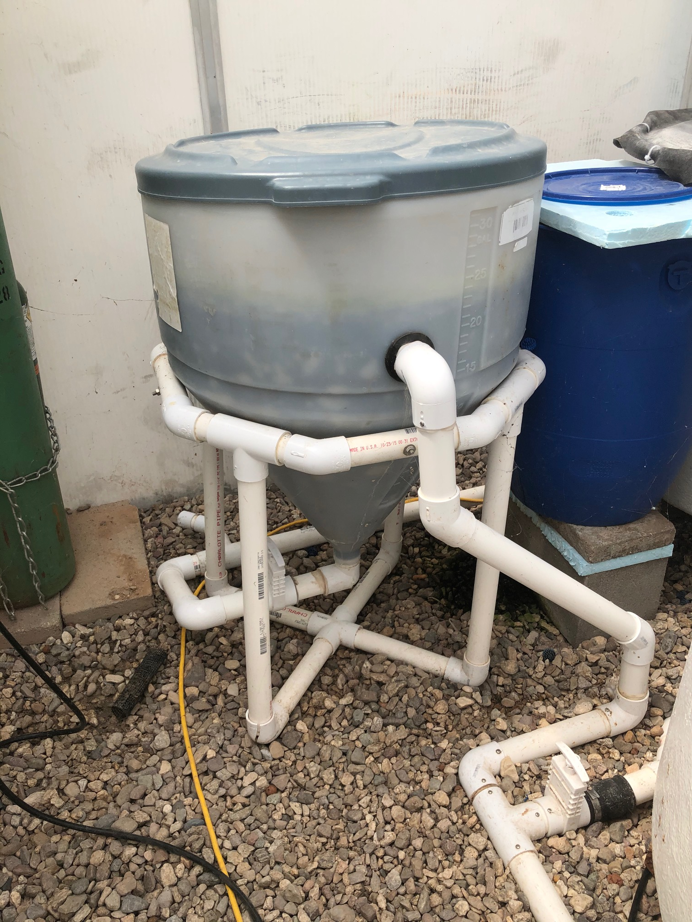
Radial Flow Clarifiers in Aquaculture

Slide 11
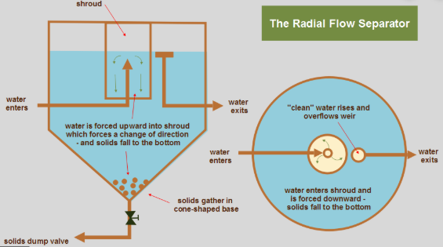
Radial Flow Settlers (clarifiers)
Can purchase conical bottom tanks online from various plastic tank suppliers
If upward water velocity is slower than 1.5 cm/s, you will get good settling

Slide 12
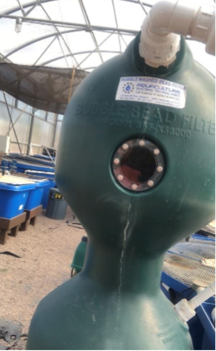
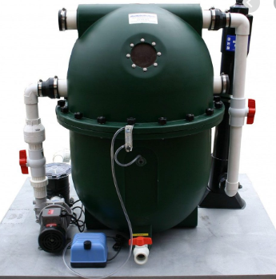
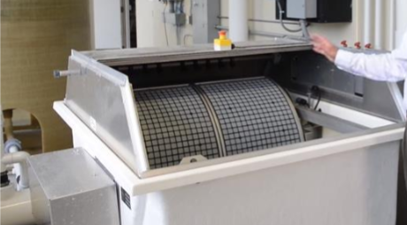
Removing TSS (total suspended solids)
Granular media filters
Bead Filters
Microscreen filters
Rotary Drum Filters
Bubble Bead Filter
Polygeyser

Slide 13
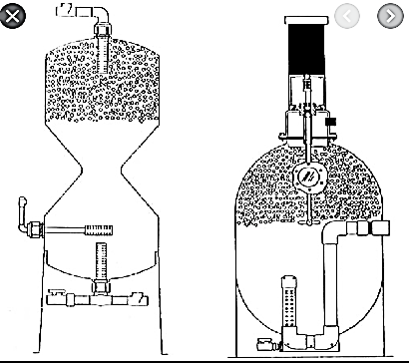
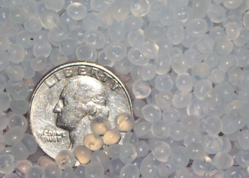
Floating Bead Filters
Best solids removal mechanism for aquaponics
Remove solids down to about 30 microns
Range from $500 ~ $4000 depending on desired capacity
Sized based on feeding capacity and flow rate

Slide 14
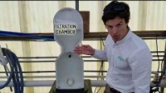
Bead filter Backwashing Video

Slide 15
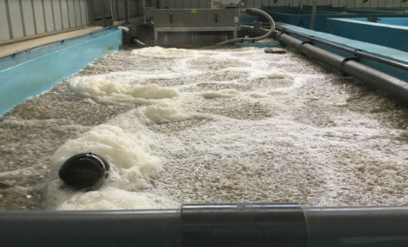
Biofilters
Capture and degrade organic compounds (fish poop)
Nitrification*
Mineralization

Slide 16
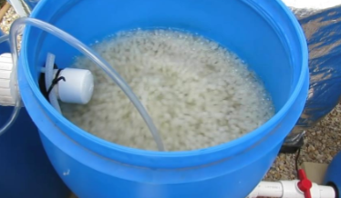
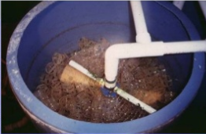
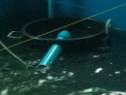
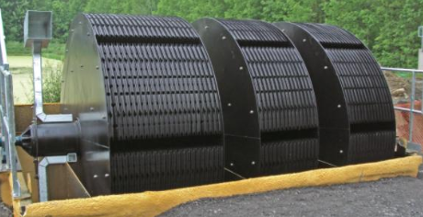
Types of Biofilters
Trickling Biofilters
Rotating Biological Contactors (RBCs)
Submerged Biofilters
Floating Bead Filters
Moving Bed Bioreactors (MBBR)

Slide 17
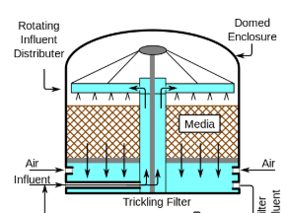
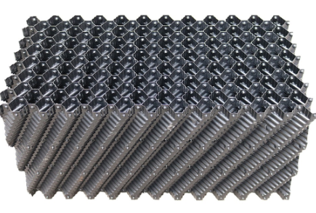
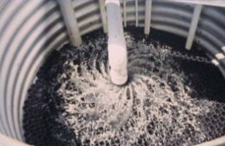
Trickling Biofilters
Fixed media bed where water flows (trickles) downward over a thin biofilm on structured or random packed biomedia
Cheap to build
100-300 m³/m²
Good aeration and CO₂ stripping (degassing)
TAN removal 0.1-0.9 g/m²
From Ebling

Slide 18
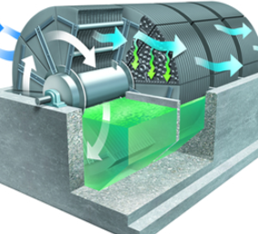
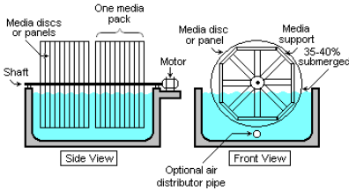
Rotating Biological Contactors (RBC)
Biodisc filter
100-300 m³/m²
Good aeration and CO₂ stripping (degassing)

Slide 19
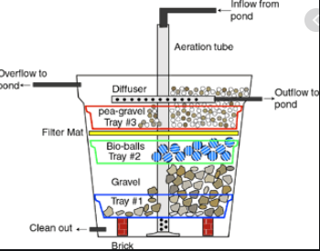
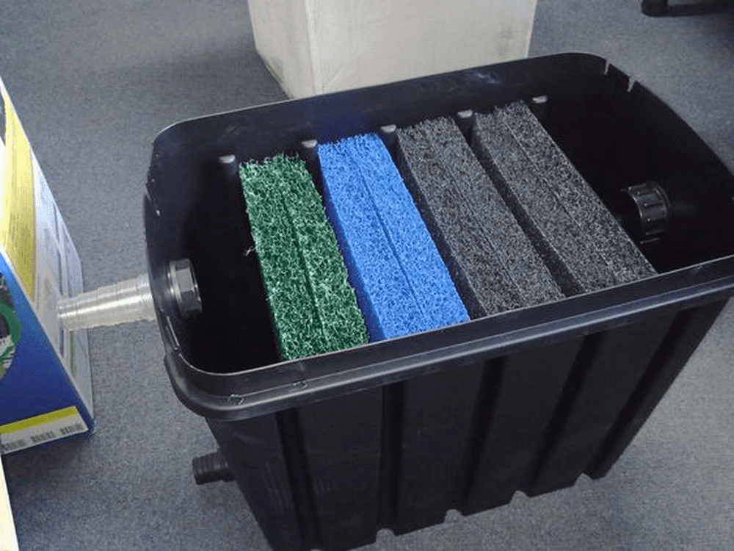

Submerged Biofilters
Upflow or downflow (or flow through)
Water flows through biomedia (Gravel, shells, plastic)
Simple and relatively cheap to build
Beneficial for trapping specific contaminants
Can be a good filter for fine solids if needed
Will require maintenance

Slide 20
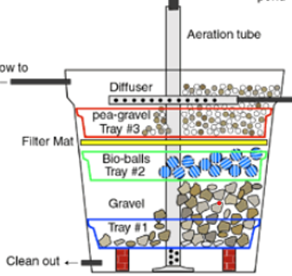
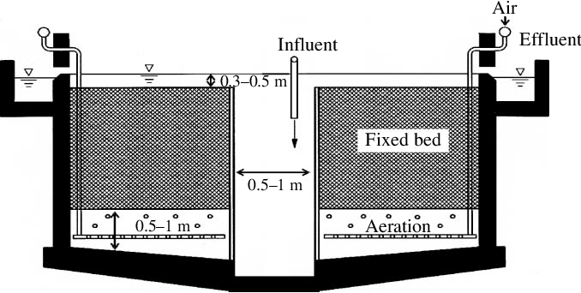
Downflow Biofilters
Upflow Biofilters
Typically run on an airlift (or pump)
Water is pushed out from the bottom of the filter causing water to flow down through the biofilter
Typically run with gravity
Water enters via gravity from above and is inserted at bottom of biofilter and thus pushes water up through biofilter and over its edges

Slide 21
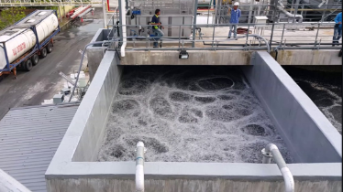
Moving Bed Biofilm Reactors (MBBR)
Media is kept moving in tank to maximize biofilm use of surface area and maximize scrubbing
Agitators and aeration
Media should occupy 50-70% of container volume
Most common*

Slide 22
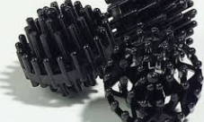
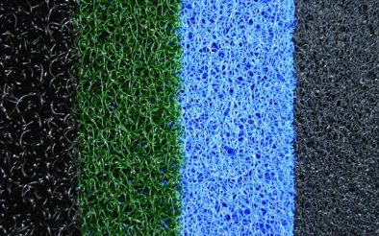
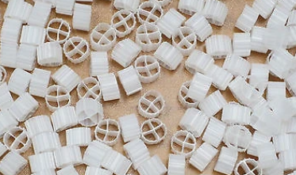
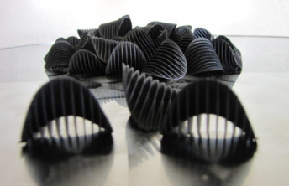
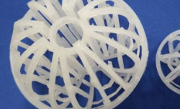
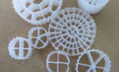
Biofilter Media
Specific surface area – Surface area per unit volume
More surface area = more room for bacterial growth
Types
Bioballs
Kaldness Biofilter media
Saddle Chips
Crushed oyster or clam shells
Gravel
LECA
Order on Amazon or other online retailers

Slide 23
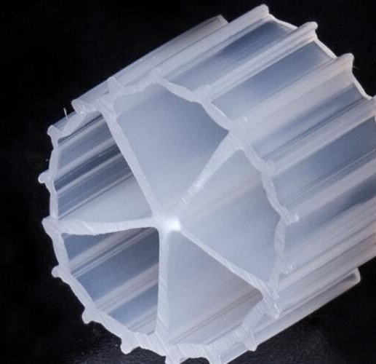
Effective Surface Area
Total surface area available for filtration
Available for bacterial growth
For nitrifying bacteria
Measured in m²/m³ (SA/Volume of media)
Used to determine filter size and amount of biofilter media needed
Not typically standardized

Slide 24
Nitrification
NH₄⁺ + 2O₂ NO₃⁻ +2H⁺ + H₂O
Water quality standards
TAN – Total Ammonia Nitrogen (NH₃/NH₄⁺)
<3.0 mg/L for warm-water fish <1.0 mg/L for cold-water fish
Nitrosomonas bacteria
Nitrite (NO₂)
<1.0 mg/L unless soft water (should be <0.1 mg/L)
Nitrobacter bacteria
NH₄⁺ + 1.5O₂ NO₂⁻ +2H⁺ + H₂O
Important note: For every gram of NH₄⁺ converted, 4.57 g of O₂ is used
NO₂⁻ + 0.5O₂ NO₃⁻

Slide 25
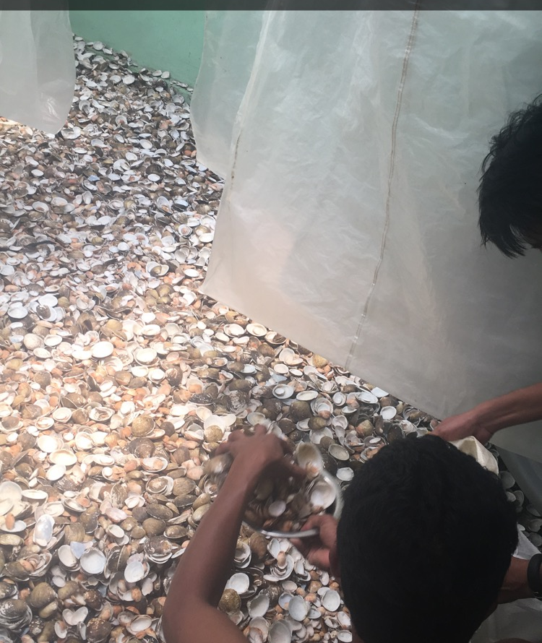
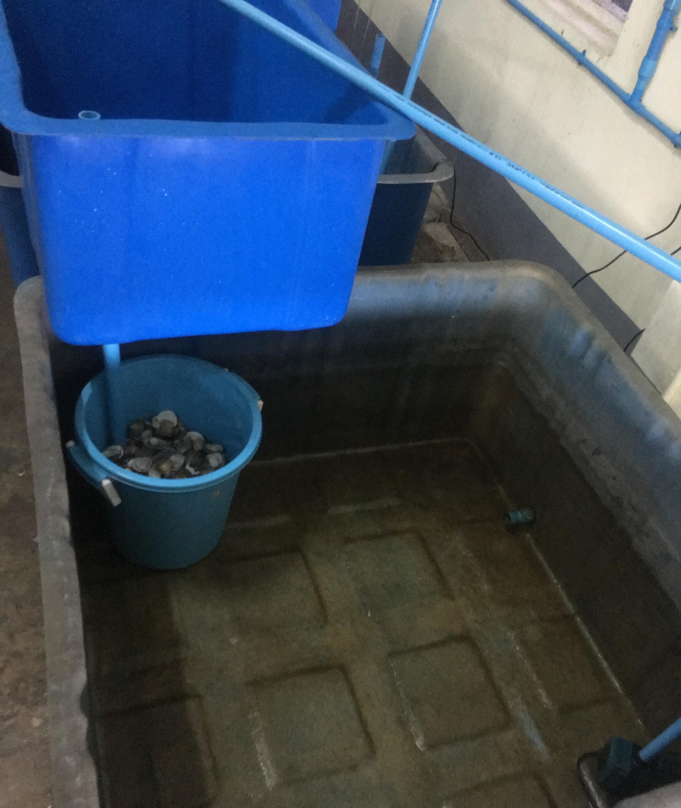
Sizing Biofilter for Nitrogen (TAN removal)
TAN = (0.092 *% Protein in feed) x Feed per day (g)
Estimated removal is 0.45 g TAN/m² day

Slide 26
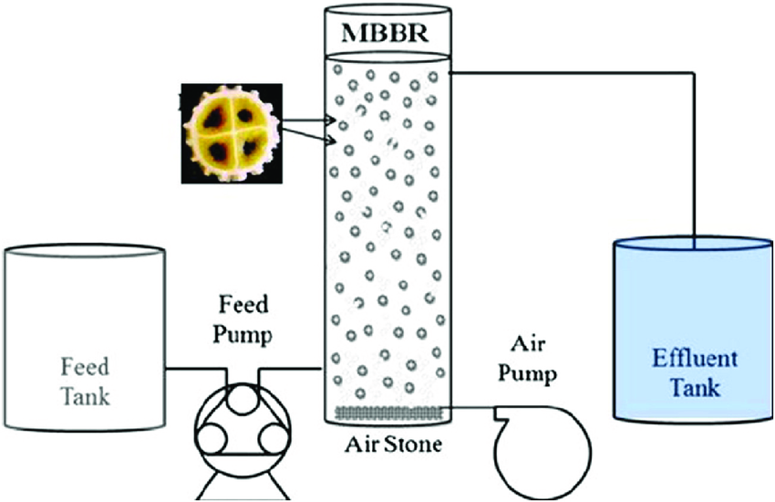

Problem: Sizing Filter
What size MBBR biofilter do you need for growing 100 lb. of fish?
Assume 30% protein feed; 2% daily feeding rate, Biomedia Effective Surface Area: 250 m²/m³
Also assume areal tan removal (ATR) is 0.45 g TAN/m² day
Step 1) $TAN=0.092 \left(\% Protein in feed\right)∗feed/day$
(2% of 100 lb. = 2 lb. ~1 kg)
$TAN=0.092 \left(0.30\right)∗1kg feed/day$ = 0.0276 ~ 0.03 kg TAN/day
Step 2) 30 g TAN / 0.45 g TAN/ m² day = 66.7 m² of surface area required
Step 3) 66.7 m² / 250 m²/m³ = 0.27 m³ of biomedia needed
Step 4) 0.27 m³ / 50% of container volume = 0.54 m³ (required volume)
*Biofilter container should be ~140 gallons

Slide 27


Filtration Review
Solids Filters
Remove TSS
Goal should be removal of >70% of solids if commercial system
especially large and coarse solids
Help prevent biofilter overload and maintain water quality
Biofilters
Convert ammonia (excreted by fish) to nitrate
Rely on adequate oxygen (aeration) and adequate surface area

