Slide 1
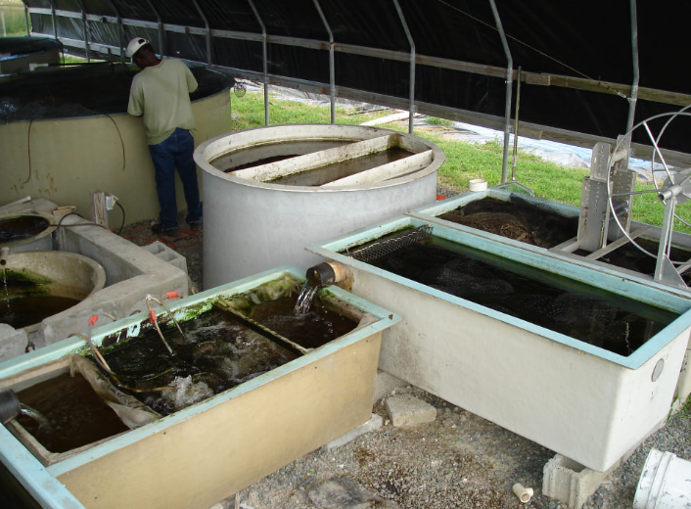
Tanks and Pumps
Fish Tank
Clarifier Tank
Sump Tank
Filter Tank
© 2025 Matthew Recsetar
Degassing Tank

Slide 2
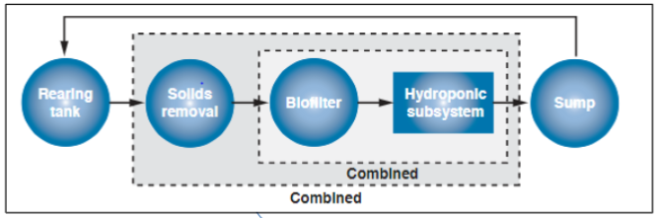
First Step – Decide on Tanks
(Some Media Bed Systems)
1
3
2

Slide 3
First Step – Decide on Tanks
(Media Bed Systems)
1
4
2
3

Slide 4
First Step – Decide on Tanks
(All Systems)
1
5
2
3
4

Slide 5
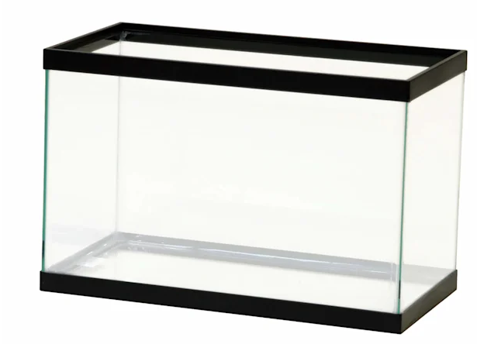
Choosing a Fish Tank
If you don’t already have other components – this is best place to start
Many different sizes, shapes and types
Round is generally better (especially for tanks over 300 gallons)
Size will be based on your needs or situation
Options on tank material based on budget and availability
Must be inert, food safe and durable

Slide 6
Choosing a Fish Tank
If you don’t already have other components – this is best place to start
Many different sizes, shapes and types
Round is generally better (for tanks over 300 gallons)
Better for flow and solids removal
Size will be based on your needs or situation
Options on tank material based on budget and availability
Must be inert, food safe and durable
Glass Aquariums

Slide 7
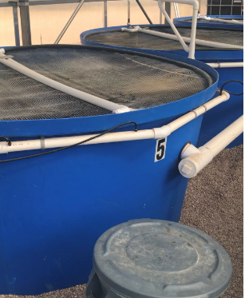
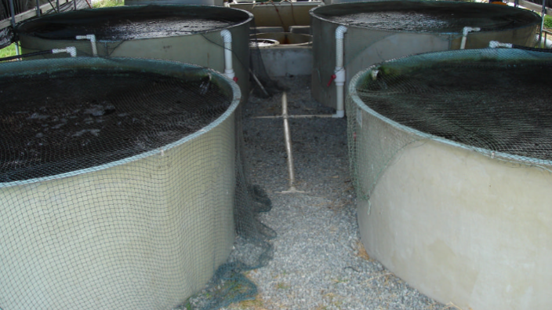
Fish Tanks Types
Polyethylene [HDPE] (ie. Polytanks, Rubbermaid Stock tanks)
Lightweight, strong, UV-protected
Polypropylene
High heat tolerance, chemical resistant, more rigid
Fiberglass
High impact strength, expensive, long-lasting, cracks repairable
Concrete
Expensive, long-lasting, can crack over time

Slide 8
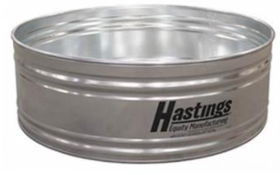
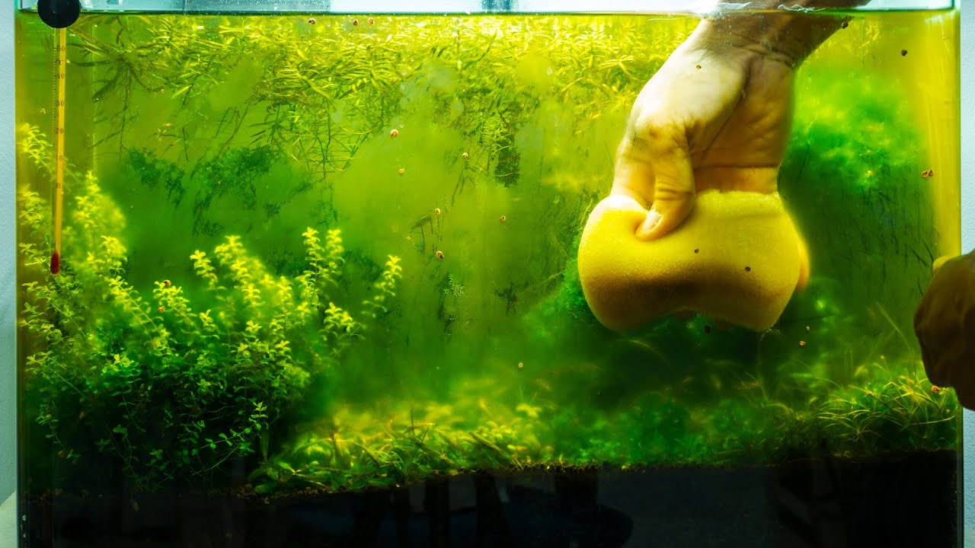
Other Suitable Tank Materials
Stainless Steel
Only safe metal for fish tanks
Heavy but durable and long-lasting
Acrylic
Commonly used in display tanks and large aquariums
Suitable for indoor use
Regular algal removal required

Slide 9
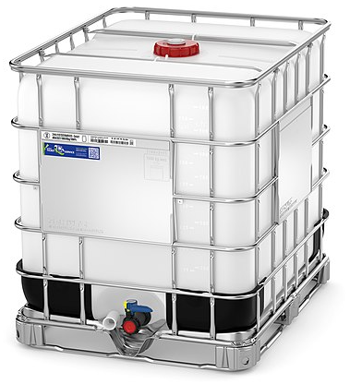
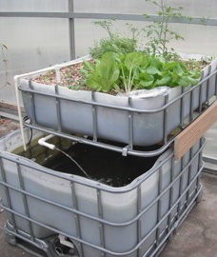
IBC Totes (HDPE)
275-gal or 330-gal sizes available
Generally, can acquire one for <$125 (USD)
Buying used will save money and is perfectly okay if it was used for a food-grade material (i.e. bleach, hydrogen peroxide, etc.)
Can cut top off with reciprocating saw (leave in cage or sides will bow!)
*Best to paint the tank black or dark blue to limit algal growth

Slide 10
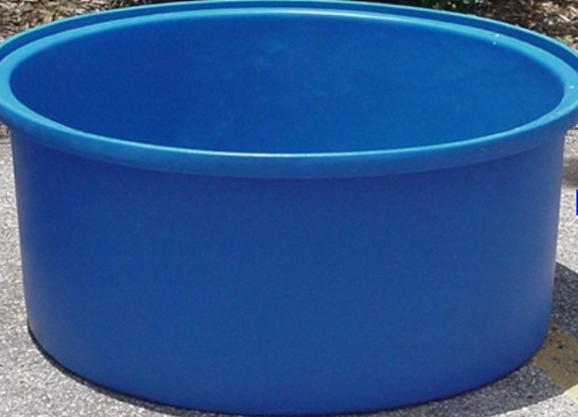
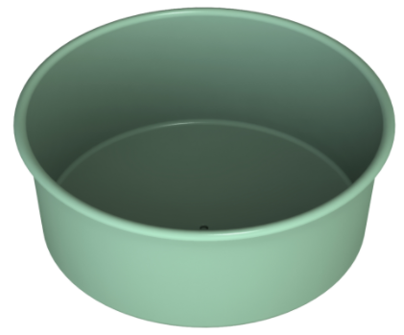
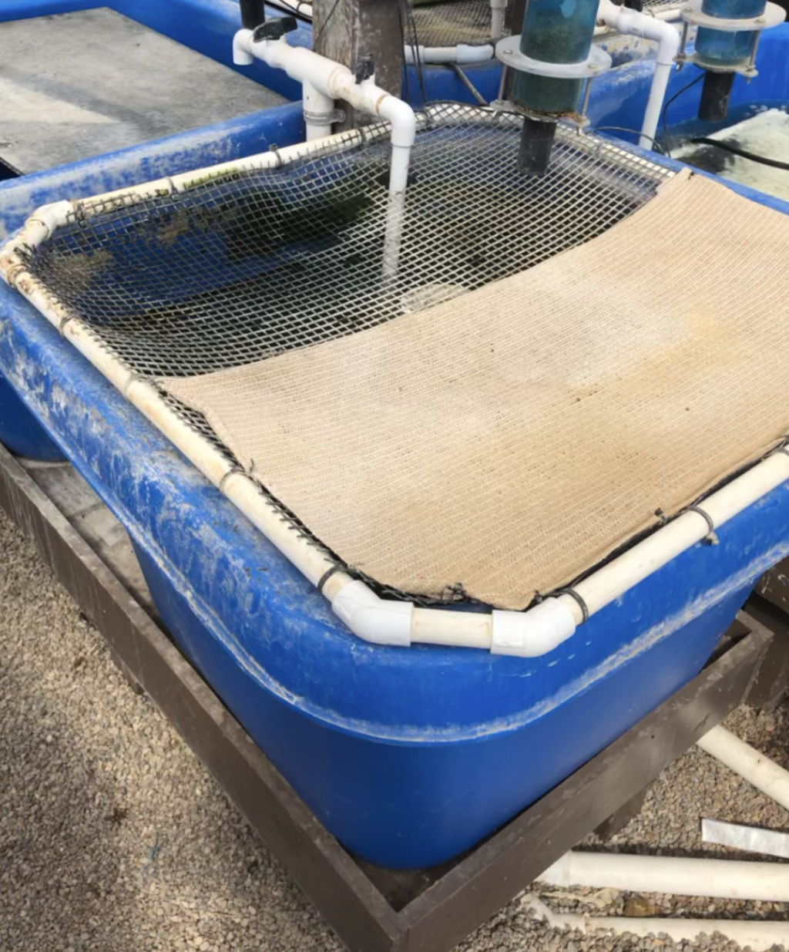
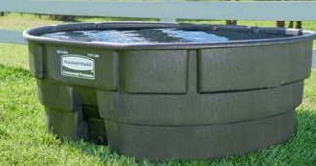
High Density Polyethylene (HDPE)
Now also have LLDPE and LMDPE tanks
Many different sizes as well as a few colors available
Some are already prefabricated with built in drains
Easy to drill holes for plumbing with a hole saw (difficult to patch)
Best to go with diameter greater than depth
Better for solids removal, flow, harvesting and aeration
For tanks over 1000 gallons, 3:1 ratio of diameter to depth is ideal up to 6:1 for larger commercial tanks
Examples:
PolyTanks (Polytankco.com, Pentairaes.com,
Tankandbarrell.com, Fishfarmsupply.ca, globalaquaculturesupply.com)
Stock Tanks (Tractor Supply, Local Feed stores, etc)
*Check the internet for suppliers in your area

Slide 11
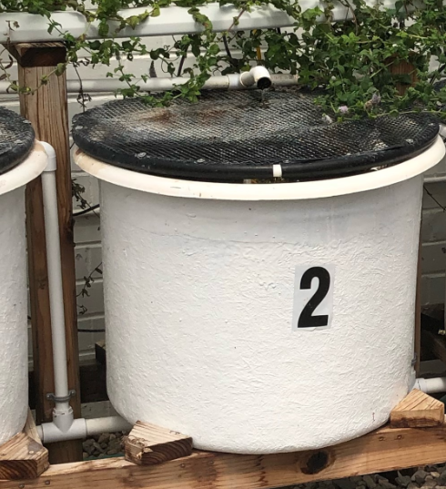
Fiberglass
Last for over 40 years and can be repaired easily when needed.
More common than plastic tanks in many parts of the world.
Prices also highly variable based on location
Can cut holes for plumbing with a hole saw
Holes are repairable with a patch kit

Slide 12
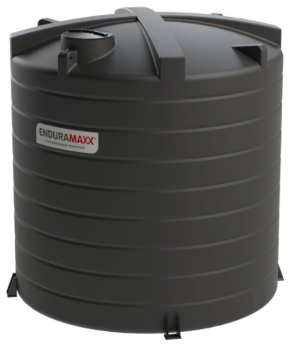
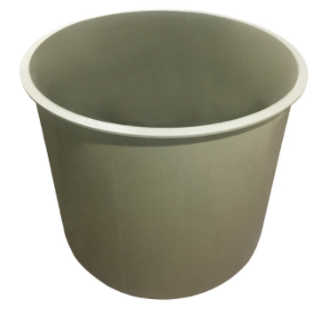
Polypropylene
Much less common than HDPE tanks
Slightly more flexible than HDPE

Slide 13
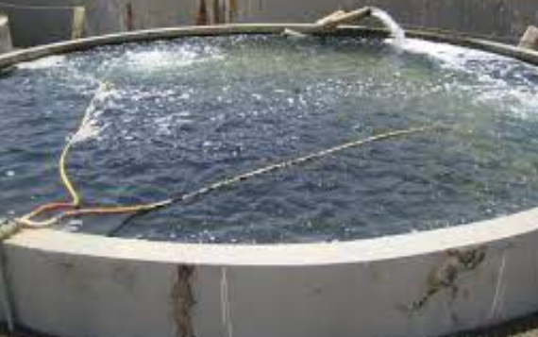
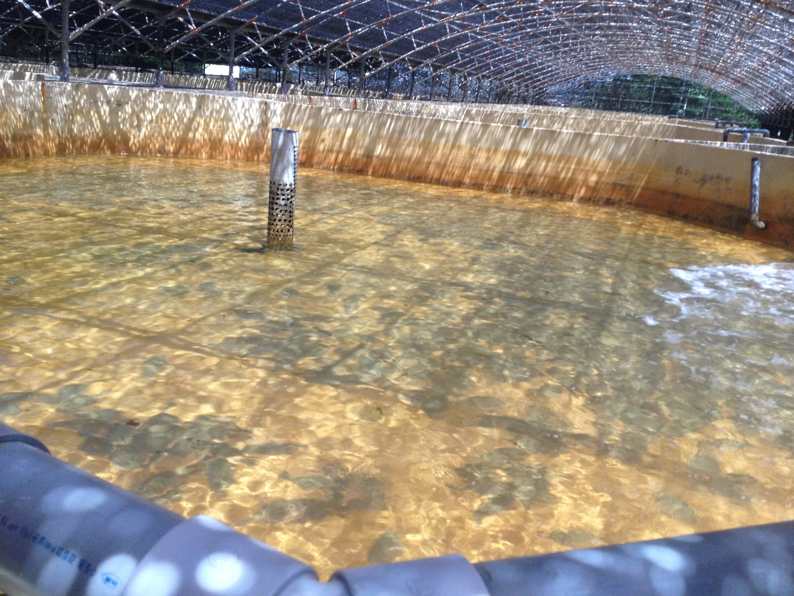
Concrete
Only used in large commercial operations
Walls need to be sealed to insure longevity
Can be very expensive

Slide 14
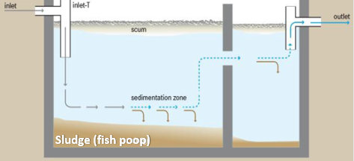
Characteristics of a Solids Removal Tank
Solids will settle to bottom of tank via gravity given enough time
No aeration or turbulent flow to keep settleable solids suspended
Usually made of Fiberglass or Polyethylene
Often have baffles to direct flow and stop flow of solids
Need to be able to drain frequently to prevent anaerobic conditions
Septic Tank (example)
Gravity
Note: Do not use a septic tank in your aquaponics system

Slide 15
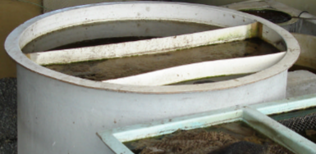
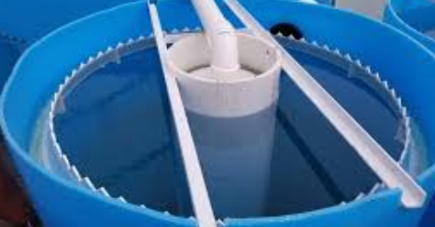
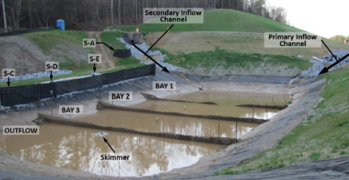
Choosing a Solids Removal Tank
Various types of clarifiers or settling basins to choose from
Round or rectangular
Round - inlet in center and flow outwards or inlet on one side and flow to opposite side via baffles
Rectangular –inlet at one end and outlet at the other. Flow and settling also aided by baffles
Fiberglass or Polyethylene (sometimes concrete)
You can add the baffles and make them out of plastic, polystyrene, non-treated wood, concrete or really any material that is safe to fish
Choosing the right clarifier is about time in the clarifier rather than the size (depends on flow rate)
HDPE Liner

Slide 16
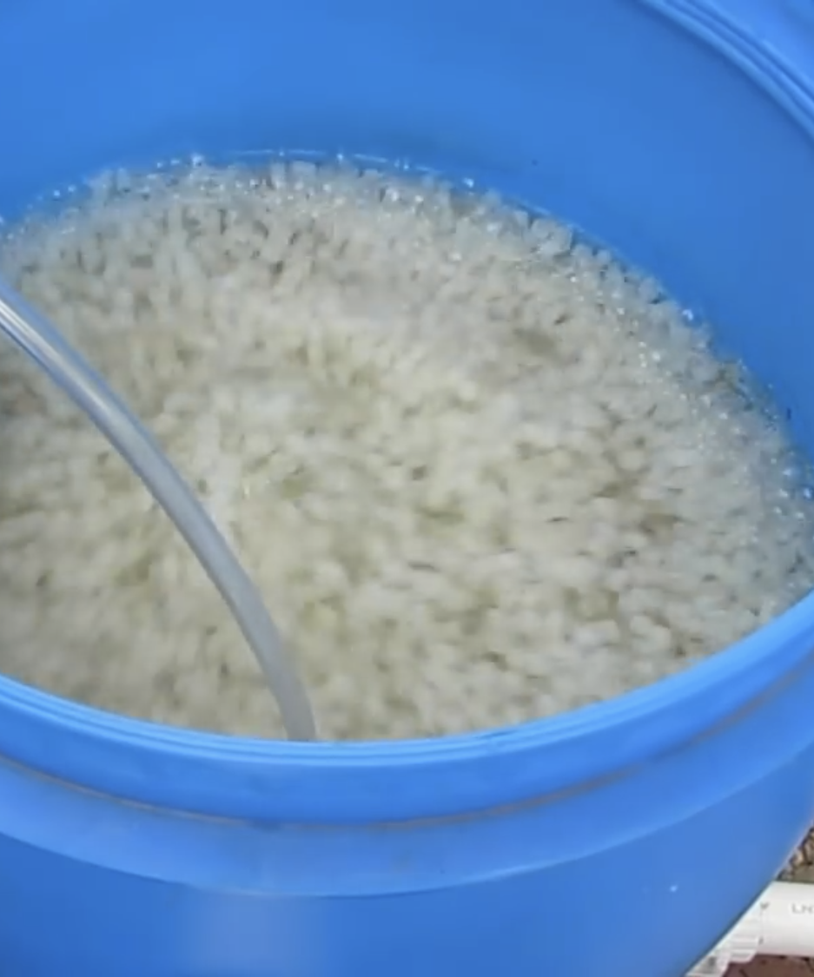
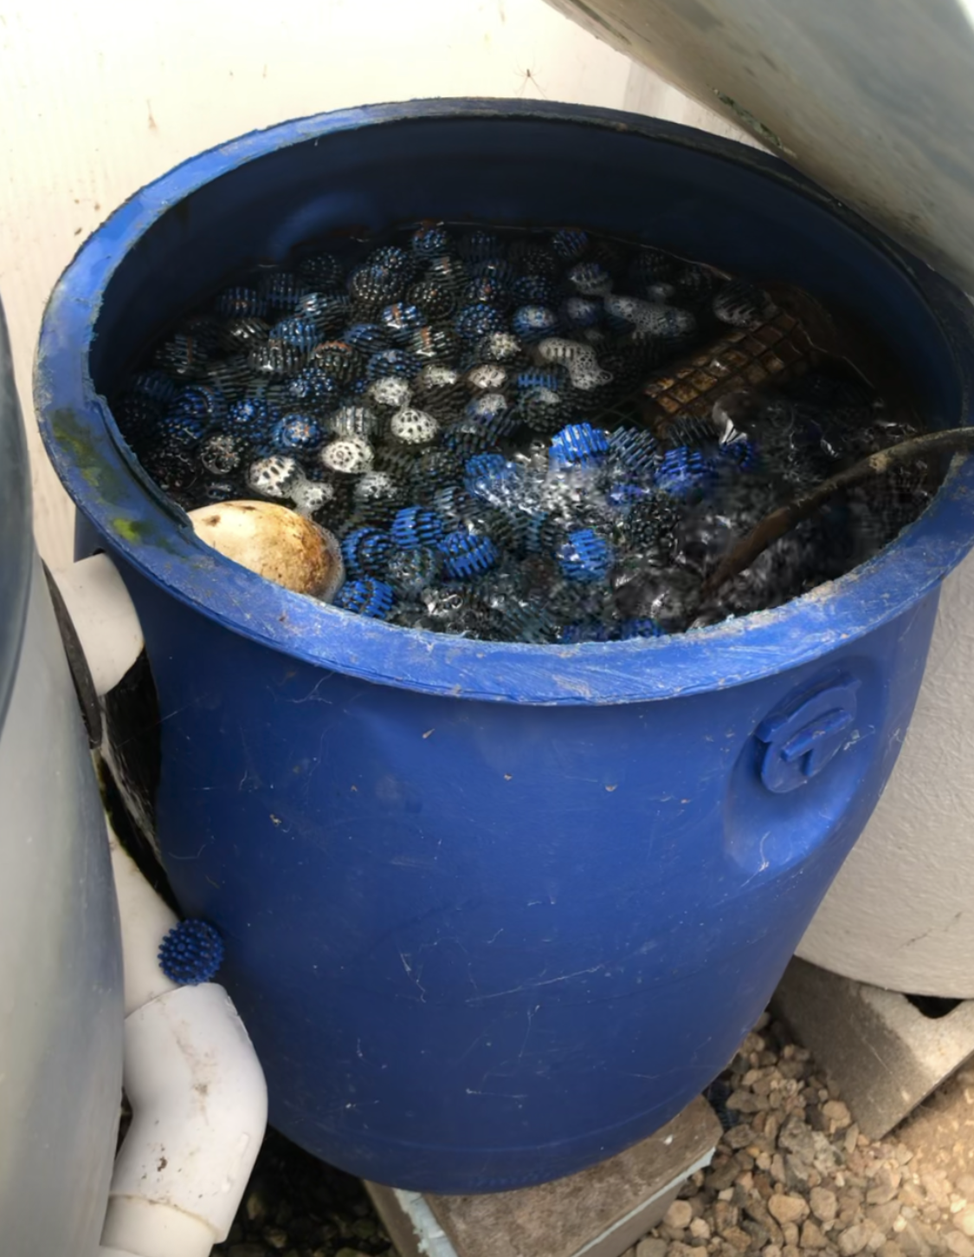
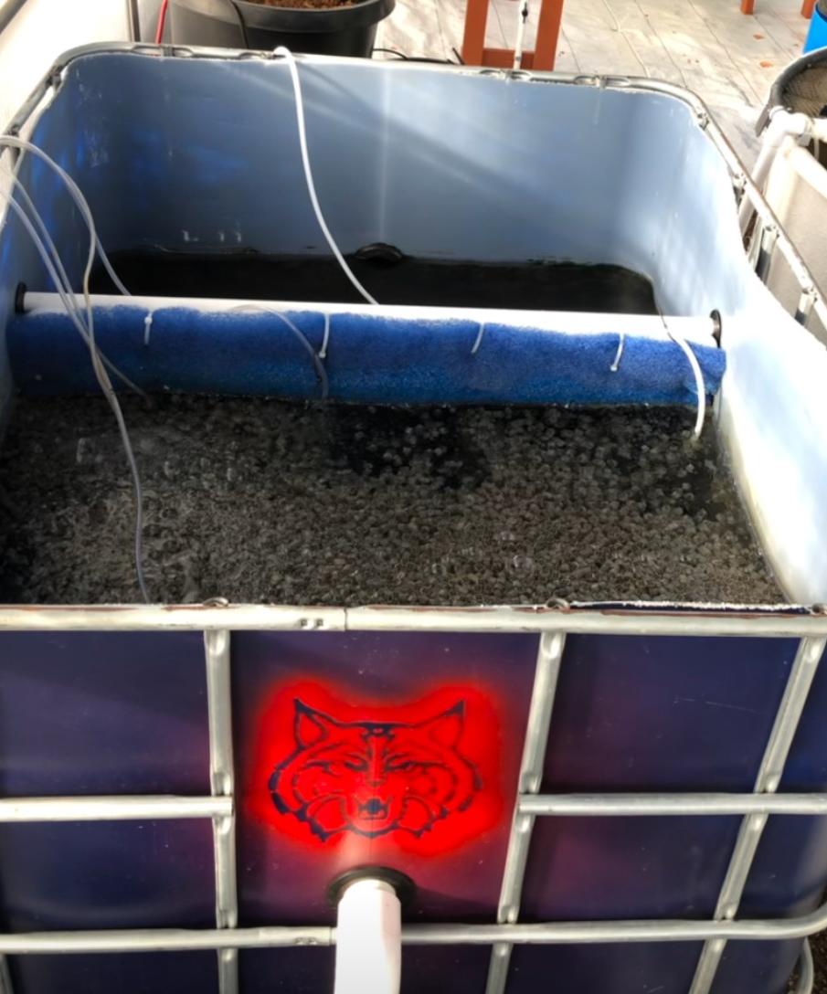
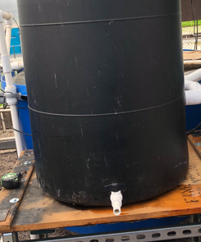
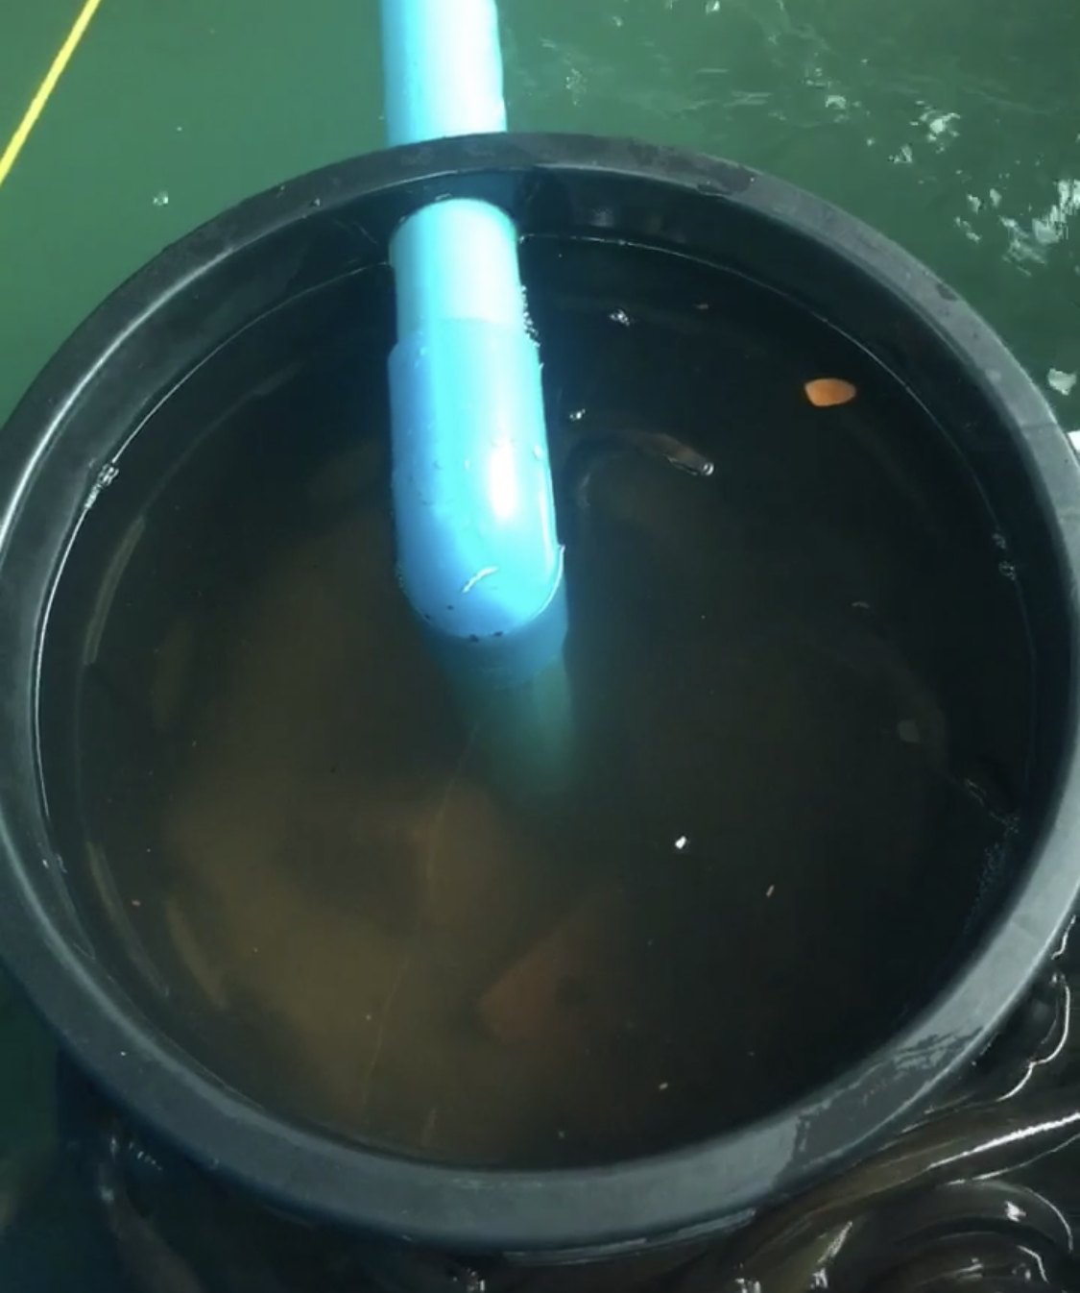
Biofilter Tanks
Sized for the feed amount and effective surface area of the biofilter medium
Should have bottom drain for removal of residual solids (If using MBBR)
Examples
IBC totes (HDPE)
55-gallon drums (HDPE)
Fiberglass tanks
Plastic Buckets
Plastic Garbage cans

Slide 17
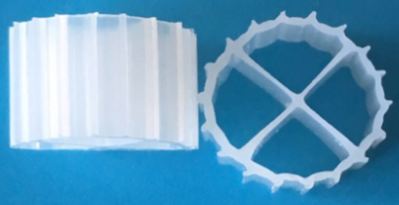
Sizing a Biofilter* (quick review)
Bacteria can nitrify ~0.5 g Ammonia (TAN) per m² of effective surface area (Surface area that bacteria can grow on)
Ammonia produced at ~0.03 - 0.05 kg/day per kg of feed depending on % protein of feed
Example:
If feeding 1 kg feed per day, fish would produce ~30g of ammonia which would require ~60 m² of media
LECA~250 m²/m³ so 60/250 = 0.24 m³ (Roughly 60 gal or 250 L) ~ 4x4 grow bed
K1 Kaldness ~ 600 m²/m³ so 60/600 = 0.1 m³ (Roughly 25 gal or 100 L)
To allow for fluidization of media, need to double volume of container (Roughly 50 gal or 200 L)

Slide 18
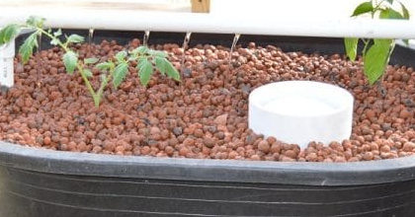
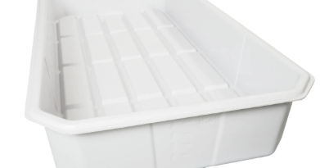
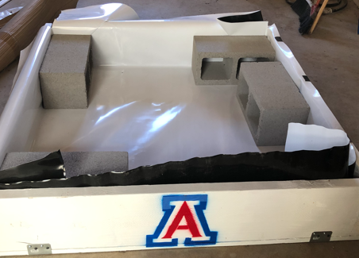
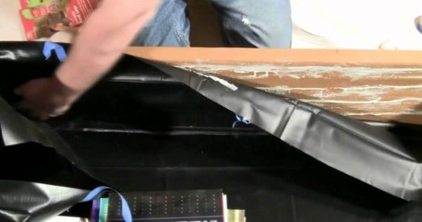
Building or Selecting Media Grow Beds
Materials
Prefab plastic flood tables
HDPE-lined wood frame (2x12’s)
Other durable (food-grade) containers
Depth
Ideally 6-12” of media
1.5-2.5” of dry media above water level
Standpipe(s) 2-3” below top of the media

Slide 19
Why Does Flowrate Through Your Media Bed Matter?
Allows time for nutrient absorption by plant roots
Allows time for finer settleable solids to settle before the drain period
Helps eliminate clogging
Faster speeds will cause water to take more paths of least resistance
*Make Sure the water velocity is < 0.5 cm/s if not flood and drain

Slide 20
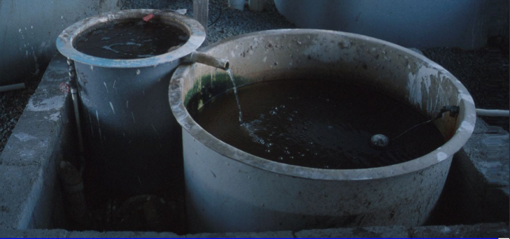
Sump Tank
Purpose: Catch the overflow water from the hydroponic component, biofilter or preceding component
Allows water to drain to the lowest point
Allows water in fish tanks to remain at a constant height
*Float valve in tank to allow for water addition to make up for evapotranspiration losses

Slide 21
Choosing a Sump Tank
Guidelines:
Depth must be enough to cover the top of the pump by at least a few inches
Should be enough to hold overflow from preceding tank if power were to go out or pump was stopped
(operating level + overflow)
Options: Stock tanks, 55-gallon drums, plastic trash cans,
HDPE tanks, fiberglass tanks, concrete tanks
How do you calculate the volume?
Rectangular tanks (L x W x H)
Circular tanks ((d/2)² x π x H)
d
H

Slide 22
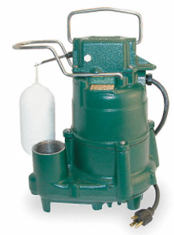
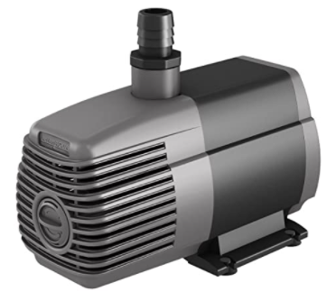
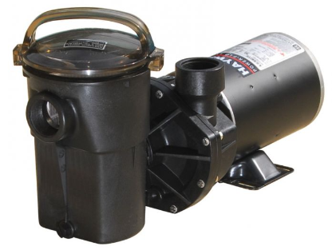
Choosing Pumps
Types of Pumps:
Submersible
Sump pumps (aquarium pumps)
In-line pumps (pool pumps)
Best to oversize your pump
Pumps lose efficiency over time
Easy to regulate flow

Slide 23
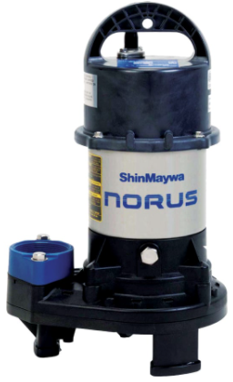
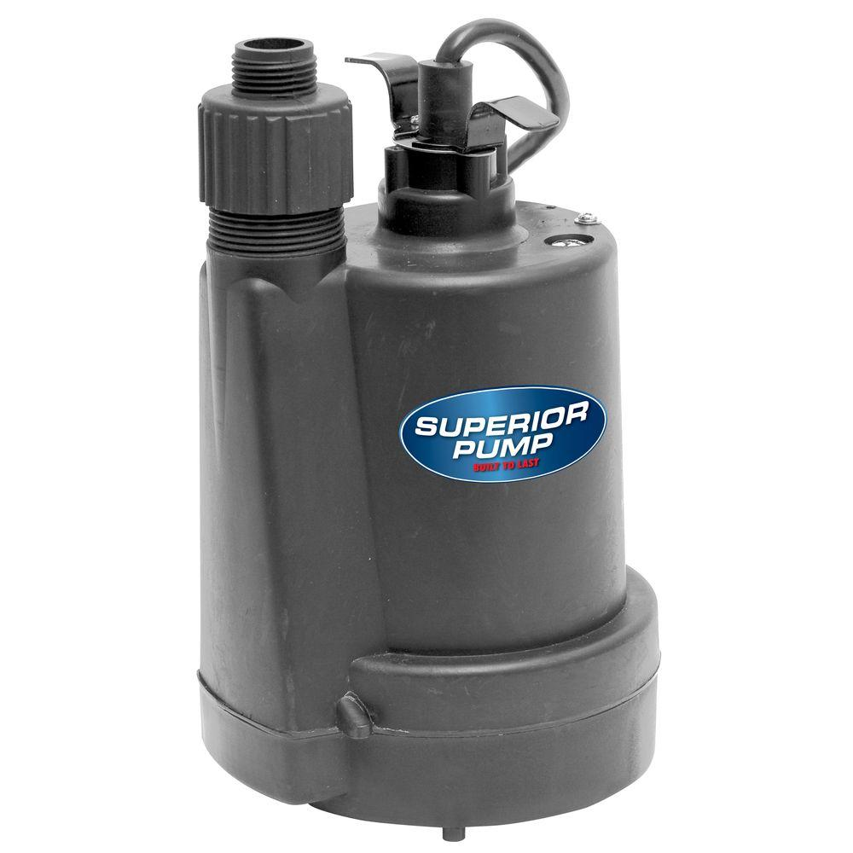
Sump Pumps
Relatively inexpensive
$50 - $350 USD
Can deliver a large amount of water
Many have automatic shutoff if water level gets too low
Threaded to connect to PVC
Not intended to be run continuously
Have had success with sump pumps, but have also had some burn out
May be worth getting a higher quality one
Purchase at: Grainger or most home improvement retailers
*Typically use ¼ - ¾ hp

Slide 24
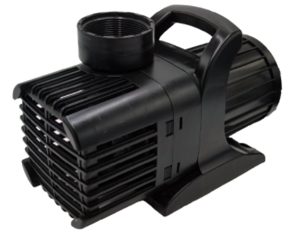
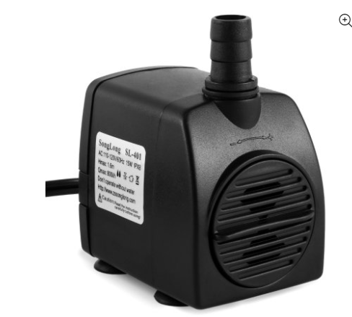
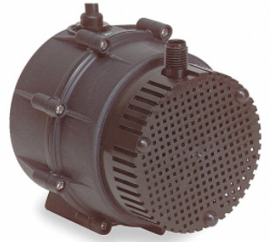
Submersible Pumps
Sometimes referred to as aquarium pumps or fountain pumps
Centrifugal pumps or magnetic drive pumps
Water moved through transfer of rotational energy
Wide range of pump capacities
50 gph – 10,000 gph
Wear out quickly if you buy cheap
Best places to purchase: Grainger, Enterprise Aquatics, home improvement retailers, online retailers
Price range $10 ~ $600 USD

Slide 25
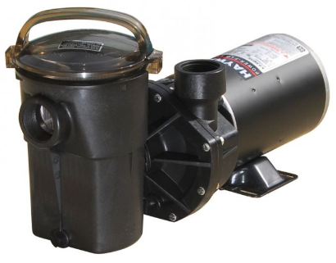
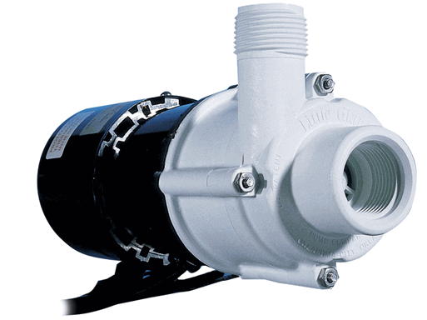
In-Line pumps (external pumps)
Centrifugal pumps
Internal impellers
Can move large volumes of water
More expensive but longer lasting
Initially need to be primed (with water)
Threaded for PVC connection
Best places to purchase: Pool stores, Grainger
Price range $10 ~ $1000 USD (ideal for commercial operations)
*Typically use ⅓ to ¾ hp

Slide 26
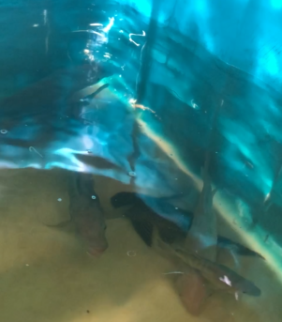
Size Pump Based on Fish Tank First
Fish tanks should be turned over 0.5 - 2 times per hour
No matter what, water needs to be moved out of fish tank to control build up of ammonia and solids
Required flow rate depends on:
Fish density
Feed rate
*The bigger the tank, the less turnovers you will have

Slide 27
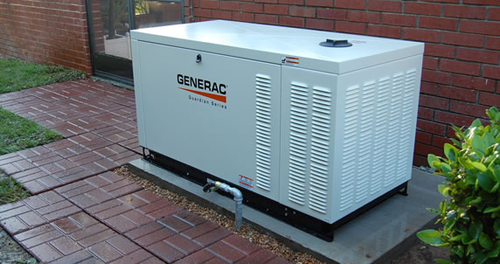
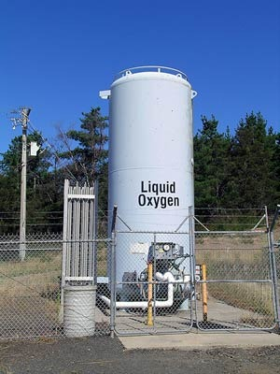
Stocking a High Density of Fish
Maximum density depends on the fish species
However, you should never try to maximize stocking unless:
You have extensive experience in fish culture
You are pumping liquid oxygen into your fish tank
You have an oxygen generating system
You have a backup generator
Stick with 0.2 lb fish /gal for aquaponics
Remember you generally don’t need a lot of fish to grow a lot plants

Slide 28
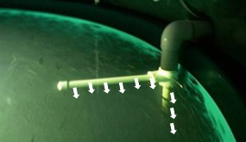
Operating Fish Tanks
Internal Flow
Inlet pipe directed to create circular flow
Helps with settling and solids flushing
Uniform mixing
Not more than 2 water exchanges per hour (usually a half is fine)
Depends on size/dimensions of tank and stocking density
Must be enough flow to facilitate movement of solids
*Optimal flow

Slide 29
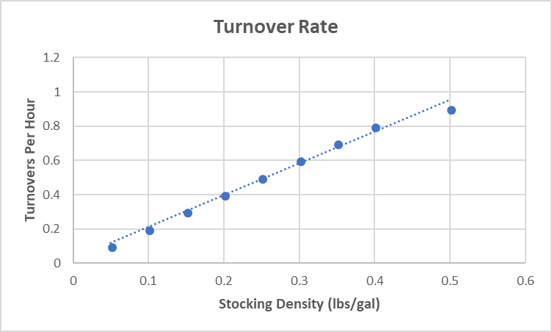
Estimating Minimum Fish Tank Exchange Rate
This chart is important!!
Rather than figure out the turnover rate, use this graph estimate
*Warmwater Fish

Slide 30
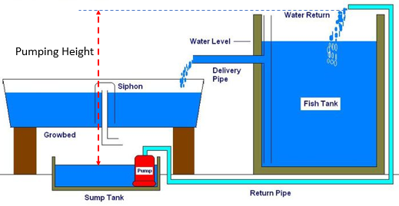
Need to Determine Lift
Measure the height from the top of the water in your sump to the maximum height the water will be pumped in your system (AKA ‘lift’)
This will help you determine your actual expected water flow for a given pump

Slide 31
Verifying your Pump
You can estimate the lift (pumping height) and desired flow rate (GPH) for your system
Then you can read the pump curve or pump chart for a given pump to see if it will work for you
Can be found on or inside package or online. Most stores have a downloadable PDF available for any pump they carry.
Every pump has a pump curve or pump chart specific to that pump

Slide 32
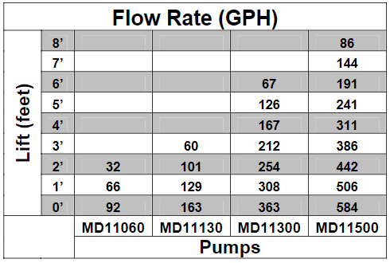
Flow Specification Chart

Slide 33

Pump Curve

Slide 34
Our Advice
Factor in 25-30% Efficiency Loss for your submersible pumps. (10-15% for inline pumps)
Example: If you bought the pump with the model number MD11130 it is capable of pumping 101 gph to a height of 2 feet.
These specs are for a new pump under optimal operating conditions
I would argue that this pump is only going to offer you 80 gph. The 25% loss also accounts for you to input a diversion loop so you can reach your desired pump rate as it changes over time.

Slide 35
Reading the Pump Curve
Pump curves are a little bit more difficult to read, but the idea is the same, make sure your system parameters are above the curve of the pump you are going to choose.
Start with the flow rate you want in your fish tank (x-axis)
Travel upwards along that value and choose a pump that you fall to the left of.

Slide 36


Remember
Fish Tank
Flow Rate
Lift
Pump Curve
Choose Pump

Slide 37
Aeration is essential to:
Fish
Plants
Biofilter
*Typically, the limiting factor in aquaponics systems
*Fish need air to provide adequate dissolved oxygen

Slide 38

Aeration allows oxygen to diffuse into the water

Slide 39

Oxygen vs. Air
Air is only ~21% Oxygen
Dissolved Oxygen saturation is affected by temperature, pressure and salinity
Higher altitude = lower DO
Higher salinity = lower DO
Dissolved air only allows for up to 40 kg/m³ of fish (0.33 lb/gal)
Using Oxygen can increase stocking densities over 150 kg/m³ of fish (1.25 lb/gal)

Slide 40

Oxygen Saturation Table
*At 25°C DO Saturation is 8.54 mg/L
Plants require 5-6 mg/L
Fish require 5 mg/L
Bacteria require 2-4 mg/L

Slide 41
Oxygen Saturation Table
*At 25°C (77°F) DO Saturation is 8.54 mg/L
Plants require 5-6 mg/L
Fish require 5 mg/L
Bacteria require 2-4 mg/L

Slide 42


How Does Air Dissolve in Water?
Air contacts water
Dissolved gases approach equilibrium
Gases dissolve based on equilibrium with partial pressures of gases in air
Effected by:
Liquid-film thickness
Turbulence and mixing
Area of gas liquid interface
Surface area key

Slide 43


Use of Aeration
Air-water contact allows for degassing of CO₂
Oxygen diffusion increased by increasing area of gas-water interface
Smaller air bubbles (diffusion)
Smaller water droplets (splashing)
Air can also be used for mixing such as with MBBR or mineralization tanks

Slide 44

Pressure
P = F/A
Increasing depth ->> Increasing pressure

Slide 45



Sources of Air
Regenerative Blowers
Air Pumps
Compressors
Sometimes used interchangeably with air pumps

Slide 46
Regenerative Blowers
High volume, low pressure
Tanks up to 1m deep
Whole greenhouse application
Energy efficient
$500-$3000

Slide 47


Air Pumps
Types:
Reciprocating air pumps
Piston, plunger and diaphragm Pumps
*Air is still being compressed
Wide range of volumes and pressures
Single system use
$35-$1000

Slide 48

Air Compressors
Small volume, high pressure
For use from 0-50 ft depth
High energy use
$500-$3,000 or more
Not likely used in aquaponics

Slide 49





Air Diffusers (bubble diffusers)
Most Common in Aquaponics
Most inefficient oxygen transfer devices
Clogging and biofouling can be common in some types
Air stones, fine bubble disc, porous grids, jet aeration (venturi)

Slide 50


Air Stones
Can be glass (better) or ceramic
Different sizes allow for different volumes of air
2-3% OTE per foot depth
Alumina air stones a great choice

Slide 51


Diffuser hoses – porous grids
Rubber polymer or other materials
Medium to fine bubbles
Less apt to clogging
Make sure you get weighted diffuser hoses or you will need a cinder block to prevent it from floating up

Slide 52

Fine Bubble Discs
Synthetic rubber membrane
ethylene propylene diene terpolymer
Thousands of tiny holes
Self cleaning when you turn it off and on
Great for use in MBBR, mineralization tanks or large fish tanks

Slide 53

Fine Bubbles
Highest efficiency oxygen transfer, Ceramic or glass air stones may get clogged over time in aquaponics systems unless you clean them
Fine bubble discs can be better for large systems (typically used in wastewater treatment aeration basins)
Up to 30% OTE depending on depth

Slide 54
Air Diffusion
Depends on:
Bubble size
CFM (kg/m³) of air at specific water pressure
0.3-0.5 kg O₂/1 kg feed required
(potentially up to 1 kg needed when factoring in biofilter and everything else)
*CFM = cubic feet per minute

Slide 55
Sizing an Air Pump
Example
~100 lb of fish fed 2 lb of fish per day (2%) >> roughly 1 kg
So, 0.5 kg of O₂ needed. There are 0.25 kg of O₂ in a m³ of air (250 g) but
Using air stones (only 7-15% OTE)
0.07 * 0.25 kg O₂/m³ of air = 0.0175 kg O₂ transferred per m³ of air pumped through air stones
0.5 kg O₂/ 0.0175 = 28.6 m³ of air required per day (0.7 cfm)
*Look at air pump to make sure it can provide that volume of air at the desired depth you need
*Fish require about 0.5 kg of O₂ per kg of feed fed

Slide 56
Aeration Requirements (100-gallon tank; 5% OTE)
Stocking Density (lb/gal) | 0.05 | 0.1 | 0.15 | 0.2 | 0.25
Feed Fed (lb) | 0.1 | 0.2 | 0.3 | 0.4 | 0.5
Feed Fed (kg) | 0.0455 | 0.0909 | 0.1364 | 0.1818 | 0.2273
Kg 0₂ required | 0.0228 | 0.0455 | 0.0682 | 0.0909 | 0.1137
Air needed per day (m³) | 1.82 | 3.64 | 5.46 | 7.27 | 9.10
CFM | 0.05 | 0.09 | 0.13 | 0.18 | 0.22
LPM | 1.3 | 2.5 | 3.8 | 5.0 | 6.3

