Slide 1
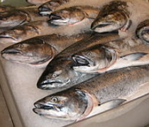

Marketing and selling your product
©2025 Matt Recsetar

Slide 2
What Policies and regulations might effect my aquaponics business?
Federal:
National Pollution Discharge Elimination System (NPDES)
National Aquatic Animal Health Plan (NAAHP)
State:
Arizona Pollution Discharge Elimination System (AZPDES)
Aquifer Protection Permit (ADEQ)
Reclaimed Water Reuse Permit (ADEQ)
Aquaculture related licenses (AZGFD)
If you are in California there appears to be a lot of additional regulations (Good luck!)

Slide 3
Discharge Permits
AZPDES Individual Permit (Through ADEQ)
This permit is for municipal, domestic and non-domestic (industrial) discharges of pollutants to a surface water that fits the definition of “waters of the U.S.” as described in the Clean Water Act. The permit is valid for five years.
https://azdeq.gov/permits/AZPDES/IND
EPA concluded that releases of pollutants to groundwater are categorically excluded from the Act’s permitting requirements because Congress explicitly left regulation of discharges to groundwater to the states and to EPA under other statutory authorities.
Aquifer Protection Permit
https://legacy.azdeq.gov/function/permits/general.html#ground
*Not usually an issue with aquaponics but may be an issue you have to address if building a large-scale operation on undeveloped land.

Slide 4
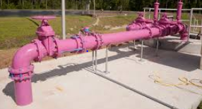
Reclaimed Water Permit
Direct reuse of reclaimed water recycles treated effluent for beneficial uses, thereby conserving potable water sources for human consumption and domestic uses
https://legacy.azdeq.gov/environ/water/permits/download/individual.pdf
Unlikely to apply to aquaponics

Slide 5
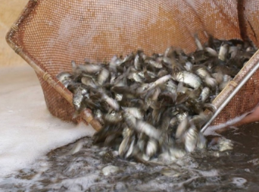
Aquatic wildlife stocking permit
Permit Cost: Free
Permit valid for 20 days of date stated within form
Form 2710-A
https://azgfd-portal-wordpress-pantheon.s3.amazonaws.com/wp-content/uploads/archive/Form-2710-A-Aquatic-Stocking-Permit-Ap_RO.pdf

Slide 6
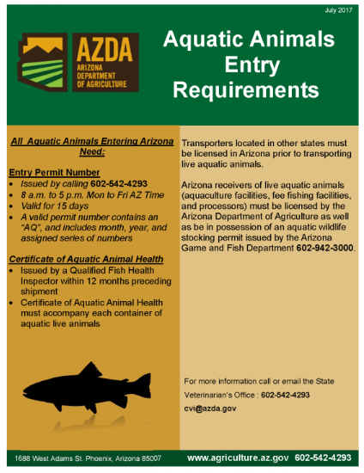
Aquatic Animal Entry
If you are getting fish from out of State, you will need to get an entry permit (AZGFD)
Issued by calling 602-542-4293
https://agriculture.az.gov/sites/default/files/documents/AZ%20Aquatic%20Animals%20Entry%20Requirements.pdf
Certificate of Aquatic Animal Health must be included with shipment of live fish (APHIS)
https://www.aphis.usda.gov/regulations/vs/iregs/animals/downloads/ca_live_food_retail_use_hc.pdf

Slide 7
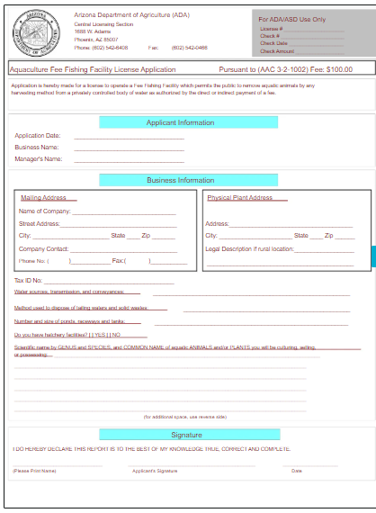
Aquaculture license
Aquaculture Facility License
Fee: $100
Covers: selling, trading, displaying, purchasing, exporting, possessing, propagating, culturing, or rearing live aquatic animals or plants in the State of Arizona for profit
https://agriculture.az.gov/download-forms

Slide 8
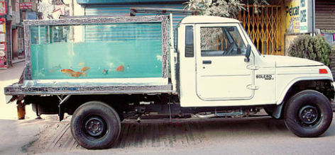
Transporting fish
Aquatic Animal Transporter License
Fee: $100
Covers: Transportation of live aquatic animals to persons who are licensed to resell, process or stock live aquatic animals in the State of Arizona

Slide 9
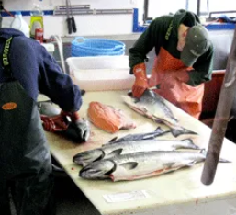
Processing fish
Aquatic Animal Processor License
Fee: $100
Covers: Processing, cleaning, reshaping or containerizing fresh or frozen aquatic animals for distribution or resale
*Do not need for selling live fish or flash frozen fish whole and unprocessed

Slide 10

Organic labeling
As of right now, farm-raised fish (and wild fish) cannot receive a USDA Organic certification
Organic certification indicates your produce was grown without the use of synthetic additives, fertilizers, pesticides or herbicides (including GMOs) and can help you get a premium price for your product
Organic Certification for your produce can cost between $250-$1500 depending on certifying agency
  Includes application fee, site inspection fee, and annual certification fee
  Federal cost-share program can reimburse 75% of certification costs up to $750
Example: One certifier says the initial cost is about $750 for the first year and between $375 and $575 in later years for small farms

Slide 11




Eco-certifications for Fish
BAP Certification
  Best Aquaculture Practices
  The standards address animal welfare, conservation of biodiversity, soil and water management, drug and chemical management, food safety, traceability as well as community and employee relation
ASC Certification
  Aquaculture Stewardship Council
  https://www.asc-aqua.org/what-we-do/our-standards/farm-standards/
Naturland
  Standards for Organic Aquaculture
  https://www.naturland.de/images/UK/Naturland/Naturland_Standards/Standards_Producers/Naturland-Standards_Aquaculture.pdf
*A good goal is to get recognized by Seafood Watch as a sustainable seafood source

Slide 12



Other Certifications and Labels for Produce
Shoppers generally willing to pay a higher price for foods with eco-labels
Sustainably Grown Certification
  Covers a comprehensive set of environmental, social, economic, safety and quality attributes related to the production of fresh fruits and vegetables, herbs, nuts, cut flowers, and ornamental plants
  https://www.scsglobalservices.com/services/sustainably-grown-certification
Naturally Grown Certification
  Grassroots organization
  Cost $150 min annual dues
  Example: Merchant’s Garden – Tucson, AZ
  https://www.cngfarming.org/
Non-GMO label can also improve marketing

Slide 13

Selling your products
Farmer’s Markets
Visit local restaurants and gauge their interest
  Find out their needs
  Can you supply them?
    Weekly?
    Seasonally?

Slide 14

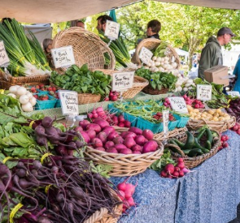
How else to sell your products?
Selling directly to consumers (most profitable)
  (Besides farmers markets and local restaurants)
  Cafeterias
    Hospitals, businesses, schools
    Must sign contract and deliver!
  Onsite
  Online sales
    Onsite pick-up
    Delivery
Building your brand – Create a website
  Offer Tours or workshops
Tell your story!
Gotham Greens

