Slide 1
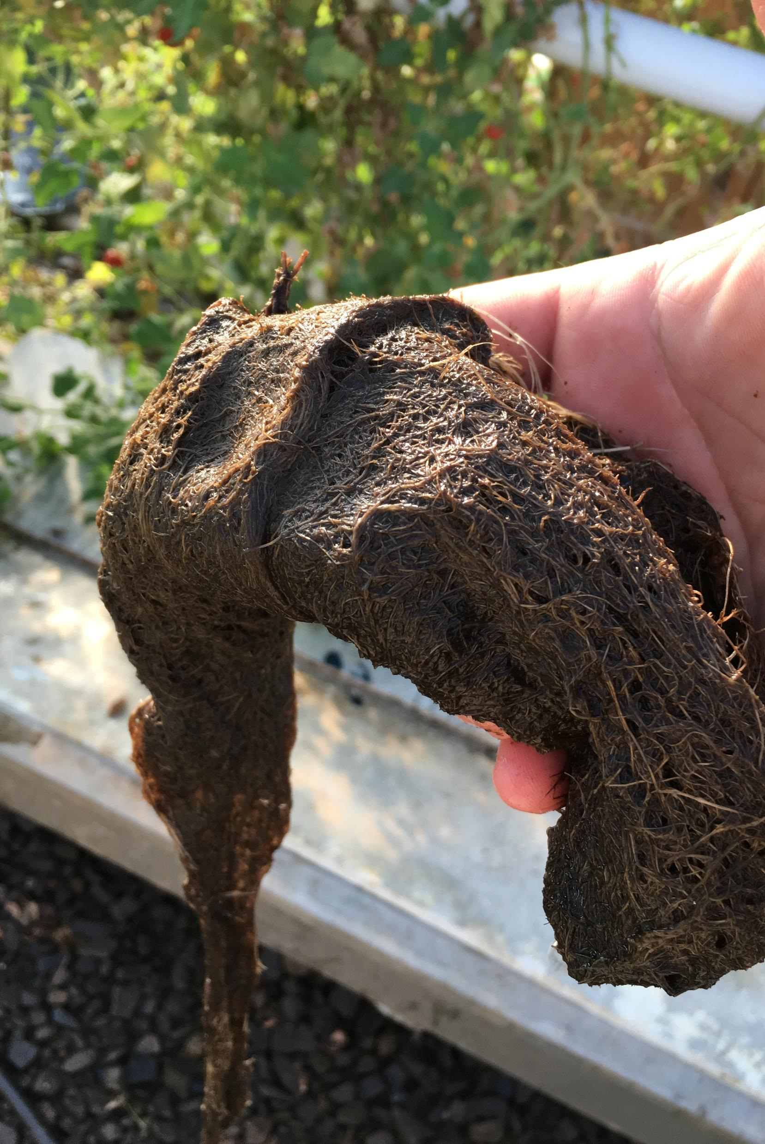
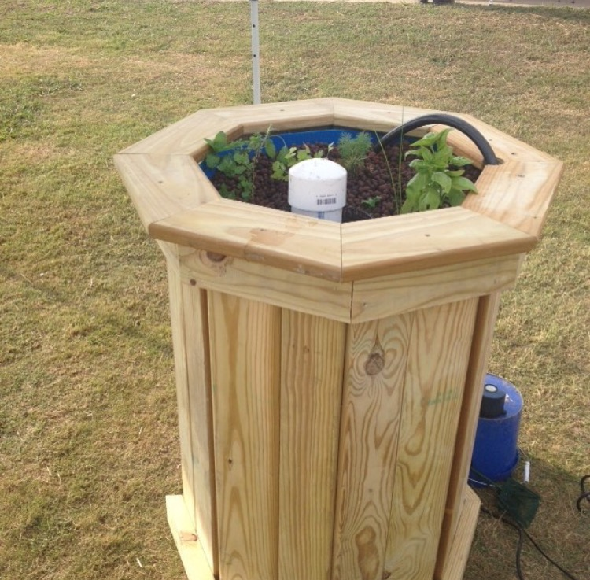
Troubleshooting, Tips and Tricks
©2025 Matt Recsetar

Slide 2
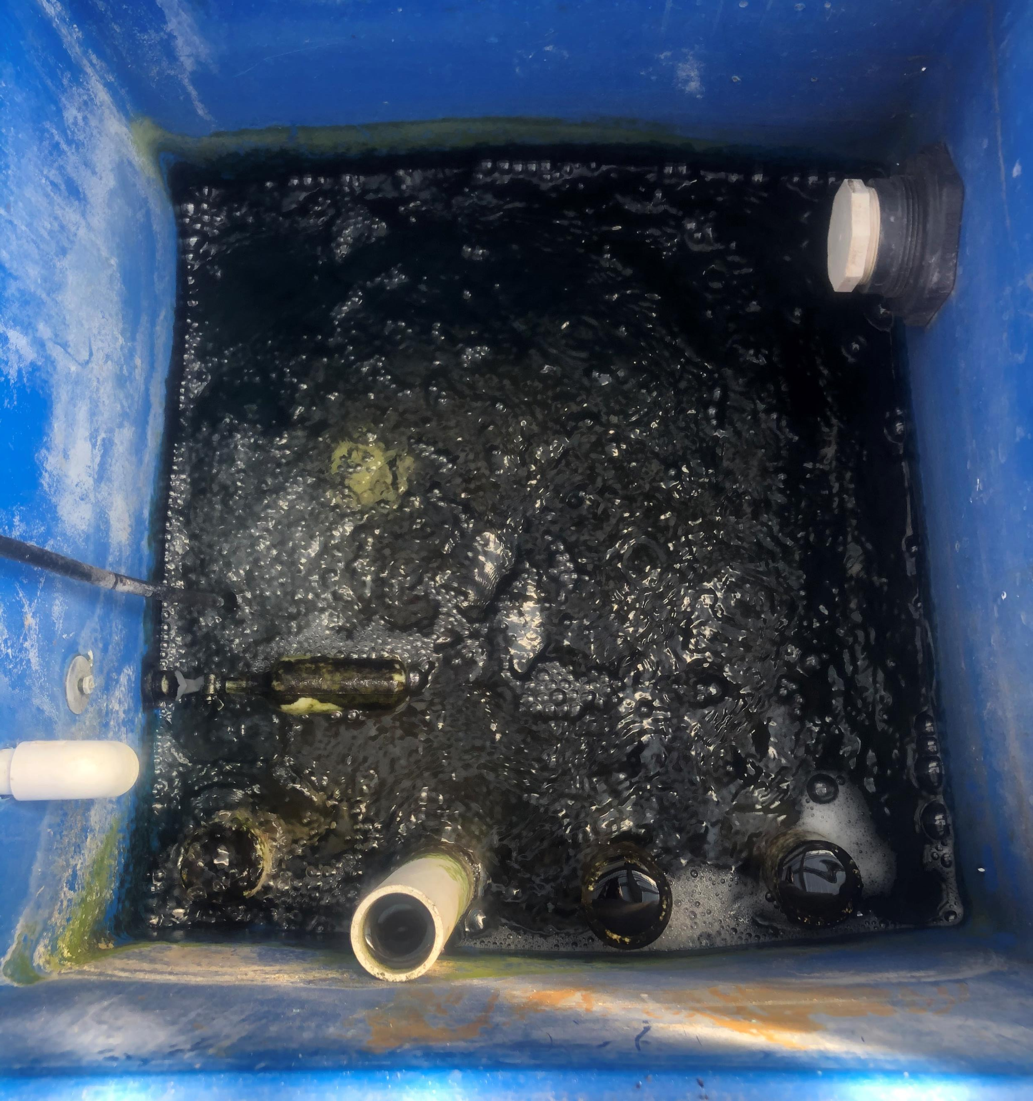
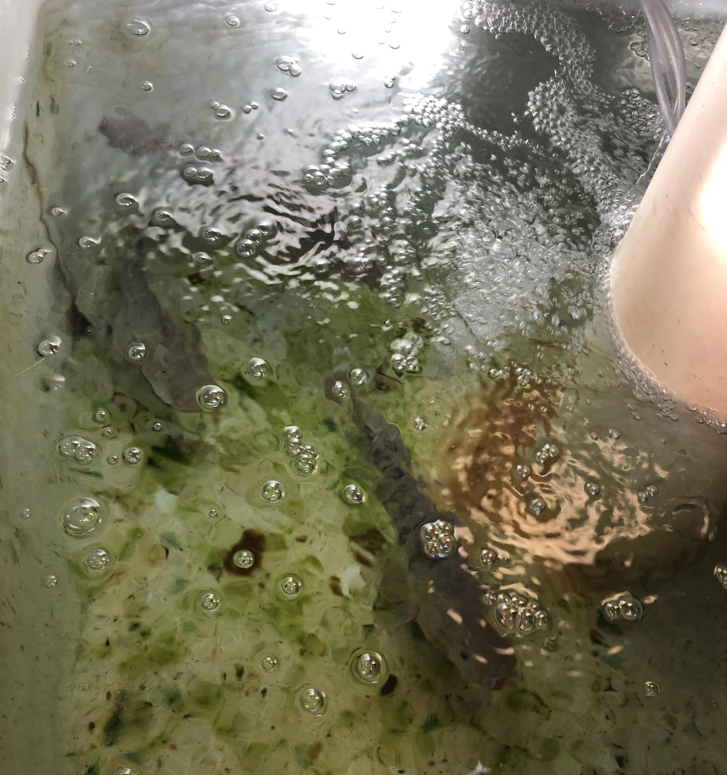

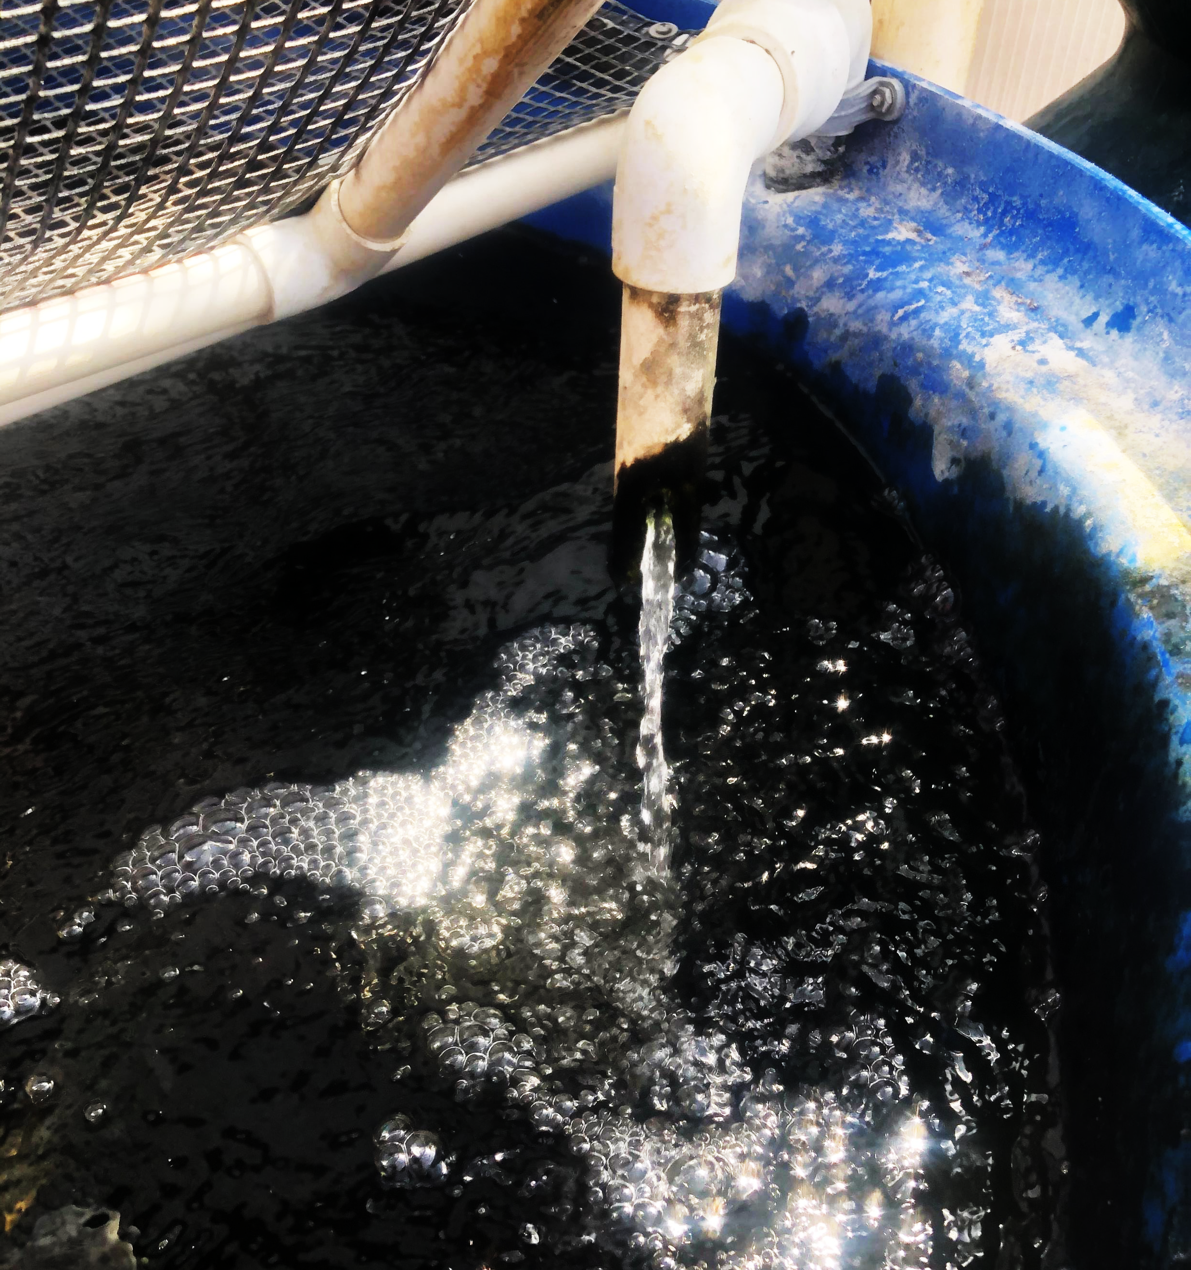
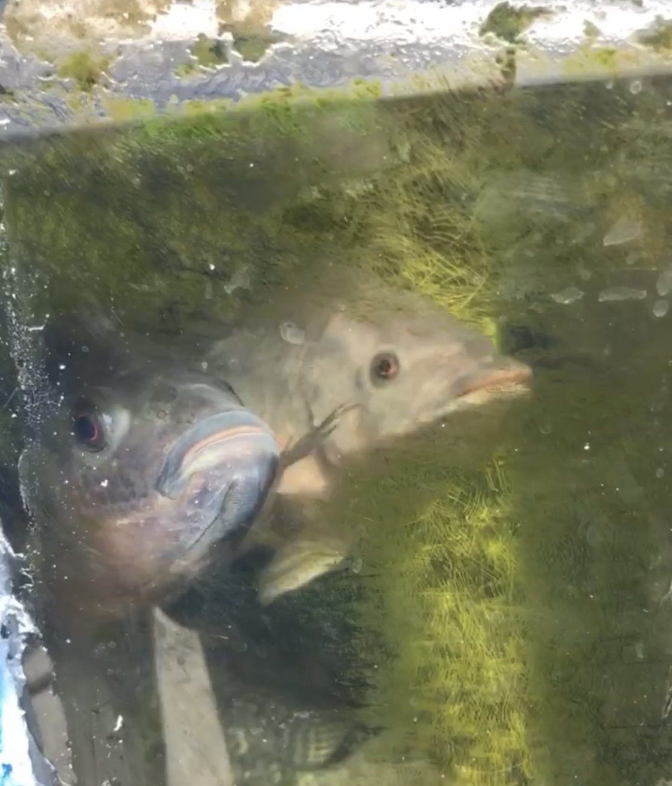
To avoid small problems from becoming large problems remember
Daily Checklist
Check for leaks
Check Sump and fish tank water levels
Check Water Flow
Check aeration (airstones)
Check for minor clogs or waste build up
Observe fish
Check water quality and D.O.
Feed Fish
Plant Maintenance

Slide 3
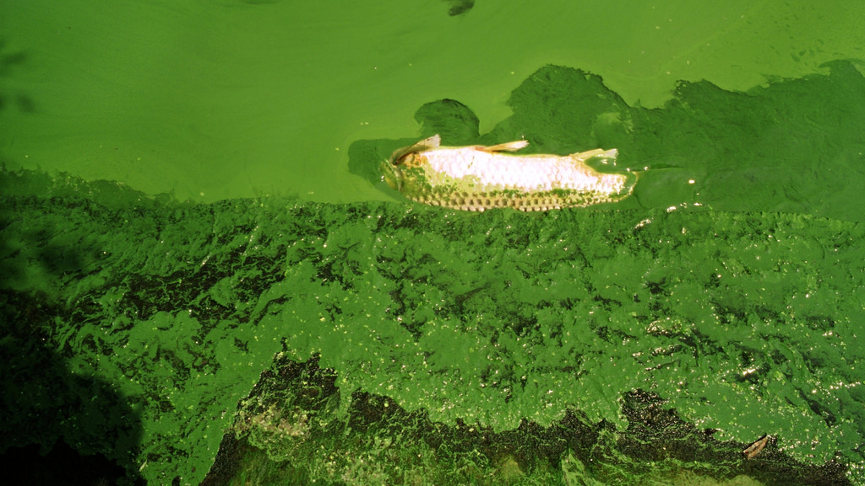
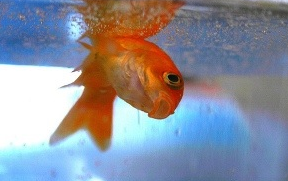
You can run into a variety of issues when operating your own aquaponics system Some will be quick and easy fixes and others will be expensive and time consuming

Slide 4
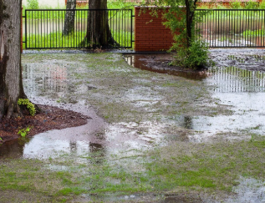
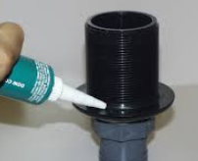
Water on the ground?
This likely indicates a leak
Could also be a hose was left on or a clog causing tanks to overflow
Leaks generally occur at a connection point
Much easier to fix leaks that are not pressurized
Always use clear 100% silicone
In new systems, tiny leaks may fill in over time
If leak is pressurized, needs to be fixed quickly
Whole fitting should be replaced
Drain water, cut section, replace with new PVC/fittings and glue (generously)
Smaller diameter fittings are much easier to fix and replace

Slide 5
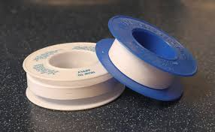
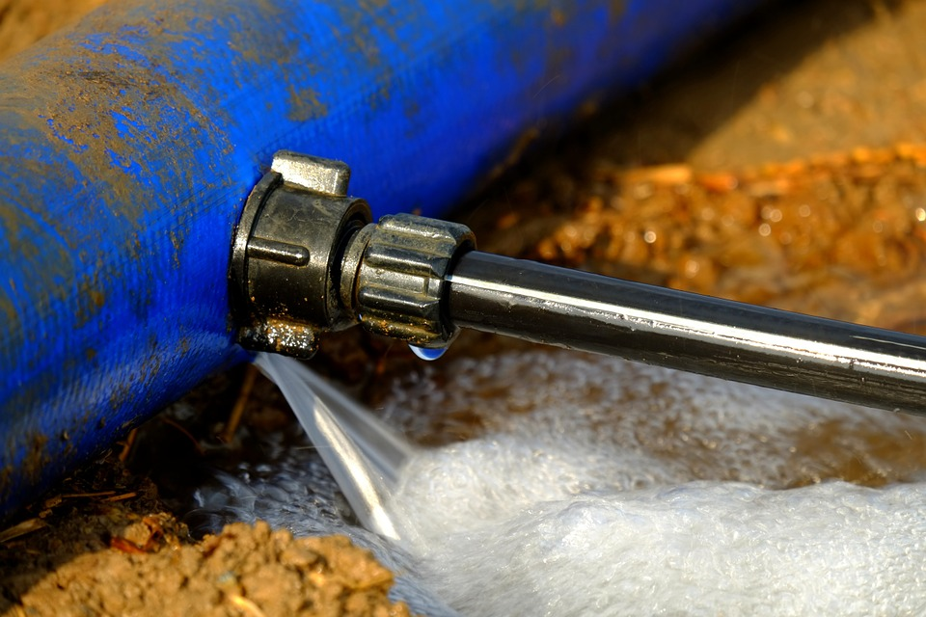
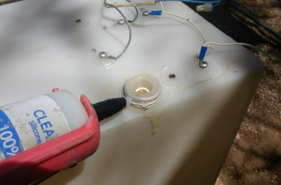
Problem | Solution
Leak in Fish Tank | Tighten bulkhead or connection first Remove fish from tank if necessary Drain tank Use 100% silicone to repair leak Use a patch to repair a crack in fiberglass tank If a crack in a tank is too large, tank needs to be replaced Teflon tape can also help seal leaks in threaded connections
*Remember silicone takes 24 hours to dry

Slide 6
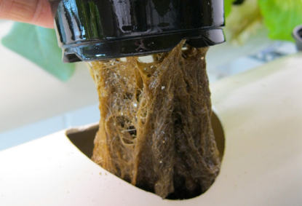
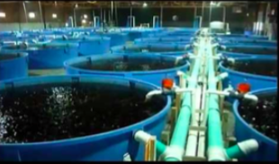
Tank Water Levels Higher than Normal
Problem | Solution
Outlet diameter to small | Able to change pipe size?? Slightly lower the flow rate
Clog – Flow is being restricted causing water to back up | Remove clog in outlet plumbing

Slide 7
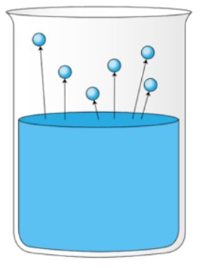
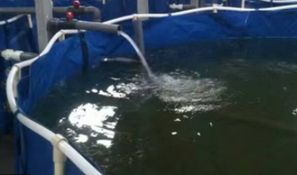
Low water level
Problem | Solution
Evaporation | Add water
Leaks | Fix as outlined in previous slide

Slide 8
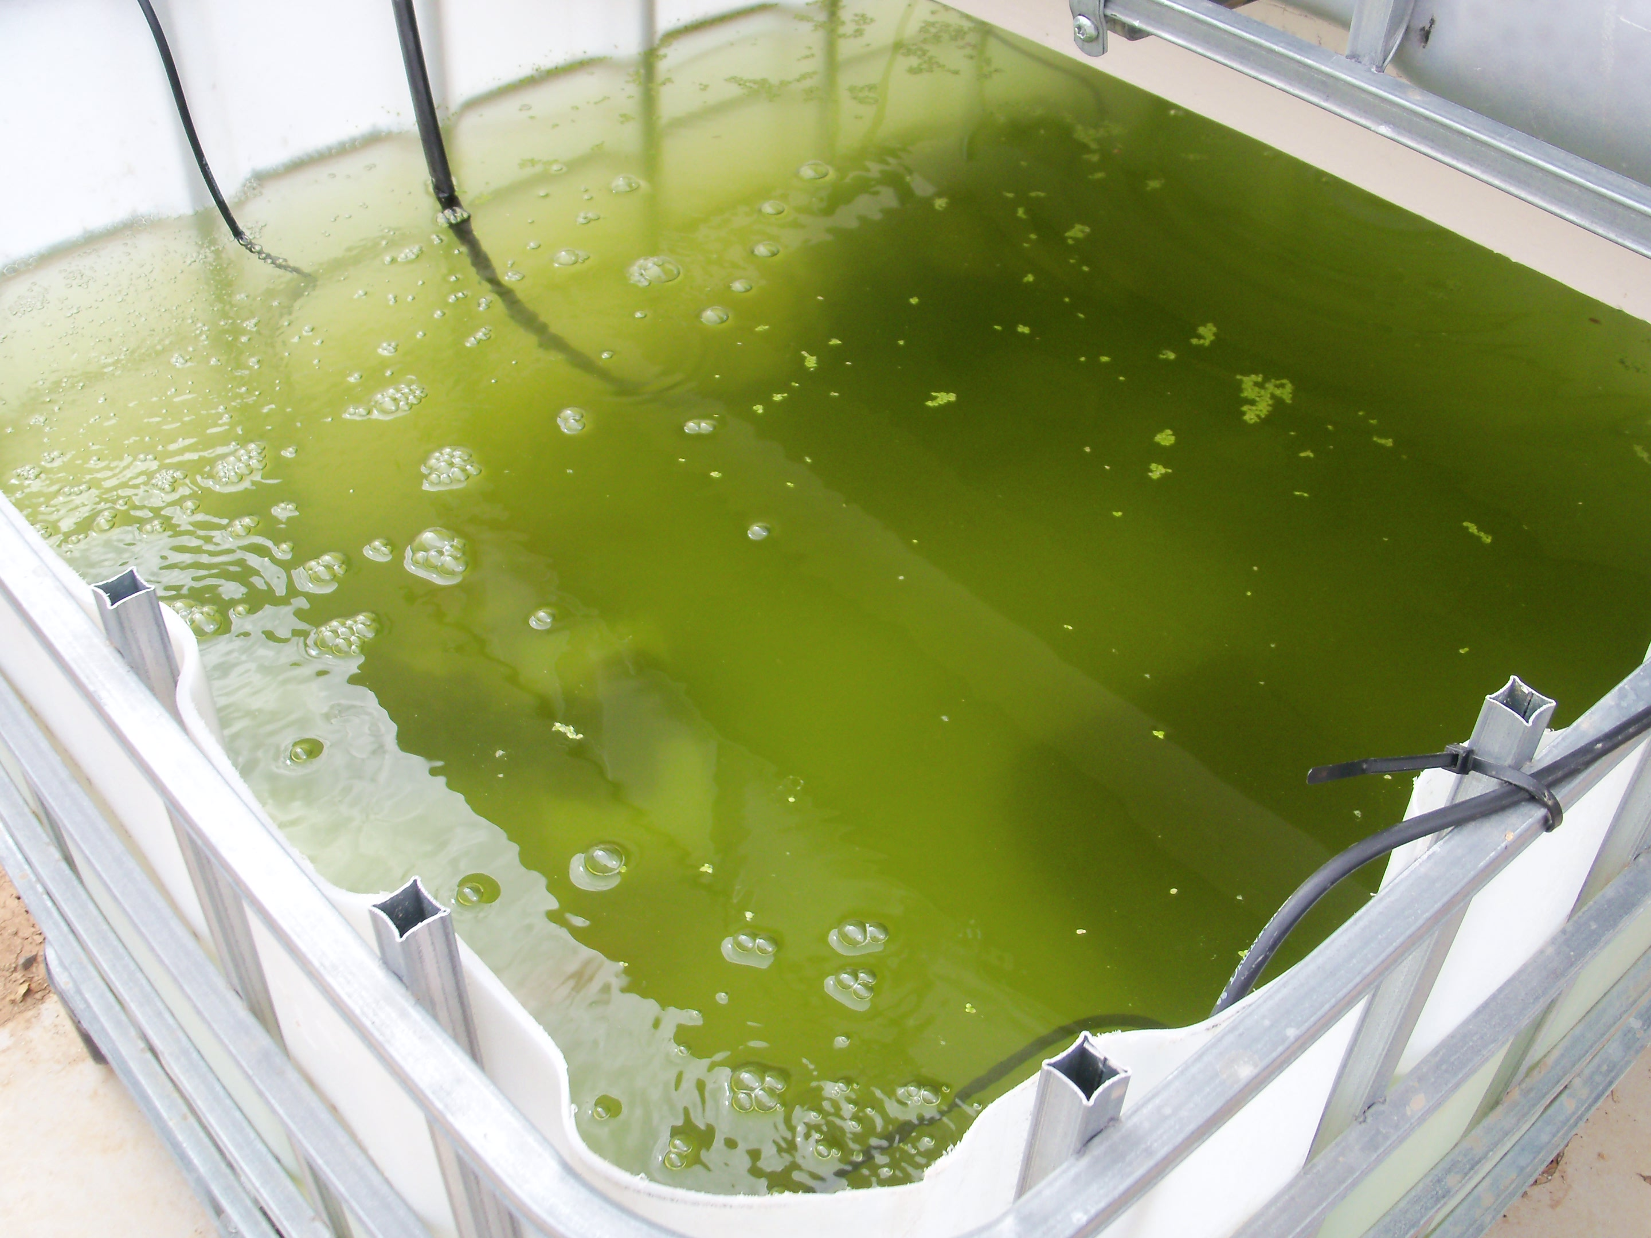
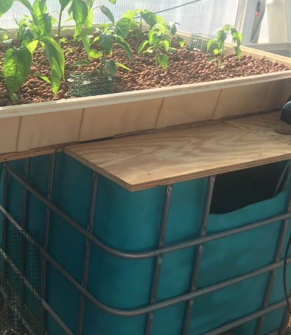
Water is Green
Algae has taken over your system!
Cause = System water exposure to sunlight
Problem | Solution
Too much light | Darken sides of growbed and fish tank (Paint blue or black) Increase shade over fish tank Decrease light exposure to water throughout system

Slide 9
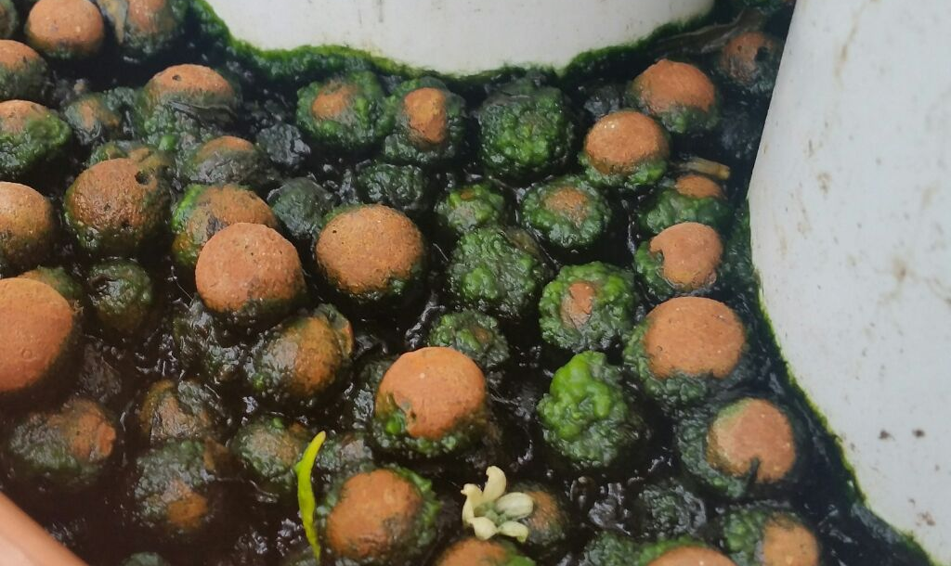

But don’t the fish need light?
No! Fish do not really need any direct light
Best not to expose any of the water in your system to light

Slide 10
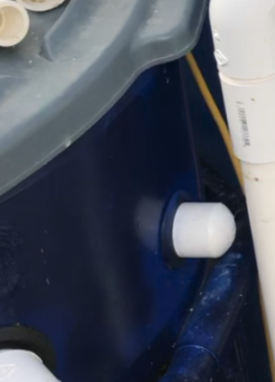
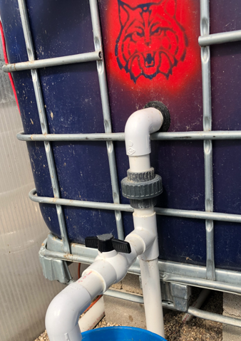
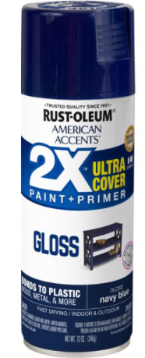
Tip: Navy Blue Spray Paint

Slide 11
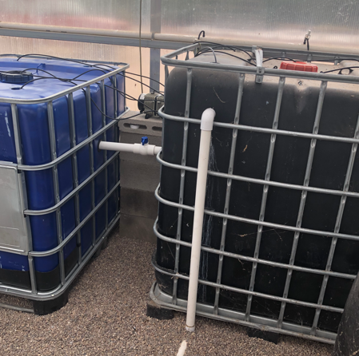
Painted Mineralization tanks
Heavily aerated fish solids
2-stages

Slide 12
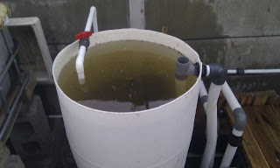
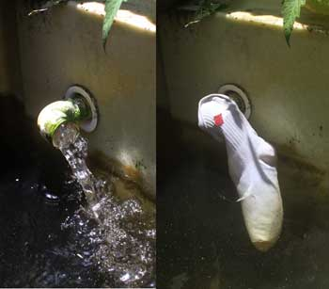
Water Looks Dirty
The suspended solids are too high
Causes: Dirty growing media, overfeeding, fish tank flow rate too slow or too fast, inadequate solids removal, poor quality fish feed (has high tannins), poorly designed system (drain or flow related)
Solutions
Increase size of clarifier or add an advanced solids filter such as bead filter or drum filter
Increase or decrease flow rate out of fish tank or improve flow within
Lower stocking density of fish
Change to a higher quality fish feed

Slide 13
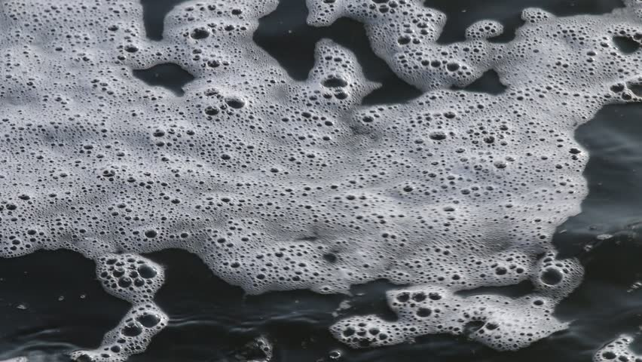
Foam in System
Foam on top of the water does not always indicate a problem
Can be caused by dissolved organics including proteins that collect on aeration bubbles
Can also be caused by detergents or sick fish
First Steps
Inspect fish for signs of illness
Check water quality
Solutions
Change out 1/4 the water in the system (last resort)
Add more biofiltration

Slide 14
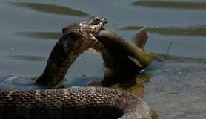
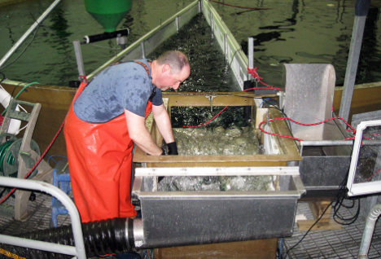
Fish are Missing
Causes:
You are underfeeding fish and fish are becoming cannibalistic
Fish are jumping out of tank
An animal is getting into your tank and eating your fish
Bobcat? Snake? Hawk? Otter? Cormorant?
Solutions:
Keep your tank covered
Feed your fish adequately
Grade your fish so they are more uniform in size
Stock to appropriate density

Slide 15
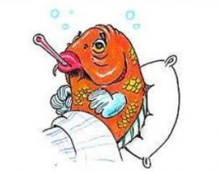
Fish Are Not Eating Like They Should Be
CHECK WATER QUALITY FIRST!
Causes:
Water temperature is too hot or too cold
Ammonia is high
Oxygen is low
Fish are sick
Carbon Dioxide too high
Solutions
Increase or decrease water temperature
Increase filtration
Increase aeration
Send fish into lab for health check (do above steps)

Slide 16
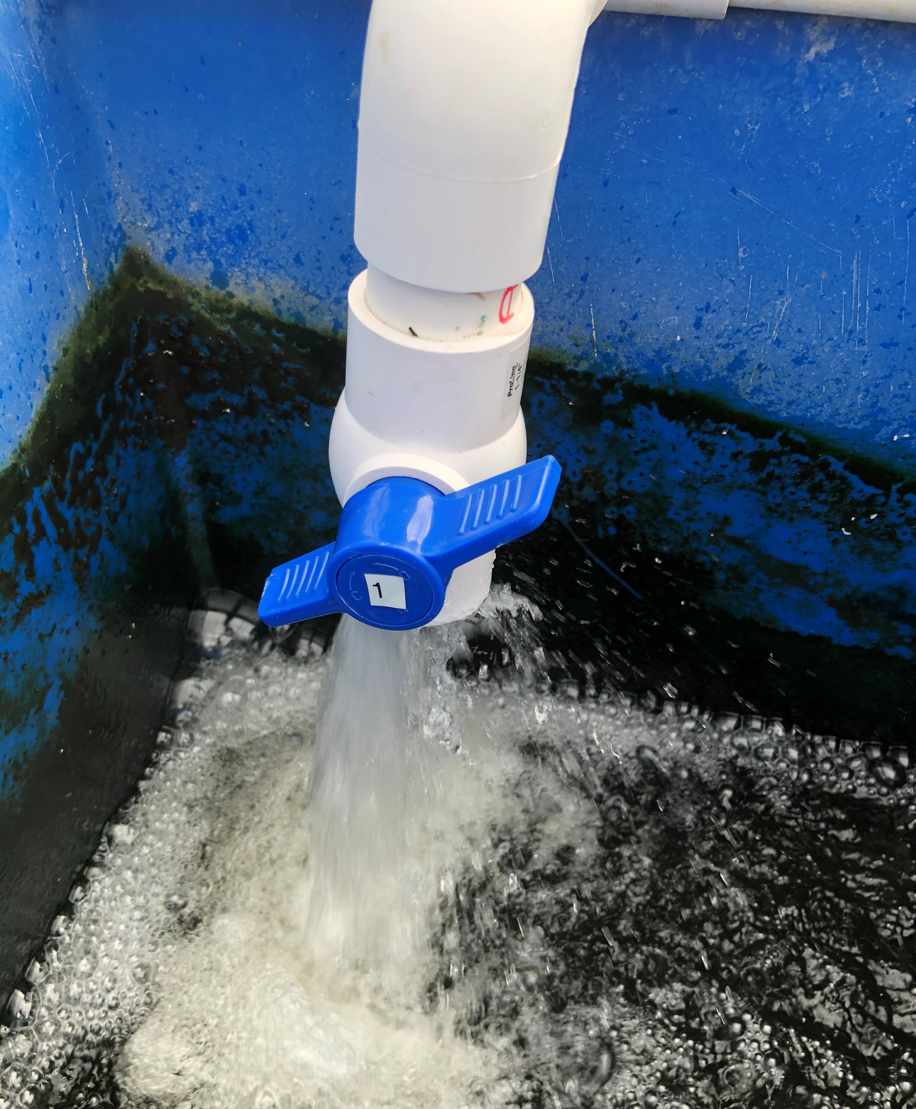
Pro Tip: Decrease Your CO₂ Via Splashing
If you divert flow from your pump back to your sump you can not only control your system flow rate but aid in degassing CO2 and increasing DO!

Slide 17
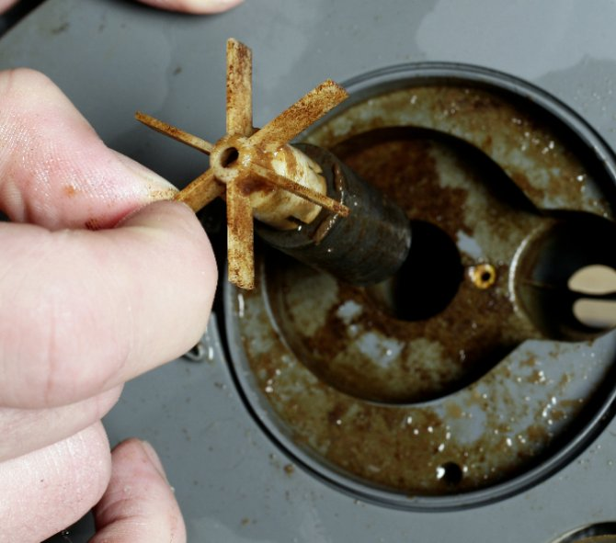
Water Pump Stops
Causes | Solution
Power is out (or fuse is tripped) | Check and reset fuse if necessary
Pump is defective | Get a new pump ASAP
Pump is clogged | Clean out pump
*Due to cavitation, submersible pumps become misaligned and propellers no longer spin smoothly
If not fixed within 24 hours, your system could crash, and you could lose your fish

Slide 18
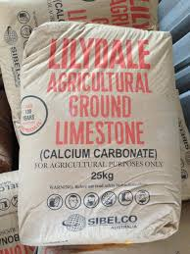
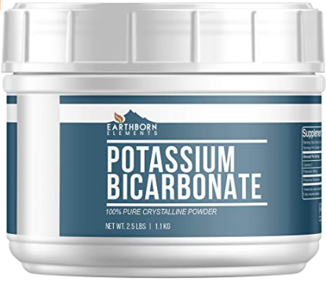
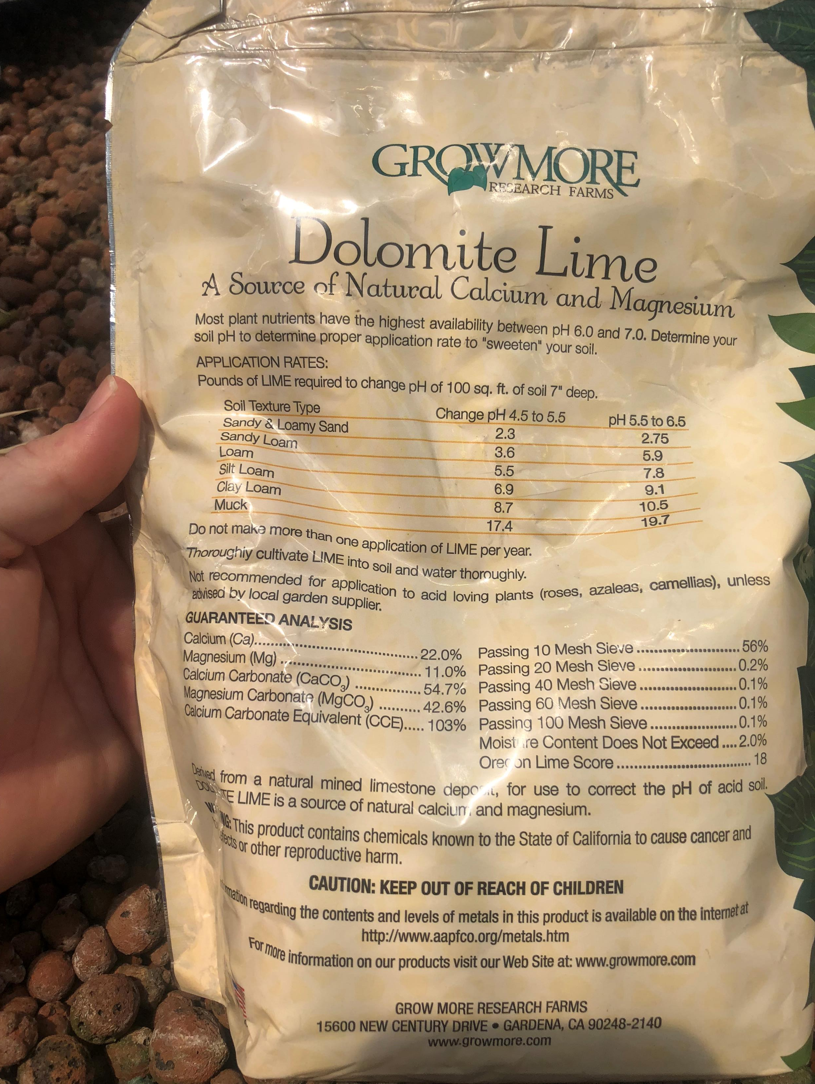
pH too Low
Long-term fix = Add agriculture lime or dolomite and potassium bicarbonate
Agriculture lime is calcium carbonate
Dolomite is calcium magnesium carbonate
Carbonate will increase alkalinity and help buffer your system
Short-term fix = Add calcium hydroxide or potassium hydroxide
But don’t raise pH to quickly or you can kill your fish!
Be careful handling as these are caustic chemicals

Slide 19
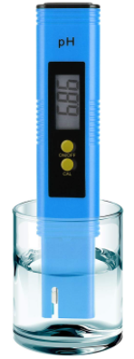
Pro Tip for Managing pH and alkalinity
Add Potassium bicarbonate when system pH drops to 6.5 and 1 g for every 10 gallons of water in system each day until pH reaches 6.9 - 7.0
Add same amount of calcium carbonate every 3rd or 4th time

Slide 20
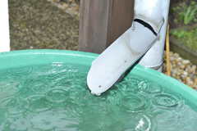
pH too High
This is an unlikely problem in most established systems
Causes:
Media in growbed is leaching carbonate or other anions
Source water has a high pH
System is not fully established
Solutions:
Do Nothing! If system is relatively new, th pH will usually correct itself
As nitrification increases, it will drive down the pH because alkalinity (carbonate) is used up during that process
Adding more plants can also help
You can add pH neutral water (i.e. rainwater, RO water)
Add Vinegar (weak acid)
Avoid adding strong acids like muriatic acid
React to quickly and can easily harm fish if not done with extreme care

Slide 21
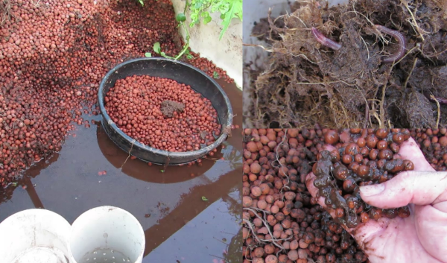
Flow Through Growbed is too slow
Reason: Media is too small
Fix 1: Change media to a larger size
Fix 2: Decrease the flow through the growbed
Reason 2: Growbed is clogged
Fix 1: Clean media
Fix 2: Increase solids filtration prior to growbed
Fix 3: Decrease fish density

Slide 22
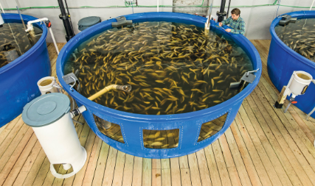
Observational Goal
Water should be clear and flowing and fish be actively swimming and feeding!

Slide 23


Questions?

