Slide 1
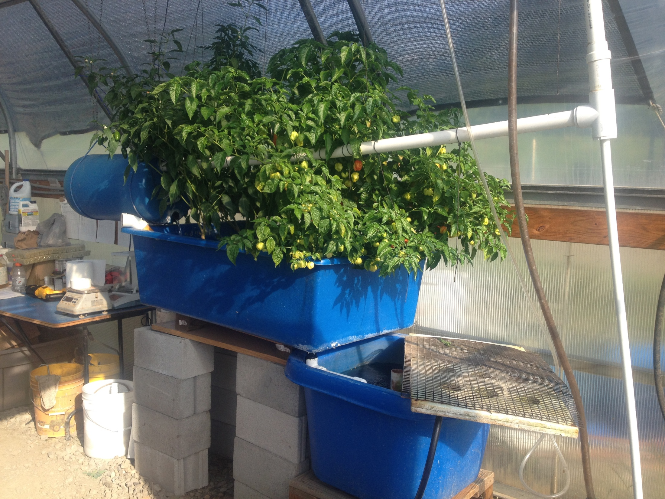
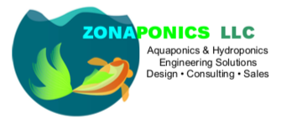

Introduction to Aquaponics and System Design
Matt “Rex” Recsetar, PhD
Assistant Professor, Extension Specialist
© 2025 Matthew Recsetar

Slide 2
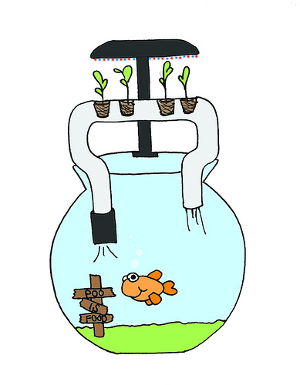
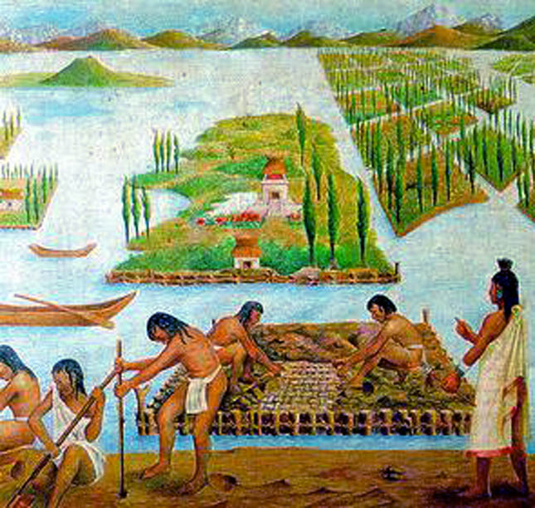
What is Aquaponics?
Aquaculture: farming of aquatic organisms under controlled conditions
Hydroponics: cultivation of plants in nutrient-rich soilless systems
Modern aquaponics: ~40 years
James Rakocy (University of Virgin Islands)

Slide 3
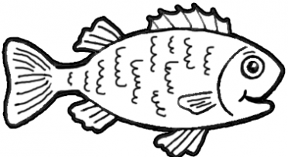
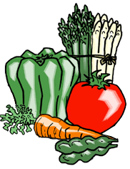
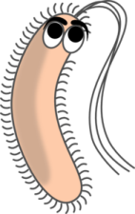
Plants filter water that is returned to the fish
Fish produce wastes
The Aquaponic Cycle
Bacteria converts wastes to fertilizer for plants

Slide 4
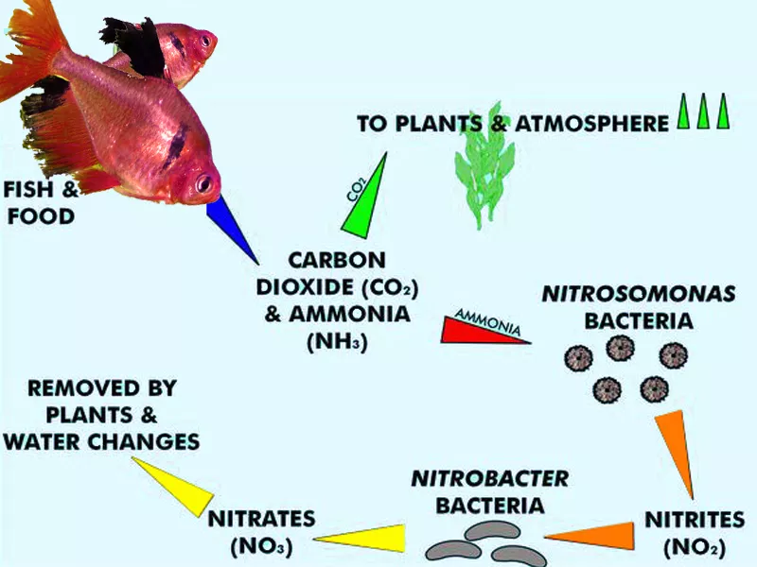
BASIC WASTE CYCLE

Slide 5
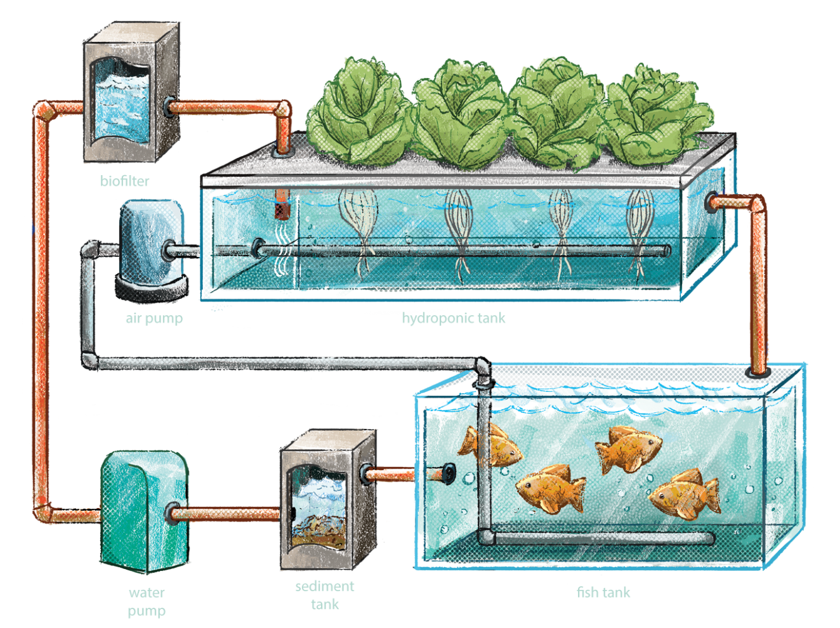
Why Use Aquaponics?

Slide 6

Trends in food markets
Demand for more locally grown, organic foods
Supply chain issues!
Increasing demand for vegetables and fish for health reasons
Need to increase economic and environmental efficiency (energy, water, land area, recycling of nutrients)

Slide 7
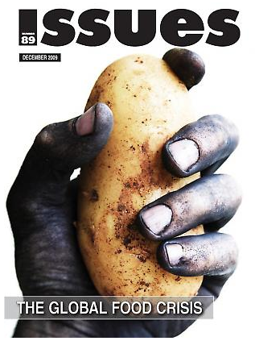
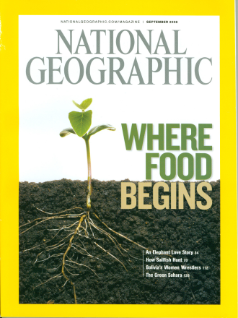


Global food crisis
Rapidly increasing population
Diversion of foods to bio-fuels
Increased costs for water, fertilizer, fuel
Multiple demands for farmland (urban sprawl, industrial and mining, solar and wind generation, wildlife conservation, watershed protection, global warming, etc.)
Demand for locally produced food
Water Shortages

Slide 8
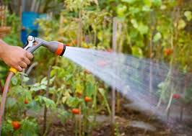
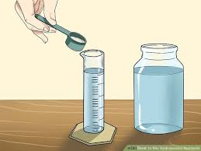
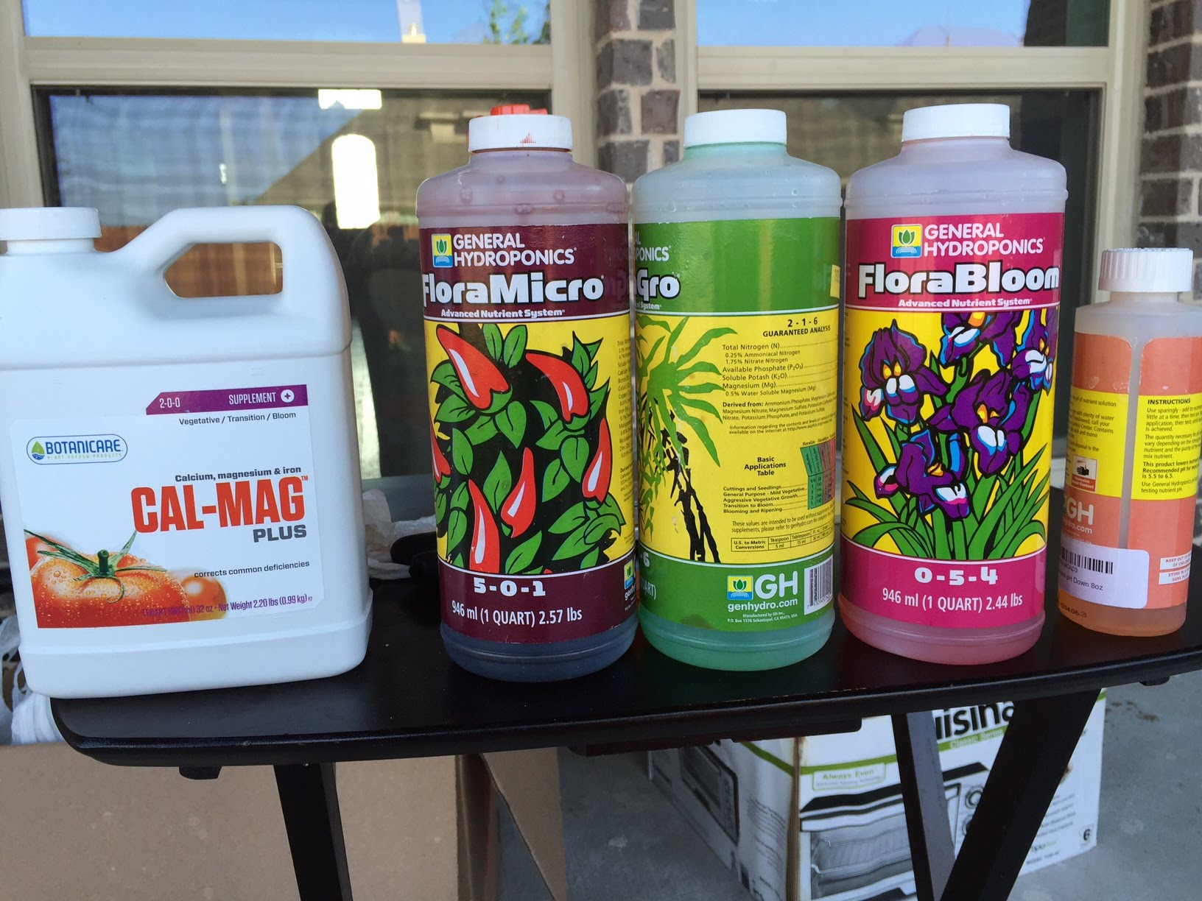
Many Advantages of Aquaponics
Uses roughly 90% less water than used in traditional gardening
Reduces cost and time mixing hydroponic nutrients plus no water changes
Notes:
Aquaponics utilizes the nutrient rich water from aquaculture that otherwise would have been a waste product or would need to be filtered in a costly manner.
Aquaponics eliminates the cost and time involved with mixing traditional hydroponic nutrients.
Aquaponics provides a truly organic, natural form of nutrients for the plants.
By eliminating the soil in vegetable production, you eliminate all soil borne disease.
Aquaponics uses a fraction of the water that traditional field production does because no water is wasted or consumed by weeds.
In aquaponics, plant spacing can be very intensive, allowing you to grow more plants in a given space.
With high stocking densities in the fish tank, plants will quickly grow and develop in an aquaponic system.
In aquaponics there cannot be any pesticides or herbicides used, making the end product healthier and safer.
If your climate permits or if you are growing in a greenhouse, you can grow crops in an aquaponic system year-round.

Slide 9
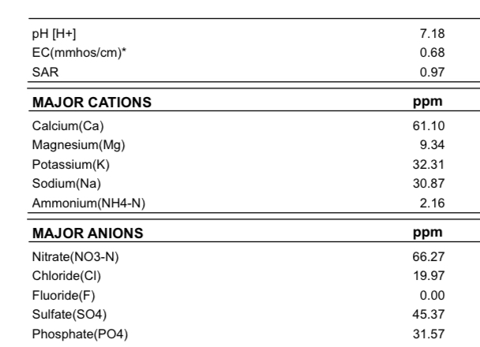
Advantages of Aquaponics
Nutrient rich water (no fertilizers needed)
*Provides organic nutrients for plants
Notes:
Aquaponics utilizes the nutrient rich water from aquaculture that otherwise would have been a waste product or would need to be filtered in a costly manner.
Aquaponics eliminates the cost and time involved with mixing traditional hydroponic nutrients.
Aquaponics provides a truly organic, natural form of nutrients for the plants.
By eliminating the soil in vegetable production, you eliminate all soil borne disease.
Aquaponics uses a fraction of the water that traditional field production does because no water is wasted or consumed by weeds.
In aquaponics, plant spacing can be very intensive, allowing you to grow more plants in a given space.
With high stocking densities in the fish tank, plants will quickly grow and develop in an aquaponic system.
In aquaponics there cannot be any pesticides or herbicides used, making the end product healthier and safer.
If your climate permits or if you are growing in a greenhouse, you can grow crops in an aquaponic system year-round.

Slide 10
Advantages of Aquaponics
Nutrient rich water (no fertilizers needed)
*Provides organic nutrients for plants
Notes:
Aquaponics utilizes the nutrient rich water from aquaculture that otherwise would have been a waste product or would need to be filtered in a costly manner.
Aquaponics eliminates the cost and time involved with mixing traditional hydroponic nutrients.
Aquaponics provides a truly organic, natural form of nutrients for the plants.
By eliminating the soil in vegetable production, you eliminate all soil borne disease.
Aquaponics uses a fraction of the water that traditional field production does because no water is wasted or consumed by weeds.
In aquaponics, plant spacing can be very intensive, allowing you to grow more plants in a given space.
With high stocking densities in the fish tank, plants will quickly grow and develop in an aquaponic system.
In aquaponics there cannot be any pesticides or herbicides used, making the end product healthier and safer.
If your climate permits or if you are growing in a greenhouse, you can grow crops in an aquaponic system year-round.

Slide 11
Advantages of Aquaponics
Nutrient rich water (no fertilizers needed)
*Provides organic nutrients for plants
Notes:
Aquaponics utilizes the nutrient rich water from aquaculture that otherwise would have been a waste product or would need to be filtered in a costly manner.
Aquaponics eliminates the cost and time involved with mixing traditional hydroponic nutrients.
Aquaponics provides a truly organic, natural form of nutrients for the plants.
By eliminating the soil in vegetable production, you eliminate all soil borne disease.
Aquaponics uses a fraction of the water that traditional field production does because no water is wasted or consumed by weeds.
In aquaponics, plant spacing can be very intensive, allowing you to grow more plants in a given space.
With high stocking densities in the fish tank, plants will quickly grow and develop in an aquaponic system.
In aquaponics there cannot be any pesticides or herbicides used, making the end product healthier and safer.
If your climate permits or if you are growing in a greenhouse, you can grow crops in an aquaponic system year-round.

Slide 12
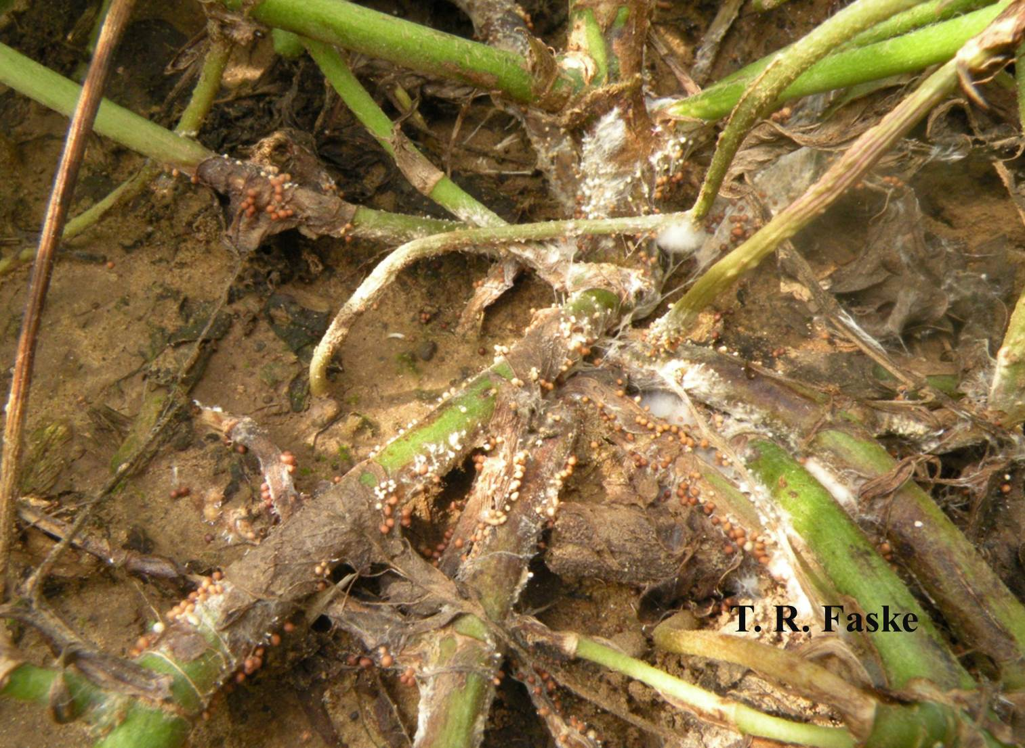
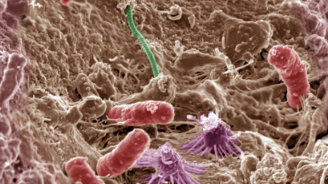
Advantages of Aquaponics
Eliminates soil borne diseases
Diverse and complex bacterial load in system has an antagonistic effect on many fish and plant pathogens thus limiting or eliminating many disease problems and even promoting plant health.
Notes:
Aquaponics utilizes the nutrient rich water from aquaculture that otherwise would have been a waste product or would need to be filtered in a costly manner.
Aquaponics eliminates the cost and time involved with mixing traditional hydroponic nutrients.
Aquaponics provides a truly organic, natural form of nutrients for the plants.
By eliminating the soil in vegetable production, you eliminate all soil borne disease.
Aquaponics uses a fraction of the water that traditional field production does because no water is wasted or consumed by weeds.
In aquaponics, plant spacing can be very intensive, allowing you to grow more plants in a given space.
With high stocking densities in the fish tank, plants will quickly grow and develop in an aquaponic system.
In aquaponics there cannot be any pesticides or herbicides used, making the end product healthier and safer.
If your climate permits or if you are growing in a greenhouse, you can grow crops in an aquaponic system year-round.

Slide 13
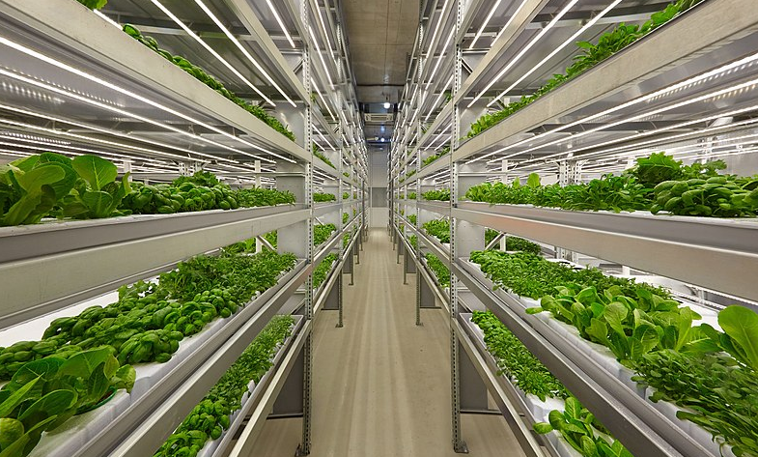
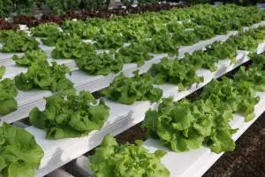
Advantages of Aquaponics
Plant spacing can be more intensive
Up to 30 times greater production in same area as row cropping
Ability to go vertical when space is limited
Notes:
Aquaponics utilizes the nutrient rich water from aquaculture that otherwise would have been a waste product or would need to be filtered in a costly manner.
Aquaponics eliminates the cost and time involved with mixing traditional hydroponic nutrients.
Aquaponics provides a truly organic, natural form of nutrients for the plants.
By eliminating the soil in vegetable production, you eliminate all soil borne disease.
Aquaponics uses a fraction of the water that traditional field production does because no water is wasted or consumed by weeds.
In aquaponics, plant spacing can be very intensive, allowing you to grow more plants in a given space.
With high stocking densities in the fish tank, plants will quickly grow and develop in an aquaponic system.
In aquaponics there cannot be any pesticides or herbicides used, making the end product healthier and safer.
If your climate permits or if you are growing in a greenhouse, you can grow crops in an aquaponic system year-round.

Slide 14
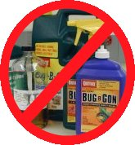
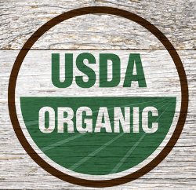
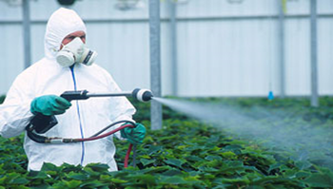
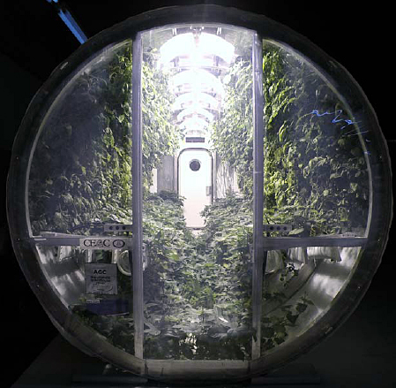
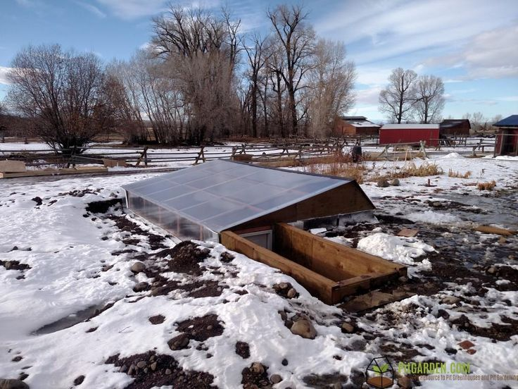
Advantages of Aquaponics
Cannot use pesticides or herbicides – healthier and safer end-products
Grow almost anywhere
Notes:
Aquaponics utilizes the nutrient rich water from aquaculture that otherwise would have been a waste product or would need to be filtered in a costly manner.
Aquaponics eliminates the cost and time involved with mixing traditional hydroponic nutrients.
Aquaponics provides a truly organic, natural form of nutrients for the plants.
By eliminating the soil in vegetable production, you eliminate all soil borne disease.
Aquaponics uses a fraction of the water that traditional field production does because no water is wasted or consumed by weeds.
In aquaponics, plant spacing can be very intensive, allowing you to grow more plants in a given space.
With high stocking densities in the fish tank, plants will quickly grow and develop in an aquaponic system.
In aquaponics there cannot be any pesticides or herbicides used, making the end product healthier and safer.
If your climate permits or if you are growing in a greenhouse, you can grow crops in an aquaponic system year-round.

Slide 15
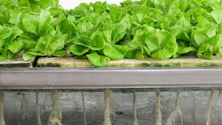
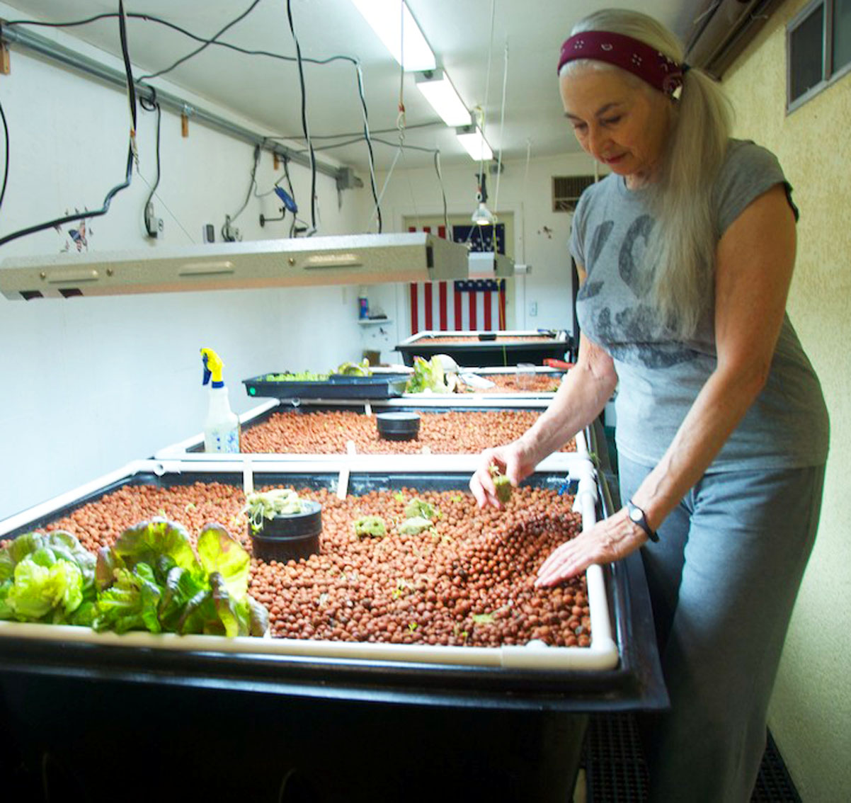
Advantages of Aquaponics
No soil to till, lower carbon footprint
Waist height; predation-less;
better on backs of workers
Can raise fish for food, aesthetics (ornamentals), baitfish or just for nutrients
Notes:
Aquaponics utilizes the nutrient rich water from aquaculture that otherwise would have been a waste product or would need to be filtered in a costly manner.
Aquaponics eliminates the cost and time involved with mixing traditional hydroponic nutrients.
Aquaponics provides a truly organic, natural form of nutrients for the plants.
By eliminating the soil in vegetable production, you eliminate all soil borne disease.
Aquaponics uses a fraction of the water that traditional field production does because no water is wasted or consumed by weeds.
In aquaponics, plant spacing can be very intensive, allowing you to grow more plants in a given space.
With high stocking densities in the fish tank, plants will quickly grow and develop in an aquaponic system.
In aquaponics there cannot be any pesticides or herbicides used, making the end product healthier and safer.
If your climate permits or if you are growing in a greenhouse, you can grow crops in an aquaponic system year-round.

Slide 16

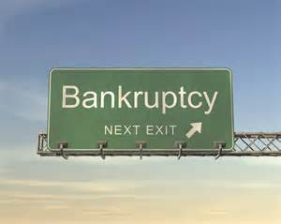
Currently only a few Commercially Viable Aquaponic Businesses Exist…As I say this, there are probably even less

Slide 17
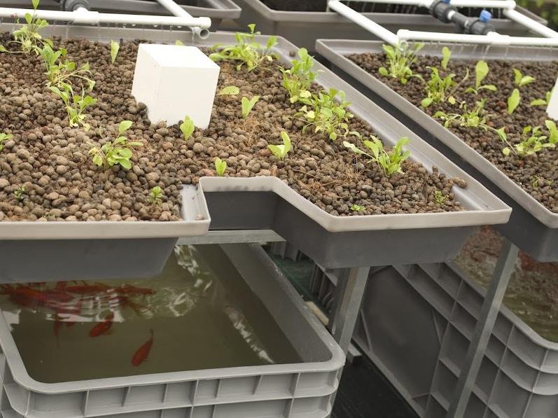
Small Scale Aquaponics
Can supplement healthy food for your family, friends and neighbors!
Once you are up and running it is easy enough to manage and maintain!
Fun and therapeutic activity!
Great teaching tool!

Slide 18
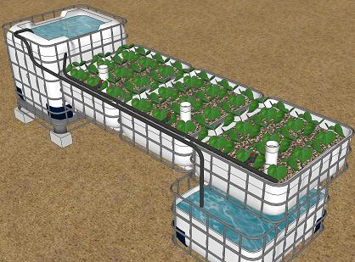
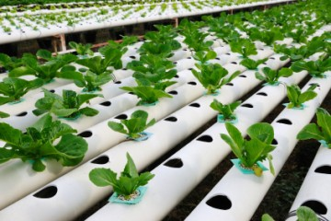
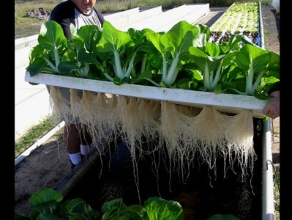
Three Main Aquaponic System Types
Deep Water Culture (DWC) or Raft System
Nutrient Film Technique (NFT)
Media Bed System
Can be Flood and Drain or Ebb and Flow system, flow through or standing water level

Slide 19
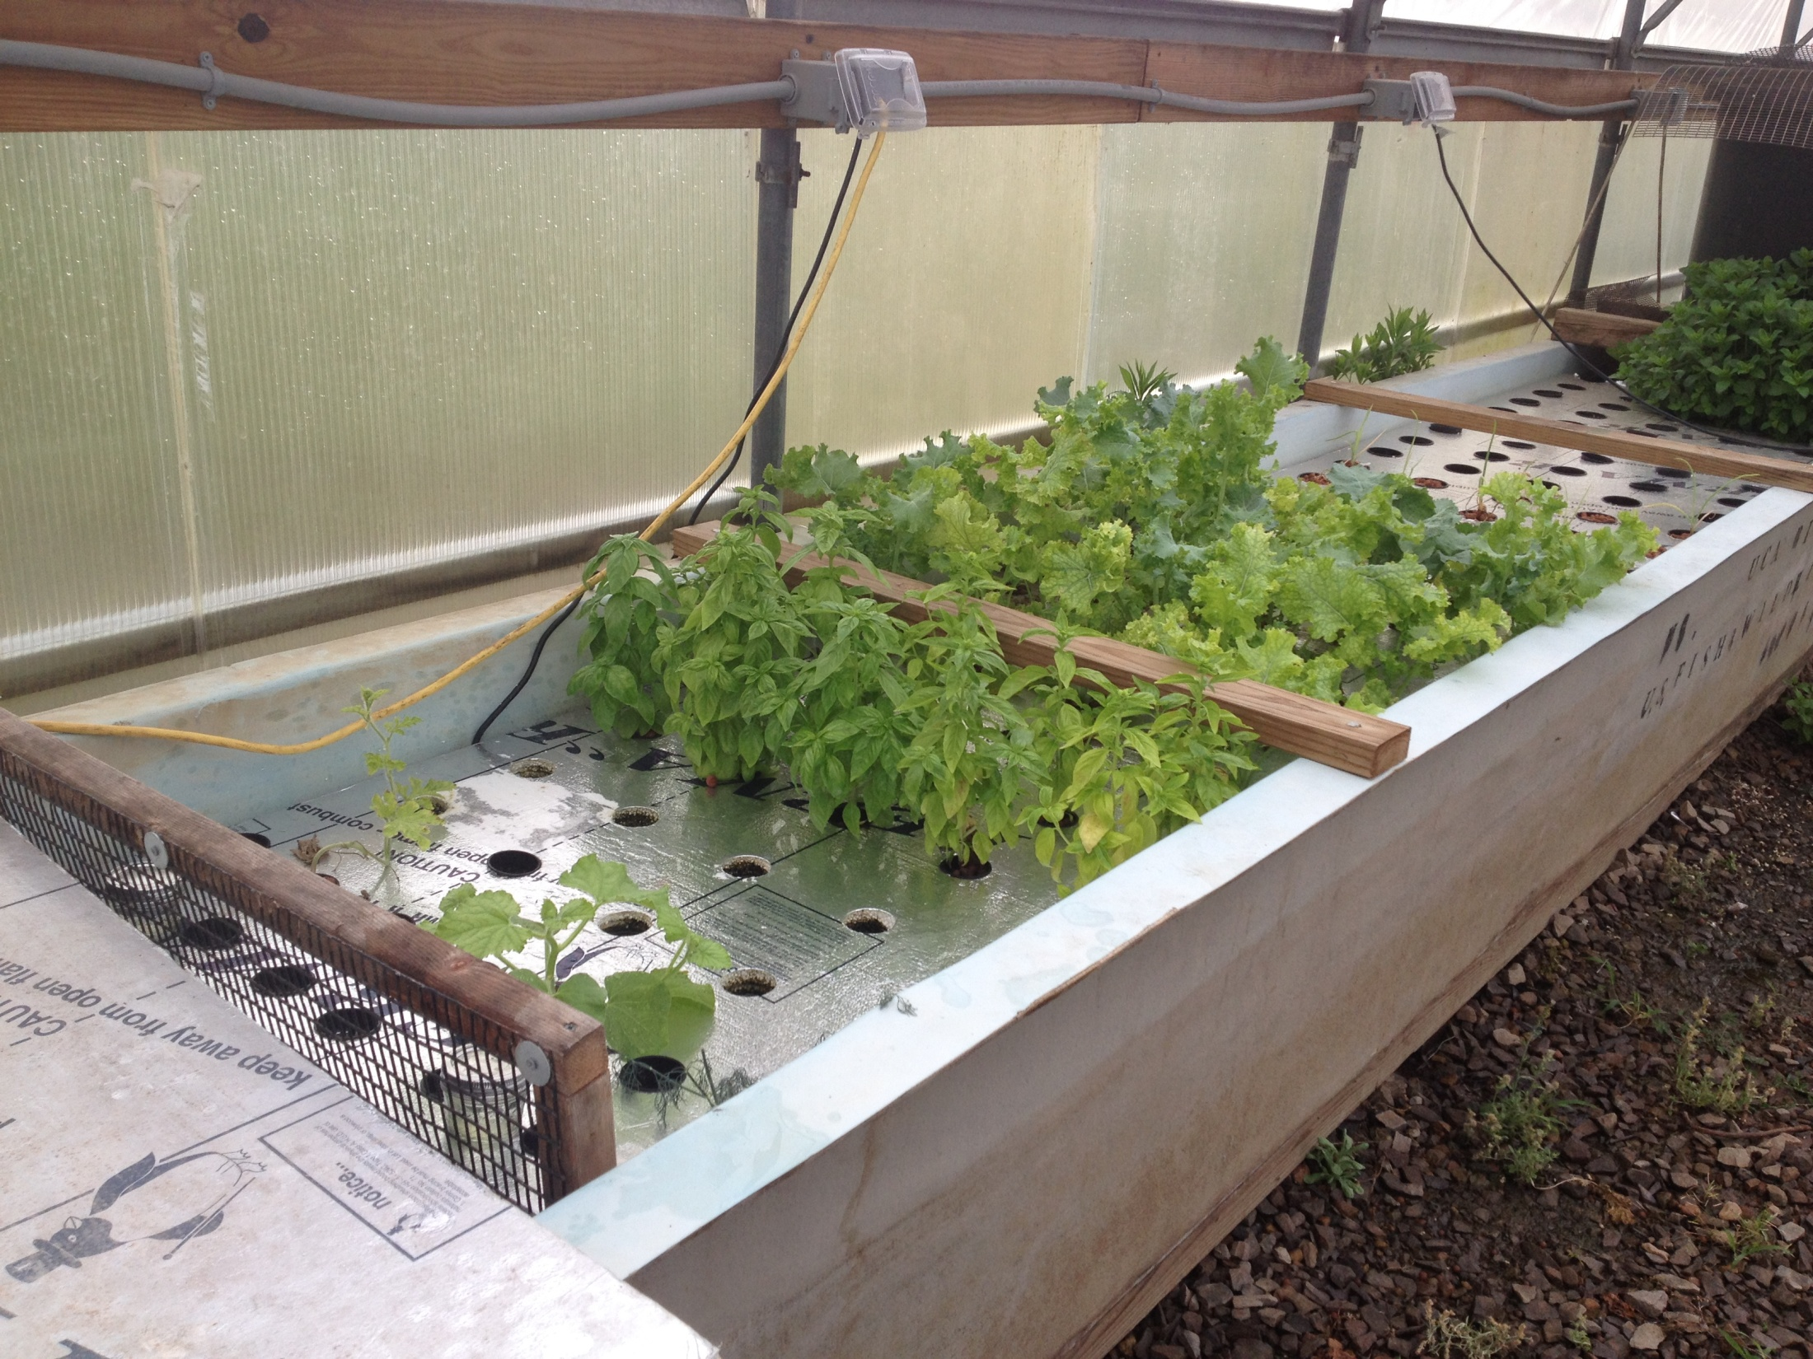
Deep Water Culture or Floating Raft Systems
Plants grown on Polystyrene boards (rafts)
01
Need separate filtration component in system
02
Fish are in separate tank
03
Need air supply to plant tank
04

Slide 20
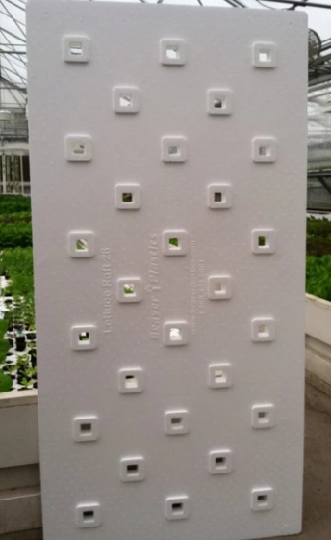
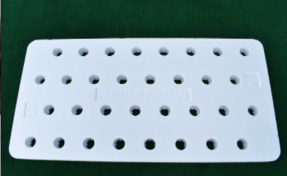
DWC Floating Raft Boards
Beaver boards
Typically come in 4’x2’ sections
Boards may have varying hole sizes and hole numbers per board
Holes for root plug (1” square holes) or net pots (circular)
18, 28, 36 and 72 holes per board depending on desired plant density
Gives growers many options for crop variety
Can also make rafts out of
insulation foam board and cut holes
with hole saw

Slide 21
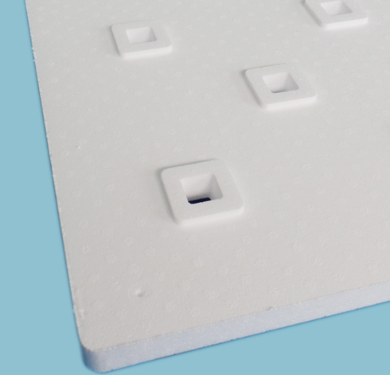
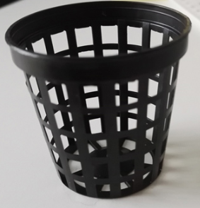
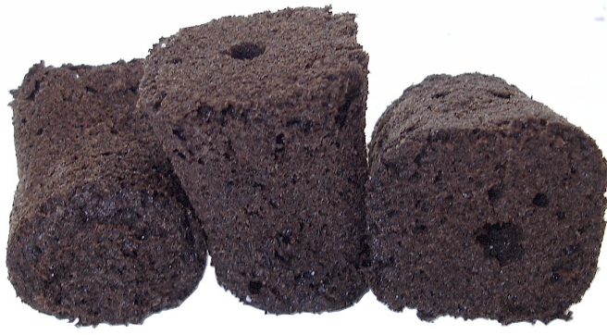
Deep Water Culture Rafts
Plants grown on and supported by a floating raft
Food grade Polystyrene boards
Various hole spacing depending on desired plant density
Precut holes (square or circle) for:
root plugs
or
net pots

Slide 22
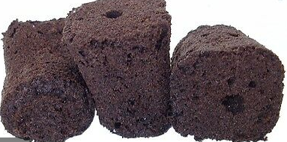
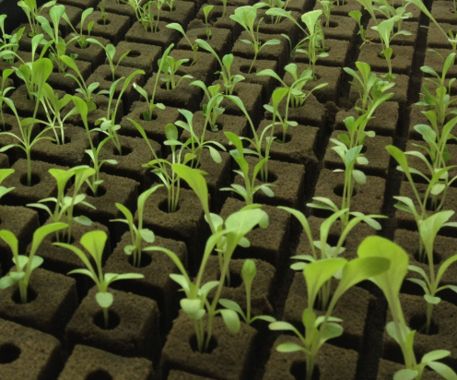
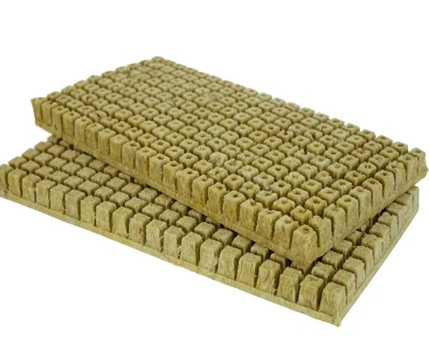
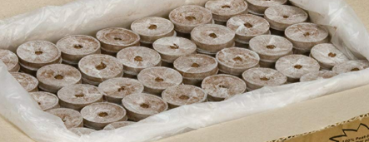
Types of Root Plugs
Peat
Ie. Root Riot, Rapid Rooter, Root!t, Accelaroot
Oasis Horticubes®
Rockwool
Coco coir

Slide 23
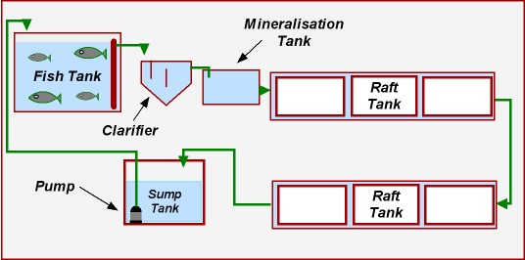
FLOATING RAFT SYSTEM DIAGRAM

Slide 24
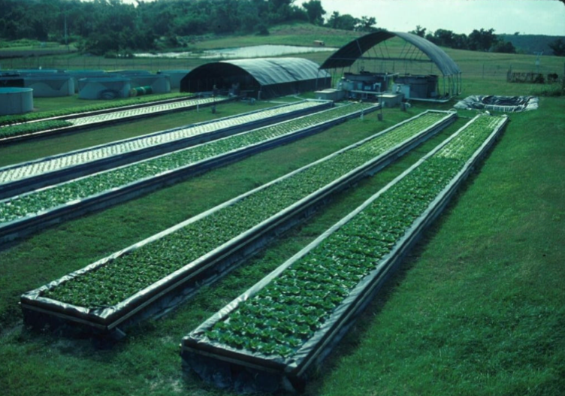
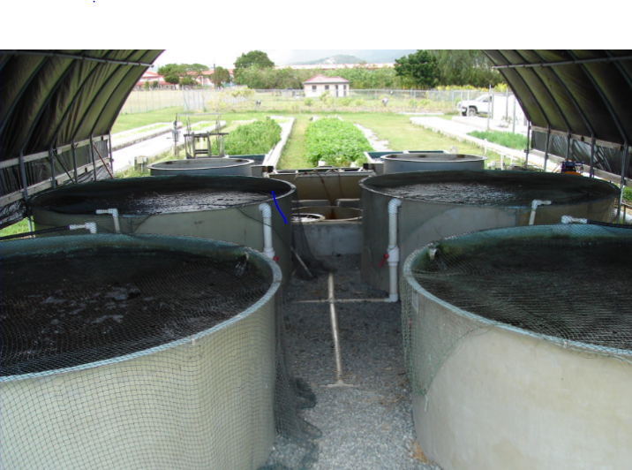
UVI System University of Virgin Islands

Slide 25
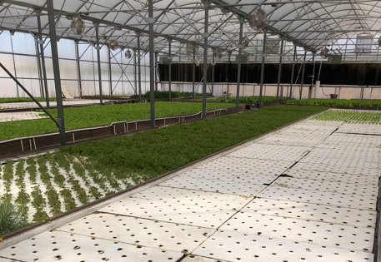
Merchant’s Garden (Tucson, AZ)

Slide 26
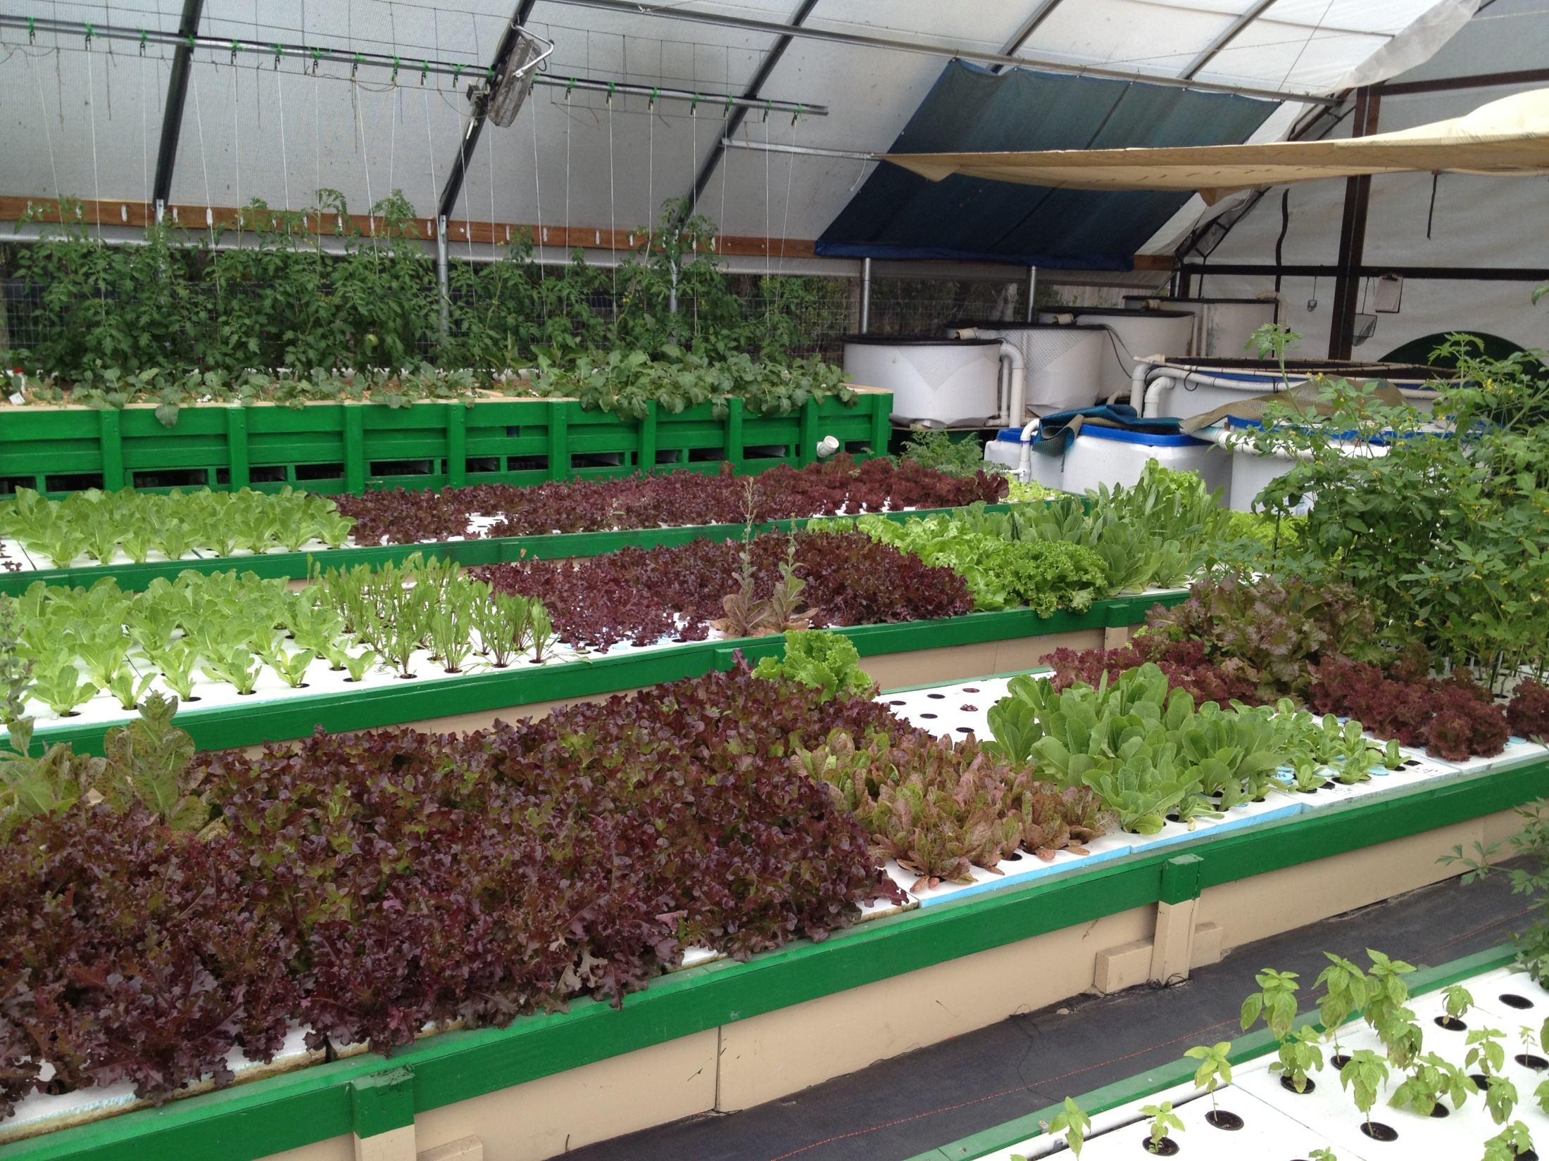

Slide 27
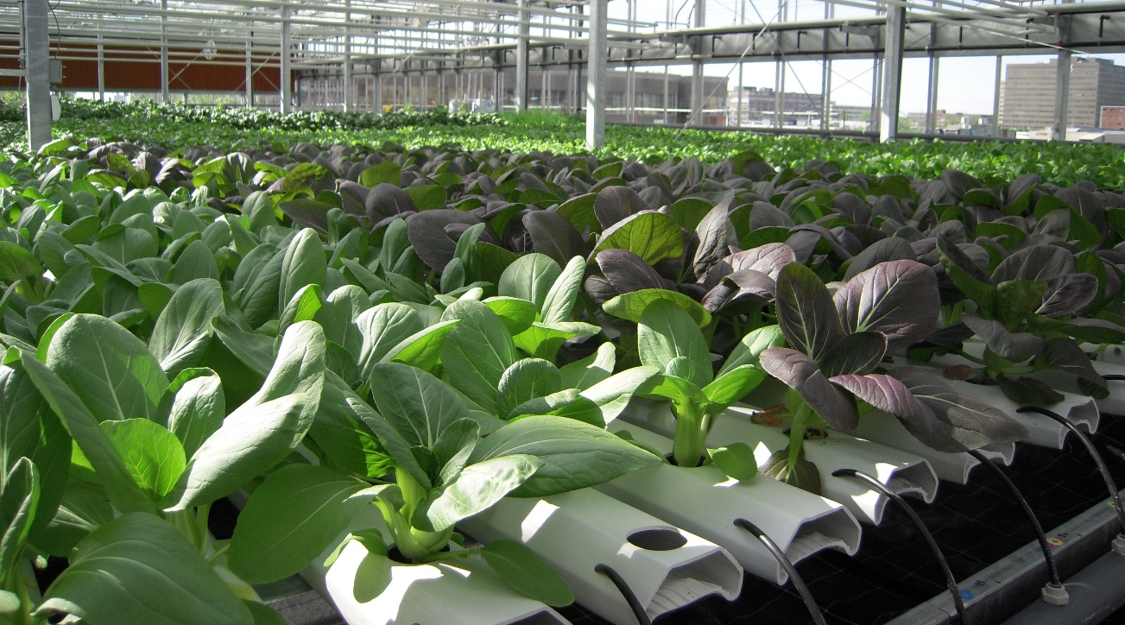
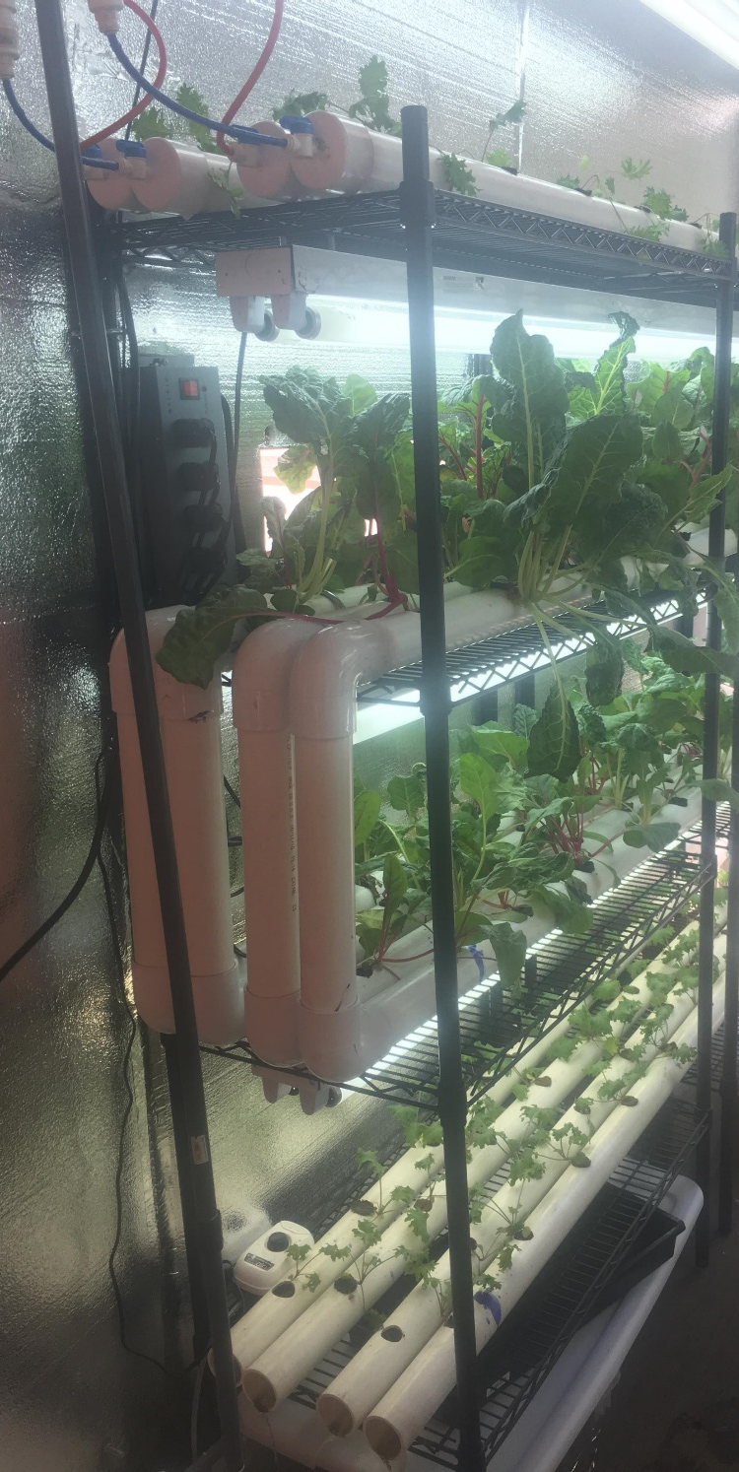
NFT Systems
Cats in the Greenbox NFT System (UArizona)

Slide 28
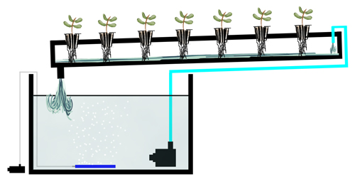
Nutrient Film Technique
Plants grown in long narrow channels
Thin film of water continuously flows down the channel
Must have separate filtration as beneficial bacteria do not have sufficient surface area to grow on.

Slide 29
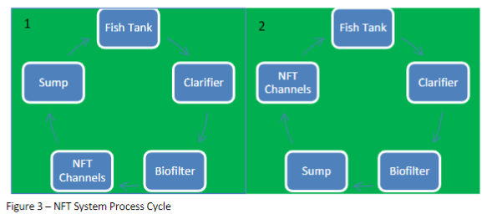
*Solids Removal
*Solids Removal

Slide 30



NFT Channels
Gutters or pipes with holes designed for root plugs or net pots filled with a variety of media
Use of net pots helps avoid risk of plants falling into channel

Slide 31

Slope of NFT Channels
1:30 to 1:40
Meaning for every 30-40” of length there should be 1” of drop
Example:
10-foot channel = 120 inches
120 inches / 40 = 3 inches of drop
Why not more slope or less?
Keep water flowing
Prevent water backing up
1”
40”

Slide 32






Slide 33

Amhydro system

Slide 34






Slide 35

Media Bed System
Can be simple or complex
Grow bed generally at least waste height
Grow bed above fish tank if no sump
Pump water to grow bed – water drains back into fish tank
Allow for widest variety of crops
Notes:
This is possibly the most simple method of setting up a flood and drain system. The grow bed sits above the fish tank, water is pumped from the fish tank into the grow bed, then the water drains straight back into the fish tank below. The ultimate in simplicity. If there's a problem with the pump or power supply the water drains straight back into the fish tank. This style of system is compact and has very few disadvantages, the only minor disadvantage is that the water level in the fish tank fluctuates when flooding the beds. Also the pump is in the fish tank so if it's only a small pump with limited solid pumping capacity, solid wastes may clog up the pump, requiring periodic maintenance.

Slide 36


Slide 37

Dry zone
Root zone
Solids collection zone
Notes:
Surface or dry zone. --- The first 50mm is the light penetration and dry zone. Evaporation from the bed is minimized by the existence of a dry zone. Water waste minimization is a very important principle in Aquaponics systems. This dry zone also protects the plant base against collar rot. Additionally, by ensuring that this zone is kept dry, algae is prevented from forming on the surface of the grow bed media. Because this dry zone is present, moisture related plant diseases such as powdery mildew are minimized.
Root zone. --- Most root growth and plant activity will occur in the next zone of approximately 150 - 200mm –in this zone, during the drain part of the flood and drain cycle, the water drains away completely, allowing for excellent and very efficient delivery of oxygen rich air to the roots, beneficial bacteria, soil microbes, and the resident earth/composting worms.
During the flood part of the cycle, the incoming water distributes moisture, nutrients and incoming solid fish waste particles throughout the growing zone. The worm population does most of its very important work in this zone, breaking down and reducing solid matter and thereby releasing nutrients and minerals to the system. worm Tea”, as it is commonly known, will be evenly mixed and distributed during each flood and drain cycle. “Worm Tea” and the fish are entirely compatible, No possible harm can come to the fish by the distribution of this wonderful nutrient material throughout the Aquaponics System. Solid collection and Mineralization Zone This is the bottom 50plus mm of the grow bed. In this zone fish waste solids and worm castings are finally collected.
The solid material has been reduced by up to 60% by volume, by the action of the resident garden/composting worms, and microbial action. During each flood and drain cycle, what is left of the solids percolates down into this zone Further and final mineralization occurs in this area via bacterial and earth worm activity. Due to the excellent action of the flood and drain cycle, this bottom area is kept “fresh” and vital by the excellent delivery of oxygen rich water during the flood cycle. Some water storage occurs in this bottom zone. Should the flood and drain cycle stop for any reason, such as a mains power outage, the bed will slowly drain down and leave approx 50mm of water at the bottom of the grow bed. The stored water provides a safety buffer in the event of power outage or pump failure... This stored water ensures that the plants will survive for very long periods without water flow.
This means that we can simplify our safety backup system to circulate only the water in the fish tank, by the use of low wattage water pumps and/or aerators. We can safely operate the system in backup mode (no main power supply) for very long periods of time–simply using an average size car battery as a power source.
This inbuilt water storage zone will supply the plants with water and nutrient should we need to isolate the fish tank for maintenance purposes, or treatment of the fish.

Slide 38


Media Bed Considerations
Inflow manifold to disperse flow
Especially if you have a square grow bed (i.e. IBC Tote)
Air diffusers in bed
You do not want anaerobic zones
Drain placement (center or opposite end as inlet)

Slide 39





Flood and Drain (Ebb and Flow)
Recommended but can function without
Allows for root aeration
Helps prevent anaerobic conditions and short-circuiting in grow bed
Even distribution of nutrients
How?
Bell Siphons
U-siphons
Solenoid Valves
Timers
For pumps and solenoid valves

Slide 40

Flood and Drain
Draining media bed periodically is important
Brings needed oxygen in contact with roots
Improves nutrient disbursement by eliminating short-circuiting
Helps push fine solids to bottom of growbed

Slide 41


Bowl Siphon (U siphon)

Slide 42


Bell Siphon Diagram (not for use in commercial systems- volumes to large)

Slide 43

Best to Use Timers
Either pumps on timers (like germination trays)
Pump and fill grow bed through a bottom drain that fills growbed to a desired height (set by stand pipe)
Normal state: Pump off, grow beds drained
OR
Solenoid valves on timers
Solenoid valve opens for set intervals to allow tank to drain
Normal state: Valve closed, grow beds full
Get very expensive after 1” pipe diameter

Slide 44


Using Solenoid Valves for Flood and Drain
Connect 110-V solenoid valve to valve to plug and plug into watering timer
Can purchase both on Amazon or get sprinkler timers at most local or online hydroponic stores

Slide 45

CHOP Constant Height One Pump System
Water flows into grow bed
Drains into sump
Water pumped from sump to fish tank
Often seen in gardens (Biosphere 2)
Ideal for low fish densities only
Notes:
This style of system uses a pump in the sump tank that pumps water into the fish tank, the overflow pipe causes the water to flow out of the fish tank, when it exceeds a certain height, and into a grow bed where it drains back into the sump tank. A simple version of this system can be seen on the left, the black pipe pumps water into the fish tank, while water flows out of the white PVC pipe into the grow bed before draining back into the sump. This system was run with a timer on the pump and a restricted outlet on the drain, this allowed for a flooding and draining action in the grow bed.
CHIFT PIST systems have many advantages over other methods, and they have a few disadvantages. The main advantage of a CHIFT PIST system, is that it means there is no pump in the fish tank, the fish tank stays at a fairly constant height, and if there's ever a pump failure or blackout the fish tank will stay full. Disadvantages are that you need a sump tank with a large volume and a short height, to hold the water and you also need a tall or raised fish tank.

Slide 46


Slide 47

Growbed Media
Non-soil media
Provides plant support and root aeration
Surface area for bacterial growth
Traps/collects solids
*Also use Pete/perlite mixes
Coco coir, etc for flow through

Slide 48


Advantages
Can grow a wider variety of plants
Mineralization in proximity to plant roots
Easy transition from traditional gardening

Slide 49


Disadvantages
Less scalable
Need to clean periodically
Media can clog (especially if no solids filter)
Short-circuiting
Anaerobic conditions
Can provide a home for pests feeding on decaying plant material

Slide 50





Slide 51


Patio Herb Garden

Slide 52


Slide 53

*Fully Automated
Controlled Evnrionment Club Aquaponics System

Slide 54

5 Weeks
2 weeks
Planting Day

Slide 55

Purpose of the Sump Tank
Allows you to have a constant height in your fish tank
Allows you to keep pump away from fish (small fish can and will get sucked into pump if in fish tank)
Allows water to move by gravity into one tank
i.e. Multiple grow beds or multiple fish tanks
Good place to add any supplements and makeup water

Slide 56

Sump
Should be sized with enough volume to cover the pump plus whatever amount of water the NFT channels or media bed can hold at one time.
If the pump stopped there should be enough space in it to hold the overflow
However, you do not want such a big sump that your nutrients would become diluted
For NFT you may want to go a little bigger to buffer against abrupt changes in water temperature
Bigger pumps should have bigger sumps

Slide 57

Solids Removal/Clarification
Removal of solids (fish poop, uneaten feed) crucial in aquaponics systems to maintain water quality for fish and plants
Problems of excess solids
Reduction of dissolved oxygen levels
Stressful to fish
Anaerobic conditions
Production of Toxic gases (i.e. H₂S, CO₂)
Clogs in pipes, pumps and plant roots

Slide 58



Solids Removal/Clarification
Mechanisms
Settling (gravity)
Physical capture
Screen filtration

Slide 59
Biofiltration
Bacteria are naturally occurring and will cover just about any surface in your system
Nitrifying bacteria convert ammonia excreted by fish to nitrate (food for plants)
If solids are not removed, then heterotrophic bacteria will compete with nitrifying bacteria for space which could lead to build up of ammonia in system or even dirty looking water

Slide 60

Biofilter Components
Physical components
Container
Air diffusers and air pump
Surface area for bacterial growth
Chemical components
Oxygen (air)
Ammonia
Alkalinity (carbonates)
Credit: BioAqua

Slide 61

Remember This Order!!

Slide 62
Remember This Order!!
*For simple media bed systems

Slide 63



Many Innovative Designs
Use the internet to search for ideas!

Slide 64

*Hybrid NFT with media

Slide 65


Bato Bucket System

Slide 66


Media Channels - Watered on a timer
Dayton Valley Aquaponics (No longer in business)
*Proprietary peat/perlite mix

Slide 67




Indoor Systems

Slide 68

Tables

Slide 69



Slide 70


Slide 71

Countertop Systems

Slide 72





Slide 73


Sleek Indoor Systems

Slide 74


Slide 75


Slide 76

Decorative Outdoor Systems

Slide 77


Slide 78


Slide 79

NFT System on Side of Building

Slide 80


Slide 81

Aquaponics Herb Garden Using a 55-Gallon Plastic Barrell

Slide 82
Features
55-gallon barrel cut in half
Pump in fish tank
Bell siphon
Air pump
Octagonal wood frame

Slide 83

Aquaponics Herb Garden Using IBC Tote and 55-gallon Plastic Barrell

Slide 84

Innovations
Water is airlifted out of fish tank
Airlift provides oxygen to roots
Breaks up solid waste
Uses less energy than water pump
Less likely chance of clogging
Growbed has a cabinet that houses
Air pump
Fish feed
Fish net
Additional Nutrients
Other supplies

Slide 85


What is an Airlift?
Innovative way to pump water by using air
Smaller bubble from air source cannot rise to the surface due to water pressure on top
Smaller bubbles combine with other small bubbles to form large bubbles which can rise to the top and lift water with them
The height that they can lift depends up on the volume of air and the diameter of the pipe

Slide 86

Aquaponics Bar at Disney’s Epcot

Slide 87

So many cool ideas out there that have yet to be put into action! Only limited to your creativity!

