Slide 1

NAWT
ETHICS
Notes:
1
Welcome to the National Onsite Foundations 101 - Inspecting Onlot Wastewater Treatment Systems
Each Trainer Introduces self
Give your background - Pumper - Installer - SEO - Home Inspector
Trainer introduces any NOF support personnel present.
Housekeeping & Ground Rules – This is an informal Session
Ask questions as you think of them. The greatest resource in this room is you, the trainees. If I get stumped, I’ll count on one of you for the answer!
Pit stops as needed - tell them where toilets are
Cell Phones and pagers on silent or vibrate – If you need to take a call – leave the room…please!

Slide 2

Conflict of Interest
Avoid any Conflict of Interest or the appearance of Conflict.
Inspectors often discover conditions and components that need upgrading/fixing.
NAWT members are often best prepared to offer to make the necessary repairs.

Slide 3
Conflict of Interest
NAWT OWTS Standard Practices:
  Never combine and Inspection Report and a proposal to repair.
  Every Inspection Report that indicates repairs are needed MUST INCLUDE THE FOLLOWING STATEMENT:
You may select any service provider; however, work not performed by this company must be inspected by a NAWT OWTS-certified inspector in order to verify satisfactory repairs and issue an updated inspection report.
Notes:
Page 44
Go over slide, then go over page 44 beginning at to enjoy. (PSMA Standard Practices)
Note: Baffle repairs and risers may be a permitted activity in some municipalities.

Slide 4
Ethics (page 59)
NAWT expects all inspectors to conduct their business in an ethical manor.
NAWT members/certified inspectors choosing not to perform a NAWT OWTS Inspection per the standards may not refer to their affiliation with NAWT or display any NAWT logo/text in their report.
Recommending a NAWT member to pump, inspect, install or repair in the report is acceptable.
Notes:
Refer to page 45
Discuss as needed.
4

Slide 5
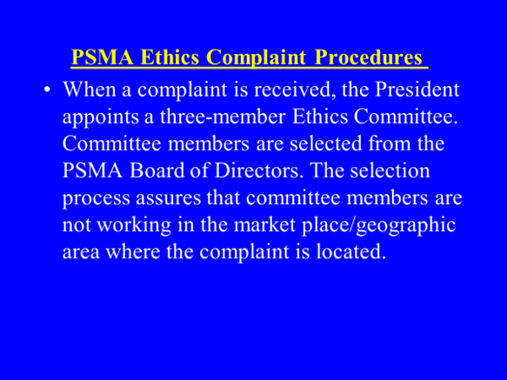
Notes:
The insert on this slide cannot be changed – we need to draft the NAWT Ethics Complaint Procedures and insert here

Slide 6
End of Ethics
Notes:
6
Any Questions?
Do summary…refer to goals and cross off accomplishments…discuss what is left.

