Slide 1

Client Reporting
Notes:
1
Review summary for section 5

Slide 2
Remember your report is based on your notes and site sketch.
Notes:
Slide 183

Slide 3
Inspection Report
Is a narrative summary of:
  Data collected and Conclusions drawn.
It should summarize the:
  The Preliminary Information Form,
  The Field Inspection Checklist, and
  The Site Sketch.
All system components should be discussed.
Pictures may be included.
Notes:
3
Inspection Report
The Inspection Report is a narrative summary of the Inspection Form.
It must be written in terms a lay person can understand.
It provides the client with information regarding:
the system type
the overall system condition
a statement of problem(s) found and suggested corrective measures.
The inspection report is prepared, signed and dated by a PSMA/NOF certified inspector.
The report is based on the Preliminary Information Form, Field Inspection and Observation Form, other notes, and a site sketch.
Pictures may be included in the report.
Write a summary description of the system components; start at the structure and work downstream.
Determine a condition for each component based on your notes on the treatment tank, effluent delivery and distribution system, absorption system, pumps and electrical components.
Select from:
Satisfactory
Satisfactory with concerns
Unsatisfactory
Condition cannot be determined; MORE investigation is needed
Indicate the condition of each component.
Where necessary, include suggested corrective measures for each unsatisfactory component.
In the case of advanced treatment units and filters, client should be directed to the manufacturer for operation and maintenance requirements.

Slide 4
Inspection Report
It is essential to include a series of statements that clearly and succinctly describe what the report is and is not.
Notes:
4
Inspection Report
If more investigation is needed, indicate the component to be investigated, the reason for and nature of the investigation to be undertaken and an estimated cost.
Restate basic information such as date(s) of inspection, property inspected, etc.
Obvious defects, missing or broken components and owner reported repairs, whether permitted or unpermitted, must be discussed in the report.
(click to show next item)
It is essential to include a series of statements that clearly and succinctly describe what the report is and is not.
Use of the forms provided is not required.
Gathering the information necessary to enable conclusions consistent with the Standards is required.

Slide 5

Inspection Report
Notes:
5
Clear communication is essential
avoids misunderstandings.
avoids disgruntled clients.
reduces your total time per inspection.
(click to show next item)
Sample Inspection Report (page 42)

Slide 6
The new standards re-enforce the idea that the inspection report should include a narrative summary.
When you write the report you should give the client as much information as possible so they can make an informed decision.
See page 57 to 58 of the NAWT Standards

Slide 7
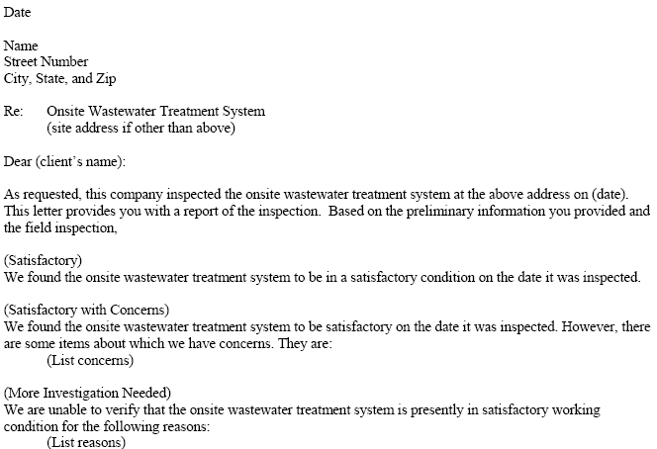
Inspection Report (pages 79-80)
Notes:
7
(refer to page 42 …discuss as necessary)

Slide 8
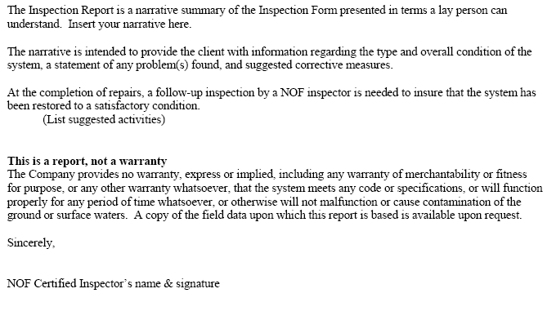
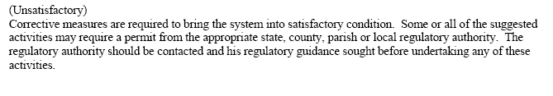
Inspection Report
Notes:
8
(refer to page 79 & 80…discuss as necessary)
Any questions on the inspection report?
Address as necessary.

Slide 9
Inspection Report Concerns
If client insists on having an HLT performed on a newly-installed or never used system, the following paragraph must be included in the authorization agreement and the inspection report:
The hydraulic load test (HLT) is designed to identify problems associated with the STA (and cesspools and seepage pits) that have, in the past, been in continuous use for at least 30 days. There is neither reason nor justification to subject a new or never used system to a hydraulic load test.
Notes:
9
(refer to page 41 …discuss as necessary)
New Jersey Regulations REQUIRE the inspector to report surface discharges to the “administrative agency”…health department...within 24 hours!
(click to show next)
If client insists on having an HLT performed on a newly-installed or never used system, the following paragraph must be included in the authorization agreement and the inspection report:
“The hydraulic load test (HLT) is designed to identify problems associated with the absorption areas (and cesspools and seepage pits) that have, in the past, been in continuous use for at least 30 days. There is neither reason nor justification to subject these systems to a hydraulic load test.”
Are there any questions on Authorization forms?

Slide 10

Corrective Measures
A follow-up NAWT OWTS inspection is necessary to verify that the components serviced are performing in a satisfactory manner.
Notes:
Corrective Measures
What are some corrective measures that might apply?
(write answers on flip chart)
Potential corrective measures include, but are not limited to:
• Replace or repair tanks, baffles, pipes, etc.
• Repair or replace electrical components (lift or dosing pump, alarms or controls)
• Repair or replace chlorinators, filters, etc.
• Install a new absorption area
• Eliminate points of infiltration
• Install water conservation devices
• Clean clogged filters, laterals or pipes
The client should be cautioned and instructed to contact the local regulatory agency for guidance regarding the permit application process, parts replacement or repairs. Following completion of repairs, a follow-up NOF inspection is necessary to verify that the components serviced are performing in a satisfactory manner.

