Slide 1

Hydraulic Load tests
Notes:
1
Section 3 – Hydraulic load test
This section provides information about the process and procedures for conducting a hydraulic load test.

Slide 2

Remember - A NAWT HLT is a not a Flood
It is a
Controlled Application

Slide 3
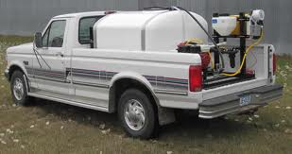
Equipment Needed to Complete a hydraulic load test
The equipment needed to perform a Hydraulic load test include:
  Water Tank, valve, hoses.
  Water meter
  Water supply
  Post hole digger
  1” steel bar
  Probe rod
Notes:
Equipment Needed
Describe and demonstrate the need and use of each item.
Water Tank, valve and hoses (click).

Slide 4
Tools used to conduct the HLT
The first variable begins with the decision to:
Transport water to the site
Use of water at the site/well or public water
Notes:
OH 225

Slide 5
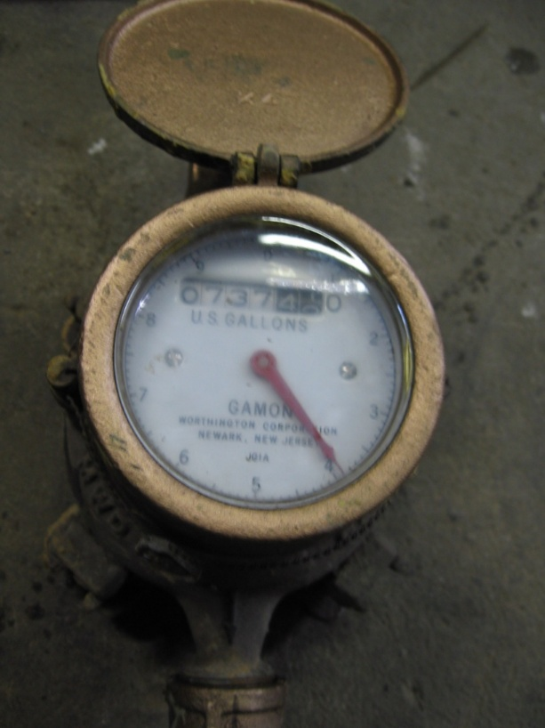
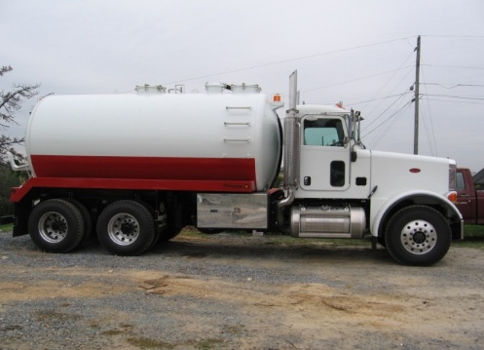
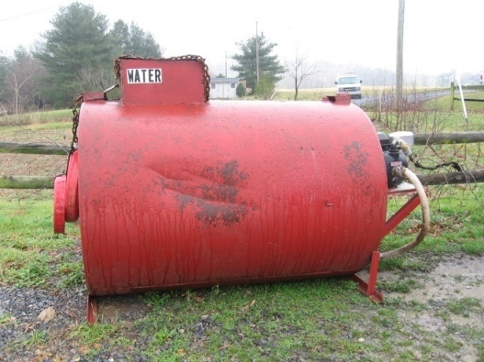
Bring in by truck or tank or
Meter the water that is on-site
Notes:
OH 226

Slide 6
Hydraulic Load Test
The Hydraulic Load Test is a procedure by which the Inspector can assess whether an aggregate or chamber-based absorption area is able to accept and absorb the Design Daily Volume of wastewater in a 24-hour period.
Notes:
6
Hydraulic Load Test
Purpose: To determine if an absorption area can satisfactorily receive and allow to pass into the soil/environment the Design Daily Volume of sewage effluent.
The Design Daily Volume is based on occupancy, number of bedrooms or other regulatory factors.
Daily volume in Pennsylvania is based on DEP Chapter 73 regulations.
Number bedrooms in houses.
Other usage factors in non-residential buildings.
Refer to Design Daily volume charts in the handouts

Slide 7
Hydraulic Load Test
In its simplest form, the Inspector adds the Design Daily Load to the absorption area, then comes back in 24 hours and determines if the liquid-level in the absorption area has returned to its previous level.
To prove the absorption area has absorbed the Design Daily Volume, water is added to bring the liquid level up to the Day 1 final level.
Notes:
Hydraulic Load Test
+In its simplest form, the Inspector adds the Design Daily Load to the absorption area, then comes back in 24 hours and determines if the liquid-level in the absorption area has returned to its previous level.
+To prove the absorption area has absorbed the Design Daily Volume, water is added to bring the liquid level up to the Day 1 final level.
+This may be repeated a third day.

Slide 8
Hydraulic Load Test
Example
A HLT is to be run on a 980-ft² gravity-fed, seepage bed serving a 4-bedroom house.
The Probe showed 4-inches of Dry Aggregate in the bed.
Notes:
Hydraulic Load Test
A Simple Example.
A 4-bedroom house has a 980 ft2 in-ground, aggregate absorption area.
When the absorption area was probed, there were 4 inches of Dry Aggregate.

Slide 9

HLT
Aggregate; Gravity
A = Aggregate Depth
B = Standing Liquid (varies)
C = Pipe Diameter (4”)
D = Dry Aggregate
K = 2 inches
Backfill
Gravity
K
D = 4”
Aggregate
C
A
Gravity
B
SOIL
Notes:
Hydraulic Load Test
A Simple Example.
As shown here, there is only 4 inches of Dry Aggregate. The Dry Aggregate Rules state that a HLT is recommended.

Slide 10
HLT- Example
The volume of water to be added, based on the 4-bdrm house, is 400 + 100 = 500 gal.
The 500 gallons of water was added via the D-box at noon, June 6.
The expected rise in the 980-ft² bed is:
  D = 4V/A = 4(500)/980 = 2.0 inches
  V = Water Volume in gallons.
  A = Bed Area in ft²
  D = Depth of expected rise in inches.
Notes:
Hydraulic Load Test
A Simple Example.
First determine the Design Daily Volume (DDV). 4 bdrms = 400 + 100 = 500 gallons.
Second add the DDV to the absorption area from a location below the treatment tank, in this case the D-box.
It is easy to estimate how much the liquid in the absorption area should be expected to rise when the Design Daily Volume is added during the HLT. The formula:
D = 4V/A
Where V is the Design Daily Volume in gallons.
A is the absorption area’s area in square feet.
D = the expected rise in liquid level as a result of adding the DDV in inches.
In our case, D = 4(500)/980 = 2.0 inches.

Slide 11
HLT - Example
The bed’s liquid level rose 2 inches (measured at 12:30pm, June 6).
At noon, June 7, the liquid level was measured show 4 inches of Dry Aggregate.
510 gallons of water was added to raise the liquid level 2 inches; the level where the bed stabilized on June 6.
Was the HLT successful? Why?
Notes:
Hydraulic Load Test
A Simple Example.
+The liquid level rose 2 inches, just as predicted. This an indication that you measured the size of the absorption area properly. It may also indicate that the aggregate is still clean and not filled with soil or other material that takes up space.
+The water was added at noon June 6.
+At noon on June 7, the liquid level was observed to show 4 inches of Dry Aggregate.
+Then water was added to bring the liquid level up 2 inches; 510 gallons of water was required.
+Was the HLT successful? YES!

Slide 12
REASONS FOR A HYDRAULIC LOAD TEST (page 35)
Less than 24 hours’ volume in cesspool or seepage pit.
Structure vacant for more than 7 days. (1)
Treatment tank pumped in past 30 days. (1)
New gray water sources added in past 30 days. (1)
Soil fracturing in past 30 days. (1)
Initial level in treatment tank is below outlet pipe. (1)
When indicated by dry aggregate rules.
Atypical flows to absorption system. (1)
If the inspector is informed that the system will be subjected to increased daily flows due to increased occupancy or change in use,
an HLT shall be recommended.
Notes:
12
Hydraulic Load Test
Indications of the Need for a HLT
A hydraulic load test should be performed if any of these conditions are discovered during the course of a PSMA/NOF Inspection:
(click to show each item)
Less than 24 hours’ volume in cesspool or seepage pit
Structure vacant for more than 7 days
Treatment tank pumped in past 30 days
New gray water sources added in past 30 days
Soil fracturing in past 30 days
Initial level in treatment tank is below outlet pipe
When indicated by dry aggregate rules
Atypical flows to absorption system
Sludge in aggregate or stains in soil above
(click & read the following)
If the inspector is informed that the system will be subjected to increased daily flows due to increased occupancy or a change in use, an HLT shall be recommended.

Slide 13
Alternatives to Conducting a
Hydraulic Load Test
With TIME available & CONCURRENCE of the Inspector, the absorption area can be re-inspected & re-evaluated when:
  House is reoccupied for 30 continuous days even if tank was not pumped.
HLT is not recommended in new, never used absorption areas.
Notes:
13
Hydraulic Load Test
Alternatives to conducting a Hydraulic Load Test
When a Hydraulic Load Test is indicated, if there is sufficient time available and with the concurrence of the inspector, the absorption area can be re-inspected and reevaluated when...
(click to show each item)
1. Occupancy for more than fourteen continuous days is reestablished and verified by the inspector
2. Occupancy for more than thirty continuous days is reestablished and verified by the inspector
(explain that the numbers after the alternatives correspond to the superscripts in the indications)
HLT not recommended in new, never used absorption areas.
HLT not recommended in new, never used absorption areas.

Slide 14
HLT Preparation
No effluent may enter absorption area during test.
If rain is forecast during testing period, the inspector should use his or her judgment to determine if the inspection should be postponed.
Use regulated Design Daily Volume
  400 gallons for first 3 bedrooms
  100 gallons for each additional bedroom
Introduce water downstream from treatment tank
If an onsite well is to be the water source for the HLT, the owner must authorize its use.
Notes:
14
Hydraulic Load Test
Preparation (click to show each item)
During the test, NO EFFLUENT may enter the absorption area.
Use the treatment tank as an interim holding tank by pumping the treatment tank prior to the test if structure is occupied.
NO EFFLUENT may enter a cesspool or seepage pit.
The client and occupants must be cautioned in this regard.
If rain is forecast during testing period, the inspector should use his or her judgment to determine if the inspection should be postponed.
Use regulated Design Daily Volume (these are Pennsylvania flows, each state may vary)
400 gallons for first 3 bedrooms
100 gallons for each additional bedroom
Introduce water downstream from treatment tank-Introduction of liquid for a hydraulic load test:
Introduce the liquid after the treatment tank on gravity systems
Introduce the liquid into a pump or dose tank for a pressure distribution system or a system with a lift pump.
(following not on slide, read and discuss)
If the onsite well is to be the water source for the test, the owner must authorize its use.

Slide 15
HLT Procedure
Prepare observation holes:
  Center of bed.
  Each trench.
Establish reference point (from which to measure liquid levels in each observation hole).
Measure distance to:
  Top of aggregate.
  Top of soil below aggregate.
  Liquid level in aggregate.
Notes:
15
Hydraulic Load Test
Procedure (click to show each item)
For all absorption areas which are a bed configuration, dig one observation hole to the surface of the aggregate at the center of the bed. Bore or dig into the aggregate until the underlying soil/sand is reached.
For all trench type systems, dig one observation hole to the surface of the aggregate in each trench. Bore or dig into the aggregate until the underlying soil/sand is reached.
For each hole, establish a fixed and recoverable reference point from which to measure.
Measure the distance from the reference point to:
the surface of the aggregate
the soil underlying the aggregate
the surface of any liquid in the aggregate

Slide 16
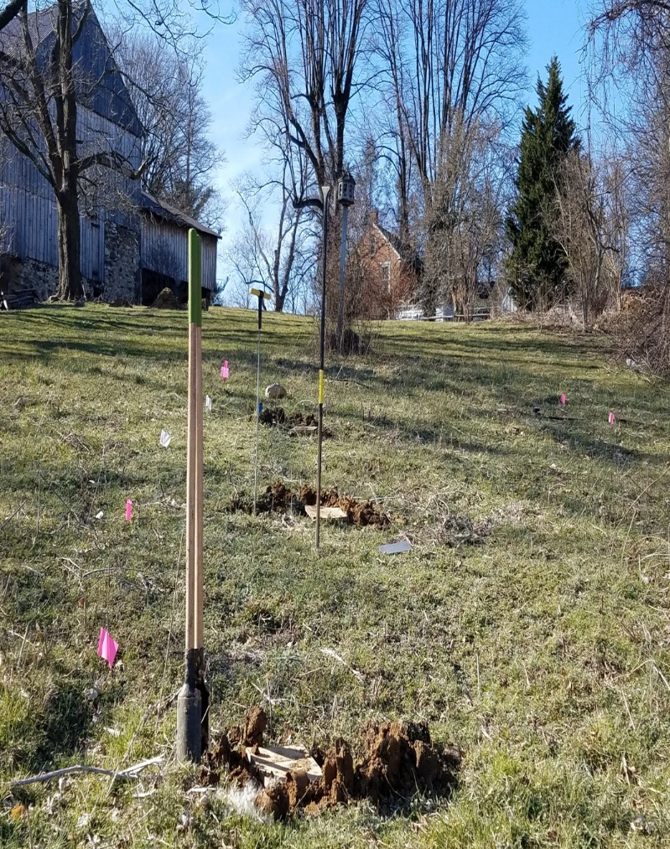
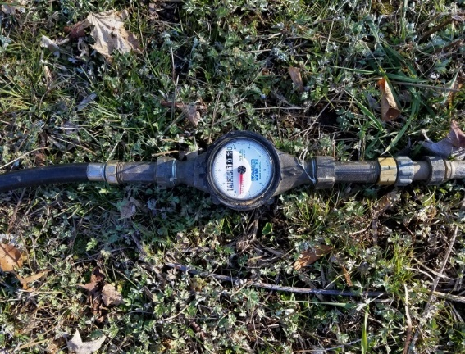
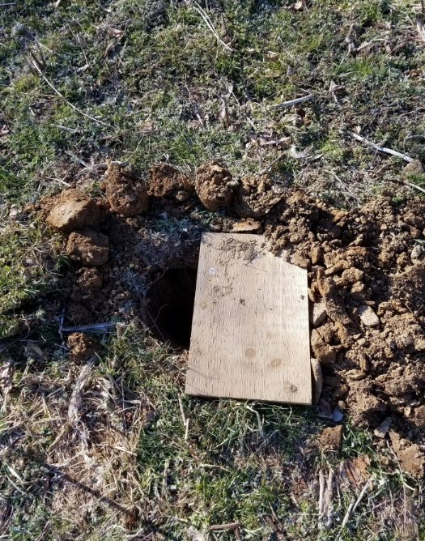

Slide 17
HLT Procedure – Day 1
Introduce Design Daily Volume of water
  STOP if unsatisfactory water level reached as per Dry Aggregate Rules:
    Top of aggregate in bed or trench
    Top of sand in sand mound
    Top of chamber in gravelless
Measure water level in each hole after liquid level has stabilized.
What do you do if the liquid level is at the top of the aggregate?
What do you do if the liquid level rises above the top of the aggregate?
Notes:
17
Hydraulic Load Test
Procedure- Day 1
Determine the liquid level before introducing water.
If the liquid level is unsatisfactory, at the top of the aggregate, do not add water.
If the liquid level is acceptable, below the top of the aggregate,
(click to show each item)
Introduce Design Daily Volume of clean water into the absorption area until the calculated volume has been added, or until the liquid level rises to the top of the aggregate, whichever comes first.
STOP if the liquid level rises to the unsatisfactory level
Top of aggregate in bed or trenches
Top of chamber in gravelless
Top of sand in elevated sand mound
After the water has been added, for gravity distributed effluent, wait thirty minutes for the liquid level to stabilize.
Then measure the distance from the reference point to the surface of the water
Record the liquid depth in each hole.
What do you do If the liquid level is at the top of the aggregate?
LOOKING FOR: Do not add water.
What do you do if the liquid level rises above the top of the aggregate?
LOOKING FOR: STOP and proceed to the next step.

Slide 18
HLT Procedure – Day 2
Return 24 hrs later.
Measure and record the liquid level remaining in the aggregate.
Introduce additional water to bring the liquid level to the level reached at the end of day 1.
The number of gallons introduced on Day 2 is the number of gallons absorbed during the prior 24 hours.
Notes:
18
Hydraulic Load Test
Procedure – Day 2 (click to show each item)
Return 24 hours later and measure and record the distance from the soil surface to the top of the liquid.
Introduce additional clean water to bring the liquid level to the level achieved on the prior day, or introduce the calculated volume, whichever is less.
Record the volume of water introduced on the second day.
Note: If the introduction of liquid is stopped on the first day because the liquid level has reached the top of the aggregate, and if the full calculated volume can be introduced on the second day, return a third day and repeat steps.

Slide 20
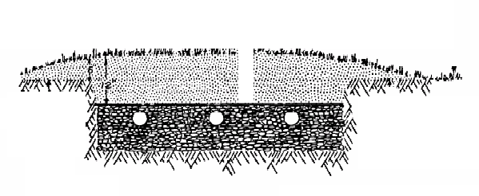
Day One
6” Dry Aggregate
12”
Notes:
20
Hydraulic Load Test
Example 2. House vacant. Four bedrooms.
Day one, bore holes for conducting hydraulic load test.
Establish fixed reference point. (click to show)
Measure to the top of the aggregate, record measurement.
Measure to the bottom of the aggregate, record the measurement.
Note the amount of dry aggregate.
In this case there is 12” of dry aggregate.
Do we still need to perform the hydraulic load test? (yes – house is vacant)
Add the prescribed amount of water, in this case 500 gallons. (click to show water addition)
At no time should you add water above the top of the aggregate.
Wait 30 minutes.
Record the amount of dry aggregate after the water addition.
In this case there is 6” of dry aggregate. (click to show)

Slide 22
Day Two
Satisfactory – 500 gallons
Absorbed in 24 hours
6” Dry Aggregate
12”
Notes:
22
Hydraulic Load Test
Day two measure and record the amount of dry aggregate.
In this case there is 12” of dry aggregate.
Do we still need to perform the hydraulic load test?
The water from day one all went away. (yes – day two is required)
Add the prescribed amount of water, in this case 500 gallons.
(click to show water addition)
Wait 30 minutes.
Record the amount of dry aggregate after the water addition.
In this case there is 6” of dry aggregate. (click to show)
What is the conclusion for this hydraulic load test?
The soil was able to absorb 500 gallons in 24 hours there fore the conclusion is……
(wait for students to answer, then click)…satisfactory.

Slide 24
Seepage Bed example
Record depth to bottom of aggregate or top of liquid from a fixed reference point
Here we read 24” to soil – no liquid.
Record depth to top of liquid from the fixed reference point
Here we read 18”
Day 1
6” Dry Aggregate
12”
Bottom of aggregate
Notes:
Example two. House vacant. Four bedrooms. Day one, bore holes for conducting hydraulic load test. Establish fixed reference point. (click to show)
Measure to the top of the aggregate, record measurement. Measure to the bottom of the aggregate, record the measurement. Note the amount of dry aggregate. In this case there is 12” of dry aggregate. Do we still need to perform the hydraulic load test? (yes – house is vacant)
Add the prescribed amount of water, in this case 500 gallons. (click to show water addition) At no time should you add water above the top of the aggregate. Wait 30 minutes. Record the amount of dry aggregate after the water addition. In this case there is 6” of dry aggregate. (click to show)

Slide 26
Seepage Bed example
Record measurement from fixed point to top of liquid level.
Stop the introduction of liquid when previous days level is reached.
Day 2
6” Dry Aggregate
12”
Introduce liquid
Determine gallons introduced and how much liquid this system absorbed in a 24 hour period.
Notes:
Day 2 Record measurement from the fixed reference point to the liquid (or soil if no liquid present). (click to show)
Add liquid up to previous days level is reached. Record the amount of liquid that is being added.
Stop if the exceeds the previous days introduction level. Record the amount of dry aggregate after the water addition. In this case there is 6” of dry aggregate again. In this example we showed that the system absorbed 500 gallons over a 24 hour period.

Slide 27
Procedural differences for
gravity trenches
with unequal distribution where
an interim
resting period is proposed.
Notes:
Locate and gain access to the distribution box.
If house is occupied pump and clean the septic tank.
Perform HLT on satisfactory trenches. Proportionate amounts of water to be applied to each satisfactory trench (600 gallons divided by 3 dry trenches out of 4 = 200 gallons to each).
If satisfactory results from the HLT are obtained, adjust the flows to the satisfactory trenches and allow to operate on those trenches. The remaining trenches should rest for for 6 to 12 months. Once the remaining trenches are dry readjust and begin using all trenches.

Slide 28
Cesspools and Seepage Pits
Day 1
Establish observation port and reference point
Introduce Design Daily Volume of water
  STOP if liquid level reaches bottom of inlet pipe
Measure liquid level after water introduced
Wait 24 hours
Notes:
28
Hydraulic Load Test
Procedural differences for cesspools and seepage pits
Procedural differences for cesspools and seepage pits under regular use preceding the test.
(click to show each item)
Establish one observation hole and reference point at which to conduct observations and measurements.
The observation hole should allow direct viewing of the liquid level.
Introduce either the calculated volume or sufficient clean water to bring the liquid level to the level of the inlet pipe.
Measure water level after water introduced (do not wait 30 minutes)
Wait 24 hours

Slide 29
Cesspools and Seepage Pits
Day 2
Measure and record the liquid level remaining in the cesspool.
Introduce water to bring the liquid level to the level reached at the end of Day 1
The number of gallons introduced on Day 2 is the number of gallons absorbed in the prior 24 hours.
May need Day 3 . . .
Notes:
29
Hydraulic Load Test
Cesspools and Seepage Pits - Day 2 (click to show each item)
Measure and record the water level remaining in the cesspool
Introduce additional water to bring the liquid level to the level reached at the end of Day 1
The number of gallons introduced on Day 2 is the number of gallons absorbed in the prior 24 hours.
May need Day 3 . . .
Refer to page 48 to explain.

Slide 30
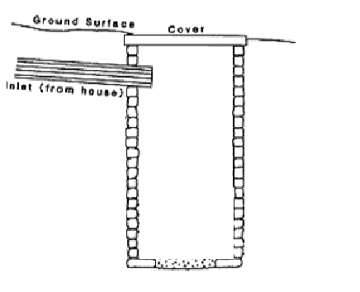
Before Day one
890 gallons
capacity
60”
←Starting Level
66”
Notes:
30
Hydraulic Load Test
Hydraulic Load example:
Beginning day one, there is 60” from the liquid level to the bottom of the inlet. Record the measurement.
How much capacity is there in this cesspool. (work through answer, then click to show)
890 gallons capacity – Why would we be performing a HLT on this system? (looking for structure unoccupied)
(click to show next page)

Slide 32
3 Bedroom Home
30”
←End Day 1 Level
400 gallons added
66”
Notes:
32
Hydraulic Load Test
After taking the initial measurement add the prescribed amount of water, in this case 400 gallons of water (3 bedroom house).
(click to show water addition)
After adding the water take a measurement from the liquid level to the inlet.
In no case allow the liquid level to rise above the inlet.
In this case the result is 30”. Record the measurement.
Return 24 hours later.

Slide 34
3 Bedroom Home
48”
←Begin Day 2 Level
66”
Notes:
34
Hydraulic Load Test
On day two again take the measurement and record before adding water.
In this case the measurement is 48”.
Is there a difference from the beginning of day one? (yes)
Does this give us a result? (No)

Slide 36
3 Bedroom Home
Did not accept 400 gallons –
UNACCEPTABLE
30”
←End Day 2 Level
270 gallons added
66”
Notes:
36
Hydraulic Load Test
(click to add water)
Add the 400 gallons or as much water as it takes to reach the level achieved on day one after adding the water.
(click to show)
In this case the water was stopped when it reached the 30” level achieved on day one.
(click to show)
Note and record the amount of water added on day 2.
Did the cesspool accept the prescribed amount of water? (No)
What is the conclusion for this example? Wait for answers.
(click to show)
Did not accept 400 gallons – Unsatisfactory

Slide 38
A subsurface sand filter absorption area which was subjected to and passed a hydraulic load test because of liquid in the absorption area, shall ALWAYS be described as
“ACCEPTABLE WITH CONCERNS”

Slide 39


At-Grade Absorption Areas
Locate the observation hole 12 inches below the downslope lateral.
Follow the same procedure as other aggregate-based systems.
12”
12”
Notes:
Hydraulic Load Test
At-grade Absorption Areas
These systems use an absorption area that is built upon the prevailing site grade.
The aggregate follows ground contour, and within the aggregate, the pressurized distribution piping is level.
Plan the test in the manner described earlier.
Location of the observation hole is critical.
The hole must be approximately 12” below the downslope lateral.
Once the observation hole’s location is selected, follow the steps described above.

Slide 40
Hydraulic Load Test
Conclusions
* * Caution * *
The results could be expressed as X gallons per day.
Do not express the results in a manner that characterizes a daily capacity of X gallons.
Do not extrapolate a theoretical population (number of people) the system could serve.
Do not prorate the results in any manner.
Notes:
40
Hydraulic Load Test
Hydraulic Load Test Conclusions
For all systems, only two conclusions are possible following a hydraulic load test.
They are:
The system has accepted and dispersed a volume of liquid equal to the calculated volume (Design Daily Volume) that is expected from the structure served, and is, therefore, “SATISFACTORY.”
The system has not accepted and dispersed a volume of liquid (Design Daily Volume) that is expected from the structure served, and is, therefore, “UNSATISFACTORY.”
(click to show and read caution)
* * Caution * *
The results could be expressed as X gallons per day.
Do not express the results in a manner that characterizes a daily capacity of X gallons.
Do not extrapolate a theoretical population (number of people) the system could serve.
Do not prorate the results in any manner.

Slide 41
Hydraulic Load Test Report
Add the following to the Inspection Report letter or generate this as a free standing letter with the appropriate caveats and cautionary statements on your company letterhead.
  On (dates) the Company performed a hydraulic load test consistent with PSMA/NOF standards.
  The absorption area initially received a volume of clean water equal to the Design Daily Volume of sewage effluent that (Regulatory Agency's name) requires for your structure.
  Design Daily Volume was (XXX gallons).
Notes:
Hydraulic Load Test Report
Add the following to the Inspection Report letter or generate this as a free-standing letter with the appropriate caveats and cautionary statements on your company letterhead.
On (dates) the Company performed a hydraulic load test consistent with the standards established by the NOF. The absorption area initially received a volume of clean water equal to the daily volume of sewage effluent that the (insert regulatory agency's name) regulations currently assign to a structure with the daily flow indicated (XXX gallons).
The volume selected is believed to be representative of contemporary water usage for a structure of this size (number of bedrooms) or use (nonresidential). The absorption area’s original design capacity may have been for a greater or lesser flow. Over a 24-hour period the absorption system received and distributed _____ gallons to the soil. This is indicative of a (choose one) satisfactory OR unsatisfactory absorption system.
This is a report, not a warranty
The Company provides no warranty, express or implied, including any warranty of merchantability or fitness for purpose, or any other warranty whatsoever, that the system meets any code or specifications, or will function properly for any period of time whatsoever, or otherwise will not malfunction or cause contamination of the ground or waters of the state, county, parish or jurisdiction.
(discuss splitting flows on page 48)

Slide 42
Hydraulic Load Test Report
  The volume selected is believed to be representative of contemporary water usage for a structure of this size (number of bedrooms) or use (nonresidential).
  The absorption area’s original design capacity may have been for a greater or lesser flow.
  Over a 24-hour period the absorption system received and distributed _____ gallons to the soil.
  This is indicative of a (choose one) satisfactory OR unsatisfactory absorption system.
Notes:
Hydraulic Load Test
Hydraulic Load Test Report
+The volume selected is believed to be representative of contemporary water usage for a structure of this size (number of bedrooms) or use (nonresidential).
+The absorption area’s original design capacity may have been for a greater or lesser flow.
+Over a 24-hour period the absorption system received and distributed _____ gallons to the soil.
+This is indicative of a (choose one) satisfactory OR unsatisfactory absorption system.

Slide 43
Hydraulic Load Test Report
This is a report, not a warranty
  The Company provides no warranty, express or implied, including any warranty of merchantability or
  fitness for purpose, or
  any other warranty whatsoever, that the system meets any code or specifications, or
  will function properly for any period of time whatsoever, or
  otherwise will not malfunction or
  cause contamination of the ground or waters of the state, county, parish or jurisdiction.
Notes:
Hydraulic Load Test
Hydraulic Load Test Report
This is a report, not a warranty
+The Company provides no warranty, express or implied, including any warranty of merchantability or
+fitness for purpose, or
+any other warranty whatsoever, that the system meets any code or specifications, or
+will function properly for any period of time whatsoever, or
+otherwise will not malfunction or
+cause contamination of the ground or waters of the state, county, parish or jurisdiction.
(discuss splitting flows)

Slide 44
The most important thing to remember is:
This test is to determine how much liquid this absorption area will absorb over a 24-hour period!
That is the over all GOAL
Notes:
OH 227

Slide 45
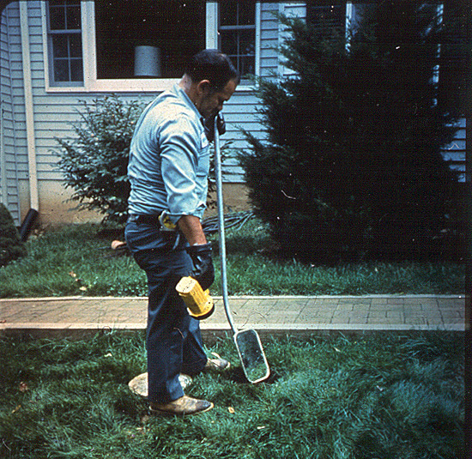
End of Hydraulic Load Test
Notes:
45
End of Hydraulic load test

