Slide 1

NAWT
Dry Aggregate Rules
Notes:
1

Slide 2
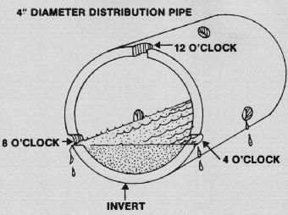
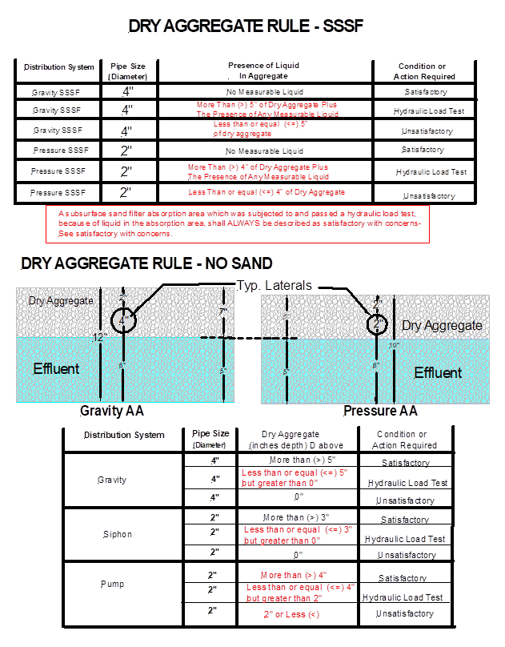
Standard Beds and Trenches - Gravity Distribution
Notes:
As you “click”, each part of the slide shows up. First is the cross section of a typical gravity bed or STA.
Say, “If a STA is fully ponded, can we all agree that the system is unacceptable?”
Say, “In most states there are 2” of aggregate over the lateral and the lateral itself is 4” in diameter. Lateral holes are typically located at 4 and 8 o’clock or some configuration of this. There may be a tolerance, up or down, that the installer had when setting the lateral. For these reasons, we drew a line at 1” above the lateral bottom.
Therefore, If the liquid level is at 1” above the bottom of the lateral, or in other words, the STA has 5” or more of dry aggregate, the system is ACCEPTABLE.
If there is less than 5” of dry aggregate in a gravity STA, we don’t know if is acceptable. This is the GRAY area, so we will conduct a Hydraulic Load Test to determine if it is acceptable.

Slide 3
Standard Beds and Trenches - Pressure Distribution, Pumped Upslope
Notes:
As you “click”, each part of the slide shows up. First is the cross section of a typical pressure dosed bed or STA.
Say, “If a STA is fully ponded, can we all agree that the system is unacceptable?”
Say, “In most states there are 2” of aggregate over the lateral and the lateral itself is 2” in diameter. Lateral holes are typically located at the bottom of the pipe.
Say, “For pump dosing systems, most systems are designed to pump up so that they drain when the pump turns off. For these reasons, we drew a line at the bottom of the lateral, making this different than the gravity situation.”
Say, “Therefore, If the liquid level is at the bottom of the lateral, or in other words, the STA has 4” or more of dry aggregate, the system is ACCEPTABLE.”
Say, “If there is less than 4” of dry aggregate, but more than 2”, in a pressure Dosed STA, we don’t know if is acceptable. This is the GRAY area, so we will conduct a Hydraulic Load Test to determine if it is acceptable. (as long as the pump is not short cycling)”
Say, “If there less than 2” of dry aggregate in a pressure dosed STA, it is UNACCEPTABLE.”

Slide 4
Standard Beds and Trenches - Pressure Distribution, Siphon Downslope
Notes:
As you “click”, each part of the slide shows up. First is the cross section of a typical pressure dosed bed or STA fed by a Siphon.
Say, “If a STA is fully ponded, can we all agree that the system is unacceptable?”
Say, “In most states there are 2” of aggregate over the lateral and the lateral itself is 2” in diameter. Lateral holes are typically located at the bottom of the pipe.
Say, “For Siphon dosing systems, systems are designed to pressure dose downslope. For these reason, we drew a line at 1” above the bottom of the lateral (like gravity), making this different than the pumped pressure dosed situation.”
Say, “Therefore, If the liquid level is 1” above the bottom of the lateral, or in other words, the STA has 3” or more of dry aggregate, the system is ACCEPTABLE.”
Say, “If there is less than 3” of dry aggregate, but more than 0”, in a Siphon Dosed STA, we don’t know if is acceptable. This is the GRAY area, so we will conduct a Hydraulic Load Test to determine if it is acceptable. (as long as the pump is not short cycling)”
Say, “If there less than 0” of dry aggregate in a pressure dosed STA, it is UNACCEPTABLE.”

Slide 5
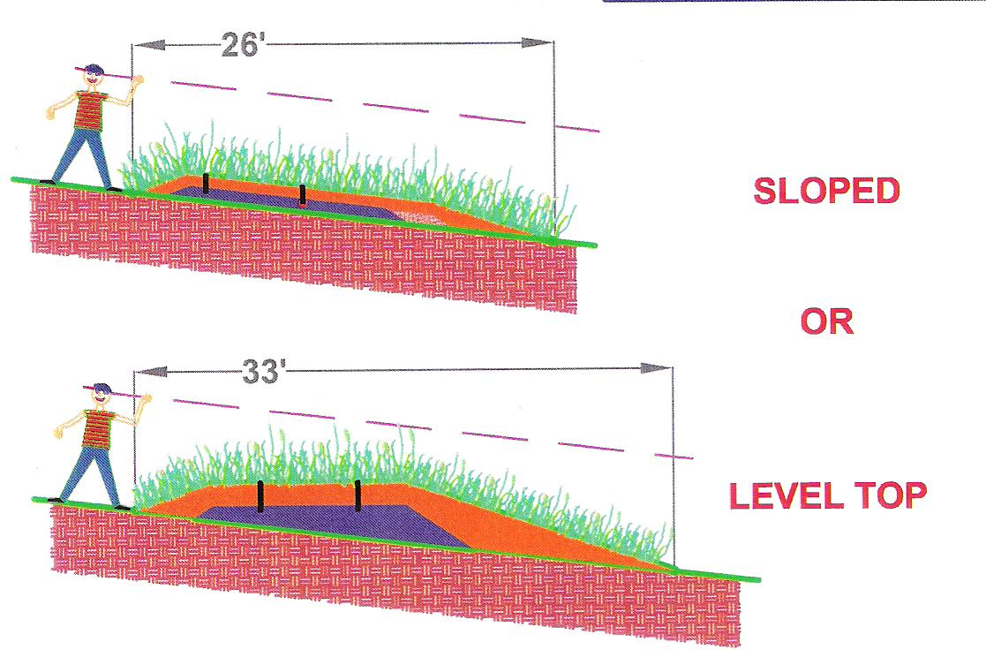
At Grade System
Notes:
Measurements of dry aggregate for an “At-Grade” STA are taken 1’ lower than the downslope lateral.

Slide 6
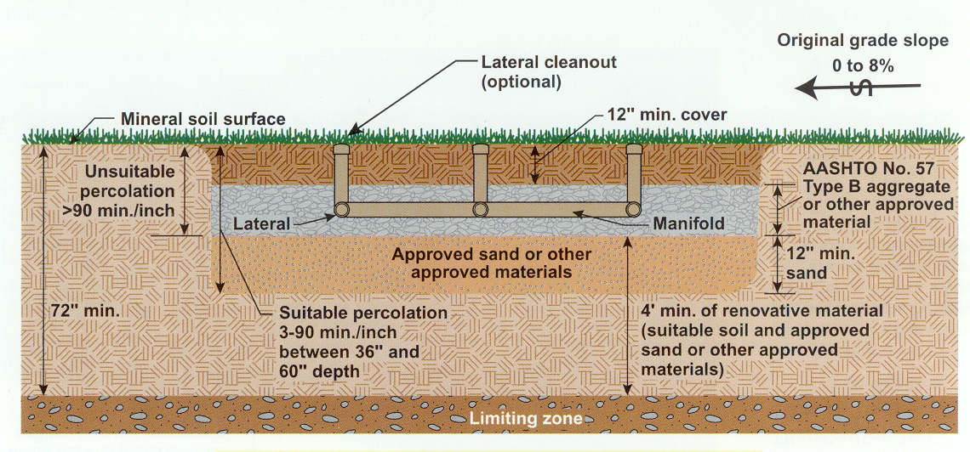
Subsurface Sand Filter
Notes:
Typical Subsurface Sand Filter STA or “SSSF”.
This is a gravity SSSF.
They can be either Gravity or Pressure Dosed.
The difference for us is the diameter of the lateral.

Slide 7
SSSF Beds and Trenches - Gravity Distribution
Notes:
As you “click”, each part of the slide shows up. First is the cross section of a typical gravity bed or SSSF STA.
Say, “ Because there is sand under the aggregate, we are going to make the rules more stringent.
Say, “If there is no liquid in the aggregate the SSSF STA is ACCEPTABLE.”
Say, “Here again, in most states there are 2” of aggregate over the lateral and the lateral itself is 4” in diameter. Lateral holes are typically located at 4 and 8 o’clock or some configuration of this. There may be a tolerance, up or down, that the installer had when setting the lateral. For these reasons, we drew a line at 1” above the lateral bottom.
Therefore, If the liquid level is at 1” above the bottom of the lateral, or in other words, the STA has 5” or more of dry aggregate down to any liquid in the STA, we don’t know if it is working correctly so we are going to need to perform a Hydraulic Load Test. This is now the gray area.
If, upon satisfactory completion of a Hydraulic Load Test, the best we can describe the conclusion is “ACCEPTABLE WITH A CONCERN.”
If there is less than 5” of dry aggregate or less in a gravity SSSF STA, it is unacceptable.

Slide 8
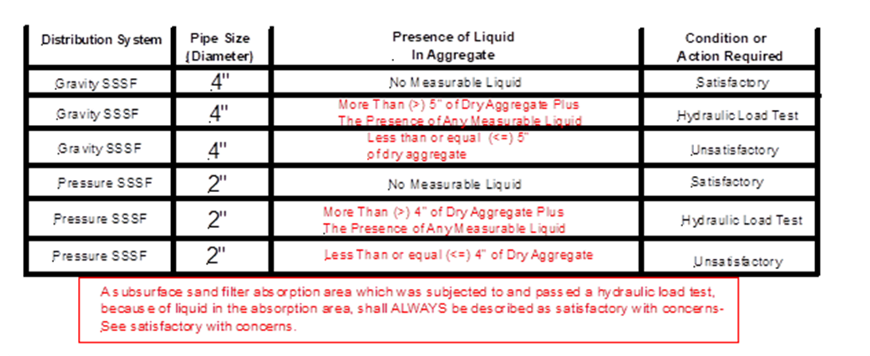
SSSF Beds and Trenches - Pressure Distribution
Notes:
As you “click”, each part of the slide shows up. First is the cross section of a typical pressure dosed bed or SSSF STA.
Say, “ Because there is sand under the aggregate, we are going to make the rules more stringent.
Say, “If there is no liquid in the aggregate the SSSF STA is ACCEPTABLE.”
Say, “Here again, in most states there are 2” of aggregate over the lateral and the lateral itself is 2” in diameter. Lateral holes are typically located on the bottom of the lateral. There may be a tolerance, up or down, that the installer had when setting the lateral. For these reasons, we drew a line at 1” above the lateral bottom.
Therefore, If the liquid level is at 1” above the bottom of the lateral, or in other words, the STA has 3” or more of dry aggregate down to any liquid in the STA, we don’t know if it is working correctly so we are going to need to perform a Hydraulic Load Test. This is now the gray area.
If, upon satisfactory completion of a Hydraulic Load Test, the best we can describe the conclusion is “ACCEPTABLE WITH A CONCERN.”
If there is less than 3” of dry aggregate or less in a gravity SSSF STA, it is unacceptable.

Slide 9
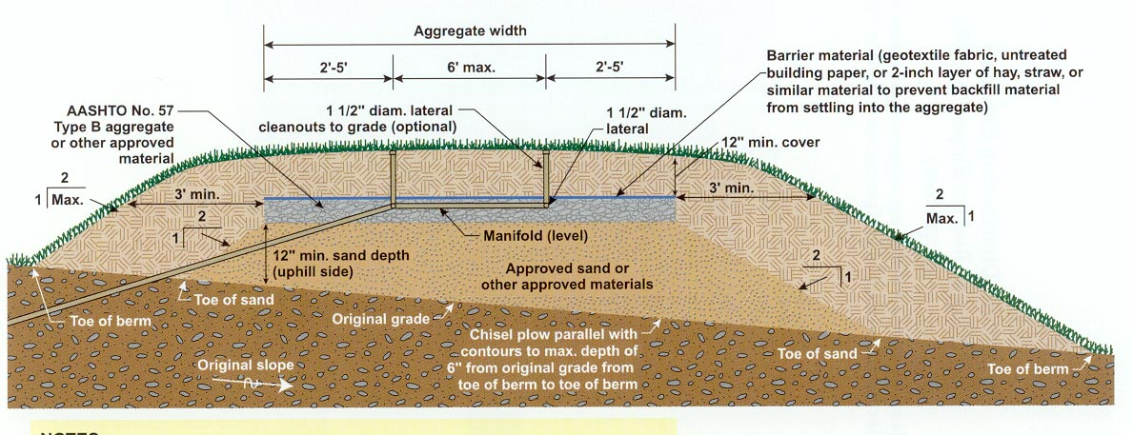
Elevated Sand Mound
Notes:
Typical Mound STA with Sand under the Aggregate.

Slide 10
ESM Beds and Trenches – Gravity or Pressure Distribution
Notes:
If there is any liquid in the course aggregate, it is UNACCEPTABLE, either gravity or pressure dosed STA.
The reason being, the sand elevates the aggregate and now it is susceptible to leaching out the sidewalls.

Slide 11
Gravelless Chambers
Notes:
Gravelless Chambers
These proprietary design devices are shaped like military “Quonset huts”.
Manufactured from a rigid plastic material, the chambers are assembled in rows, and replace the aggregate in any soil-based system.
The effluent can be delivered to the chambers either by gravity or pressure.
Gravity system require a D-box or other means of dividing the flow equally.

Slide 12
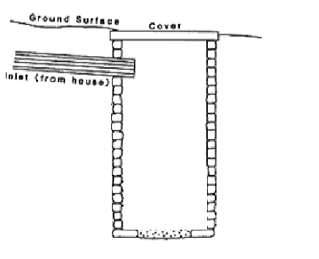
Cesspools and Seepage Pits
812 Gallons
One Day’s Flow or Greater
66”
60”
Notes:
For Cesspools and Seepage Pits, if the municipality you are working in allows them…
If there is one day’s flow for the structure of more, the cesspool or Seepage it is ACCEPTABLE.
Calculate the available space (work through answer, then click to show)
890 gallons capacity

Slide 13
Cesspools and Seepage Pits
No Space From Top of the Liquid to the Bottom of the Inlet Pipe or Higher
66”
Notes:
If the liquid is at or above the Inlet Invert, it is UNACCEPTABLE.

Slide 14
Cesspools and Seepage Pits
600 Gallons
48.75”
One Day’s Flow
(5 Bed)
60”
Notes:
If there is less than one day’s flow, we don’t know if it is working correctly or not, we conduct a Hydraulic Load Test.

Slide 15
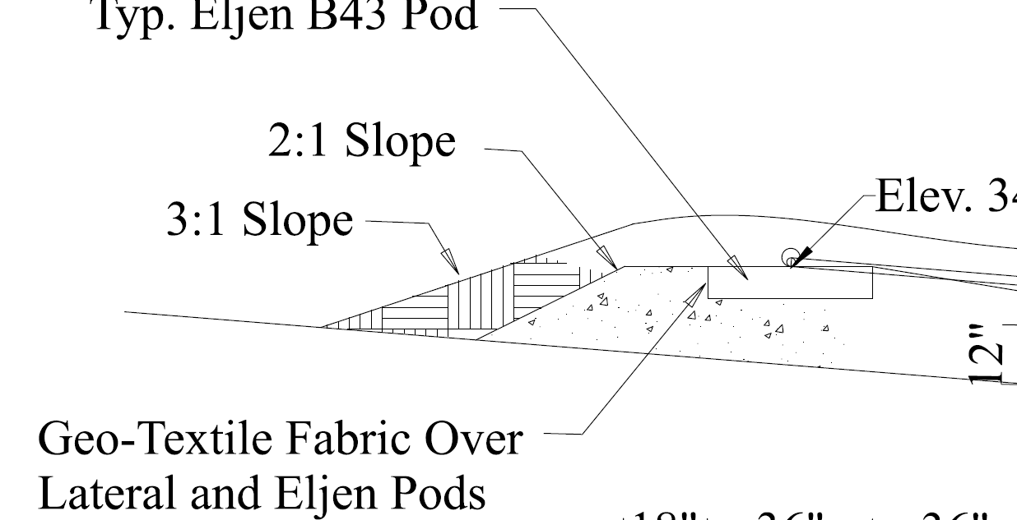
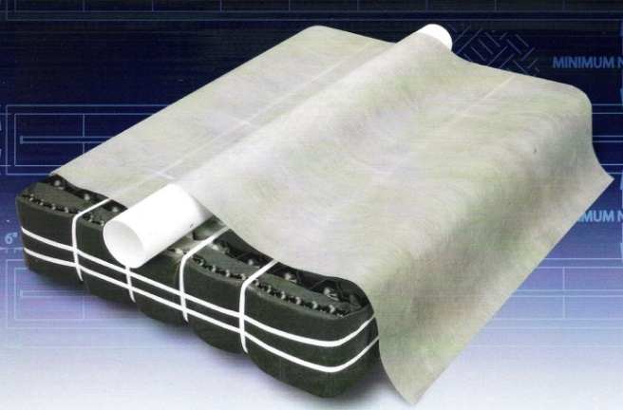
Prefabricated Drainage System (Eljen GSF Filter)
Notes:
Do not probe an Eljen Module or pod. An Eljen system will have 4” vented pipes at the end of the laterals. If you look in these 4” lateral pipes you will see a 1 ½” pressure lateral pipe in the 4” pipe.
(Click the slide – once the module will fill with blue).
If you look in the 4” end pipe and see no measurable liquid this is ACCEPTABLE.
(Click slide – gray water will fill the 4” pipe)
If there is 1 ½” or less of measurable liquid in the 4” pipe it requires more investigation.
(click again chart will come up)
If there is more than 1 ½” of liquid in the 4” pipe then the system is UNCCEPTABLE. See Dry aggregate rules
SEE Appendix I for more info.

Slide 16
Green Dot Findings
Be Aware…
With pressure distribution piping, you can discover visual evidence of localize lush/dark grass with regular patterns. These patterns can be the result of improper modification of pressure lateral pipes from drilling down thru, or organic clogging of the gravel immediately below discharge holes.
Regardless of the cause, More investigation is required to determine the proper resolution to produce equal distribution.
Lets discuss circumstances and remediation options surrounding these conditions.
Notes:
More investigation is required to determine the proper resolution to produce equal distribution.

Slide 17
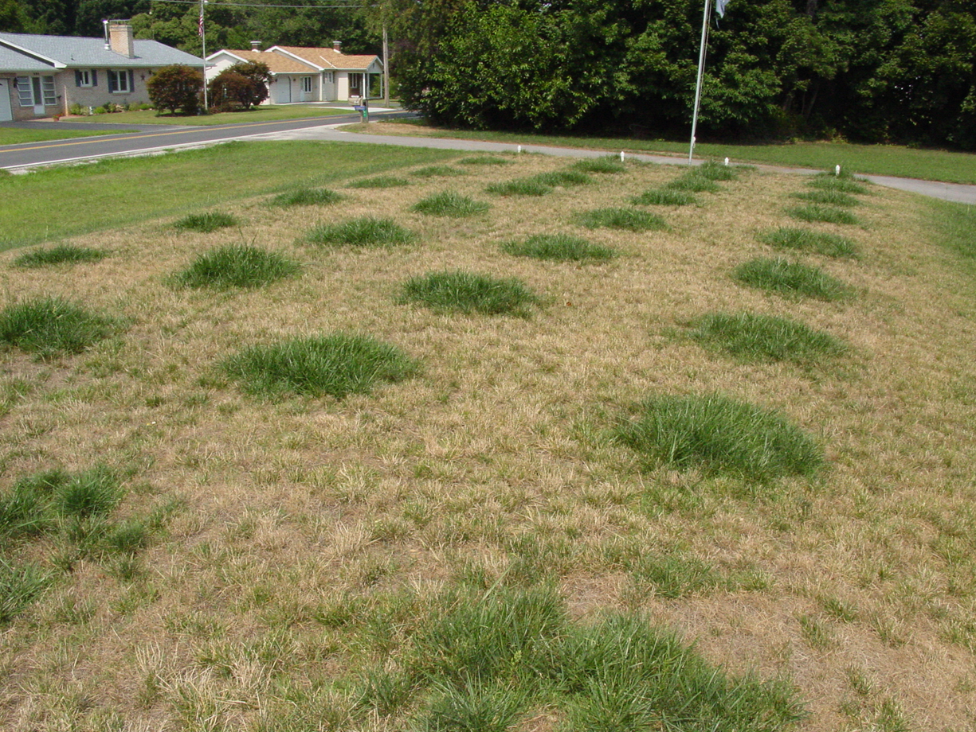
Green Dot Findings

