Slide 1

Preliminary Information
Notes:
1
Section 3 – Inspection Procedures
This session will focus on the actual field inspection portion of the inspection and what you can expect to find when you inspect an onlot system for a client.
As we said before: Our goal is to bring everyone to a base level of understanding in the hope that you can:
identify each component you may find,
know how and where each component is used, and
have a basic understanding of what it is supposed to do and how it works.
Never assume you will find what you think should be on a site.

Slide 2
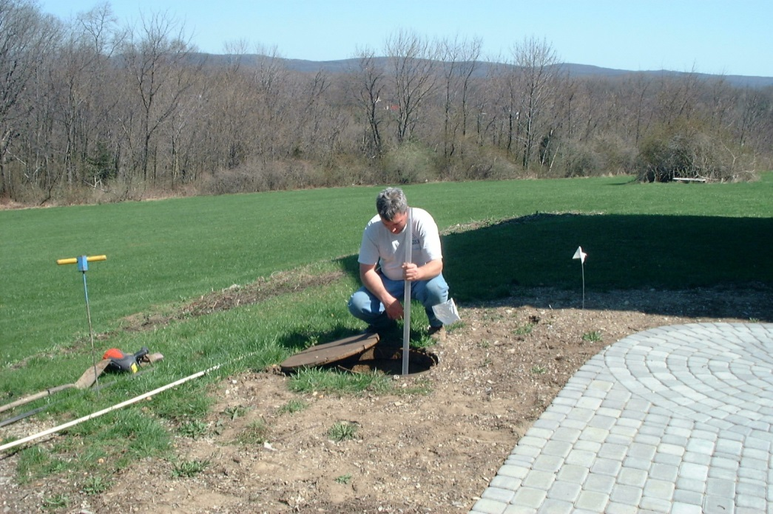
Inspection Procedures
What is the FIRST step in any inspection?
  Before you start any inspection…
  Getting an Authorization Form signed by the responsible party, your client, is recommended.
There is a sample form within the Standards
Appendix A - Pages 66 - 67
Notes:
Inspection Procedures
?What is the FIRST step in any inspection?
Ans: Get an Authorization Form signed.
A sample can be found within the standards – Appendix A pages 66 - 67.
This form is recommended

Slide 3
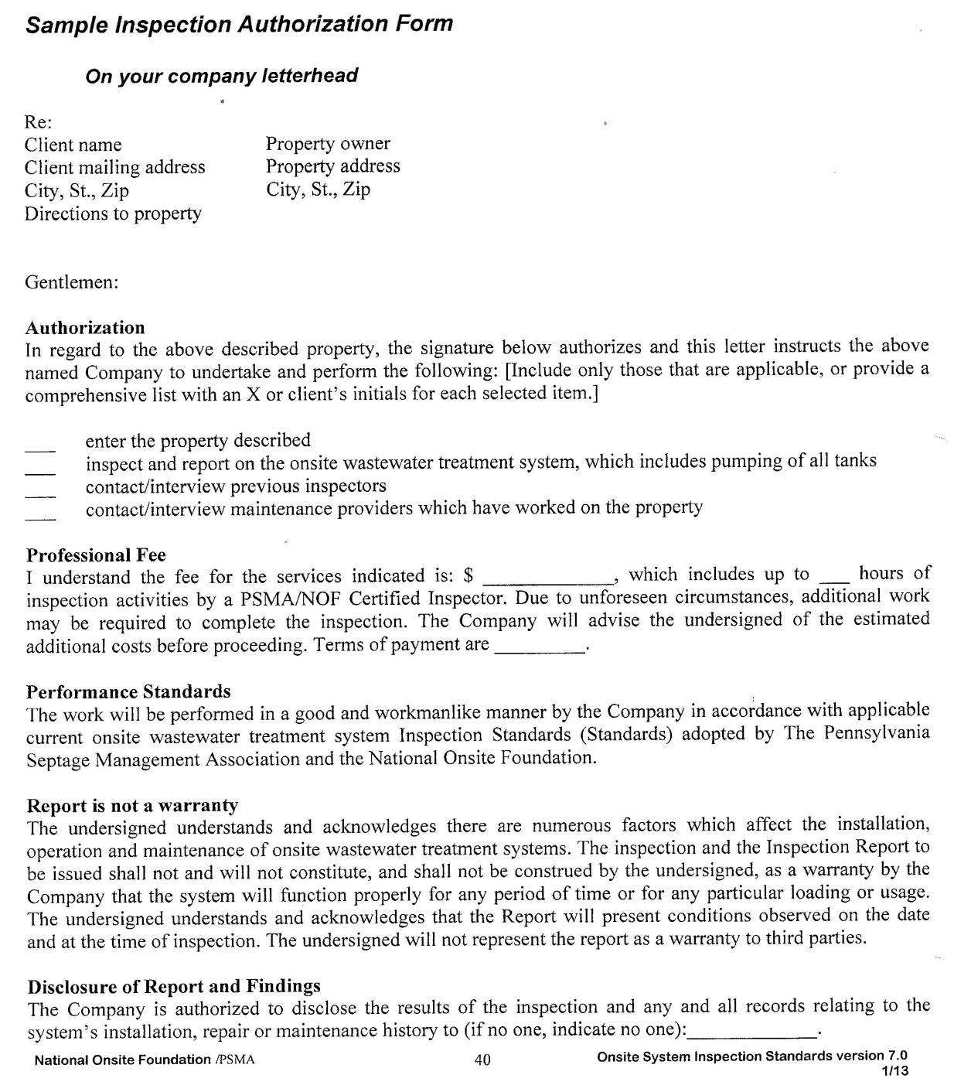
Sample Authorization Form
This form found in Appendix A – page 69
Notes:
Sample Authorization Form
This letter gives you the right to be on the property and to do the inspection.

Slide 4
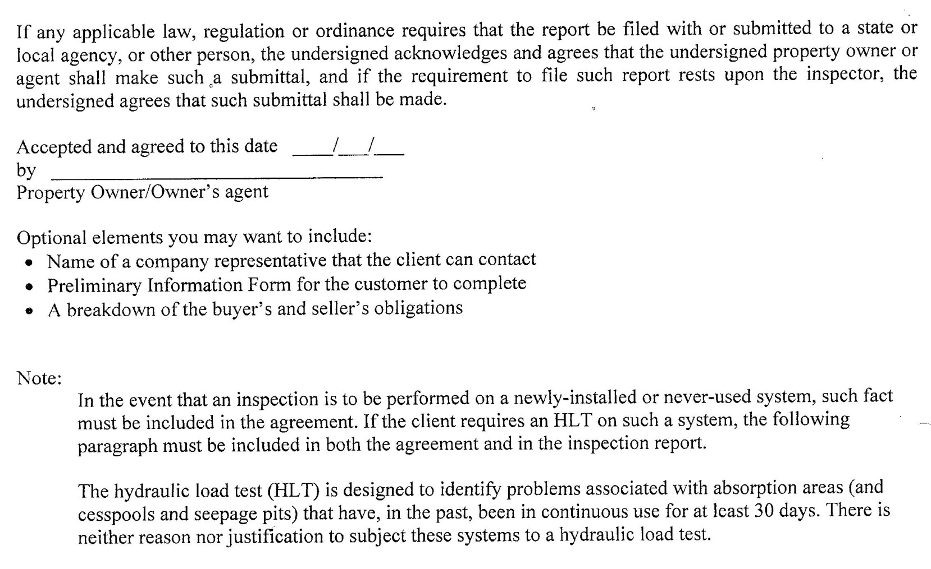
Sample Authorization Form
This form found in Appendix A – page 67
Notes:
Sample Authorization Form (page 2)
It explains that there is no Warranty on the inspection
Ideally should be signed by the buyer and the seller

Slide 5
Sample Authorization Form
This form found in Appendix A – page 68
Notes:
Sample Authorization Form (page 3)

Slide 6
Authorization Form
On your Letterhead
Key Points to include:
  Authorization to:
    Enter the property
    Inspect & submit a Report
    Pump the tanks
    Contact previous inspectors
    Contact maintenance providers
  State your fee for doing the inspection
  That you will use the NAWT Standards
Notes:
Authorization Form
Should be on your letterhead.
Key points to include:
Authorization to:
Enter the property.
Inspect the on-lot system.
Issue the inspection report.
Pump all tanks as needed for the inspection.
Contact previous inspectors.
Contact maintenance providers.
State your fee for doing the inspection.
Make it known that you will use NAWT Standards.
Your report is not a warranty.

Slide 7
Authorization Form
Key Points to include (con’t):
  That your report is not a “Warranty” or “Guarantee”
  Who will be allowed to see your report
  HLT may be performed if needed and approved
  Authorizing and acknowledging signatures
See the Standards for a sample Authorization Form
Notes:
Authorization Form
Key points (con’t):
Who will be allowed to see your report.
HLT may be performed if needed and approved.
All Parties signatures.

Slide 8
Preliminary Information Form
With the Authorization Form signed and in hand:
Where/How should the inspection begin?
  Give the Preliminary Information Form to the client for completion
  This form may be completed by the client
  Any unanswered questions should be resolved before starting the inspection
  A sketch of the OWTS is also desirable
Notes:
8
Preliminary Information Form
Before your field visit occurs, complete the Preliminary Information Form.
Much of the information requested on this form can be provided by the homeowner.
It is okay (suggested) that you include this form with the Authorization Letter,
with the request that the homeowner complete as much of this form as possible.
The inspector needs to finish obtaining any omitted information before he/she starts the field inspection.
Where did we say you start a system inspection? (wait for responses)
(looking for:) In the office - before you ever get to the property.

Slide 9
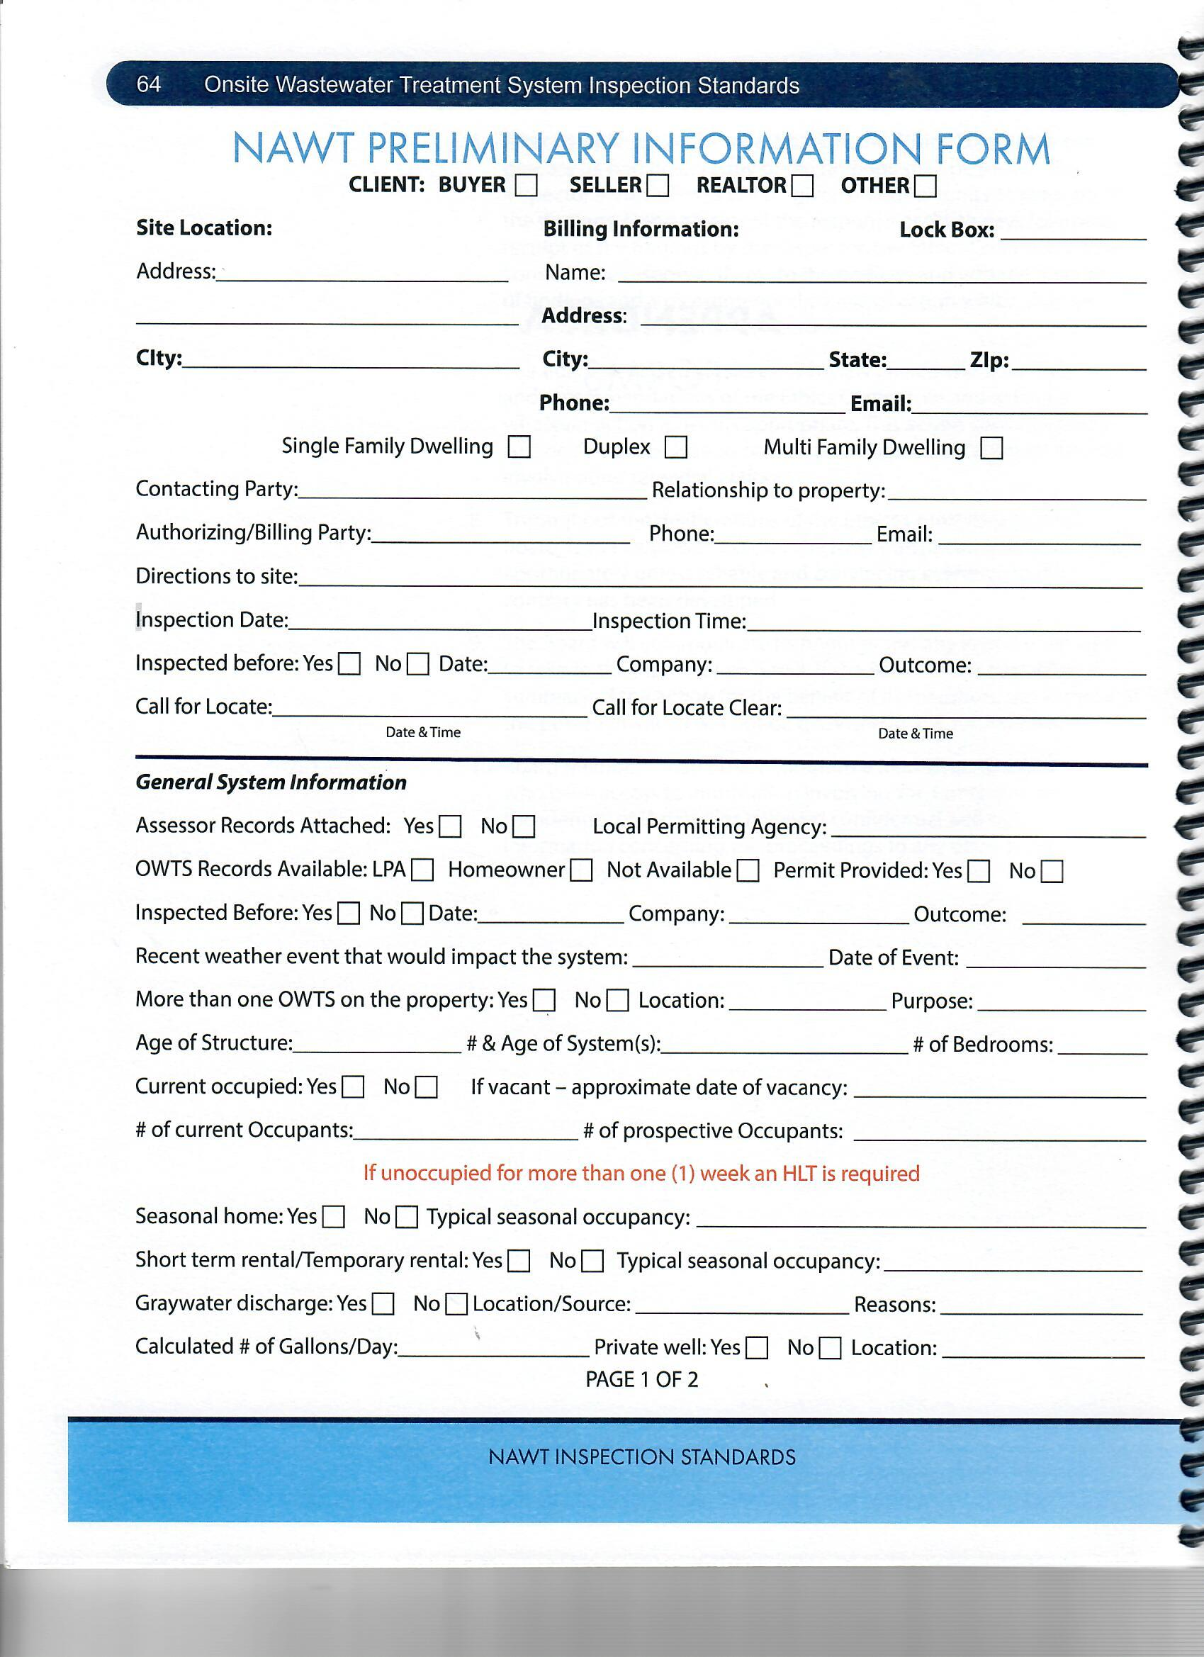
Preliminary Information Form
Notes:
Preliminary Information Form
Completed by the homeowner and the inspector before the inspection begins.
As much information as possible should be gathered in advance of a site visit.
Use the Preliminary Information Form (Appendix A pages 64 & 65) for this task.

Slide 10
System Design or Site Sketch
Notes:
A Site Sketch – design or permit information
Ask the landowner if they have a site sketch of the system or the original design and any repair permits, and arrange for them
to send it with the preliminary information or to have them on site for the inspector.
If there is one available via the homeowner or the LPA you will be verifying that what was permitted matches the site sketch.

Slide 11
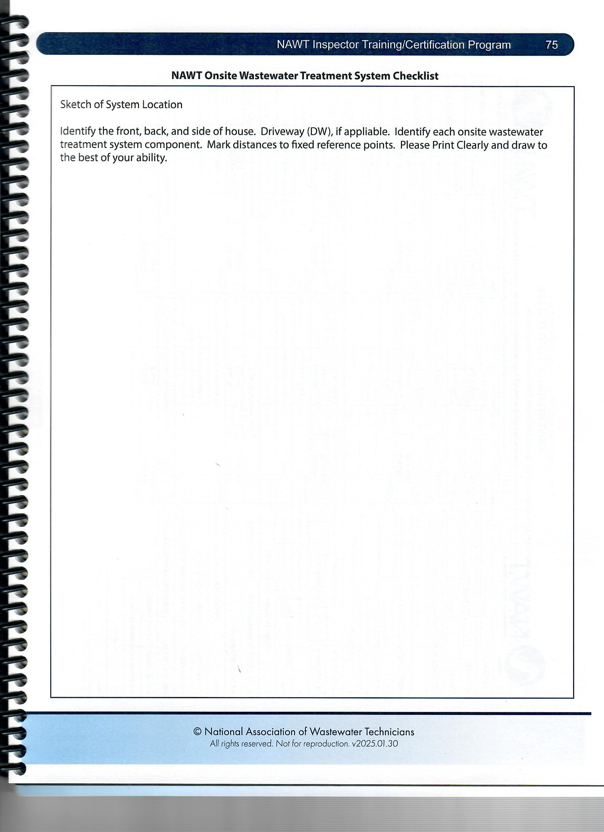
If no site
Sketch is
Available
Create one,
Gather information
And take measurements
See page 75
Notes:
No Sketch Available:
If a sketch is not available create a new site sketch. While on-site gather information and take enough measurements to
create a drawing. An as Built Drawing of Record needs to be completed, and it should be to scale.
See page 75 in your standards book.
Check with your local LPA for any requirements or if they would like the updated sketch for their records.

Slide 12
Preliminary Information
Age of dwelling.
Is there more than one system currently in use? If yes, then
  Complete an Inspection and Field Observations Form and prepare a separate Report for EACH system.
Age of sewage disposal system to be evaluated
Most recent number of occupants (residential uses) or daily flows (nonresidential uses)
Number of occupants or daily flow expected by the new occupant
Notes:
Preliminary Information Turn to page 7 of your standards book
Any information not gathered in advance must be gathered while on site.
(click to show each of the following items, and discuss each)
1. Age of dwellings
2. Is there more than one system currently in use? If yes, then complete an Inspection and Field Observations Form and prepare a separate report for each system. Each OWTS must be inspected independently and completely.
3. Age of the OWTS to be evaluated
4. Most recent number of occupants (residential uses) or daily flows (nonresidential uses)
5. Number of occupants or daily flow expected by the new occupant

Slide 13
Preliminary Information
Number of bedrooms in dwelling
Is the structure CURRENTLY occupied and in normal use?
If the structure has been unoccupied continuously for more than seven days, or the structure is subject to seasonal use or non-continuous use, then in addition to the inspection, a NAWT Hydraulic Load Test must be conducted.
Notes:
Preliminary Information
(click to show each of the following items, and discuss each)
6. Number of bedrooms in dwelling
Is the structure CURRENTLY occupied and in normal use?
ASK: What does this mean? (then click again)
If the structure has been unoccupied continuously for more than seven days, or the structure is subject to seasonal use or non-continuous use, then in addition to the inspection, a PSMA/NOF Hydraulic Load Test must be conducted. A comprehensive discussion of the NAWT Hydraulic Load Test is contained in this manual. Test question
NAWT understands that some localities may not be on board with the completion of an HLT. You must abide by all local codes and regulations. But as far as the NAWT Inspection Standards, it you are advertising as a NAWT Inspection it must be completed. Where it cannot be completed, your report would indicate that the inspection is NOT an NAWT OWTS Inspection
Lead discussion regarding WHY .

Slide 14
Preliminary Information
If the structure is used only on a seasonal basis, what is the usage frequency?
Request that the landowner obtain the original and any repair permits and arrange to have them on site for the inspector
Inquire if there was any repair activity and gather as much detail as possible regarding such repairs
Ask where the washing machine, all gray water lines and all other water-discharging appliances discharge. If not to the treatment tank, where do these discharges go (surface of the ground, to a stream)? Note these
Notes:
Preliminary Information
(click to show each item and continue to discuss)
8. If the structure is used only on a seasonal basis, what is the usage frequency?
9. Request that the landowner obtain the original and any repair permits and arrange to have them on site for the inspector.
10. Inquire if there was any repair activity and gather as much detail as possible regarding such repairs.
11. Ask where the washing machine, all gray water lines and all other water-discharging appliances discharge. If not to the treatment tank, where do these discharges go (surface of the ground, to a stream)? Discharges to locations other than the treatment tank should be noted.

Slide 15
Preliminary Information
When was the treatment tank last pumped?
  What is the typical pumping frequency?
Determine in advance if the treatment and pump tanks will be accessible (main access port dug open)
Determine if the system was the subject of a soil fracturing process within the last 12 months
Is the system covered by a systematic maintenance program?
  If yes
    Record the maintenance provider’s name, address and phone information
Notes:
Preliminary Information
(click to show each item and continue to discuss)
12. When was the treatment tank last pumped? What is the typical pumping frequency?
13. Is the system covered by a systematic maintenance program? If yes, record the maintenance provider’s name, address and phone information. ---- Test Q. The maintenance provider should be contacted.
14. Determine in advance if the treatment and pump tanks will be accessible (main access port dug out).
15. Determine if the system was the subject of a soil fracturing process within the last 12 months
With the Preliminary Information Form completed, it is time to start the Field Inspection.

Slide 16

Field Inspection Procedure
If there has been measurable precipitation in the last 48 hours, or if flood water or storm water runoff is standing on the absorption area, or if an unusual volume of water has been introduced to the treatment system in the last 48 hours, the inspector should use his/her judgment to determine if the inspection should be postponed.
Notes:
Field Inspection Procedure
If there has been measurable precipitation in the last 48 hours, or if floodwater or storm water runoff is standing on the absorption area, or if an unusual volume of water has been introduced to the treatment system in the last 48 hours, the inspector should use his judgment to determine if the inspection should be postponed.
Test Q.

Slide 17


Before You Start
The Field Inspection
Contact the utility locating or "one call" service in the locality to request that any utility lines be located.
NOTE: This will not identify privately installed utilities.
Notes:
Before You Start The Field Inspection
Ask: What is the first step in an inspection after the initial call, preliminary info and authorization?
(looking for one call – click to show the first item)
+Contact the utility locating or "one call" service in the locality to request that any utility lines be located. NOTE: This will not identify privately installed utilities.
(click to show the logo and discuss)
ASK: HOW MANY DAYS PRIOR TO THE SITE VIST DO YOU NEED TO CALL IN?
Looking for 3

Slide 18
READY TO GO TO
THE SITE?
WHAT TOOLS ARE
NEEDED?
Notes:
Before we leave for the inspection site what tools do we need to take with us?
The following tools are not all inclusive and some tools may not need for all inspection sites.

Slide 19

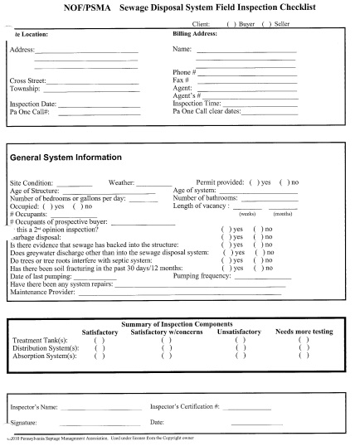

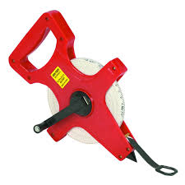
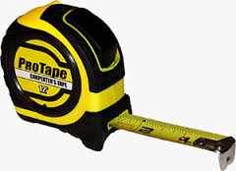
Equipment Needed to Complete the Field Inspection
The equipment needed to perform a field inspection include:
  Clipboard & pencil
  Field Inspection Form.
  Tape(s).
  Probe
Notes:
Equipment Needed
An Inspector, going to a home to conduct a NAWT OWTS inspection needs access to several pieces of equipment. Make sure you have all this equipment in your truck before you leave for the client’s site.
Describe and demonstrate the need and use of each item.
Clipboard (click) to hold the Field Inspection Form (click). You should also have the site sketch if provided, the authorization form, and copies of any maintenance contracts.
Tape(s); a pocket tape [15 to 25ft long] and a 100-ft tape (click)
Probe (click) – used to locate tanks and absorption areas.

Slide 20
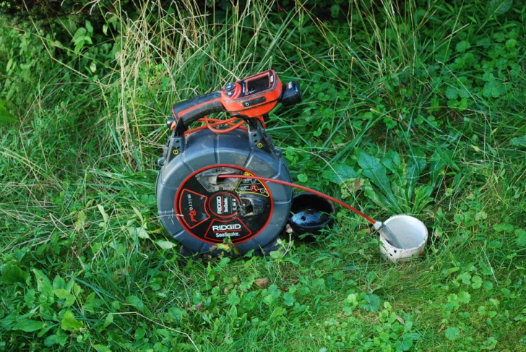
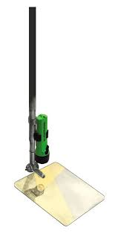
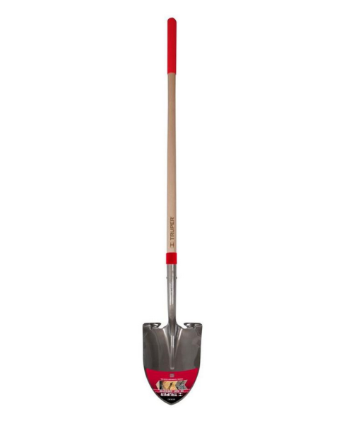
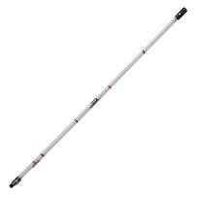
Equipment Needed to Complete the Field Inspection
The equipment needed to perform a field inspection include:
  Pressure Indicator
  Mirror
  Flashlight
  Sludge Judge or Sludge Stick
  Shovel
  TV camera
Notes:
Equipment Needed
Describe and demonstrate the need and use of each item.
Pressure Indicator (click). This is a tube to install on a pressure lateral to test for head pressure.
Mirror (click). Used to inspect the inside of tanks.
Flashlight (click)
Sludge Judge or Sludge stick (click) To inspect sludge levels in a tank.
Shovel(click)- for exposing tank lids
TV camera (click) used for locating and inspecting tanks & pipes

Slide 21

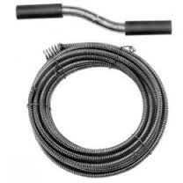
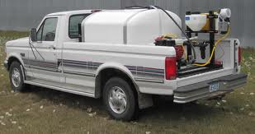
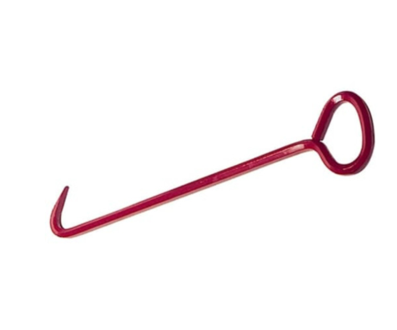
Equipment Needed to Complete the Field Inspection
The equipment needed to perform a field inspection include:
  Snake
  Water Tank, valve, hoses, water meter.
  Rake
  Hook.
Notes:
Equipment Needed
Describe and demonstrate the need and use of each item.
Snake (click).
Water Tank, valve, water meter, & hoses (click).
Rake and possibly a hoe to lift dose or pump floats (click)
Hook to lift manholes and floats (click)
ASK: What else is useful?
Looking for Flags and markers – paint.
A waterproof digital camera.
They may come up with other stuff?

Slide 22

General Field Procedure
During the Site Visit:
Walk the entire property looking for
  Lush vegetation
  Discharges on or through any of the following:
    The surface of the ground
    Streams
    Road ditches
    Storm drains or
    Unexpected pipes
Be alert for the presence of large trees that may affect any part of the OWTS
Notes:
General Field Procedure
(click to bring up each item)
1. During the site visit, walk the entire property looking for lush vegetation or discharges on or through any of the following: the surface of the
ground, streams, road ditches, storm drains or unexpected pipes.
2. Be alert for the presence of large trees that may affect any part of the OWTS (onlot wastewater treatment system)

Slide 23
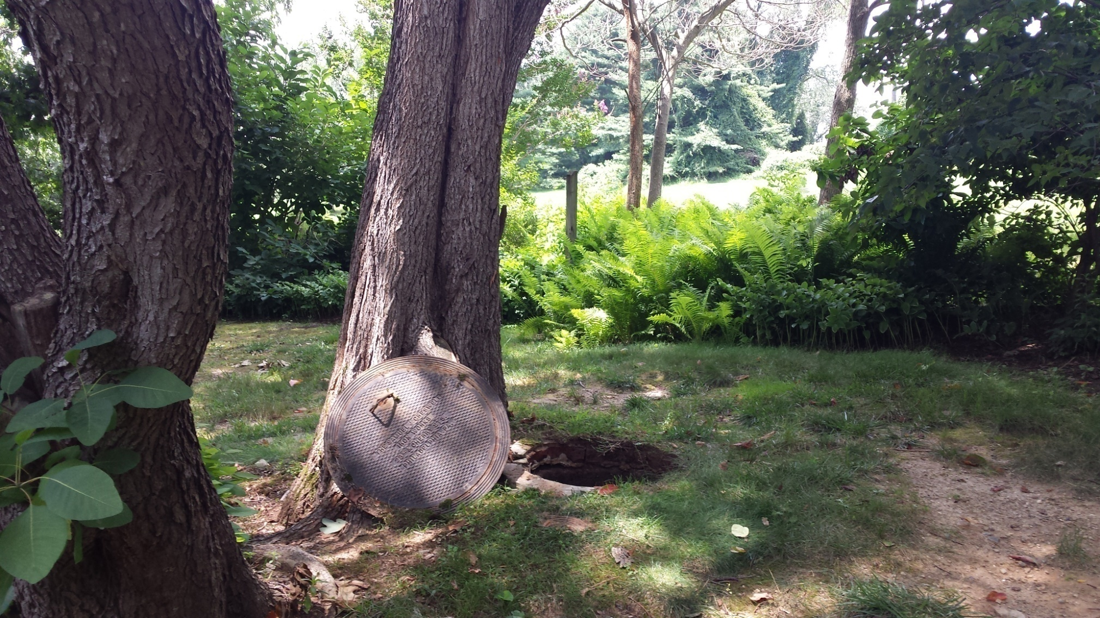
Here a tree is over a tank
Notes:
Homeowners have been known to plant trees and other plants over septic systems as well as build sheds and other structures over tanks and absorption areas.

Slide 24
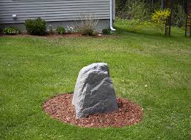
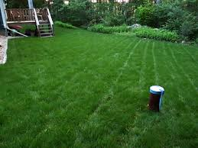
General Field Procedure
During the Site Visit:
Be alert for above-grade evidence of a well.
  If a well is observed, note its location in the field notes and on the site sketch
Notice whether a trap/vent exists and is above grade with a secure vented cover
Locate and gain access to the treatment tank(s), either now or as indicated below
Notes:
General Field Procedure
(click to bring up each item)
1. Be alert for above-grade evidence of a well. If a well is observed, note its location in the field notes and on the site sketch.
4. Locate and gain access to the treatment tank(s), either now or as indicated below (under treatment tanks Page 13 & 14).

Slide 25
Field Inspection Goals
Carefully inspect each component of the system in question,
Complete the Field Inspection Checklist, and
Assign one of the following value-judgments to each component:
  Acceptable
  Acceptable with concerns
  Unacceptable
  More investigation is necessary to reach a conclusion (Testing)
Notes:
Field Inspection Goals
(click for each item and discuss)
+Carefully inspect each component of the system in question.
+Complete the Field Inspection Checklist, and
+Assign on of the following value-judgments to each component:
+Acceptable
+Acceptable with concerns
+Unacceptable
+More investigation is necessary to reach a conclusion (Testing).

Slide 26
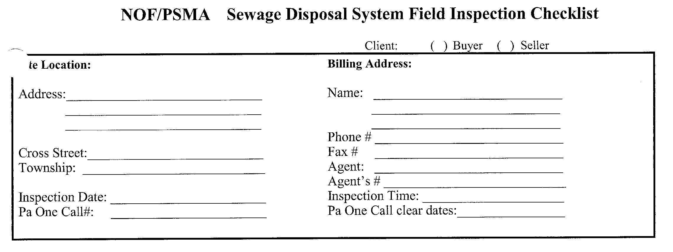
Field Inspection Checklist
This form found in Appendix A – page 69
1 page
Site information
Billing information
General system info
Basic Summary
Notes:
Field Inspection Checklist Found on page 69 to 75
Obtain names and addresses of the client.
Site address and billing address

Slide 27
Field Inspection Checklist
Page 2
Initial and Advance
Treatment component
For systems with multiple treatment components - a separate form should be filled out for each component
This form found in Appendix A – page 70 & 71
Notes:
Field Inspection Checklist Found on page 69 to 75
Obtain names and addresses of the client.
Site address and billing address

Slide 28
Field Inspection Checklist
Page 3
Initial and Advance
Treatment component (cont)
For systems with multiple treatment components - a separate form should be filled out for each component
This form found in Appendix A – page 70 & 71
Notes:
Field Inspection Checklist Found on page 69 to 75
Obtain names and addresses of the client.
Site address and billing address

Slide 29
Field Inspection Checklist
Page 4
Distribution components
Several components can be logged on this form
This form found in Appendix A – page 72
Notes:
Field Inspection Checklist Found on page 69 to 75
Obtain names and addresses of the client.
Site address and billing address

Slide 30
Field Inspection Checklist
Page 5
Final Treatment component
For systems with multiple Final Treatment components - a separate form should be filled out for each component
This form found in Appendix A – page 73 & 74
Notes:
Field Inspection Checklist Found on page 69 to 75
Obtain names and addresses of the client.
Site address and billing address

Slide 31
Field Inspection Checklist
Page 6
Final Treatment component
(cont)
For systems with multiple Final Treatment components - a separate form should be filled out for each component
This form found in Appendix A – page 73 & 74
Notes:
Field Inspection Checklist Found on page 69 to 75
Obtain names and addresses of the client.
Site address and billing address

Slide 32
Field Inspection Checklist
Page 7
Sketch of System
This should include the source, and all the components associated with the system and their locations
Ideally the drawing will be completed to scale
This form found in Appendix A – page 75
Notes:
Field Inspection Checklist Found on page 69 to 75
Obtain names and addresses of the client.
Site address and billing address

Slide 33

Building Sewer
Check for continuous flow through the building sewer into the treatment tank. Look for obvious backups or defects
Check for Unnecessary Flows (Concern)
  Condensate
  HVAC flows
  Continuous/draining ice makers
Check for Unacceptable flows
  Leaking fixtures
  Improperly adjusted equipment
  Roof gutters
  Foundation drains
  Sump pump discharge
Notes:
Building Sewer - - Read Slide
+Check for continuous flow through the building sewer into the treatment tank. =T
+Look for obvious backups or defects.
Unnecessary Flows
Evaluate whether unnecessary flows enter the system, such as, condensate, and HVAC flows or
continuously draining ice makers. These may be concerns.
Unacceptable Flows
Discharges from malfunctioning fixtures, improperly adjusted equipment, roof gutters, foundation
drains, sump pumps, and similar fixtures are unsatisfactory.
You will need to refer to your LPA to determine what is considered “unnecessary” and “unacceptable” flows. Some areas require water softener recharge to go through the OWTS other require it does not.

Slide 34
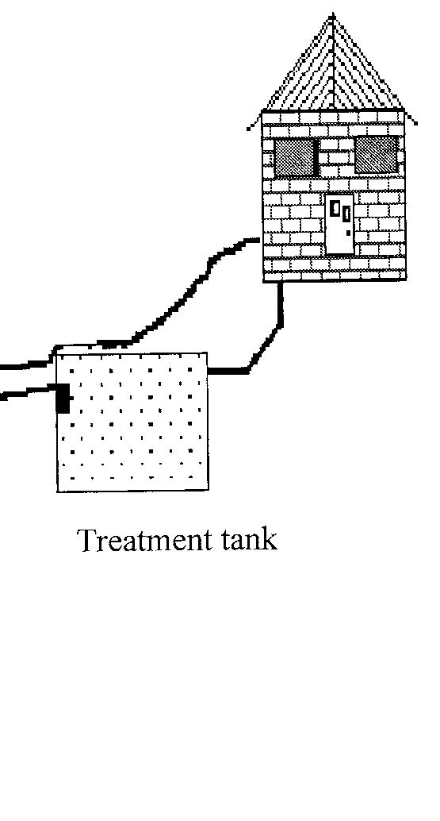
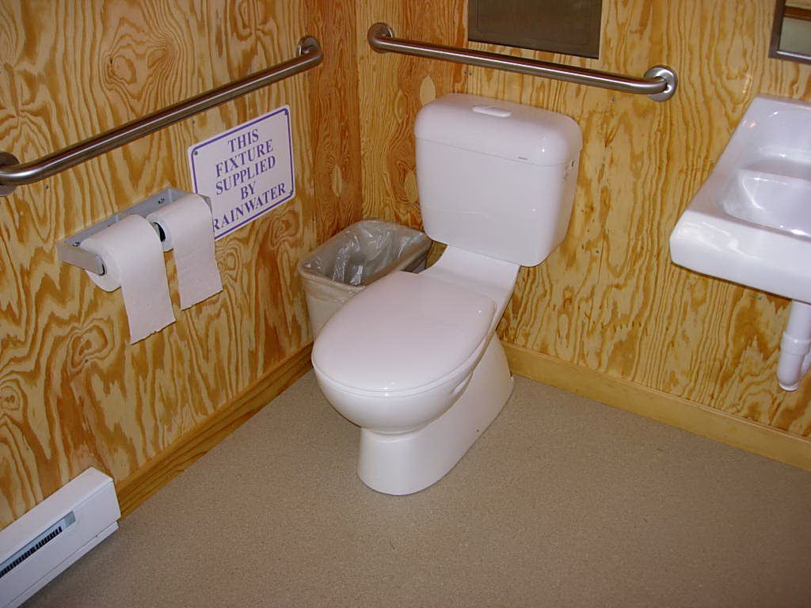
Inspecting Treatment Tanks
Locate and identify the point to which each fixture discharges.
Notes:
Inspecting Treatment Tanks
Ask: What clues can you garner from the landscape or the structure in your search for a treatment tank?
LOOKING FOR: Look for clean outs, access covers, soil depressions & thin or dead vegetation in a rectangle or circle Look at the windows and position of roof vents. Use a probe rod or locater.
WHEN ALL ELSE FAILS. . . ASK THE LANDOWNER!!!!!
ACTION: Show a probe, discuss how it is used Show/demonstrate the Prototek RDF. (click to show each step in the inspection of treatment tanks)
1. Locate and identify the point to which each fixture discharges. =T

Slide 35
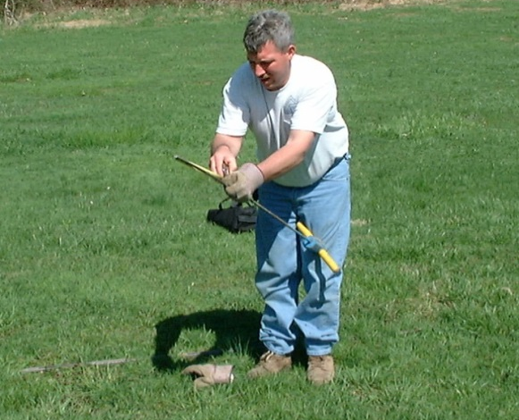
Inspecting Treatment Tanks
Carefully probe the top of all concrete and metal tanks to determine:
  Their dimensions and
  For signs of major deterioration, indicating replacement is needed.
  Care must be used to avoid damaging plastic, and fiberglass tanks.
Notes:
Inspecting Treatment Tanks
+Carefully probe the top of all concrete and metal tanks to determine their dimensions and for signs of major deterioration. Replacement of some components may be necessary.
+Care must be taken to avoid damaging plastic and fiberglass tanks.

Slide 36
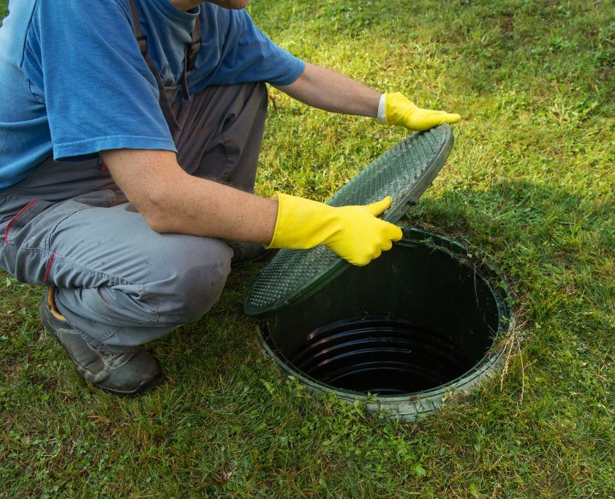
Inspecting Treatment Tanks
Locate inspection port(s) and main access way(s)
Notate position, depth, and condition of the port(s) and main access way(s)
Water resistant, cracks, compression, root infiltration, deterioration, exposed rebar, askew positioning?

Slide 37
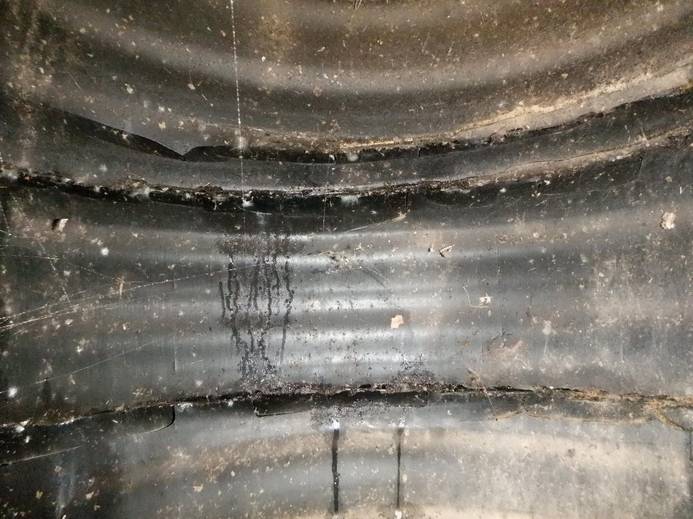
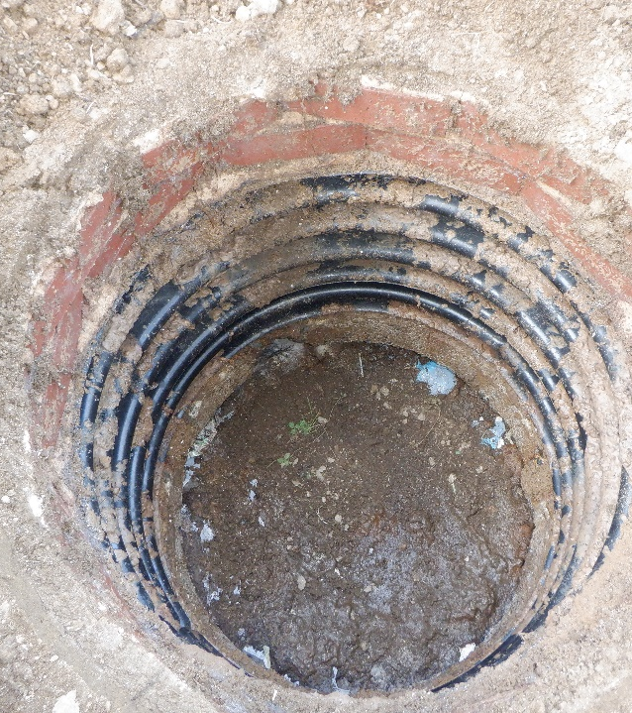
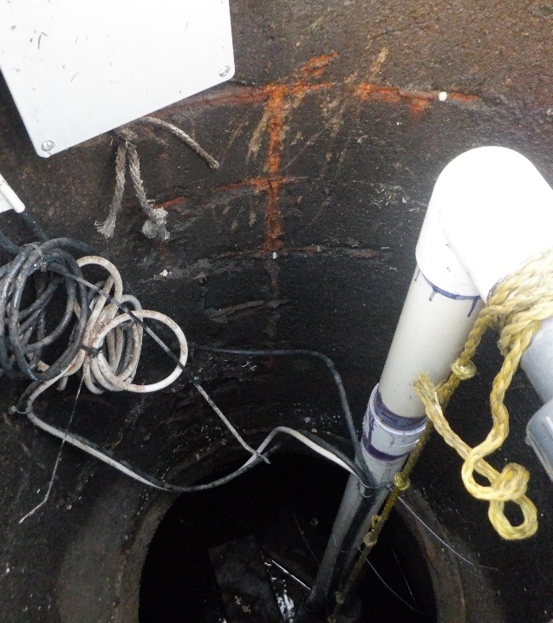
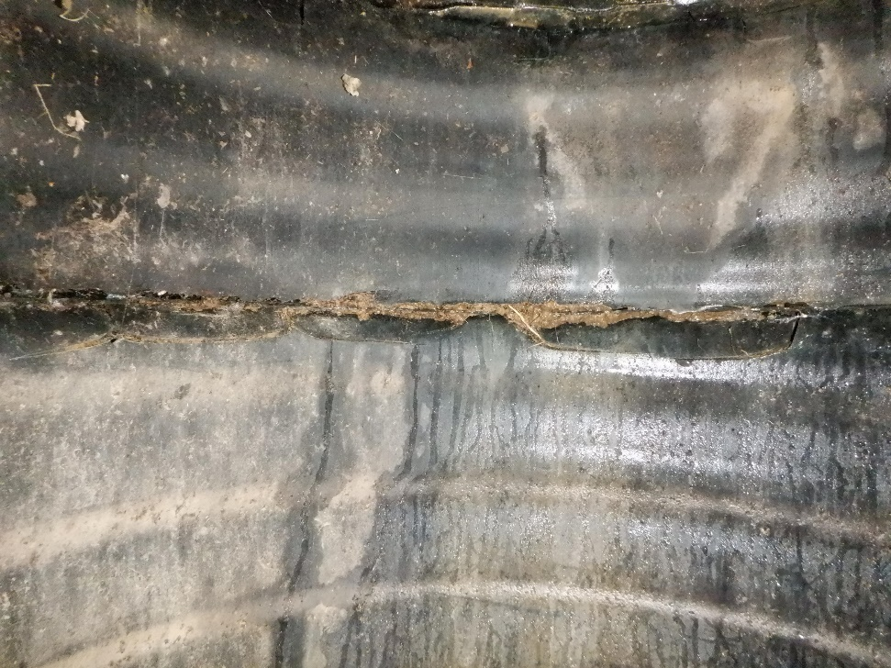
Main Access Pics

Slide 38
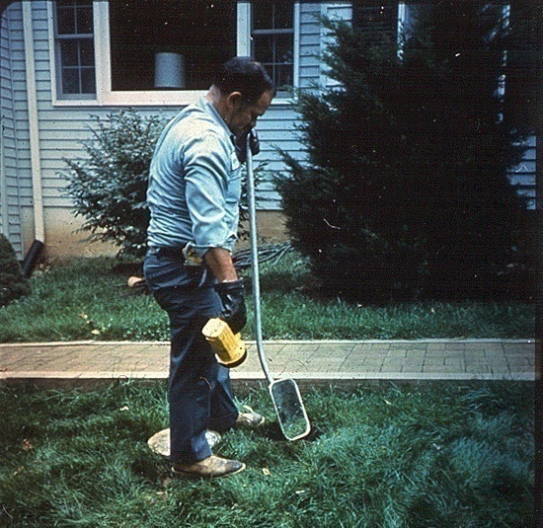
Inspecting Treatment Tanks
Open main access port and inspect the visible portions of the interior using a flashlight and mirror or other method
  Determine the treatment tank’s construction, composition (material), and condition of the tank, and the cover
  Determine the tank’s capacity
  Do this for every tank in the system
  Other inspection technologies may be employed to visually inspect the tanks in the manner described
Notes:
Inspecting Treatment Tanks
(click for each item and discuss)
+Open main access way and inspect the visible portions of the interior using a flashlight and mirror or other method.
+Determine the treatment tank’s construction, composition (material), and condition of the tank, and the cover.
+Determine the tank’s capacity.
+Do this for every tank in the system.
+Other inspection technologies may be employed to visually inspect the tanks in the manner described.
NOTE:A septic tank cannot be inspected properly through the 4” inspection port located over the inlet baffle. = T

Slide 39
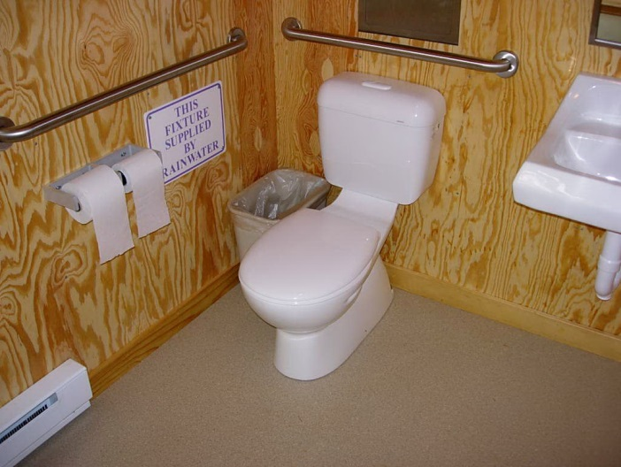
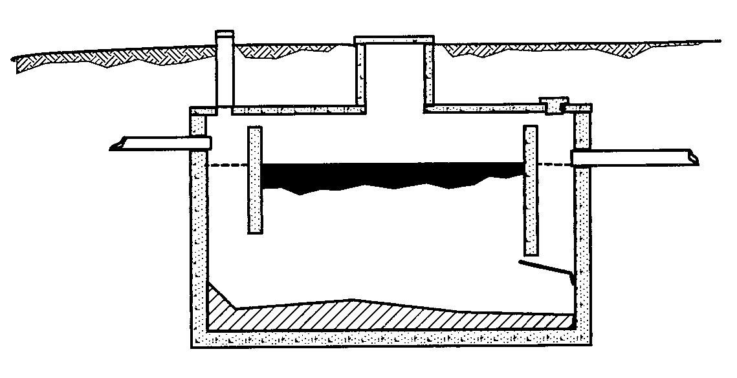
Inspecting Treatment Tanks
Measure the liquid level in the treatment tank.
  Then flush every toilet in the structure at least once.
  Use the observation port over the inlet or main access to verify fixture discharges into the tank and to note changes in the liquid level or observe backup conditions.
Notes:
Inspecting Treatment Tanks
(click for each item and discuss)
+Measure the liquid level in the treatment tank.
+Then flush every toilet in the structure at least once.
+Use the observation port over the inlet or main access to verify fixture discharges into the tank and to note changes in the liquid level or observe backup conditions.
ASK: Why do we do this? What does this tell Us?
Looking for: Change in liquid level – indication of a leak or other problems.

Slide 40
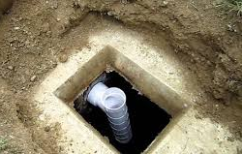
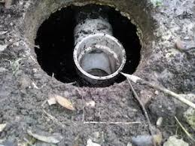
Inspecting Treatment Tanks
Check the baffles in every compartment by inspecting them:
  Directly through the inspection ports, or
  By using a mirror and flashlight or digital camera through the main access port of the treatment tank.
  Confirm that baffles are:
    In place,
    In good condition and
    That they have an air space between the top of the baffle and the tank.
Notes:
Inspecting Treatment Tanks
(click for each item and discuss)
+Check the baffles in every compartment by inspecting them directly through the inspection ports, or by
using a mirror and flashlight through the main access port of the treatment tank.
+Confirm that baffles are in place, in good condition and that they have an air space between the top of the baffle and the tank.

Slide 41
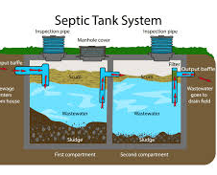
Inspecting Treatment Tanks
An acceptable treatment tank liquid level occurs when the liquid level is below the inlet invert and equal to the height of the outlet invert
  If a treatment tank is overfull, you must determine whether the problem is
    In the tank
    The distribution system or
    In the absorption area
    Has the tank been installed backwards or
    Is a filter clogged?
Notes:
Inspecting Treatment Tanks
(click for each item and discuss)
+An acceptable treatment tank liquid level occurs when the liquid level is below the inlet invert and equal
to the height of the outlet invert.
+If a treatment tank is overfull, you must determine whether the problem is in the tank, the
distribution system or in the absorption area. Has the tank been installed backwards or is a filter
clogged?
+If a treatment tank's liquid level is below the outlet invert, you must determine why the liquid level is not at the outlet invert.

Slide 42
Inspecting Treatment Tanks
  If a treatment tank's liquid level is below the outlet invert, you must determine
    Why the liquid level is not at the outlet invert?
Notes:
Inspecting Treatment Tanks
(click for each item and discuss)
+An acceptable treatment tank liquid level occurs when the liquid level is below the inlet invert and equal
to the height of the outlet invert.
+If a treatment tank is overfull, you must determine whether the problem is in the tank, the
distribution system or in the absorption area. Has the tank been installed backwards or is a filter
clogged?
+If a treatment tank's liquid level is below the outlet invert, you must determine why the liquid level is not at the outlet invert. = T

Slide 43
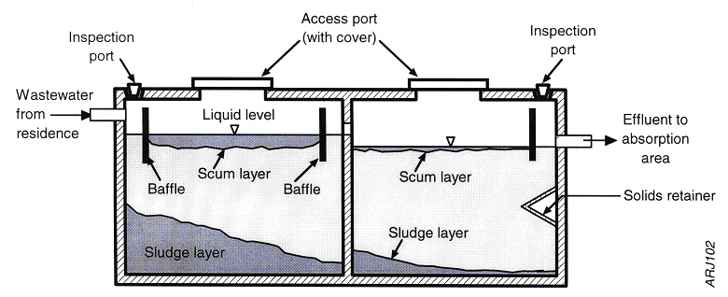
Inspecting Treatment Tanks
Measure and record the liquid, scum and sludge levels. Scum thickness and sludge depth must be measured through the main access port by using a Sludge Judge, Sludge Stick or similar “coring” device
Notes:
Inspecting Treatment Tanks
(click for each item and discuss)
+Measure and record the liquid, scum and sludge levels. Scum thickness and sludge depth must be measured through the main access port by using a Sludge Judge, Sludge Stick or similar “coring” device.

Slide 44
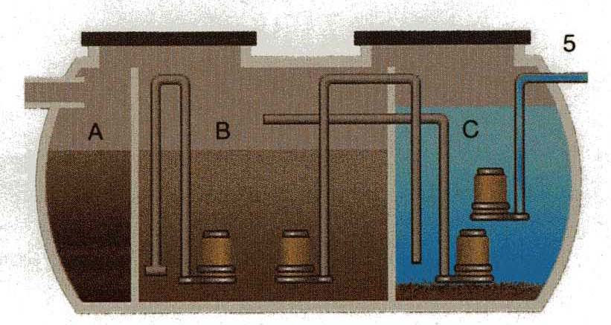
Inspecting Treatment Tanks
In the case of an aerobic treatment tank, the electrical and mechanical operation of the pumps and compressors must be checked by observing them in operation.
  If you are not familiar with these tanks, contact someone who is.
Notes:
Inspecting Treatment Tanks
+In the case of an aerobic treatment tank, the electrical and mechanical operation of the pumps and
compressors must be checked by observing them in operation.
+If you are not familiar with these tanks,
contact someone who is. = T

Slide 45
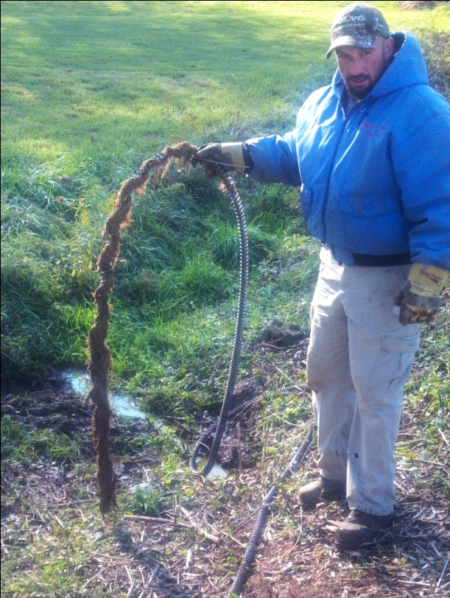
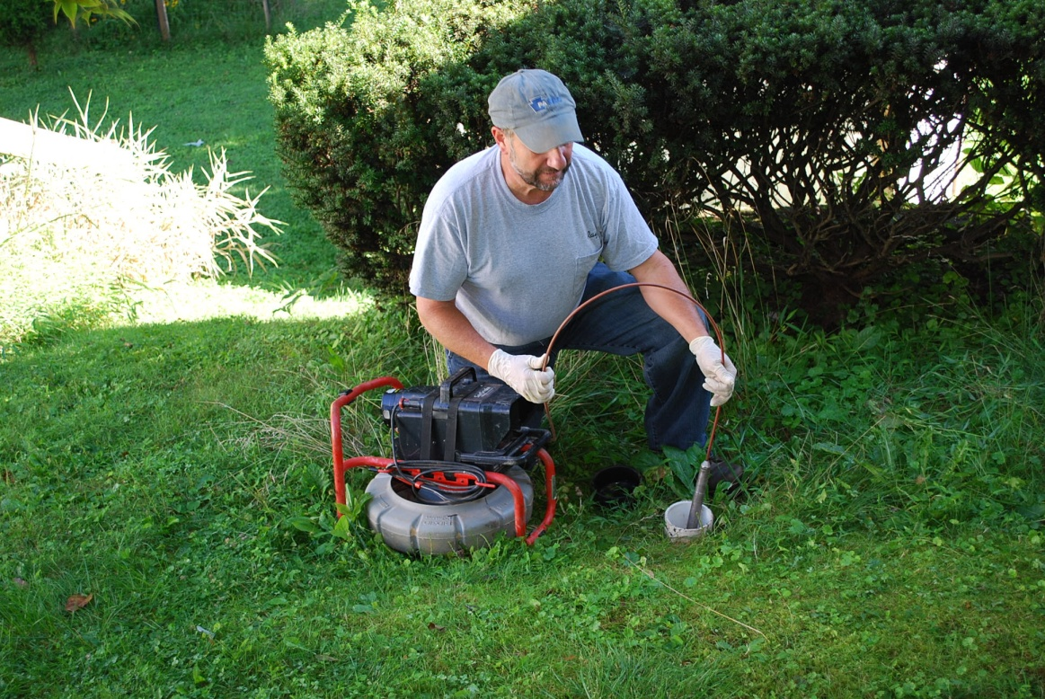
Inspecting Treatment Tanks
Check for obstructions in the effluent delivery line between the treatment tank and absorption area. If in doubt, run a snake through or camera through this line
Notes:
Inspecting Treatment Tanks
(click for each item and discuss)
+Check for obstructions in the effluent delivery line between the treatment tank and absorption area. If in
doubt, run a snake or camera through this line.

Slide 46
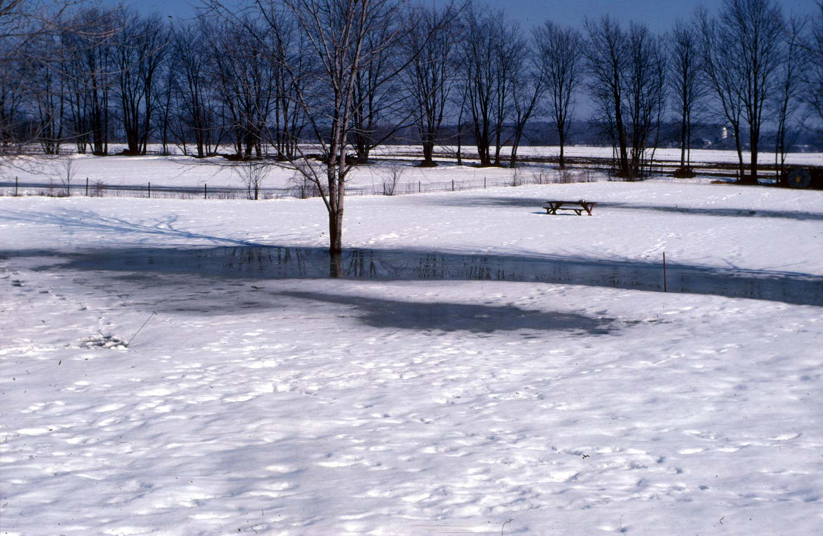
Inspecting Treatment Tanks
Check for infiltration of surface water into all tanks.
Notes:
Inspecting Treatment Tanks
(click for each item and discuss)
+Check for infiltration of surface water into all tanks.

Slide 47
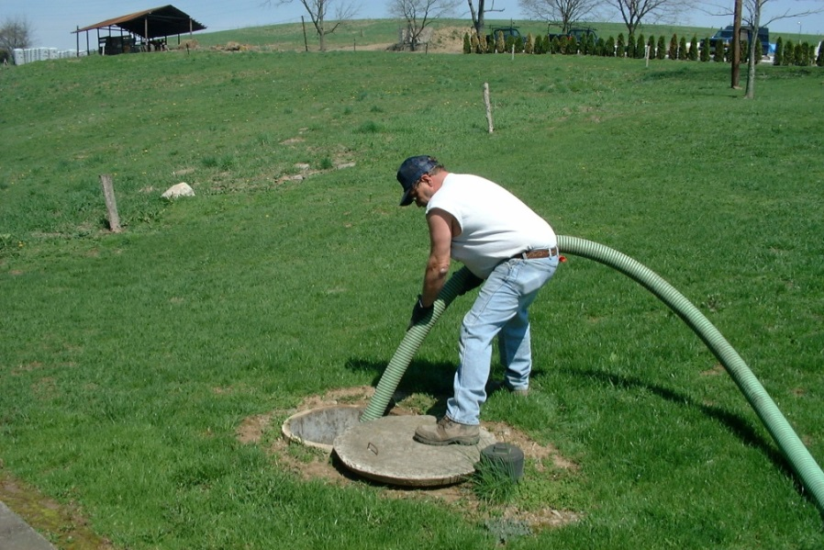
Inspecting Treatment Tanks
Do NOT pump any treatment tank until the soil treatment area has been investigated
Notes:
Inspecting Treatment Tanks
(click for each item and discuss)
+Do not pump any treatment tank until the absorption area has been investigated
SEE PAGE 25 of the standards
These criteria determine when to pump the treatment tank(s):
If the liquid level in the absorption area, cesspool or seepage pit is found to be satisfactory, then pump all tanks in accordance with the NAWT or applicable state association or regulatory tank pumping standards.
If the liquid level in the absorption area, cesspool or seepage pit is found to be unsatisfactory, then do not pump any tank or component to enable a second opinion inspection under the same conditions as the initial inspector encountered.
If the treatment tank’s liquid level is above the outlet invert, then do not pump any tank or component to enable a second opinion inspection under the same conditions as the initial inspector encountered.

Slide 48

Inspecting Treatment Tanks
As each tank is pumped, look for inflow, cracks, holes and deficiencies that were previously hidden below the surface. Also look for structural integrity and root invasion.
Notes:
Inspecting Treatment Tanks
The decision of when to pump a treatment tank is based on the absorption area’s condition and may be influenced by the liquid level in the treatment tank. – BLACK box
+As each tank is pumped, look for:
+Inflow.
+cracks.
+holes.
+deficiencies that were previously hidden below the liquid surface.
+structural integrity of the tank.
+root invasion.

Slide 49
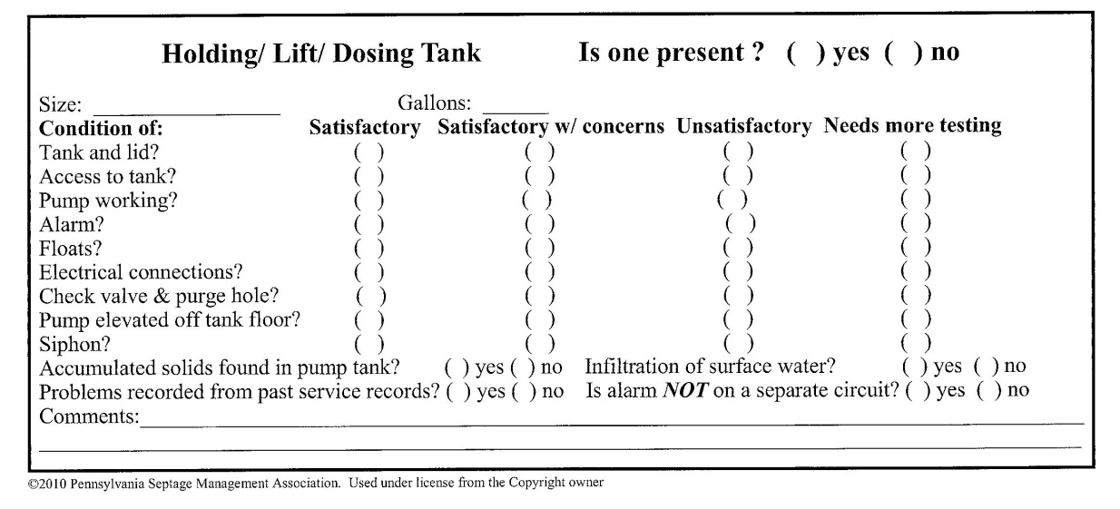
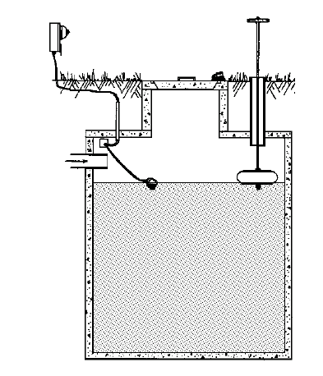
Inspecting Holding Tanks
Verify that alarm is functioning property.
Measure liquid level in each tank.
Pump each tank.
Look for cracks, holes, deficiencies.
On the Inspection Report, include an estimated annual cost for holding tank maintenance. The report must notify the client of the need for an ongoing maintenance contract.
NEVER Hydraulic Load Test a holding tank.
Notes:
Inspecting Holding Tanks
+Verify that the alarm is functioning properly.
+Measure and record the liquid level in each tank.
+Pump all tanks in accordance with the NAWT or applicable state association or regulatory tank pumping standards.
+As each tank is pumped, look for inflow, cracks, holes and deficiencies that were previously hidden below the liquid surface.
++NEVER Hydraulic Load Test a holding tank. = Test
++On the Inspection Report, include an estimated annual cost for holding tank maintenance. The report must notify the client of the need for an ongoing maintenance contract.
49

Slide 50
How to determine the
Size of a tank
What ways can you determine the size or volume of a treatment or pump tank?
Notes:
Click to bring up question.
ASK: What ways can you determine the size or volume of a treatment or pump tank?
Looking for: Pump the tank and read the gauge. Or measure the inside dimensions of the tank and calculate the volume or capacity.

Slide 51
Volume Calculations
All tanks must be measured, and
The volume of the liquid they will hold must be checked/determined
Keep your units consistent
There are 7.5 gallons in a cubic foot
Tank (or tank chambers) are usually in one of two shapes:
  Rectangular
  Cylindrical
Notes:
Volume Calculations – Appendix B
The size and volume of all tanks and secondary filters must be verified or determined.
The most common calculation is to determine the volume of liquid a rectangular or cylindrical tank will hold.
The following examples should reinforce your basic understanding of these calculations.
Always pay attention to the units required in each equation.
The only unit conversions you should need are:
There at 12 inches in a foot.
There are 7.5 gallons in a cubic foot.

Slide 52
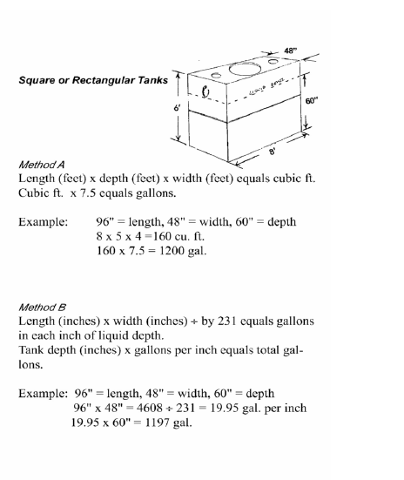
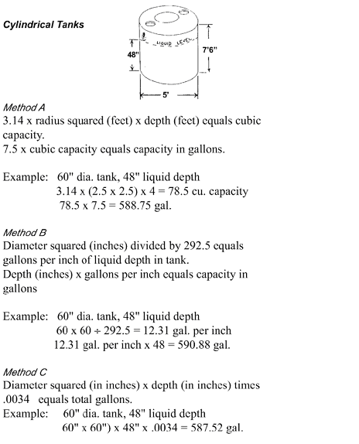
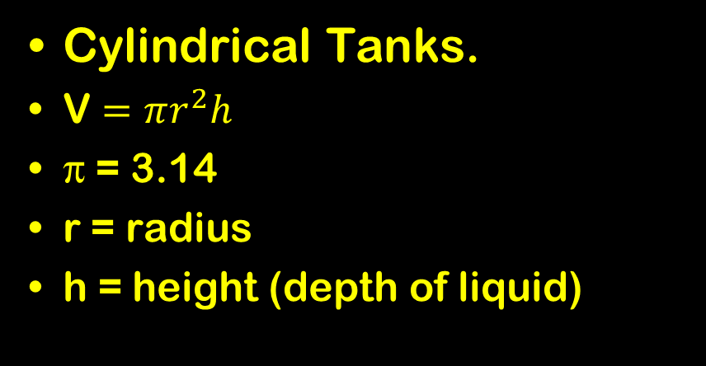
Volume Calculations
Rectangular Tanks.
Volume = LDW
L = length
D = depth (of liquid)
W = width
Cylindrical Tanks.
V $=πr^{2}h$
π = 3.14
r = radius
h = height (depth of liquid)
Notes:
These are the basic formulae used to determine the volume of liquid a rectangular and a cylindrical tack will hold.
Note: units are not given. If you are working in inches, all parameters should be in inches. If you are working in feet, use feet for all units. The answers may be expressed in cubic feet and then converted to gallons.

Slide 53
Rectangular Volume Calculations
Volume = LDW
Method A (units = feet)
L = 8ft = 96in.
D = 5ft = 60in.
W = 4ft = 48in.
V = 8(5)(4) = 160 ft³
V = 160 ft³ (7.5) = 1,200 gallons
Notes:
53
Volume Calculation – Appendix B
Rectangular (or Square) Tanks
Rectangular Tanks (click to show each method – be sure they understand before moving on – also offer to tutor students at the evening session)
Method A
Length (feet) x depth (feet) x width (feet) equals cubic ft. Cubic ft. x 7.5 equals the volume in gallons.

Slide 54
Rectangular Volume Calculations
Gal/in = LW/231
Method B (units = inches)
L = 8ft = 96in
D = 5ft = 60in
W = 4ft = 48in
Area = 96”(48”) = 4608in²
Or 4608/231 = 19.95 gal/in
19.95(60”) = 1197 gallons.
Notes:
54
Volume Calculation - Appendix B
Rectangular Tanks (click to show each method – be sure they understand before moving on – also offer to tutor students at the evening session)
Method B
Length (inches) x width (inches) divided by 231 equals gallons in each inch of liquid depth.
Tank depth (inches) x gallons per inch equals total volume in gallons.

Slide 55
Cylindrical Volume Calculation
Volume = V = π r² h
Method A (units = feet)
r = 2.5ft
h = 4ft
V = 3.14(2.5)²(4) = 78.5ft³
V = 12.31(48) = 590 gallons
Notes:
55
Volume Calculation
Cylindrical Tanks
Appendix B. Cylindrical Tanks (click to show each method – be sure they understand before moving on – also offer to tutor students at the evening session)
Method A
3.14 x radius squared (feet) x depth (feet) equals the volume in cubic feet.
7.5 x volume in cubic feet equals the tank volume in gallons.
In our example: 3.14 x (2.5 x2.5) x 4 = 78.5 cu.ft. x 7.5 = 590 gallons.

Slide 56
Cylindrical Volume Calculation
Gal/in = d²/292.5
Method B (units = inches)
d = 5ft=60in
Gal/in = 60²/292.5 = 12.31 gal/in
V = 12.31(48) = 590 gallons
Notes:
56
Volume Calculation
Cylindrical Tanks
Appendix B. Cylindrical Tanks (click to show each method – be sure they understand before moving on – also offer to tutor students at the evening session)
Method B
Diameter squared (inches) divided by 292.5 equals gallons per inch of liquid depth in tank.
Depth (inches) x gallons per inch equals tank volume in gallons
In our example: 60 x 60 ÷ 292.5 = 12.31 gal./in. x 48 = 590 gallons

Slide 57
Cylindrical Volume Calculation
Volume = V = 0.0034d²h
Method C (units = inches)
d = 5ft = 60in
h = 4ft = 48in
V = 0.0034((60)²(48) = 587 gal.
Notes:
57
Volume Calculation
Cylindrical Tanks
Appendix B. Cylindrical Tanks (click to show each method – be sure they understand before moving on)
Method C
Diameter squared (in inches) x depth (in inches) times 0.0034 equals tank volume in gallons.
In our example: (60 x 60) x 48 x .0034 = 587 gallons.

Slide 58
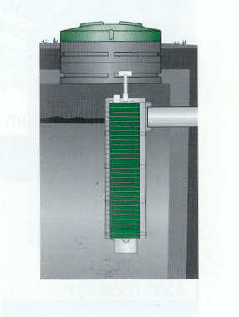
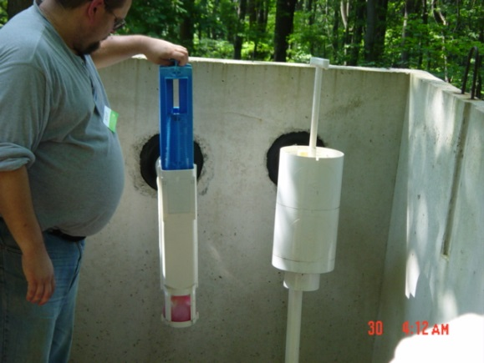
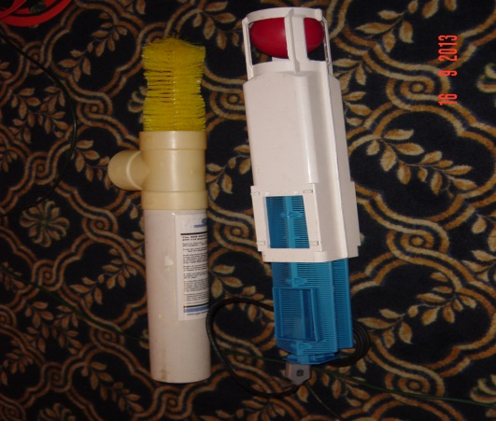
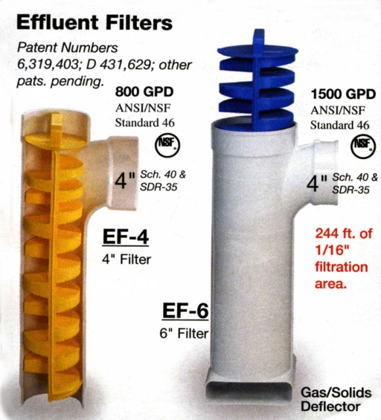
Septic Tank Outlet Filters
Observe liquid level.
Do not remove until tank has been pumped.
After tank has been pumped,
  Remove filter.
  Clean the filter.
  Inspect the filter.
  Reinstall the filter.
Notes:
Septic Tank Outlet Filters
+Observe the liquid level around the filter, along with the amount of accumulated waste material.
+Do not remove the filter until after the treatment tank has been pumped.
+After the tank has been pumped,
+Carefully remove and clean the filter. = T
+Inspect the filter for damage.
+Reinstall the filter.

Slide 59
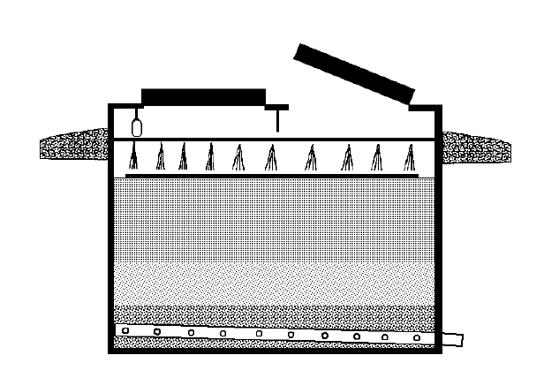
Secondary Treatment Filters
Media Based Filters
Inspect hatches; physical integrity.
Is there surface water infiltration?
Look for clogged delivery pipe holes.
Is there a splash block under each hole?
Activate the pump.
Activate the alarm.
Is treated effluent is leaving the filter?
Is effluent ponded on top of the sand?
Ponding of liquid over the entire surface of the sand is UNACCEPTABLE
Notes:
Secondary Treatment Filters –SEE Page 16 standards – When any proprietary unit or component is encountered, appropriate and specific training from the manufacturer should be obtained by the inspector
Media Based Filters (Click for each item)
+Inspect the filter vessel and hatches for physical integrity.
+Is there surface water infiltration.
+Look for clogged holes in the effluent delivery pipe.
+Is there a splash block under each delivery hole.
+If the filter is supplied by a pump, activate the pump by introducing sufficient CLEAN water to cause the float to energize the circuit. The normal discharge to the filter is a volume of 2" of liquid depth per dose.
+If an alarm is present, verify that it activates when the liquid reaches a depth of 12" above the sand surface.
+Verify that the filtered effluent is leaving the filter by observing its inflow into the next system component.
+Look for effluent ponded on top of the sand. (click to show next item)
++Ponding of liquid over the entire sand filter surface is an UNACCEPTABLE condition.

Slide 60
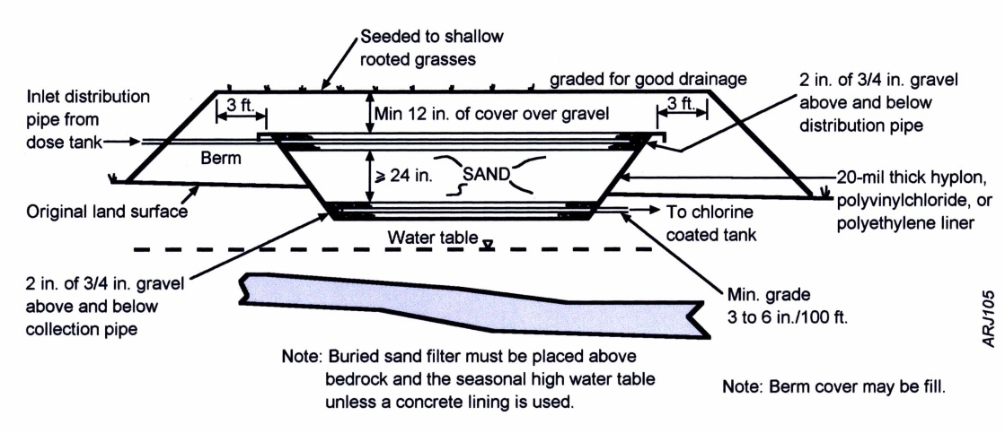
Secondary Treatment Filters
Buried Sand Filters
Is lush vegetation above or near the filter?
Is there ponded liquid above or near the filter?
Verify that effluent is entering the filter.
If risers, is effluent flowing through the filter?
Is treated effluent is leaving the filter?
Do not probe a buried sand filter.
Notes:
Secondary Treatment Filters
Buried Sand Filters – (Click for each item) -used for small flow treatment facilities
+Look for lush vegetation.
+Is there ponded liquid above the filter at or near the soil surface.
+Verify that effluent flows through the effluent delivery line to the filter.
+If risers are present, verify that effluent is flowing through the filter normally.
+Verify that the filtered effluent is leaving the filter by observing its inflow into the next system component. (click to show next item)
Do not probe buried sand filters.
Ask: Does anyone know why?
Danger of puncturing liner.

Slide 61

Secondary Treatment Filters
Media-Based Filters
It is Never recommended to open a media filter w/o manufacturers instruction.
Is lush vegetation above or near the filter?
Is there ponded liquid above or near the filter?
Verify that effluent is entering the filter.
Is treated effluent is leaving the filter?
See manufacturer-specific information.
See Appendix D – OWTS Alternate Technology Listings
Notes:
Secondary Treatment Filters
Media-Based Filters can use peat or coco fibers
+Never open a media-based filter without manufacturer’s instruction. = T
+Refer to Appendix D for a current list of Alternate Technologies that you may want to obtain additional training on for components in your area.
+Basic inspection of these filters will be the same as buried sand filters.
+Verify effluent is entering and leaving the filter.
Newer units may have a dose or pump tank at the outlet end of the unit. Verify the pump functions properly.

Slide 62

Secondary Treatment Filters
Recirculating Sand Filters
Is lush vegetation above or near the filter?
Is there ponded liquid above or near the filter?
Verify that effluent is entering the filter.
Is effluent flowing through the filter?
Is treated effluent leaving the filter?
Notes:
Secondary Treatment Filters
Recirculating Sand Filters
+Look for lush vegetation.
+Is there ponded liquid above the filter at or near the soil surface.
+Verify that effluent flows through the effluent delivery line to the filter.
+Open the filter, verify that effluent is flowing through the filter normally.
+Verify that the filtered effluent is leaving the filter by observing its inflow into the next system component.

Slide 63

Secondary Treatment Filters
Advan Tex® Treatment System
Is lush vegetation above or near the unit?
Is there ponded liquid above or near the unit?
Verify that effluent is entering the unit.
Open the unit, is effluent flowing through the unit?
Is treated effluent is leaving the unit?
Notes:
Secondary Treatment Filters
Advan Tex Treatment System – from Orenco
+Look for lush vegetation.
+Is there ponded liquid above the filter at or near the soil surface.
+Verify that effluent flows through the effluent delivery line to the filter.
+Open the unit, verify that effluent is flowing through the filter normally.
+Verify that the filtered effluent is leaving the filter by observing its inflow into the next system component.

Slide 64

Disinfection Units
Solid Chlorine Tablet Unit
Are solid chlorine tablets present?
Are the Cl tablets resting on the channel?
Verify that the tablets are not fused together.
Are the tablets free to slide down the tube?
Review the maintenance records for the unit.
The inspector must advise the client that further testing is required to verify that the system is properly disinfecting the effluent.
The inspector must advise the client that a permit may be required to operate this type of system. The client must verify that a valid permit exists for their use of those systems requiring operating permits.
Notes:
Disinfection Units
Solid Chlorine Tablet Units
+Check that solid chlorine tablets are present and that they are resting in the channel.
+Verify that the tablets have not fused together (like ice cubes in ice tea) and failed to progressively move downward into the channel.
+Review the maintenance records for the system, if available.
NOTE: just the smell of chlorine is not enough to test it. =T
(click to show each of the following and discuss as needed)
++The inspector must advise the client that further testing is required to verify that the system is properly disinfecting the effluent.
++The inspector must advise the client that a permit may be required to operate this type of system. The client must verify that a valid permit exists for their use of those systems requiring operating permits.

Slide 65

Disinfection Units
Liquid Chlorine Unit
Verify that the chlorine pump activates at the proper time in the system’s cycle.
Review the maintenance records for the unit.
The inspector must advise the client that further testing is required to verify that the system is properly disinfecting the effluent.
The inspector must advise the client that a permit may be required to operate this type of system. The client must verify that a valid permit exists for their use of those systems requiring operating permits.
Notes:
Disinfection Units
Liquid Chlorine
+Verify that the chlorine pump actuates at the proper time in the system’s cycle.
+Review the maintenance records for the system, if available.
(click to show each of the following and discuss as needed)
++The inspector must advise the client that further testing is required to verify that the system is properly disinfecting the effluent.
++The inspector must advise the client that a permit may be required to operate this type of system. The client must verify that a valid permit exists for their use of those systems requiring operating permits.

Slide 66

Disinfection Units
Ultraviolet Light Unit
Verify that the ultraviolet light is working properly.
Review the maintenance records for the unit.
The inspector must advise the client that further testing is required to verify that the system is properly disinfecting the effluent.
The inspector must advise the client that a permit may be required to operate this type of system. The client will need to be made aware of reporting obligations to authorities, if appropriate.
Notes:
Disinfection Units
Ultraviolet
+Verify that the ultraviolet light is working.
(click to show each of the following and discuss as needed)
++The inspector must advise the client that further testing is required to verify that the system is properly disinfecting the effluent.
++The inspector must advise the client that a permit may be required to operate this type of system. The client must verify that a valid permit exists for their use of those systems requiring operating permits.

Slide 67



Effluent Delivery & Distribution Systems Gravity
Examine treatment tank outlet.
Verify tank’s outlet pipe is sound and unobstructed.
Is the tank’s liquid level at the outlet pipe invert?
  If not; find out why?
Is there equal flow to all parts of the STA?
  If not, find/open D-box.
  Is this a serial distribution system?
Expect the unexpected.
Notes:
Effluent Delivery and Distribution Systems(click to show each of the following)
Gravity Distribution
+Gravity distribution systems are checked by examining the treatment tank’s outlet. If the tank’s liquid level is at the lowest point of the outlet pipe (invert) and if the effluent delivery line to the absorption area is sound and unobstructed, then the effluent is properly reaching the effluent distribution system (soil treatment area).
+If the liquid level is above the lowest point of the outlet pipe, further investigation is needed to locate and evaluate the cause of this condition.
+If conditions in the absorption area signal potential unequal distribution, then the D-Box, if found, must be exposed and evaluated. If no D-Box is found, the absorption area investigation should proceed. The client should be offered the option of continued investigation until the cause of unequal distribution is identified and understood.
+If, in the course of inspection, it is discovered that the laterals in a trench or bed system are installed perpendicular to the contour lines, be alert to the likelihood of unequal distribution and effluent accumulating in the farthest downslope areas of the aggregate.
Ask: Must all D-Boxes be found and opened?
Answer: No (click to show next item)
Remember to expect the unexpected in older gravity systems

Slide 68

Effluent Delivery & Distribution Systems Pump and Siphon Tanks
Check STA before turning on a pump.
Inspect the dose tank (previous procedure).
Check tanks for foreign contaminates.
Measure the liquid level in each tank.
Pump all tanks.
Inspect all tanks.
Optional: verify adequate head in the STA piping.
Notes:
Effluent Delivery and Distribution Systems (click to show each of the following)
Pump and Siphon Tanks
+Always check the soil treatment area (STA) before turning on either a lift or dosing pump; however, if the pump has recently been activated, finish all aspects of the inspection before checking the water level in the STA. = T
+Check the condition and soundness of all pump and siphon tanks, using the tank inspection procedures described previously.
+Check tanks for any foreign contaminates such as FOG’s (fats, oils and greases), organic solids, inorganic matter (wipes, shop rags, underwear, etc.) floating scum, sludge or condoms. Review previous components to determine why these substances are passing through.
+Measure and record the liquid level in each tank.
+Pump all tanks in accordance with the NAWT or applicable state association or regulatory tank pumping standards.
+As each tank is pumped, look for inflow, cracks, holes and deficiencies that were previously hidden below the surface.
Remember Each tank must be emptied to perform a complete NAWT inspection.
++Inspectors may choose to verify that adequate head pressure is attained in the STA (see soil treatment areas below).

Slide 69


Effluent Delivery & Distribution Systems; Pump Tanks
Verify that all pumps are resting on a 6-inch-high concrete block.
Check soundness of pumps & that it works.
Inspect all electrical cables & connections.
Verify that the alarm and pump are on separate circuits.
Activate all float switches.
Notes:
Effluent Delivery and Distribution Systems-(click to show each of the following)
Pump Tanks
+Verify that all pumps are resting on a concrete block and elevated above the tank bottom. Pumps should not be suspended unless specified by the manufacturer.
+Verify the operation of the pump, its control and alarm systems.
+Visually inspect exposed electrical cables, junction boxes, etc. Do NOT touch any electrical wires or components unless you have PERSONALLY de-energized the circuit. Verify that the alarm and pump are on separate circuits.
+Use a rake, hoe or similar device or add sufficient water to elevate the appropriate float and activate the various components.

Slide 70
Effluent Delivery & Distribution Systems; Pump Tanks
Check for excessive runback
If more than 50% of dose volume runs back after pump stops, MORE INVESTIGATION is needed. If the pump short cycles, it is UNACCEPTABLE
If the dose cycle lasts more than 15 minutes the pump is UNACCEPTABLE, unless indicated as normal by design. Inspectors shall verify this
Notes:
Effluent Delivery and Distribution Systems- (click to show each of the following)
Pump Tanks
+Check for excessive runback of effluent from the STA after the pump stops. If excessive runback is observed, note whether it causes the pump to short cycle.
(explain short cycle – pump turning on again before runback stops-discuss if needed) (click to show each of the next items)
++If more than 50% of dose volume runs back after pump stops, MORE INVESTIGATION is needed. If the pump short cycles, it is UNACCEPTABLE.
++If the dose cycle lasts more than 15 minutes the pump is UNACCEPTABLE, unless indicated as normal by design. Inspectors shall verify this.

Slide 71

Effluent Delivery & Distribution Systems;
Siphon Tanks
Open observation port and check for continuous trickling.
Add sufficient water to activate the siphon.
Watch for proper operation.
Notes:
Effluent Delivery and Distribution Systems
Siphon Tanks
+For siphon and flout systems, open the observation port and check for continuous trickling.
+Run sufficient water into the siphon tank to cause the siphon to cycle, and
+Watch for proper operation.

Slide 72
Absorption Areas
In order to complete an inspection, the STA MUST be located.
If no STA is found, the report MUST conclude that MORE INVESTIGATION IS NECESSARY.
If the inspector observes or has reason to believe that the system is discharging raw or partially treated wastewater directly to the surface of the ground or to a waterway, such conditions shall be noted and the system shall be described as UNACCEPTABLE.
Notes:
72
noted,Systems
The STA is the most critical component of an onsite wastewater treatment system.
(click to show each of the following)
++In order to complete an inspection, the STA MUST be located.
++If no STA is found, the report MUST conclude that MORE INVESTIGATION IS NECESSARY.
++If the inspector observes or has reason to believe that the system is discharging raw or partially treated wastewater directly to the surface of the ground or to a waterway, such conditions shall be noted and the system shall be described as UNACCEPTABLE.

Slide 73

Cesspools & Seepage Pits
Calculate the structure’s capacity.
Identify all pipes delivering waste to the vessel by running water, flushing toilets, etc.
Any pipes, not identified as sewer pipes, may be out/over flow pipes to secondary STAs. Investigate each of these.
Notes:
Cesspools & Seepage Pits – NOTE: Many areas have determined that Cesspools and/or Seepage Pits/Dry Wells are no longer ACCEPTABLE – and when found need to be replaced. – Know your area!
+Determine the structure’s capacity.
+Identify all pipes entering the vessel by running water, flushing toilets, etc.
+Any pipes not identified as building sewer pipes may be "overflow" pipes to secondary STAs. These must be identified and investigated according to the relevant field procedures.

Slide 74
Cesspool & Seepage Pits
Measure distance from water level to inlet invert.
D
If liquid is touching the inlet pipe, the system’s condition is UNACCEPTABLE.
Notes:
Cesspools & Seepage Pits
+Measure the distance from the water level to the bottom of the inlet pipe.
(click to show next)
++If liquid is touching the inlet pipe, the system’s condition is UNACCEPTABLE.

Slide 75
Cesspool & Seepage Pit
Determine the daily flow, f(bdrms).
Calculate the available storage capacity in the vessel.
Available vessel capacity
One day’s wastewater volume.
D
One day’s waste volume > Vessel’s remaining capacity.
Must do a Hydraulic Load Test.
Notes:
Cesspools & Seepage Pits
+Determine daily flow using the regulations in the jurisdiction.
+Determine the available storage capacity in the seepage pit or cesspool.
+Determine if there is capacity for one day’s flow.
++If there is less than one day’s capacity, perform a hydraulic load test.

Slide 76
Cesspools & Seepage Pits
Verify liquid, scum, and sludge levels.
Pump the vessel.
  Look for additional inflow.
  Look for vessel deficiencies.
  Look for structural integrity.
  Look for root invasion.
Note: Some States Deem Cesspools to be UNACCEPTABLE for property transfer.
Notes:
Cesspools & Seepage Pits
+Verify the liquid, scum and sludge levels.
+Pump the cesspool or seepage pit in accordance with the NOF or applicable state association or regulatory tank pumping standards.
+Look for inflow.
+Deficiencies that were previously hidden below the liquid surface.
+Look for structural integrity.
+Look for root invasion.
Note: Some States Deem Cesspools to UNACCEPTABLE for property transfer.
+Evaluate separately the components of a system comprised of a cesspool followed by a STA. Inlet and outlet baffles to the cesspool are not required.

Slide 77

General Probing
Probing & effluent level exploration is the same for all soil-based Soil treatment areas.
NEVER probe a drip, IRSIS, Prefabricated Drainage Systems (Eljen), or gravelless chamber system.
Notes:
77
General Probing
The probing and effluent level exploration process is the same for all soil-based systems, except drip irrigation, IRSIS and gravelless chambers.
Never Probe a Drip, IRSIS, Prefabricated Drainage Systems (Eljin) or Gravelless Chamber System.
Probe to the bottom of the aggregate with a 1" diameter bar or auger and then insert a smaller diameter rod in the same hole.
(show various probing equipment and explain the use)
Serial distribution systems should not experience liquid in the lower trenches while there are unfilled upper trenches.
Regardless of system type, careful note taking is necessary.

Slide 78

General Probing
Probe to the bottom of the aggregate with a 1-inch diameter bar or auger
Then insert a smaller rod in the same hole
Note & record location of
  Top of aggregate
  Bottom of aggregate
  Top of ponded liquid
Notes:
78
General Probing
Probe to the bottom of the aggregate with a 1" diameter bar or auger and then insert a smaller diameter rod in the same hole.
Measure and record the location of:
Top of the aggregate.
Bottom of the aggregate.
Top of ponded liquid.

Slide 79

General Probing
Note location of:
Top of aggregate.
Liquid level.
Bottom of aggregate.
Backfill
Gravity
Pressure
Aggregate
SOIL
Notes:
General Probing
This graphic shows a typical aggregate-based STA with ponded effluent.
Note, the locations of interest.

Slide 80



In Ground Beds and Trenches
Standard Trenches
Seepage Bed
Notes:
In Ground Beds and Trenches

Slide 81
In Ground Beds and Trenches
Locate the STA.
Probe the STA to:
  Determine type and size of the area.
  Locate the edges of the bed or all trenches.
  Is there liquid standing in the area?
    If so, determine the depth of DRY AGGREGATE.
    Is the liquid evenly distributed throughout the entire area?
Notes:
In Ground Beds and Trenches
+Locate the STA.
+Probe the aggregate in the manner described under “General Probing” above.
+Determine the type and size of the STA.
+Locate the edges of the aggregate in all trenches and beds.
+Determine if there is liquid standing anywhere in the STA. If so, determine the amount of dry aggregate throughout the STA.
When liquid is present in an STA, it should be of an equal depth and evenly distributed throughout the entire STA.

Slide 82
In Ground Beds and Trenches
If there is liquid present, is the liquid evenly distributed throughout the entire area?
If not, consider:
  The bed/trench may not be level
  Sludge may be clogging the piping
  The pipe may be crushed, broken, or improperly installed in the D-box
Notes:
In Ground Beds and Trenches
+If the liquid is not evenly distributed, further testing must be conducted or the cause must be determined.
Consider these possibilities:
+The bed may not have been excavated with a level bottom.
+Sludge may be clogging the distribution piping.
+A pipe may be crushed, clogged, broken or not properly installed in the D-Box.
The STA is the most critical component of an onsite wastewater treatment system = T

Slide 83


Serial Distribution
Check the liquid levels in all trenches:
  Upper trenches must be filled with water before lower trenches have water in them.
DRY AGGREGATE rule only applies to lowest trench.
Notes:
Serial Distribution Trenches
+Serial distribution systems should not experience liquid in the lower trenches while there are unsaturated upper trenches.
+Follow procedures as with any other gravity in ground system, however
+The dry aggregate rule is only applied to the last (downslope) trench.
Serial Distribution Systems
Locate all trenches
Begin at highest trench as explained in the general probing section.
Determine the liquid conditions in each trench.
Use the dry aggregate rules on the bottom trench
Check for signs of unsatisfactory distribution.
Crushed pipes
Lush vegetation or effluent surfacing
Signs of elevated liquid level in treatment tank

Slide 84
HLT Required if
A = Aggregate Depth
B = Standing Liquid (varies)
C = Pipe Diameter (4”)
D = Dry Aggregate
K = 2 inches
Backfill
Gravity
K
D < 5 in
Aggregate
C
A
Gravity
B
SOIL
Notes:
Dry Aggregate Rule
Gravity Distribution – No Sand
Say: Refer to the dry aggregate rule pages of the Standards.
In a gravity fed effluent delivery system, if there are 5 or more inches of dry aggregate, the STA is acceptable.
A Hydraulic Load Test is required if the DRY aggregate depth is less than 5 inches.
If there is no dry aggregate, the STA is UNACCEPTABLE

Slide 85
HLT Required if
A = Aggregate Depth
B = Standing Liquid (varies)
C = Pipe Diameter (2”)
D = Dry Aggregate
K = 2 inches
Backfill
Pressure
K
D < 4 in
Aggregate
C
A
Pressure
B
SOIL
Notes:
Dry Aggregate Rule – No Sand
Pressure Distribution
Say: Refer to the dry aggregate rule pages in the standards.
If a pressurized effluent distribution system is used, and there are (<) more than 4 inches of dry aggregate, the STA is ACCEPTABLE.
A Hydraulic Load Test is required if there are 4 inches or less of dry aggregate.
If there is no dry aggregate, the STA is UNACCEPTABLE.

Slide 86
Green Dot Findings
Be Aware…
With pressure distribution piping, you can discover visual evidence of localize lush/dark grass with regular patterns.
These patterns can be the result of improper modification of pressure lateral pipes from drilling down thru, or organic clogging of the gravel immediately below discharge holes.
Regardless of the cause, More Investigation is Necessary to determine the proper resolution to produce equal distribution.
Let's discuss circumstances and remediation options surrounding these conditions.

Slide 87


Elevated Sand Mound & Trenches
Probe the mound.
Check if liquid is ponded on the sand.
If ponding, determine if the ponding is uniform in all areas of the mound.
ANY standing effluent in the aggregate of an elevated sand mound is UNSATISFACTORY.
Notes:
Elevated Sand Mounds and Trenches
+Probe the aggregate in a sand mound in the manner described under “General Probing” above.
+Note the presence of standing liquid.
++ANY standing effluent in the aggregate of an elevated sand mound is UNACCEPTABLE.
+Determine if the standing liquid is consistent throughout the aggregate or isolated in one area to assist in determining appropriate repair recommendations.

Slide 88
Elevated Sand Mound & Trenches
If pressure distribution & lateral end caps exposed:
  Verify that effluent reaches each lateral end.
  Inspectors not required to verify lateral end pressure.
Notes:
Elevated Sand Mounds and Trenches – P 33
2. If the distribution system is pressurized, and the lateral end caps are exposed, verify that effluent reaches each lateral end.
+Inspectors are not required to verify proper head is delivered to the farthest lateral end. Inspectors may choose to verify proper head is achieved.

Slide 89
Elevated Sand Mound & Trenches
Examine horizontal mount top and berm for:
  Leakage on top or side slopes.
  Sufficient soil depth/cover.
  Animal burrows, deeply rooted vegetation.
  Erosion.
  Exposed aggregate.
Notes:
Elevated Sand Mounds and Trenches
+Examine the horizontal soil surface and berm for:
+Any leakage on the top and all side slopes
+Sufficient depth of soil cover
+Animal burrows, deeply rooted vegetation.
+Erosion
+Exposed aggregate
Refer to page 33 for the dry aggregate rule.
Notice how for each type of system the conclusions are clearly spelled out.
Remember:
If the STA is unacceptable DO NOT PUMP THE TREATMENT TANK = T
If it is satisfactory, follow all steps in the treatment tank section.

Slide 90
Dry Aggregate Rules
Elevated Sand Mound
Distribution System | Pipe Size | Presence of Liquid | Condition Action
Gravity | 4” | No Liquid | ACCEPTABLE
Gravity | 4” | Any Liquid | UNACCEPTABLE
Pressure | 2” | No Liquid | ACCEPTABLE
Pressure | 2” | Any Liquid | UNACCEPTABLE
If Soil Treatment Area is UNACCEPTABLE
DO NOT PUMP THE TREATMENT TANK
Notes:
Dry Aggregate Rules
Elevated Sand Mounds
The elevated sand mound is quite simple.
If the is liquid ponded in the aggregate above the sand layer, the system is unsatisfactory.
If there is no liquid ponded in the aggregate, the system is ACCEPTABLE. = T
Refer to the dry aggregate rules in the standards.
Notice how for each type of system the conclusions are clearly spelled out.
Remember:
If the STA is unacceptable DO NOT PUMP THE TREATMENT TANK
If it is acceptable, follow all steps in the treatment tank section.

Slide 91


At-Grade Systems
Locate and determine the size of the STA by probing.
Measure the depth of DRY AGGREGATE a foot below the downslope lateral.
Notes:
91
At-Grade Systems
+Locate the STA. Probe the aggregate to locate the edges of the aggregate.
+Determine the size of the STA.
+When checking an at-grade STA for standing effluent, measure the amount of dry aggregate approximately 12 inches below the downslope lateral.
(click to next slide to discuss dry aggregate rule)

Slide 92
HLT Required if
A = Aggregate Depth
B = Standing Liquid (varies)
C = Pipe Diameter (2”)
D = Dry Aggregate
K = 2 inches
Backfill
Pressure
K
D < 4 in
Aggregate
C
A
Pressure
B
SOIL
Notes:
This system is applied to this page because there is no sand in the system.
If there are more than 4” of dry aggregate, the STA is ACCEPTABLE
If there are 4” or less of dry aggregate, consult the Dry Aggregate Rules for conclusions.
Ask: What is the conclusion if there is 2 inches of dry aggregate?

Slide 93

Prefabricated Drainage System
(Eljen GSF Sand Filter)
Seek info from manufacturer for more info.
Is lush vegetation above or near the unit?
Is there ponded liquid above or near the unit?
Verify that effluent is entering the modules.
Is effluent ponded on the sand layer below the module?
Notes:
Geotextile Sand Filter – GSF
SEE manufacturer for more information on inspections
+Look for lush vegetation
+Is there ponded liquid above the filter at or near the soil surface.
+Verify that effluent is entering the modules.
+Is effluent ponded on the sand layer below the module?

Slide 94


Eljen GSF Systems
Notes:
This information was provided by Eljen for their system.
Do not probe an Eljen Module or pod. An Eljen system will have 4” vented pipes at the end of the laterals. If you look in these 4” lateral pipes you will see a 1 ½” pressure lateral pipe in the 4” pipe.
(Click the slide – once the module will fill with blue).
If you look in the 4” end pipe and see no measurable liquid this is ACCEPTABLE.
(Click slide – gray water will fill the 4” pipe)
If there is 1 ½” of measurable liquid in the 4” pipe it requires more investigation.
(click again chart will come up)
If there is more than 1 ½” of liquid in the 4” pipe, then the system is unacceptable. See Dry aggregate rules

Slide 95

Subsurface Sand Filter
Locate and determine the size of the STA by probing.
Measure the depth of DRY AGGREGATE.
Notes:
95
Subsurface Sand Filter
+Locate the STA. Probe the aggregate to locate the edges of the aggregate.
+Determine the size of the STA.
+When checking a subsurface sand filter STA for standing effluent, measure the amount of dry aggregate.
(click to show next slide to apply DRY AGGREGATE rule)

Slide 96
HLT Required if
A = Aggregate Depth
B = Standing Liquid (varies)
C = Pipe Diameter (4”)
D = Dry Aggregate
K = 2 inches
Backfill
Gravity
K
D < 5 in
Aggregate
C
A
Gravity
B
SOIL
Notes:
Subsurface Sand Filter
Refer to the dry aggregate rules of the Standards
If no standing liquid is present in the aggregate, the component is ACCEPTABLE.
If standing liquid exists, consult the dry aggregate rule (SSSF) for determination of MORE INVESTIGATION IS NEEDED, or UNACCEPTABLE conclusions.
What is the conclusion if we have 4 inches of dry aggregate on a pressurized SSSF?
Answer: More investigation needed…..Hydraulic Load Test.
Any questions? (be certain that everyone is following the connection between data and conclusions)
Remember if the STA is completely saturated, do not pump the treatment tank.

Slide 97
HLT Required if
A = Aggregate Depth
B = Standing Liquid (varies)
C = Pipe Diameter (2 )
D = Dry Aggregate
K = 2 inches
Backfill
Pressure
K
D < 4 in
Aggregate
C
A
Pressure
B
SOIL
Notes:
Subsurface Sand Filter
If no standing liquid is present in the aggregate, the component is ACCEPTABLE.
If standing liquid exists, consult the dry aggregate rule (SSSF) for determination of MORE INVESTIGATION IS NEEDED, or UNACCEPTABLE conclusions.
What is the conclusion if we have more Than (<) 4 inches of dry aggregate on a pressurized SSSF?
Answer: More investigation needed…..Hydraulic Load Test.
Any questions? (be certain that everyone is following the connection between data and conclusions)
Remember if the STA is completely saturated, do not pump the treatment tank.

Slide 98

Individual Residential Spray Irrigation Systems (IRSIS)
If you are not familiar with these systems, seek assistance or training. The maintenance provider must be interviewed along with recent maintenance records retrieved and reviewed.
Notes:
Individual Residential Spray Irrigation Systems (IRSIS)
Inspecting these systems requires specialized skills.
(click to show next item – stress)
If you are not familiar with these systems, contact someone who is to assist with or conduct the inspection.
The firm under contract to provide maintenance for the IRSIS must be interviewed.

Slide 99
Individual Residential Spray Irrigation Systems (IRSIS)
Tanks and Pumps
  Inspect the tanks.
  Inspect the pump tank, pump, floats, & alarms.
Secondary Treatment Filters
  Inspect the secondary filter.
Disinfection
  Inspect the disinfection unit.
Notes:
99
Individual Residential Spray Irrigation Systems (IRSIS)
Tankage and lift pumps
+Inspect the treatment tank(s) as described in “Treatment Tanks”.
+Inspect the pump tank, the pump, and its actuating and alarm devices as described in “Dosing, Lift Pump and Siphon Tanks”.
+All tankage and lift pumps must be inspected for physical integrity.
+Septic or aerobic tanks, and dosing, lift and siphon tanks must be inspected as described above.
Secondary Treatment Filters
+Inspect the filter(s) as described in “Filters”.
Disinfection
+Inspect the disinfection unit as described in “Disinfection”.
(click to show spray field)

Slide 100

Notes:
100
Spray Field

Slide 101
Spray Field
To inspect the spray field, activate the spray field pump.
Every spray head must function properly.
The spray field pump is a dosing pump and a system specific head must be maintained.
The head cannot be calculated; the original design must be consulted to learn the designed head.
Notes:
Spray Field
+To inspect the spray field, activate the spray field pump.
+Every spray head must function properly.
+The spray field pump is a dosing pump and a system specific head must be maintained.
+The head cannot be calculated; the original design must be consulted to learn the designed head.

Slide 102
Spray Field
Measure the system’s head (PSI) by removing the most distant spray head and installing a pressure gauge in the fitting.
The spray area of adjoining spray heads should touch, not overlap (excluding effects of wind).
The effluent should not pond on the surface, as only about 6/100 of an inch of effluent is applied per dose.
Notes:
Spray Field
+Measure the system’s head (PSI) by removing the most distant spray head and installing a pressure gauge in the fitting.
+The spray area of adjoining spray heads should touch, not overlap (excluding effects of wind).
+The effluent should not pond on the surface, as only about 6/100 of an inch of effluent is applied per dose.

Slide 103

Drip Irrigation
NEVER probe a drip irrigation STA.
NEVER Hydraulic Load Test a drip system.
Notes:
103
Drip Irrigation
Drip Irrigation inspection are going to require an intimate knowledge of these systems.
The company providing the ongoing system maintenance should always be consulted when a drip system is encountered.
(click to show next item)
NEVER probe a drip irrigation absorption area.
Why? Answer: Drip irrigation system could become a spray irrigation system.
(click to show next item)
NEVER Hydraulic Load Test a drip system.

Slide 104

Chamber or Gravelless STA
Inspect the inspection ports; a 4-inch PVC pipe with a removable cap, located near the center of each row of chambers.
Measure the depth of liquid in the chamber.
Apply the DRY AGGREGATE rule.
Notes:
104
Chamber or Gravelless Absorption
+One chamber manufacturer, Infiltrator, instructs inspectors to first look for inspection ports which are extended to or above grade over the center of the chamber closest to the center of a row of chambers. These ports are generally 4” PVC pipe with a removable cap.
+Infiltrator’s instructions for inspectors are clear: Observation ports should be installed near the linear center point of every “run” of chambers. This will enable direct observation of the presence/absence and measurement of the depth of any standing effluent in the chambers.
+The presence of standing liquid in the chambers is assessed and evaluated in the same manner that the presence of standing effluent in a aggregate system is evaluated. However, in a chamber, the Dry Aggregate rule is modified because there is no aggregate present.

Slide 105
HLT Required if
A = Chamber Depth
B = Standing Liquid (varies)
C = Pipe Diameter (2 or 4)
D = Dry Aggregate
Backfill
Gravity
Pressure
C
C
D < 5 in
A
Gravity
Or
Pressure
B
SOIL
Notes:
Chamber or Gravelless Absorption
In a typical chamber, the clear depth (A) should be about 12 inches or more deep.
When the STA is inspected, you may find a depth of effluent stored in the chamber (B). If “D”, the clear depth is greater than 5 inches, the daily effluent is assumed to being absorbed into the soil below the STA and the system is ACCEPTABLE. If the clear depth is less than 5 inches, The Hydraulic Load Test (HLT) should be applied.

Slide 106

Evapotranspiration Systems
Surface discharge is UNACCEPTABLE.
Be alert for the presence of an overflow pipe where none was designed or permitted.
Notes:
106
Evapotranspiration Systems
+The treatment tank and effluent delivery piping of these systems should be evaluated as described above.
+The bed or trough area should be examined for any surface discharge.
(click to show next items)
Surface discharge is UNACCEPTABLE.
(click to show next item)
Be alert for the presence of an overflow pipe where none was designed or permitted.

Slide 107

Newly Installed or Never used Systems
Systems not subjected to 30 or more days of normal loading.
Not able to detect unacceptable conditions.
No value in running HLT, do not apply HLT.
All other aspect of NAWT Inspection apply to these new/non used systems.
Notes:
107
Newly Installed or Never used Systems
(discuss the following as needed)
Newly installed or never used systems are those systems that have not been subjected to thirty or more days of continuous normal loading and use and will, therefore, not display conditions of systems that have been subject to normal use. Unacceptable conditions related to use will not be discoverable in newly installed or never used systems.
The hydraulic load test (HLT) is designed to identify problems associated with STAs (and cesspools and seepage pits) that have, in the past, been in continuous use for at least 30 days. There is neither reason nor justification to subject these systems to a hydraulic load test.
Potential buyers of properties with newly installed and never used systems sometimes seek to have these newly installed or never used systems inspected. All aspects of a NAWT Inspection are applicable to newly installed systems with the exception of the HLT.

Slide 108
Dormant or Unused STA
There are many scenarios in this category, such as STAs with a Diverter Valve (Bull Run valve) or a cesspool with a trench, etc. Consult your client to determine if they would like you to locate and evaluate these components (the evaluation may add to the inspector's workload). The inspector should use best professional judgment when inspecting these
Notes:
Page 39 Standards – new 2019

Slide 109

End of Field Inspection Procedures
Summary
Notes:
109
End of Field Procedures
( go through the summary of section 4)

Slide 110
Your Where do you start
the Inspection?
IN THE OFFICE
Notes:
This Summary is designed to be a quick verbal exchange between the trainer and the participants.
Trainees should be instructed to call out the answers, not wait to be called upon.
If no one calls out an answer, the trainer should point to someone and ask for the answer.
If wrong answers are presented, correct them before moving on.
ASK .....Where do you start a system inspection? Answer: In the office

Slide 111
Why get prior authorization?
Right to enter the property
Defines the customer
Define who pays
Property owner understanding of process
Notes:
ASK .....Why get prior authorization?
Gives the inspector the right to enter the property
Defines who’s the customer
Defines who pays the bill
Allows you to educate the owner of the inspection process.

Slide 112
Is the use of an authorization form . . . required or suggested?
Suggested
Notes:
ASK… Is the use of an authorization form . . . required or suggested?
Answer: Suggested – however smart inspectors will use one.

Slide 113
What forms are used for an inspection?
Preliminary info Form
Field Observation Report form
Site Sketch
Notes:
ASK .....what forms are used for an inspection?
Preliminary info Form
Field Observation Report form
Site Sketch

Slide 114
Prior to visiting the site for the inspection
who else must you contact?
Your state underground
locating service
Notes:
who else must you contact?
One call - in EVERY STATE
PA is 811
NJ is 800-272-1000

Slide 115
When you walk the property, what are you looking for?
Signs of . . .
well, system, lush vegetation,
surface discharges, tanks,
observation ports/pipes and cleanouts
Notes:
ASK .....When you walk the property, what are you looking for?
signs of . . .
Click for (our answers)- well, system, lush vegetation, surface discharges, tanks,
observation ports and cleanouts

Slide 116
What methods can you use to locate a treatment tank?
Ask the property owner
Follow building sewers w/locator
Probe rod
Surface indications
Notes:
ASK .....What methods can you use to locate a treatment tank?
(our answers)
ask the landowner
follow building sewers with an electronic locator – RDF- TV camera etc.
Probe rod
Surface indications

Slide 117
When inspecting the treatment tank, you are looking for . . .
Internal & external physical conditions
Liquid level
Baffles/Tee
Leaks - in and out of tank
Sludge depth, scum thickness
ALL discharges to a treatment tank
Notes:
ASK .....When inspecting the treatment tank, you are looking for . . .
(our answers):
Internal & external physical conditions
Level - liquid level
baffles
leaks - into and out of tank
sludge depth, scum depth
all discharges to the treatment tank- flows in and out

Slide 118
What inspection tools
can you use?
Mirror & flashlight
Probe rod
Video camera
Sludge stick
Notes:
ASK .....
What inspection tools can you use?
(our answer)
mirror & flashlight
Probe rod
video camera
sludge stick
Shovel

Slide 119
What can the tank’s liquid level tell you?
Not working as intended – More Investigation Needed
Outlet is obstructed
STA is full
Tank is not level
Crack or leakage outward in the tank
Notes:
ASK .....What can the tank’s liquid level tell you?
(our answer)
outlet is obstructed
Most importantly – More Investigation Needed
STA is full
Tank is not level
Crack or leakage outward in the tank

Slide 120
Why measure the sludge depth through the main access port?
Only way to get A representative
picture of THE tank condition
Notes:
ASK .....Why measure sludge depth through the main access port?
Only way to get a representative picture of tank condition

Slide 121
When is the treatment tank NOT pumped?
As determined by the Dry Aggregate Rule
Unrepairable decomposed tank
Notes:
ASK .....When is the tank NOT pumped?
Dry Aggregate Rules:
Soil treatment area is filled with liquid = no dry aggregate
< 5” dry aggregate in gravity fed system
<4” dry aggregate in pressure dosed system
If it is clear that the tank is going to have to be replaced -

Slide 122
Can I have a volunteer to calculate the volume of a cube?
4’ x 6’ x 5’
876.6 to 900 Gallons Depending on formula used
Notes:
ASK .....for a volunteer to come up and calculate the volume of a cube
4’ x 6’ x 5’
Our answer:
876.6 to 900 Gallons depending on formula used
4x6x5=120 x 1728 = 207360 cubic inches / 231 cuin/gal = 876.6 gallons
4x6x5=120 x 7.5 = 900 Gal.

Slide 123
Can I have a volunteer to calculate the volume of a cylinder 4’ dia x 6’ high
Area of a circle = Pi X r²
3.1416 X 1296 = 4071 sq in
231 cu in/gal = 17.62 gal/in of depth
17.62 X 72” = 1,269 gal
1,269 Gal.
Notes:
Ask….for a volunteer to calculate the volume of a cylinder 4’dia x 6’ high
Answer : Approx. depending on formula used = 1,269 Gal.
area of circle = Pi x r2
3.1416 x 1296 =4071 SQ IN / 231 cuin/gal = 17.62 gal per inch of depth
17.62 x 72 = 1,269 Gal.

Slide 124
What is the difference between dosing and pump tanks?
Nothing - it's just a name
Notes:
ASK .....What is the difference between dosing and pump tanks?
nothing - it's just a name

Slide 125
Effluent is always delivered by?
Gravity
A Pump
A Siphon or Flout®
Notes:
ASK .....Effluent is always delivered by?
Click- our answers
gravity
a pump
a siphon

Slide 126
What must you find, and evaluate for every onsite system?
Final Dispersal
The Soil Treatment Area
Notes:
Ask…….What must you find, and evaluate for every onsite system?
Our answer – click
Final Dispersal –
Most often a soil treatment area

Slide 127
How can you evaluate a treatment tank you can not find?
You can’t!!
Notes:
ASK .....How can you evaluate a treatment tank you can not find?
Our answer
you can’t
This goes for each and every component – including the final dispersal

Slide 128
If you can’t find the tank, what will your report say?
More Investigation Needed
Notes:
Ask…..If you can’t find the tank, what will your report say?
Our answer: - click
more investigation needed

Slide 129
PART 2 Conclusion
QUESTIONS?

