Slide 1

Final Treatment aka: Soil Treatment Area
IN-GROUND [TRENCHES] & ABOVE GROUND [MOUNDS]

Slide 2
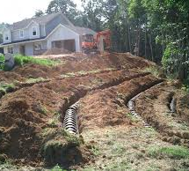
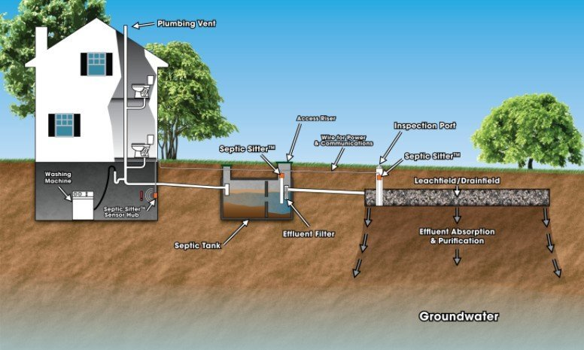
Soil Treatment Area (STA)
Final Dispersal
Notes:
The Soil Treatment Area is the final dispersal area for the wastewater
The soil in this area will determine what components are needed to treat the water enough for the soil to do its work
Gravity fed systems are the most basic without all the bells and whistles of the advanced treatment units
If the system is gravity fed, it should have the most idealistic soil to do the final treatment before the wastewater is retuned to the water cycle.

Slide 3
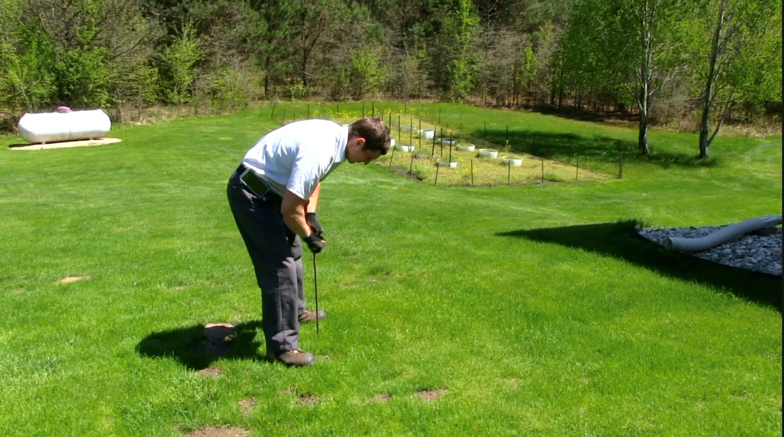
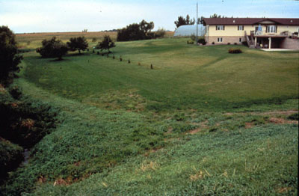
Locating the STA
Critical skill
Obvious keys
  Topography
  vegetation
Notes:
Locating the STA is a critical skill – it can take years of practice to be able to walk a site and determine the location of an STA.
Look for obvious keys that the system is not installed level on contour or if there is evidence of other problems. Look at the discharge points in the landscape
Locating the STA in certain areas at certain times of the year can be very complicated process. There very well may be two trips for your inspections – you may find things on the second visit that didn’t present themselves the first visit – IT IS NOT YOUR FAULT if the system is not working – your job is to ensure that the system is properly and fairly evaluated – a system evaluated during the winter months in certain areas cannot be fully evaluated.

Slide 4
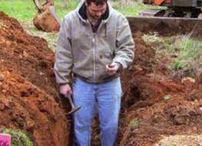
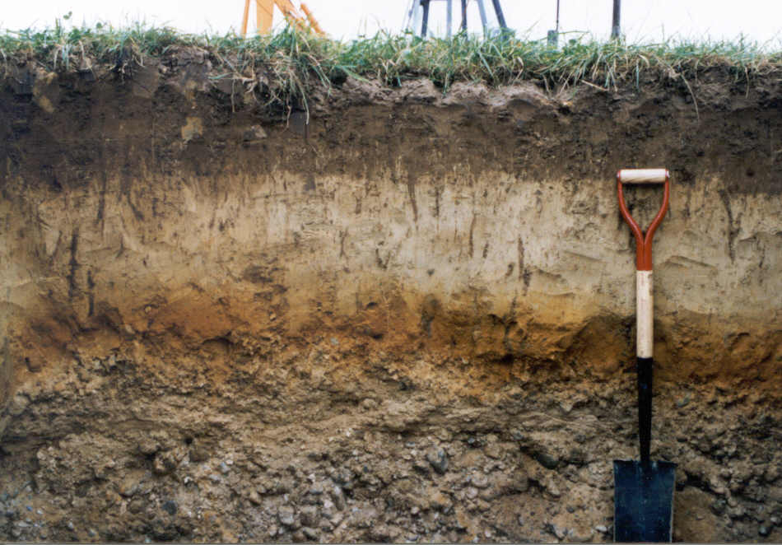
What determines the type of STA?
Determined by soil type
  texture/structure/consistence
Sized/type to address acceptance rate of soil
  LTAR – long term acceptance rate
Notes:
How STA distribution is will create the formation of a biomat.
Again, the LTAR is different than the Ksat. It’s the rate the soil can accept sewage effluent long term; not just water

Slide 5
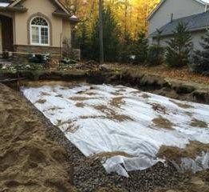
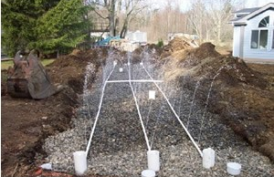
How does wastewater reach the STA?
Gravity flow
  Minimum – 1 inch in 8 feet
  Maximum – 2 inches in 8 feet
Pumped flow
  Drain the piping
Notes:
Wastewater moving from the tank to the STA should not have solids and therefore the fall is not as critical, but it MUST BE POSITIVE FALL to the STA
** click
If a pump is used to get the wastewater to its final destination fall is not of concern

Slide 6
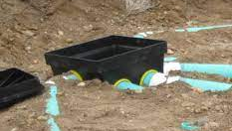
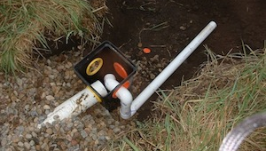
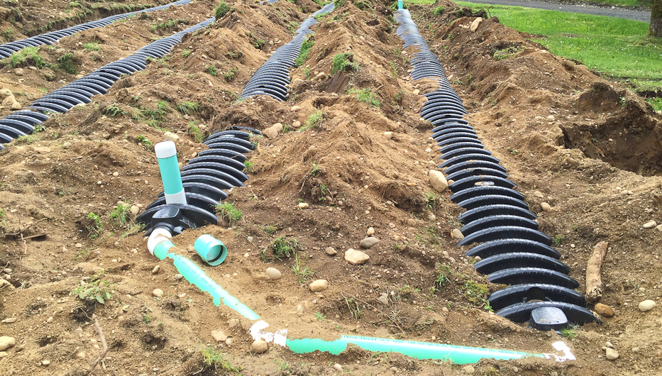
Gravity distribution
Parallel
  Distribution boxes
  Header pipe – [manifold]
Sequential
  Drop boxes – [slope]
Serial
Notes:
These are the typical means for gravity distribution once the wastewater has been transported to the STA
Drop box distribution is sequential, not serial. Serial would involve continual flow through the trenches.
Parallel distribution is generally accomplished thru d-boxes.

Slide 7
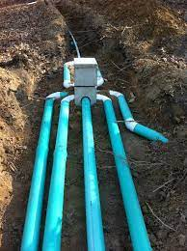
Gravity flow
Parallel distribution
  Distribution box
    Two or more outlets
    Objective – equal flows
    Equal lateral length
    Needs level installation of d-box
    Allows periodic cleaning
Notes:
Conventional distribution with a distribution box. Problems with freezing due to water standing in pipes in areas of cold climate. If slope is too much there is the potential for effluent to only flow to the lowest line in the system, bypassing part of the system.
If freezing is not an issue, then no drop is needed between trenches to get effluent to move.
If there isn’t any slope, this method can be installed without excessive excavation.
This system must be installed perfectly which is difficult to accomplish. It is likely that the first bucket of backfill will change the orientation.
With management, you can cap off exit ports to rest portions of the system (if there is a riser in the D-box).
With access to the D-box the flow can be managed, and these make very functional systems

Slide 8
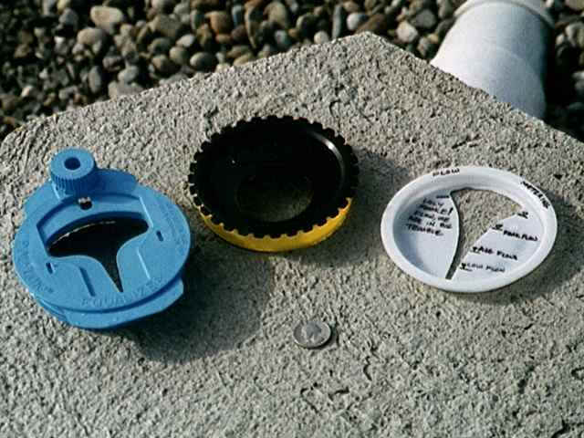
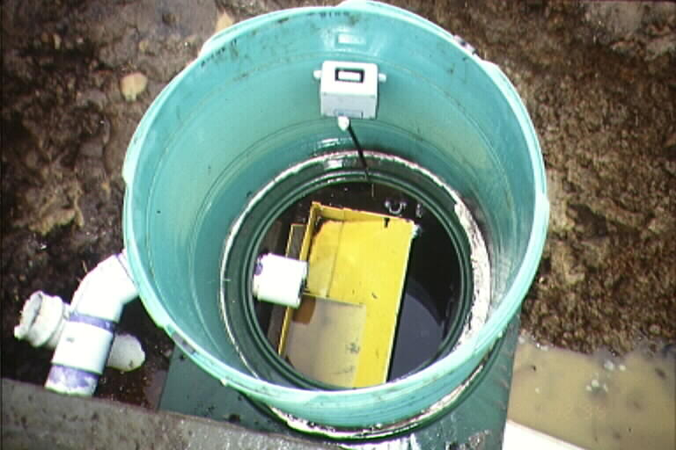
Gravity flow
Distribution box with access
Products to help equalize distribution
  Levelers
  Tipping buckets
Notes:
These are some of the devices that can be used to help equalize flow into the trenches of a gravity system

Slide 9
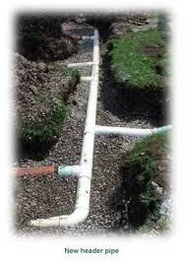
Gravity flow
Parallel distribution
  Header pipe/manifold
    Two or more outlets
    Objective – equal flows
    Equal lateral length
    Needs level installation of header pipe/manifold
    Does not Allow for periodic cleaning
Notes:
Conventional distribution with a header pipe/manifold. Problems with freezing due to water standing in pipes in areas of cold climate. If slope is too much there is the potential for effluent to only flow to the lowest line in the system, bypassing part of the system.
If freezing is not an issue, then no drop is needed between trenches to get effluent to move.
If there isn’t any slope, this method can be installed without excessive excavation.
There is NO access with a manifold and therefore cannot be managed.

Slide 10

Gravity flow
Sequential distribution
  Drop box
    Two or more outlets
    Objective – equal flows
    Good for sloping sites with minimum 2” drop
    Installed on the contours
    Allows for management
Notes:
The picture of sequential distribution through drop boxes set-up. It is preferable to a continual distribution.
It is good for very sloping sites
Can use Speedy Levelers or valves to rest the initial trench(es)
To have a drop box system function correctly, you need a minimum of 2-in drop: 1” between the drop box and the pipe entry and 1” between individual drop boxes.
Drop boxes are made of concrete (weighs ~ 45 lbs), fiberglass (weighs 5-6 lbs), and plastic.
Compare to Continual distribution .
The first trench will take a real beating because all the septic-tank effluent goes through it. Will have all the solids moving into it.

Slide 11
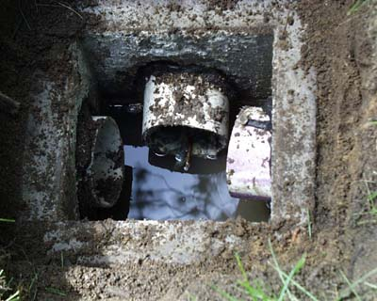
Gravity flow management
If drop box or d-box is accessible
  Can be opened
  Verify flows
  Periodic cleaning
  Inspection tool!
Notes:
Open the boxes. This can give important clues to what may be the matter with the system. If solids have carried over from the tank, it will show up in the boxes.
All components to the system need to be accessible for maintenance and inspection
What would your observation of this distribution box be?

Slide 12
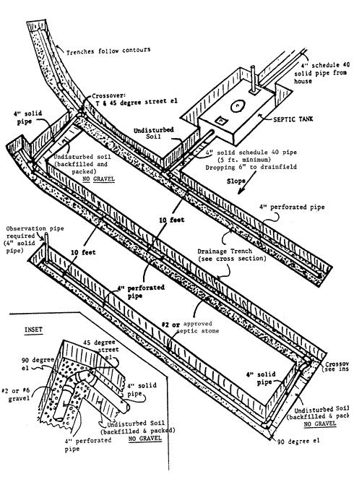
Gravity flow
Serial distribution
  Continual flow
    Forces liquid to pone to predetermined level in lateral before flowing to the next lateral
    Good for seasonal home where sta is allowed to rest
    no management capabilities
NO Management
Notes:
The biggest struggle with these systems is that the first trench cannot be rested – there will always be effluent flowing over or through the trench – if would not be uncommon to find ponding in an inspection port located anywhere along the first trench in a serial distribution system – does this mean it has failed?

Slide 13
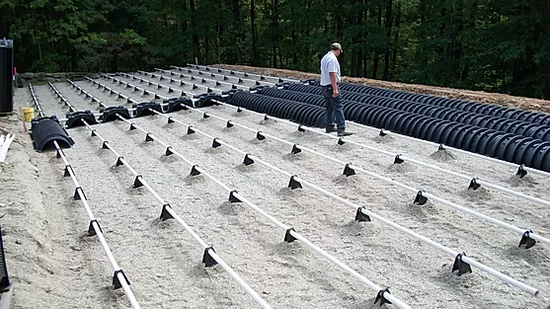
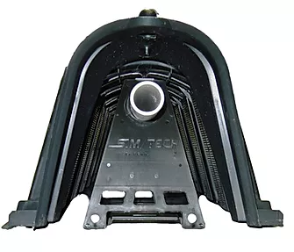
Pressure distribution flow
When do we use pumps?
  Elevation/distance issues/type of soil
Advantages of pump systems
  Access to entire lot
  Pressured dosing utilizes entire sta
Disadvantages of pump system
  Electrical components
  maintenance
Notes:
Why do we use pumps? Pump to gravity occurs when the site has good/optimal soil, but the location of the field to the tank is challenging
Pumps are utilized on sites where the most optimal location for the STA is higher than the location of the tank(s)
If the soils is good for gravity distribution – nice, loamy soils – not much clay or too much sand to deal with, pump to gravity is an option
The effluent is pumped to the site and dumped into the proximal end and then gravity feeds the effluent across the field – same as any other gravity system
There are several factors that will come into play for a pressure distribution field, i.e. type of soil, size of field, coverage we are trying to achieve

Slide 14
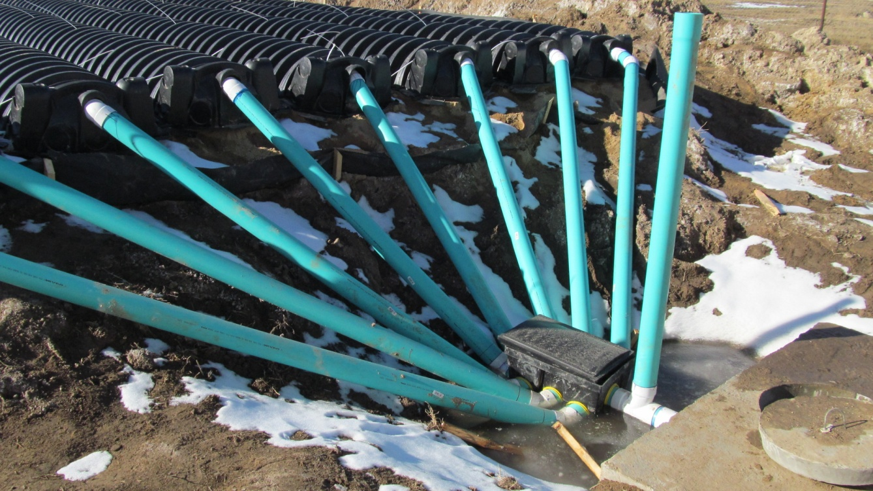
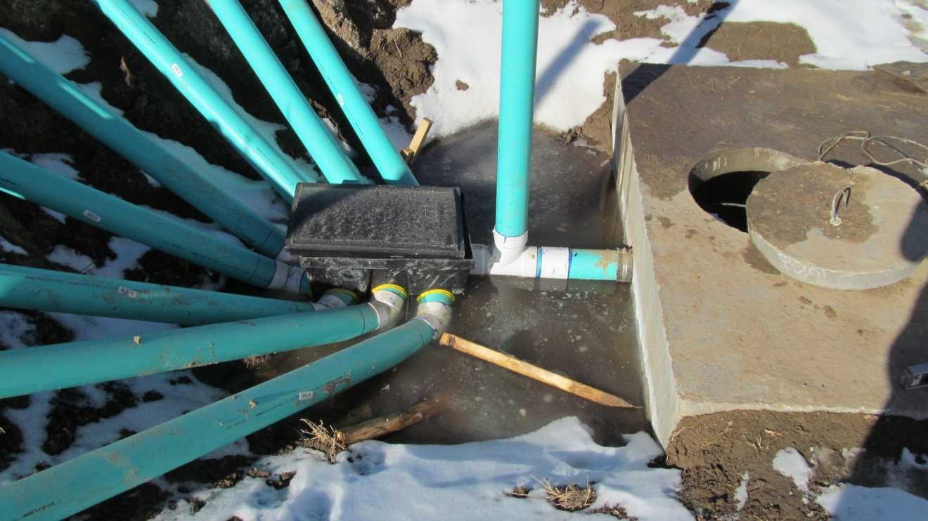
Pump to Gravity
Homeowner
Install
Notes:
Homeowner install of a “pump to gravity”
He did not understand the assignment

Slide 15
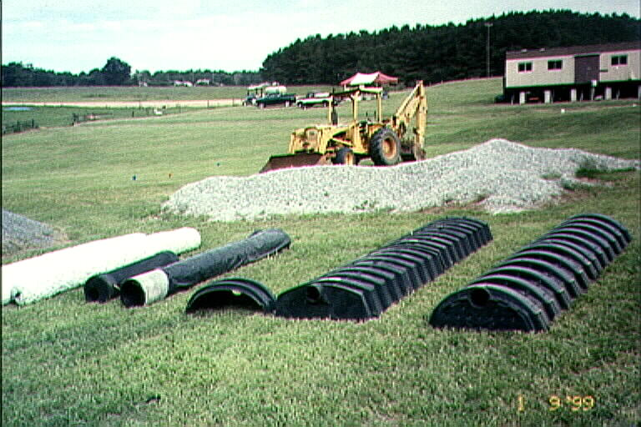
Media in the STA
Purpose
  Void space
Materials
  Rocks
  Chambers
  Gravelless pipe
  Synthetic material
Notes:
Lots of options today for distribution media. In the old days it was only aggregate or rock.

Slide 16
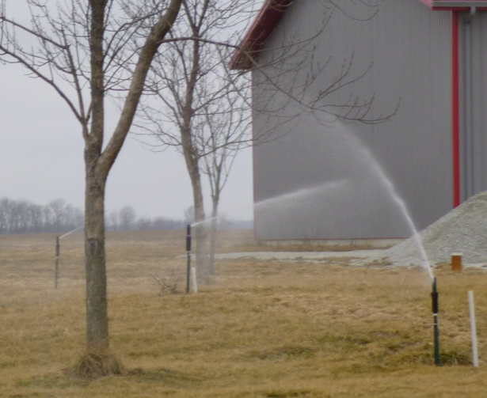
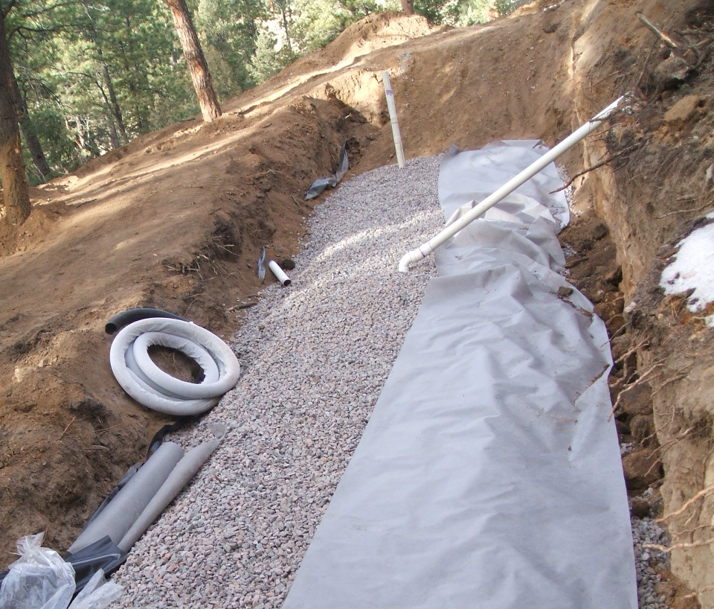
Local Specific Systems
Systems unique to a geographical area
  Designed to meet local constraints
  Soils
Regulations
Notes:
Spray irrigation in area with high water tables and high evaporations rates – TX OK

Slide 17
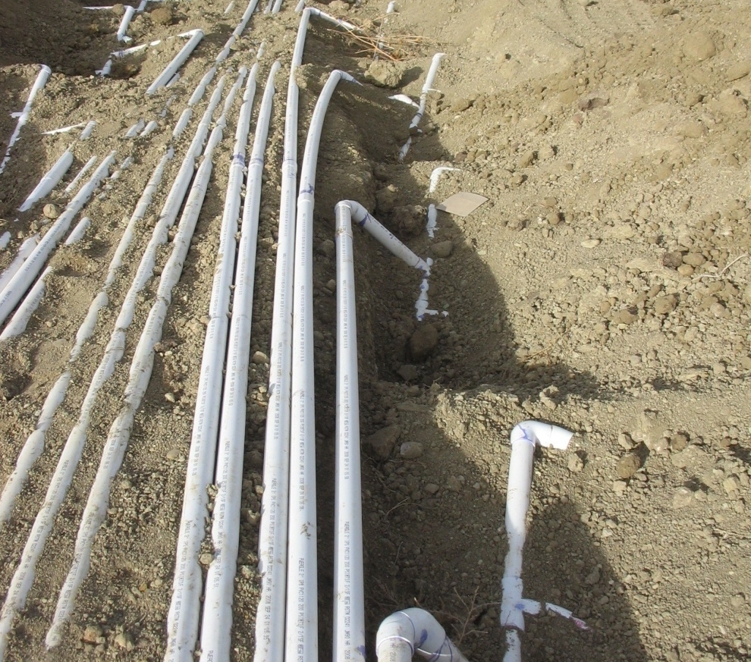
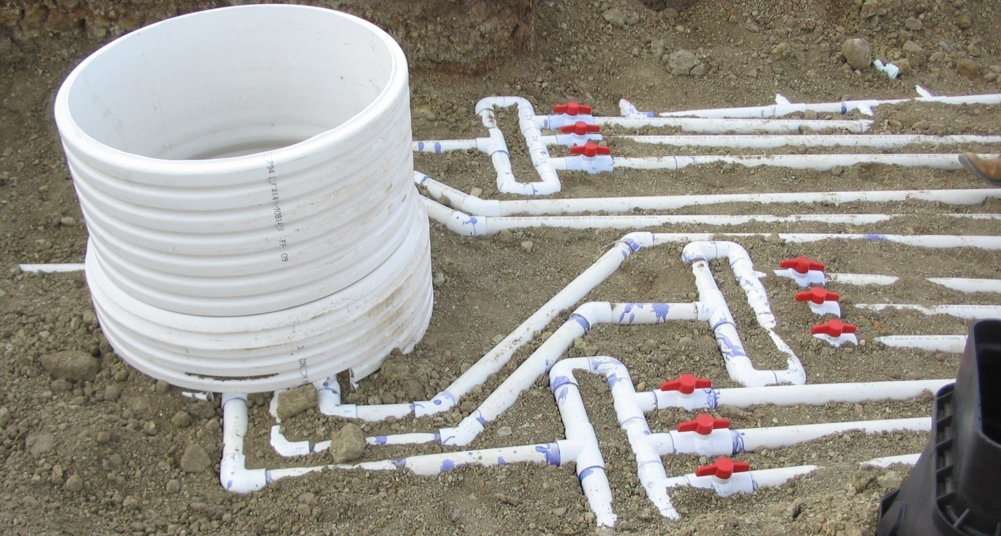
Colorado special
NDDS
(Non-pressurized Drip Dispersal System)
Notes:
This is a design that and engineer, installer and regulator came up with to try to overcome the heavy clay soils on the eastern plains
Every area is going to have their “mouse trap” to combat regulations, soils, topography

Slide 18
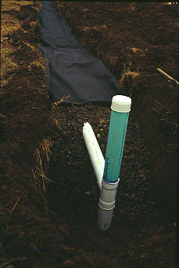
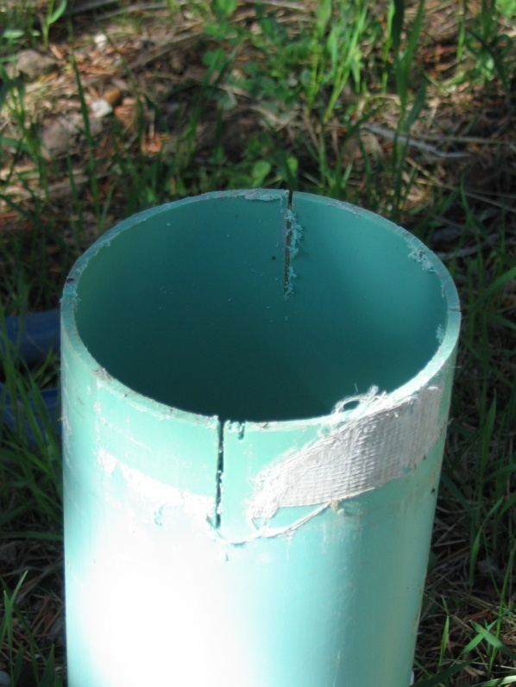
Accessibility for the STA for evaluation
Inspection ports
Located at the end or corners of the system
Used for checking for ponding
Notes:
Inspection ports if properly installed can help with system inspection and management by being able to assess ponding depths in the trenches or beds.
In an NDDS system the observation/inspection port is part of the loop of piping. Therefore, if it gets broken off it needs to be repaired as soon as possible to keep dirt and debris out of the laterals in the loop.
Inspection ports at the end of the trenches or in a bed go to the infiltrative surface and are there to measure ponding in the media.
Understanding the different, what would your assessment be of water in an observation port in an NDDS system? In a trench or bed system?

Slide 19

Soils
Heart of the STA
Notes:
The soils are what dictate many things about the system
Location – level of treatment – size of system

Slide 20
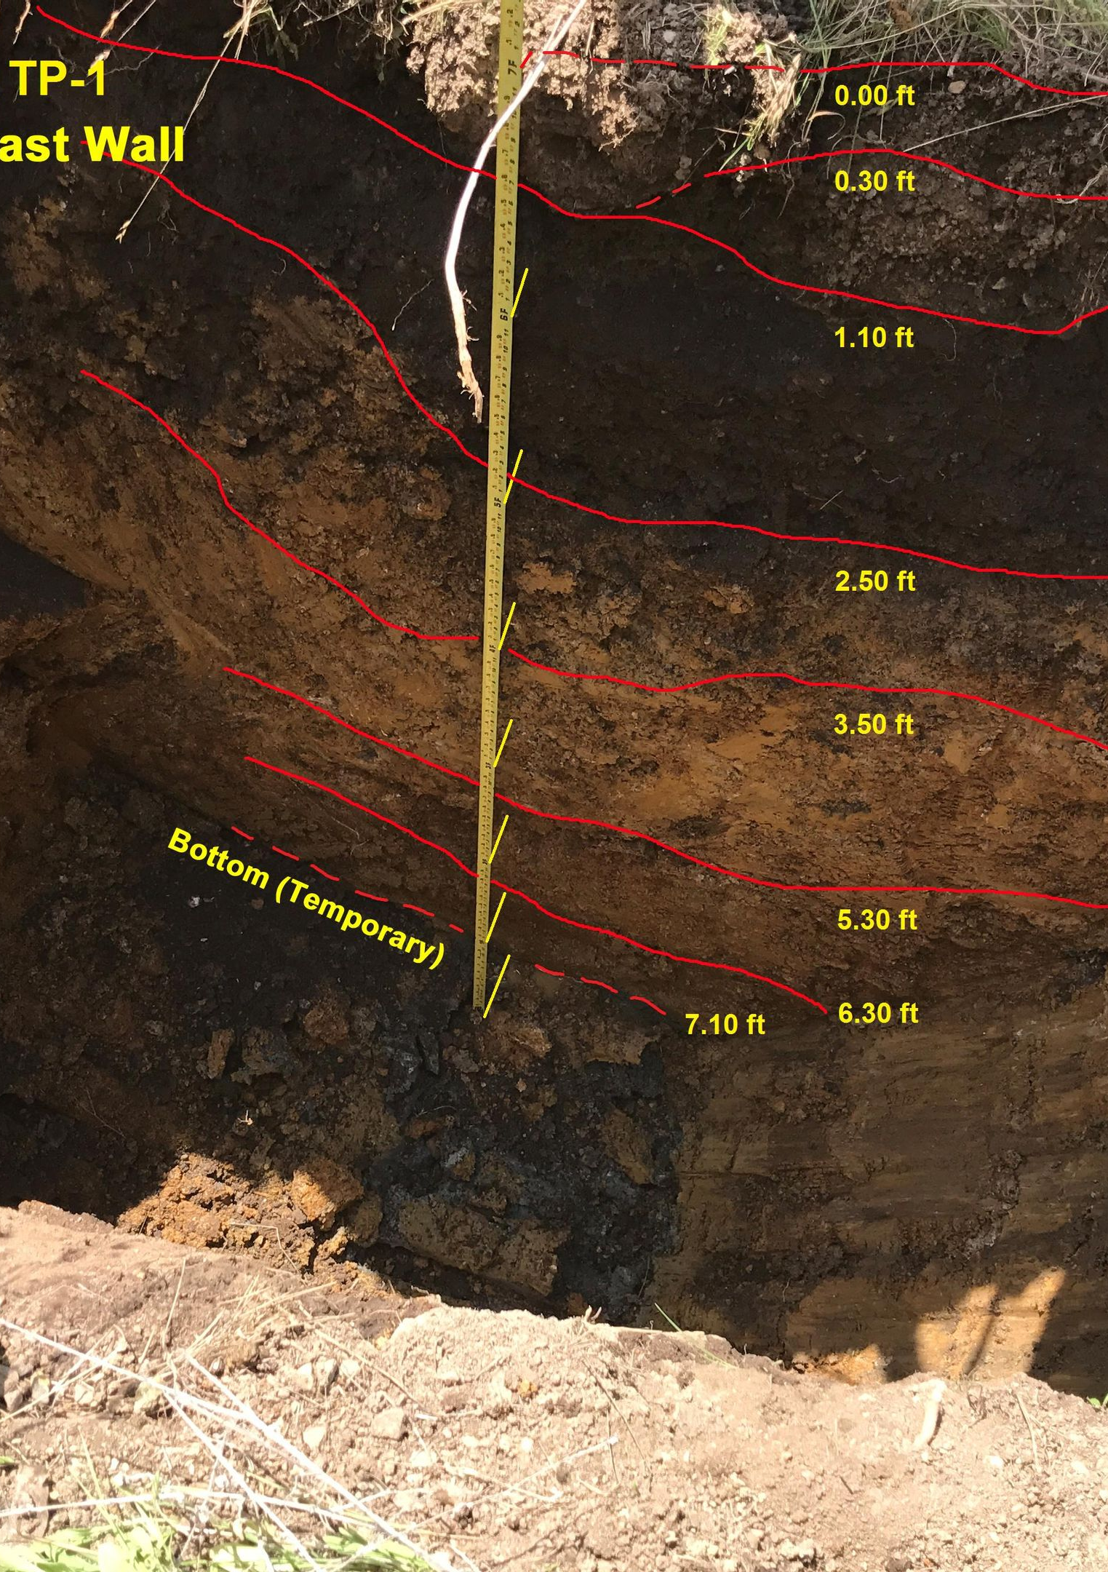
Soils evaluation
Notes:
If you need to check sizing relative to sewage flow you need to evaluate the soil.
The best way is by digging a soil pit.
Having a basic understanding of this process can be very helpful in evaluating the functionality of a system

Slide 21
Visual
&
Tactile Soils Analysis
Need to be done by someone with training
Take a site and soils class
Why the move from perc tests??
Soil Morphology
Notes:
Many areas across the country are using this methodology to determine the type of soils that will be accepting the final effluent – the soils will drive what type of technology will have to precede the STA for the system to be successful.
Visual/tactile evaluation provides a complete view of the soil profile. ** click Also known as Soil Morphology - Much more able to see limiting layers, such as water table (redox features), compacted soil, bedrock, etc.
To gain the credential of “Competent Technician” one would have to take and pass the CO Site and Soils class
Why have we moved away from Perc Tests to soils analysis?
Soil's analysis is a better indicator of the type of soils the site actually has.
Perc Tests are good if they are done correctly and one of the big problems is that they seldom are run in accordance with their original intent.
Soil's analysis can be completed in a fraction of the time and the results are more accurate – because we know how effluent flows through certain types of soils – with a Perc Test clean water is used, which hardly mimics wastewater effluent.

Slide 22
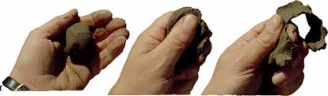
Soil evaluation
Texture, Structure, Consistence
Notes:
These soil characteristics relate to how well sewage effluent will move through the soil.
There are classes that look specifically at soils and these characteristics.

Slide 23
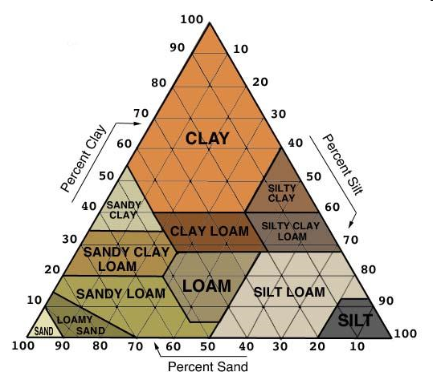
Soils evaluation sizing the STA
USDA soil triangle
Notes:
Soils are made of three components – Sand, Silt and Clay and depending upon the % of the component will tell you what type of soils are on the site.

Slide 24
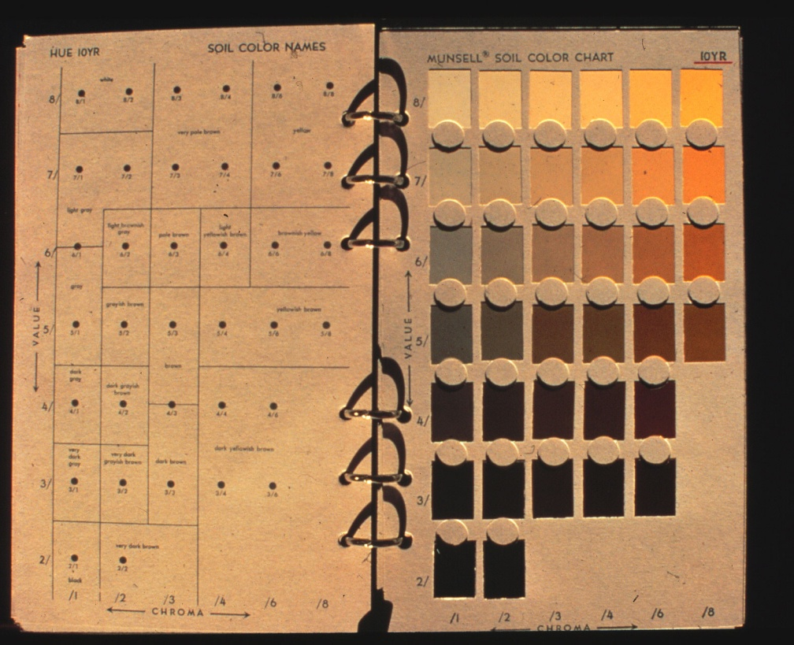
Soils evaluation color
Munsell notation
  Page: 10 YR
  Value: 5
  Chroma: 4
  10 yr 5/4
  Brown – wet
  Gray – wet
    Chroma <2
Notes:
Soil color can help identify problems, such as fill soils or disturbed sites. Most often it is used to identify seasonal or periodic saturation.

Slide 25
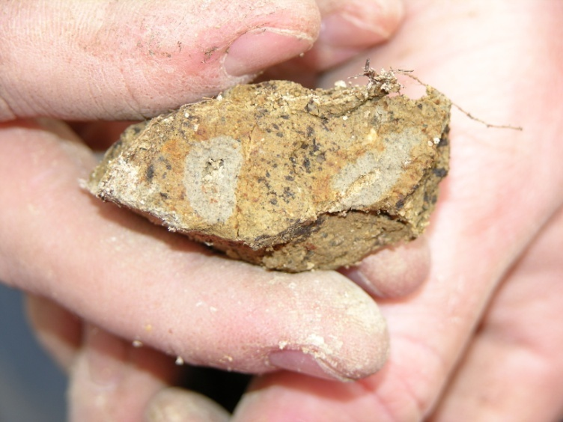
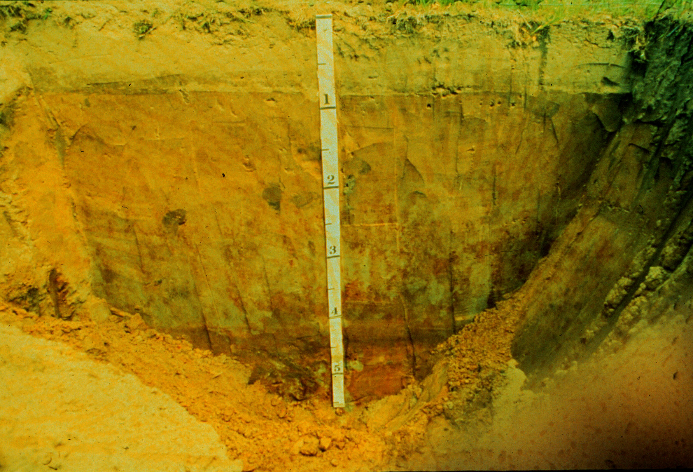
Soils evaluation season saturation
Redoximorphic features
Notes:
An example of soil where water is at 6 feet today, but the color shows it can be within a foot of the surface.

Slide 26
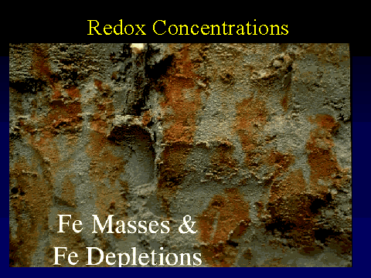
Iron Masses, &
Iron Depletions
Notes:
Anytime we have rust color we know there is occasional water in the soil

Slide 27
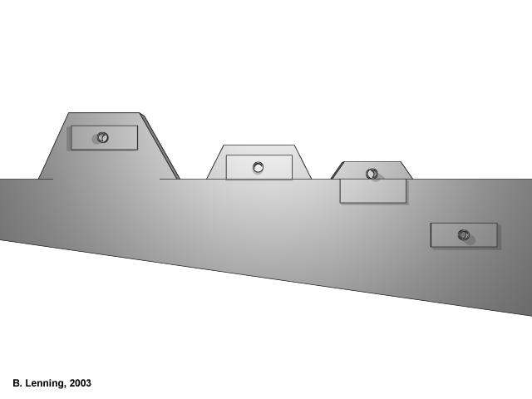
Limiting layer
Restrictive layer
Notes:
One of the biggest determining factors for the type of STA that will be installed is the restrictive layer. Science tells us we need X number of inches in a type of soil to get adequate treatment of the wastewater – the restrictive layer means the water can only go this far! We need to have treatment before we reach that point.
A restrictive layer most often is ground water but can be bedrock or other type of formation.
An example of how the system changes with depth to limiting soil layer.
Limiting = NO treatment

Slide 28


What is a Mound?
Definition of a “MOUND”:
Mound: a soil treatment area whereby the infiltrative surface is at or above original grade at any point.
Final Grade
Distribution Media
Infiltrative Surface
Treatment Sand
Existing Grade
Notes:
This is the definition of a mound as – many of the mound regulations refer to the Wisconsin Mound for definition and description of what a “mound” is and how it is created.
Note the Infiltrative surface

Slide 29
Basic Principals of a Mound System
Elevate the infiltrative surface above the limiting layer to ensure aerobic treatment of the effluent prior to contacting the limiting layer
The system must be properly designed to ensure that the effluent will move into the in-situ soils at an application rate that it can readily accept
Notes:
The mound artificially creates that “treatment” area for the wastewater. It creates that separation distance so that the wastewater can be cleaned up before it is returned to the water cycle. ** 2 clicks

Slide 30
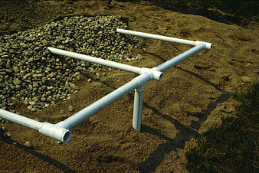
Above ground systems at-grade and mound systems
To create separation
To allow for treatment
To allow for construction – make a site “buildable”
Notes:
Mound system or at grade systems creates that separation distance if we do not have adequate soils before the restrictive layer.
Cut away of a mound treatment system.

Slide 31
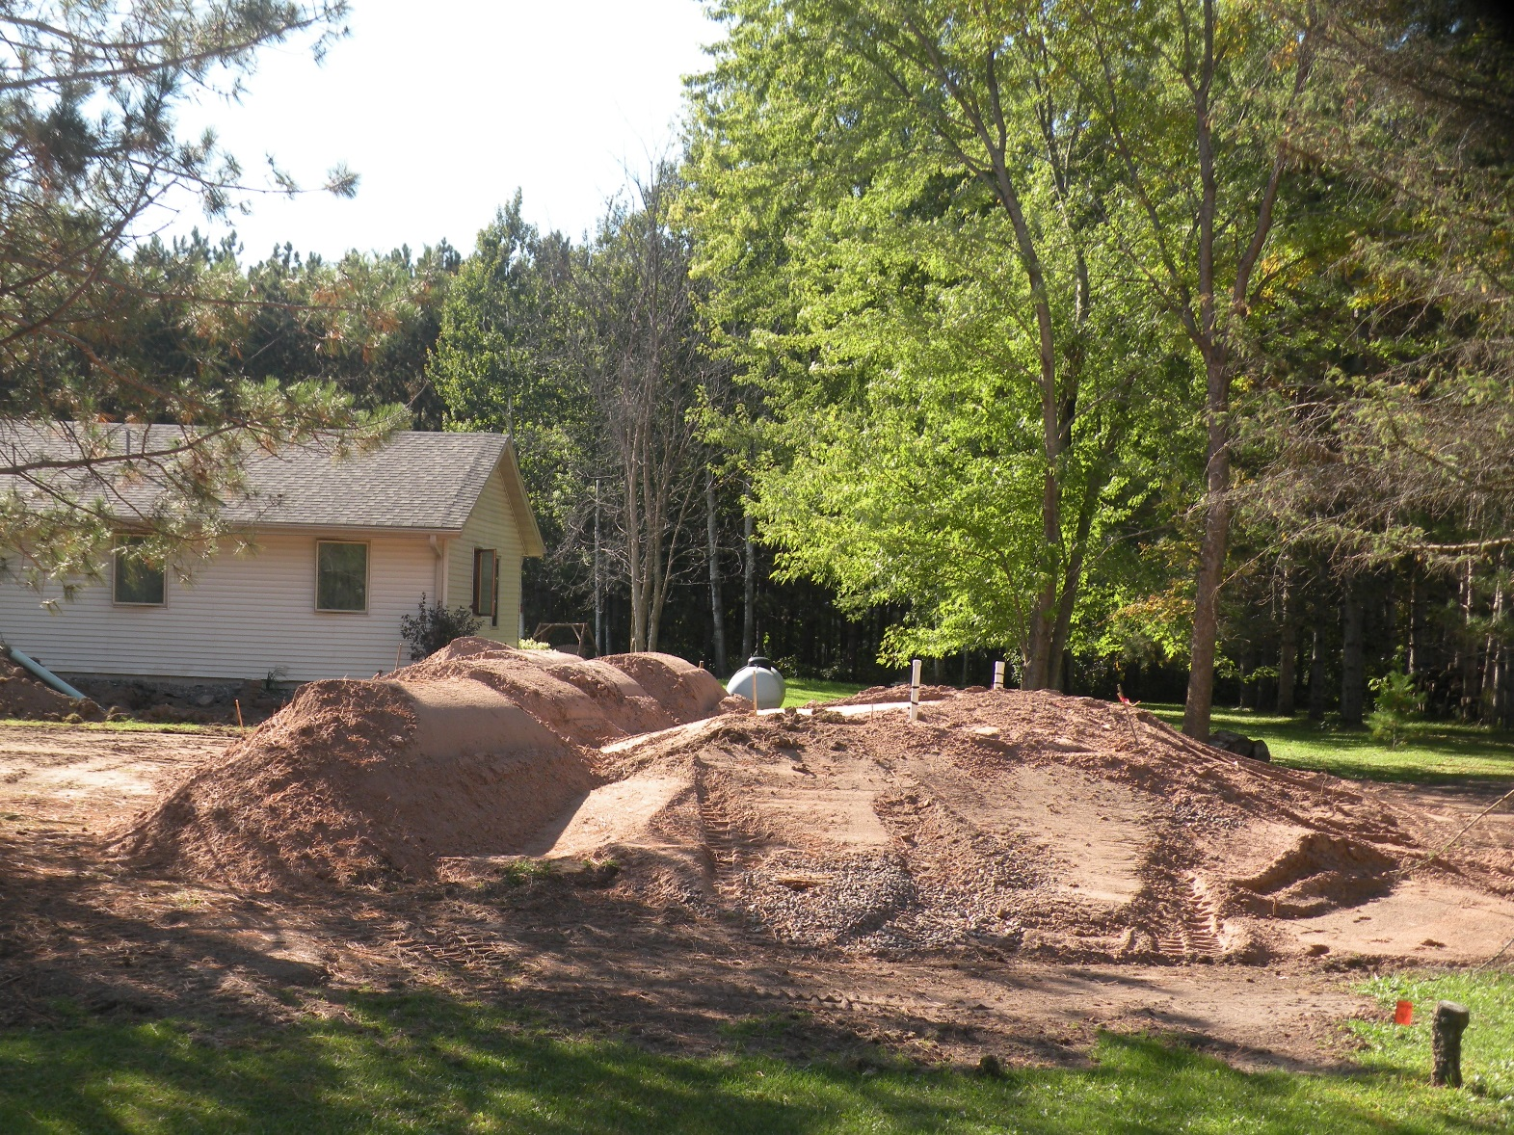
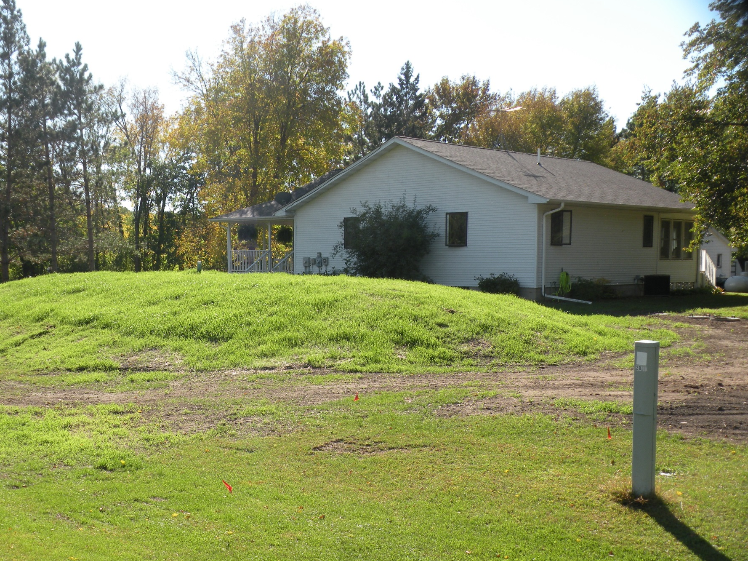
Above Ground Systems
Mounds
Notes:
Segway into the next module on…. “mounds”!
Mound systems are tricky to install and very sensitive to errors – once in they are fairly easy to manage but need to be maintained and monitored.

Slide 32
QUESTIONS?

