Slide 1
Alternative
WASTEWATER TREATMENT SYSTEMS
(MORE ON ADVANCED TREATMENT)
WHAT ARE THE CHOICES??
Notes:
Don’t get too deep into explaining any of the treatment concepts in this module, as they will all be addressed in further detail in Mod. 11
This is just a flyover

Slide 2
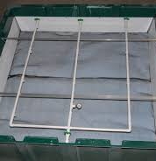
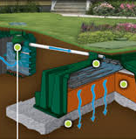
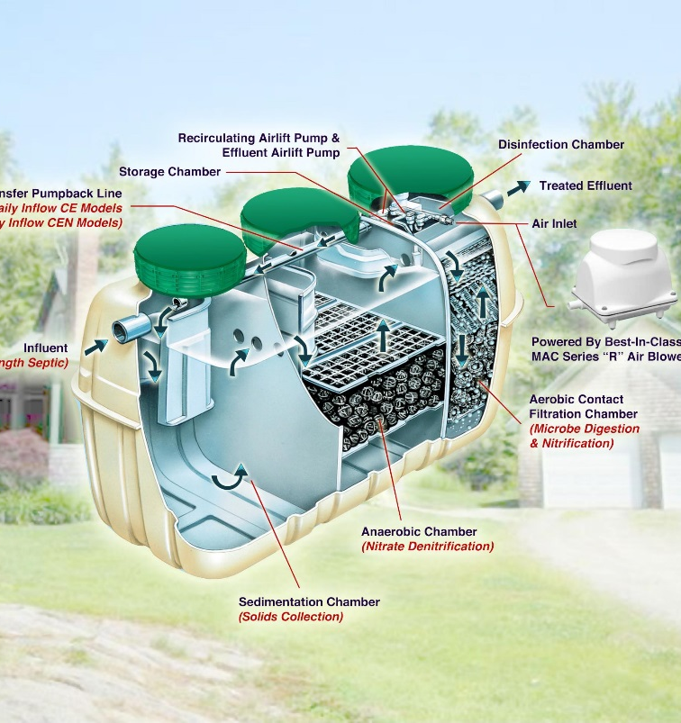
ALTERNATIVE TECHNOLOGIES
Notes:
There are many different types of Alternative Technologies out there to treat the wastewater and make the effluent as clean as possible before being discharged into the STA
Some are part of the “initial treatment” portion of the system. Others are part of the “final treatment” portion.

Slide 3
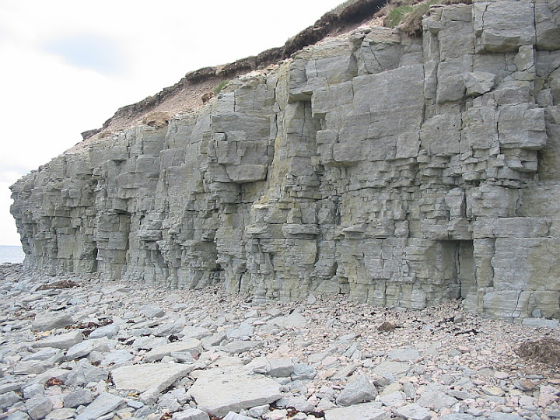
WHY USE ALTERNATIVE SYSTEMS?
New ideas
Possible size reductions
Additional treatment
  Meet separations req
Soil problems
  Natural
    Clay
    Fissured rock
  fill
KEYS
RECORDS
PROPER APPLICATION
PROPER INSTALLATION
MANAGEMENT
Notes:
Summary of why we see more alternatives than ever.

Slide 4
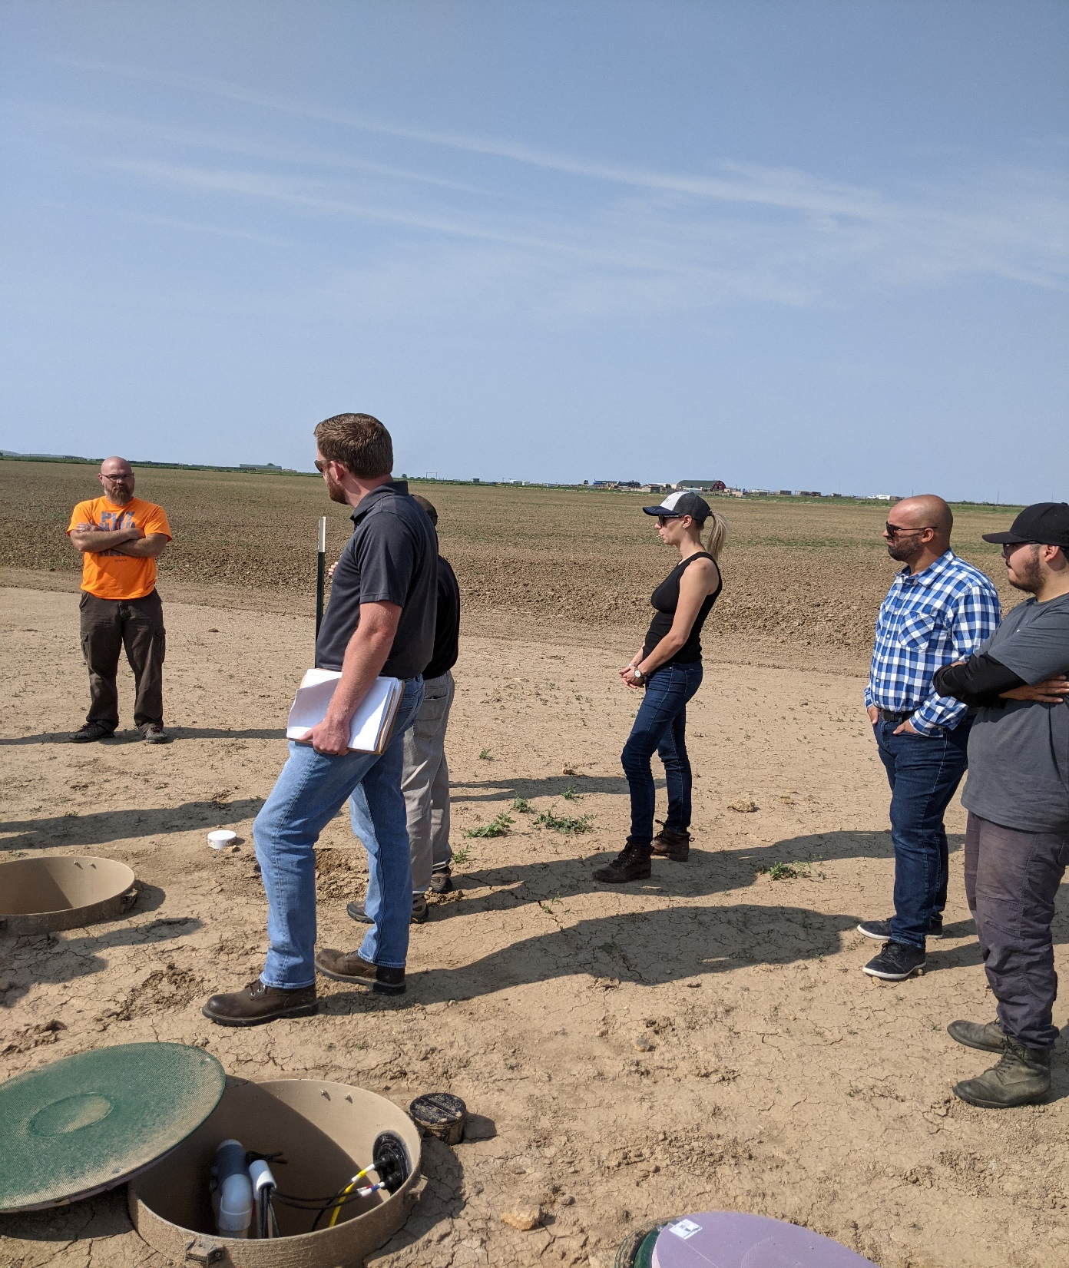
What comes along with this?
New ideas
A need to educate; industry wide
PROPER APPLICATION (design)
PROPER INSTALLATION
System MANAGEMENT
Record keeping
Regulatory oversight
Notes:
Summary of some key items that come along with the use of alternative systems

Slide 5
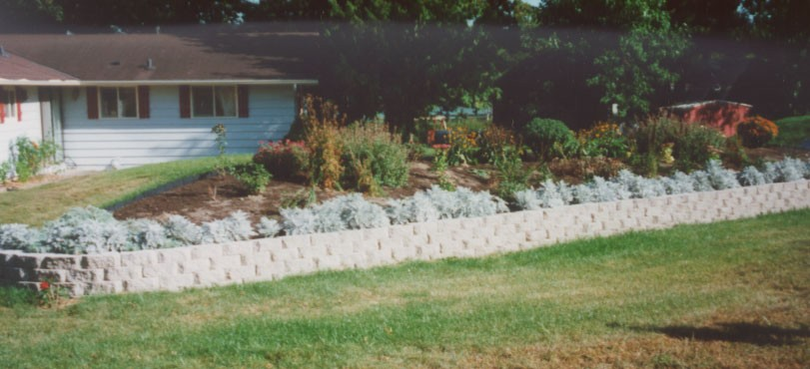
Concerns for technology application
INCREASED COST
INCREASED MAINTENANCE
COVENTIONAL SYSTEMS HAVE PROVEN THEMSELVES
Notes:
Picture of a small elevated bed to avoid high water situation. Shows it landscaped in.

Slide 6
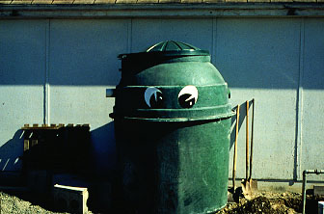
What are the choices?
AEROBIC TREATMENT UNITS (atu)
MEDIA FILTERS
DISINFECTION
DRIP DISTRIBUTION
SEPARATION TECHNOLOGIES
OTHERS
Notes:
There are numerous technologies out there today to choose from – much of what you see will be dictated by what has been approved for use in your area. Not ALL systems/units are approved everywhere.
There typically is a process through your state or local regulations
ATU / Media filters (aka: packed bed filters) / disinfection; typically following an ATU or Media filter / Drip; not really a stand-alone treatment system; but some jurisdictions realize the additional treatment attained through the shallow dispersal of the effluent / separation; composing toilets; graywater systems; check local regs for allowances

Slide 7
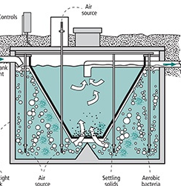
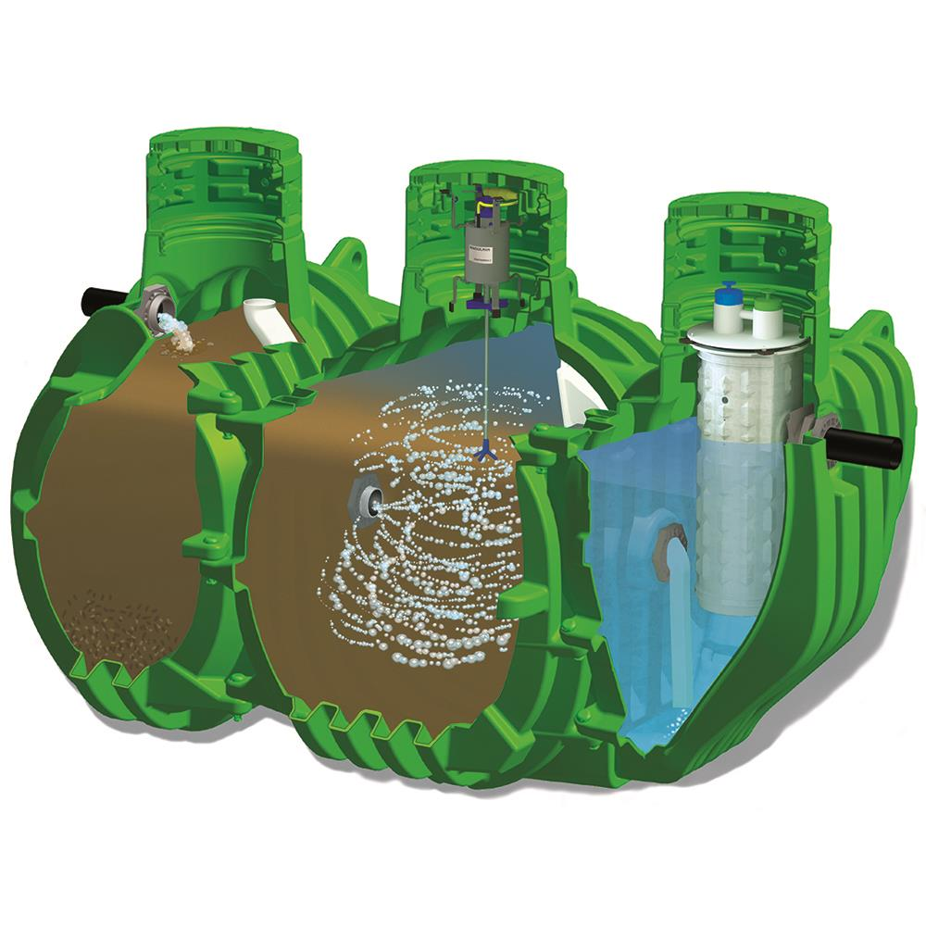
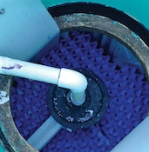
AEROBIC TREATMENT UNITS - ATU
Notes:
The parts of an aerobic treatment unit. Trash tank; mixing tank (air + biomass); clarifier (settling) – this would be considered part of the Initial Treatment because it’s prior to Final Treatment.
Again, we will get a little further into this tomorrow

Slide 8
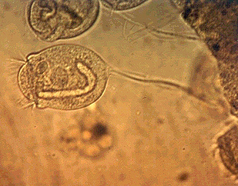
ATU
(Aerobic Treatment Unit)
How do they work?
The effluent is aerated; available oxygen (Do)
Microorganisms and food must be in contact
Aerobic organisms digest the food
Generates high quality effluents with variety of oxidized end products – little odor, stable effluent not requiring further breakdown
10-20 times faster/more efficient than anerobic organisms

Slide 9
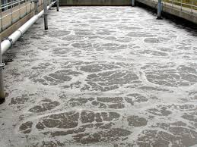
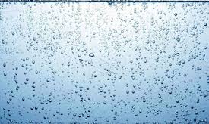
Two types of Aerobic Treatment Units
Suspended Growth
Attached Growth
Notes:
Two basic types of Aerobic Treatment products out there – Suspended or Attached
This is a picture of suspended growth system in a municipal treatment plant; our residential systems use the same basic concepts

Slide 10
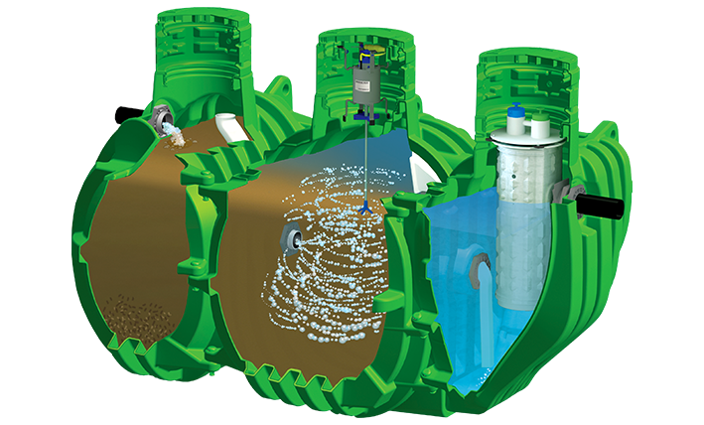
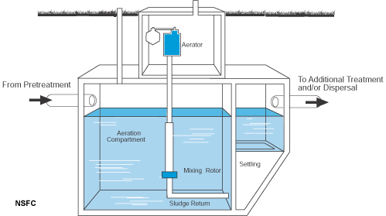
Suspended growth ATU
Notes:
Example of suspended growth aerobic unit.
In the picture on the left, the trash tank would be prior to the tank that is shown. We see the aeration/mixing tank; the aerator; and the clarifier (settling tank)
Again, in the suspended growth systems, air is forced in and the bubbles naturally mix throughout this compartment and are used by the biomass (bugs) in the tank

Slide 11
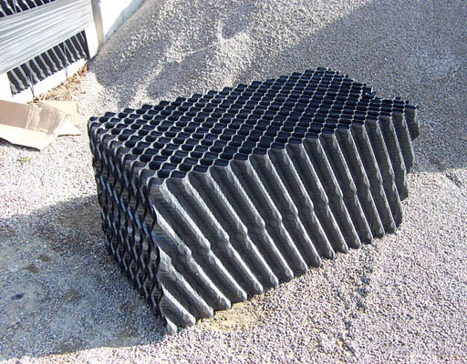
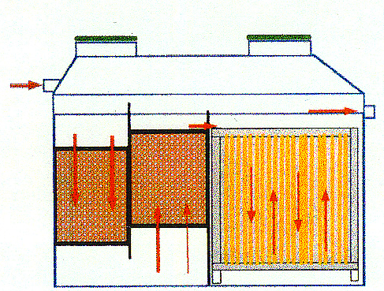
Attached growth ATU
Attached growth media
Notes:
Numerous kinds of media in attached growth systems
In this case you can see the air forces the aerated effluent over the media

Slide 12
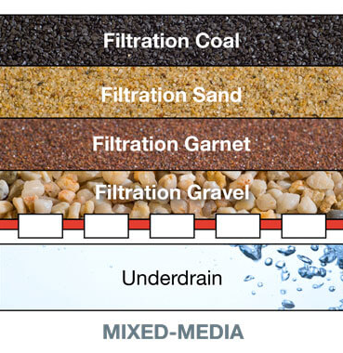
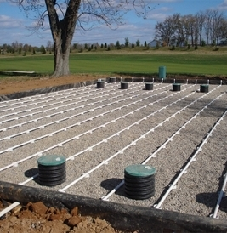
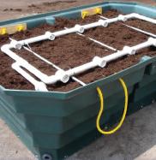
Media filters
Notes:
There are many different types of “media filters” out there. Some refer to these as Packed Bed Filters. Some of these will be part of initial treatment because they are prior to final treatment. Or they could be part of final treatment if they are the last thing wastewater passes through.
The effluent is introduced to the media and as it passes through the media in an unsaturated flow pattern, the biological community that is living on and in the media, feed on the food within the effluent – the pathogens, chunks, anything it sees as edible. Note that free oxygen must be available for these systems to work.

Slide 13
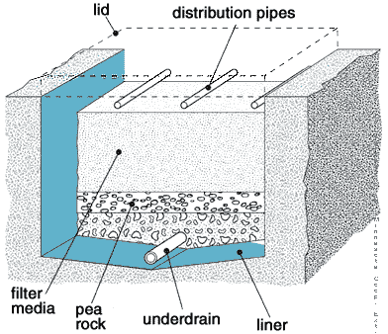
Media filter
What is it?
A container or lined excavation with specific media through which wastewater flows
  Single pass
  Recirculating
Unsaturated flow
An aerobic, fixed-film bioreactor
Notes:
Cut away of important parts of a media filter
Note that the slide indicates that the media filter is contained or lined. They can be single-pass or recirculating (recirc. requires the container or a liner in order to capture the effluent and return it to the headworks
Again, unsaturated flow is required; free oxygen is necessary for these systems to function as intended
An unlined media filter is the last thing before the wastewater is released and could be part of what we would call final treatment.

Slide 14
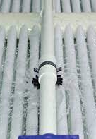
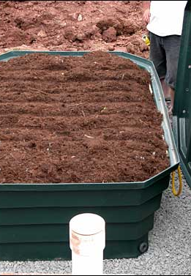
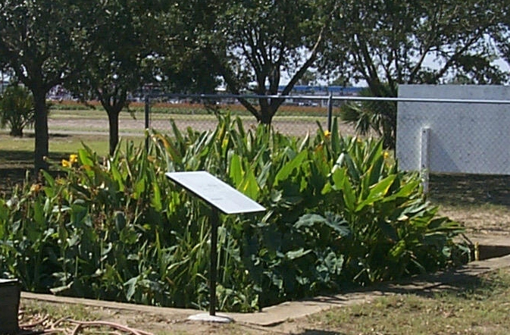
Media choices
Washed, graded sand
Gravel
Peat
Synthetic textile materials
Foam chips or cubes
Crushed glass
Wetlands
other
Notes:
All kinds of media are used depending on product selected.
Many choices are based upon geographical location and where manufactures want to market their product; Also, can be affected by regulatory requirements

Slide 15
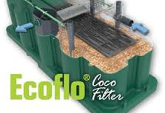
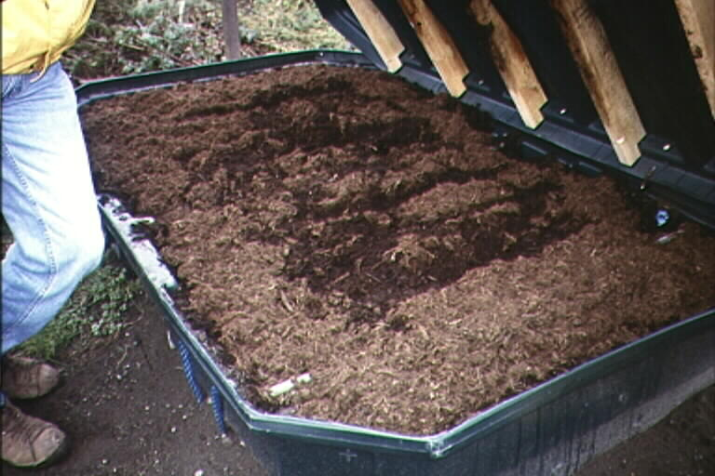
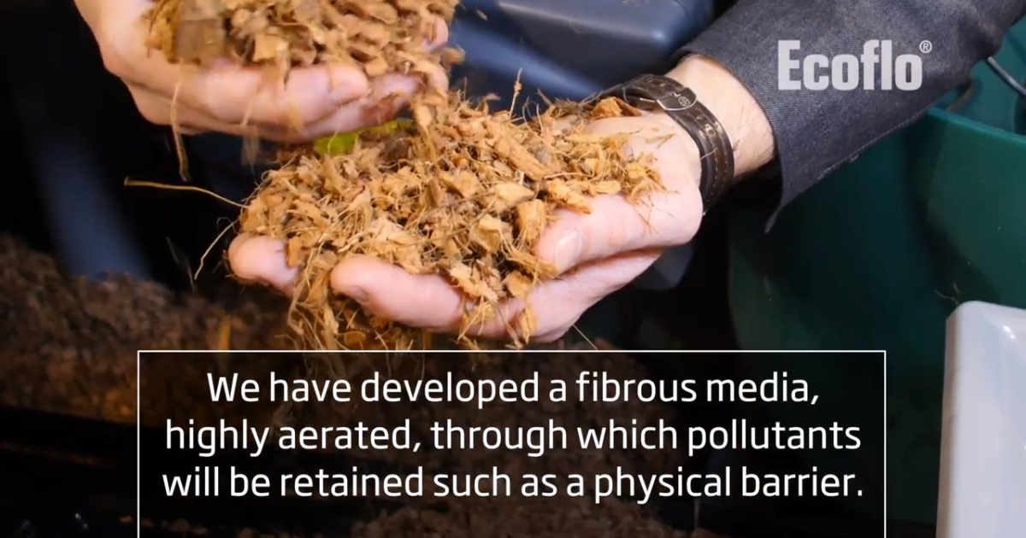
PEAT FILTER AND COCONUT FIBERS
Notes:
Left is coconut husks – right is peat

Slide 16
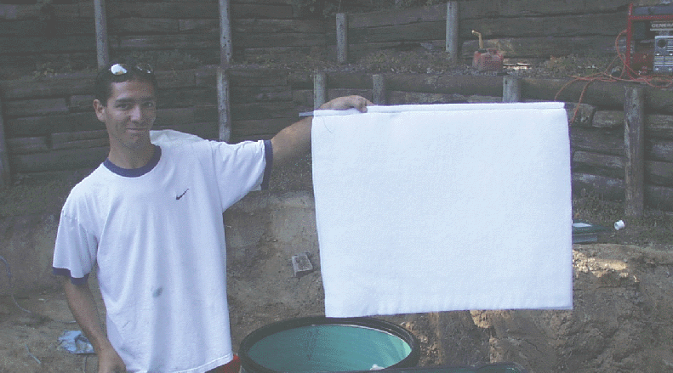
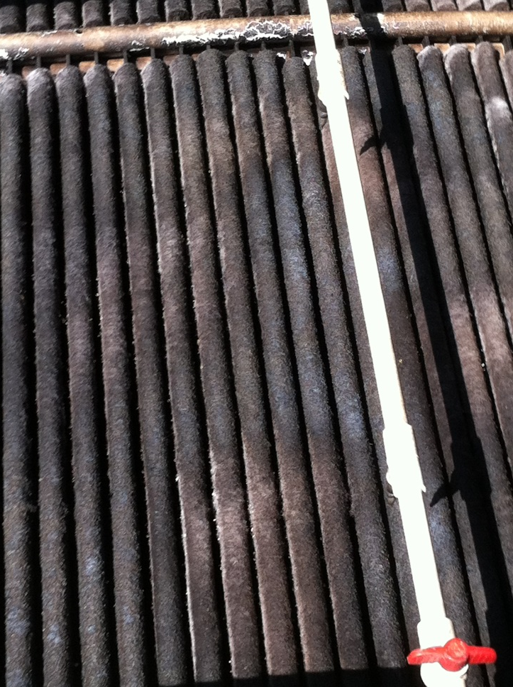
Textile Filter Sheet
Notes:
Textile filter – photos show brand new on the left, and in use on the right
These are used in the Orenco, Advantex systems

Slide 17
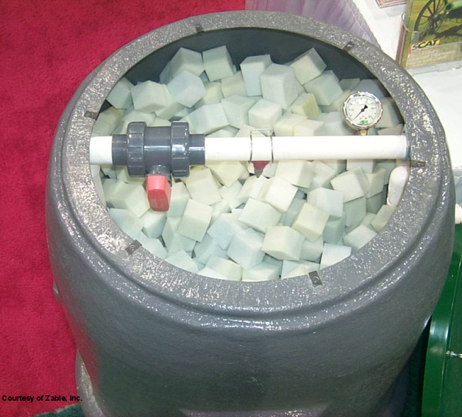
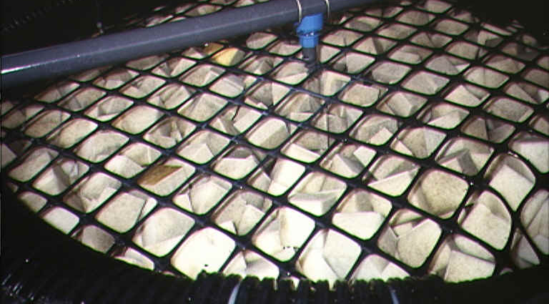
Foam cubes
Notes:
Original: Waterloo Biofilter
Now ; Aero-cell

Slide 18
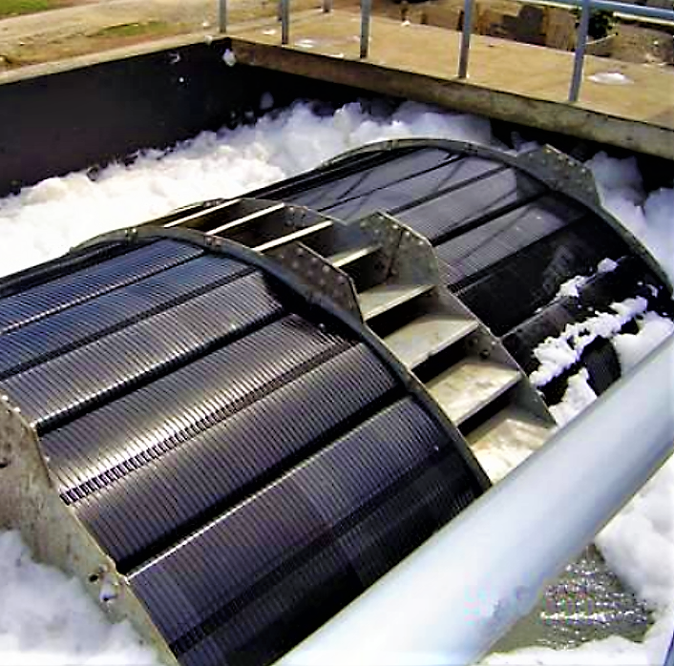
Rotating Biological Contactor
RBC
Notes:
Also, an example of an attached growth ATU. Finding new popularity again after being out of favor. Lower cost than some other types of units.
Rarely used for a single-family home; typically, cluster systems or commercial
This system slowly rotates through the effluent where the biomass attaches to the discs on the unit. The discs then rotate above the water level to allow access to the free oxygen

Slide 19
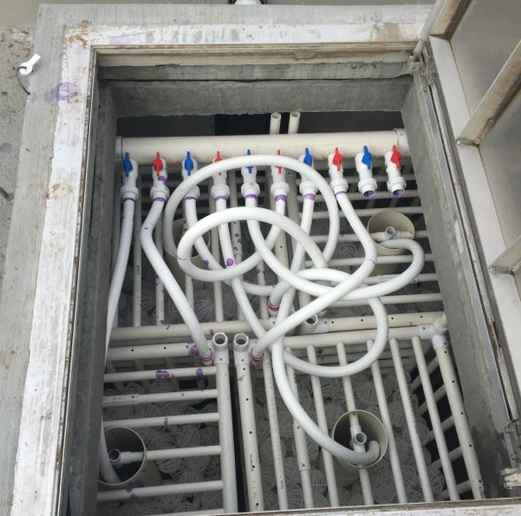
Other media
Notes:
Nibbler Unit – the ball are suspended in the aeration unit but provide a place for the bugs to attach
This is what I would call a combined attached/suspended growth system. The bubblers provide the oxygen and force the wiffle balls into suspension as they float around within the effluent where the bugs can attach and still have access to the oxygen provided

Slide 20
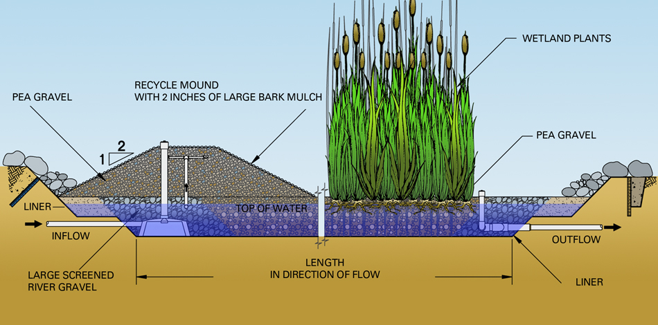
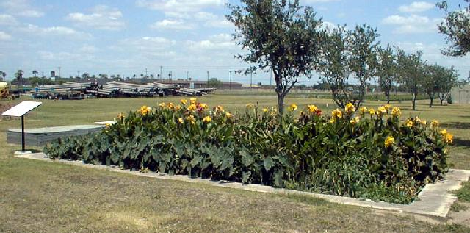
Wetlands
Notes:
An important component of wetlands is the vegetation. Should not be open water.
Don’t necessarily work as well in cooler climates. Especially if you are looking for nitrogen reductions (won’t happen in the winter)
Historically noted as not necessarily work well in cooler climates. Especially if you are looking for nitrogen reduction; however some recent studies with some design modifications (vertical flow vs. horizontal flow) have noted promising results for both BOD and nitrogen removal

Slide 21
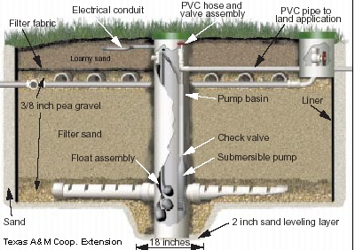
Single-pass sand filter
Notes:
Can have single pass filters (the easiest to manage) or re-circulating filters.

Slide 22
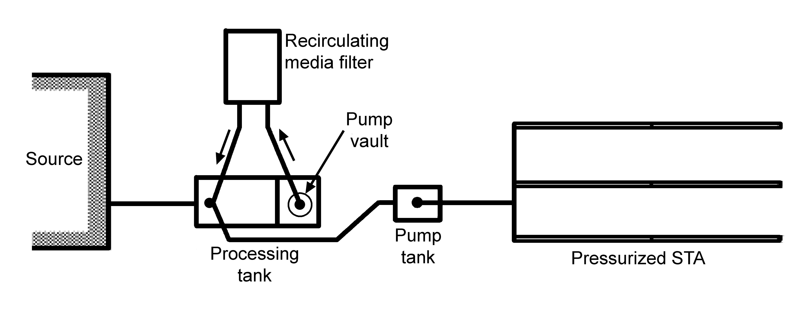
Recirculating media filter
Notes:
Re-circulating media filter flow path. Discuss the pieces.
Recirculation of the nitrified effluent is necessary if nitrogen reduction is proposed. The media filter nitrifies the effluent, returning it back to the headworks provides the carbon source to allow the denitrification process to take place

Slide 23
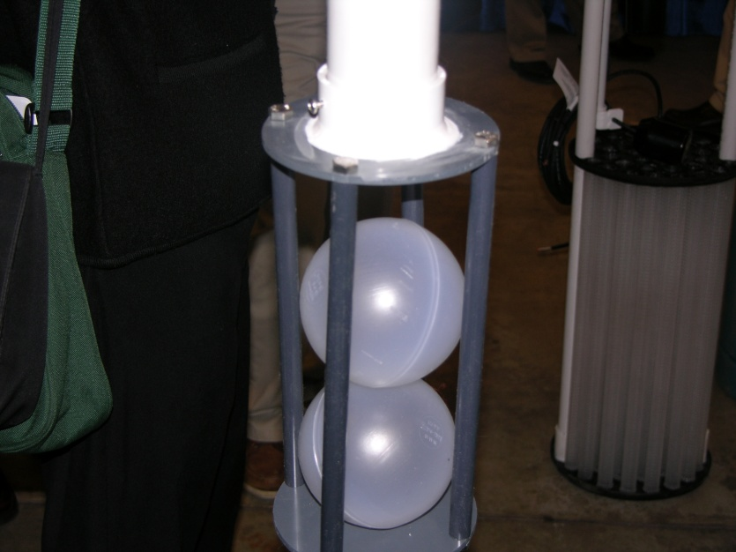
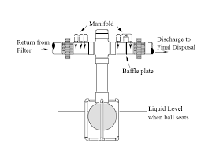
Recirculating ball valve
Notes:
This is the component that allows for recirculation to work

Slide 24
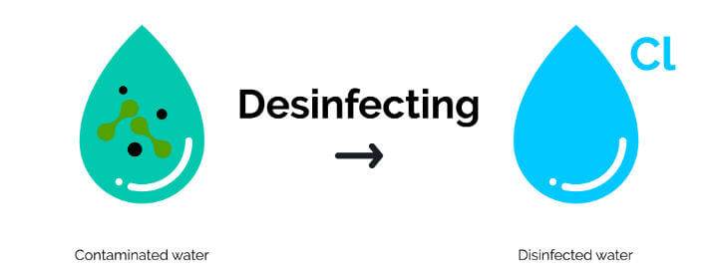
Additional Pretreatment
Disinfection

Slide 25
What is Disinfection?
A process of destroying pathogens in the wastewater stream by killing them or preventing their replication
Disinfection can be accomplished by:
  Chemical agents – ph neutralizers, anti foaming agents, coagulants & flocculants - chlorine
  Physical agents – sedimentation, adsorption, filters & screens
  Irradiation – ultraviolet (uv) radiation
For small flows soils, chlorination and ultraviolet light are usually used
Notes:
Disinfection is typically required if there is going to be some kind of surface discharge – this is to ensure that the bacteria is killed or rendered sterile to prevent the discharge from causing a severe health issue for those that may come in contact

Slide 26
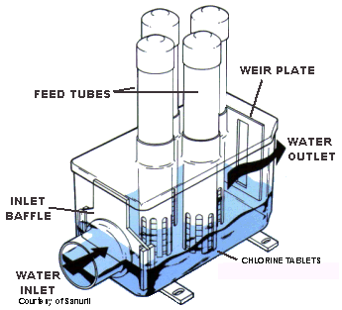
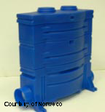
Disinfection - Chlorination
Most widely used disinfectant
For individual systems, calcium hypochlorite is used
Needs both
Low BOD & TSS
Notes:
Again, this is typically a tertiary treatment component installed after a secondary treatment system; ATU, packed bed filter, etc.
The photos shown here are of a standard “tablet chlorinator”
Make sure correct tablets are used and they come in contact with the effluent
Moisture can cause the tablets to get stuck and not fall into position

Slide 27
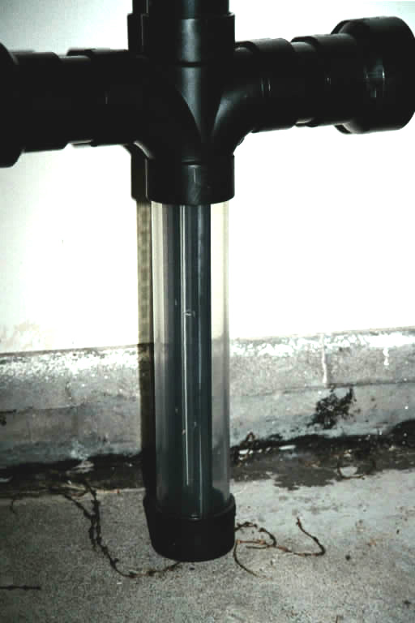
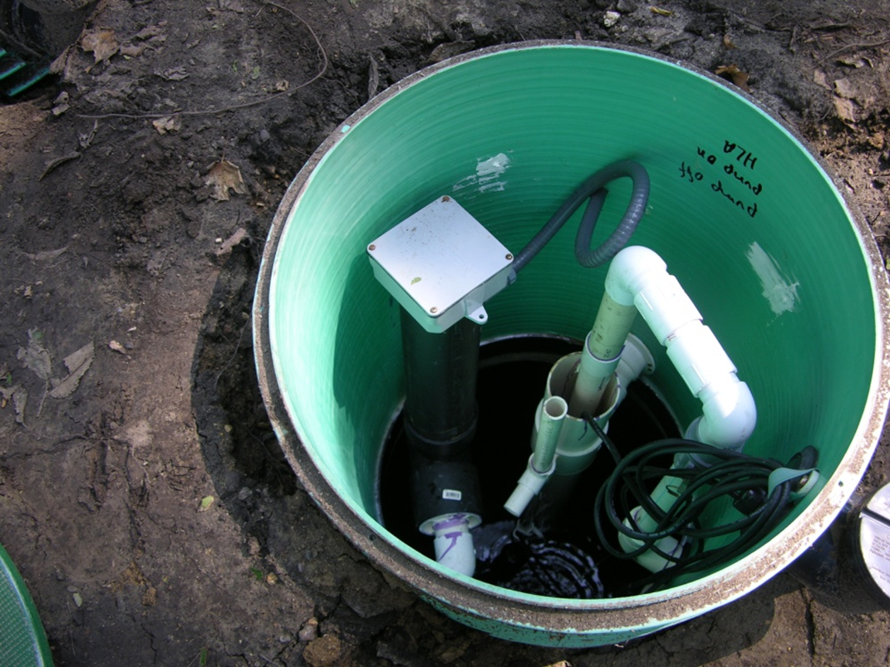
Disinfection – Ultraviolet Radiation
Currently for small wastewater flows most uv units have a bulb vertically oriented
Notes:
Need at least yearly maintenance to clean tubes etc.
Remember, this is typically installed as tertiary treatment

Slide 28
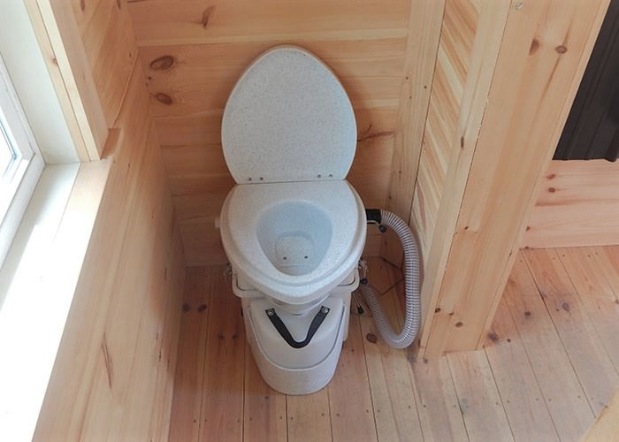
Separation technologies
“separate” different kinds of wastewater
Dual systems:
Toilet – composing, incinerating, low-flow to holding tank (black water)
All other wastewater:
  Downsized typical tank/soil treatment
  Downsized tank/pretreatment/soil treatment
  Graywater, reuse systems
Notes:
Separation Technologies is simply separating the blackwater from the graywater
This is best done on a new build – retrofitting a home to separation technologies is very expensive

Slide 29
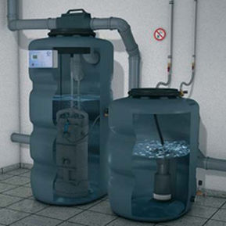
REUSE
Domestic wastewater Recycling system
Notes:
When wastewater streams are separated and proper treatment is included, you can reuse the gray water; AS LONG AS YOUR LOCAL OR STATE REGULATIONS ALLOW FOR IT
Colorado Regulation 86 for Graywater; Regulation 84 for reclaimed water re-use

Slide 30
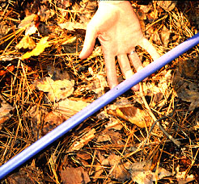
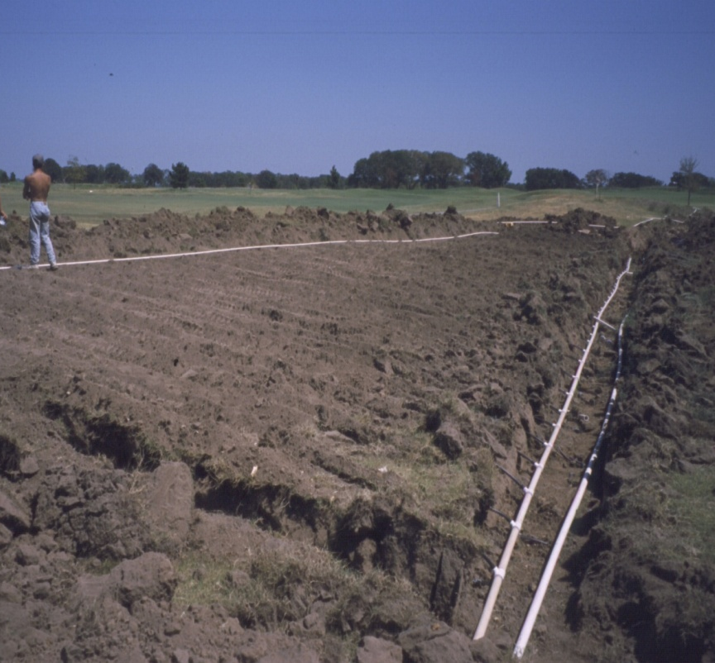
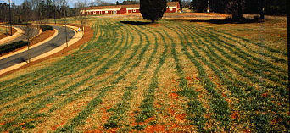
Drip Irrigation Systems
Adding water to a large area
Adding water slowly
Adding water shallowly
Notes:
Drip is advanced treatment and advanced STA all in the same system -
Drip irrigation/dispersal systems are becoming more popular – the drip portion is the final treatment -
These typically take up a large area; Installed shallow to utilize the biologically active topsoil
Effluent is added slowly to provide unsaturated flow and time for the biological process to occur

Slide 31
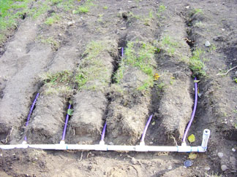

Drip Dispersal Systems
Specific loading rates
Sizing
Treatment
Application methods
Pressure systems
Drip at zero pressure
Notes:
Loading rates are determined by regulations or mfgr; whichever is larger
The shallow-narrow trench provides the maximum treatment that the soil can provide; the topsoil contains the most bacterial activity than deeper soil profiles
While the system is technically under pressure; the emitters are designed to reduce the pressure and provide dispersal at a “drip”

Slide 32


Drip emitters
Pressure compensating or non-pressure compensating
Controlled flow rate for emitters – friction used to control flow
The operating pressure is typically 15-25 psi for non-pressure compensating and 15-45 psi for pressure compensating emitters with water always exiting at 0 psi
Notes:
Emitters

Slide 33



Drip filters
Types
Screen
Disc
Remove particles greater than 100 microns
Protects emitters from plugging by particles in the effluent
Notes:
The filtering device can be media (including sand), disk or screen filter.
Its main purpose is to remove larger particles from the wastewater, so they do not cause problems with the drip emitters. Generally, remove particles greater than 100 microns.
Depending upon wastewater quality, the filter may need to be an automatic cleaning system.
Reverse flushing functions are typically incorporated into the design of the system
System O/M is necessary to ensure the filters are routinely cleaned

Slide 34

Pressure gauge
Return flush valve
Notes:
pressure gauge provided. Installation should be done so you can read the gauge.
Return flushing valve is typically controlled by a solenoid valve from the control panel

Slide 35


Vacuum breaker
Clean the ball valve component
Be careful of scaring ball
Make sure air can flow around valve
Notes:
Important that these not stick open, so check to be sure they operate. In cold weather they can freeze.

Slide 36


Drip zone
Visual evaluation
Uniformity of water distribution
Vegetation uniformity
  Type
  Color
Notes:
Check for equal vegetation growth and no surfacing or odors.

Slide 37
QUESTIONS??

