Slide 1
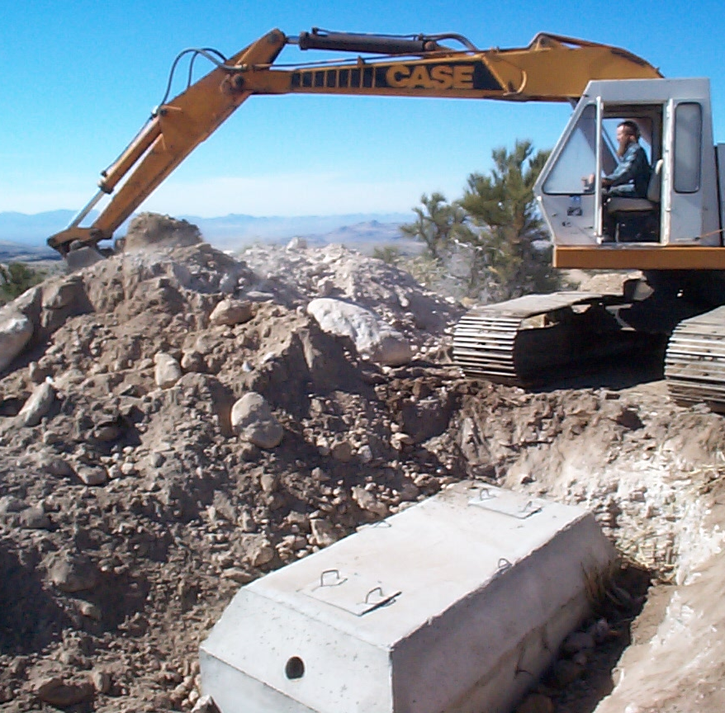
Initial and Advanced Treatment
Initial Stop(s) on the Treatment Train
Septic Tanks, Pretreatment, and Pump Tanks
Notes:
We will be discussing the tank components and considerations

Slide 2
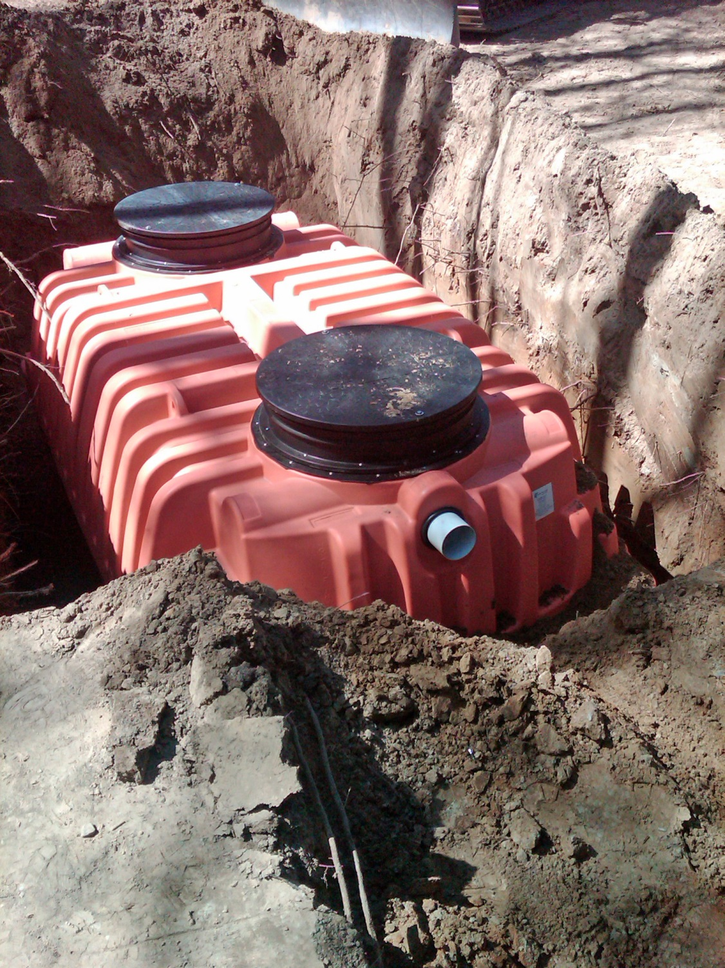
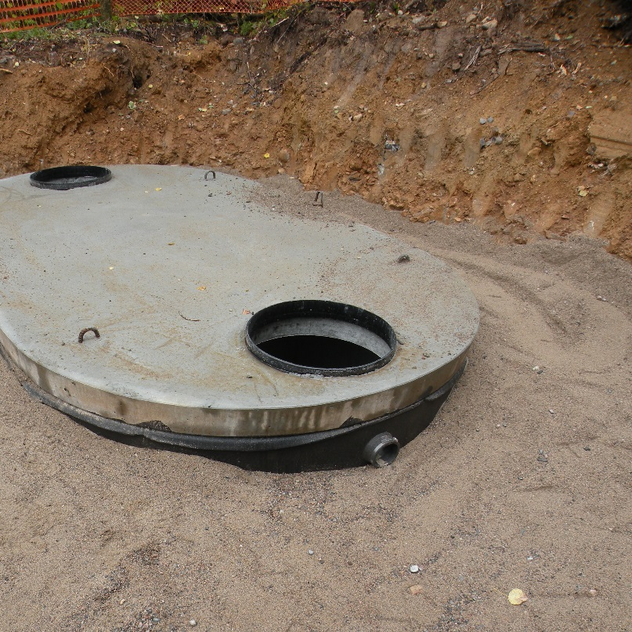
Types of tanks
Types of tanks
  Holding tank
  Septic tank
  Pump tank
  Aerobic treatment unit (ATU)
All must be
Watertight
Notes:
Tanks are watertight vessels that are meant to collect the wastewater from the source, hold the solids and allow the wastewater to flow onto the next component
Depending upon the type of “tank” we are dealing with will determine what we expect to see and how we evaluate its condition.
Materials: Concrete, Plastic, Fiberglass, Steel
Concrete Construction: 1-piece w/lid, 2-piece (clamshell)
Considerations: Buoyancy, Weight, Corrosion
Three processes occur in the tank: Separation (solids), Biological (anaerobic bacteria), Chemical (nitrogen cycle) – this is the beginning of treatment of the wastewater

Slide 3
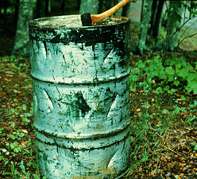
What’s the PROBLEM?
TREATMENT!!
Typical Construction
  Separation
Depth
Saturated flow
Disposal Systems
Notes:
Increasing depth means less oxygen in the soil.
Adding pretreatment affects homeowners in 3 ways:
1) More money needs to be invested.
2) More maintenance required because the treatment system is more complex.
3) The soil treatment system needs pressure distribution.

Slide 4
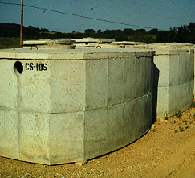
SEPTIC TANK KEYS
SEPARATION
  SIZING
  GEOMETRY
  COMPARTMENTS
STORAGE
  WATERTIGHT
  MAINTENANCE
Notes:
Discuss tank requirements. They need to be watertight, properly sized. Many areas require two compartments for better performance.
The number of bedrooms determines the required tank size – the more bedrooms, the more anticipated flow, the more need for detention, the more tank capacity that will be needed

Slide 5
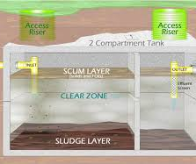
Separation – Proper Operation
SCUM
CLEAR ZONE
SLUDGE
Notes:
When you look into a septic tank, you should see 3 distinct layers:
1) Scum – floatables (soap, fats, oils, greases)
2) Clear zone – the layer that goes into the final treatment and dispersal system
3) Sludge – the “sinkers;” the accumulation of non-decomposed solids

Slide 6
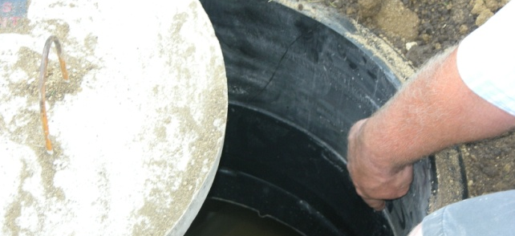
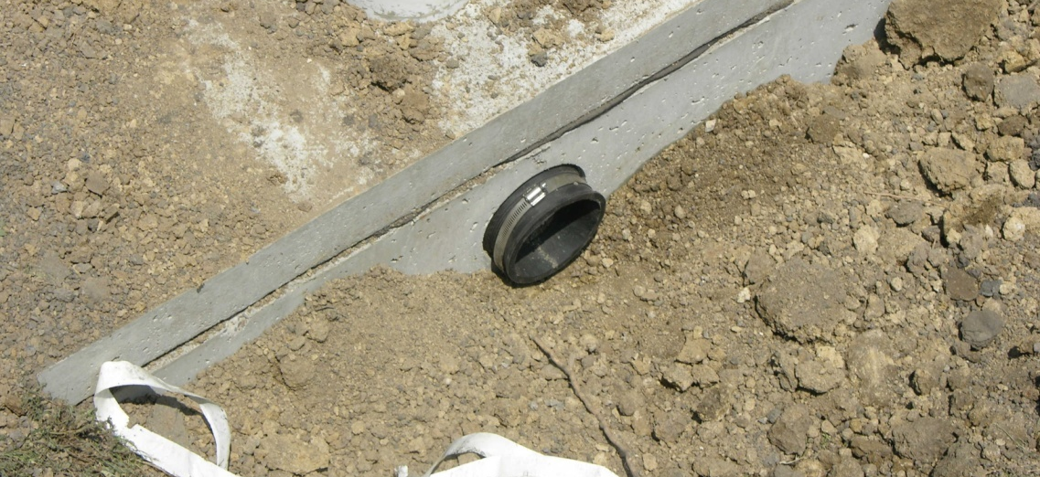
WATERTIGHT CONNECTIONS
RISERS
PIPING
  INLET
  OUTLET
Notes:
You must make all connections watertight. Using mastic and concrete is a good method. Now many connections are cast in place. Flexible boots at outlets etc.
If there are roots – there is no watertightness

Slide 7
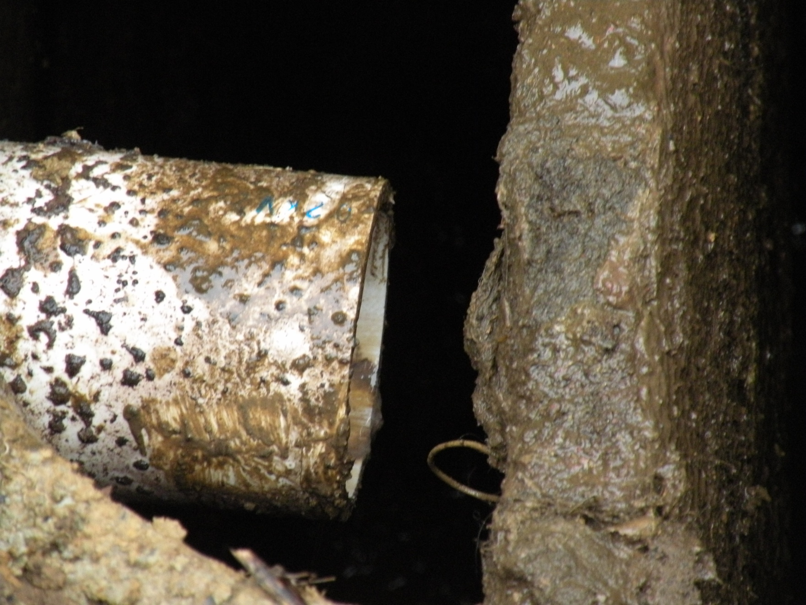
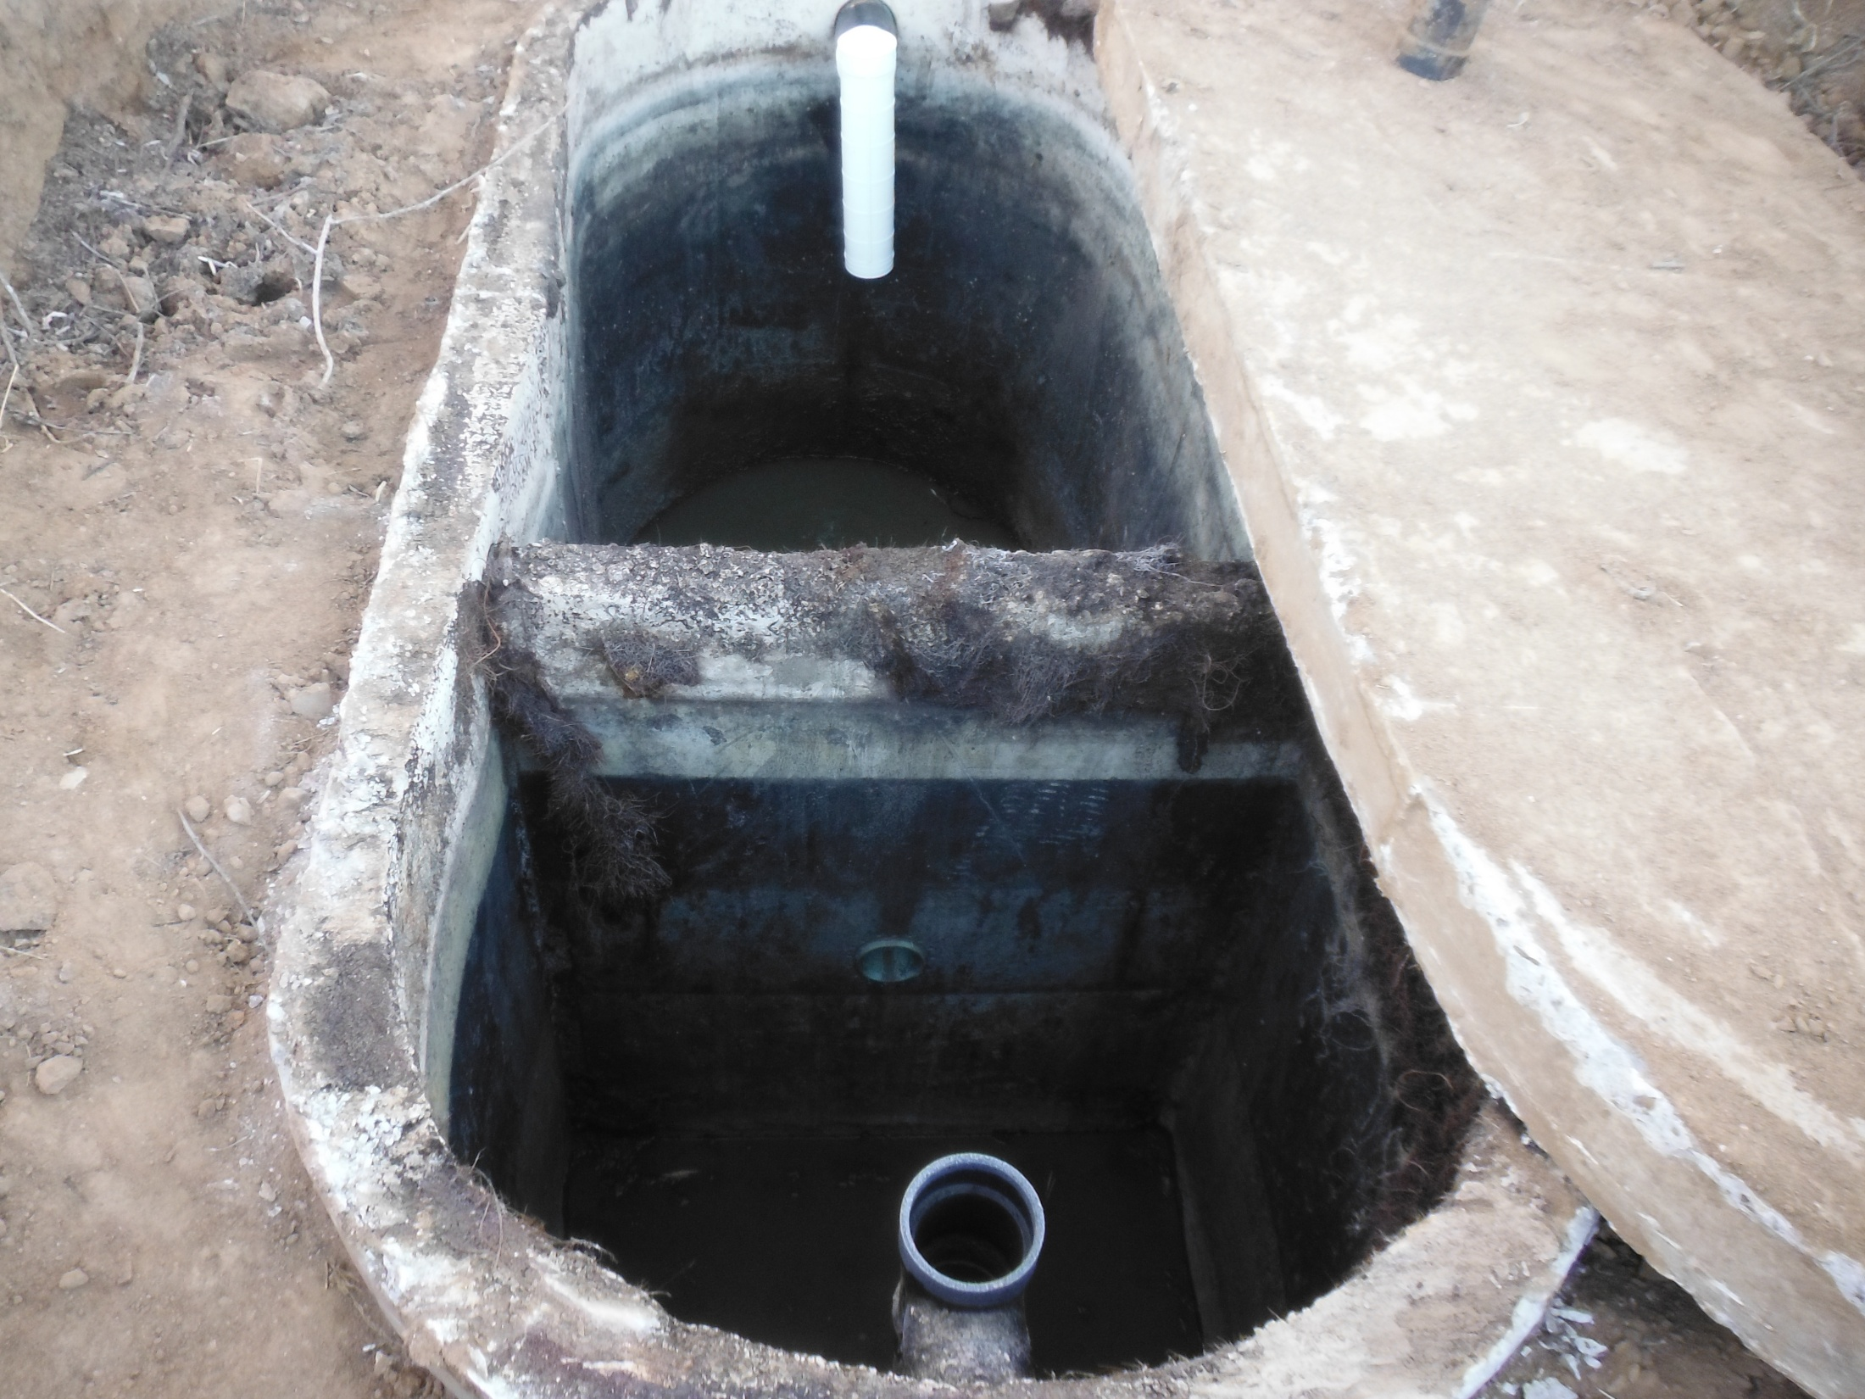
BAFFLES
INLET
OUTLET
Notes:
A lot of baffles are either:
• concrete (and pumpers are reporting problems with concrete breaking down, which means that (a) not enough cement in mix or (b) ??)
• Sanitary tees – a good baffle
The baffles provide protection – on the inlet side it helps to displace surges into the tank so as not to disturb the scum development on the top and force waste down into the tank – on the outlet it help keep the scum layer from floating out to the STA and causing plugging of the soil pores.
If you see the baffles showing corrosion, inspect the other parts of the tank, particularly the underside of the lid. If you see problems with the underside of the lid…..Get off the tank. This is a dangerous situation!

Slide 8
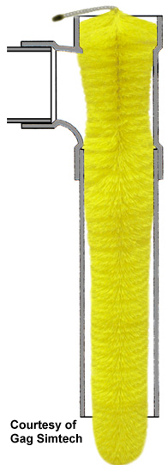
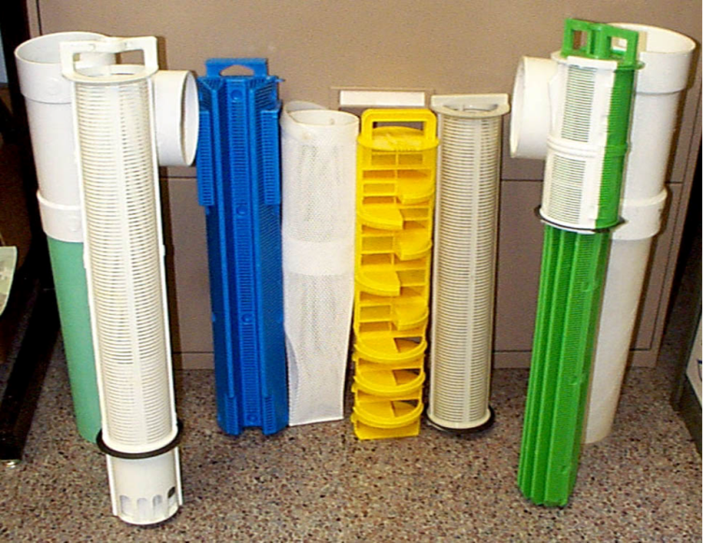
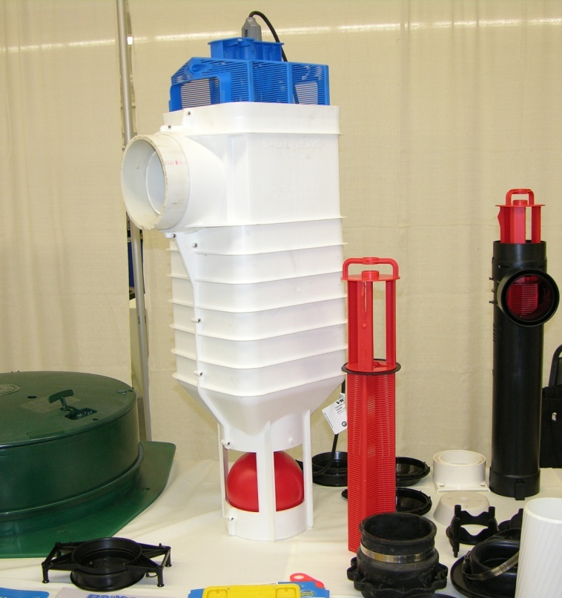
EFFLUENT SCREENS
Notes:
Effluent screens are now required in many areas. There are many kinds of products available.
If there is need of a pump, pump vaults can be used. Be aware that the vaults must be matched with the pump capacity. If the pump pumps faster than the water can fill into the vault there will be issues.
A variety of screen products.
Is there a better screen than another… some feel there is… It should be noted that the smaller the orifice or slot in the screen, the more likely it will become plugged – which means that to operate correctly it will need to be maintained.
Effluent screens have been found to provide some pretreatment to the wastewater.

Slide 9
Effluent screen
Screens can add treatment
Notes:
The biologic community appears to benefit from a screen – it provides a media for the bugs to grow on and as the wastewater passes by the bugs knock down the pathogens
The screen also has a positive effect on the suspended solids in the tank – it catches larger particles and keeps them from traveling to the STA and causing problems there.
The nutrients are not affected by the screen because they are chemicals within the water and need to be addressed in a different fashion
FOG also gets knocked down with the use of an effluent screen because it is physical and can be trapped by the screen and removed from the wastewater stream,

Slide 10


Effluent screen alarm
Notes:
If you have an effluent screen, there should be an alarm, so the warning device is not sewage backing up into the house.
Some alarms are the homeowner when they see the sewage all over the floor!!

Slide 11

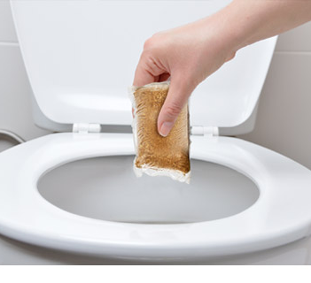

maintenance
additives
Notes:
There is not definitive research on additives. Previous studies have shown there is no advantage to additives and some can be detrimental.

Slide 12
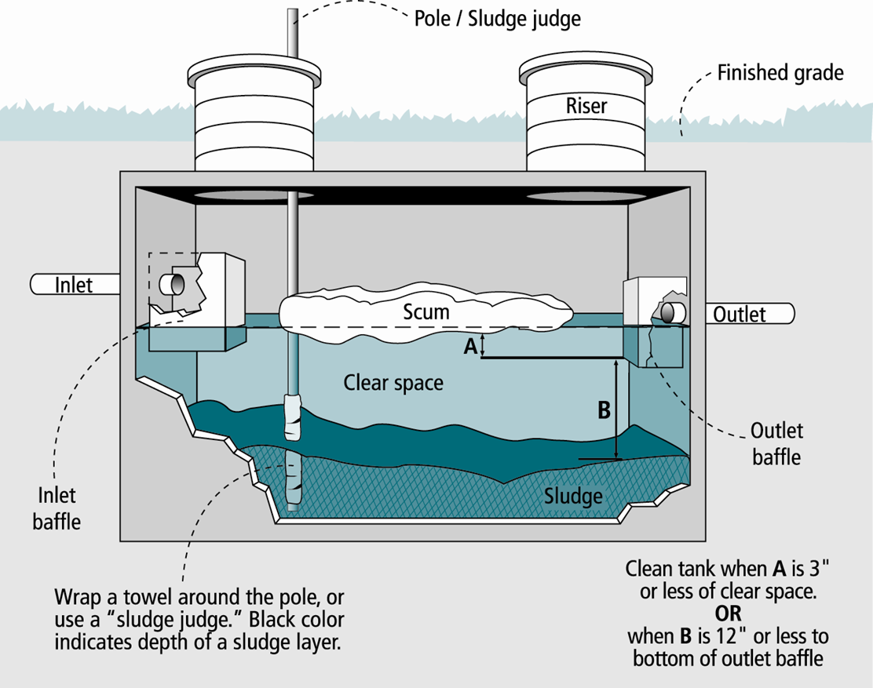
Is the Tank Full
OR
A => 3”
OR
B <= 12”
Sludge + Scum > 25-33% of volume
Notes:
Pumping is based upon usage and the collection of solids in the tank – Today’s systems are not like Grandpa’s where only the toilet and shower went into the septic tank - Everything today is going into the tank and the more “stuff’ that goes in the more often the tank needs to be pumped
On average science has found that a family of 4 on a 1000-1250-gallon tank needs to be serviced about every 2-4 years depending upon usage - There are always those extremes
The conversation with the homeowner needs to cover how they are using their system
There are two ways of measuring the solids in the tank – first ** click is the total solids as a percentage of the total volume ** click – second ** click is comparing the scum or sludge depth to the bottom of the baffle or tee ** click

Slide 13
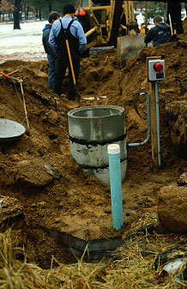
Other concerns
Tank depth
  Maintenance
  Strength
Lift stations
  Pump access
  Watertight
  controls
Notes:
Give examples of tank concerns or history in your state if it is known.
The deeper the tank, the more concerns we have for maintenance and inspection – the deeper it is the harder it is to pump and evaluate
Anything with advance treatment or pumps need to be close to the surface for maintenance – it’s not a matter of “IF”, but “WHEN” something will need to be replaced
Tanks with pumps must also be watertight and meet all other tank requirements set forth by the Local Permitting Agency (LPA)
.

Slide 14
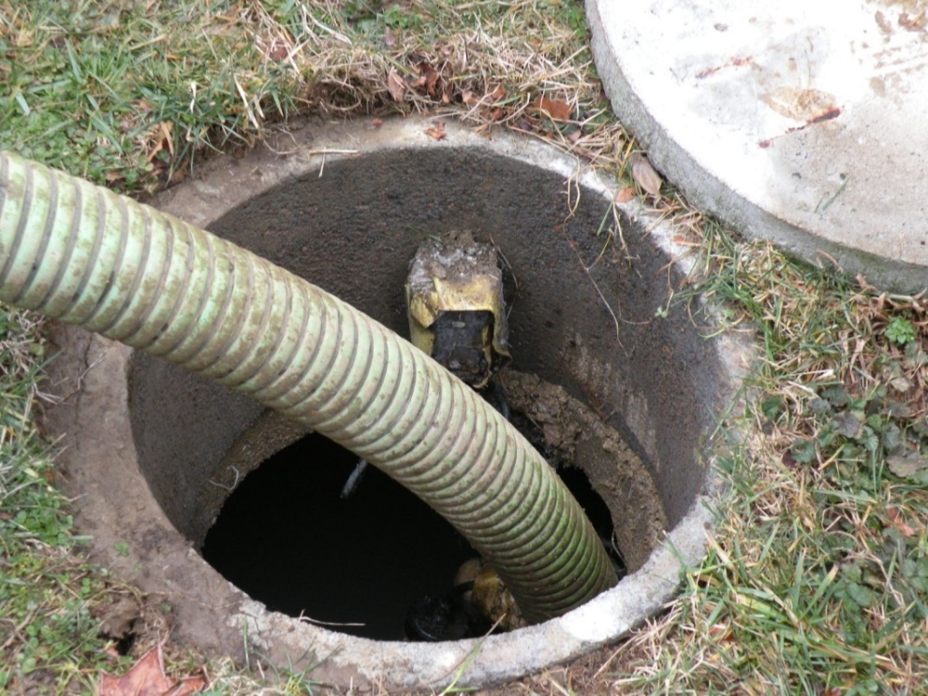
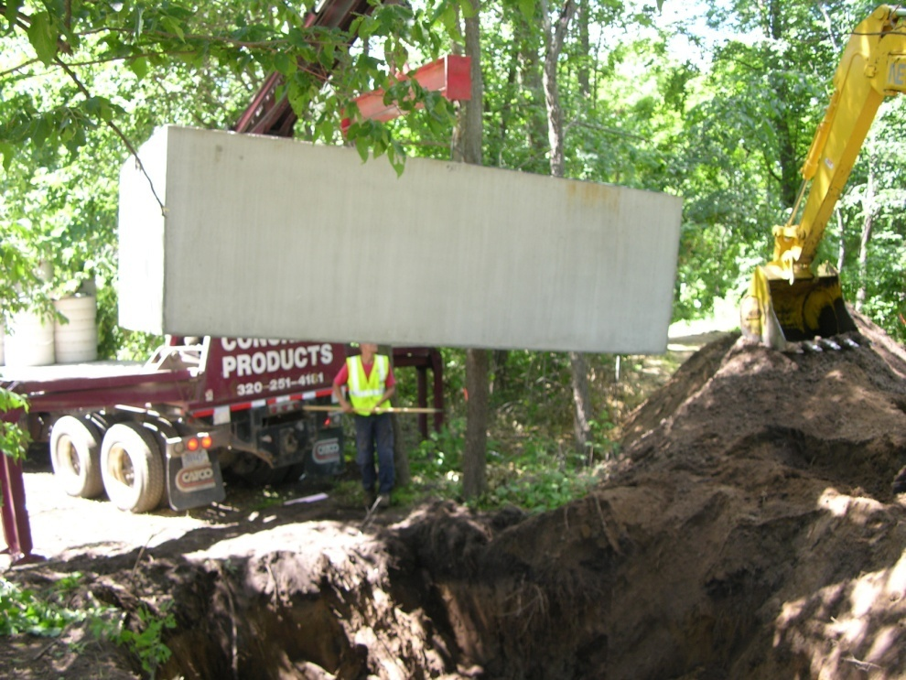
Holding tank
Pump & haul
Capacity
  5 days minimum
Most expensive
  Owner
  Regulator
Midnight pumper
  use
Notes:
Holding tanks are to collect the wastewater and have it removed and moved to another site.
There are many reasons why a holding tank would be utilized, and there are very few that are actually allowed by most state and county codes.
They can be a very good learning tool for the homeowner to never quite understands their particular water usage pattern.

Slide 15
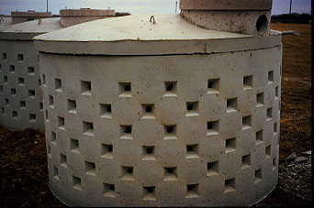
What is NOT a tank
Cesspool
Leaching pit
Seepage pit
Drywell
Notes:
These are not pretreatment OR treatment systems. They are disposal systems.
When you go through the history of onsite systems you see originally waste was deposited out in the open, then in a privy, then into a system with water that conveyed it to a stream or river, then a system from the house into a cesspool – then they added a tank to collect the solids and sent it on to the leaching pit or seepage pit – some call a seepage pit a drywell – but in CO drywell is typically for stormwater not wastewater.
Cesspools are no longer allowed under CO state and county codes. Cesspools are raw sewage with nothing in front of them to catch, hold and process any of the solid waste – all wastewater travels from the source directly to the cesspool, where it seeps into the ground, unseparated, untreated
Seepage Pits/dry wells, would be the next generation – It would be interesting to see the looks on people face when that first guy said, “HEY, lets put a TANK in front of the Cesspool to catch the solids.”

Slide 16
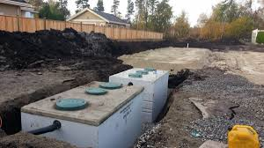
TANK Questions?

Slide 17
Pumping systems
Introduction to
systems that require a pump
Notes:
Not done until form is fully completed.

Slide 18
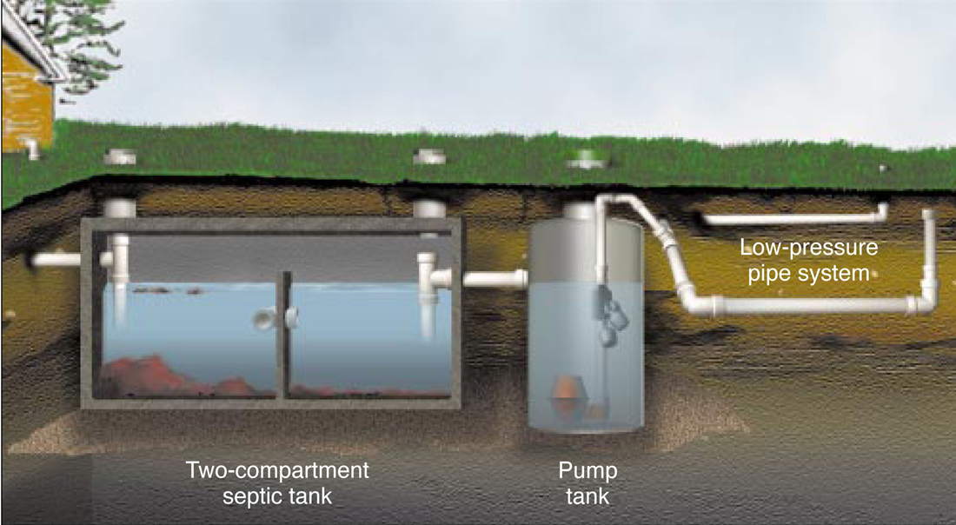
Parts of the pump system
Pump tank: vault
Pump
Controls
  Alarm
    Demand dose
    Timed dose
Supply lines
Final dispersal/treatment
Notes:
These are the typical components to a pump system - Walk through the parts of the systems.

Slide 19
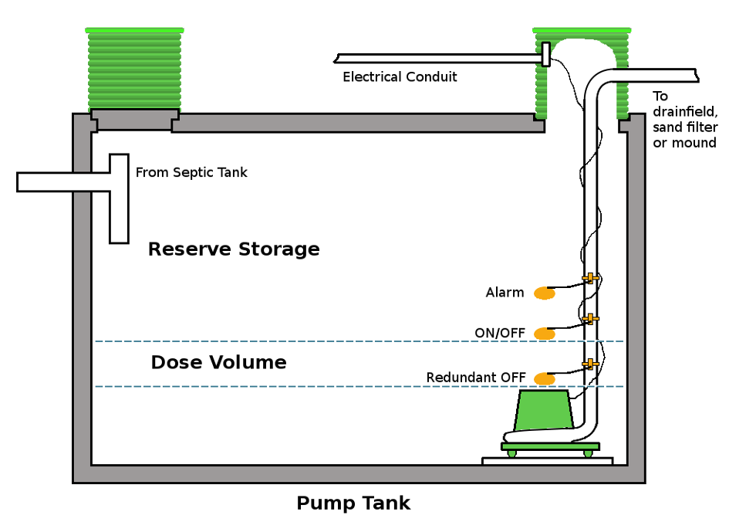
LOCATION
TO THE TREATMENT TANK
TO THE PRETREATMENT
TO THE FINAL TREATMENT AND DISPERSAL SYSTEM
  PUMP TO GRAVITY
  PRESSURE DOSED
Notes:
Situations where pumps are used in systems. Anytime we need to move wastewater and can’t use gravity to accomplish it, a pump will be involved.
To the initial treatment tank would be a “lift station/pump”
To the pretreatment could be lift station or dosing if they are trying to spread across the pretreatment unit
To the final treatment/ STA whatever that may be

Slide 20
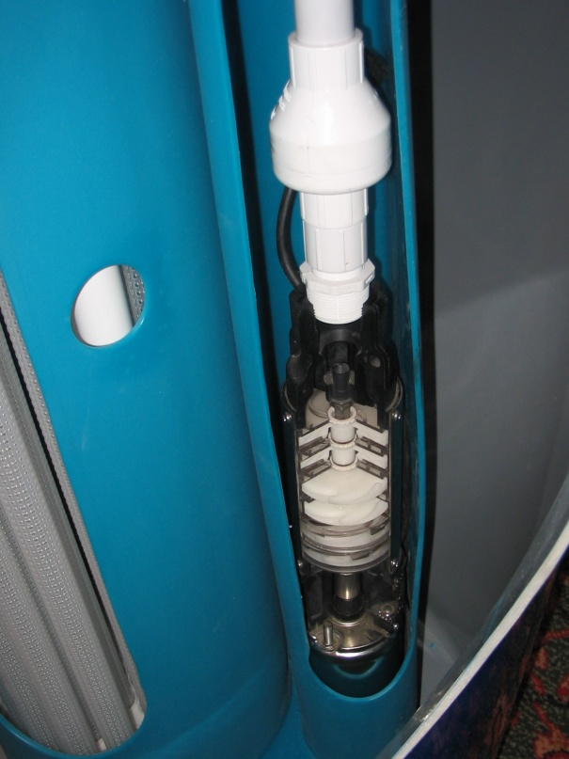
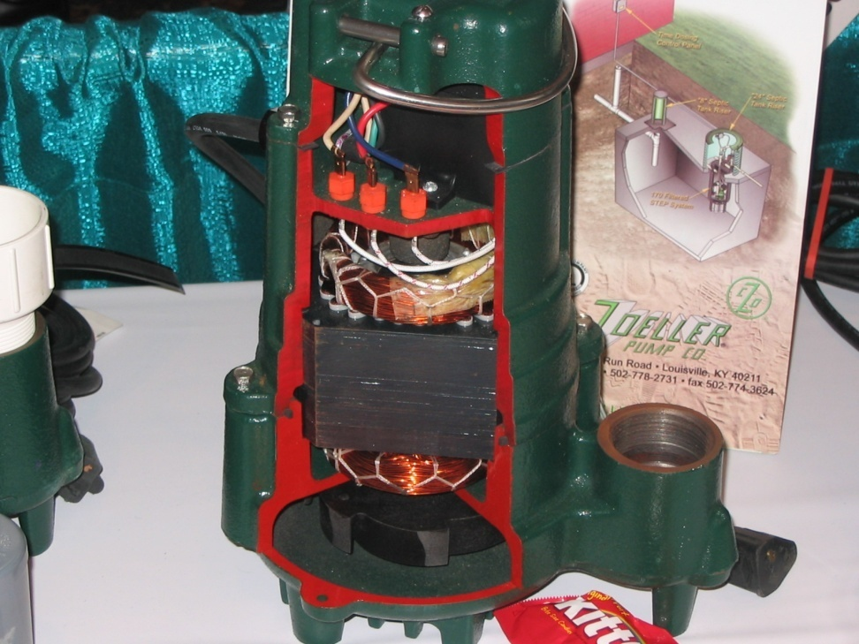
PUMP TYPES
SUMP [CLEAR WATER]
EFFLUENT
  MULTISTAGE
  SINGLE STAGE
SEWAGE
  GRINDER
Notes:
Different types of pumps are used for different applications – a ½ horsepower pump is NOT a ½ horsepower pump.
Pump curves must be referenced when designing a system. Some will have a low gpm (pump rate) and be able to overcome high head; while others will have a high gpm, but with low head pressure

Slide 21
SIZING
PRESSURE
  HEAD [IN FEET]
FLOW RATE
  CAPACITY [GPM]
PUMP CURVE
20 gpm @ 10’ tdh
Notes:
Pump has characteristics. - ** 3 clicks – TDH – how much pressure; GPM – how many gallons per minute they are delivering; the pump curve tells the designer if the pump will meet the specs
Flow capacity in gallons per minute and the operating pressure or head.
Each pump has a characteristic curve of capacity at different pressures. The curve tells you where the pump operates at – it is a fixed operation – you want that point to be under the curve itself
However, the pump will always run on the curve; as noted on the next slide

Slide 22
SIZING
DESIGN POINT
OPERATING POINT
Where the system is running
SYSTEM CURVE
PUMP OPTIMAL RANGE CURVE
Actually: 25 gpm @ 15 TDH
Notes:
There are many things that need to be figured to determine what the right pump is:
Size and type of piping
Bends – type and number
Elevation – or lift
Orifices: Size of the holes in the pipe matters
These calculations are completed during the design process – understanding the importance of using the spec pump is what we need to understand as an inspector
(The pump optimal range will appear with the **click) This is where the pump should run to optimize pump performance and life of the pump

Slide 23
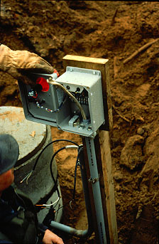
ELECTRICAL WORK
DONE PROPERLY
REMOVABLE
SEPARATE CIRCUITS
ENOUGH JUICE [VOLTAGE]
Notes:
All electrical needs to meet NEC codes – As an inspector you’re going to check to make sure it meets the local septic code (is in the proper location, is proper for the conditions internal vs. external, etc., and whether it is operational). You do not need to know NEC code or be an electrician to do an inspection. Good work is easy to identify, whether it turns on and off is easy to identify.

Slide 24
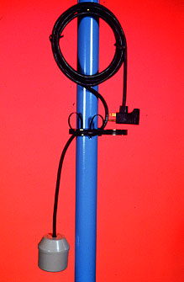
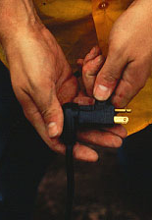
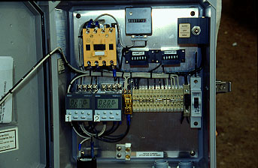
OPERATING DESIGNS
DEMAND DOSE
  PIGGYBACK
TIME DOSE
Notes:
Discuss timers and floats relative to pump dose cycles. The timer and floats are what activate the pump to dose – it’s important to understand how these work to be able to evaluate them correctly. Time dosing and demand dosing are distinctly different
From a troubleshooting aspect, which is outside the scope of an inspector, a lot can go wrong with the settings, so for troubleshooting it is important to know pump and flow characteristics and what the float or time settings should be.
This is even more true in panels today.

Slide 25
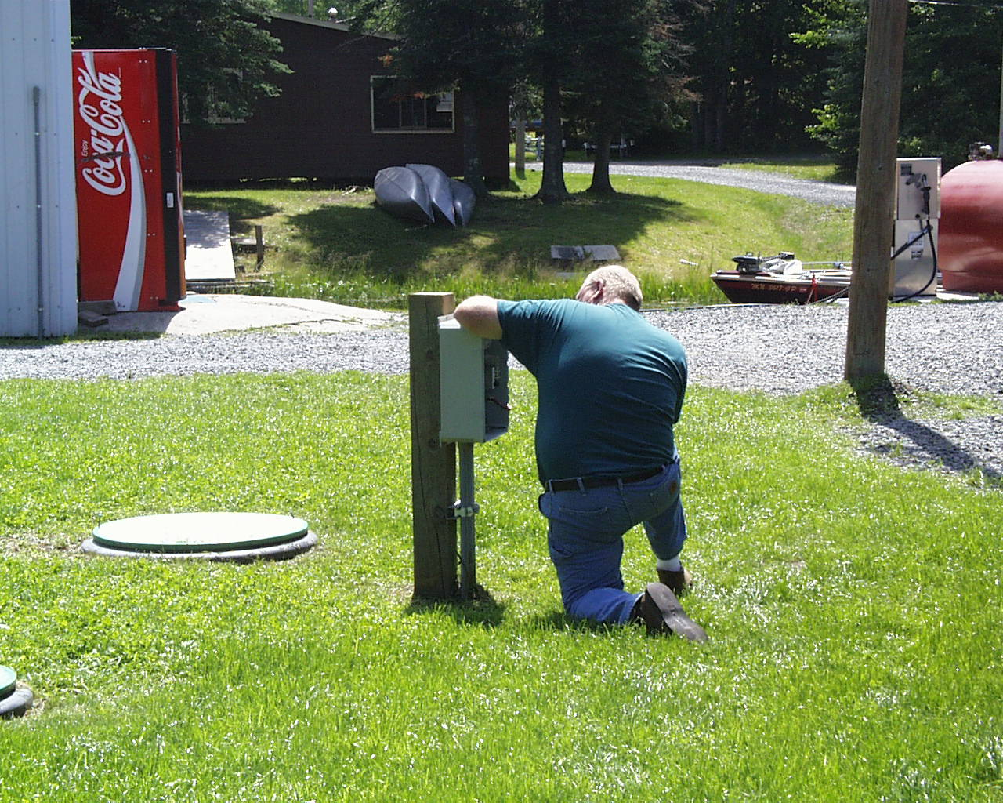
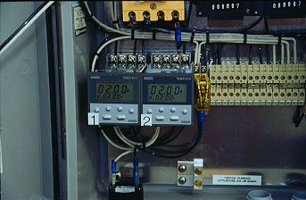
TIMERS
Calibrate the Pump Rate
Notes:
As before, we always need to verify flow rates – the base information will be found in the design, but we should have field verified data; remember the design point and operating point are typically different. If the counters and timers have been properly logged, this will provide valuable information regarding the functionality of a system.
If this information is not available, you will have to utilize other skills to determine if the system is operating as designed. More thoroughly discussed in the O/M classes

Slide 26
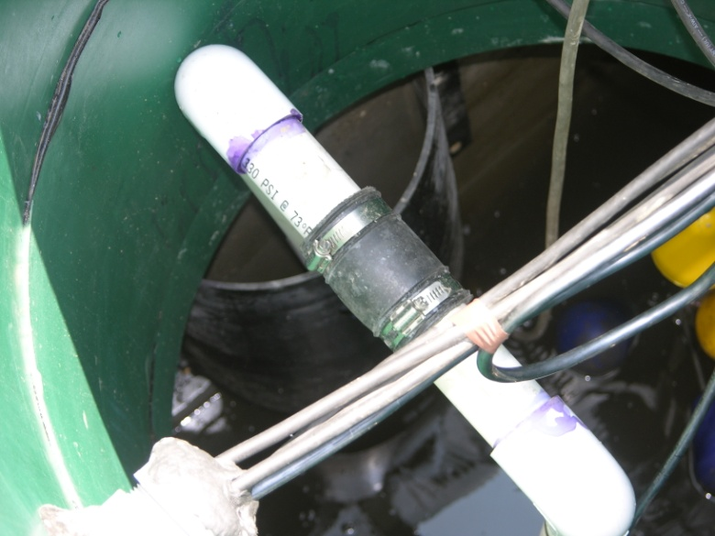
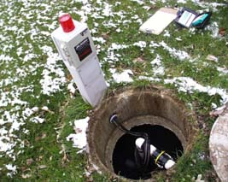
COMPONANTS ACCESSIBLE
ACCESS FROM THE SURFACE
REACHABLE
QUICK DISCONNECT
FLOATS [FLOAT TREE?]
Notes:
The pump needs to be installed so it is accessible from the surface for service and replacement.

Slide 27
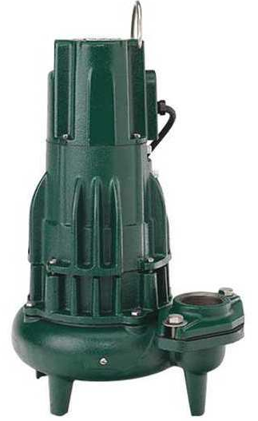
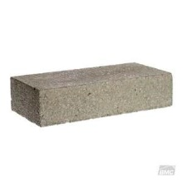
PUMP IS:
ELEVATED OFF the FLOOR OF The tank; 4” – 6” typ.
Keep COVERED WITH WATER
  Runs cool
  Prevents corrosion
WIRED PROPERLY
Notes:
Example of pedestal to set the pump on.
Pumps need to be elevated to keep them from sucking up the sludge at the bottom of the tank
They need to be properly wired to ensure that they will work in the corrosive environment

Slide 28
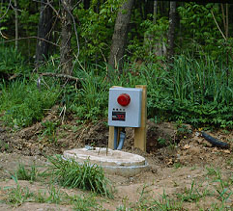
DOSING CHAMBER
WATERTIGHT
SURFACE WATER
ELECTRICAL
CAPACITY
DOSE
  DRAIN-BACK
  RESERVE CAPACITY
Notes:
Characteristics of pump or dosing chambers. They need to be watertight. They need to be large enough for the dose size and for any reserve capacity. You need to be able to calculate tank volumes and pump out depths

Slide 29
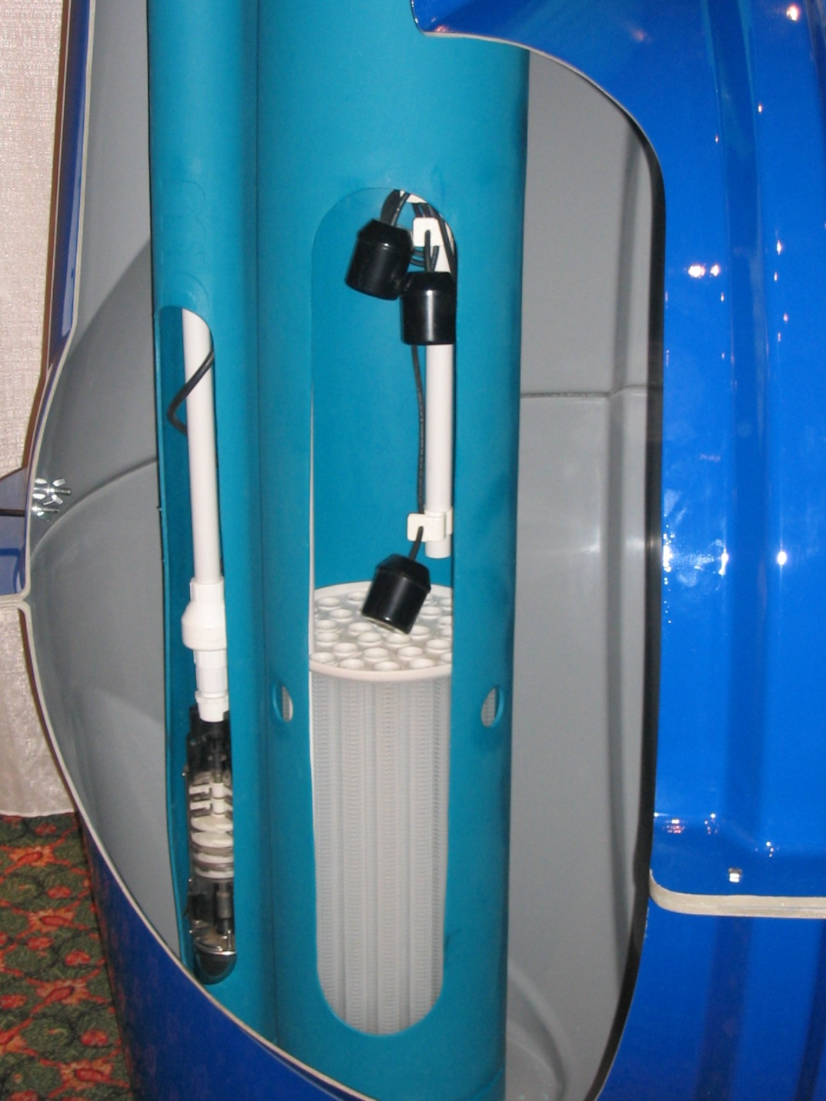
PUMP VAULTS
SIZING
CAPACITY
  PUMP
  SCREEN
    20% MORE THAN THE PUMP GPM
Notes:
The pump and the vault capacities need to match. Having a 40-gpm pump and a vault that allows 20-gpm through it will not work the pump would be pumping faster than the water would be coming in causing it to be pumping “dry”. It is the water that keeps the pump cool and operating so there always needs to be water surrounding the pump,

Slide 30
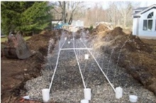
PRESSURE DISTRIBUTION
GOAL – UNIFORM DISTRIBUTION
AEROBIC BIOMAT
TIME
  DOSING TIME “AMOUNT”
  RESTING TIME
Notes:
In pressure distribution using a pump the goal is to spread the flow out over both time and space.
Applying the effluent at an application rate that the soils can handle; with resting periods to allow oxygen – treatment.
UNSATURATED FLOW THROUGH THE SOIL PROFILE

Slide 31
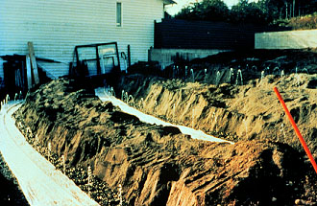
EVEN DISTRIBUTION [SPACE]
NUMBER OF ORIFICES/LATERALS
  PUMP CAPACITY
  PUMP HEAD
  PUMP CHOICE
EVEN DISTRIBUTION OVER LATERALS
  DETERMINE NUMBER OF DOSES/DAY
  MINIMUM
  MAXIMUM – MICRO DOSING
Notes:
What does even distribution mean?
The pressure distribution system is matched with pump capacity and operating head.
When being replaced not any old pump will do. It needs to fit the operating requirements. This is found in the design – replace “like for like”

Slide 32
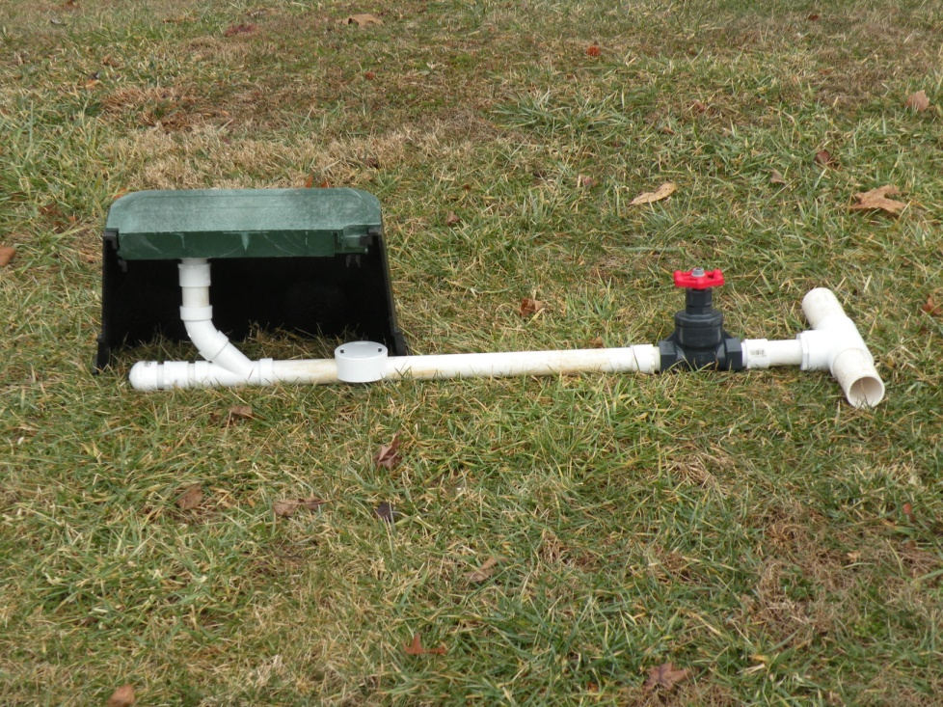
CONSIDERATIONS EMPLOYED BY DESIGNERS
PUMP LIFE
PUMP SIZING
SYSTEM MAINTENANCE
SYSTEM CAPABILITY
Notes:
All of these are used during the system design portion. As the inspector you will be making note of anything that is not functioning or showing signs of issues.

Slide 33
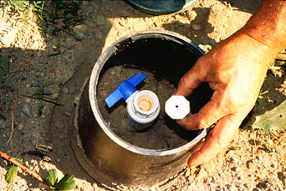
PERFORATION SIZING
CODE
  MINIMUM IN CO 1/8”
  MAXIMUM IN CO 3/8”
LOW HEAD
  LARGER ORIFICES
HIGH HEAD
  SMALLER ORIFICES
Smaller~ More care
Notes:
Access to check pressure and to clean the laterals.
If you’re from another area – check your local regulations – they may have different min and mx for orifice size
While smaller orifices may allow for a smaller pump, they may need to be serviced more often.
Industry suggestion that any orifice 1/8” or smaller should be proceeded by some form of HLT to remove TSS and BOD

Slide 34
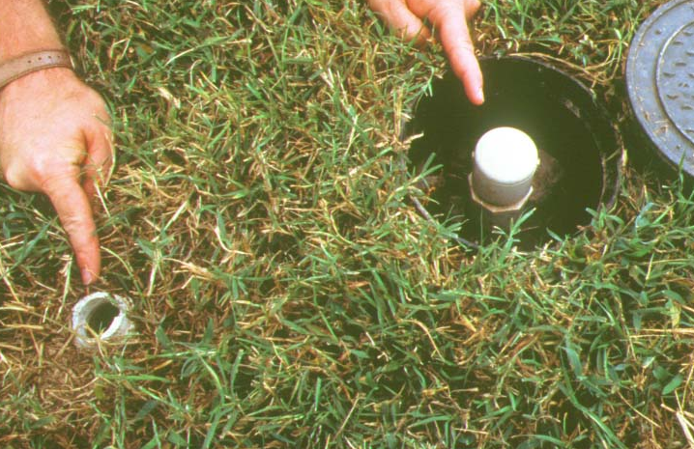
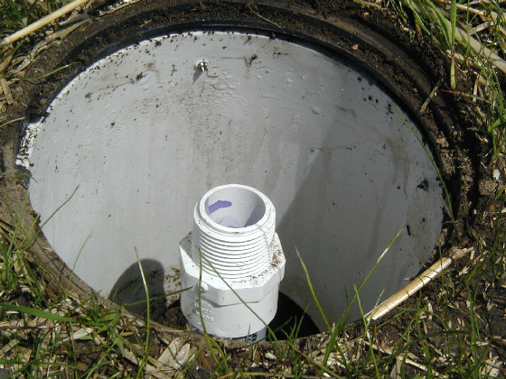
Determining distal head pressure
Locate lateral ends
Remove endcap
Flush laterals
Attach endcap w/orifice on at least one lateral
Cycle pump
Measure squirt height
Notes:
Determining the distal head pressure is a function of Operations and Maintenance. Ideally, pressure dosed systems will have a SP that is periodically checking to make sure the system is functioning as intended and cleaning the laterals as needed.
In order to accurately determine if the system is functioning as designed, you should check to make sure that each lateral is receiving approximately the same amount of measure the distal head pressure of the system; aka: squirt height
To do this you will need to: (read the above bullets)
As an inspector you do want to verify that the laterals are receiving approximately the same amount of effluent when the lateral is pressurized. You would check this in the same manner, but you may not have the information to verify if the squirt height is within reason for the design. You would note any significant discrepancies in height across the laterals as needing more investigation.

Slide 35
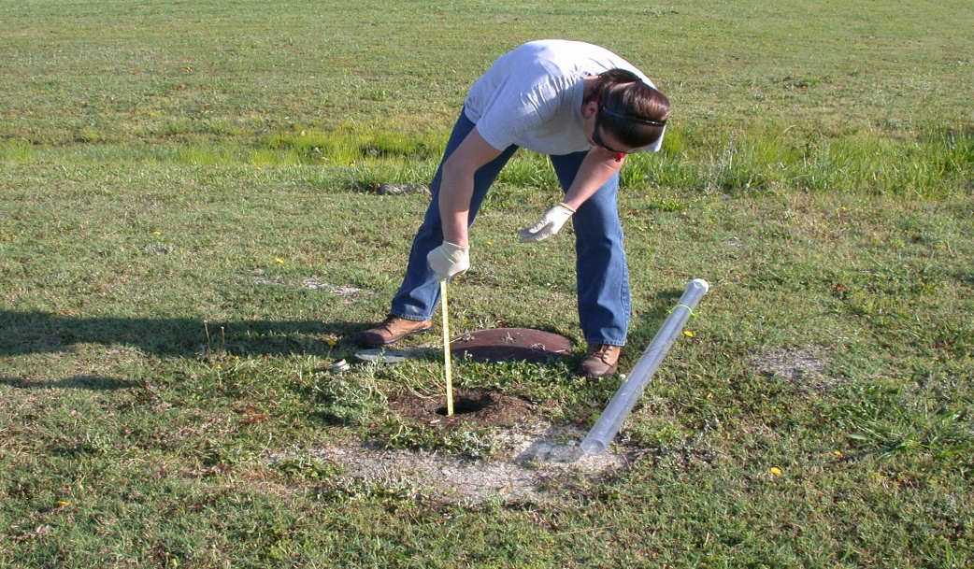
READING SQUIRT HEIGHTS
Squirt height too low
Squirt height too HIGH
Cracked pipe (leak)
Is pump functioning properly?
Correct pump?
ORIFICES PLUGGED
PIPE BLOCKED
CORRECT PUMP?
Notes:
Design plans should be able to tell you what the expected squirt height should be. However, it is best if this information was collected at system start-up and provided on a certification letter or on the final permit approval
Note that the “design” expectation is not always what is actually noted at “start-up”
Too low: leak somewhere in the system (cracked pipe) - Is the pump functioning properly? Proper amps/voltage; pump wear - is it the correct pump? Did someone replace the original pump with the incorrect model (re: GPM/TDH)
Too high: are the orifices plugged; organics will eventually plug the lats if not maintained - Is a portion of the system blocked off by solids? - is it the correct pump? Did someone replace the original pump with the incorrect model (re: GPM/TDH)

Slide 36
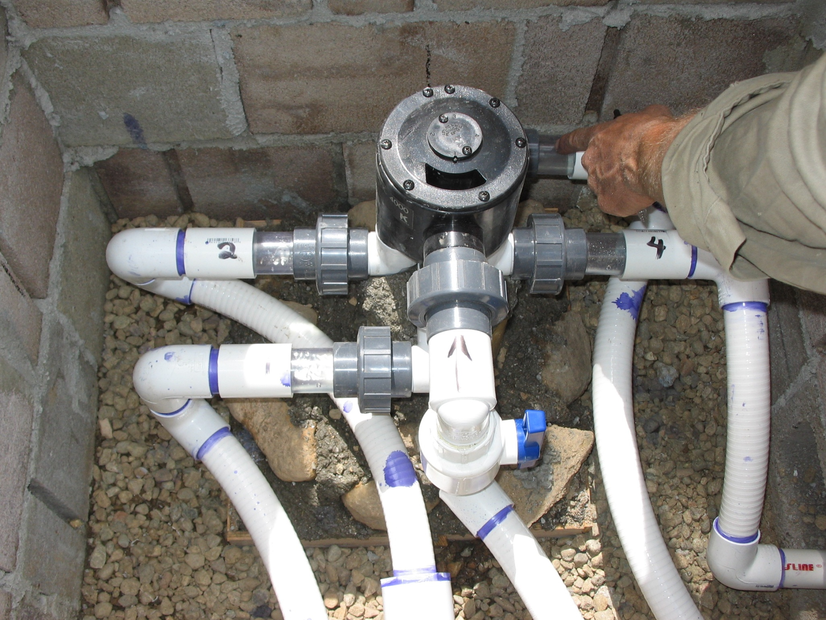
ADV: Automatic
Distribution
Valve
Notes:
Automatic Sequencing Valve – Automatic Distribution Valve allows for smaller STA cells; Unsaturated flows!! – these can help with pump sizing and other design issues -
Adopted from Irrigation Industry
Sequentially doses sections of field

Slide 37
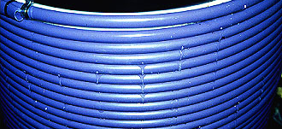
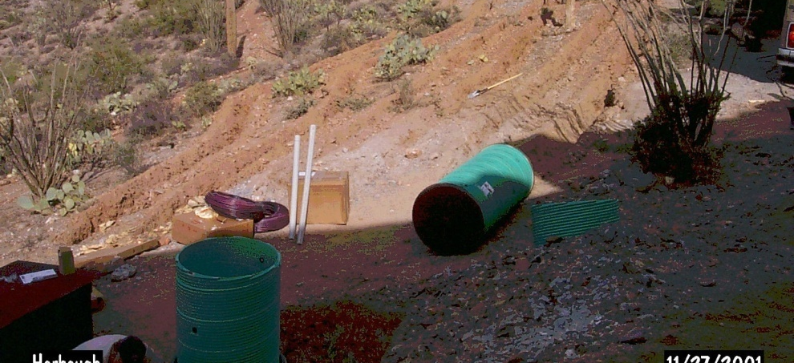
DRIP IRRIGATION SYSTEMS
EVEN AMOUNT SPREAD OVER LARGE AREA
SMALL AMOUNT
  ADDING WATER SLOWLY
  ADDING WATER SHALLOWLY
SLOPE
Notes:
Photo by Colin Bishop: in Queen Valley, you can see they hand dug the trenches for the drip lines. The drip lines aren’t in yet.
Drip systems are very popular in many areas due to their flexibility in site application – however, they are a maintenance item for sure.

Slide 38
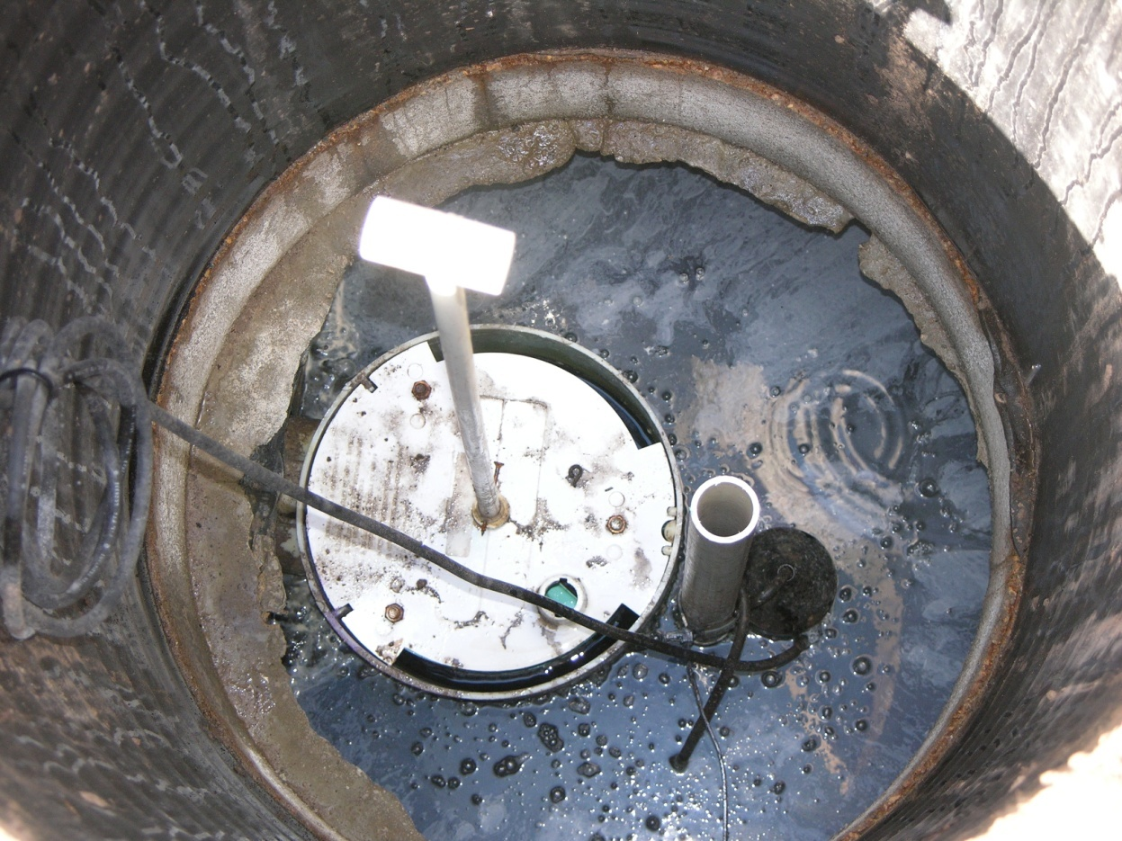
Questions

