Slide 1

Source & Flow
SYSTEM USE

Slide 2
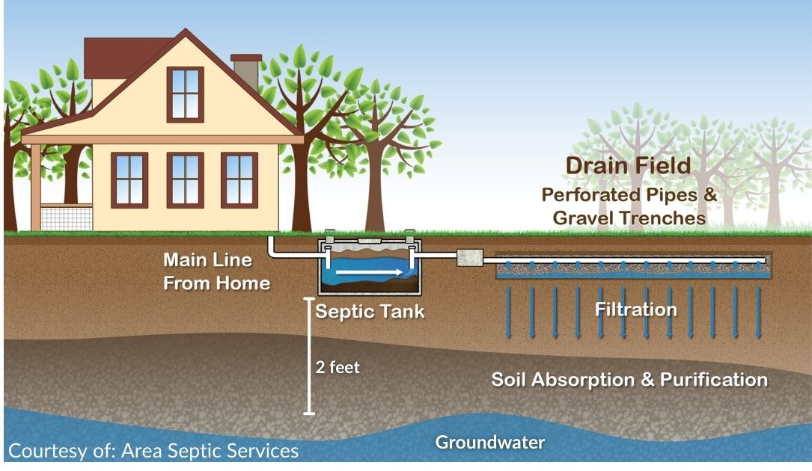
Source & Flow
Goals
What is the source – things to think about
  Residential vs. Commercial
  What is the difference
Source issues
What is sewage
How it flows
Notes:
System management and problems start in the residence and the daily sewage flow.
It is important to understand what wastewater is and where it comes from to be able to evaluate a systems functionality, especially when a component does not appear to be functioning correctly. The flows from the source will have an impact on how the system functions. Not just the amount of water flowing, but what is in the water will impact each and every component of the OWTS.
We cover these things in this talk.
What is “the source” and things to think about – the difference between residential and commercial sources (1 slide)
Then we’ll discuss issues caused by the source – with respect to system function (11 slides)
We’ll wrap up with what exactly is sewage (36 slides) and how if flow through the OTWS and the STA (10 slides)

Slide 3

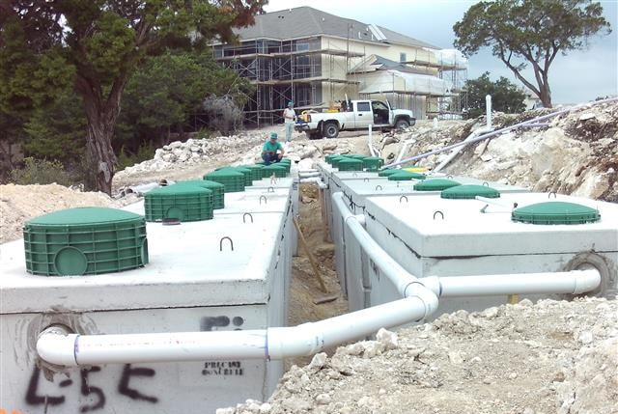
What is the “SOURCE” of an OWTS
Notes:
The source is where the wastewater is generated from – there are two primary types of wastewater sources: commercial or residential. (
Depending upon whether the source is residential or commercial will make a huge difference in what type of wastewater is generated and what the strength of that wastewater is going to be. The Strength of the wastewater is very important for design and maintenance and understanding what makes up wastewater strength is going to be very important for the OWTS practitioner.
NAWT considers the building sewer to fall under two categories – Source, where all wastewater is generated from and also a distribution component, we’ll talk more about this later.
We are going to be start by talking about some of the issues that occur in the source that may have an impact on the OWTS.

Slide 4
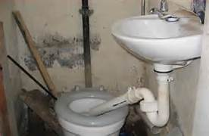
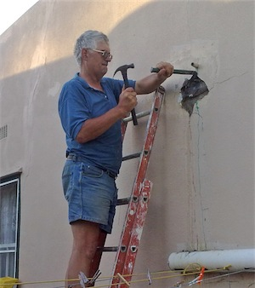
PLUMBING ISSUES
TOILETS
FROZEN VENT
  COPPER PIPE IN VENT
NEW WORK/UPGRADES
  FORGOT THE TRAP
COVERED WORK
  ABANDONED
Notes:
Plumbing can always be interesting with onsite – especially if the homeowner is a McGyver type that wants to “FIX-IT”. It’s also surprising how many actual plumbers struggle with their understanding of onsite….
Suffice it to say that all plumbing from the source needs to flow through the OWTS per most codes. There may be some legacy systems out there that will have flows separated like grey water or kitchen grease trap that flow to a separate system. You will need to know what your LPA regulations are regarding separate flows when you complete an inspection. It may be a required repair to move all wastewater to flow through the OWTS or they may allow it to stay.

Slide 5

ODORS
INSIDE ODORS
  VENTING
OUTSIDE ODORS
  SEALS
  FILTERS
Notes:
If odors from the OWTS are inside, it typically is a plumbing or installation problem with improper venting.
If outside check the seals. It also may be due to weather conditions… if it is venting off the roof as it should, the colder air may be pushing it back down and round the house… it may be necessary to install a carbon filter.

Slide 6
Tank start-up [new systems/remodels]
Toxic tank
  Cleaning chemicals
  Construction chemicals
  Paint
Other outcomes
  If first time on septic – educational opportunity
  Understanding the need for maintenance
Clean within the first three Months
Notes:
NAWT recommends following new construction and start up to pump the tank(s) in the first 1 to 3 months.
Avoid toxic problems due to any paints or solvents introduced to the system.
This can be a Marketing opportunity for the practitioner – getting to know the HO, HO education

Slide 7
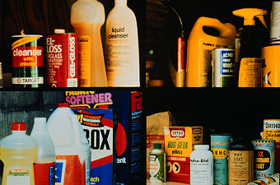
Toxic waste
pH
Low Acid
High Ammonia
Medicines
Meth Labs
Notes:
If toxic materials or drug labs are encountered notify the proper authorities, do not pump the tank if there is anything suspicious.
Meth Labs: Off color [red or orange], Ammonia odor ***4 clicks
Dialysis machines or those receiving Chemo treatments can also kill a tank
If you have ever taken the Vac Truck Training, we go into a lot of issues of “once you pump it – you own it” and it’s now your responsibility to dispose of it..
There have been studies done trying to determine if household chemicals are detrimental to onsite systems – Mark Gross – 1987 paper – AR Water Research Center – U of AR
What was found that most chemicals did not have a horrendous impact on the system when used in moderation – in fact the only chemical that the bacteria struggled to recover from was lye – drain cleaner. One concern in recent times is the overuse of antibacterial soaps, cleaners, etc. We are looking to create a bacteria environment in the septic tank, too much of these types of products will have an impact on the functionality of a system.
But things like poisons, insecticides, herbicides, etc will cause problems with recovery in the septic tank and should be avoided

Slide 8
UNDERSTAND “DETENTION TIME”
Settling time (tank capacity)
Temperature of effluent
Notes:
Detention time is settling time – that is how long the wastewater is in the tank as it moves from the inlet side to the outlet side – **click
It makes sense then that when we have an “event” where we are using or pushing water through the system that there is less detention time and more suspended particulates making their way through the tank and into the field – good argument for an effluent screen or filter.
CO regulations require minimum detention time of 48 hours
The temperature of the sewage impacts how well the bugs work – the colder the climate the less active the bugs are

Slide 9
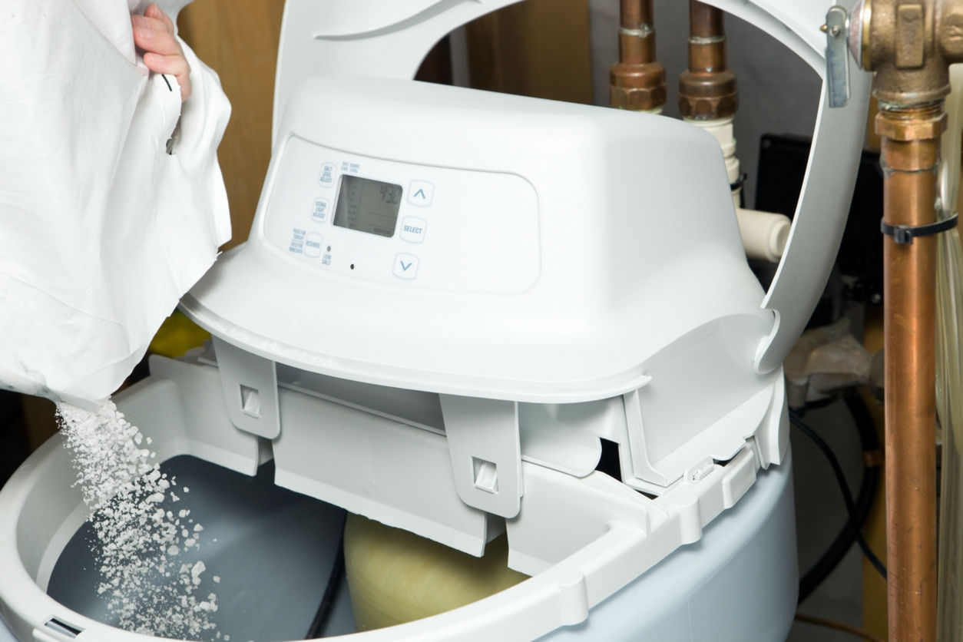
Water Softener
Regeneration cycle
Salt-concrete
Scum-separation/suspension
Additional water
Notes:
Anecdotal information from pumpers on water softener discharge. Best if it can be discharged to soil other than in the septic system. Task force is currently looking at information on softeners and recommending research to EPA to answer some of the questions.
Common sense tells us however: excess water that the system was not designed to handle, copious amounts of salt keep things in suspension and reduce the settling capacity of the wastewater and salt eats concrete

Slide 10
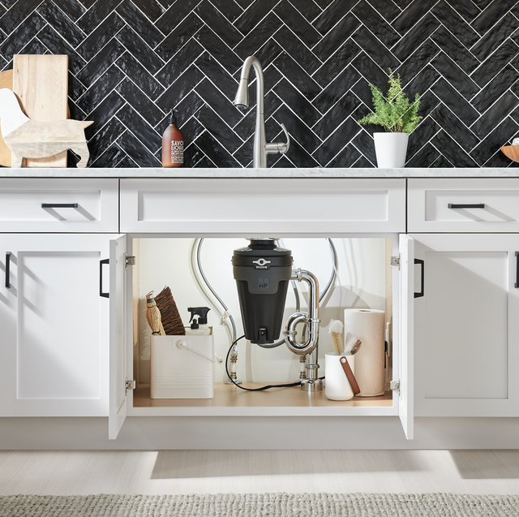
Extras
Garbage disposals
  Higher organic/hydraulic loading
  Slower breakdown/settling
Jacuzzi tub
Additions on the house
Notes:
Talk about issues related to garbage disposals. Water from large tubs can put systems over the top.

Slide 11
Mixing of tank
Problems
Solutions
Peak use
Entergy input
  Pumping to tank
  Elevation difference
    Upstairs
Temperature
Capacity
Effluent screen
Loading
Time controlled
Notes:
Summary of tank mixing problems and potential solutions if peak use and certain pumping situations are causing problems.
Peak use would be times when everyone is home and utilizing the system in one way or another – showers, laundry, dishes, toilets – typical households have two peak times – AM when everyone first gets up and PM when everyone gets home
Elevation differences – story of the Jacuzzi on the second floor of the house on the hill

Slide 12
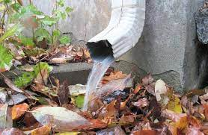
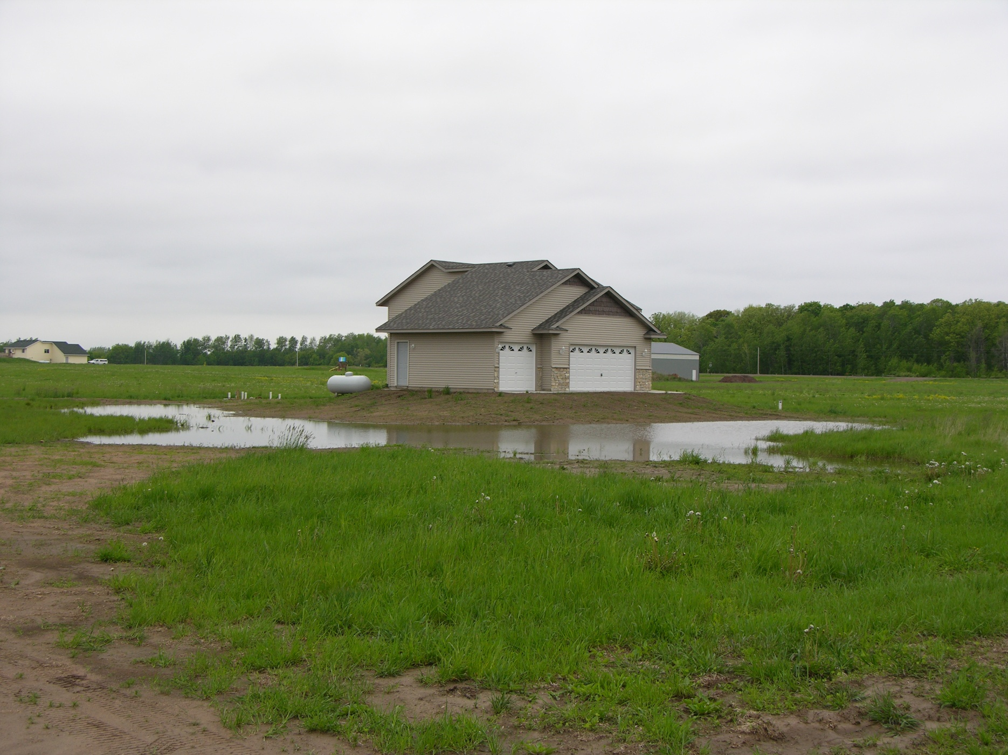
Other water sources “clean”
Drains
Sump pumps
Roof leaders
Additional water
Site drainage
Notes:
Surface drainage can add large amounts of extra water.
All these water sources should be dealt with and kept away from the system.

Slide 13
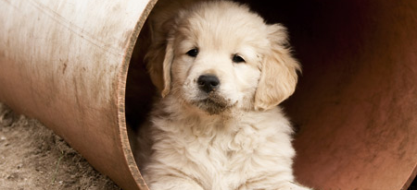
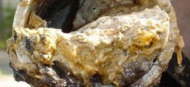
Blockage
Building sewer
Septic tank
Distribution box – drop box – adv
Frozen pipes
Animals getting into system
Notes:
Discuss aspects of potential blockages.
Line Cameras can help with these troubleshooting issues – TOOL IN THE TOOLBOX

Slide 14
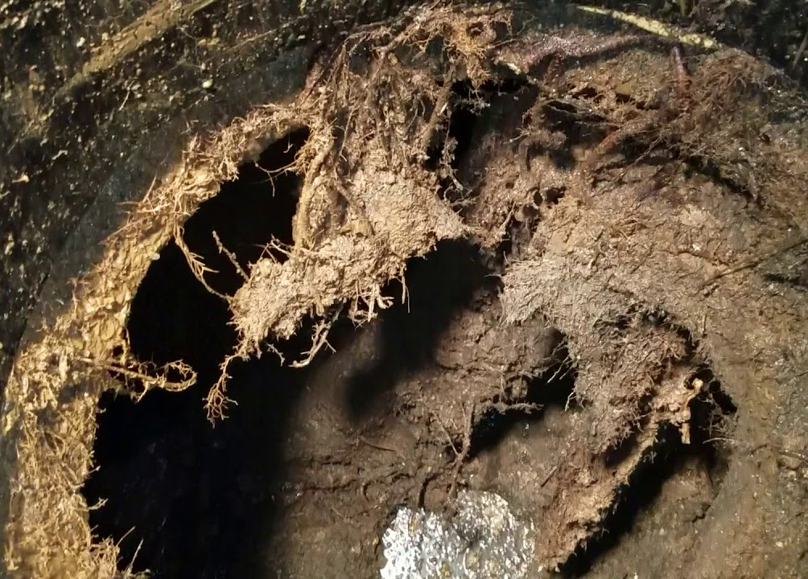
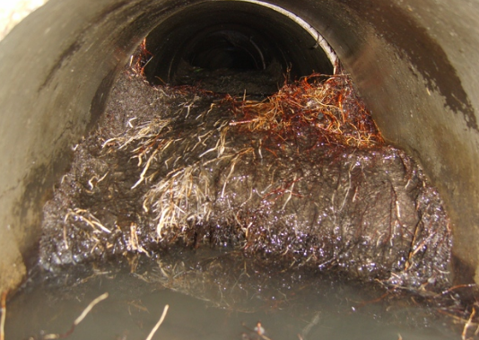
Roots
Symptom of the problem
Replace all leaky components
Soil treatment area?
  Wet?
Notes:
If roots are getting in the tank or component is not watertight, and it needs to be fixed. Generally, if system is used, they will not be a problem in drain fields. In arid zones this may not be the case. Staying away from vegetation may be necessary.

Slide 15
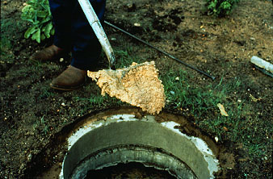
WHAT IS SEWAGE?
USED
WATER
Notes:
We always start here because it is sometimes surprising that not everyone understands sewage terms.
Today, sewage is ALL wastewater from the house – does not matter the source, it is all considered Wasted Water
Why is it important to understand flows?
Regulations – regarding flows
Designed – for flows
Troubleshooting for flows
As an inspector we are going to be determining if the water if “going away” – we cannot guarantee that the wastewater is “treating” that is for the regulators and designers to determine – however, if you understand flow and biomat development, you will have TOOLS in the TOOLBOX to help your customer with next steps.

Slide 16
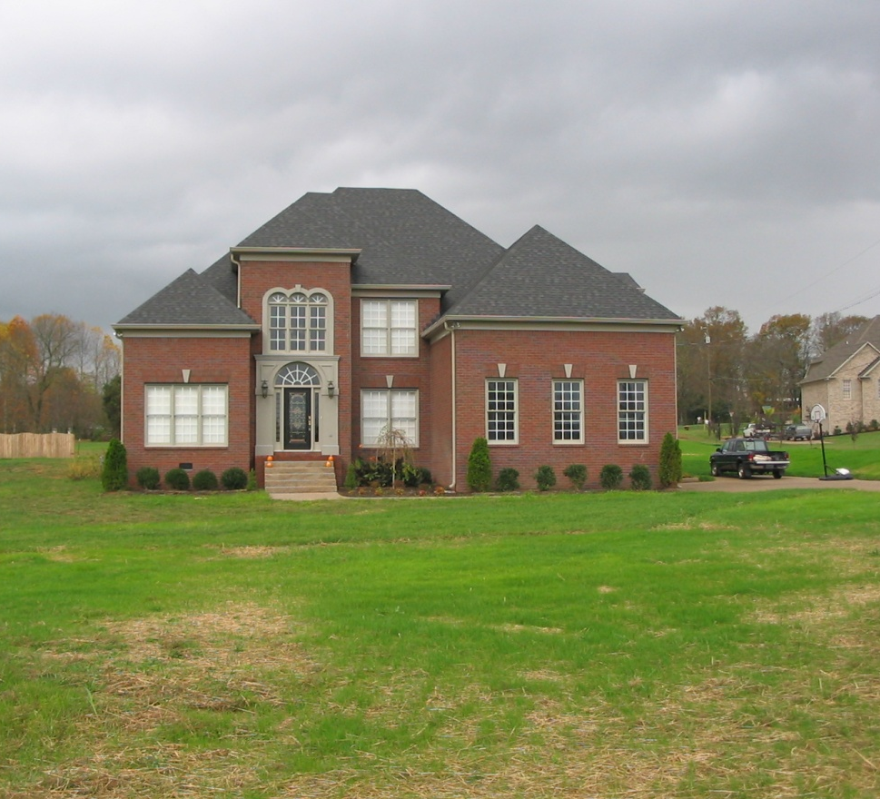
WHERE DOES IT COME FROM?
“USED” WATER
BATHROOM
  BLACK WATER
LAUNDRY
  GRAY WATER
KITCHEN
  BLACK WATER
Notes:
Sewage sources within the house.
The design of a system typically is dependent upon the number of bedrooms – it is critical during the inspection process to verify the number of bedroom – if a system is designed for 3 and the homeowner has expanded that to 5 or 6 and have filled those rooms with people that is going to be a huge impact on the system –
The NAWT Standards includes verification of the number of bedrooms for that reason!! Make sure you are checking and verifying – even if the rooms are not “full” at the time of your inspection – at some point in that systems future they could be full – even more reason to evaluate how the system is functioning
It is important to know the number of bedrooms in case you have to conduct an HLT – this test should be conducted on the number of bedrooms present to test whether the STA can handle the flow based upon the actual number of bedrooms. This is a change from past NAWT Inspector courses – but it is important to understand that the buyers is buying it assuming it will work for the number of bedrooms they just purchased. – more on this later.

Slide 17
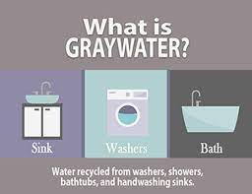
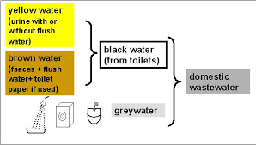
BLACK OR GRAY –
THE PROBLEMS ARE THE SAME
Graywater does not include wastewater from toilets, urinals, kitchen sinks, dishwashers or non-laundry utility sinks
Notes:
Graywater” means that portion of wastewater that, before being treated or combined with other wastewater, is collected from fixtures within residential, commercial, or industrial buildings or institutional facilities for the purpose of being put to beneficial uses. Sources of graywater are limited to discharges from bathroom and laundry room sinks, bathtubs, showers, and laundry machines.
Graywater does not include the wastewater from toilets, urinals, kitchen sinks, dishwashers, or non-laundry utility sinks.
NAWTs position on Gray Water is that it is the same as Black Water
Gray water needs to be treated also! - Showers, laundry and lavatory wastewater is not actually clean water.
Bacteria levels almost as high as black water.
Reason clothes are in contact with us. If we have a virus, throw up on our cloths or bedding, kids pooping in their cloths – all contribute to bacteria levels in laundry and shower wastewater
Often homeowner will think if they are having problems that just running the wash water out is a good solution to their problems.
Some states and jurisdictions do have the ability to collect and reuse these water sources. There may be a specific regulation for graywater reuse – check your local LPA
In CO it is governed under Reg 86 Graywater Control Regulation – and it still has to receive a certain amount of treatment before it can be reused for irrigation.
Most locations need to make this decision in the construction phase – once the plumbing is put in it is very difficult to separate wastewater streams retroactively
Note that local agencies need to adopt a local graywater regulation that is at least as stringent as Reg. 86 before a graywater system could be installed in that jurisdiction

Slide 18
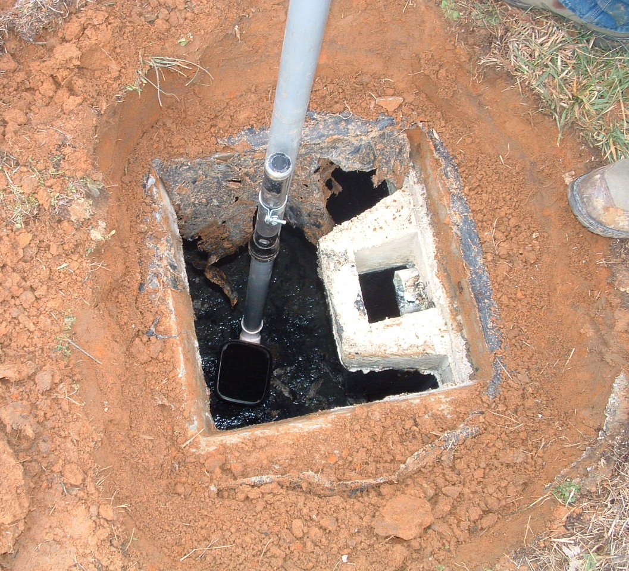
Sewage composition
Organics
Inorganics
Nutrients
Pathogens
Chemicals
Notes:
(Keep the discussion brief on this page as we will be discussing each of these constituents in detail on upcoming slides)
We are going to discuss what makes up sewage – what its composition is
We’ll be discussing each of these individually

Slide 19
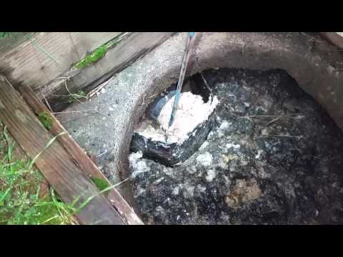
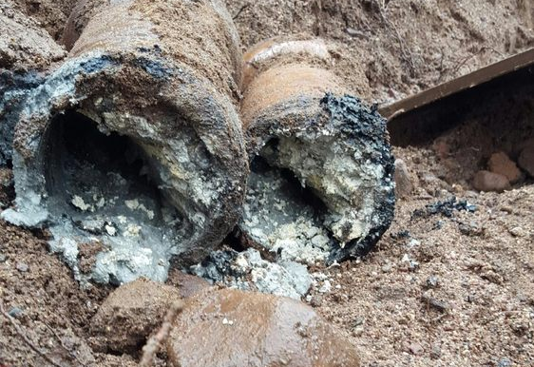

High strength waste what it is and how it impacts the system
BOD
FOG
TSS
Notes:
OWTS designs deal a lot with anticipated waste strength – so having a basic understanding of where it comes from and how it is developed is going to be vital to the OWTS Inspector – more for potential troubleshooting problems than actual inspection protocol or processes.
Residential High Strength is much different than High Strength waste such as from restaurants or bars are special problems.
If you’re seeing HSW that equal restaurant values in a resident – that tells you something.

Slide 20
Sewage composition
Organics
Inorganics
Nutrients
Pathogens
Chemicals
Notes:
Keep the discussion brief on this page as we will be discussing each of these constituents in detail on upcoming slides
First, we’ll discuss the Organic and Inorganic components of sewage.

Slide 21
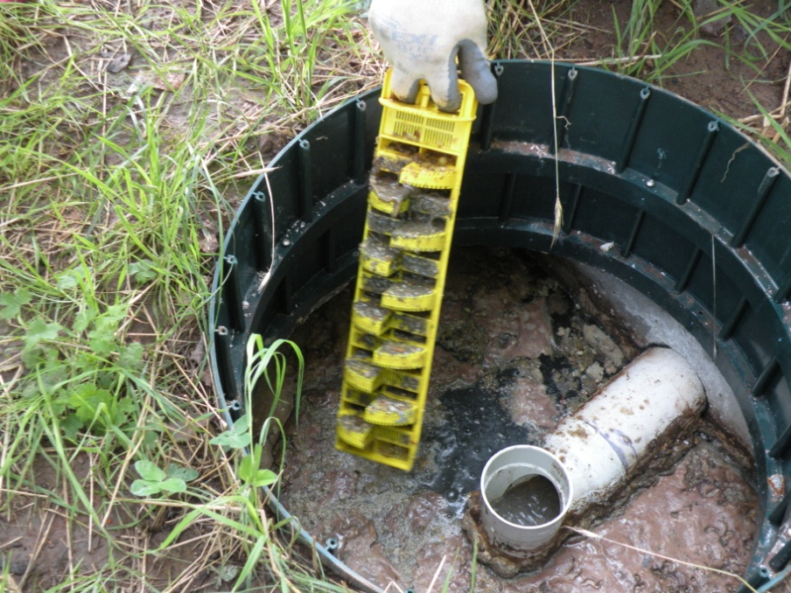
Organic & Inorganic loading
Bod5
  Biochemical Oxygen Demand
  Measure of biological activity
TSS
  Total suspended solids
    Organic vs Inorganic
Fog
  Fats, oils & greases
Treatment
  Captured in the tank
  Treated with advanced treatment units
  Filtered in the soil
Notes:
These are the culprits for Organic and Inorganic loading – all but TSS are going to be Organic in nature, TSS is going to have organic and inorganic componets
BOD5 is a 5-day test to determine how much oxygen is consumed by the bacteria over that time period – this is an inverse relationship to dissolved oxygen (DO) – basically, when you have high BOD, you’re going to have low DO and if you have high DO, you’re going to have low BOD – this can be helpful when you’re evaluating advance treatment units
TSS is the floaties that we want to keep in the tank due to potential clogging of components downstream and the soils in the STA
FOG is Fats, Oils & Greases – these can tell you a lot about household habits; typically, from the kitchen. How do they handle their grease? (Discuss as appropriate)
And we’ll talk about what treatment occurs within the different components of the system later in the class

Slide 22
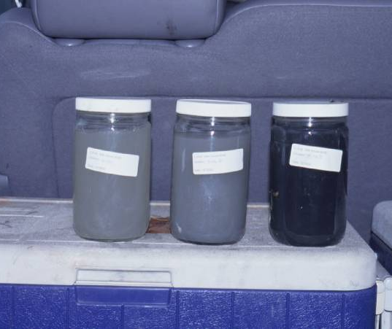
Solids: organic loading
BOD5
  Biochemical Oxygen Demand
  Bacteria digest the organic material while consuming oxygen
  5-day test of how much oxygen is used/consumed to break down material present
  <170 mg/l is a value coming out of a typical domestic septic tank
  Higher the number the dirtier the water is – the stronger the waste
    Fast food restaurants ~1,500 mg/L
  Note: this is opposite of dissolved oxygen (do) –
    if you know one value to have a good idea of the other!
Notes:
BOD is the most common test to determine waste strength. This is that 5-day test to determine how much oxygen is being consumed or depleted by the bacteria. The larger the number the higher the waste strength, the more important it will be to clean up the water prior to introducing it to the soils in the STA or final treatment
Through research we have found that typical residential BOD coming out of a domestic septic tank is <170 mg/l. It’s about 250 mg/l going in. So, you can see right away there is treatment going on in the anaerobic septic tank to knock that down. That’s the bugs doing their job.
There is an inverse relationship between BOD and DO (dissolved oxygen) – when one is high the other is low – so if you are expecting high DO number and you get low, you can assume (or test for and prove) that the BOD is high. This is helpful when you have ATUs that utilize aerobic microbes to treat the wastewater.

Slide 23
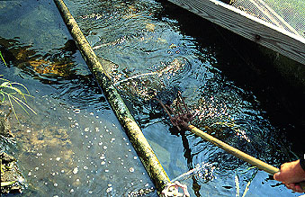
BOD5
Biochemical Oxygen Demand
Amount of oxygen used by bacteria to digest
CBOD is different
Typical amount: 170 mg/L
Biomat development
Recoverable
Fix
  Use
  Maintenance
  pretreatment
Notes:
Quick summary of BOD and its impact on an OWTS – gives us the best test for waste strength – we expect to see BOD coming into the tank at approximately 250 mg/l and leaving the tank at approximately 170 mg/L. This helps illustrate that the wastewater is beginning the treatment process in the tank.
It has a direct impact on the development of the biomat in the field – the higher the BOD, the faster the biomat will develop or the thicker it will get – a little bit of biomat is a good thing, too much is a bad thing – we will discuss this further in a bit.
Any type of “organic” overload has the potential to be recovered or fixed – just depends on how willing and how much time the homeowner is willing to give the system to recover.
BOD should not be confused with CBOD: Carbonaceous biochemical oxygen demand or CBOD is a method defined test measured by the depletion of dissolved oxygen by biological organisms in a body of water in which the contribution from nitrogenous bacteria has been suppressed.
BOD5 is the test that determines how much oxygen is used by the bugs – the higher this number the less dissolved oxygen there will be (that inverse relationship). Also, the higher the number the stronger the waste and the more problems the system may be having.

Slide 24
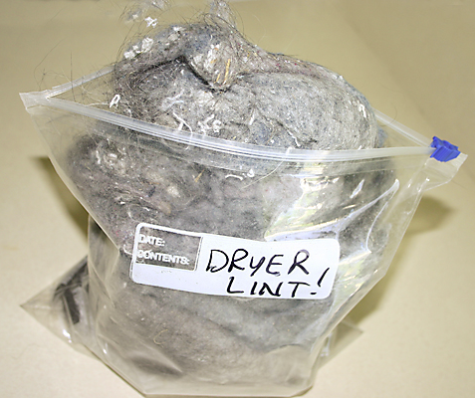
Solids: organic loading
TSS
  Total Suspended Solids
  Measures both organic and inorganic solids which have not settled out (lettuce, polyester, dirt, etc.)
  < 60 mg/L is a value coming out of a typical domestic septic tank
  Settled in the tank and filtered in soil –
    inorganic material can cause plugging in the soil pores
Notes:
TSS is anything solid that stays in suspension and potentially can float or migrate downstream into the next component or final treatment.
The typical amount of TSS coming into a tank can range from 155 to 330 mg/L, average 250 mg/L – coming out of a domestic septic tank is about 60 mg/l. And can be lower if an effluent screen is utilized which have proven very effective in collecting the TSS and removing from the waste stream before it become problematic downstream..
The organic TSS is less of a concern because by its organic nature, it has the ability to be consumed by the microbiological community in the following components and final treatment or STA.
The inorganic TSS is much more of a problem because it is synthetic and will never be consumed by the biological community.

Slide 25

TSS
Total suspended solids
Organic
  Paper
  dirt
Inorganic
  Synthetic material
Typical amount out: 60 mg/l
Physical plugging
Fixable??
  Avoid, especially inorganic TSS
  Effluent screen
  maintenance
Notes:
Total Suspended Solids can be organic or inorganic
If organic TSS makes it to the field, there is a chance that it will eventually decay and desiccate and go away – Inorganic TSS – synthetic fibers and such will not they will just plug the pore and damage the STA
Total Suspended Solids can be organic or inorganic
If it is inorganic and physically plugs the soil pores it may not be recoverable.
If organic TSS makes it to the field, there is a chance that it will eventually decay and desiccate and go away – Inorganic TSS – synthetic fibers and such will not they will just plug the pore and damage the STA

Slide 26
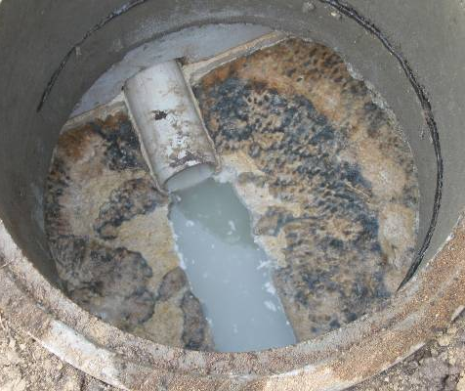
Solids: organic loading
FOG
  Fats, Oils, & Greases
  Fats are animal based and solid at room temperature
  Oils are vegetable based and liquid at room temperature
  Greases are petroleum, burnt fats, and oils
  <25 mg/L is a value coming out of a typical domestic septic tank
Notes:
Fats, Oils, and Greases are going to be problematic downstream from the septic tank. They goo components up including the pore in the soil at the final treatment. It is best to get them removed early in the treatment train, or better yet, educate the homeowner on not putting them into the system in the first place.
The typical amount of FOG coming into a tank can range from 50 to 150 mg/L, the value will vary greatly depending upon usage – coming out of a domestic septic tank is typically less than 25 mg/l. And can be lower if an effluent screen is utilized. Effluent screens have proven very effective in collecting and removing the TSS and FOG from the waste stream before it become problematic downstream..
FOG also is removed when the tank is large enough to allow for significant detention time, the time the water remains in the tank to allow for the separation process to work, The larger the tank, but more chance the FOG will have to coagulate and float to the top.

Slide 27
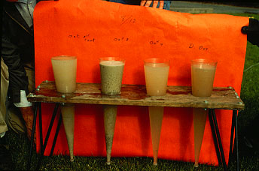
FOG
Fats, oils, and greases
Fats
  Animal/solid
Oils
  Vegetable/liquid
Greases
  tougher
  Burnt fats/oils
Typical amount: 25 mg/l
Be aware of what is put into system
Use
  Degreasers
  Temperature
  Pretreatment
Notes:
FOGs will always be a problem down stream, it is necessary to capture them before they make their way through the entire system
According to industry standards, FOG needs to be less than 30 mg/l coming out of the septic tank, but more desirable to be less than 20

Slide 28
Restaurant results
170
60
25
Type of Restaurant
# of Restaurants
BOD5 mg/L
TSS
mg/L
FOG
mg/L
Fast Food
8
1286
202
282
Service
5
1130
213
219
Golf Club
4
1010
142
200
Bar
3
874
184
132
Notes:
Looking at the different waste composition differences between commercial and residential
This graph shows you what they found for BOD, TSS and FOG coming out of commercial sources – primarily restaurant type sources
High BOD from bar without food is due to alcohol which does not settle out.
Remember the domestic values for each of these – 170, 60 and 25
This highlights why commercial OWTS are much tougher to deal with than domestic

Slide 29
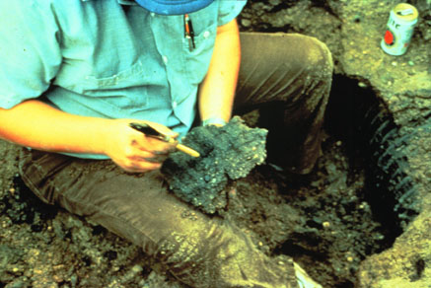
Biomat = BOD – O2
TSS = Plugging
Notes:
We are going to discuss BIOMAT for a minute.
(Always joke here as the biomat is discussed that if you use the right beverage, you can get anyone to do about anything! )
Biomat is a naturally occurring process and is a connected to the amount of organics that make their way through the treatment train to the final treatment. Depending upon the type of OWTS you have (standard, HLT systems, commercial, pressure distribution, etc…) will determine the type of development you would expect to see over time
Note that at some point, the Biomat reaches an equilibrium; which allows for slowly dripping the effluent through to the receiving soils, vs. totally plugged and ponding
TSS can present plugging problems if it is inorganic material or synthetics that are slow to break down; if at all

Slide 30
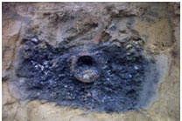
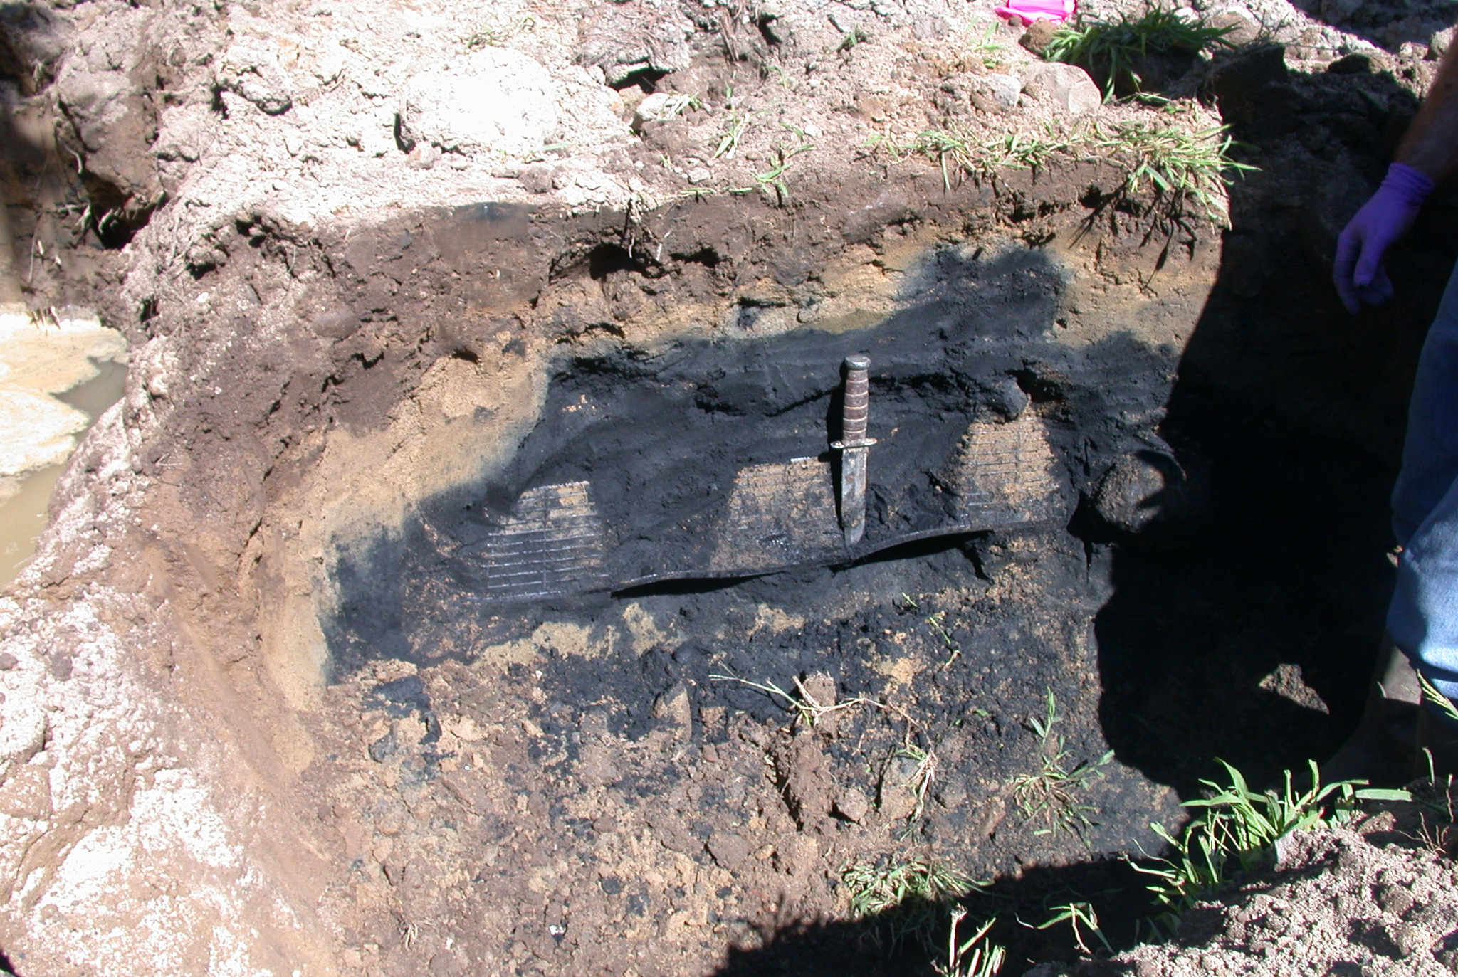
Overactive Biomat Development
Notes:
These are examples of biomat out of control. Doesn’t matter if it is chambers or rock. Extreme organic overload.
The organic loading in this system created an over abundance of biomat development, which in turn created excessive ponding, which in turn created an anaerobic environment in the soils sucking the oxygen out of the soils and making it black – it’s a process
The black is where the oxygen has been depleted out of the soil. This material is typically a slimy substance, and it inhibits the water from moving through the soil pores and what water does get through typically has not had the pathogens removed
The left is a rock and pipe failed trench, and the right is an oversaturated chamber

Slide 31
How does unsaturated flow in the STA happen?
Unsaturated flow is key to treatment
Biomat formation
  BOD concentration
  Oxygen relationship
  TSS
Water needs to slowly pass-through soils for treatment
Benefits of pressure distribution
Notes:
Water Flow through Septic System Drain fields
Although wastewater application to the drain field of gravity-fed septic systems is different than pressure dosed ones, the soil hydrology at the site is the same for both types of wastewater application. In order for a soil treatment area to function properly, all the wastewater applied to the system must infiltrate the soil in an unsaturated condition and move away from the soil treatment area without surfacing. This process takes place in three stages.
First, all the wastewater applied to the trenches daily must infiltrate the soil within a 24-hour time period. Otherwise, the soil treatment area of the system will eventually fill up and wastewater will surface over the soil treatment area or sewage will back up into the dwelling.
Second, wastewater entering the soil through the sides and bottom of the trenches must move vertically through the least permeable layer near the bottom of the trenches before reaching an impermeable layer (e.g., bedrock) or water table. If the area application rate of wastewater to the drain field is greater than the rate of vertical water flow through the least permeable layer below the trenches, the soil immediately under the trenches become saturated resulting in hydraulic and/or treatment failure of the system (remember the black trench we just looked at).
Finally, wastewater reaching the impermeable layer or ground water under the drain field must move laterally away from the system. Ground water mounding (which is essentially localized rise in the water table immediately below the drain field) occurs when the amount of wastewater applied to the drain field exceeds the total lateral flow from the area. Treatment of wastewater by soil may cease if the mounding reaches within a certain distance (e.g., 30 cm) below the bottom of the trenches, or the system may fail hydraulically if the mounding reaches the trenches.
Benefits of Pressure distribution is that the effluent is introduced to the soil at a rate that it can deal with without the development of the biomat to slow things down.

Slide 32
Flow pattern through a gravity trench
Beginning of biomat growth
Middle age of biomat growth
Mature biomat growth
Biomat moves the water
Adding Effluent to the System
Growth of the Unsaturated Zone
Mature Biomat
Notes:
In a gravity system (either trench or bed)
Effluent is added to the system and the biomat will start to develop. This development is a factor of the waste strength (organic load) in the effluent. The more BOD, the higher the waste strength, the faster development of the Biomat.
In a gravity fed system wastewater always enters the beginning part of each trench. If the applied wastewater cannot infiltrate the soil within the first few meters of the length of the trench, it will flow by gravity along the trench until the surface area of infiltration matches the ratio of the volume of applied wastewater and the average infiltration rate of wastewater into the soil from the bottom and side walls of the trench. As the time progresses, due to the ponding of wastewater at the beginning of the trench, a biological mat (also called biomat, clogging mat or biological clogging mat) will be created at the interface of gravel and soil in the trench (see Siegrist, 1986). With time, this biological mat may eventually cover the entire length of the trench and result in a substantial reduction in the infiltration capacity of the trenches.
Surfacing of wastewater over the drain field and/or backing of sewage into the dwelling occurs when the trenches of a septic system fill up and the volume of wastewater applied daily to the trenches can no longer infiltrate the soil within each 24-h period.
The biomat will develop along the bottom of the systems first. As the biomat grows down the trench or line, it pushes the saturated flow down the trench to create more biomat.
The front edge of the flow is highly saturated, and under the biomat the flow is unsaturated; basically, dripping into the receiving soil (equilibrium). Similar to a pressure dosed system rate.
A little biomat development is necessary and vital for two reasons – it forces the flow down the line or trench AND it also provides a filtration system for the ongoing application of wastewater which slows the flow into the soils and creates that unsaturated flow we need to have for treatment
A mature biomat extends along the bottom of the system and will begin to develop along the sidewalls.
This will appear as ponded effluent in the system. When the biomat is developed the flow under the trench is unsaturated
The unsaturated flow through the soil pores is the key to treatment
If the system is too small or too much organics (high strength waste) the biomat will be a problem and hydraulic failure will occur

Slide 33
Flow pattern with pressure distribution
Beginning use of pressure distribution
On going use of pressure distribution
Biomat~ Uniform minimal distribution
Created by the Pump
Proper loading rate
Maintains Biomat development
Notes:
In a pressurized system – the application rate and being able to utilize the entire STA right from the start helps these systems be more efficient than a gravity system.
Instead of relying on the biomat to produce unsaturated flow, the rate of application in a pressure distribution system is controlled by a pump and the distribution piping.
This produces a loading rate across the entire STA which maintains unsaturated flow. If the loading is too high an anaerobic biomat will form and the system will fail.
Pressure distribution moves the application of the effluent to the pump; thus, the soil receives the effluent at a rate that the it can accept; an unsaturated flow
In many PD systems, the biomat is very minimal, if any

Slide 34
Biomat & sidewalls
Biomat develops along the bottom and then around the trench
Ponding levels use the sidewalls
Excessive ponding depths creates saturated flow
Narrower trenches allow for more surface area vs. wide beds
Narrower & shallower allows for better o2 exchange
Notes:
A big part of the treatment in the soils relies on the air exchange in the soils – the more the oxygen can penetrate the soils and feed the microbiological community the better they can treat the water.
Through science we have found that narrow trenches as opposed to wide beds encourages that air exchange and allows for better treatment
The movement thru the side walls is through matrix potential described earlier
But again, too much biomat development can be detrimental to the functioning of the trench

Slide 35
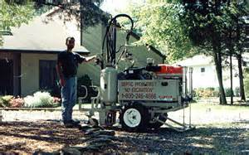
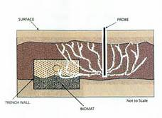
Influencing the biomat
Good
Loading
  Hydraulic
  Organic
Resting
Depth of cover
  Oxygen availability
Bad
Peroxide
Acid
Terra lift???
Managing the STA
Notes:
How do we influence the biomat
The use (loading hydraulically & organically) of the trench will impact LTAR
The amount of effluent and the organic strength influence life and biomat thickness
The resting of the system can make the system operate longer and more effectively
The biomat can be managed to increase treatment efficiency. This can be done by controlling loading, resting and installing the system where natural aeration is effective.
In order for a system to function hydraulically, the rate of potential infiltration at any location within the trenches must not exceed the calculated rate of infiltration based on the design daily flow for the system. Basically, it has to be able to absorb faster than the amount of wastewater it is receiving. This is why the designers calculate “daily flow” or “peak flow” to determine the size of a system.

Slide 36
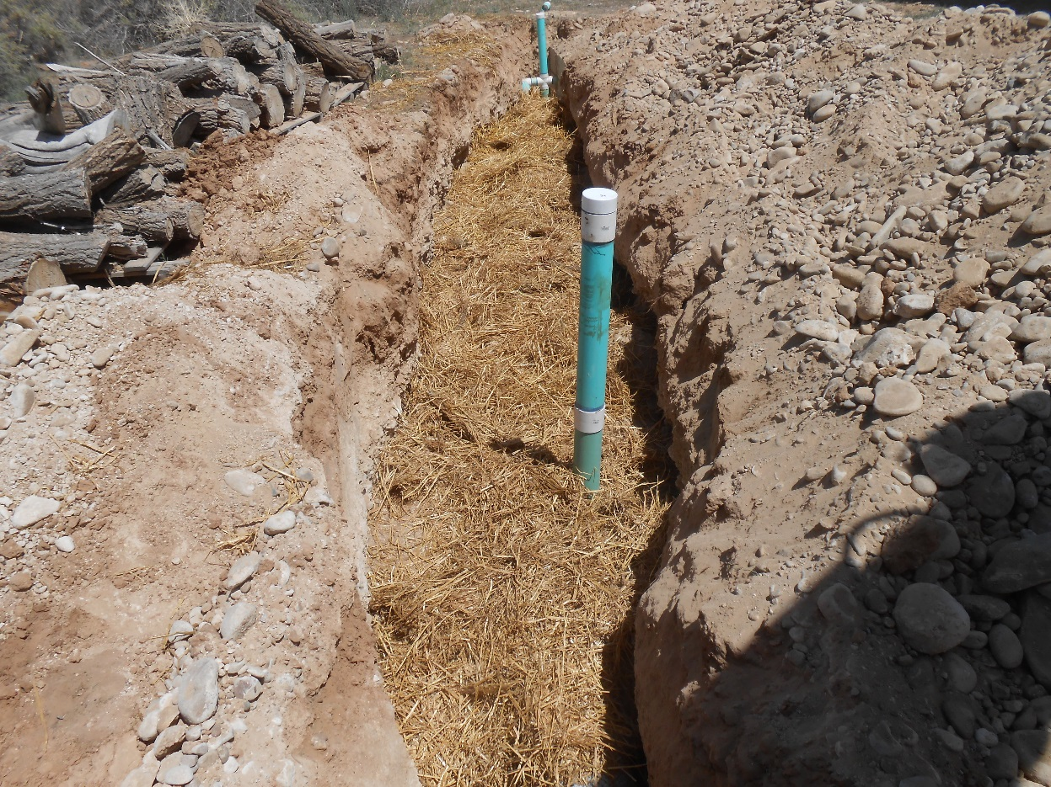
Soil Treatment Area sizing
Sewage effluent characteristics
  BOD, TSS & FOG
Soil properties
  Texture
  Structure
  Consistence/minerology
The biomat
Notes:
The size of the STA is based on the acceptance of the water and the waste strength of the sewage – this equates to the LTAR – long term acceptance rate.
The Long-Term Acceptance Rate is the anticipated time that the system will be able to accept effluent – LTAR’s have been studied with the different types of soils and there are charts to help designers determine what type and what size a system has to be to work well into the future. These are typically found in regulation

Slide 37
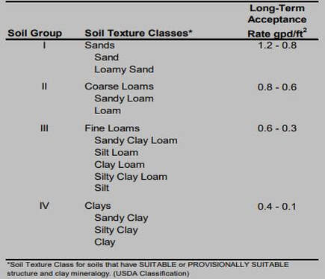
Long Term Acceptance Rate (LTAR)
The biomat controls the ability of the soil to accept effluent – this is LTAR
Generally state codes dictate LTARs
Soil type helps determine LTAR code
Texture/structure
Percolation rates and soils morphology
Soil horizons
Notes:
When the biomat formation is in equilibrium with the biomat breakdown it equals the Long-Term Acceptance Rate.
Ksat is the ease with which pores in saturated soil transmit WATER – effluent has organics which create the biomat and therefore slow the rate that water can move through the soil pores – so they are not the same, and should not be confused
Saturated flow is much faster through soil pores.
The soil characteristics such as texture and structure, determine the rate of WW movement.
How much effluent that will be accepted over the entire area
Loading rates are mostly based on soil texture and structure.
Perk test and soil morphology (visual/tactile analysis) are a couple of methods to identify the texture. Many areas across the county have moved to requiring a V/T evaluation to determine soil type as opposed to the percolation tests. Though there are still areas that utilize the perc tests for system sizing.
Relating the soil layers and identifying where problems can be anticipated are critical for good decision making when it comes to soil treatment.

Slide 38
Sewage composition
Organics
Inorganics
Nutrients
  Phosphorus
  nitrogen
Pathogens
Chemicals
Notes:
Our next item in what makes up sewage is related to “nutrients”
Nutrients of primary concern are Nitrogen and Phosphorus.
N a ground water problem and P a surface water problem.

Slide 39
Nutrients
Nitrogen – ground water
Phosphorus – surface water
While soluble forms of phosphorus are negatively charged, they effectively attach to soil particles by forming chemical bonds
Dissolved phosphorus is effectively attached to chemicals elements in the soil; is not much of an issue in groundwater
However, in saturated conditions the dissolved phosphorus is carried away by the moving water
Ammonium (NH4+) is the main form in the septic tank
In the aerobic STA, almost all of the NH4+ is quickly converted to nitrate (NO3-)
As soil surfaces are negatively charged, any remaining NH4+ attaches to the soils – it’s the negatively charged nitrate that does not attach and continues down that is a problem
Notes:
Why we worry about these nutrients - N is a ground water problem, and P a surface water problem.
We worry about N and blue baby syndrome or methemoglobinemia (met.hee.muh.glow.buh.nee.mee.uh). This occurs when nitrate is converted to nitrite in the body and then binds to hemoglobin preventing it from effectively carrying oxygen in the blood.
Phosphorus in surface waters contributes to algal blooms which causes reduced water clarity and low dissolved oxygen levels. The algae consumes the oxygen in the water as it decays. This is often referred to as eutrophication and is a major concern for water quality in lakes, rivers, and streams.
How nutrients move through the soil profile
So, it’s the nitrate that contaminates ground water and it’s in saturated conditions that phosphorus becomes an issue for surface water

Slide 40
Step 1
Step 2
Step 3
Step 4
NO3--> N
Denitrification needs
Low DO
Food {BOD or organic matter}
Bacteria
Notes:
Discuss the Nitrogen cycle. For denitrification to occur low oxygen, some organic matter and bacteria. We can actually create these conditions in re-circulating filters or mound systems.
The four main steps are: - ((**5 clicks))
Nitrogen fixation – chemical process – molecular nitrogen (N2) is converted to ammonia (NH3)
Ammonification/decay – chemical reaction where ammonia (NH3) is converted into Ammonium (NH4+)
In the septic tank the anaerobic conditions convert the ammonium into Nitrate (N03)
Nitrification occurs when oxygen is added; typically, in the STA, or more fully nitrified in an ATU or packed bed filter – the biological oxidation of the ammonium to Nitrite (NO3-N)
Denitrification usually will involve a recirculation system that returns the nitrified wastewater back to an anaerobic source such as the septic tank to complete the cycle
The nitrogen is then converted into nitrogen gas and is discarded into the atmosphere

Slide 41
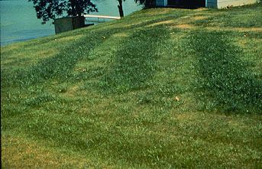
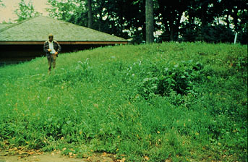
Plants Help
BUT can’t do it all
Notes:
Some nitrogen and phosphorus will be taken up by plants and grasses; but in general, it is a small portion

Slide 42
Dealing with nutrients
Phosphorus
Nitrogen
To increase treatment and the likelihood of phosphorus being retained in the soil:
  Need soils with high clay content – slower water movement, more soil surface area
  Red soils – high iron content
  Well-drained soils – deep water tables
Shallow systems allow for root uptake
Shallow systems allow for utilization by micro-organisms in the soil profile (unsaturated)
Denitrification requires:
  Organic matter
  Anaerobic conditions
  This process converts a large port of the nitrogen to nitrogen-gas (n2)
Notes:
These are some of the ways we deal with nutrients in the water

Slide 43
Sewage composition
Organics
Inorganics
Nutrients
  Phosphorus
  nitrogen
Pathogens
Chemicals
Notes:
Moving on to another item that makes up sewage: Pathogens

Slide 44
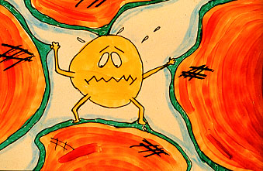
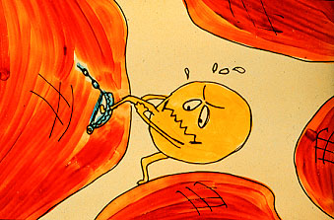
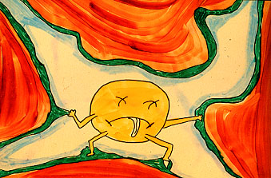
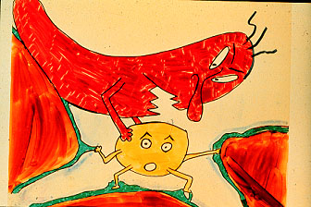
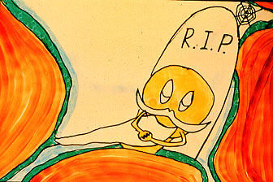
BACTERIA
Some are pathogenic
They will have different degrees of negative charge
Survival depends on:
  Moisture conditions
  Availability of carbon (food)
  pH of soil (6-8)
  Aeration
  Ability to compete with other bacteria
Removal depends on:
  If they attached or are filtered by the soil
    Fine textured soils are good at this but must still allow for effective water movement (unsaturated flow)
  Growing conditions – oxygen, temperature, etc.
  If they are able to compete with the native soil organisms
    Negative aerobic bacteria will out-compete anerobic
Notes:
If water movement is around the soil pores, bacteria and virus can be captured by a variety of mechanisms. If the soil is saturated the bacteria and viruses are pushed past these mechanisms before treatment can be completed – or the saturation has inhibited the mechanism to do its job
Soil bacteria secrete sticky slimes where the bacteria can stick to, or be captured;
Clay soil particles have negative electrical charges where dissimilar charges will attract like magnets. Bacteria can be both positive or negatively charged
Once captured they lose ability to infect, they die off or are a part of the food source for other organisms.
They are out of their comfortable environment and are cannibalized by the soil bacteria, which are in their element

Slide 45

PATHOGENIC BACTERIA
E-COLI GASTROENTERITIS
SALMONELLA TYPHI TYPHOID FEVER
SALMONELLA SALMONELLOSIS
SHIGELLA SHIGELLOSIS (DYSENTERY)
VIBRIO CHOLERAE CHOLERA
Notes:
These are some of the more common bacteria we are targeting for treatment with an OWTS

Slide 46
Sewage composition
Organics
Inorganics
Nutrients
  Phosphorus
  nitrogen
Pathogens
Chemicals
Notes:
The final component of sewage that we are going to discuss is chemicals

Slide 47
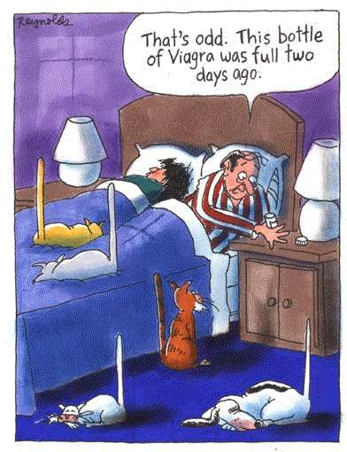
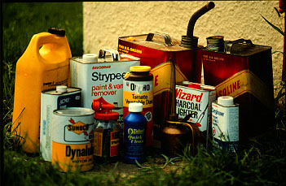
Chemicals and medicines
Notes:
Harsh chemicals, paints, solvents, etc, should be kept out of the system
Household chemicals – cleaners, soaps, bleach, etc can be used in moderation – as they were intended – excessive use can cause issues with the system. Household chemicals are usually used to kill bacteria and viruses so if they are used in excess, they will have an impact on the functionality of the OWTS.
Medicines need to be kept out as much as possible – but what travels through the human body cannot be controlled – DO NOT FLUSH MEDICINES DOWN THE TOILET

Slide 48
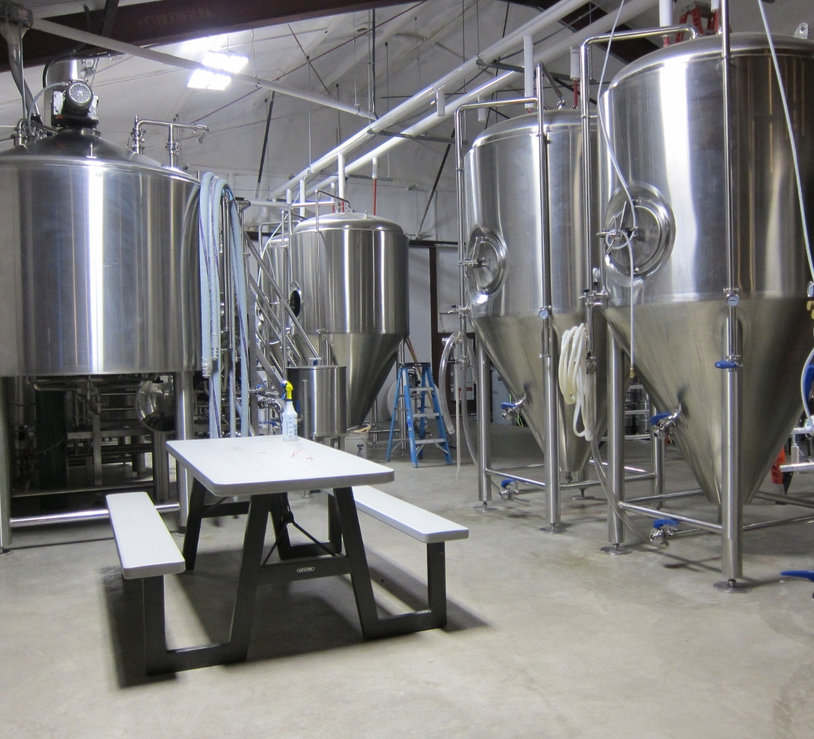
CLASS V Injection Wells
EPA Terminology
System with chemicals
Service stations
Industrial users
Other
Notes:
If there are oils from truck or car washing or service bays these need to be handled differently.
Recognize these are in a different category and under a different regulatory system. Usually considered under hazmat laws and regulations
This photograph shows a micro-brewery; which would be determined as a process waste
EPA will typically issue either an “authorization”, or a permit by rule.
Note however that in Colorado, the local OWTS permitting agency may also issue a local OWTS permit for the system (43.8.L)

Slide 49

What is the “FLOW”
WHERE DOES THE WASTEWATER COME FROM??

Slide 50
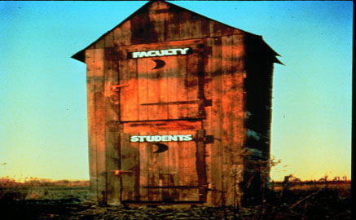
What are the problems?
Leaks
  All bad
  Repair when identified
Use
  Varies by fixture
Notes:
The final piece is water use – where is it coming from and what is its impact on the system.
Any excess, unplanned/unaccounted for water from any source is bad. According to the EPA, an average leaky toilet can generate around 200 gallons of water per day. This can be enough to put a system over the top over time.
Consistently hydraulically overloading a system will cause a failure in a relatively short period of time

Slide 51
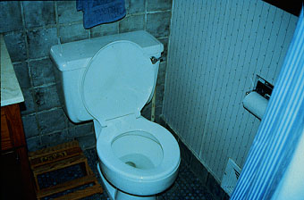
Bathroom - 60% (Toilet - 40%)
Toilet paper
Other Trash
Wipes
Cleaning Products
Notes:
Toilet is still primary contributor. Work with homeowner not to flush things down the toilet that should not be. Excessive use of toilet cleaners can create problems in the tank. Low flush toilets are much better now than they used to be relative to removing solids
Bathrooms typically use 60% of the wastewater from the home; toilets 25 – 40%, showers typically 20%, and sinks 10 – 20%

Slide 52
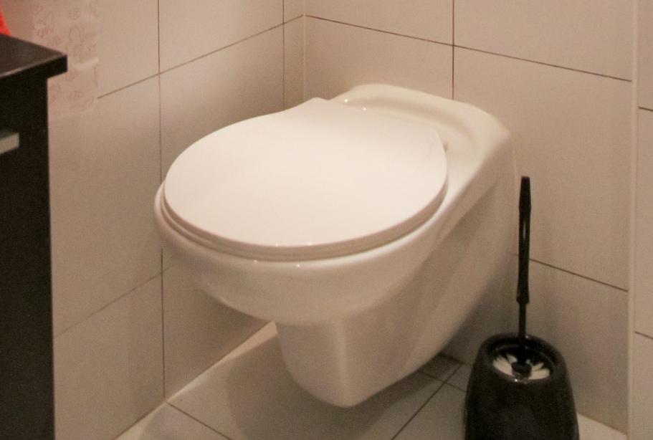
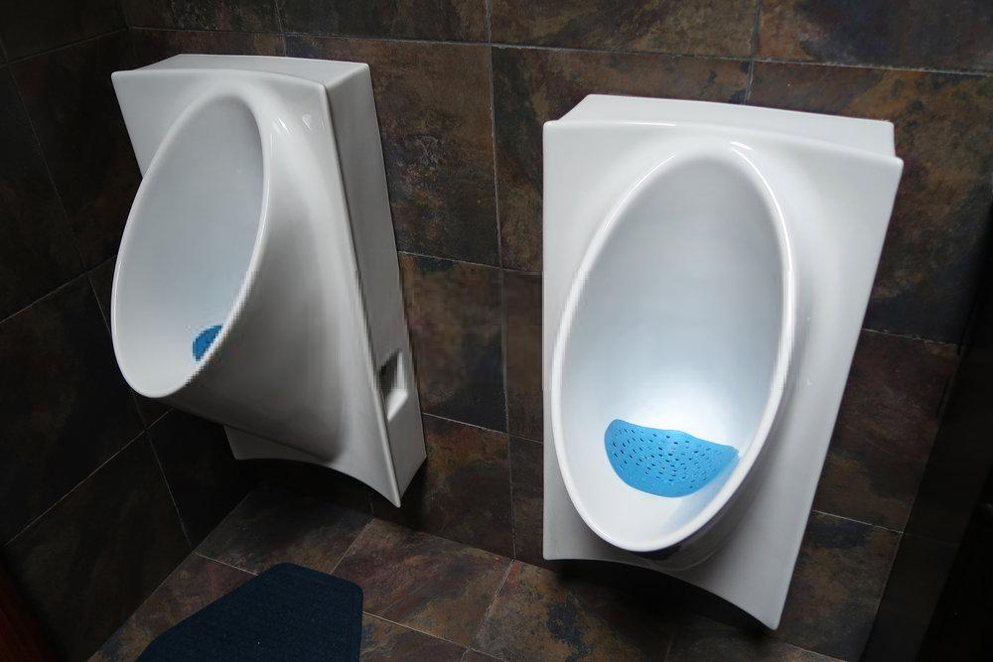
Low-flow toilets & fixtures
Notes:
Low flush options are more now. Automatic flushes, a button to flush only urine. Even non-flush options. All helpful to lower water use.

Slide 53
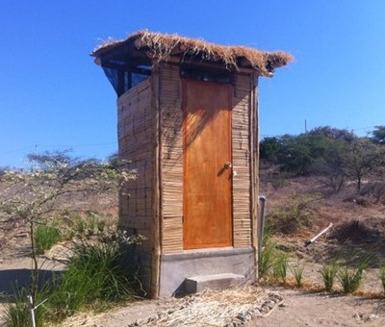
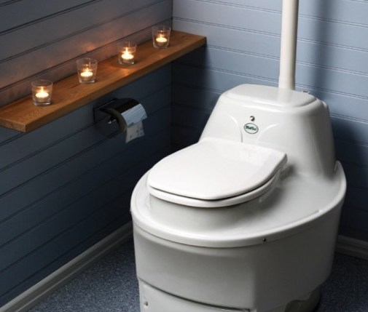
No-flow toilets
Benefits
  Flow
  Nitrogen
Drawbacks
  Different maintenance
  Plumbing codes
Notes:
These are a thing. Their primary impact to an OWTS is that there will be no dilution in the wastewater from these fixtures.

Slide 54
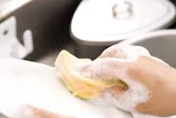

Kitchen - 20%
Notes:
Its not so much that they have a dishwasher as to how they use it. It should only be run when its full. And hopefully that wont’ be back-to-back with other water activities.

Slide 55

Garbage disposal
More solids
Longer to break down
Longer to settle out
More waste
Increases the need for maintenance
Notes:
Garbage disposals are not recommended. People will have them though. We always say get a dog as a joke. No joking matter though is that they can have a large impact on the system both in the organic load and the additional water being introduced into the system.

Slide 56


Laundry – 20%
Bleach additives
Soap choices
  Powder vs. liquid
Timing
  Spread use out
Notes:
These days everything seems to have bleach. This can have a negative impact on bacterial action in the tank.
Powder soaps have a clay like base that can build up as sludge in the tank – liquid typically is a better choice
The issue is to not overload the system by doing many loads of wash in a short time.
Front loaders now use as little as 5 gallons for a load too, much less than the 20 gallons or more previously.
All of these water activities are educational opportunities we need to have with the homeowner – if they understand that its not always about WHAT your put down, but HOW you put wastewater down… Understanding the impact of too much water at once and what it does to the system is an important concept

Slide 57

Typical use
150 gpd per bedroom
50-80 gpd per person
Notes:
Highlight your states estimate of daily flow for design purposes. Typically, the use is about 50 gallons per person per day. New research is being conducted on water use, so this story may change.
Many areas are still using 75 gal/person/day – 2 person/bedroom
Reality is, especially with the low flow fixtures – 30-50 gal/per/day
So, if they are still using the 75 gpd there is an automatic safety factor in place
Again, this is why knowing and verifying the number of bedrooms is going to be critical – additional, unaccounted bedrooms changes the “USE” of the system
Remember, on a typical day, we do not want to charge the system with any more than 70% of the design flow. The extra size is for rare occasions; parties, etc..

Slide 58

How NAWT looks at design flows
Design/peak flow
  400 gpd
Normal use: 70% of design flow peak flow
  400 gpd x 0.7 = 280 gpd
Typical use should not exceed this number
Notes:
Depending on the type of average you use, when you become concerned about flow from a troubleshooting standpoint changes.
The example starts with an estimated flow of 400 gpd. If use a weekly average, worry if it is within 80 percent of 400 or 320 gpd.
Ideally, we want systems to be used at 70% of design – the 100% is for peak flows

Slide 59

How do you figure it out?
Use
Maintenance
Testing
Notes:
It comes from educating yourself and experience –

Slide 60

Sampling
Average
  Mixed location
18 hours of peak
  Worst case
BOD5/TSS
  Plastic
Fog
  glass
Notes:
Sampling typically is required through the O&M process – systems that have advanced treatment typically will have some kind of monitoring system with expected outputs – As inspectors we are typically not asked to do these types of testing, but if you are inspecting a system that has requirements make sure you contact the O&M provider to obtain the history and records of the O&M performed and the outcomes for your records.
You need to be knowledgeable of sampling requirements and techniques
Lab will have equipment for shipping samples

Slide 61

Questions?

