Slide 1

WELCOME
NAWT OWTS INSPECTION STANDARDS
INTRODUCTION TO SYSTEMS AND EXISTING SYSTEM INSPECTION
Notes:
NAWT program started because of national concerns over septic inspections at time of property transfer.
Inspection is also the key to the start of managing systems.
Worked with USEPA to develop this inspection program.

Slide 2
AGENDA
DAY 1
8:00 AM – 8:30 AM Introduction – Septic 101
8:30 AM – 10:00 AM Source and Flows
10:00 AM – 10:15 AM BREAK
10:15 AM – 12:00 Initial, Advance and Final Treatment
12:00 – 1:00 LUNCH
1:00 PM – 2:00 PM Introduction to the NAWT OWTS Inspection Standards
2:00 PM – 5:00 PM Preliminary Information & Field Procedures
DAY 2
8:00 AM – 10:00 AM Preliminary Information & Field Procedures (cont)
10:00 AM – 10:15 AM Break
10:15 AM – 11:00 AM Dry Aggregate Rules
11:00 AM – 12:00 Hydraulic Load Test
12:00 – 12:30 PM LUNCH
12:30 PM – 1:30 PM Reaching Conclusions
1:30 PM – 2:00 PM Client Reporting and Ethics
2:00 PM – 5:00 PM Certification Exam
Notes:
2
Review agenda – NEED TO ADJUST AGENDA AFTER PRESENTATIONS HAVE BEEN UPDATED – REMOVE TIMES
2-days - MUST attend both days
first day - all classroom, mid-morning and afternoon breaks
second day- AM meet in classroom; prepare for field sites in the field
lunch
discussion
exam

Slide 3

introductions
THE PLAN STANDARDS
MANUALS
HANDOUT PACKET
INSTRUCTOR
CELL PHONES
Notes:
The NAWT Standard for OWTS inspections
The Intro covers first day – septic 101 NAWT Standards Manual – NAWT protocol
Copies of the presentations can be helpful for notes for the exam
Introduce instructor
Cell phone and ZOOM

Slide 4
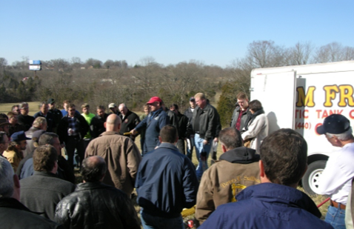
National Association of Wastewater Technicians
State groups-National Goals
Industry Standards
Nawt programs
  Inspection
  Installation
  O&M- Service Provider
  Design & Soils Education
Notes:
NAWT stands for National Association of Wastewater Technicians
The organization began as a voice for Waste Transporters. When the education courses began to expand, we saw that we were really representing Technicians in the Onsite industry
NAWT courses are setting the industry standard for practitioners within the onsite industry. NAWT programs are great introductory courses that cover the basics everyone needs to know within the industry regardless of location.
They cover the principles needed and things you need to know as a professional within the onsite industry.
Other NAWT programs including Installer, Operations and Maintenance, Design. We are currently building a Business 101 course for practitioners in the onsite industry.

Slide 5

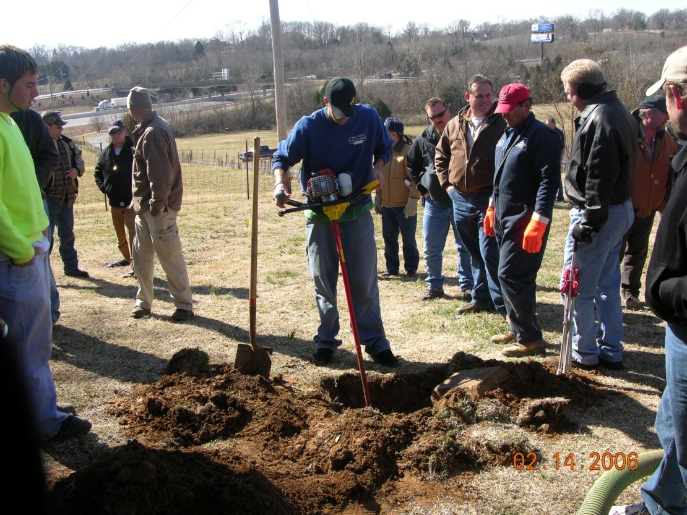
certification – How it works
Education
  Introduction – day 1
  Inspection standards – day 2
Exam
Continuing Education
Notes:
Education a key to the standard. Each course is a 2 day, in-person course with an exam at the end.
Once the initial certification is obtained to keep it current, NAWT requires 8 hours continuing education every two years.
REMEMBER you do NOT have to keep taking the inspector course for your CEU’s you can take 8 hours of any of the NAWT courses (1 day) or
there are several other ways to gain CEU’s – the goal is to learn about not only your little piece of the world, but all the pieces and parts that make up the onsite industry.
We do recommend repeating the Inspector Course every other cycle to catch up on what is new or changes to the Standards.

Slide 6
Other requirements for you
State
Local
other
Notes:
You may have state rules and requirements.
Some areas may be state driven, county driven, municipality driven, but somewhere out there are the rules that have to be followed for onsite systems.
TALK ABOUT THE IMPORTANCE AND NEED FOR INSPECTIONS – THIS REQUIRES CERTAIN TRAINING AND EDUCATION AND PREFERABLEY CERTIFICATION AND LICENSING OF INDIVIDUALS – THE IS ACCOMPLISHED WITH AND THROUGH THE REGULATORY AGENCIES.
The goal of the inspector should be to do the same type of inspection regardless of state/county/local regulations. If you follow the NAWT Inspection Standard, you should arrive at the same conclusion as any inspector before and following you.
The NAWT Inspection Standards provides a very thorough, comprehensive evaluation of the system – regardless of location and local rules or regulations
INSERT Specific State Code for area of presentation here:
CO Onsite Systems are regulated at the state level by Reg 43 –
This provides the umbrella regulations that each county MUST adhere to
Within CO each county or health agency can add to these regulations and make them more stringent, but not less
That is why working across county lines can become very frustrating at times.

Slide 7

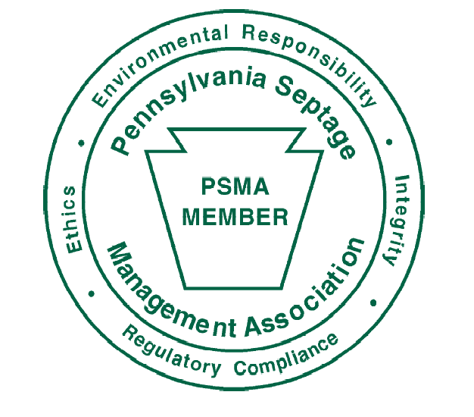

Sponsors
Notes:
Back in the 1990’s NAWT worked with an EPA Grant and utilized a program started by PSMA **click and brought the NAWT Inspection Course to the National stage – ** click NOF is an organization dedicated to the development of certification programs for the OWTS industry.
**click NAWT continues to work on development of appropriate TEC course for the OWTS industry.
If there are sponsors a place to thank them. INSERT appropriate logo for sponsor or training partner. Discuss partnership with local training partner
– Jeffco brought the course to CO due to an area with specific concerns – CPOW brought them all to CO as a result of the reg changes – and CPOW and NAWT continue to provide virtual OWTS training that spans the US – the is the industry working together

Slide 8

Why?
Don’t be afraid to ask what you may think is a dumb question
It’s easier to handle than a dumb mistake
Notes:
Workshops are informal. Questions are encouraged as well as discussion. In the interest of time, we may have to defer some questions or cut the discussion off and save for later to get through all of the material.
ZOOM has allowed us to continue these courses/workshops
Please do not feel intimidated to speak up during the discussion – this is how we learn and network.
Sharing of stories and ideas is very important to this process

Slide 9


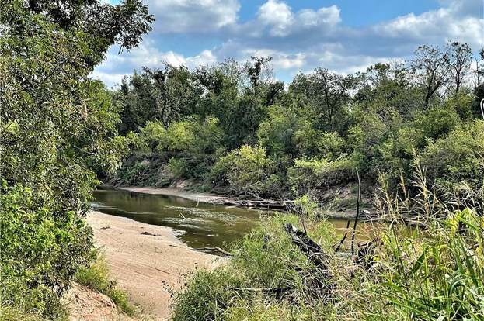
Groundwater
Notes:
Why do we do this?
Reason to do this to protect public health and the environment.

Slide 10

Public Health
Protection
Notes:
Protect public health – as our communities become denser, it is vital that we think about our neighbor and the impact of malfunctioning OWTS
Bad systems make people sick
Good systems keep the public healthy

Slide 11
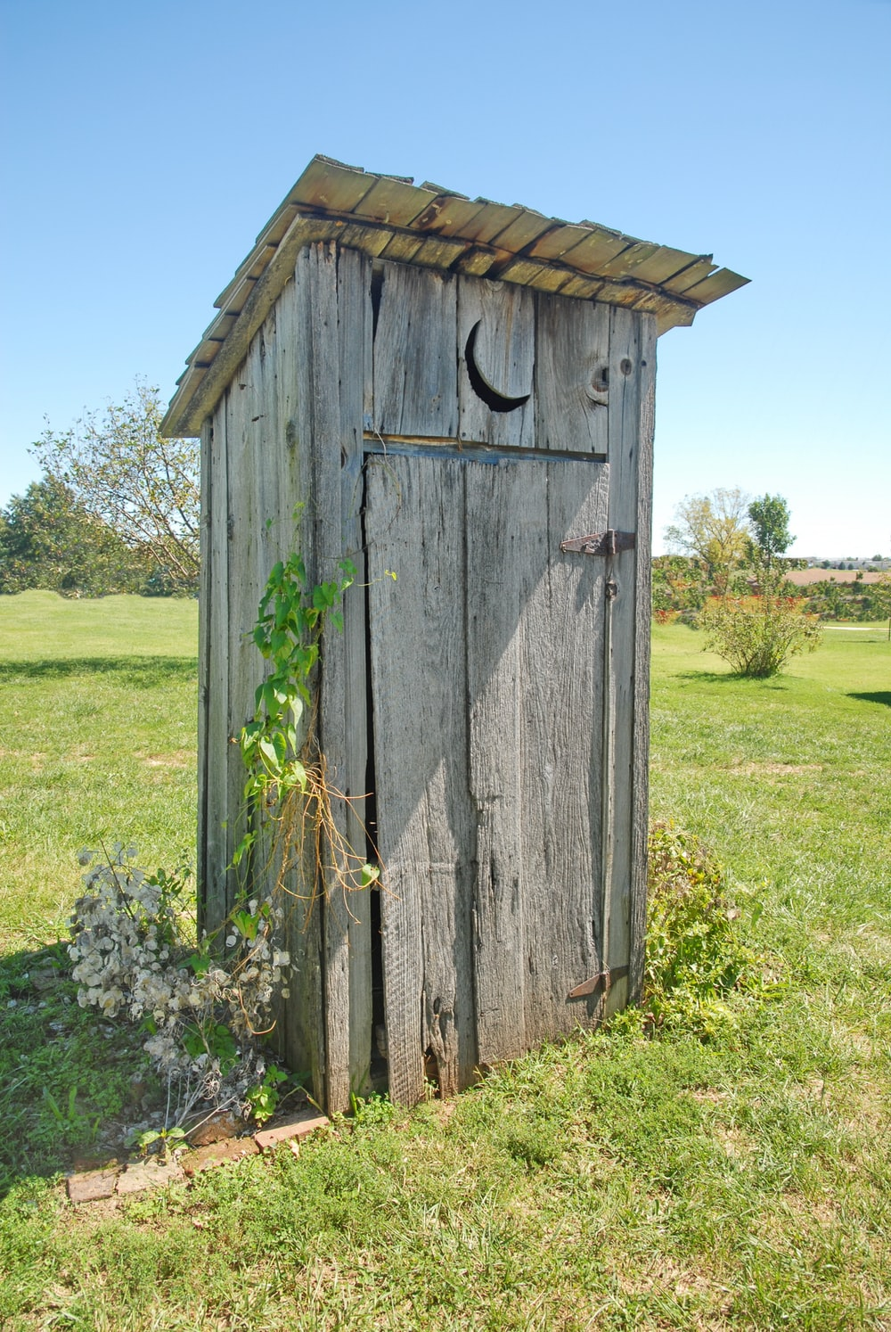
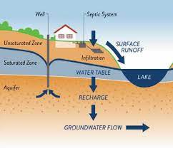
Wastewater Infrastructure
Notes:
Discuss that the entire country cannot be sewered!
The cost of infrastructure to accomplish this would be astronomical! The logistics of creating this type of infrastructure is incomprehensible – think about some of the areas you work in that have septic – the mountains, the plains with miles and miles between homes….

Slide 12
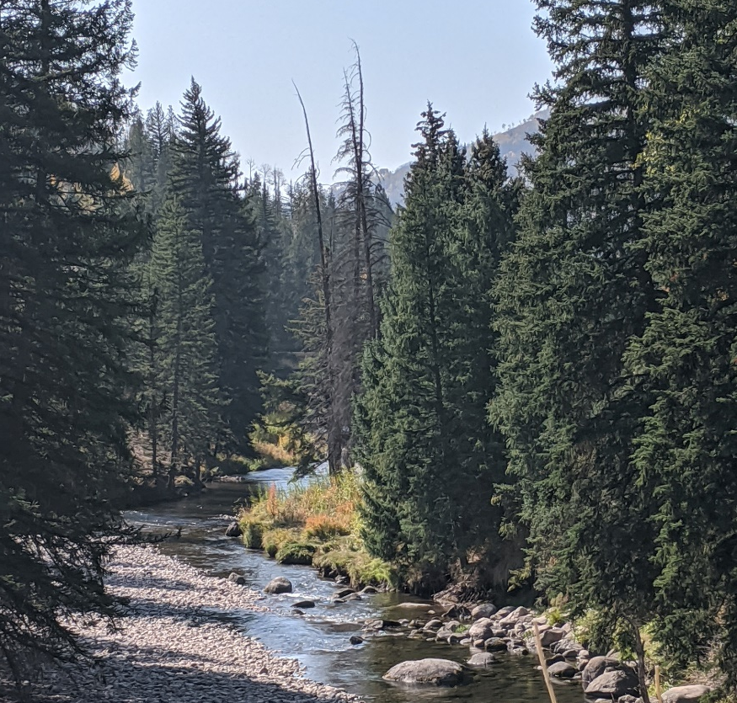
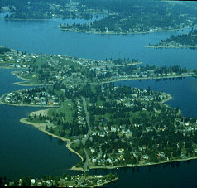
Wastewater
Infrastructure
Right System
Good Installation
System Care
Notes:
Discuss that the entire country cannot be sewered!
The cost of infrastructure to accomplish this would be astronomical! The logistics of creating this type of infrastructure is incomprehensible – think about some of the areas you work in that have septic – the mountains, the plains with miles and miles between homes….

Slide 13
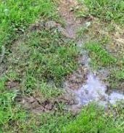
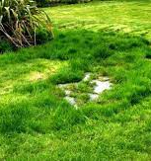
Notes:
One More Home Sewage Discharge Just before Effluent Stream Reaches Pond in Ditch
Anytime we see anything that could be considered broken or on the verge of broken we need to bring that to the attention of the user, which in most instances is a homeowner.
There are 6 to 7 different parties that impact a septic system during its life and the one that has the least amount of knowledge of how they work and how they should be maintained is the one that is actually using the system. Keep that in mind.

Slide 14

Industry Protection
Notes:
Some type of OWTS inspection should be occurring anytime we as professionals are looking at a system. We need to use that opportunity to education the homeowners on how to properly use and maintain their systems.
Promote industry professionalism.
This industry has a hard time because of subject matter convincing people we are providing a valuable service. Being that professional that takes the time to educate their customer about how the system works and the importance of good maintenance builds credibility not only for the professional, but the industry as a whole.
Every failure gives the industry a bad name. Hard to overcome.

Slide 15
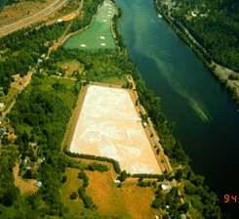
WWTP Performance
BOD5
TSS
Pathogens
Notes:
Treatment plants break and fail also with disastrous results. Often with more impact to public health and the environment than an OWTS failure.
Give examples of failing WWTP, especially if there is a local
2021 Mega Conference – Houston was having an issue with bacteria in the water – wanted to blame OWTS – but eventually they found that the contamination was coming from the pipes that were discharging from the WWTP

Slide 16
EPA: A Significant Issue Nationally
30% of homes use onsite treatment
(30-40% of new construction)
> 50% more than 30 years old
10-20% fail each year
2nd highest threat to groundwater
Notes:
This is from the old section in the presentation, but still rings true today –
From an EPA Study in the 1980’s they found that:
One-fourth of the households in the U.S. are served by onsite systems (primarily conventional septic systems). Well over 4 Billion gallons/day of effluent being discharged to soil, groundwater and surface waters of the U.S.
About 1/3 of new construction nationally is being served by onsite systems. In some areas, the number is much higher.
Small communities (less than 10,000 population) represent over 10% of the total wastewater need in this country. These communities are prime candidates for decentralized approaches.
Onsite systems are not just a rural issue, however. Over half of the onsite systems in the U.S. are located in SMSA’s (cities and their suburbs).

Slide 17
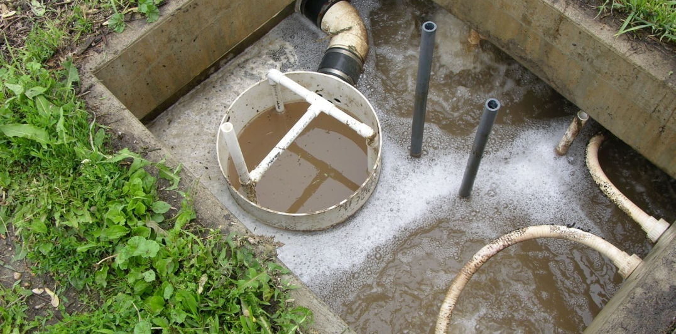
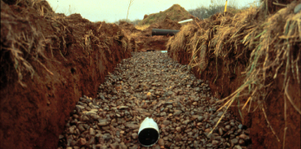
WWTP
vs.
OWTS
Notes:
The EPA study found that a properly designed, installed and MAINTAINED onsite system can be a good alternative. And in many cases work better than the municipalities because the homeowner can control what is put into the system, where the municipality cannot.
In the early days of OWTS the goal was to “dispose” of the wastewater – we now know that our wastewater in an OWTS is returned to the watershed and is used again, and again. WWTP typically send the wastewater downstream, which may or may not return to the watershed in which the water was originally pulled from.

Slide 18
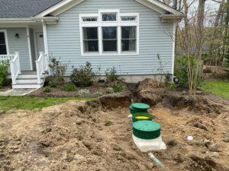
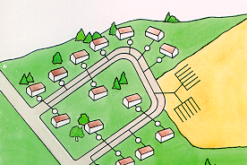
What are onsite wastewater treatment systems?
A.k.a
  Septic systemS
  Decentralized wastewater treatment systems
  Individual sewage systems
  Cluster systems
  Package plants
  Class V (epa terminology)
Notes:
In the early days of these systems the goal was to “dispose” of the wastewater. Septic system by any other name is still and OWTS
We now know through science and studies that what is really going on is “treating” the wastewater before it is returned back to the water cycle.
Your wastewater today, becomes someone else's drinking water down stream –
Life Cycle of an OWTS – cradle to grave – what and who impacts the system through its life
Regulations – what their purpose is – using regulations to ensure systems that are designed, installed and utilized can perform
Design – using the regulations and site information to create a system
Installation – the builders
Maintenance – the service providers – pumpers, O&M and INCLUDES INSPECTORS!
2021 Onsite Conference speaker talked about how Dallas’ wastewater becomes Houston’s drinking water – think about that! That’s pretty close in proximity…. We need to make sure that these systems are functioning as intended

Slide 19
Going through the system
Source
Initial treatment
  Septic tank
  ATU
  Advanced Treatment
Distribution system
  Distribution method
  laterals
Final treatment & dispersal
  soils
Notes:
We will be covering the parts of a typical individual system. We need to understand the components and what they are supposed to be doing before we can evaluate how they are functioning
And we will be discussing how to evaluate their functionality for the purposes of completing an inspection

Slide 20
“good systems”
Standard
  State rules
  National goals
Process
  How to process
  What to process
Goal
  Treatment!!!!
Notes:
The goal of all the professionals in the OWTS industry to regulate, design, install and maintain “Good Systems”
The goal of the inspector should be to do the same type of inspection regardless of state/county/local regulations
The NAWT inspection Standards provides a very thorough, comprehensive evaluation of the system – regardless of location and local rules or regulations
Talk about your state rules and requirements. Every area, may be state driven, county driven, municipality driven, but somewhere out there are the rules that have to be followed for onsite systems.
CO Onsite Systems are regulated at the state level by Reg 43 –
This provides the umbrella regulations that each county MUST adhere to
Within CO each county or health agency can add to these regulations and make them more stringent, but not less
That is why working across county lines can become very frustrating at times.

Slide 21
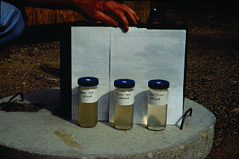
Treatment
Taking care of Problems
Notes:
We will talk about troubleshooting problems and what to do about them in the context of good system installation and management.
As a professional within this industry, you may be asked to wear many hats. The more you know about the different stages of the life of an OWTS the better you will be able to switch hats and answer questions.

Slide 22
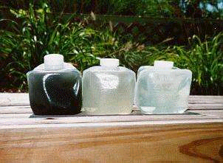
Treatment Capabilities
Notes:
With proper management, these systems can reliably meet environmental and public health requirements, even in sensitive areas which require high levels of performance. There are systems out there that are over 50 years old that are still functioning as intended. It all depends on how the were designed, installed and most importantly MAINTAINED
Here’s a picture of samples from a sand filter system in Maryland, showing septic tank contents on the left and filtered effluent on the right.

Slide 23
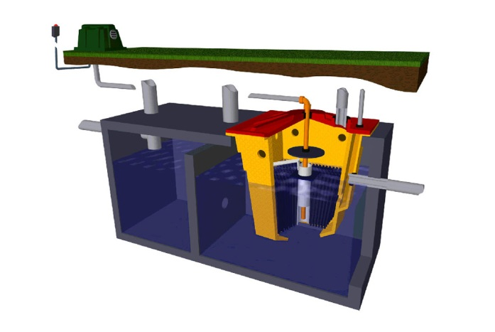
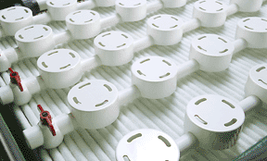
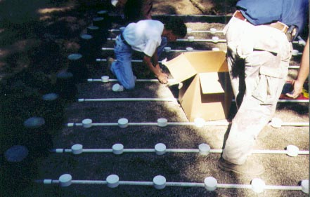
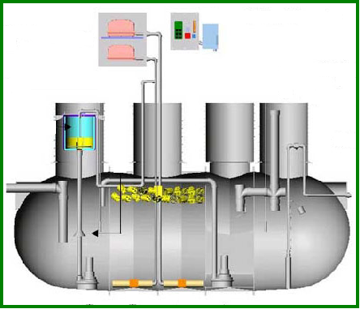
Examples of Typical Technologies
FIXED FILM AEROBIC TREATMENT UNIT
TEXTILE FILTER
SAND FILTER
AEROBIC TREATMENT UNIT (ATU)
Notes:
We are going to be talking about different technologies and what is available for systems these days. This diversity means that as an inspector you need to know how these work to be able to evaluate if they are functioning correctly – sometimes, your inspection will refer to O&M reports – but that does not mean that you should not understand how that system works when you’re looking at it.
Examples of some treatment options available today:
Bottom two are variations on filtration through bed of sand, with one being a single-pass dosing filter, the other recirculates the effluent, so it makes several passes through the filter;
Top left is a pumping chamber which pumps effluent from a septic tank to a small-diameter collection line which serves a cluster of homes and carries the effluent to a site for treatment;
Top right is a textile filter -- there are many variations on media used, such as foam, various types of gravel, plastic, and peat.

Slide 24
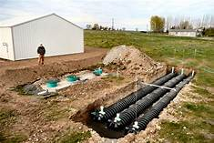
FINAL TREATMENT AND DISPERSAL TECHNOLOGIES
IN-GROUND SYSTEMS
  TRENCHES
  BEDS
DISTRIBUTION
  GRAVITY
  PRESSURE DOSING
  DRIP DISPERSAL
MOUNDS
Notes:
We are going to talk about final treatment – the importance of the soil component and how it drives what type of distribution system is going to be utilized, what types of technologies are out there these days and how all of that works for our systems and how to evaluate them effectively.

Slide 25
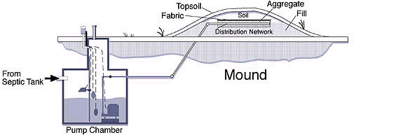
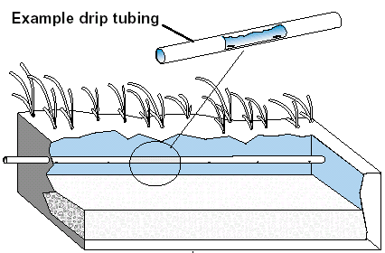
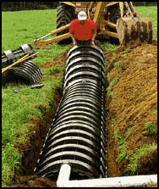
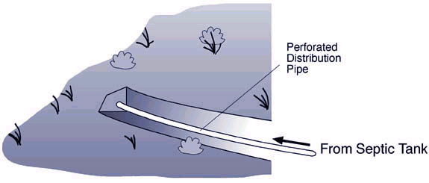
Examples of Dispersal Technologies
Mound System
Drip Dispersal
Chamber System
Trench
Notes:
Again, as we see areas that used to be tagged as “unbuildable” being built on we are seeing new and innovated ways of treatment and dispersal.
These are some of the types of soil treatment areas you will find today, but these are not the only ones, and there may be ones that are specific to your demographics or locality. It is important that the NAWT Inspector understand what is in their area and how to effectively evaluate the system as a whole, in its entirety.

Slide 26
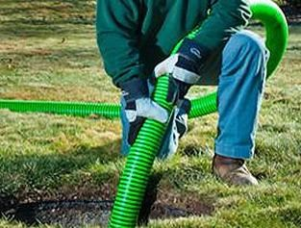
MANAGEMENT – THE KEY
INSPECTION
O & m
MONITORING
COSTS $$
Notes:
Inspection a key to operation and maintenance and management.
It is a way to keep costs down. If systems are “serviced” in regular intervals issues can be resolved early before they become catastrophic

Slide 27
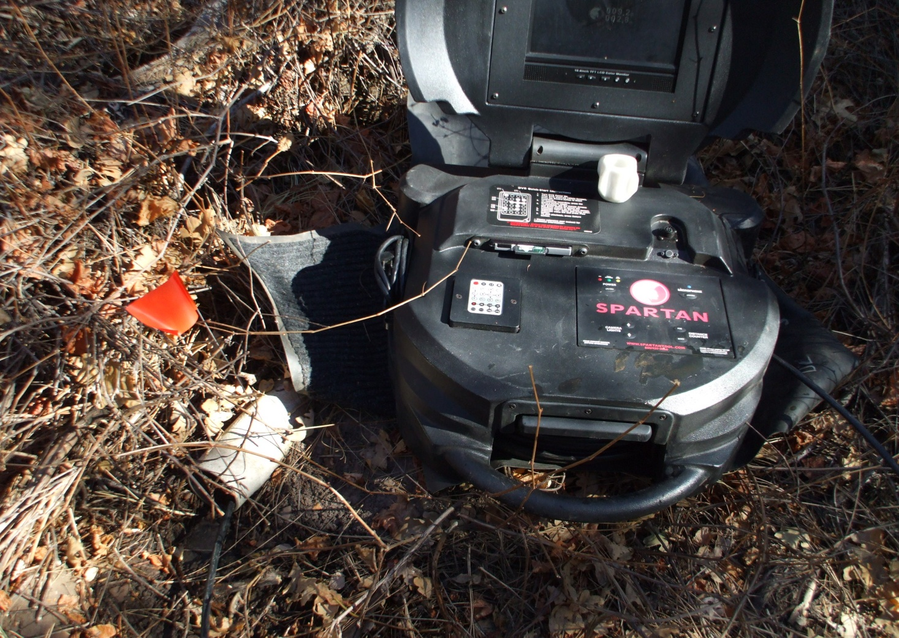
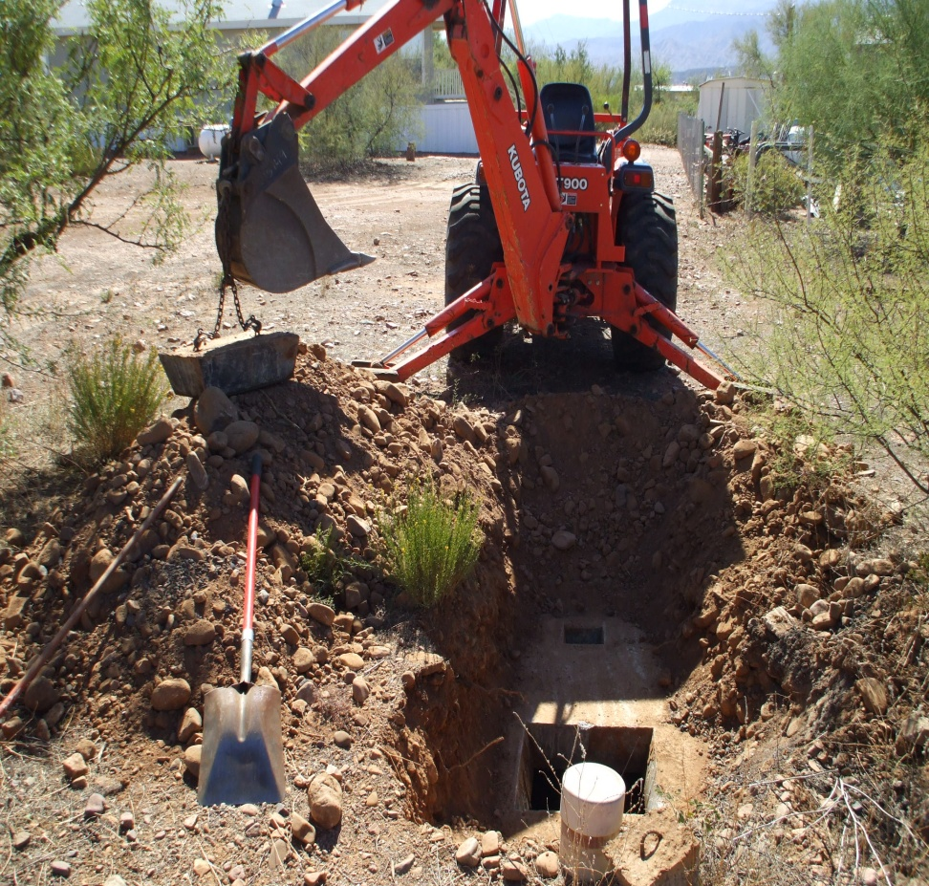
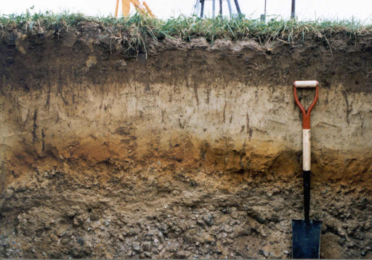
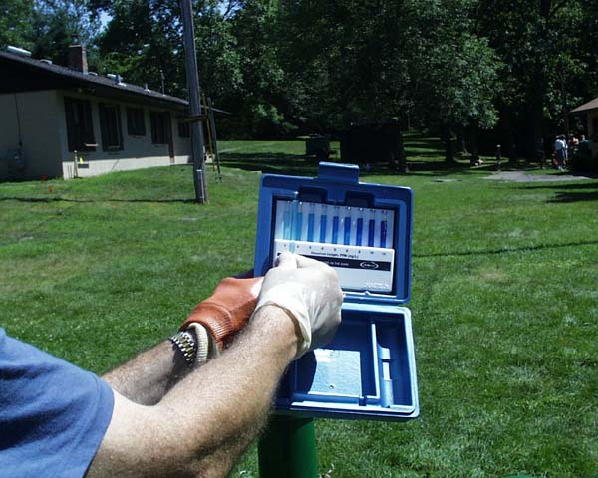
TOOLS
USE
PRETREATMENT
SOIL
FLOW
  WATER METER
WATER QUALITY
  WASTE STRENGTH
  SAMPLING
PH/DO TESTING
LOCATING TOOLS
  TRANSMITTERS
  METAL DETECTORS
OPENING TOOLS
  SHOVELS
INSPECTION TOOLS
  MIRROR
  CAMERA
    LINE
    PHOTO
SOIL SURVEY
BORING (pit) TOOLS
MUNSELL COLOR BOOK
SOIL UNDERSTANDING
Notes:
Inspection tools that are helpful depending on the type of system to be evaluated.
Depending upon your area and what types of systems you will be inspecting will determine the types and quantity of tools in your toolbox.
Different jurisdictions have different inspection requirements – it is important that you set your standard and determine what type of inspection you will be doing and what tools you will have to have to do YOUR inspection
If you have many advanced treatment units in your area, you will probably want to invest in tools to do certain types of testing
Using a dissolved oxygen kit to evaluate an aerobic treatment unit ATU
List of tools in red and blue manuals. We will discuss using all of these tools.
Since the inception of this course many of the advanced tools have become more affordable and can serve multiple functions for you as a practitioner
Soil evaluation and troubleshooting tools.
Through science we have found that the soil is a very critical piece to the functionality of onsite systems.
Having soil analysis skills, even if you don’t do it for designs, can be very helpful in diagnosing what is going on with a particular system

Slide 28
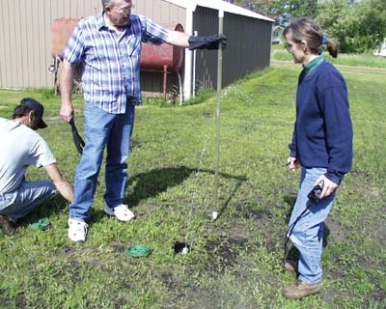
SOIL SYSTEMS/FINAL DISPERSAL
LOCATIONS
DISTRIBUTION METHOD
  GRAVITY
  PRESSURE
  SPRAY
Notes:
With a multitude of options for dispersal and today’s inspector must be prepared to be able to evaluate any type of system they run across.
Evaluating squirt height in a pressure distribution system.
Seepage Pits and Cesspools are unique dispersal components, sometimes hard to find but can be – once they are identified, the homeowner needs to be aware of them…. And that they most likely do not have a long-life expectancy going forward.

Slide 29

EPA’s DECENTRALIZED WASTEWATER MANAGEMENT GUIDELINES
EPA Office of Wastewater Management
www.epa.gov/owm/onsite
Notes:
This course was developed through a grant from the EPA –
The EPA looked at wastewater and wanted to understand the impact onsite systems were having – they found that onsite systems are here to stay and that they function very well if maintained and managed accordingly.
Inspections play a very important part in this goal

Slide 30
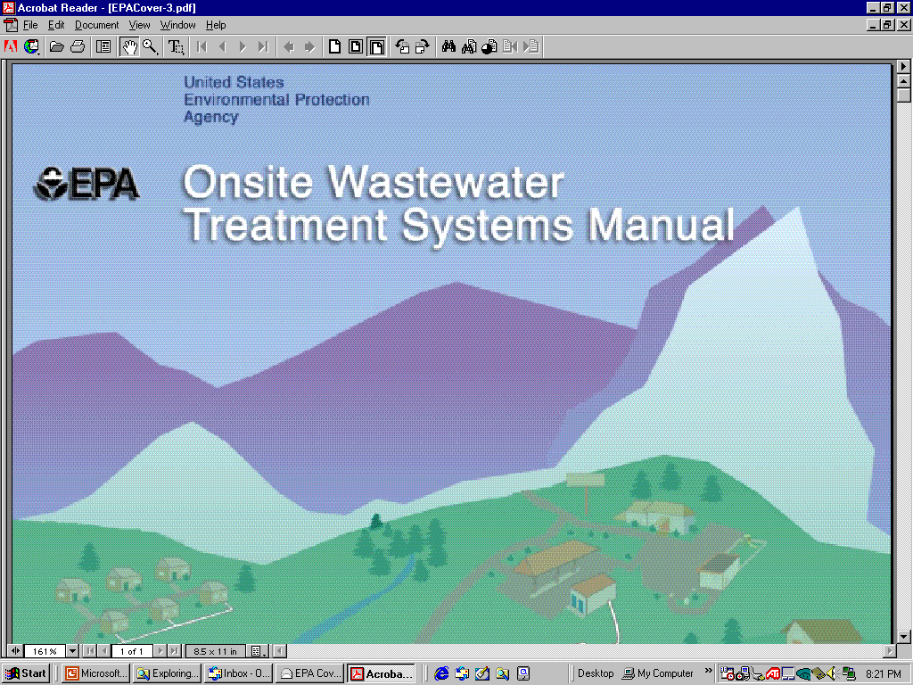
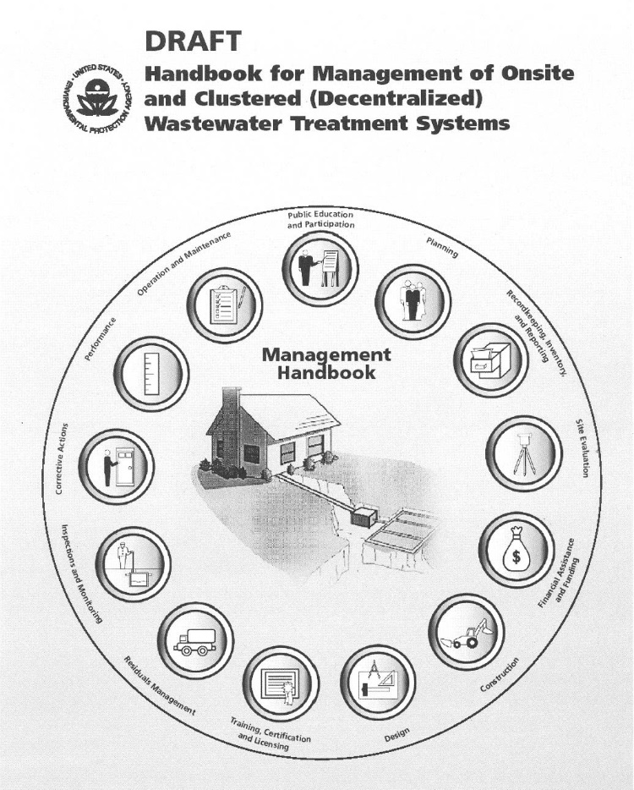
www.epa.gov/owm/onsite
Notes:
Website to EPA for more information

Slide 31
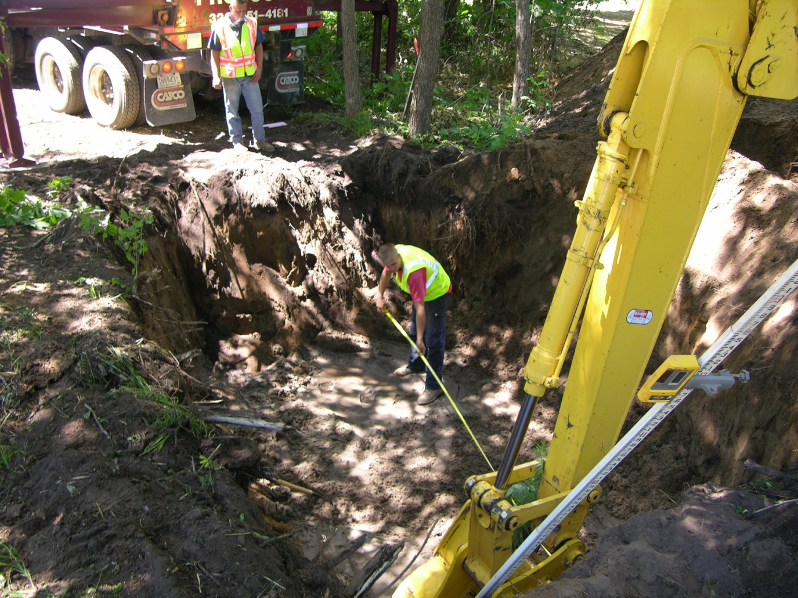
Good luck!

