Slide 1

Mushroom Cultivation Workshop
Edible Mushroom Production
Growing Mushrooms: a process overview
The Fruiting Process
Hands-On Activities

Slide 2
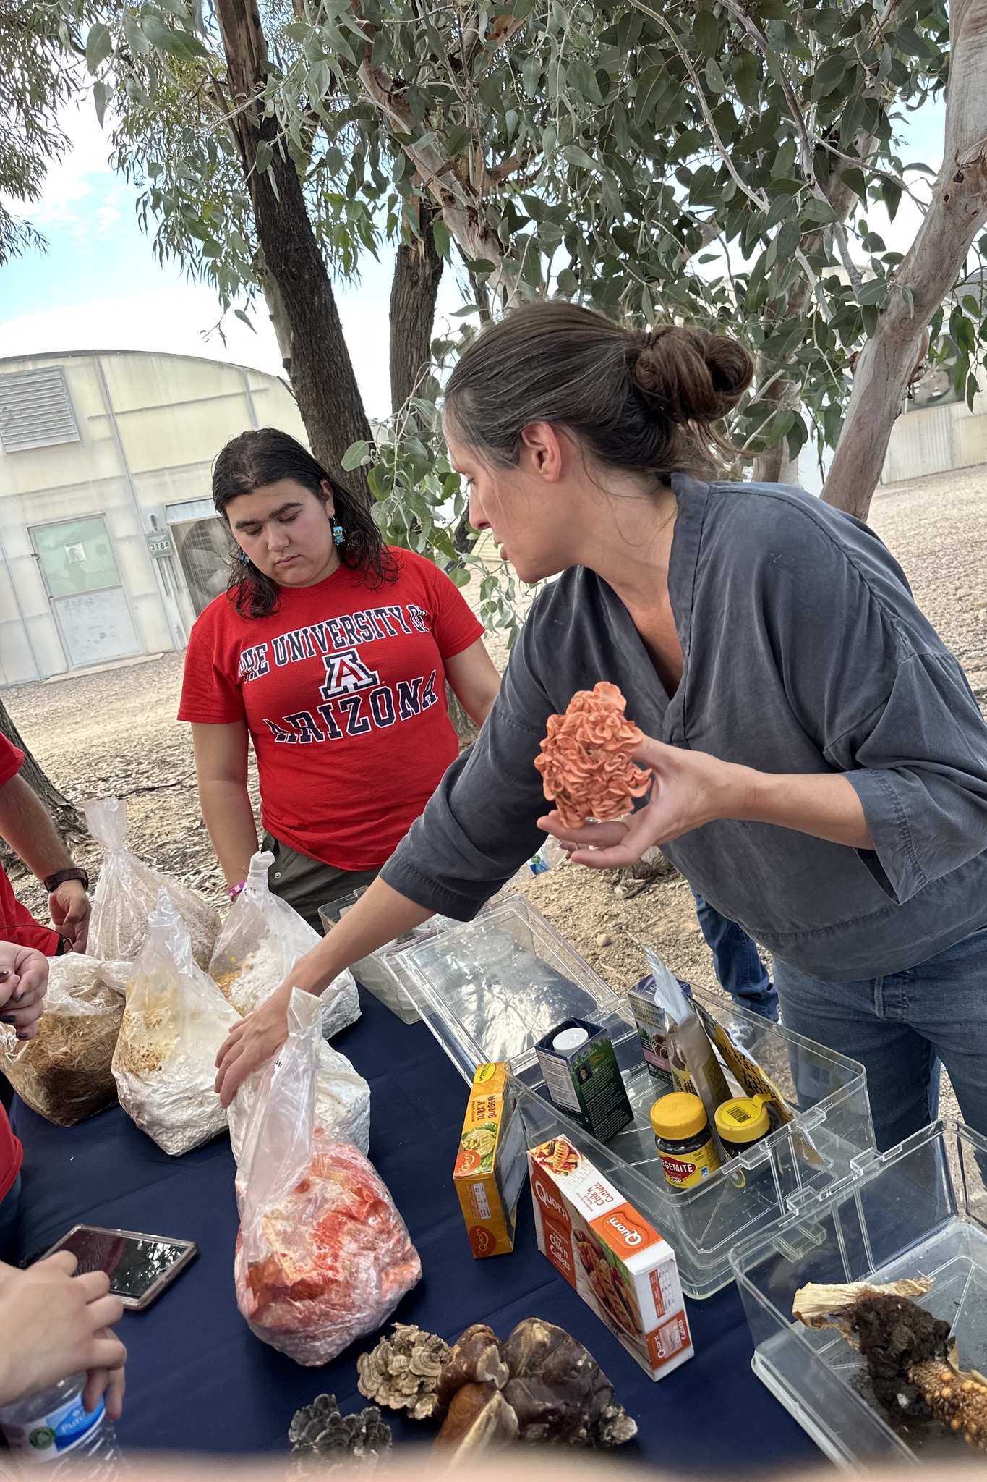
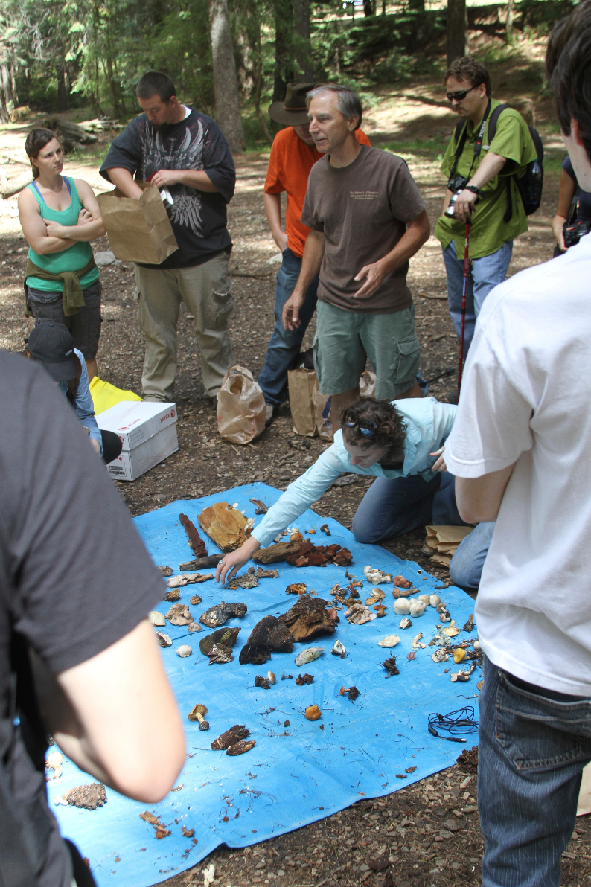
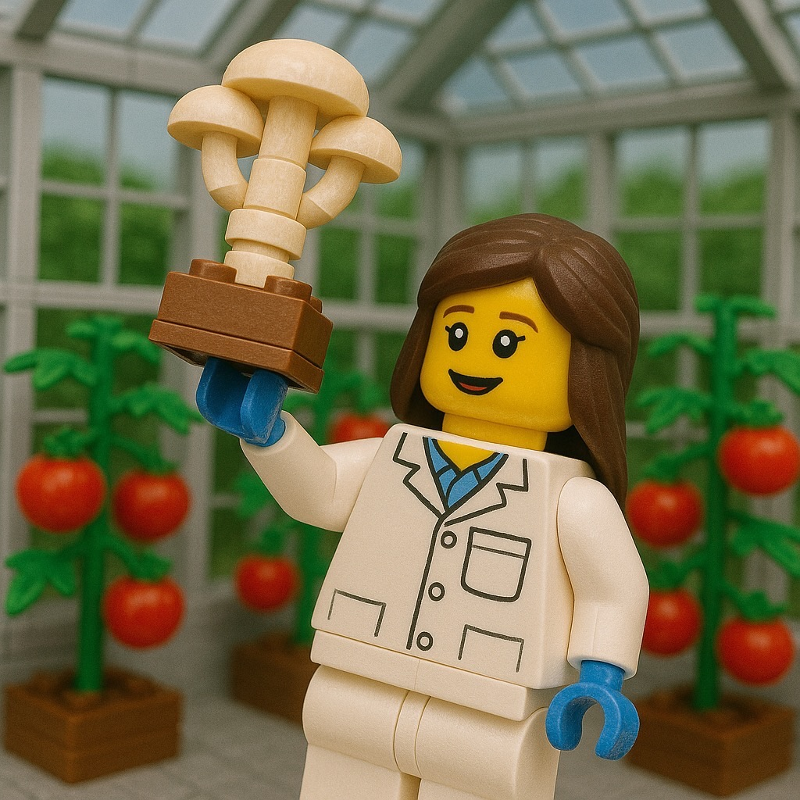
Bree Gomez
Educational Background
University of Arizona, Tucson, AZ
Master of Science in Geographic Information Systems Technology
(GIST), December 2019
Bachelor of Science in Environmental Sciences, Microbiology Emphasis, December 2013
Mushroom Cultivation Background
Pryor lab,
10 years this January!
Ag. Discovery, 2023
Dr. Pryor on Fungal foray with students
-Mt Lemmon, 2015-

Slide 3
Edible Mushroom Production
Introduction to Fungi
The benefits of mushroom cultivation
The growing industry of fungal products
Mushrooms currently in cultivation

Slide 4
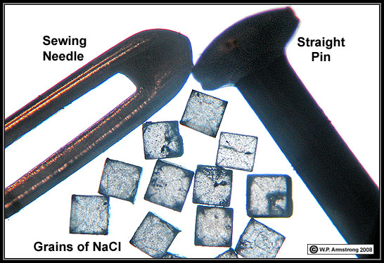
Introduction to Fungi
Mycological terms
Fungi
Kingdom of organisms including what we often refer to as mushrooms, yeasts and molds
Hyphae
Filamentous fungi grow by one-cell thick filaments called hyphae.
Mycelium
Collectively, a colony of hyphae is referred to as mycelium.
How fungi get around. Most forcibly discharged, and wind blown.
Small, generally 5-50um in diameter
Spores
Mushroom
Fruiting body
Sclerotia
Hardened, compact mass of mycelia.
A salt crystal is about 300 um

Slide 5
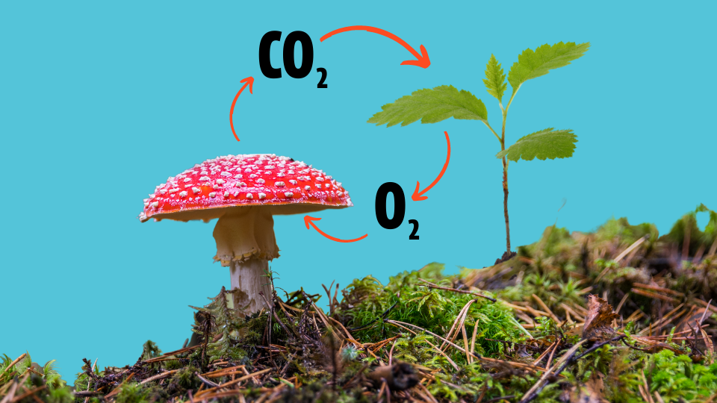
Introduction to Fungi
Achlorophyllous,
and therefore: heterotrophs just like us!
Typically, filamentous
but: yeasts are fungi too!
Reproduce via spores
…there are always exceptions
Cell walls are composed of chitin
    Which is largely indigestible, so: Cook your mushrooms
Haploid most of their life cycle
    Single set of chromosomes
Respire
    Producing CO₂ …just like us
Image: Thanks to Fresh Cap Mushrooms @ Freshcap.com

Slide 6
Introduction to Fungi
Obtain nutrients through: Absorptive nutrition!
      One of my personal favorite characteristics!
Eukaryotes:
      Just like us!
Molecular evidence shows that fungi are more closely related to animals than to plants or protists.
  - We are more closely related to fungi than we are to plants and protists
  - Cells sharing similar cellular structures and biochemical pathways
In broad terms:
- Fungicides can pose a greater risk to us compared to say insecticides or herbicides
- Also why treating fungal infections is somewhat tricky for us humans

Slide 7
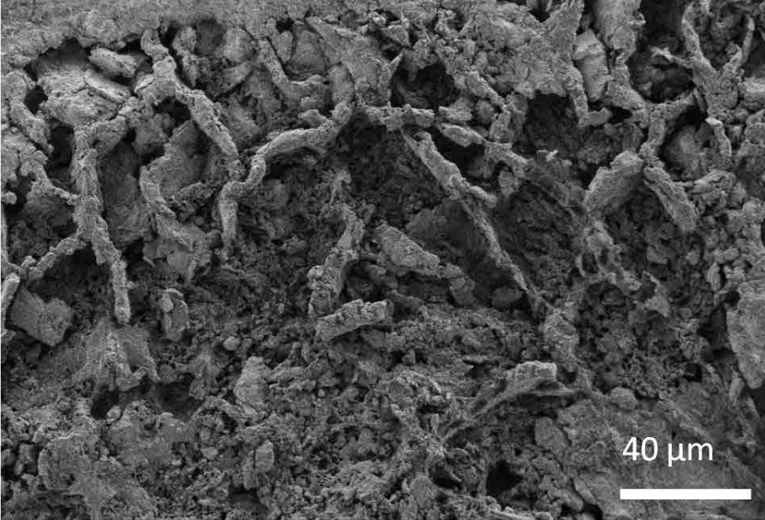
Introduction to Fungi
  Fungi are their own Kingdom!
  Fungi belong to one of the largest and most diverse groups of living organisms.
Indeed, fungi are much older than plants:
  Fungi are estimated to have evolved 1,300 million years ago
  Plants are estimated to have evolved 700 million years ago
https://www.nationalgeographic.com/science/article/oldest-fungus-fossils-found-earth-history

Slide 8
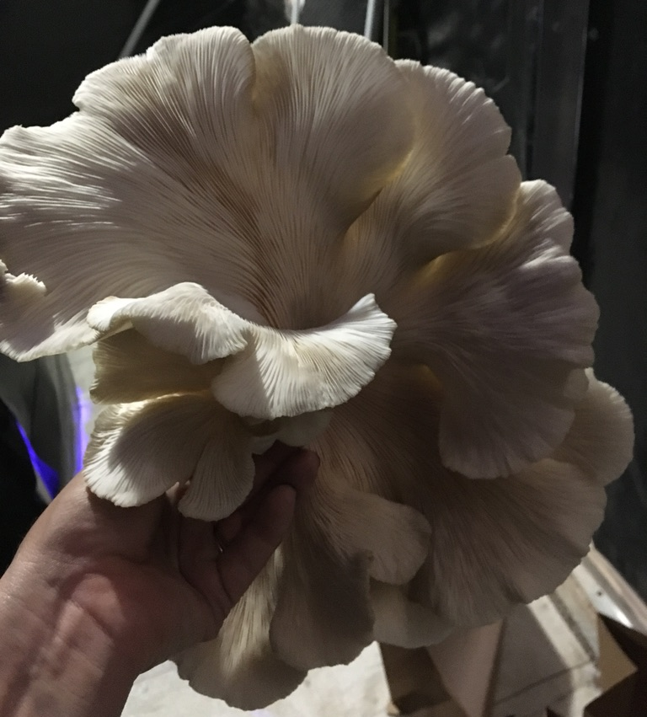
Introduction to Fungi
Largest and most diverse groups of living organisms:
  Less than 10% of all fungal species have been described
Ecologically, fungi are the single most important of decomposers in all ecosystems
And, so, how does this all play into:
Why Mushrooms in CEA?

Slide 9
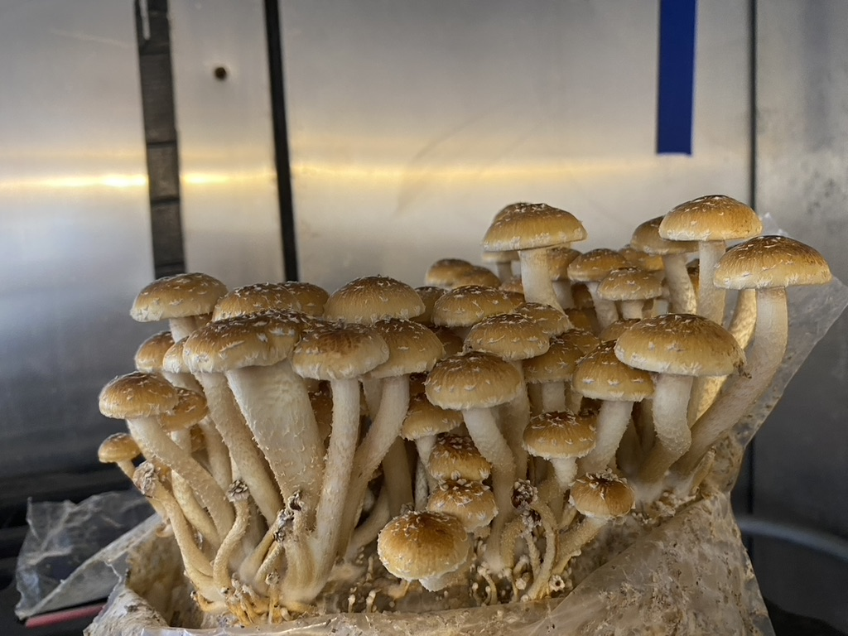
Benefits of Mushroom Cultivation
Why Mushrooms in CEA?:
Nutritional and Health benefits
Environmental benefits
Growing industry
Key for closed modular energy and resource-efficient ag. systems

Slide 10
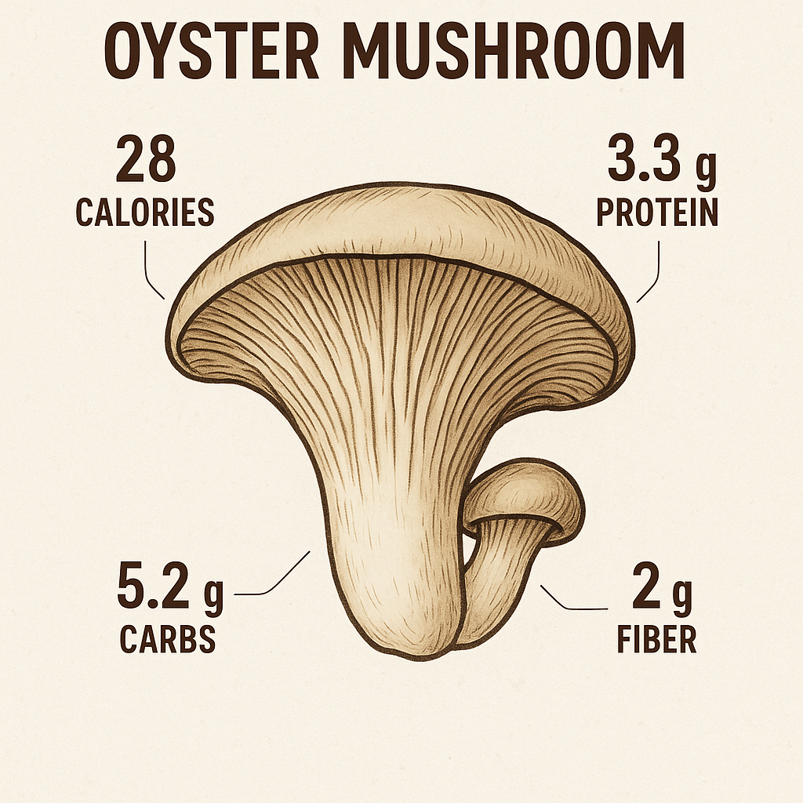
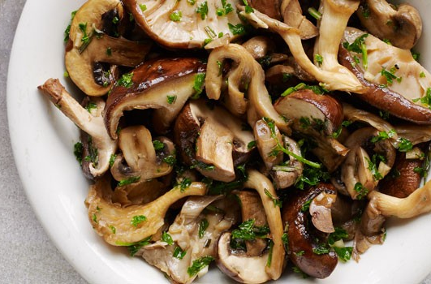
Benefits of Mushroom Cultivation
Nutritional and Health Benefits
- High in Protein
  Content varies by species, but ~15-35% protein content by dry weight
  Complete protein, providing all 9 essential amino acids
High in Fiber
Antioxidants
  Ergothioneine (“longevity vitamin”), specific transporter protein in our cells
Vitamins
  High concentrations of B vitamins
  UV for increased vitamin D
Polysaccharides
  Beta-glucans
    Soluble fibers that can help lower LDL (the bad cholesterol)

Slide 11
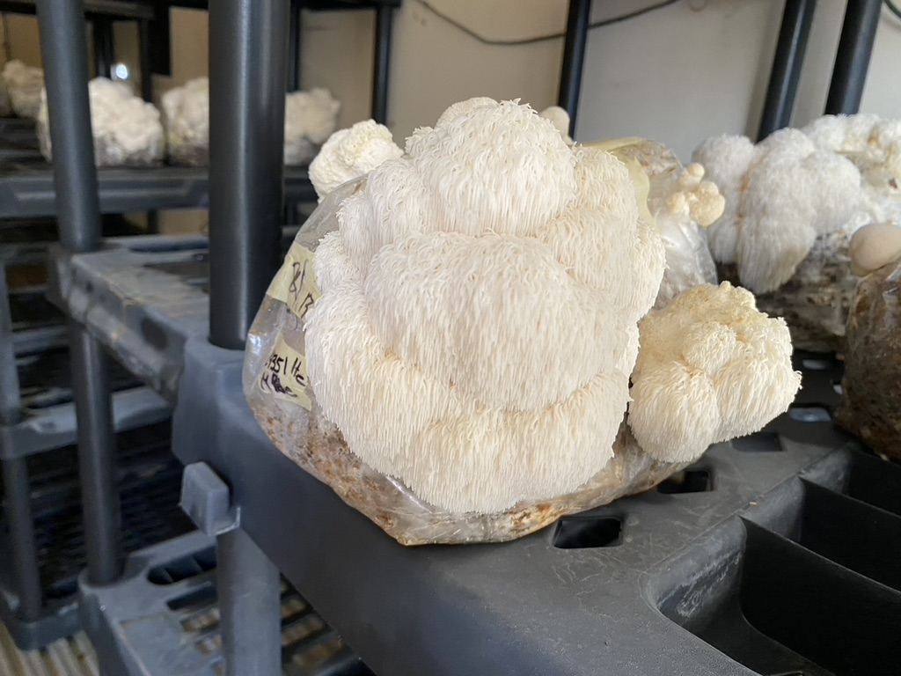
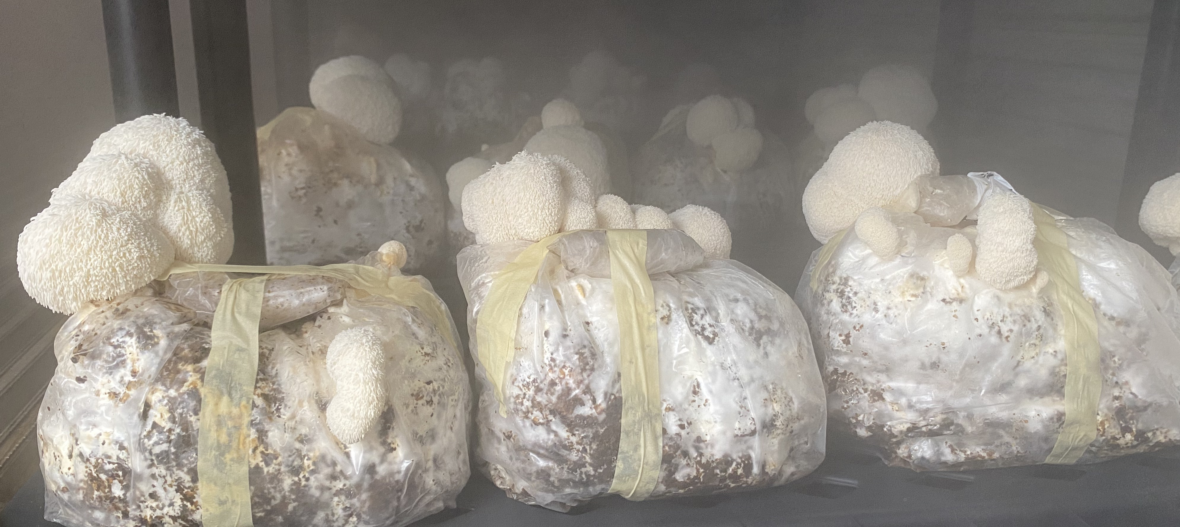
Benefits of Mushroom Cultivation
Nutritional and Health Benefits:
Hericium erinaceus
Cognitive Support
Nerve Health – Hericenones and diterpenoid derivatives found to promote Nerve Growth Factor (NGF), Neuroprotective properties, Alzheimer’s & Parkinson’s
Immune System Boost
Digestive Health
Bioactive compounds:
Erinacines – mainly found in mycelia
Hericerins – only found in fruiting bodies
Steroids
Alkaloids
Lactones
More than 35 polysaccharides isolated

Slide 12
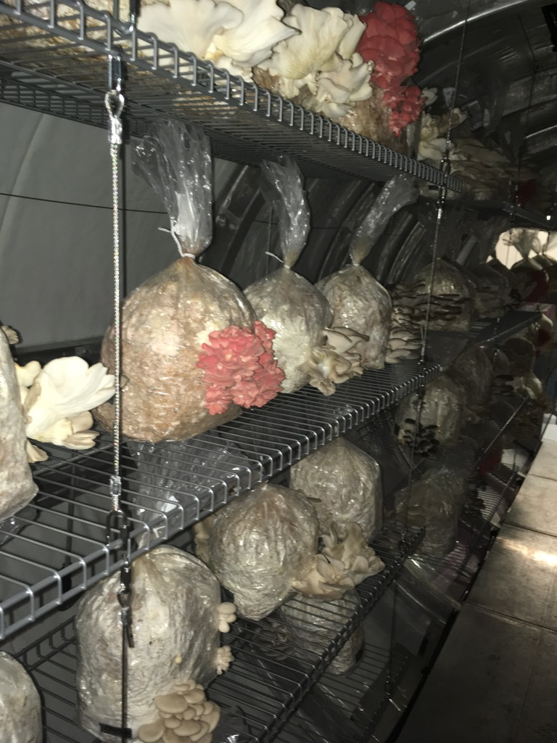
Benefits of Mushroom Cultivation
Environmental Benefits:
Highly sustainable protein source
Low Land Use
Low Water Usage
Grown on non-edible biomass
Comparison of bioefficiencies
Beef 5-15%
Chicken 30-50%
Fish 60-80%
Crickets 70-90%
Mushrooms 80-150%
NGM Staff. Sources: Gidon Eshel, Bard College; Alon Shepon AND RON MILO, Weizmann Institute of Science; Tamar Makov, Yale School of Forestry and Environmental Studies, PNAS, July 21, 2014

Slide 13
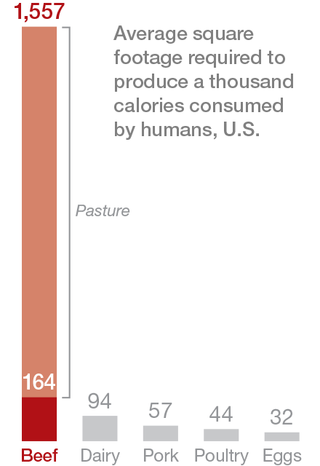


Benefits of Mushroom Cultivation
Sustainable food productions systems, on Earth and beyond…
….Key for closed modular energy and resource-efficient ag. Systems…
http://www.nationalgeographic.com/foodfeatures/meat/.

Slide 14
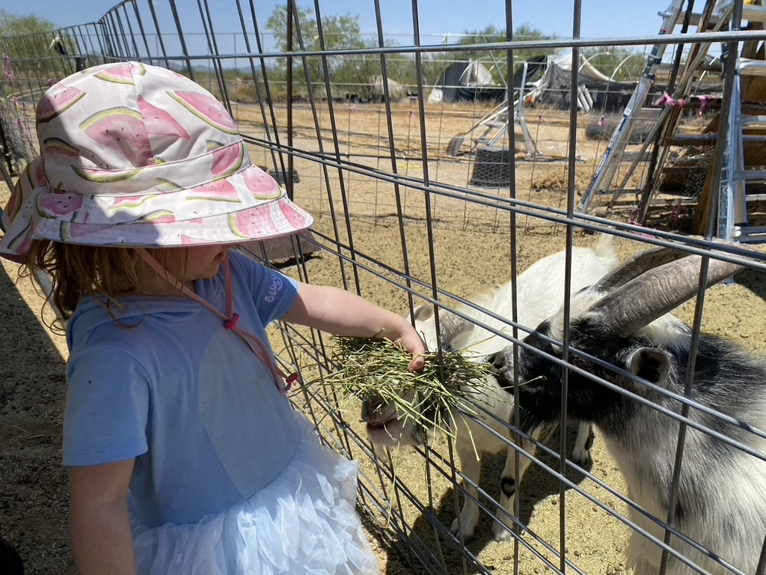
Benefits of Mushroom Cultivation
Circularity
The use of lignocellulosic biomass for substrate is an exciting part of mushroom production in that it enables us to re-incorporate many agricultural or landscaping waste products to produce a highly nutritious mushroom crop.
~100 million tons of crop residues are created each year in the U. S. alone
Major commodity crops produce large quantities of residues: rice, wheat, cotton, corn
Uses for these residues:
Fodder
Energy
Compost
Mushrooms!

Slide 15
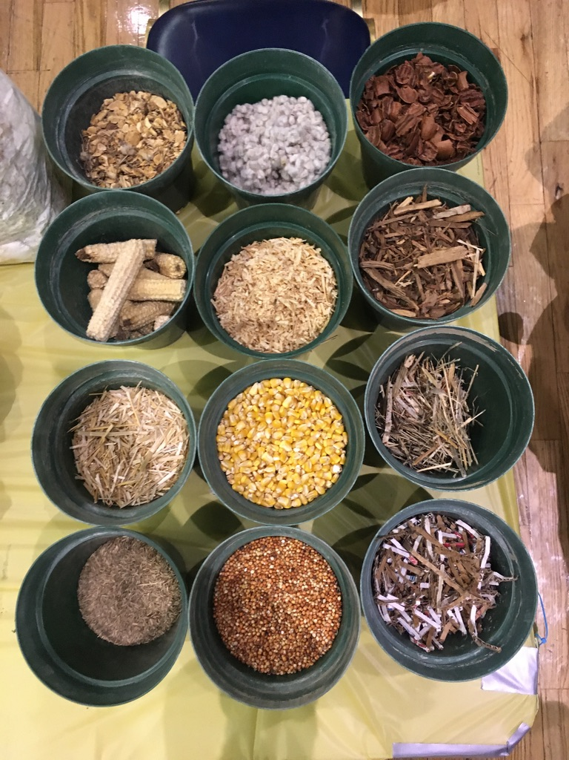
Benefits of Mushroom Cultivation
Our mushrooms will grow on nearly anything!
Corn, Corncobs, Cornstalks
Cotton and Cotton Waste
Textiles
Garden and Yard Waste
Hemp
Nut casing
Seed Hulls
Paper Products
Soybean Roughage
Brewery Waste
Cacao Shells
Coconut and Coir
Used Coffee Grounds
Agave
Straws, wheat, rye, etc.
Sugarcane
Tea waste, leaves and trimmings
Water hyacinth
Wood Construction Waste
Tomato vines

Slide 16
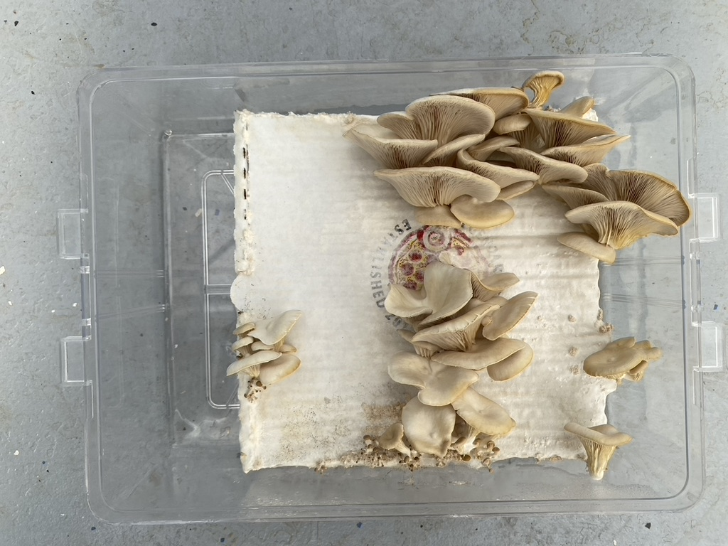
Benefits of Mushroom Cultivation
Yes, so many things can be substrate:
Lignocellulosic biomass for mushrooms

Slide 17
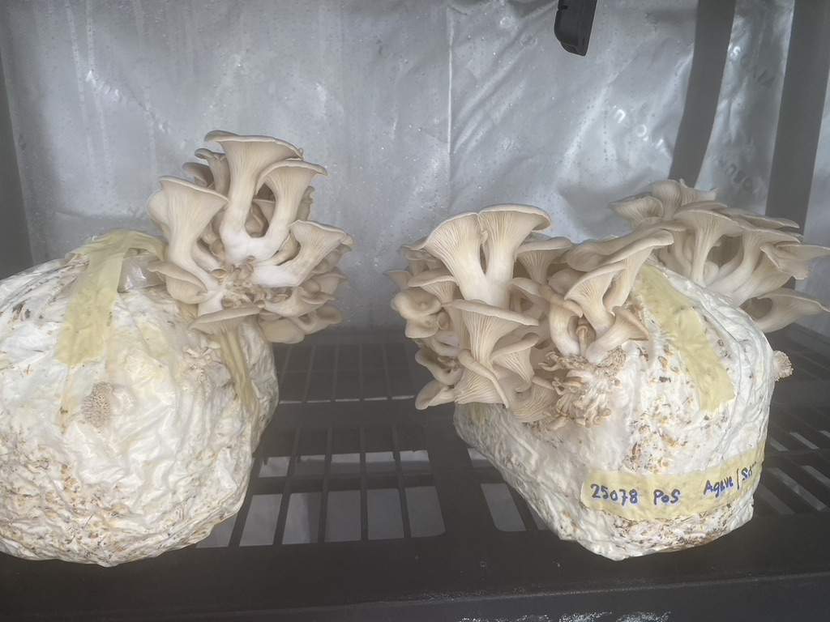
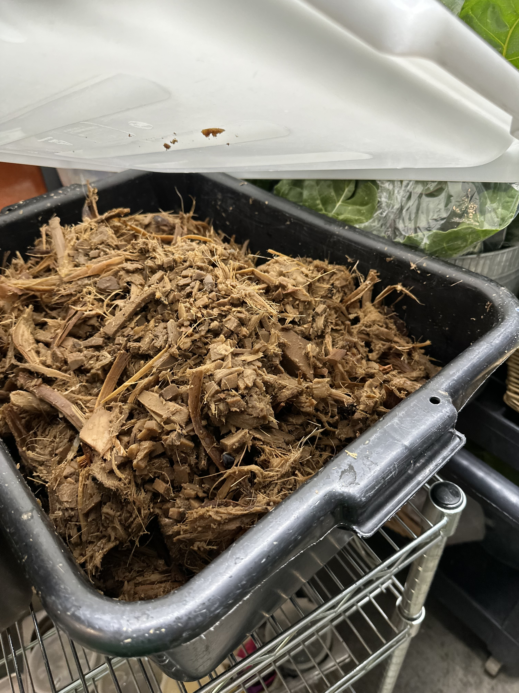
Benefits of Mushroom Cultivation
On average: ~2000g Roasted agave post syrup extraction to 700g oyster mushrooms
Roasted agave post syrup extraction

Slide 18
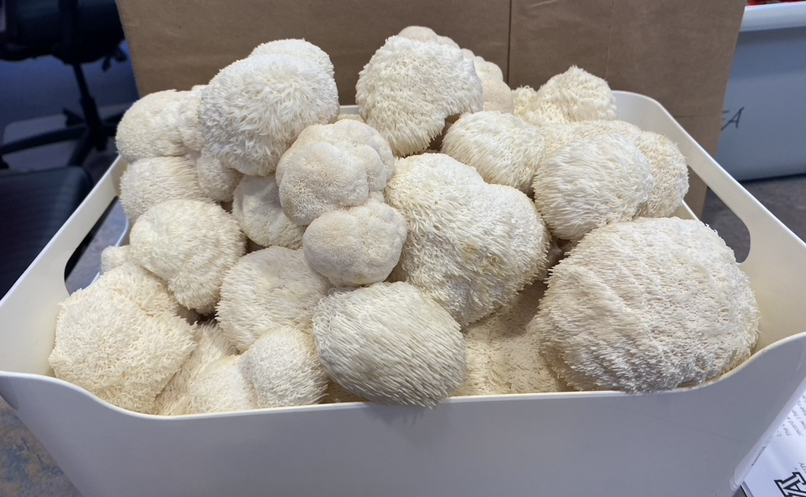
Benefits of Mushroom Cultivation
Growing industry:
U.S. market:
~$1–1.5 billion in cultivation/value
Volume ~1 Mt production
25.4 million pounds, just in specialty mushrooms
~7–8% share of global cultivated volume.
Global market:
$65–70 billion in 2023
Forecast to reach $125–145 billion by early 2030s
Volume ~17 Mt cultivated annually.
Growth comes from tech, niche varieties, and health trends aligning with global drivers.

Slide 19
Why Mushrooms!
Benefits of Mushroom Cultivation
Growing industry:
Almonds – $15B
Mushrooms $1.2 B
Strawberries – $22B
Tomato $2.5 B
Mushrooms – $45 B
Broccoli $800 M
Sweet Corn $800 M
Apples – $76B
Bananas – $41 B
Head Lettuce $1.3 B
Romaine Lettuce $1.4 B
Oranges – $34B
Melons – $11 B
Carrot $1.1 B
2022 US Crop Values
Fresh and Processed
ers.usda.gov
Lettuce – $20 B
World Market Values
FAOSTAT 2020

Slide 20
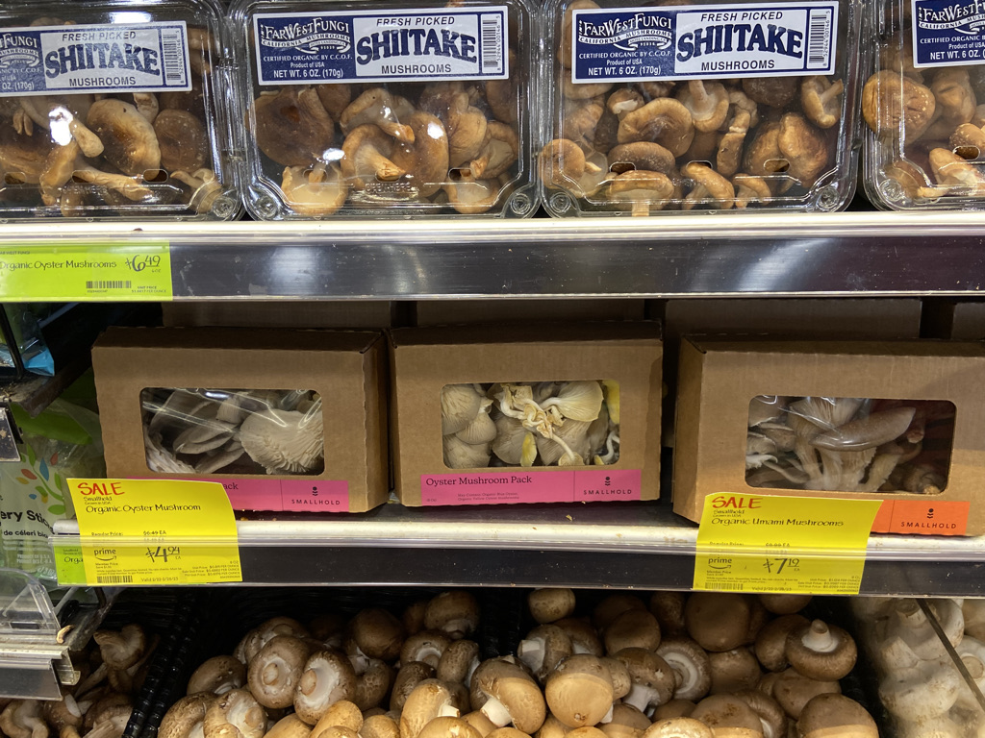
Benefits of Mushroom Cultivation
Typical prices:
Mushroom | Yield (per m²/month) | Selling Price | Profit Potential
Oyster | 10–25 lbs | $5–$10/lb | High if sold direct
Shiitake | 5–15 lbs | $8–$15/lb | Moderate
Lion’s Mane | 5–12 lbs | $10–$20/lb | Higher margin, but more complex to grow
Reishi | Lower yield (dried) | $30–$80/lb dried | Niche, value-added products

Slide 21
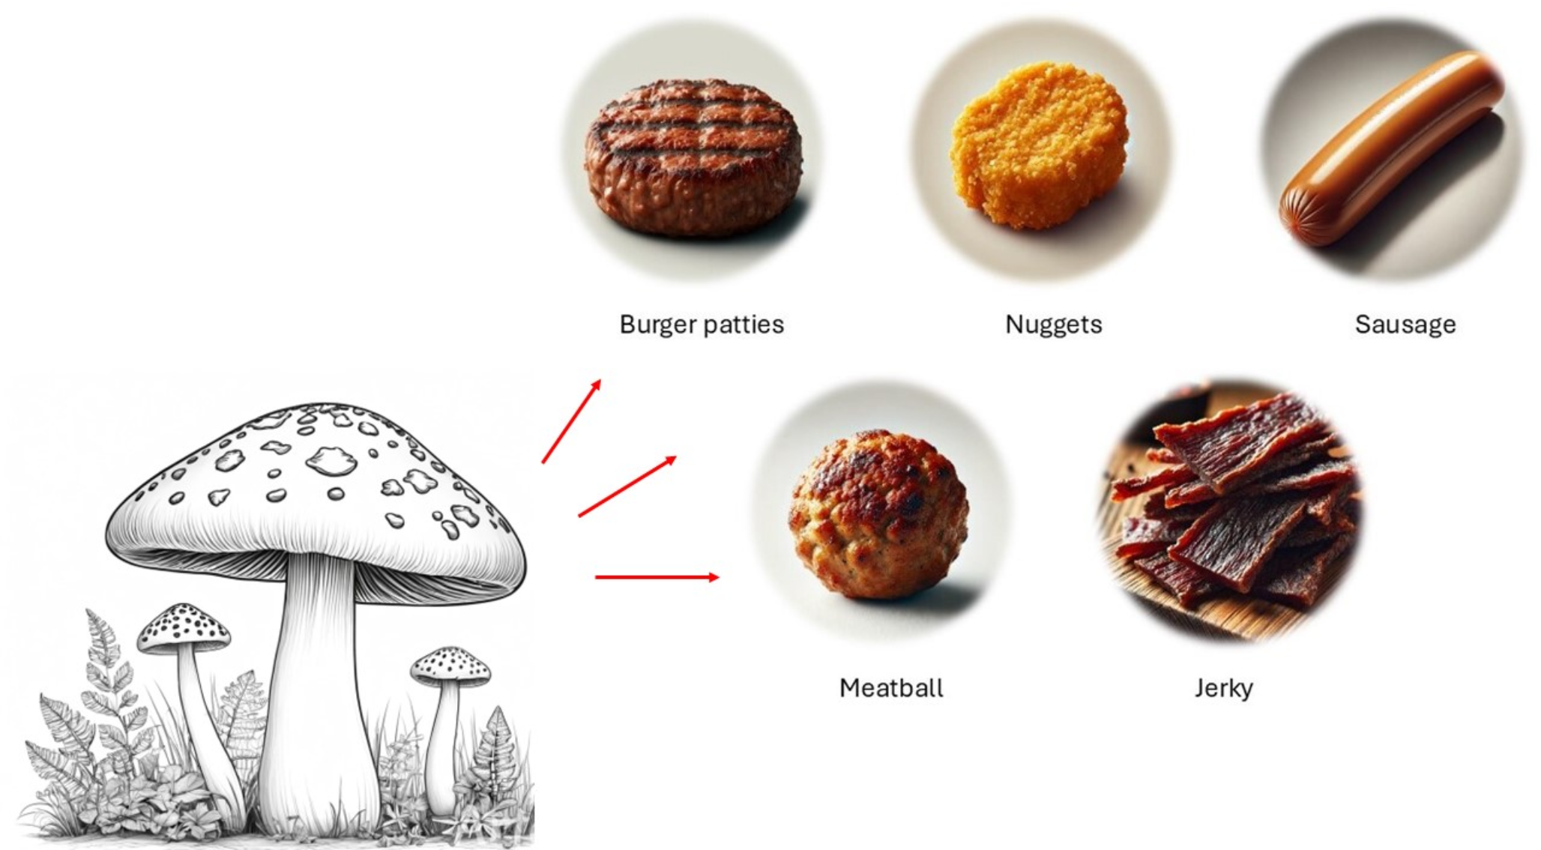
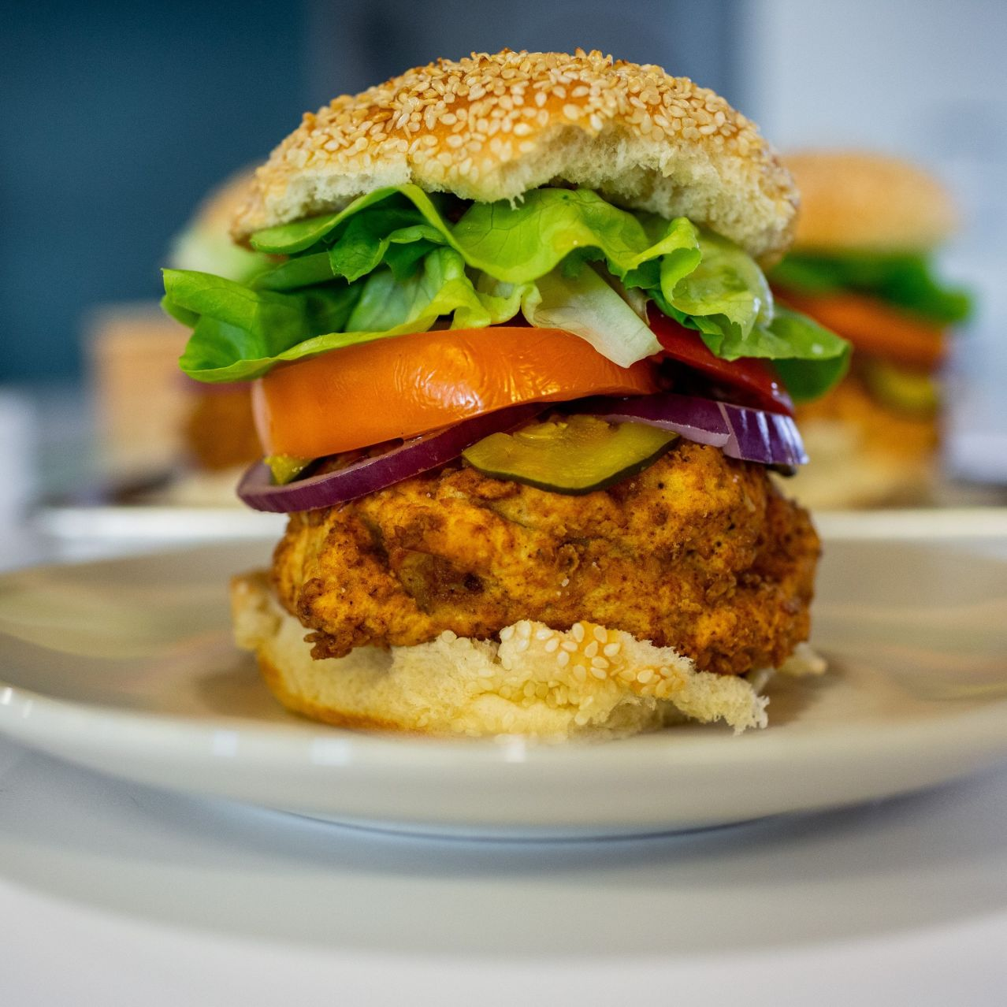
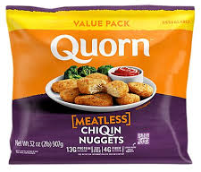
Growing Industry of Fungal Products
Mycoprotein products - no mushrooms involved
Contato, A.G., Conte-Junior, C.A. Mushrooms as meat substitute in plant-based diets. Eur Food Res Technol (2025). https://doi.org/10.1007/s00217-025-04722-0

Slide 22
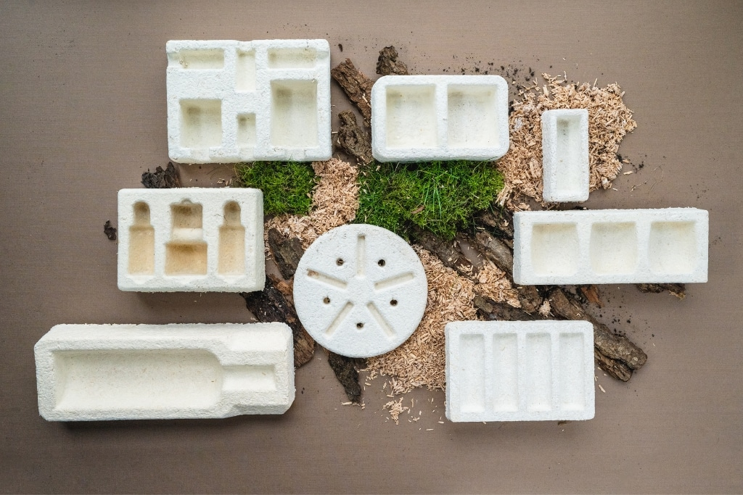
Growing Industry of Fungal Products
Bioremediation
Fungal compost starters
Ag. Inoculants and bio-control products
Composites for:
- Packaging
- Insulation
- Binding of particle board
Photo from company selling mycelium-based packaging solutions
https://www.grown.bio/

Slide 23
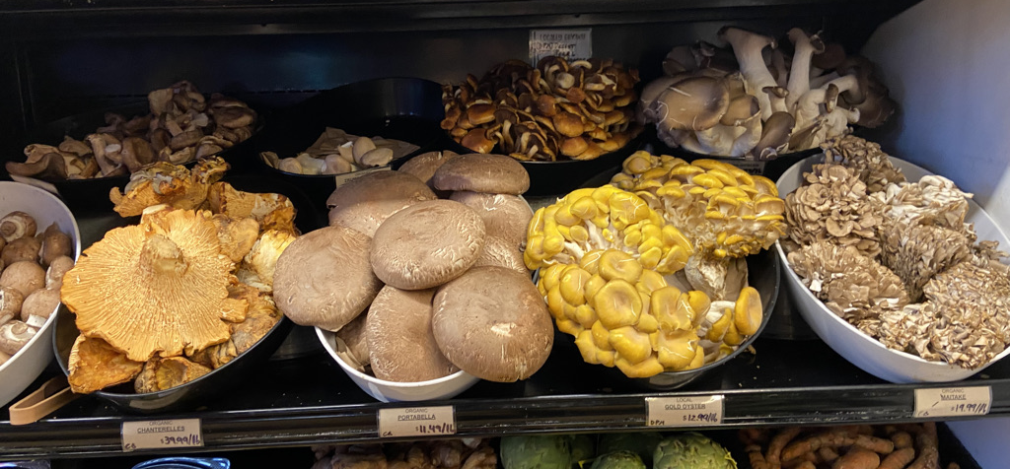
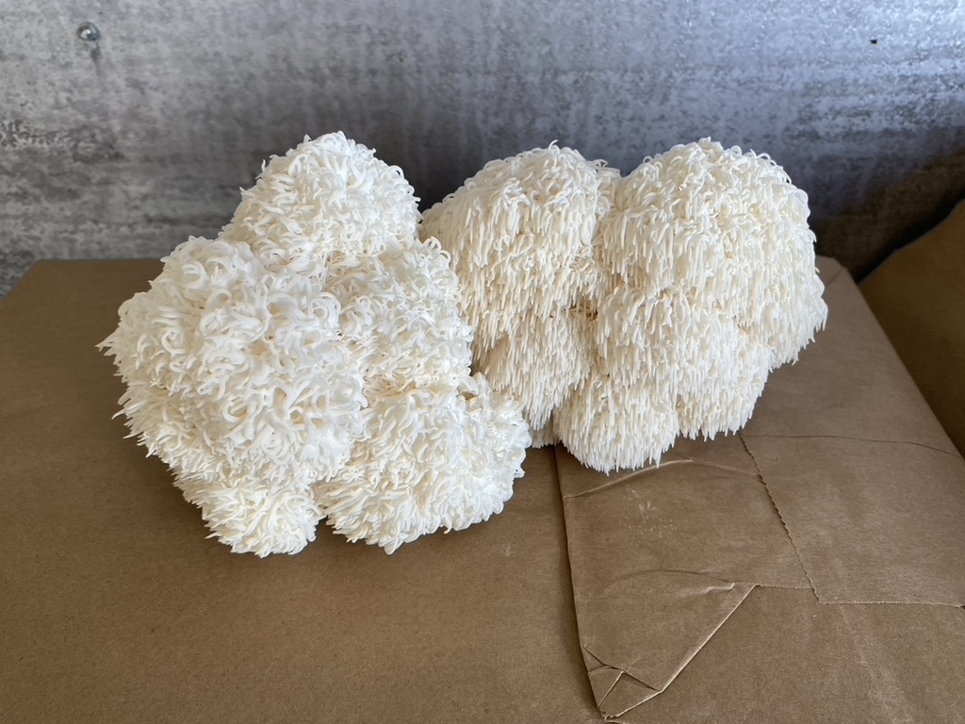
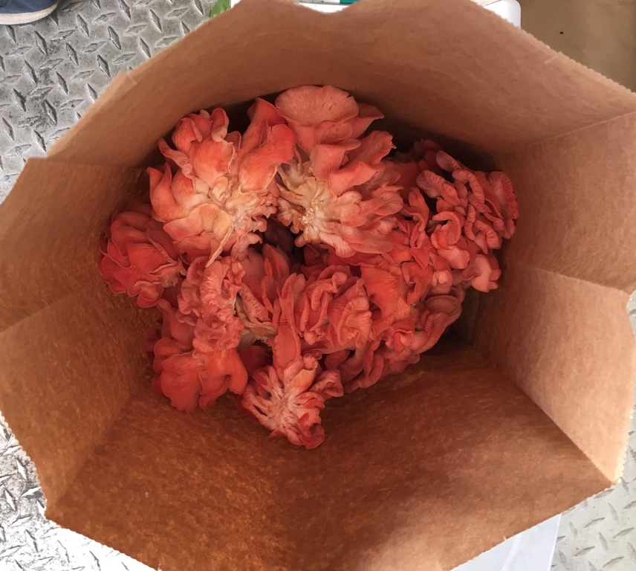
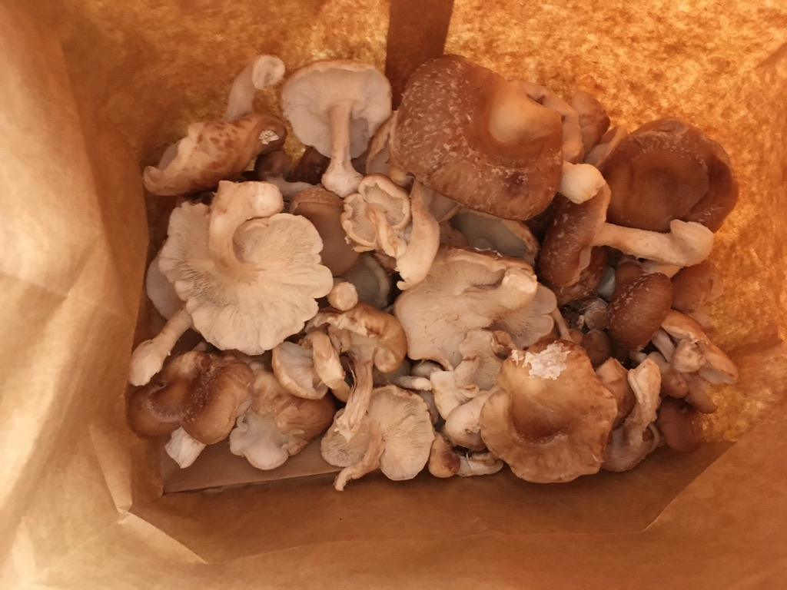
Mushrooms Currently in Cultivation
Current estimates put us at having identified ~10% of fungi, of which:
About 20,000 species fruit mushrooms
Over 1000 mushrooms have been found to be edible
Of these about 200 species have been cultivated, with about 20 being cultivated at a large scale.
Common Name | Scientific Name
White Button | Agaricus bisporus
Crimini / Baby Bella | Agaricus bisporus (brown strain)
Portobello | Agaricus bisporus (mature)
Oyster | Pleurotus ostreatus + others
King Oyster | Pleurotus eryngii
Shiitake | Lentinula edodes
Enoki | Flammulina velutipes
Beech Mushroom | Hypsizygus tessellatus
Straw Mushroom | Volvariella volvacea
Wood Ear / Black Fungus | Auricularia auricula-judae
Maitake / Hen of the Woods | Grifola frondosa
Paddy Straw Mushroom | Volvariella volvacea

Slide 24
Mushrooms Currently in Cultivation
Note:
Many of the edible mushrooms we love to eat are mycorrhizal and these we will just need to keep foraging for.
Common Name | Scientific Name | Primary Tree Partners
Truffle (Black/White) | Tuber spp. | Oak, hazel, beech, pine
Chanterelle | Cantharellus cibarius, C. formosus | Birch, beech, oak, conifer
King Bolete / Porcini | Boletus edulis | Spruce, pine, fir, chestnut
Matsutake | Tricholoma matsutake | Pine, fir, hemlock
And others are just tricky due to:
Slow growth rates
Environmental triggers
High contamination
Low yields
Common Name | Scientific Name | Why It’s Difficult
Morel | Morchella spp. | Complex life cycle, needs sclerotia formation, sensitive to environment
Cauliflower Mushroom | Sparassis crispa | Cultivable but slow and contamination-prone
Hedgehog Mushroom | Hydnum repandum | Mycorrhizal; lab cultivation not yet scalable
Lobster Mushroom | Hypomyces lactifluorum | Actually a parasite of other mushrooms (usually Russula), so must grow host

Slide 25
Mushrooms Currently in Cultivation
Note:
Many of the edible mushrooms we love to eat are mycorrhizal and these we will just need to keep foraging for.
Common Name | Scientific Name | Primary Tree Partners
Truffle (Black/White) | Tuber spp. | Oak, hazel, beech, pine
Chanterelle | Cantharellus cibarius, C. formosus | Birch, beech, oak, conifer
King Bolete / Porcini | Boletus edulis | Spruce, pine, fir, chestnut
Matsutake | Tricholoma matsutake | Pine, fir, hemlock
And others are just tricky due to:
Slow growth rates
Environmental triggers
High contamination
Low yields
Common Name | Scientific Name | Why It’s Difficult
Morel | Morchella spp. | Complex life cycle, needs sclerotia formation, sensitive to environment
Cauliflower Mushroom | Sparassis crispa | Cultivable but slow and contamination-prone
Hedgehog Mushroom | Hydnum repandum | Mycorrhizal; lab cultivation not yet scalable
Lobster Mushroom | Hypomyces lactifluorum | Actually a parasite of other mushrooms (usually Russula), so must first grow a host
Huitlacoche | Ustilago maydis | Plant pathogen that infects living corn plants and distorts kernels into galls.

Slide 26
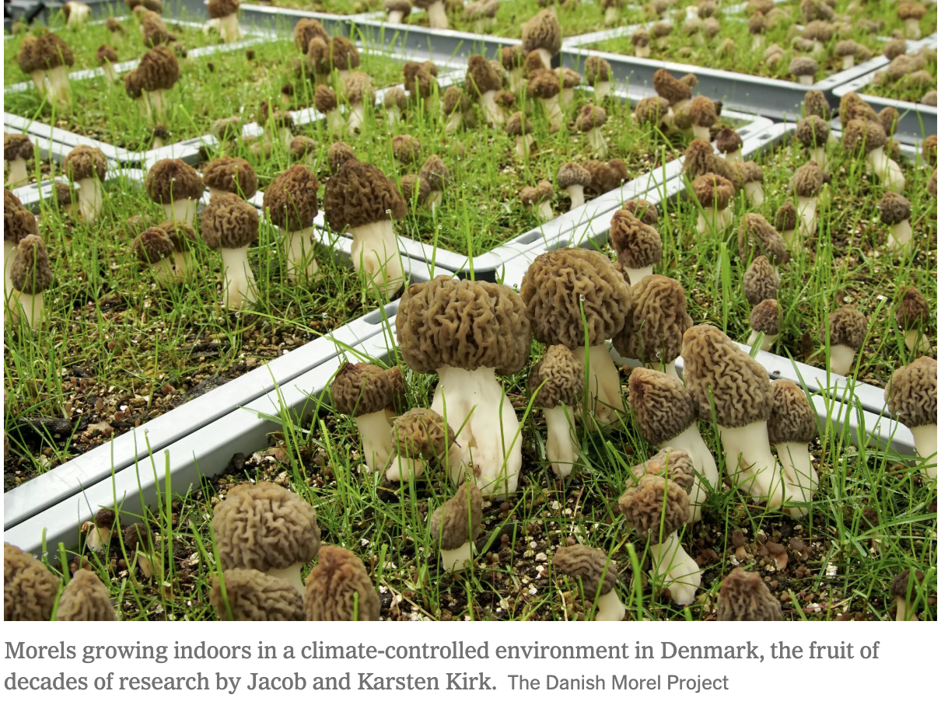
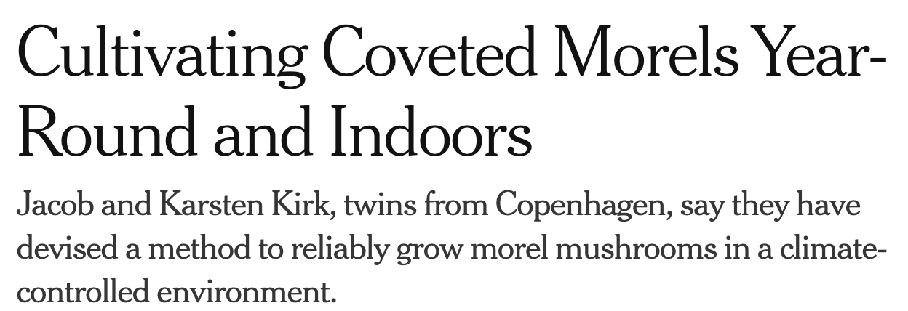
Mushrooms Currently in Cultivation
Note on Morels:

Slide 27
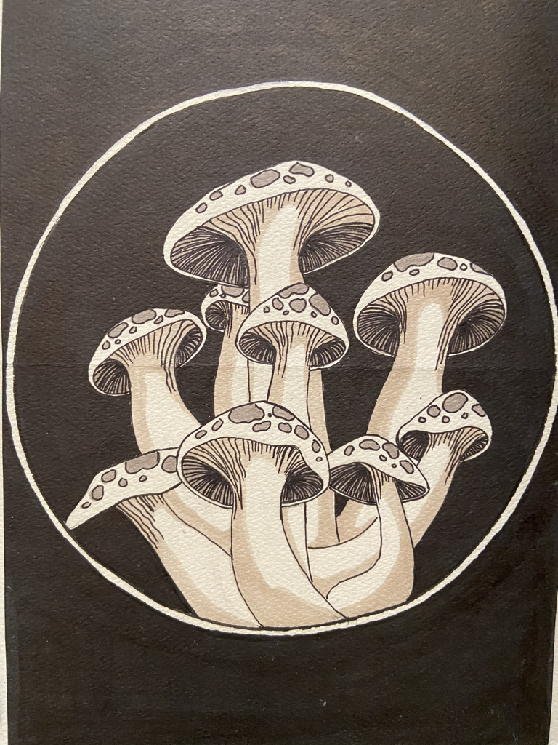
Questions
&
Break

Slide 28
Growing mushrooms: a process overview
Maintaining mushroom cultures
Spawn Production
Substrates (Composition, Moisture, Sources)
Sterilization vs. Pasteurization
Equipment

Slide 29
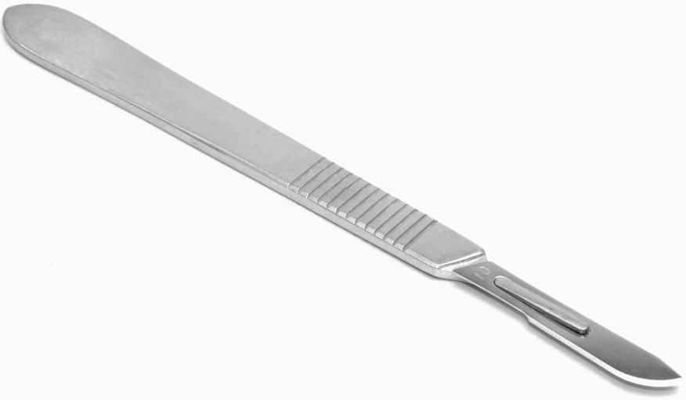
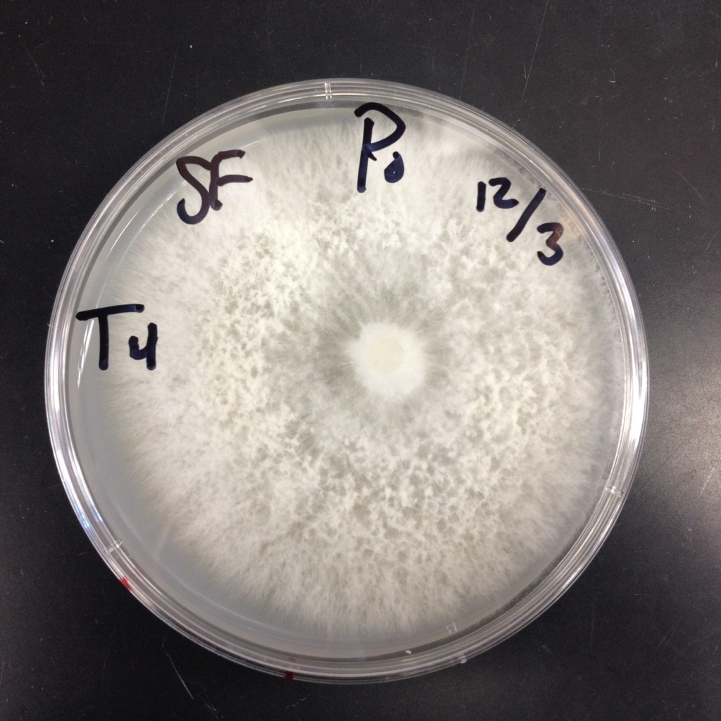
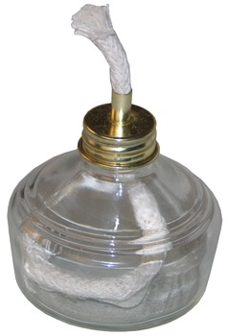
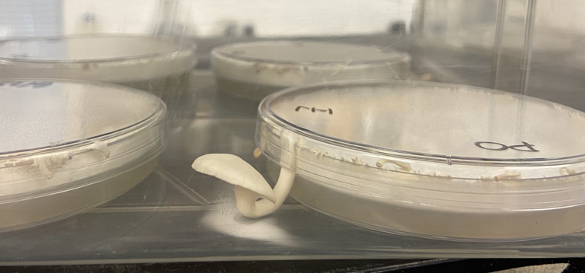
Growing mushrooms: a process overview
Maintaining mushroom cultures:
Hyphal fragment propagation.
Materials:
Fungal colony
PDA media (Potato Dextrose Agar)
Scalpel
An alcohol lamp

Slide 30
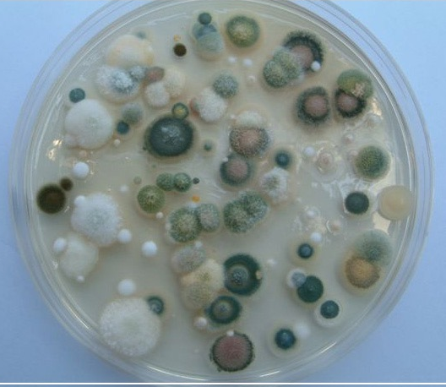
Growing mushrooms: a process overview
Maintaining mushroom cultures:
Note on Cleanliness and Sterility
Interior spaces: Molds
Keep competition down.

Slide 31
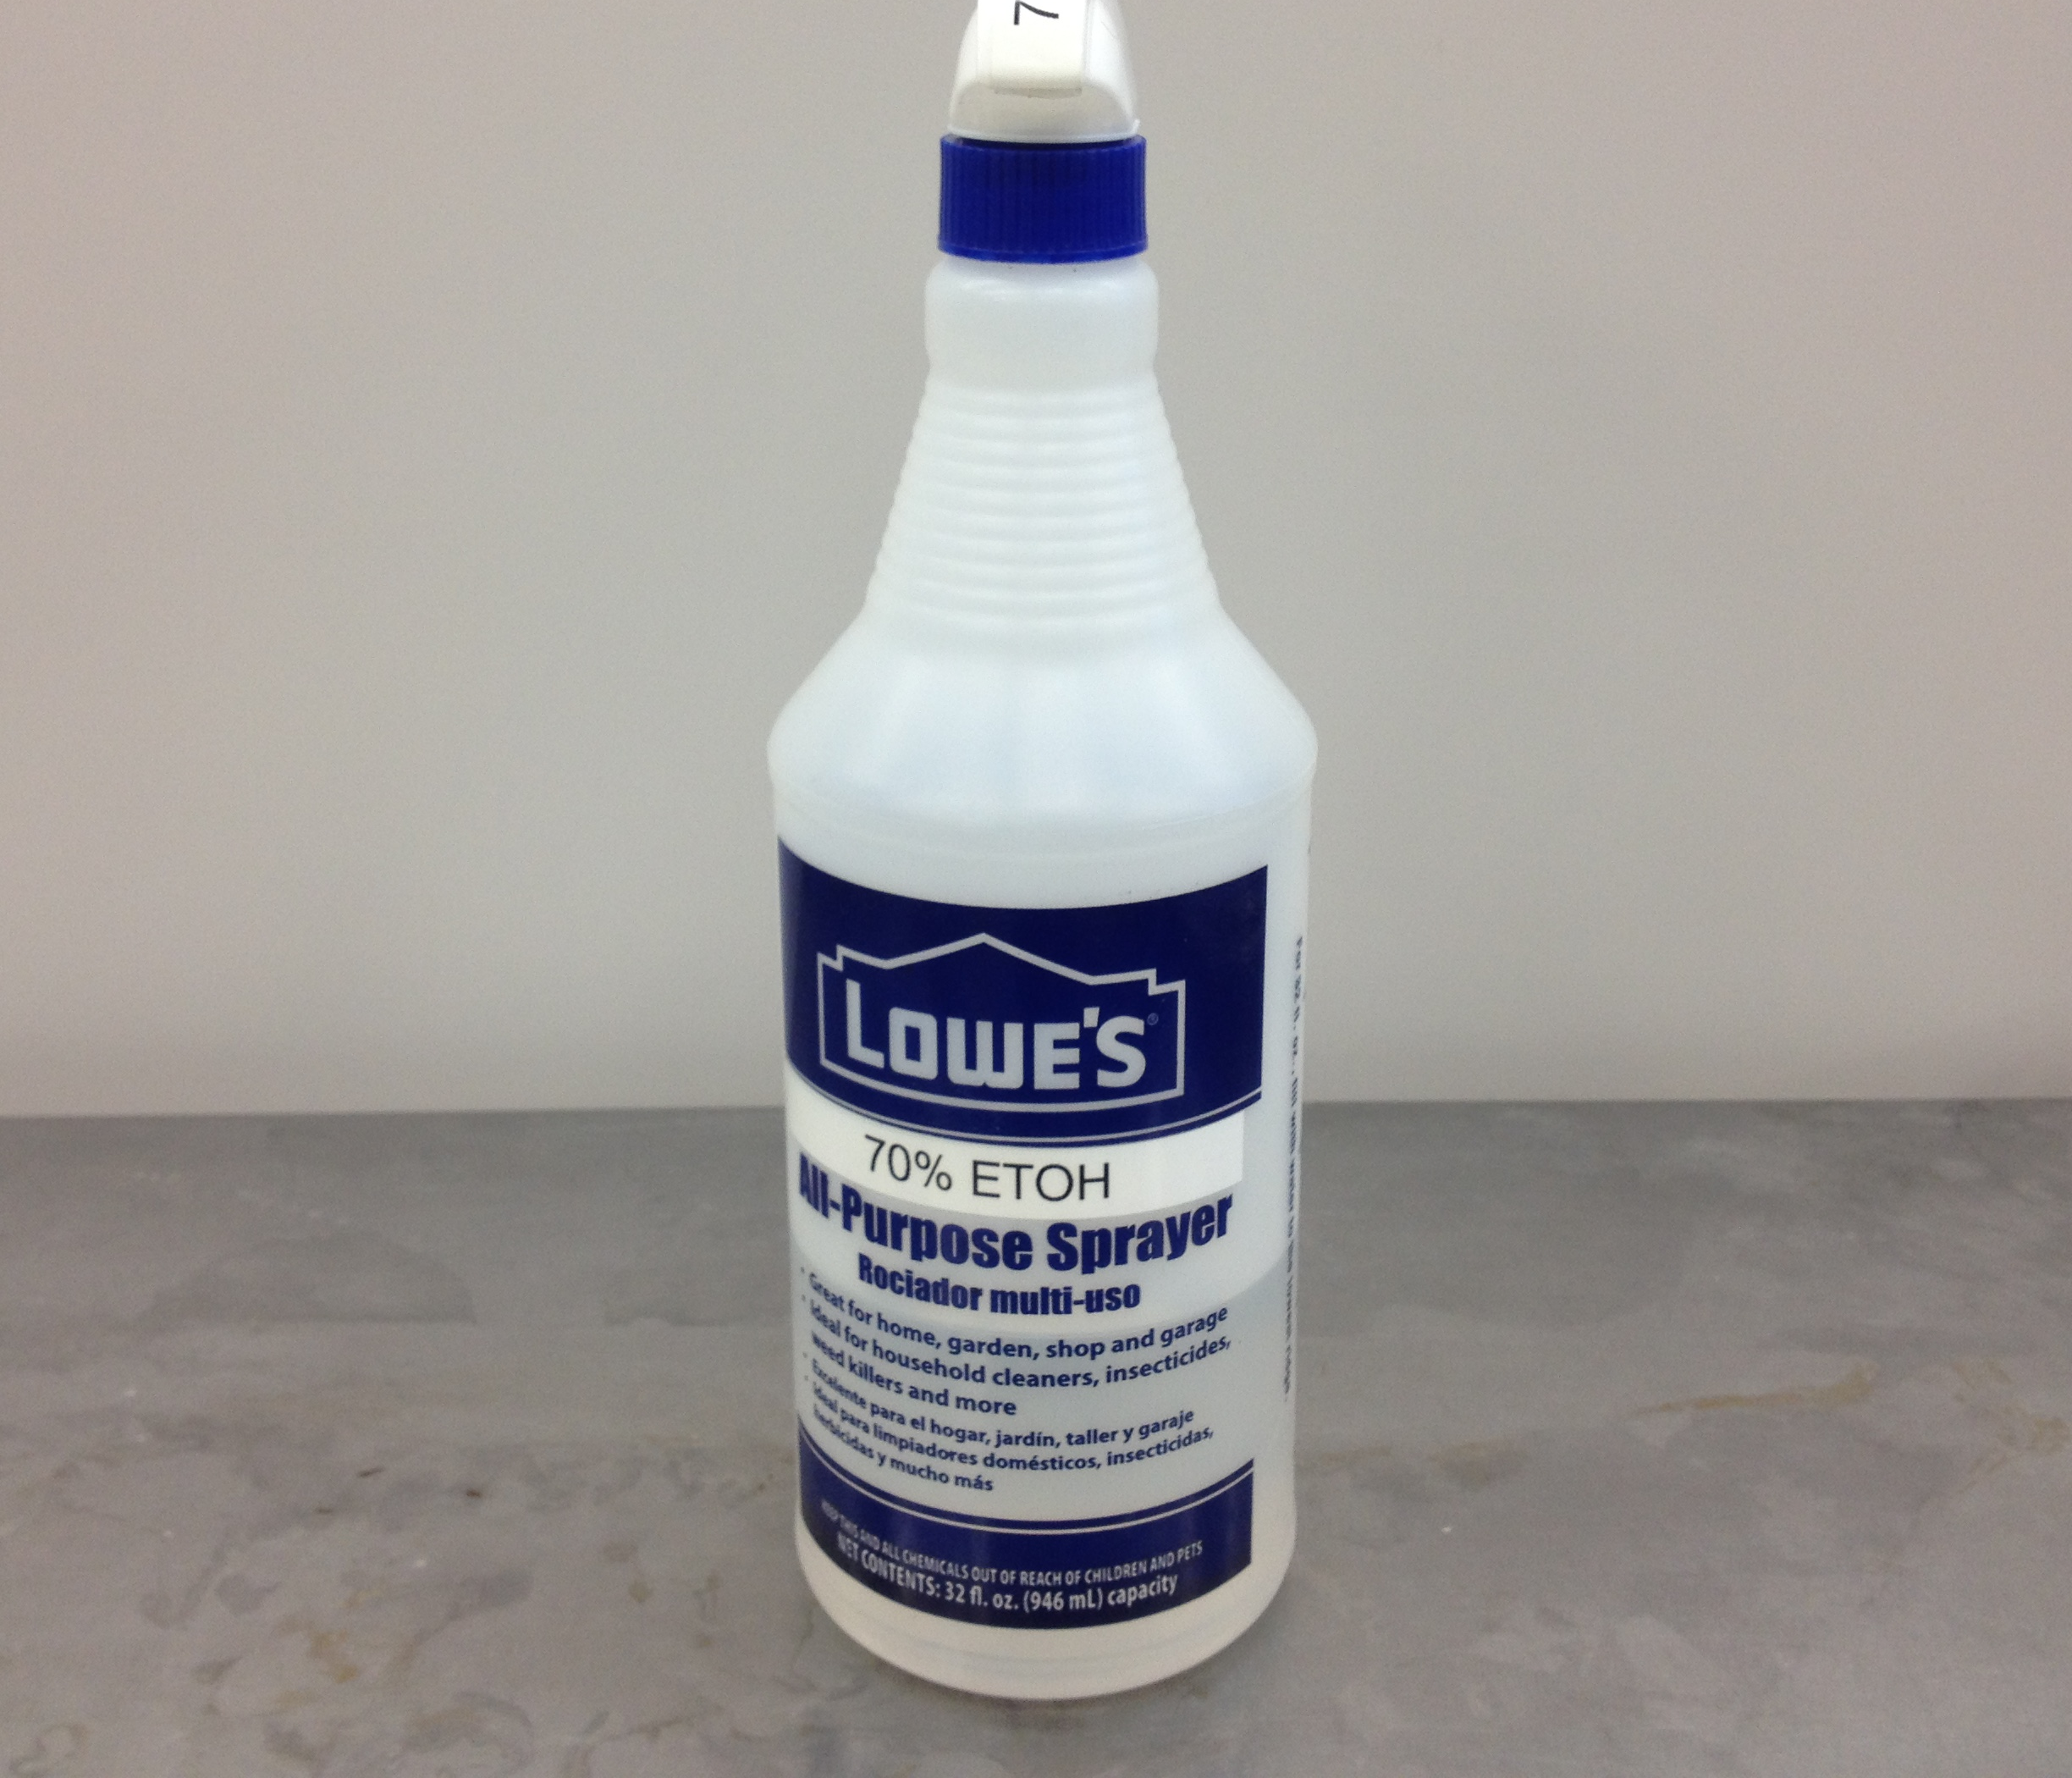
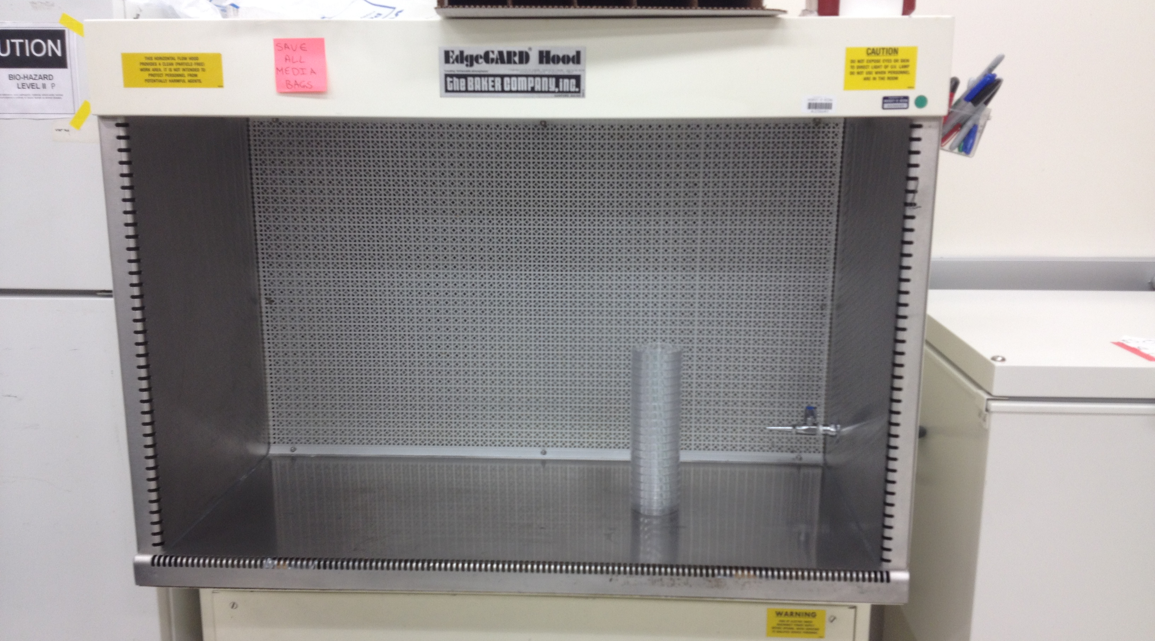
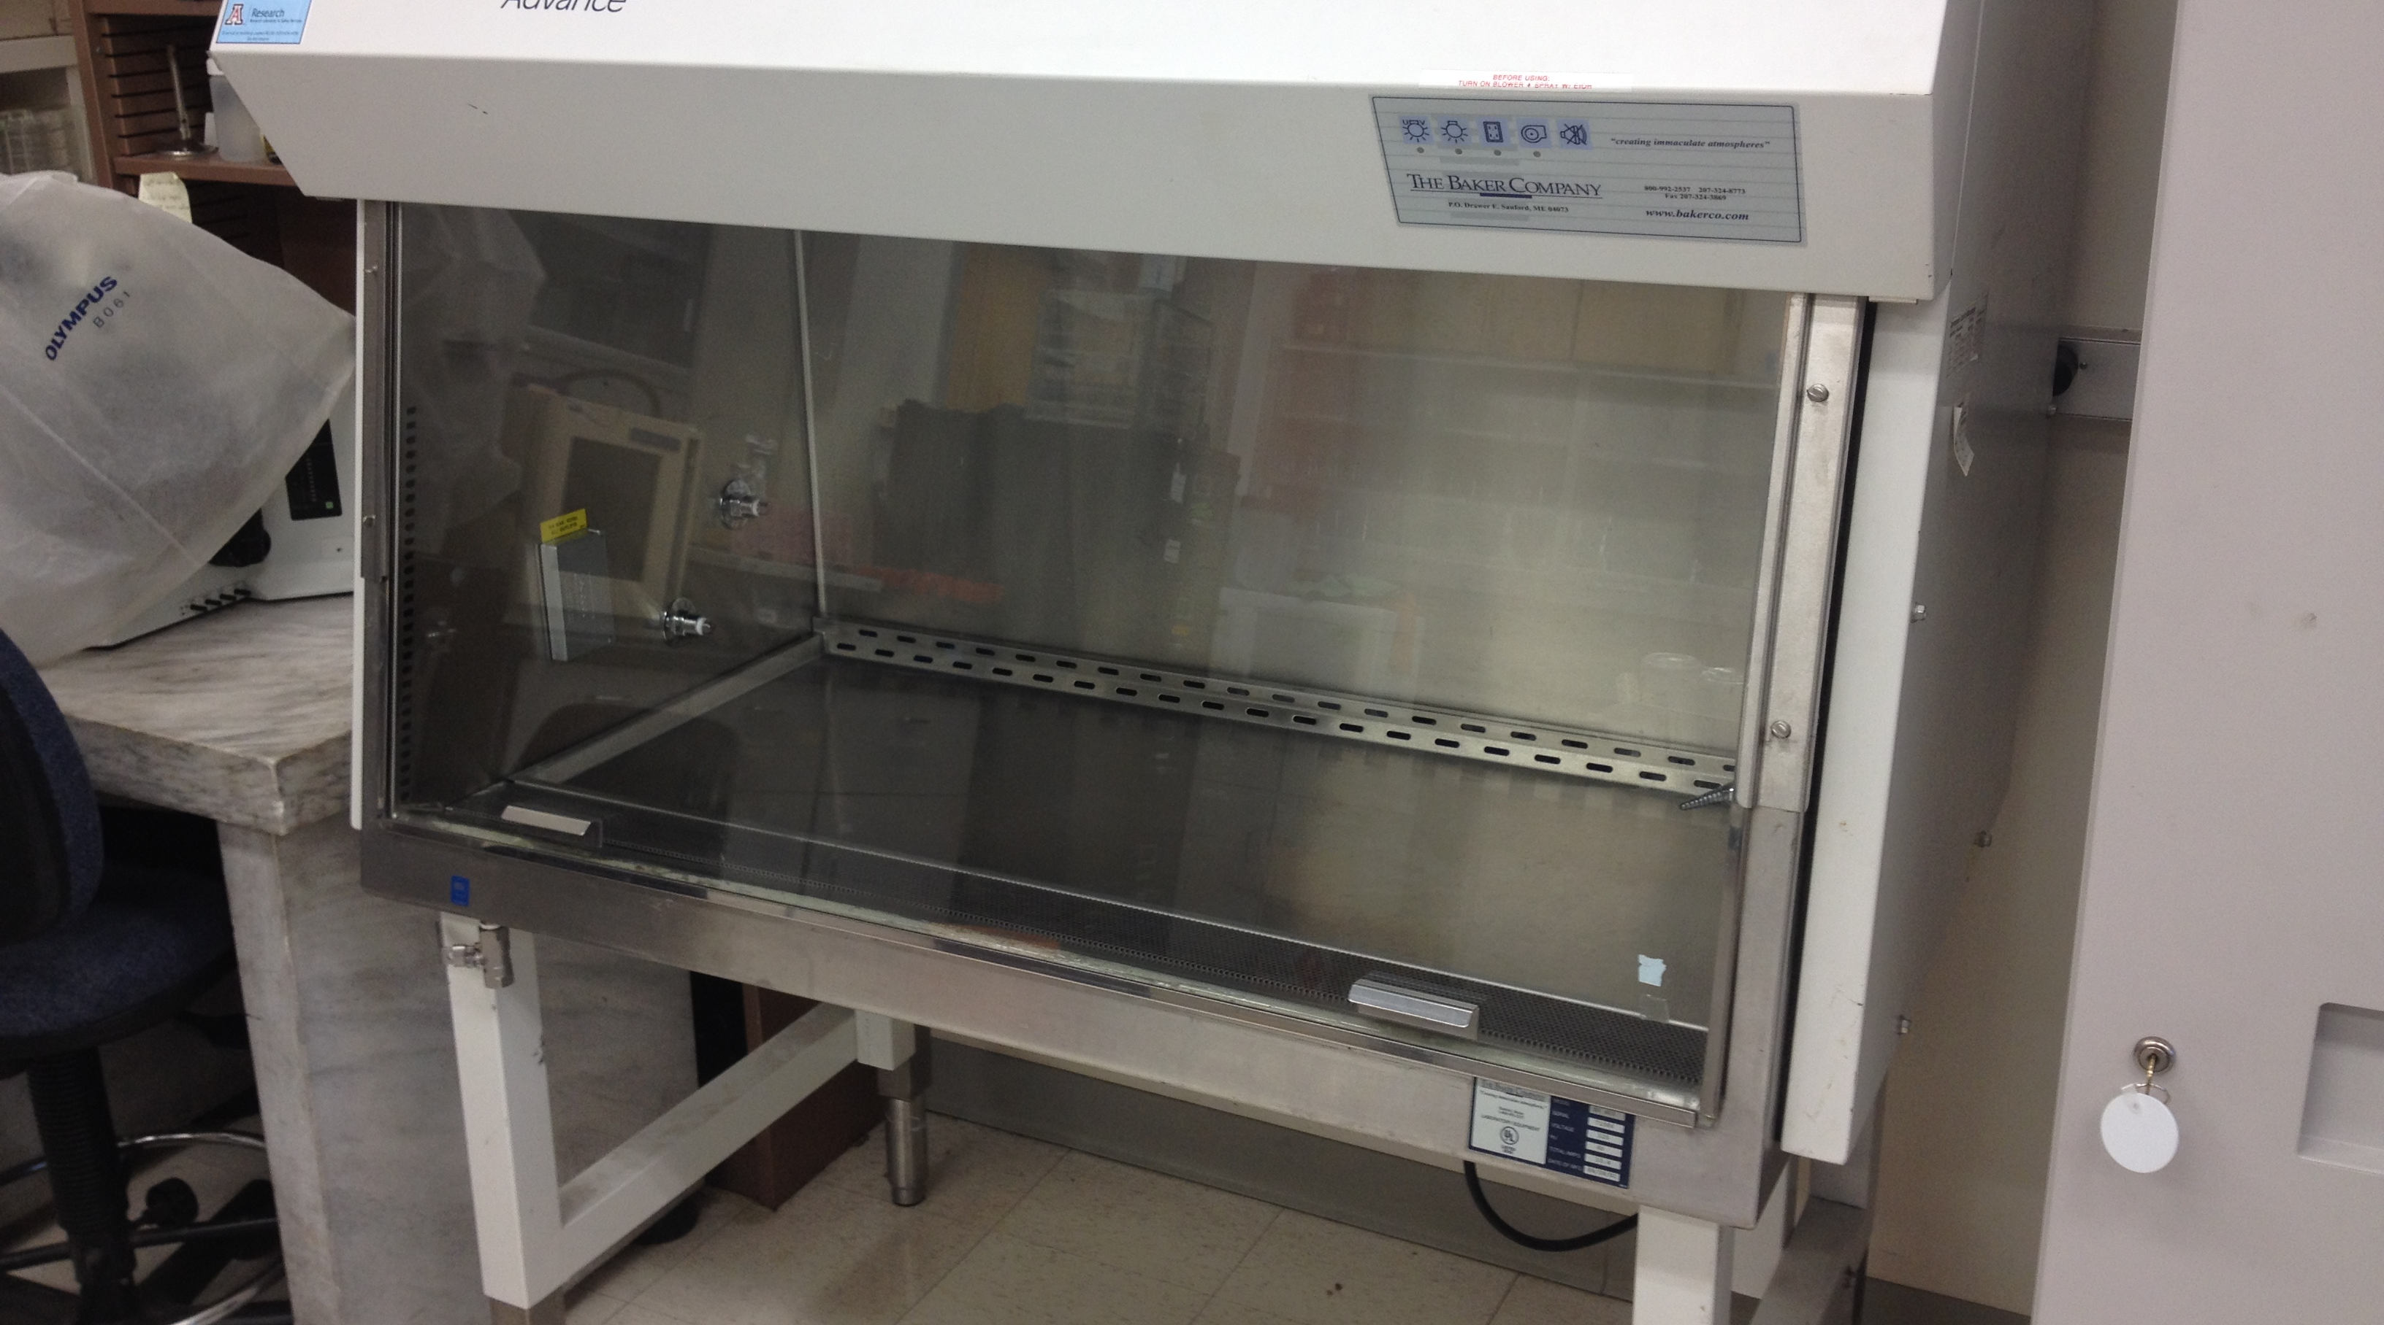
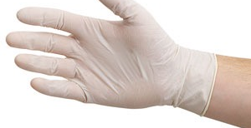
Laminar Flow Hood
70% Alcohol, such as rubbing alcohol goes a long way
Bio-safety cabinet

Slide 32
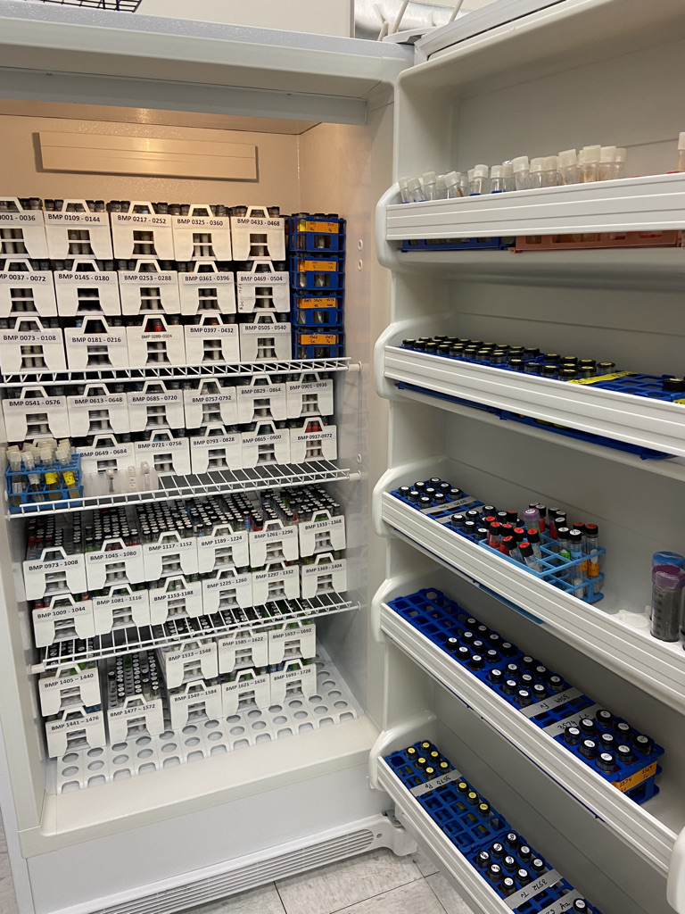
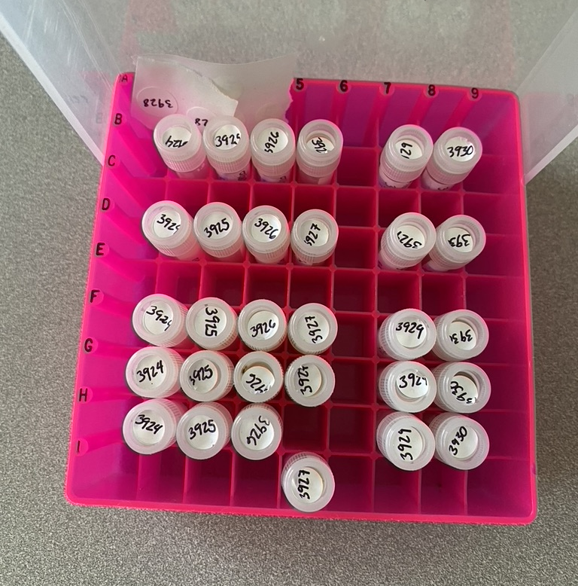
Growing mushrooms: a process overview
Maintaining mushroom cultures
Spore prints
Silica gel storage
Water Vouchers
Slants

Slide 33
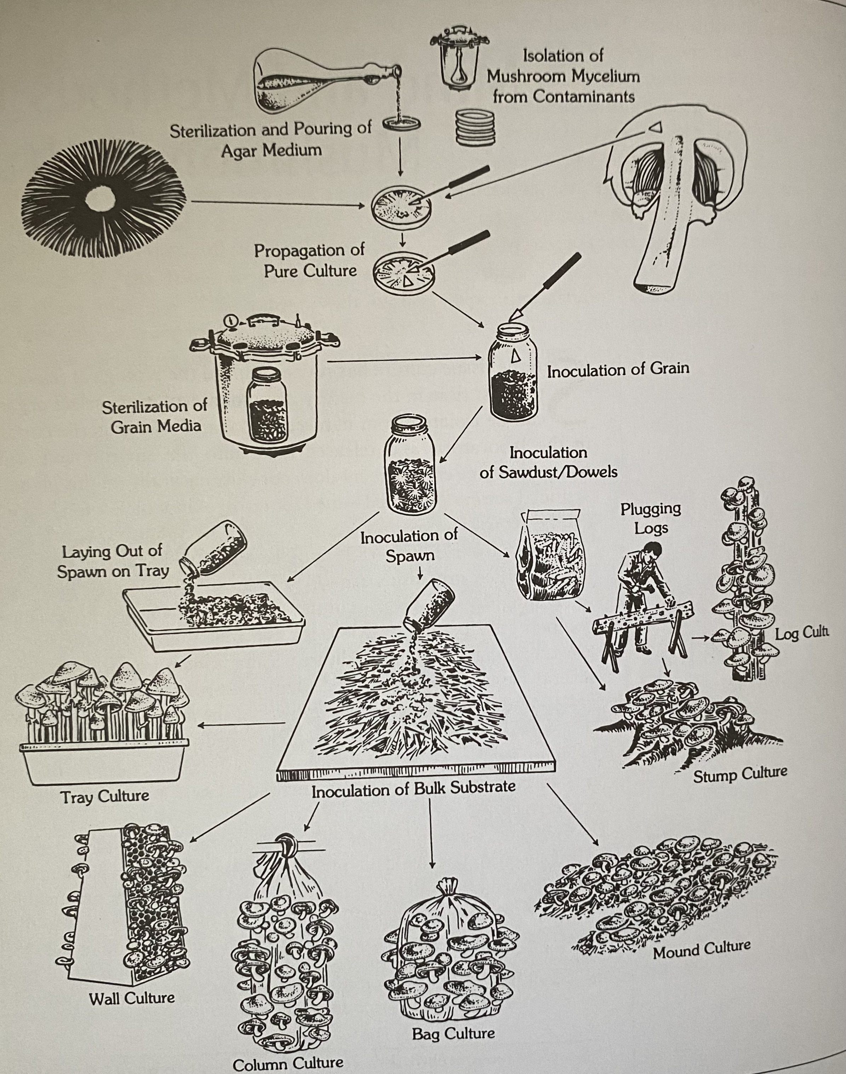
The General Process
Prepare cultures
  (7-10 d)
Spawn production
  (10-14 d)
Substrate preparation
  (2-4 d)
Spawn run
  (14-21 d)
Production flush
  (7-42 d)
Total time = 40-90 days to finish
Paul Stamets

Slide 34
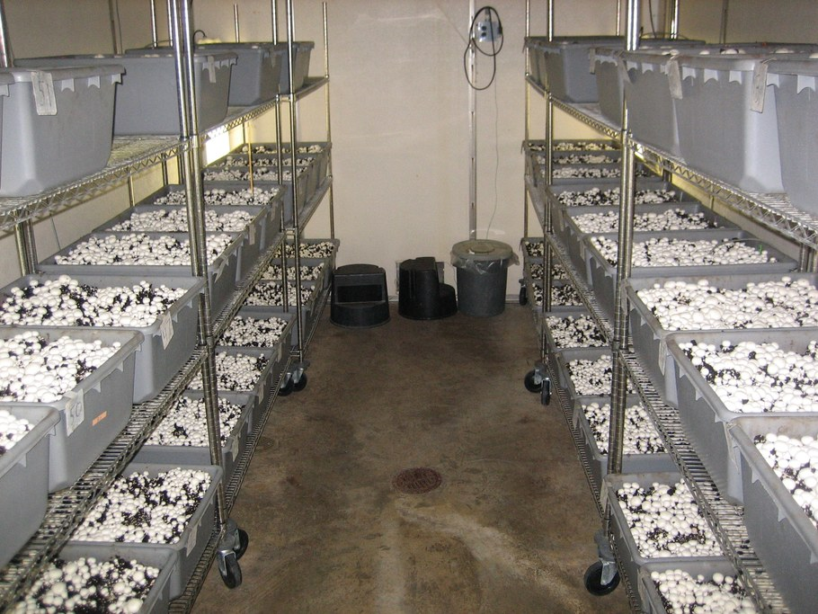
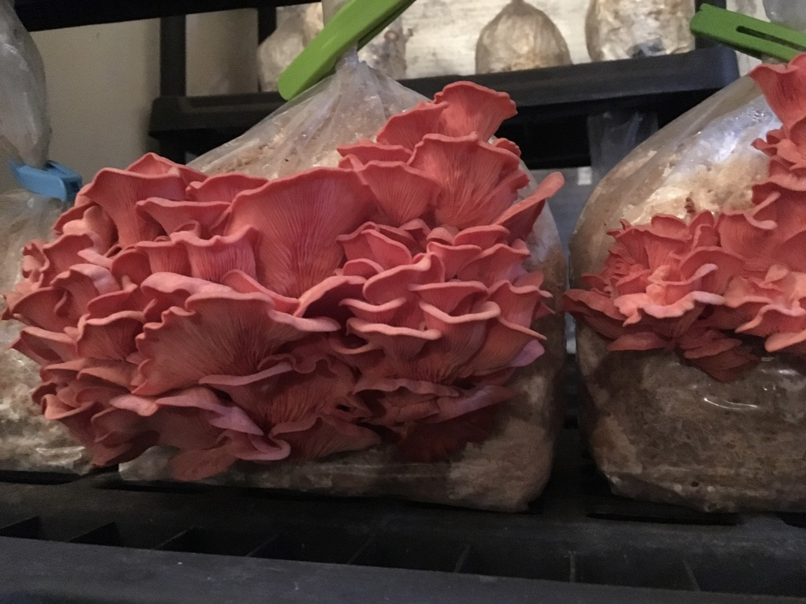
The Cultivation Process is very different for
Growing mushrooms: a process overview
Field mushrooms
Forest mushrooms

Slide 35
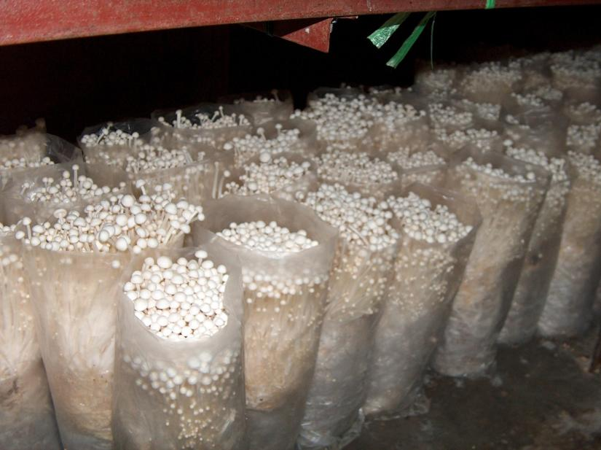
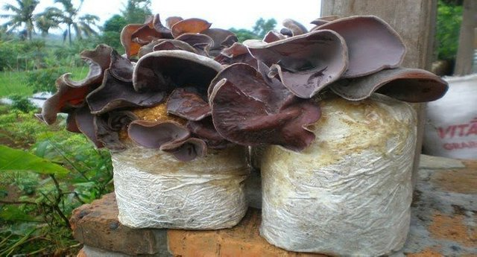
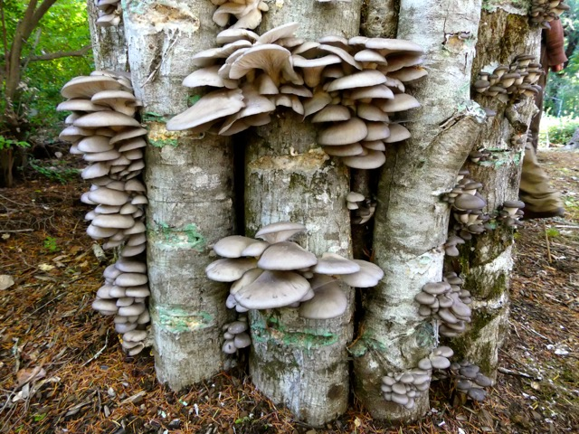
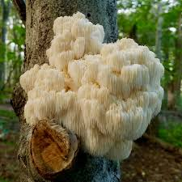
Growing mushrooms: a process overview
Forest mushrooms, or wood decay fungi:
Are those that grow on living or dead trees and decompose wood.
Commercial production of wood decay fungi historically performed on inoculated natural logs.
Today, most commercial production occurs on “artificial logs” composed of sterilized or pasteurized substrates packed in bags.
Flammulina velutipes
(Enoki)
Auricularia auricula
(wood ear)
Pleurotus ostreatus
(pearl oyster)
Hericium erinaceus
(Lion’s mane)

Slide 36


White rot vs. Brown rot
Brown rot fungi, capable of breaking down cellulose and hemicellulose (carbohydrate polymers)
White rot fungi, capable of breaking down Lignin (aromatic polymers)

Slide 37




Forest/wood decay fungi
Slew of enzymes making them unequal for breaking down a diverse array of substrates – LIGNIN
High protein food item that can be produced in isolation making them desirable for production in harsh or remote environments (i.e.: the south pole, or ISS)

Slide 38



From the beginning, commercial mushroom production was a CEA industry
1707 France
  - Tourefort describes cultivation of Agaricus campestris, the common field mushroom, and modern mushroom cultivation began.
    Using straw and horse manure and as a substrate
    Using limestone mines as the production facility
Agaricus campestris
Mushroom production in limestone caves: Temperature control
(Published 1883)

Slide 39


Growing mushrooms: a process overview for our wood decay fungi
Four principles of mushroom cultivation:
Create a nutrient source (the substrate) that is optimal for your fungus.
Inoculate the substrate with your clean fungus inoculum (the spawn) so it will dominate the substrate.
Manage an environment to favor initial growth and nutrient utilization of substrate (the spawn run).
Closely manage an environment (which may be different from #3) to favor periodic mushroom initiation and development (the production run).

Slide 40



Growing mushrooms: a process overview
Spawn Production
Allows for the bulk amounts of mycelia needed for substrate inoculation.
Examples of grains typically used:
    Cracked corn, millet, rye, barley, rice…
Main Steps:
  Soak grain to increase moisture content
  Sterilize
  Inoculate

Slide 41

Growing mushrooms: a process overview
Substrate - Composition
Carbon source + Nitrogen source + moisture.
Main Steps:
Soak, sterilize and inoculate.
Note: shredding the material creates more surface area for the mycelia

Slide 42
Growing mushrooms: a process overview
Substrate - Composition
Plant Material | Cellulose (%) | Hemicellulose (%) | Lignin (%)
Wheat straw | 33–40 | 20–25 | 15–20
Corn stover | 35–40 | 20–25 | 15–18
Switchgrass | 30–35 | 25–30 | 12–20
Softwood (e.g., pine) | 40–45 | 25–30 | 25–35
Hardwood (e.g., poplar) | 40–50 | 20–25 | 20–25
Alfalfa | 25–30 | 20–25 | 10–15

Slide 43


Substrate Optimization
Growing mushrooms: a process overview
Water holding capacity
Particle size
Carbon to Nitrogen ratios

Slide 44

Hericium
Growing mushrooms: a process overview
Items to keep in mind:
Moisture content
Particle size of substrate material
Environmental conditions of fruiting chambers
Currently working with:
Carbon Sources:
Nitrogen Sources:
Milled Mesquite Wood
Milled Palo Verde Wood
Mesquite Pellets
Oak Pellets
Straw Pellets
Almond Hulls
Rice Hulls
Pecan Shells
1:1
Soy Hull Pellets
Cotton Seed
Mesquite Pods
Tomato vines

Slide 45
Optimization of Substrate for Hericium
Growing mushrooms: a process overview
Treatment | %Bioefficiency
Oak pellets/Mesquite pods | 21.89
Oak pellets/Cotton seed | 22.68
Oak pellets/Soy hulls | 50.77
Treatment | %Bioefficiency
Mesquite pellets/Mesquite pods | 21.43
Mesquite pellets/Cotton seed | 33.9
Mesquite pellets/Soy hulls | 47.88
First flush data

Slide 46
Growing mushrooms: a process overview
Substrate – Moisture
Hydration of lignocellulosic biomass: “holding and retention capacities are associated to biomass type and surface size”
Higher cellulose content usually leads to greater water holding capacity
Higher lignin content usually leads to reduced water holding capacity
Smaller particles tend to have higher water holding capacity due to increased surface area.

Slide 47

Growing mushrooms: a process overview
Substrate – Moisture
Note on Hydrating:
Aim for 70% moisture content.
We often soak and then calculate our moisture based on weight
For example:
Dry Weight: 2700g
Wet Weight: 8500g
8500/2700 = 0.31x 100 = 31.7
100% - 31.7% = 68.3%

Slide 48
Growing mushrooms: a process overview
Substrate – Moisture
Substrate type | Water
Cotton Seed | 55%
Mesquite Pods (chipped) | 59%
Rice hulls | 60%
Milled mesquite wood | 66%
Milled Palo verde | 67%
Milled almond Hulls | 81%
Milled pecan shells | 49%
Alder shavings | 80%
Straw - pellets | 80%
Oak - pellets | 64%
Tomato vines (chipped) | 76%
Corn stalks (chipped) | 79%
- Higher cellulose content usually leads to greater water holding capacity
- Higher lignin content usually leads to reduced water holding capacity

Slide 49

Growing mushrooms: a process overview
Substrate – Sources
What non-edible biomass do you have in your area?
And, what’s currently happening to it?

Slide 50


Growing mushrooms: a process overview
Sterilization vs. Pasteurization
Think of it as a spectrum

Slide 51

Growing mushrooms: a process overview
Sterilization vs. Pasteurization
The Autoclave:
Creates an environment with higher-than-normal atmospheric pressure so that water boils 20° C hotter than normal, thus creating steam hot enough to effectively kill microbes.

Slide 52
Growing mushrooms: a process overview
Sterilization vs. Pasteurization
 | Autoclaving | Pasteurization
Typical temperature | 121 °C (250 °F) under pressure (15 psi). | 60–80 °C (140–176 °F) at atmospheric pressure.
Duration | 60–120 minutes depending on load size. | 1–2 hours, often with soaking or steaming.
Goal | Sterilization – kills all microorganisms, including spores. | Partial sanitization – kills most competing organisms, but not all spores.
Used for | High-nutrient substrates (e.g., grain spawn, supplemented sawdust) that are highly prone to contamination. | Low-nutrient substrates (e.g., straw, agri-waste) where beneficial microbes can be tolerated.
Required | Autoclave or high-pressure steam sterilizer. | Large drums, barrels, water heaters, or steam tunnels.
Cost | High (especially for large-scale autoclaves). | Low to moderate (can be done with simple equipment).

Slide 53
Growing mushrooms: a process overview
Gen. Production Equipment
Equipment | Purpose
Laminar flow hood or still-air box | To maintain sterile conditions while inoculating
Pressure cooker or autoclave | For sterilizing grain, agar, tools
Bag sealer or impulse sealer | Bag sealer or impulse sealer
Chipper or shredder | To break down agricultural waste or wood
Soaking tanks or barrels | For hydrating straw or sawdust
Pasteurization system | Hot water bath, steam tunnel, or 55-gallon drum pasteurizer

Slide 54


Questions
&
Break

Slide 55
The Fruiting Process
Environmental conditions for production
  CO₂ venting requirements
  Humidity requirements
  Temperature requirements
  Lighting requirements
Fruiting chamber
Fruiting chamber upkeep
Equipment

Slide 56



The Fruiting Process
Fruiting
Previously, sterility was key but for this Stage in the process Environmental Conditions become front and center

Slide 57



The Fruiting Process
The Optimal Fruiting Environment:
….Depends on the fungus, but usually:
Relative Humidity: 80 - 85%
Temperature: less than 80°F
CO2: less than 600 ppm
Notes:
rel. humidity in Tucson between 7% (lowest) and 82% (high)

Slide 58




The Fruiting Process
Most modern mushroom production occurs in dedicated controlled environment facilities. And this is a good thing
Improved mushroom quality:
Nutritional qualities (lighting)
Optimal timing for harvest
Removal of exposure to the elements
Allows for us to improve on mushroom varieties

Slide 59






The Fruiting Process

Slide 60




The Fruiting Process

Slide 61
Introduction to Fungi
Achlorophyllous,
and therefore: heterotrophs just like us!
Typically, filamentous
but: yeasts are fungi too!
Reproduce via spores
…there are always exceptions
Cell walls are composed of chitin
    Which is largely indigestible, so: Cook your mushrooms
Haploid most of their life cycle
    Single set of chromosomes
Respire
    Producing CO₂ …just like us
Image: Thanks to Fresh Cap Mushrooms @ Freshcap.com

Slide 62



The Fruiting Process
Environmental conditions for production
  CO₂ venting requirements
Vivosun grow tents

Slide 63




Environmental effects on production
Environmental Conditions:
Temperature: 50-90 F
50-60F Blue and pearl oysters fruit fine
60-70 Blue oyster production drops, pearl oyster increases
70-80 No blue oyster production, pearl oyster steady
Humidity 75-95%,
Low humidity results in aborted clusters, excessive humidity results in mold and bacteria.
50-60% most mushroom primordia dries and aborts
60-80% most mushroom production increases
80-90% Pearl production optimum, lion’s mane production increasing
90-95% Pearl oyster mushrooms become slimy; lion’s mane mushrooms thrive.
CO2
450-600 ppm Mushroom morphology normal
800-900 ppm Mushrooms begin to get “stemmy”
900-1100 ppm Mushrooms begin to get deformed
> 1200 ppm Many species fail to produce
CO2

Slide 64



The Fruiting Process
Environmental conditions for production
  Humidity requirements, depending on the variety can be anywhere between 75-97% RH
Atomizer
Humidifier
Foggy!

Slide 65

The Fruiting Process
Environmental conditions for production
  Temperature requirements
  Personally, I like to grow with the seasons
  Cold season
  Warm season

Slide 66



The Fruiting Process
Environmental conditions for production
  Lighting requirements…dim but interesting to note:
  Different cap and cluster Morphology
  Changes in amounts of dif. Compounds produced
  Active area of research

Slide 67


The Fruiting Process
Growth Stage
Oyster mushrooms can double in size in a day
Fluctuation in environmental conditions can affect:
  Speed of growth
  Quality of final product
  Bio-efficiency.
Each harvest batch is referred to as a flush, the first flush is usually 60% of the total yield.
When to harvest:
  Turgidity
  Temperature
4 - 5 Days
7 - 10 Days

Slide 68


Harvesting
Bio-efficiency
The yield as related to the weight of dry material in the substrate, expressed as a percentage.
$$BE\%= \frac{Fresh Weight}{Dry Substrate Wt.}×100$$
Example:
700g Dry Material per bag
If, 525g of mushrooms are harvested per bag,
BE:
525/700 = 0.75
0.75 x 100 = 75% Bio-efficiency

Slide 69

The Fruiting Process
Biological Efficiency
$$BE\%= \frac{Fresh Weight}{Dry Substrate Wt.}×100$$
Evaluation of yield per quantity of substrate
How efficient are mushrooms in biomass conversion to protein?
Biological Efficiency:
An Expression of Yield
- Growing Gourmet and Medicinal Mushrooms, Stamets
Notes:
Industry standard method to determine substrate or process quality.

Slide 70
Fruiting Equipment
Equipment | Purpose
Humidifier or fogger | To maintain 85–95% relative humidity
Exhaust fans or air exchange system | For fresh air intake and CO₂ removal
Lighting (LED or CFLs) | Mushrooms need light for triggering fruiting (~500–1000 lux)
Racks or hanging systems | For organizing grow bags or blocks
Misting system (optional) | For manual or automated humidity control
Timers & automation | For scheduling misting, lighting, and airflow

Slide 71
Post- Harvest
Shelf Life
Different shelf life
Different mushroom varieties
But also, in general:
Harvest before mushrooms reach full maturity and start dropping spores.
Turgidity and temperature can often be used as a gauge.
Harvest gently and keep fruiting chambers clean.
Packaging tactics:
Modified Atmosphere Packaging (MAP): Uses low O₂ and elevated CO₂ to slow spoilage.
Perforated plastic films: Allow gas exchange to avoid anaerobic spoilage.
Paper bags or breathable clamshells: Wick away excess moisture but retain some humidity.

Slide 72
Post- Harvest
Shelf Life
Examples:
Mushroom Species | Main Issues | Optimal Storage | Shelf Life (Days) | Tips
Shiitake (Lentinula edodes) | Browning, stem hardening | 1–4°C, 80–90% RH | 10–21 (fresh), 180+ (dried) | Vacuum or MAP, trim stems, dries well.
Oyster (Pleurotus spp.) | Wilts & changes color | 0–2°C, 90–95% RH | 6–8 (fresh), 180+ (dried) | Perforated or paper bags, no washing, dry at 50–55°C.
Button (Agaricus bisporus) | Bruising, browning, high respiration | 0–2°C, 85–90% RH | 7–10 (fresh), 180+ (dried) | MAP (5–10% CO₂), ascorbic/citric acid dips, UV-B enhances vit D.
Enoki (Flammulina velutipes) | Sliminess, water-logging | 1–4°C, wax paper or MAP | 10–14 (fresh) | No washing, store upright in paper or MAP.
Maitake (Grifola frondosa) | Wilting, limp texture | 1–2°C, breathable packaging | 5–7 (fresh), 180+ (dried) | Slice & dry, vacuum-seal refrigerated for short-term.
Pioppino (Agrocybe aegerita) | Cap separation, dehydration | 0–2°C, perforated film | 6–8 (fresh), 150+ (dried) | Perforated or paper bags, no washing. Dry or pickle for extended storage.
Nameko (Pholiota nameko) | Slimy spoilage, microbial risk | 1–3°C, breathable packaging | 5–7 (fresh), 90+ (lightly dried or frozen) | Slight stickiness is normal. Avoid sealed containers.
Reishi (Ganoderma lucidum) | Woody; usually dried | Fully dried; room temp or fridge | 180–730+ (dried) | Dry fully. Extremely shelf-stable when dried.
Wood Ear (Auricularia spp.) | Toughens with age, microbial risk | 1–4°C (fresh) / Room temp sealed (dried) | 7–10 (fresh), 365+ (dried) | Best dried. Rinse only before use.
Examples of Fresh mushrooms with a Shelf Life of about a week:

Slide 73
General resources
Arizona Mushroom Society
  https://arizonamushroomsociety.org/
The American Mushroom Institute.
https://www.americanmushroom.org/
The North American Mycological Association
https://www.namyco.org/
CornellCALS
https://smallfarms.cornell.edu/projects/mushrooms/
The Mushroom Growers Newsletter
https://www.mushroomcompany.com/
FungiAlly
https://www.fungially.com/

Slide 74
General resources
Growing Gourmet and Medicinal Mushrooms, Paul Stamets, 1993
Mushrooms: Cultivation, Nutritional Value, Medicinal Effect, and Environmental Impact, Chang and Miles, 2004
Fungi Treasure: Chinese and American Edible Mushroom Treasures, Mo Mei Chen, 2010
Radical Mycology, Peter McCoy, 2016

Slide 75
General resources
Fungi Perfecti, Olympia, WA
Field and Forest Products, Peshtigo, WI
Mushroom Mountain, Easley, SC
Mushroompeople, Summertown, TN
MycoSupply, Pittsburgh, PA
Mushroom Shack, Akron, OH
United States-Canadian Tables of Feed Composition https://nap.nationalacademies.org/download/1713

Slide 76




Notable Fungi in your area:
Desert & Lowland:
Podaxis pistillaris – Desert Shaggy Mane
Battarrea phalloides – Sandy Stiltball
Carbomyces emergens – Desert Truffle

Slide 77


Fungi in your area:
Sky Islands:
Hericium erinaceus – Lion’s Mane
Auricularia auricula – Wood Ear Fungus
Amanita muscaria – Fly Agaric
Entoloma occidentale var. metallicum
Wikipedia image
This is Tucson – article
https://thisistucson.com/tucsonlife/this-stunning-purple-mushroom-had-never-been-documented-in-arizona-until-this-ua-student-found/article_a533e6f4-b2dc-11ec-b125-ef98f1b02151.html

Slide 78









Thank you!

