Slide 1
When Systems get Hot
System evaluation and repair after a Wild fire

Slide 2
Wild Fires & System Performance

Slide 3
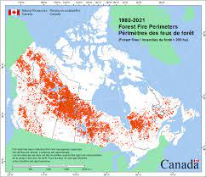
Nature’s Plan for renewal

Slide 4
Heat Impacts
PVC handles up to 140˚
Deformation
Expansion
Movement

Slide 5
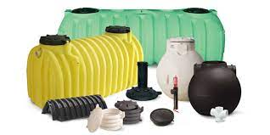
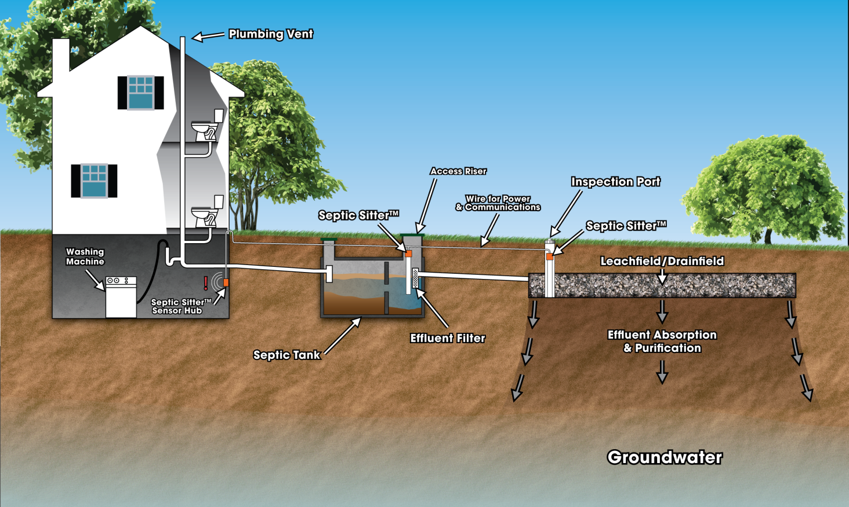
Fires and Systems
Heat is significant
Use of Plastics in the System
Risers
Tanks
Supply piping
Distribution
Boxes
Piping
Inspection pipes

Slide 6
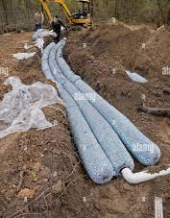
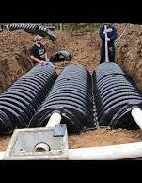
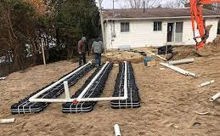
Distribution Media
Plastic Distribution Media
Chambers
EZ Flo
Elgin Indrain

Slide 7
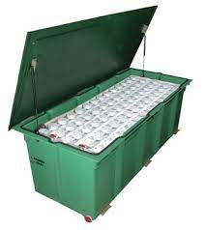
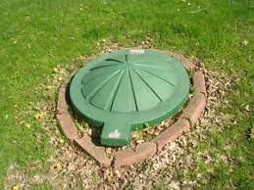
Treatment technologies

Slide 8
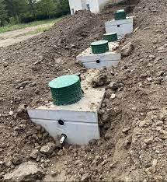
Heat Impacts
Plastic Impacts
Melted
Warped
Concrete and heat
Depth reduces impacts

Slide 9
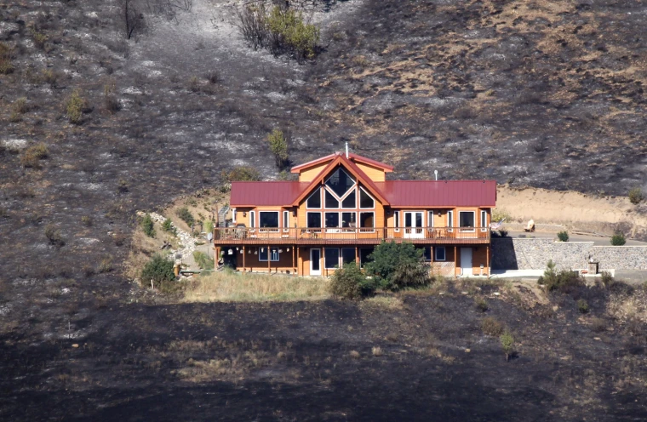
Existing Home
All Piping
Camera
Replaced if damaged
Plastic risers
Plastic tanks
Electrical

Slide 10
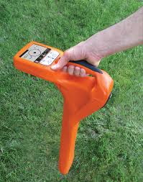
System Location

Slide 11
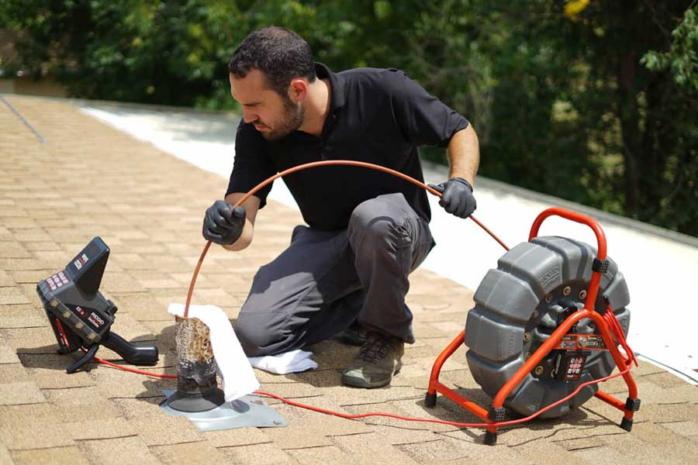

Slide 12
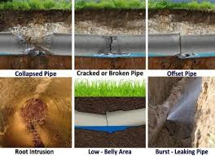

Slide 13
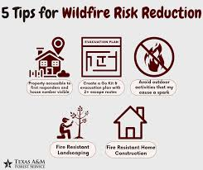
Fire Planning

Slide 14
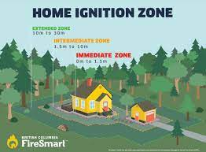
Site Development
Immediate zone
Intermediate zone
Extended zone

Slide 15
Soil Impacts Due to Fire
Reduced organic matter
Reduction is temperature related
Decreased water holding capacity
Increased infiltration rate
Change in surface Soil color record

Slide 17
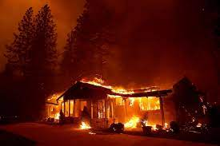
New Home
Current PERMITED Home & System
New Home
Number of Bedrooms
Tank size
System application
Additional treatment requirements

Slide 18
Questions

Slide 19
Eljen GSF
More information: https://www.eljen.com/eljen-gsf/

Slide 20
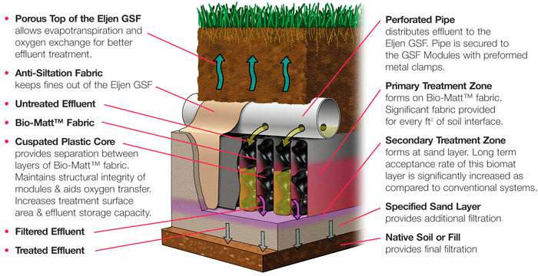
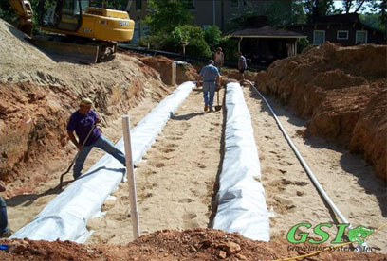
Treatment Systems - Eljen In-drain

Slide 21
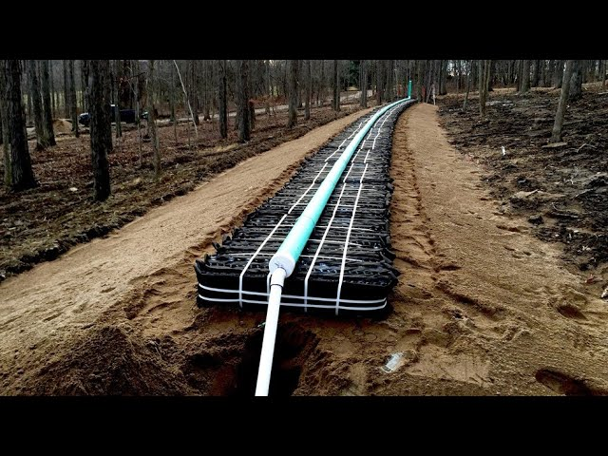

Slide 22
Pump tank Pump tank
Pressure distribution
Pump tank Pump tank
Elgin Pads
Sand per Manufacture
24” Clean sand
Coarse Material
>50% rock

Slide 23
