Slide 1
Choosing the Right Technology
Matching Sites & Systems

Slide 2
SYSTEM Problems
Users
Type of Waste
Delivery
The Site

Slide 3
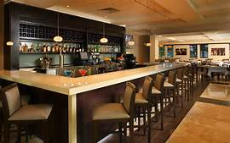
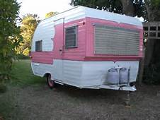
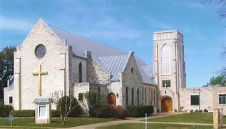
Users
High strength
Hard to treat
Peak flows

Slide 4
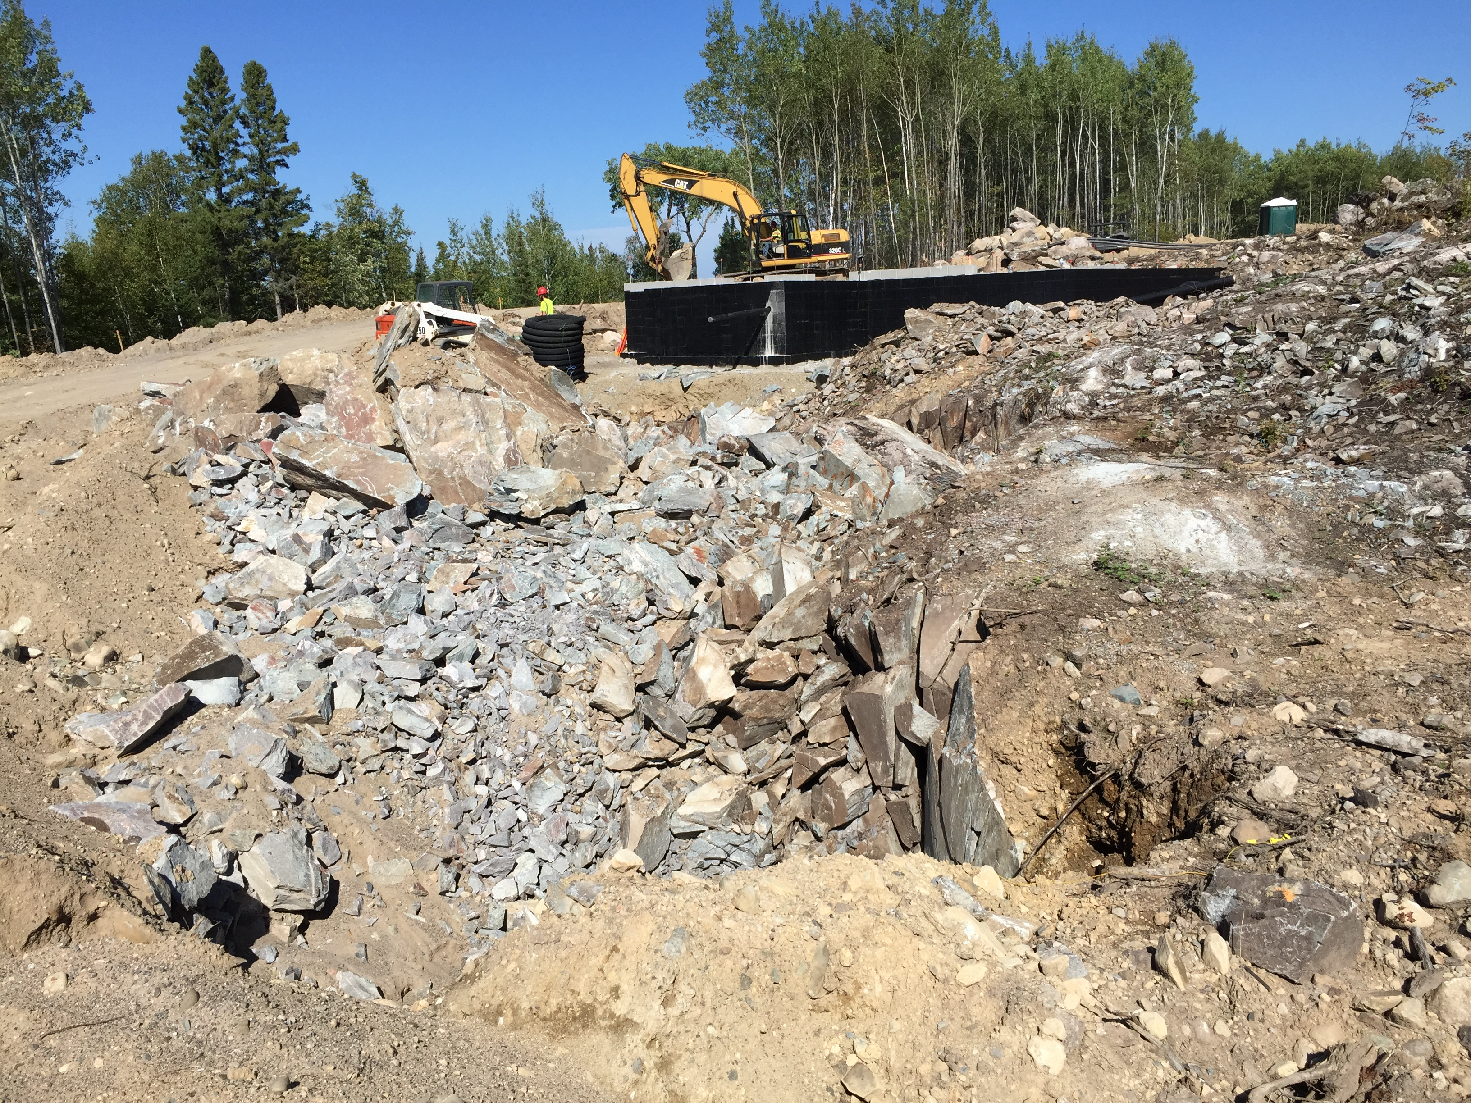
The Site
The Neighborhood
The Density
The SITE
RISK

Slide 5
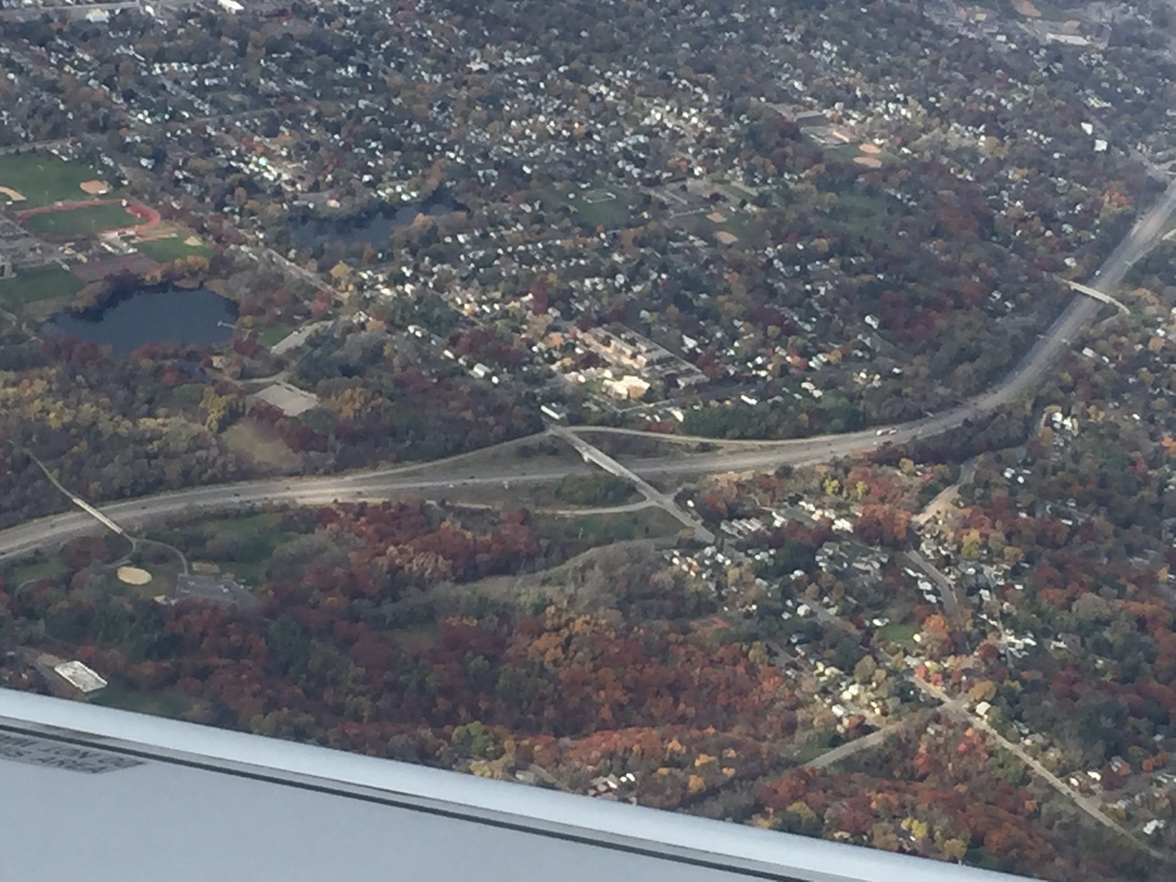
Tough Neighborhoods
High Density
Shallow Aquifers/ Unconfined Aquifers
Groundwater Recharge Areas
Surface waters
Salt water
RISK

Slide 6
EPA Water Quality Programs
Onsite Wastewater Treatment Systems
Non-point source of pollution
Total Maximum Daily Loads {TMDL}
Coastal Zone Management Program
Notes:
The EPA has implemented many programs such as the Total Maximum Daily Load or Coastal Zone Management Program, both of which impact The onsite wastewater treatment industry since on-site systems all are considered a nonpoint source of pollution. The TMDL program relates to stream segments and CZMP applies to coastal water resources.

Slide 7
Ground water
Shallow aquifers
Unconfined aquifers
Increased Nitrogen loading
Potential cross connections

Slide 8
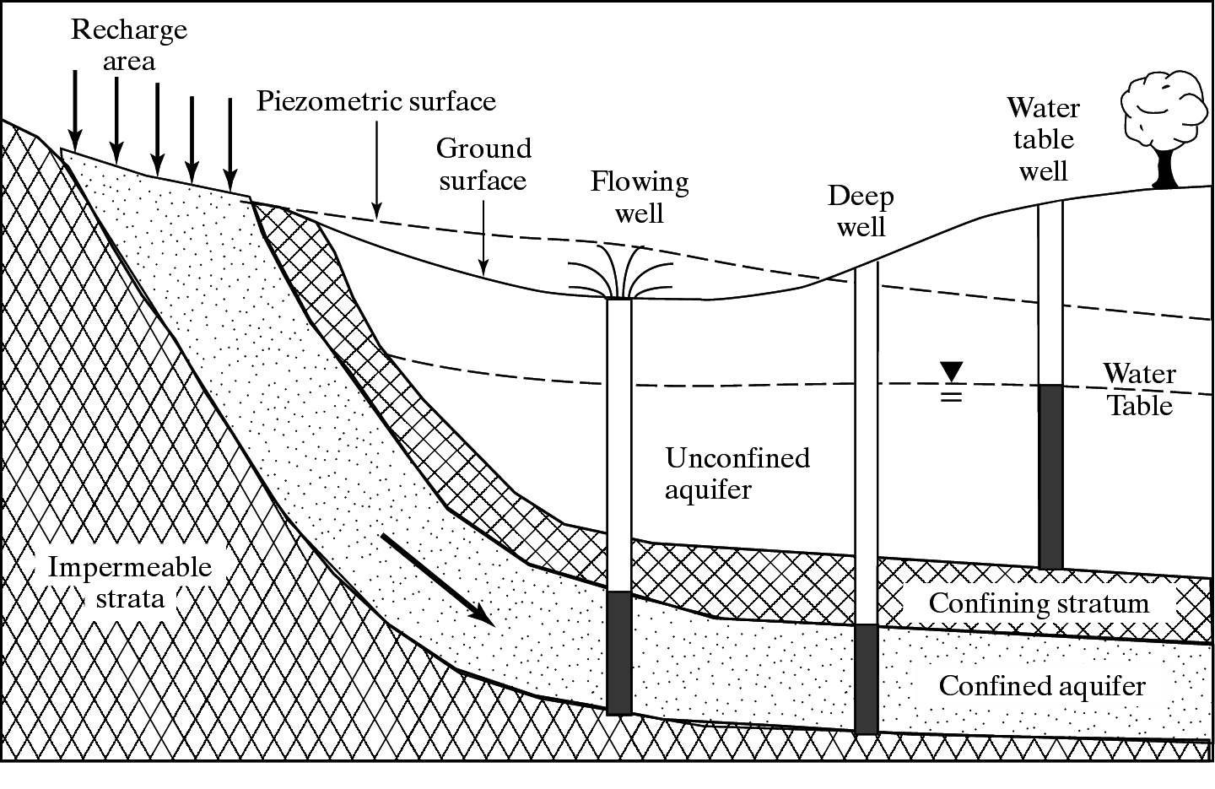

Slide 9
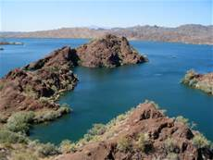
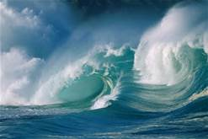
Surface water
Freshwater
Increased Phosphorus loading
Increased organic loading
Saltwater
Nitrogen [TMDL]

Slide 10
High Density
Lot Sizes
Low risk
Medium risk
High risk
Increased Nitrogen loading
Potential cross connections
+2 sites
1 site
< 1 site

Slide 11
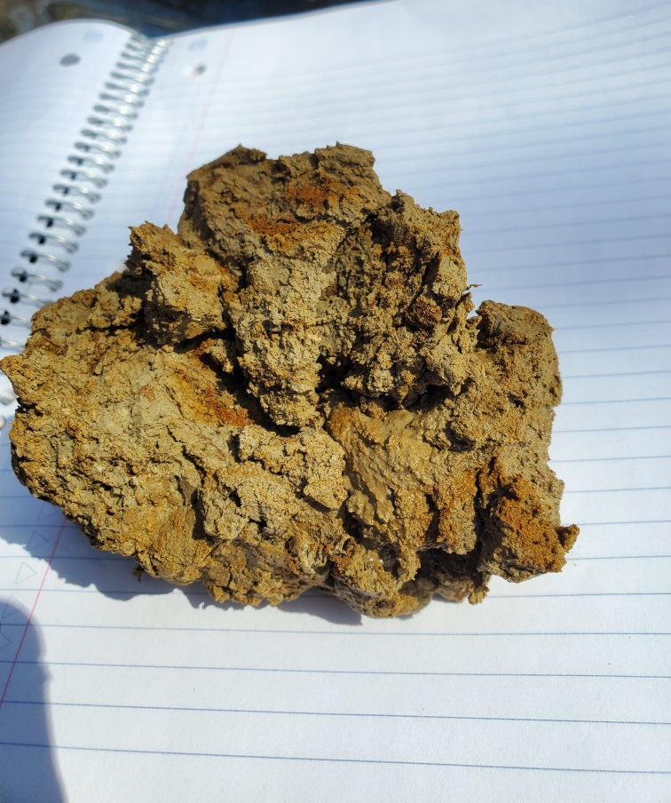
Tough Soils
Fast
Slow
Shallow
Water table
Bedrock
Treatment
Acceptance
Sizing [Area]

Slide 12
The Technologies
Legacy Systems
Conventional
Additional treatment
ATU [MBR]
RBC
Media filters
Wetlands
Gray water Technologies
Cluster technology

Slide 13
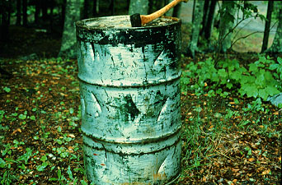
Legacy Systems
Obsolete Systems
What is in the ground but Not RIGHT

Slide 14
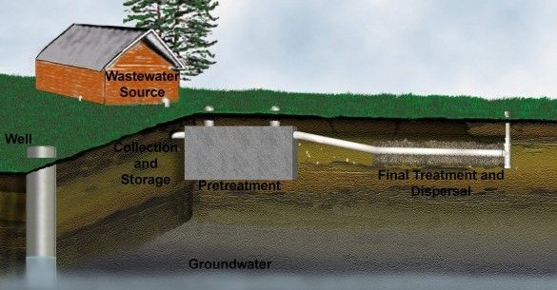
Conventional Systems
Anaerobic
Aerobic

Slide 15
Making them work
Normal waste
Watertight tanks
Required Area & Separation
Management:
Tank access &cleaning

Slide 16
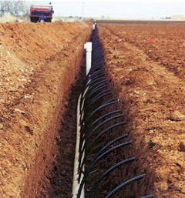
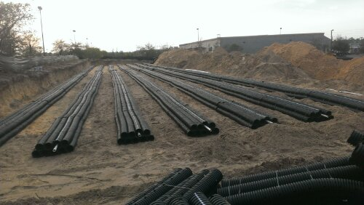
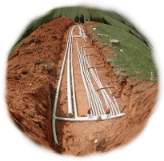
Soil Treatment Areas

Slide 17
Where they FIT
Strengths
Low Power
Weaknesses
Tough waste
Nutrients
Size & Soil

Slide 18
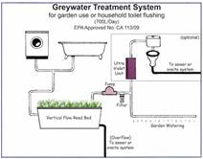
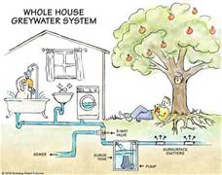
Graywater Technology
“Shower to Flower”
Definition

Slide 19
Graywater Technology

Slide 20
Where they FIT
Strengths
Reuse
Sustainability
Weaknesses
Unclear definitions
Current Science
RISK

Slide 21
Additional treatment
Concerns
System Benefits
Organic loading
Pathogen removal
Nutrients
Acceptance
Smaller size
Separation reduction
Neighborhood concerns
Cost: Power & Care

Slide 22
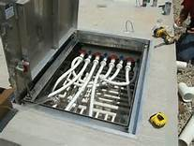
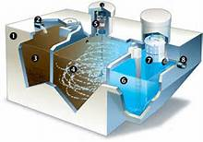
Aerobic Treatment Systems

Slide 23
Making them work
Normal waste to HSW
Watertight tanks
Air delivery system
Required Area & Separation
Management:
Tank access &cleaning
Performance testing
Allows the use
of Disinfection

Slide 24
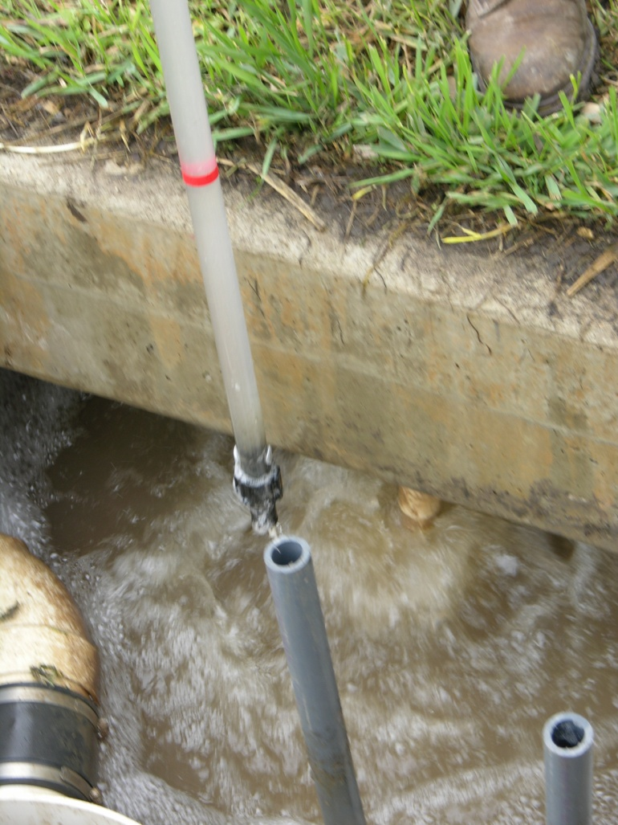
ATU
Aerobic treatment Units
Aerobic treatment
BOD5: 25 mg/L
TSS: 25 mg/L

Slide 25
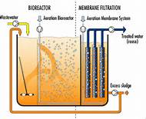
Membrane Bio Reactor

Slide 26
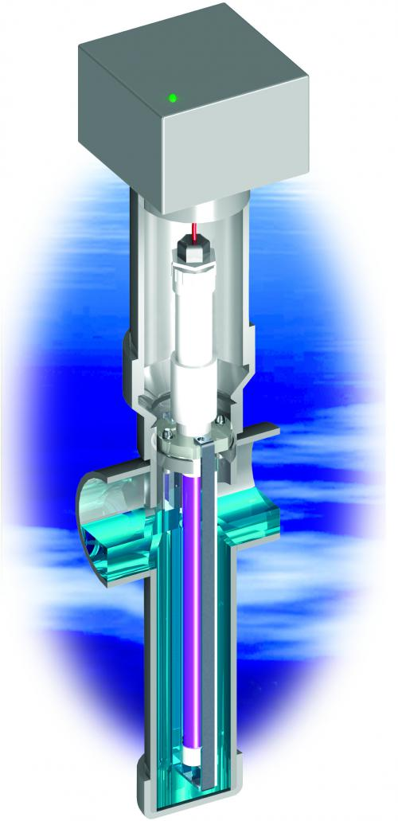
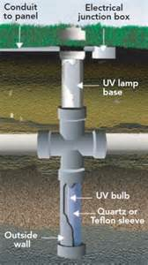
UV Disinfection

Slide 27
Where they FIT
Strengths
Footprint
Upgrading
Adjustability
HSW
Weaknesses
Power req
Ability to Break

Slide 28
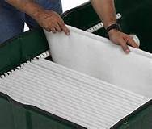
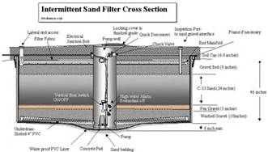
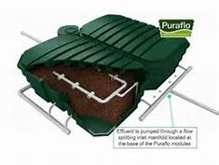
Media Filters
Aerobic

Slide 29
Making them work
Normal waste
Watertight tanks
Effluent distribution
Media & Recirculation
Required Area & Separation
Management:
Tank access &cleaning
Media access & service
Performance testing
SPF: May meet
Disinfection
RMF: Allows the use
of Disinfection

Slide 30
Media filters
BOD5: 15 mg/L
TSS: 15 mg/L
Fecal coliform~

Slide 31
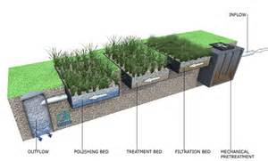
Constructed Wetlands

Slide 32
Making them work
Normal waste
Watertight tanks
Effluent distribution
Media & Recirculation
Required Area & Separation
Management:
Tank access &cleaning
Media access & service
Performance testing
Sewage Gardening

Slide 33
Where they FIT
Strengths
Passive Technology
Flex loading
SPMF Bacteria
RMF Nitrogen
Weaknesses
Footprint
Parts
Media selection

Slide 34
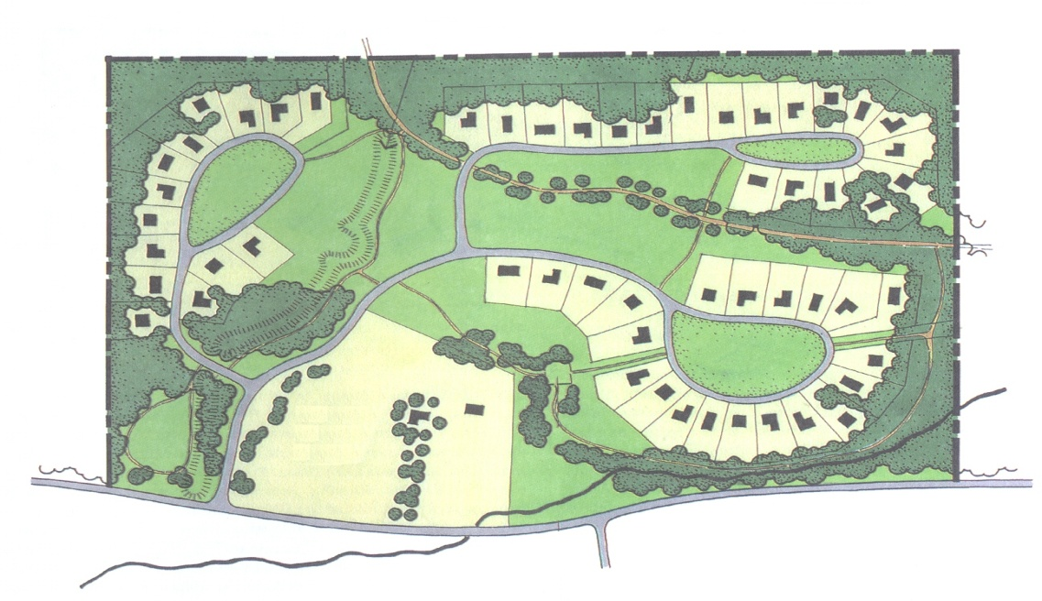
Cluster Technologies
System sizing
System siting
Management

Slide 35
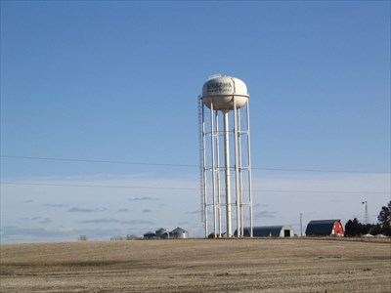
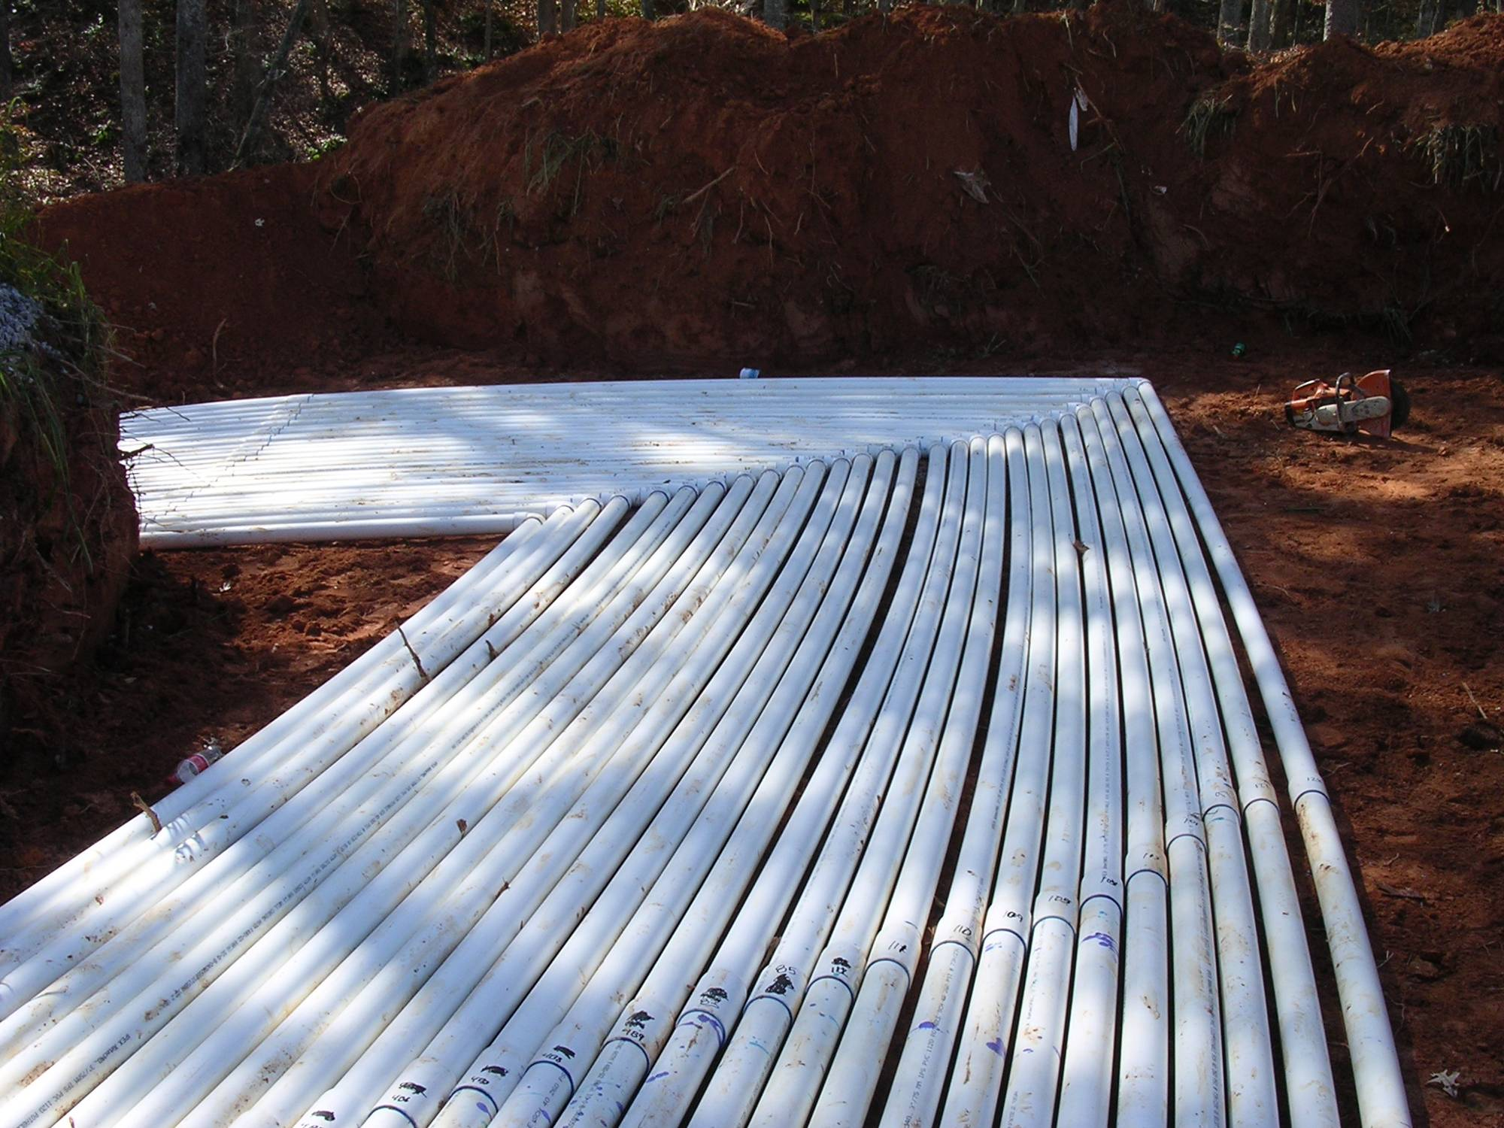
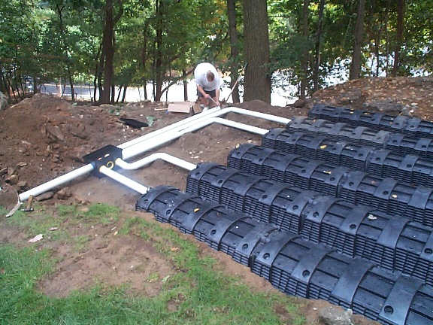
Cluster Choices
Shared well
Individual Clusters
Collection Systems
Conventional Sewer
Solids Handling
Septic tank to Collection

Slide 36
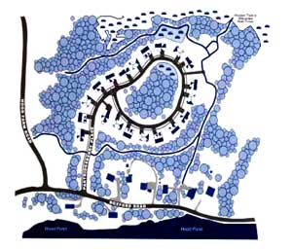
Cluster Keys
Flow determination
Flexibility
Soil identification
Care
Serviceability
Communication

Slide 37
The Costs
Buildable
System
Usable lot
Desirable location
Environmental Protection
System Access
System distribution
System Care
System Reporting

Slide 38
Questions
David Gustafson, PE
gusta002@umn.edu

